Slide 1
Model predictive control (MPC)

Slide 2
Model predictive control
MPC is by far the most commonly applied APC (Advanced process control)strategy for multivariable control in process control.
MPC can effectively handle complex sets of constraints.
MPC needs modeling, but relatively simple, using finite step response (FSR) model usually.

Slide 3
A human activity example
Suppose we are going to complete a task, and the work begins at 8'clock...
The rule of the game is that we always plan our activies for the next 8 hours work, however, we only implement the plan for the first hour.
The planning and implementation is repeated for every fresh hour until the tasks are completed.

Slide 4
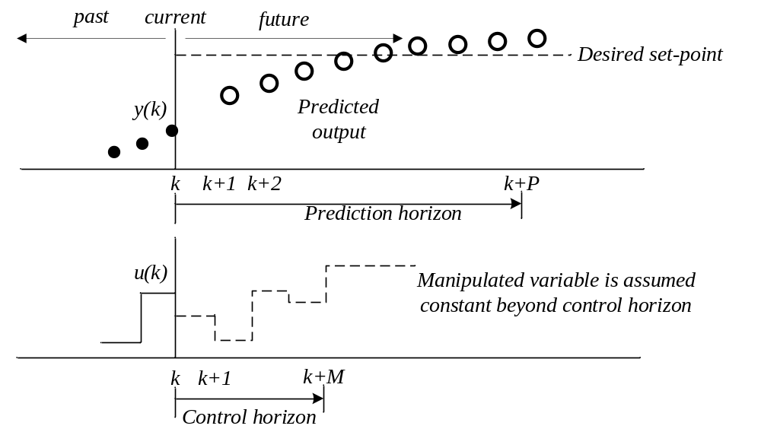
Basic principle of MPC

Slide 5
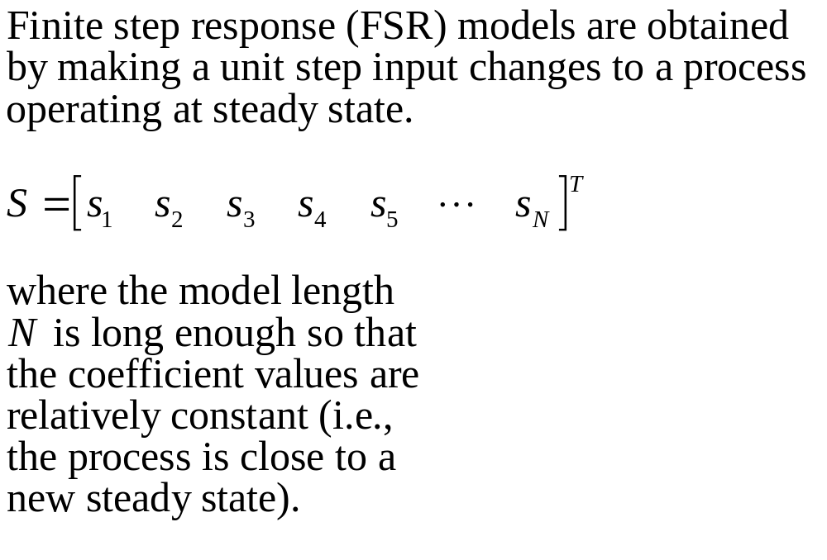
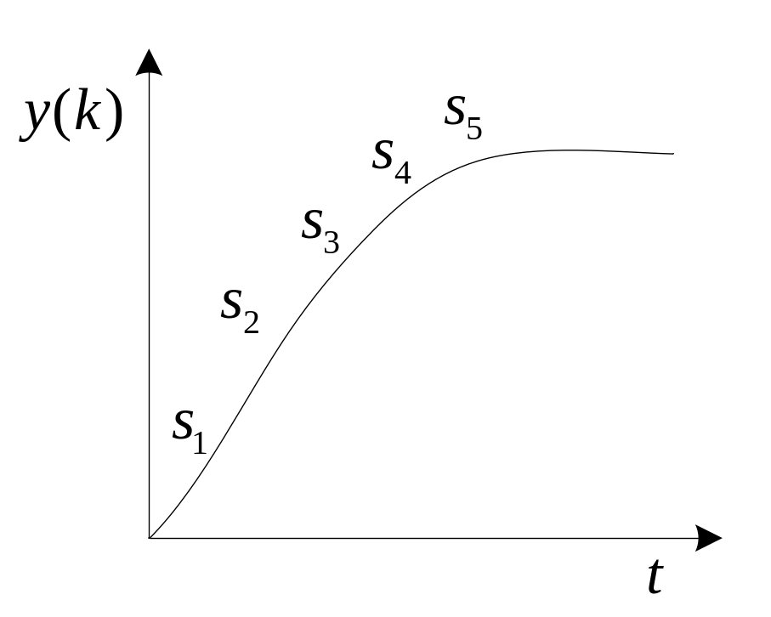
FSR models

Slide 6
A Series of input changes
Definition of FSR is based on a single step input change.
But feedback control is implemented every cycling time which means a series of changes.
To use a FSR to predict the output behaviour for a series of input changes, linear superposition is assumed, i.e., the process response is equal to the sum of the individual step responses.

Slide 7
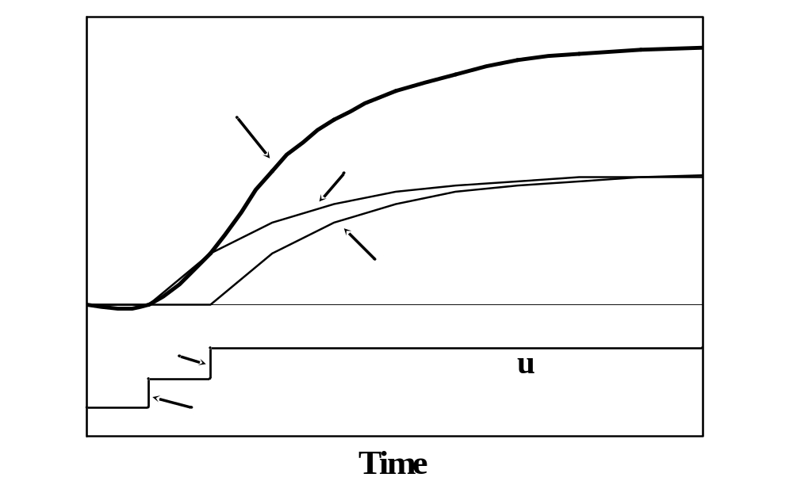
Superposition of 2 step input changes

Slide 8
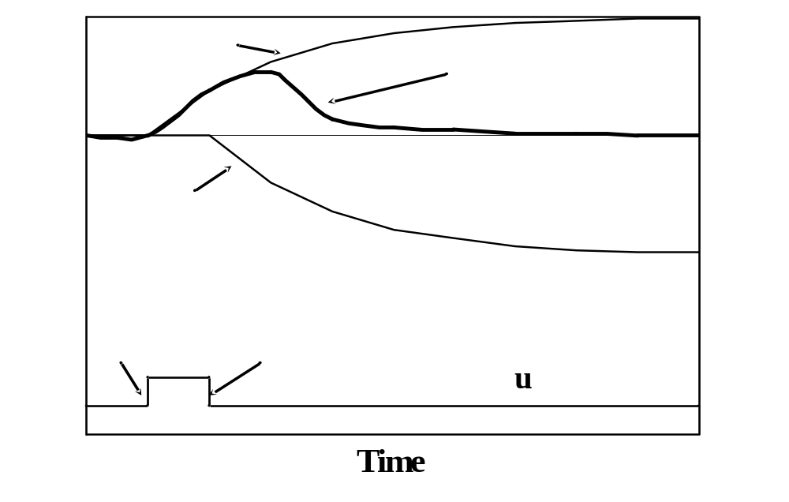
Superposition of 2 step input changes

Slide 9
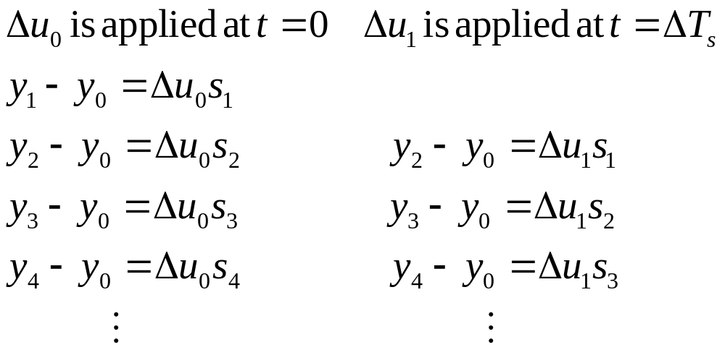
Equation form for 2 sequential input changes
Consider the the response of a process to two step input changes separately

Slide 10
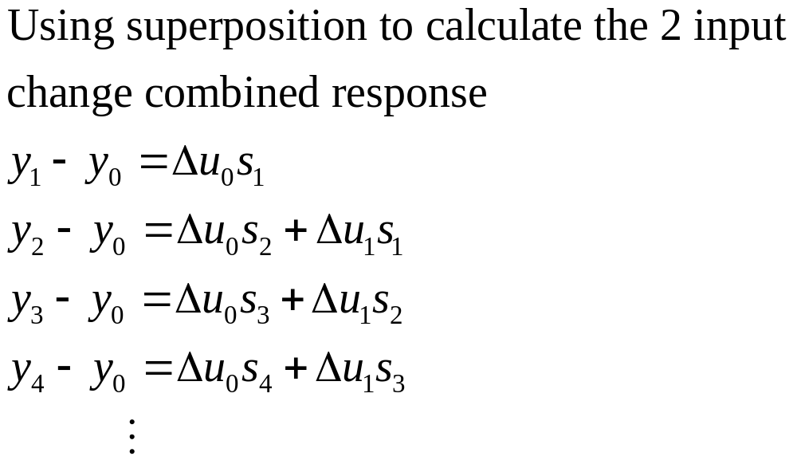
Combined response for 2 input changes

Slide 11
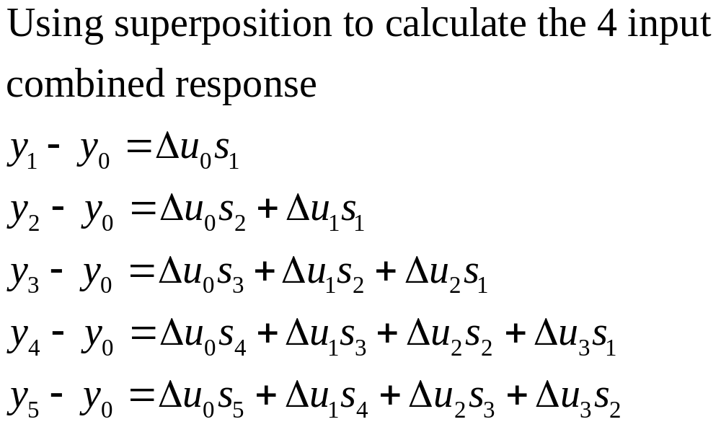
Combined response for a series of 4 input changes

Slide 12
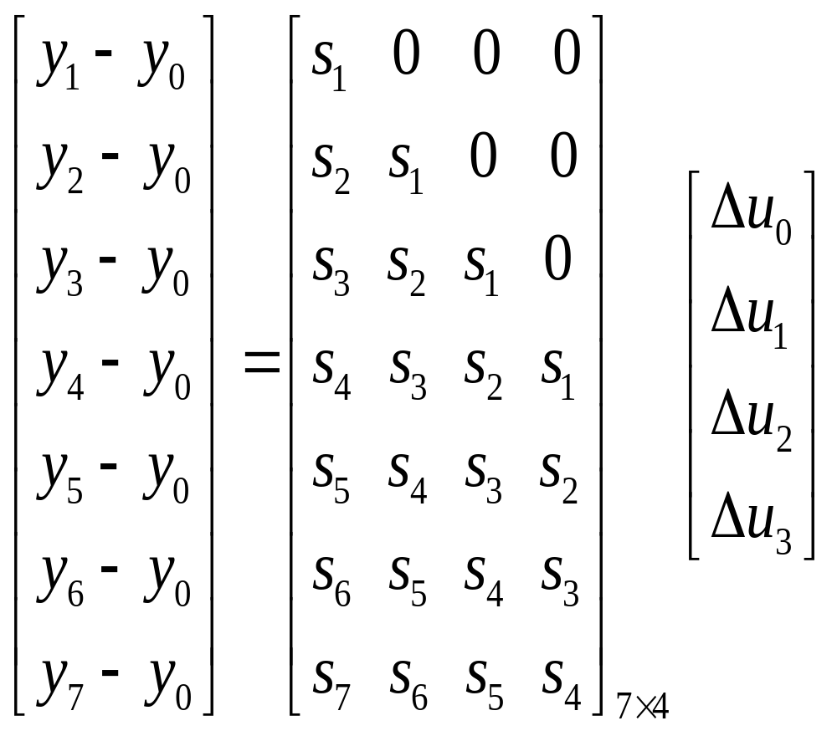
Matrix form for combined response for a series of 4 input changes
FSR: [s₁ s₂ s₃ s₄ s₅ s₆ s₇ s₈ s₉ s₁₀]

Slide 13
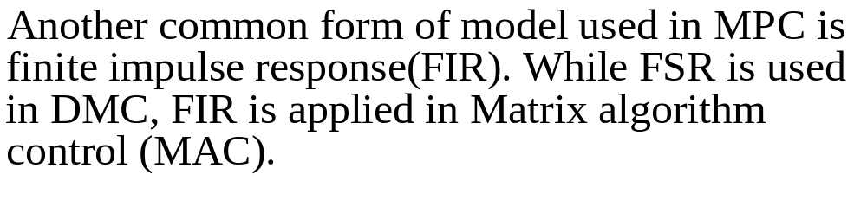
FIR models

Slide 14
Major limitations to FSR and FIR
They require a large number of paratmeters (model coefficients) compared to state space and transfer function models.
They can only be used to represent open-loop stable process.

Slide 15
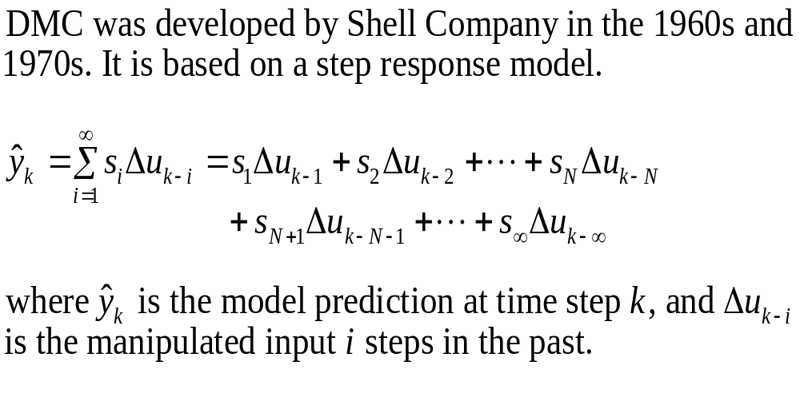
DMC principle

Slide 16
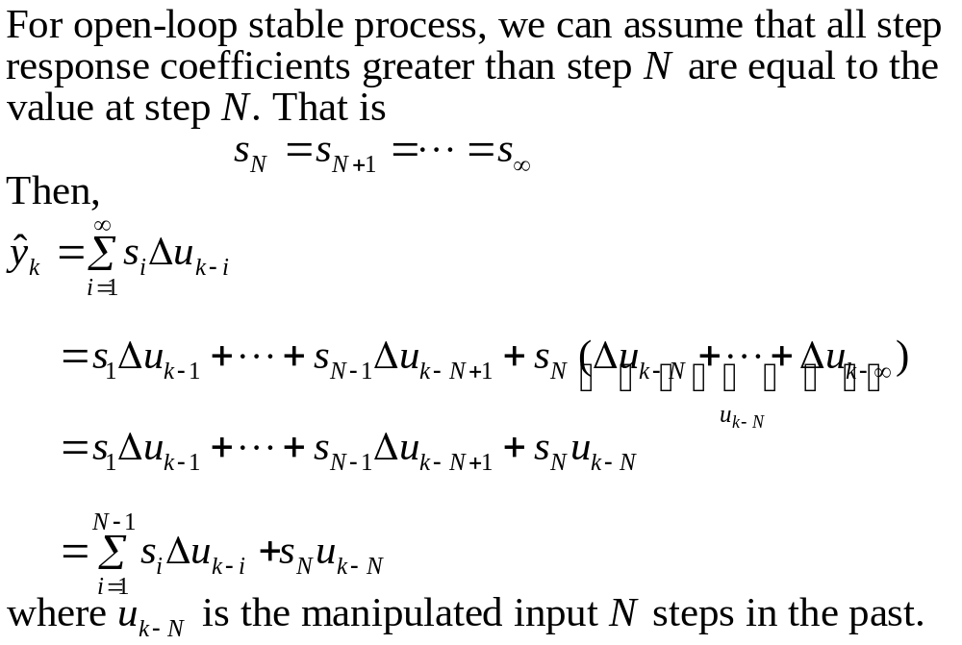
Model prediction in DMC (cont.)

Slide 17
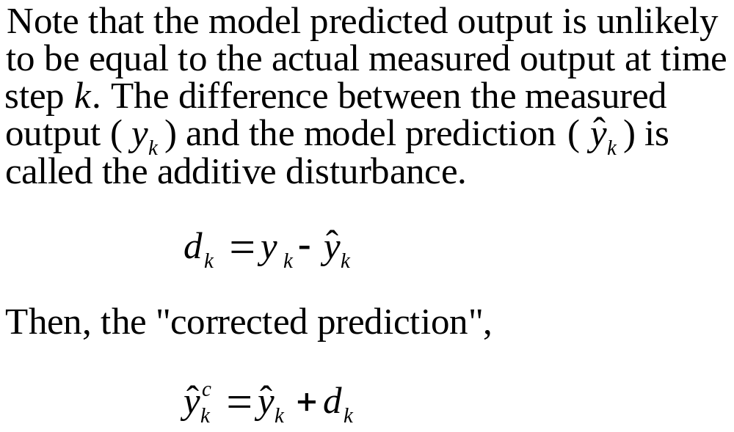
Corrected prediction

Slide 18
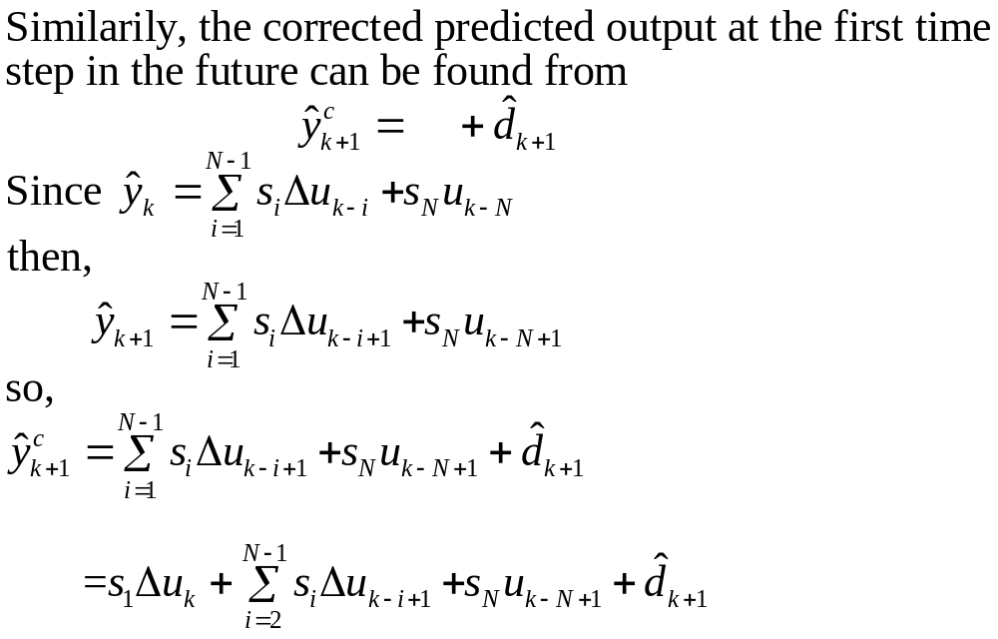
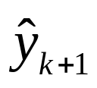
Corrected predicted output at the first time step in the future

Slide 19
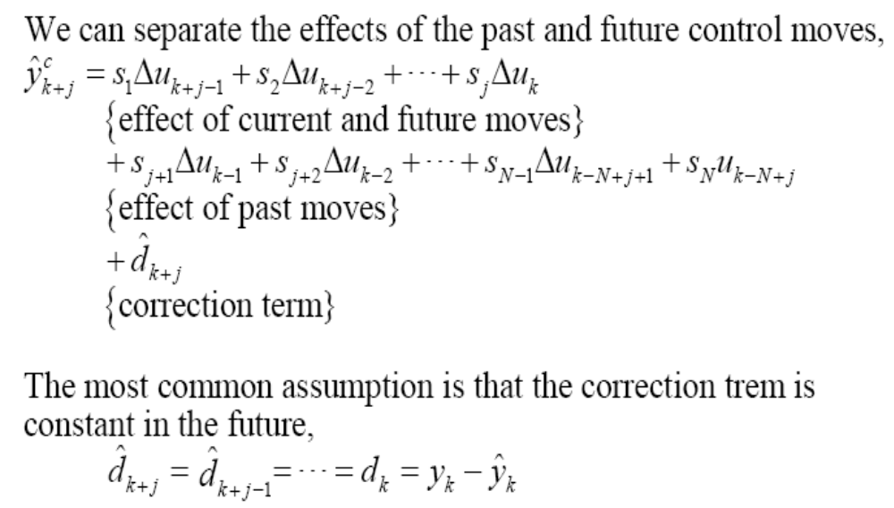
Corrected predicted output
Why?

Slide 20
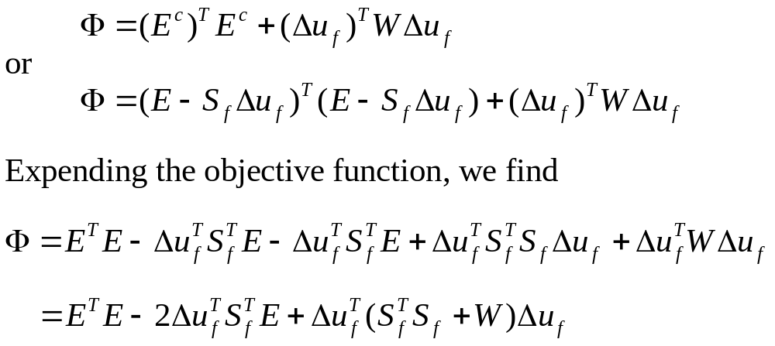
Optimization objective function

Slide 21
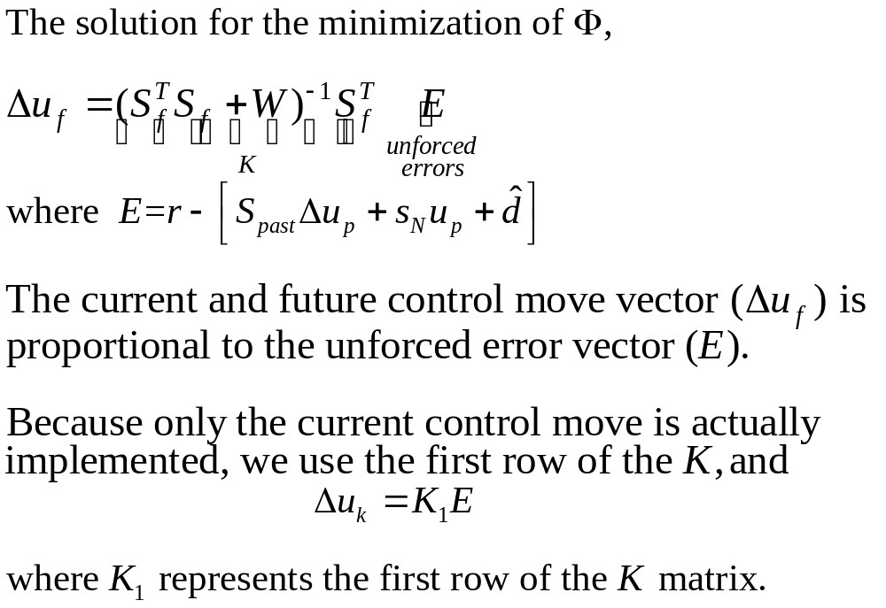
Control move

Slide 22
Common tuning parameters
N and ∆t selection are not independent. N *∆t should be approximately the “settling time” of the process. N will be roughly 50 coefficients.
P and M differ in length. Usually, P is selected to be much longer than M. Often P=20 or so, while M=1~3.

Slide 23
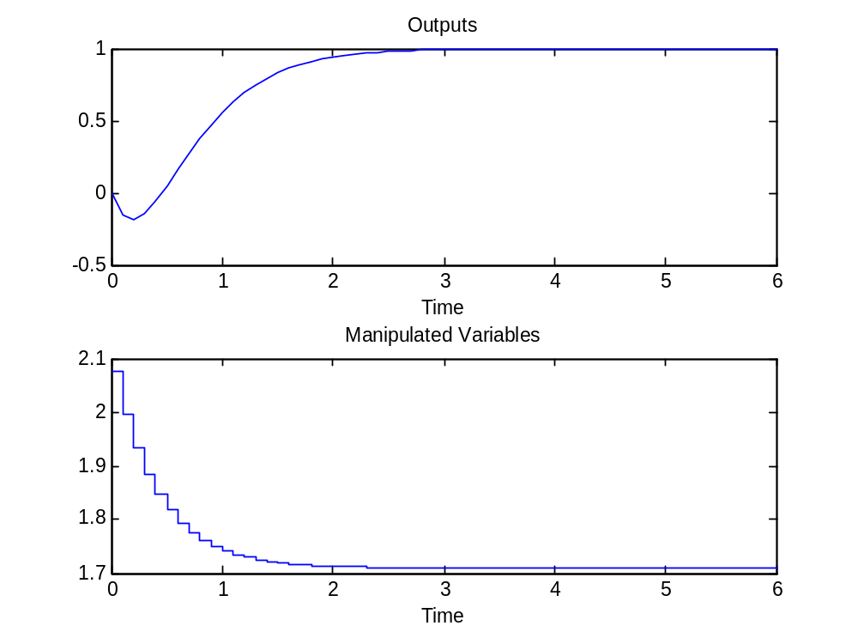
Van de Vusse reactor example

Slide 24
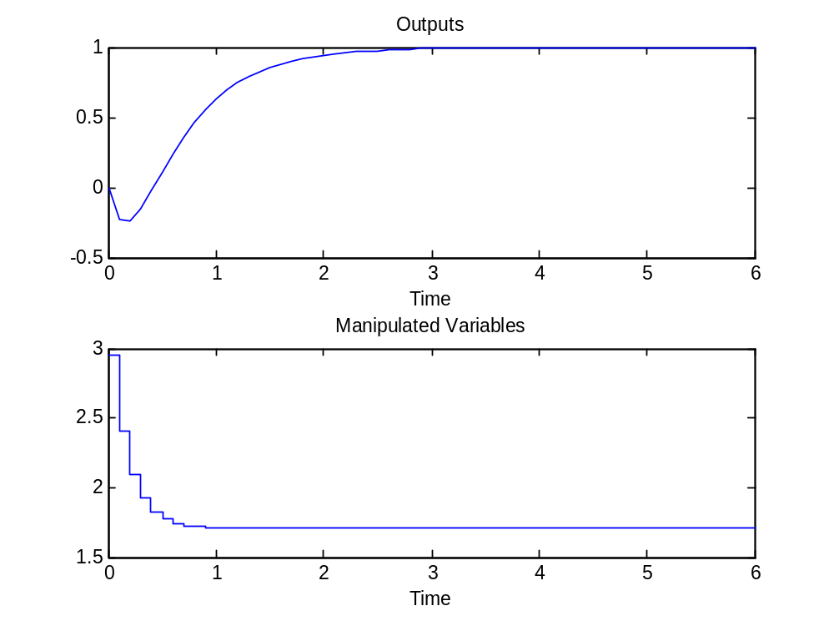
Van de Vusse reactor example

Slide 25
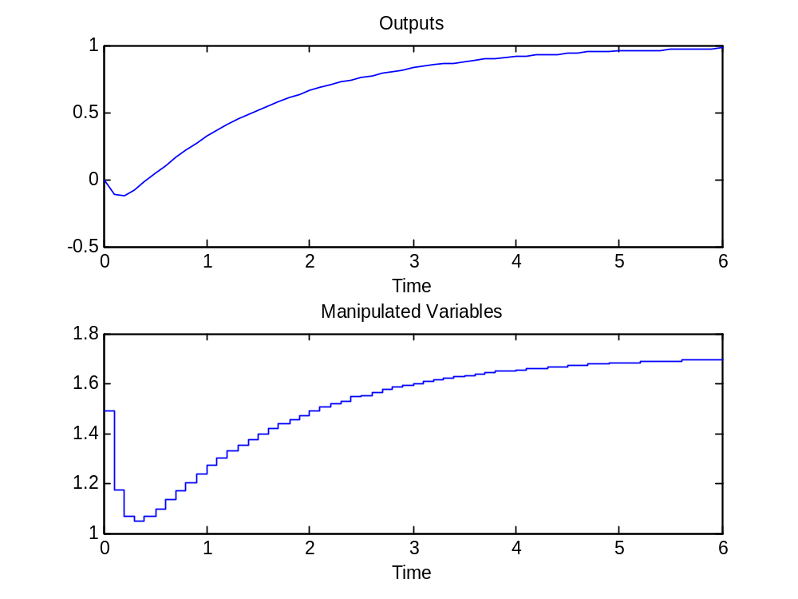
Van de Vusse reactor example

Slide 26
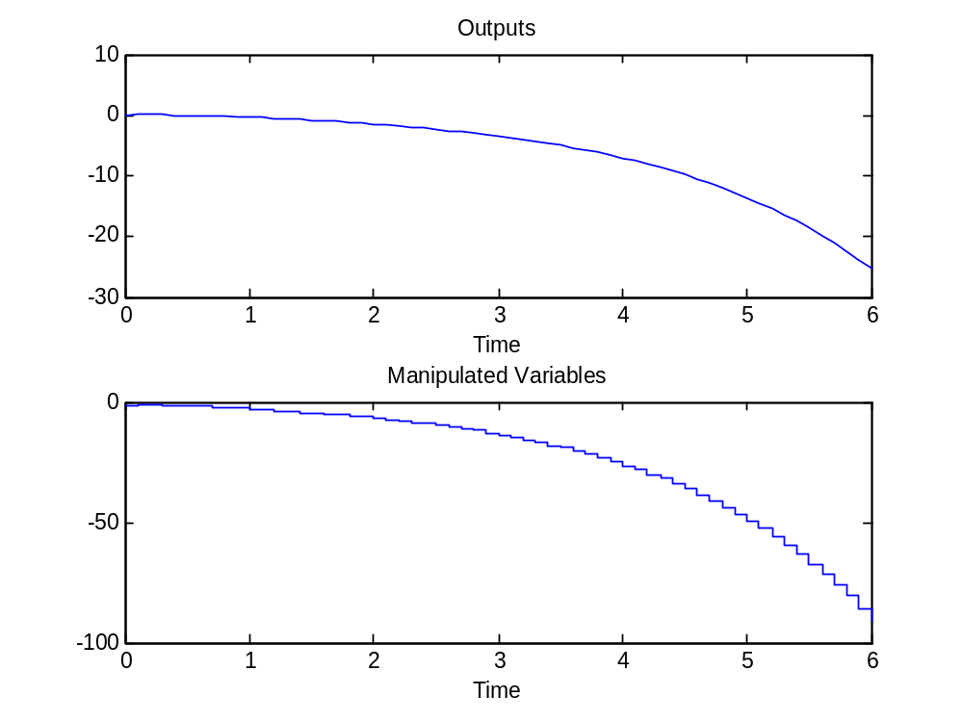
Van de Vusse reactor example
Why does it occur?

Slide 27
Any Question?

