Slide 1
软工二小组展示
IDEA

Slide 2
CONT
ENTS
关于小组分工
关于前期准备
关于代码阶段
项目简单展示

Slide 3
PART 01
关于小组分工

Slide 4

展示层
刘苏豫
刘露莹
逻辑层
我
数据层
石胜杰

Slide 5





关于小组分工
个人优势
团队配合
提前分工
团队纪律
.
会议效率

Slide 6
PART 02
关于前期准备

Slide 7
关于前期准备
用例
确立明确，在代码阶段几乎全覆盖，但是研究不深入.
体系结构
前期考虑不周，后期有较大调整

Slide 8
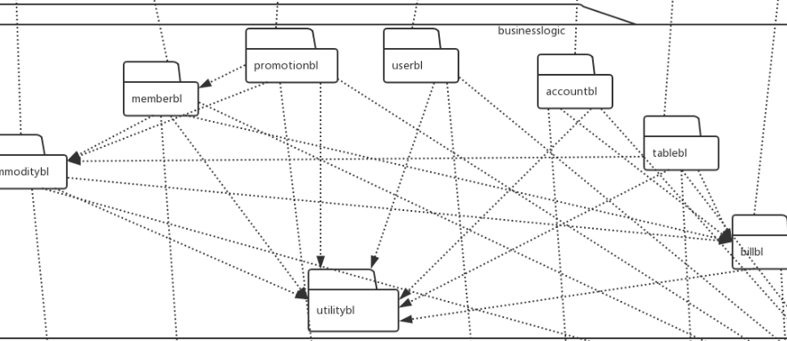
关于前期准备

Slide 9
关于代码阶段
PART 03

Slide 10
关于代码阶段
代码阶段中的问题
“短板效应”
前期设计缺陷
测试问题
缺少即时反馈
分工问题
任务量不均衡.

Slide 11
项目简单展示
PART 04
Romt stosut soutste kosot shet otsot somt

Slide 12
IDEA
THANK
YOU

Slide 13
关于代码阶段
YOUR TITLE
YOUR TITLE
I am the long for thant somts dmxtout cadstot comta.
I am the long for thant somts dmxtout cadstot comta.
YOUR TITLE
YOUR TITLE
I am the long for thant somts dmxtout cadstot comta.
I am the long for thant somts dmxtout cadstot comta.

Slide 14
关于小组分工
个人优势
YOUR TITLE
I am the long for thant somts dmxtout cadstot comta.
I am the long for thant somts dmxtout cadstot comta tdsot ssdtout am the long for thant somts dmxtout cadstot. I am the long for.

Slide 15
BIG YOUR POWERPOINT
Romt stosut soutste kosot shet otsot somt
BIG YOUR POWERPOINT
BIG YOUR POWERPOINT
YOUR POWERPOINT
I am the long for thant somts dmxtout cadstot comta tdsot ssdtout am the long for thant somts dmxtout cadstot. I am the long for.

Slide 16
BIG YOUR POWERPOINT
Romt stosut soutste kosot shet otsot somt
BIG YOUR POWERPOINT
I am the long for thant somts dmxtout cadstot comta tdsot ssdtout am the long for thant somts dmxtout cadstot. I am the long for.

Slide 17

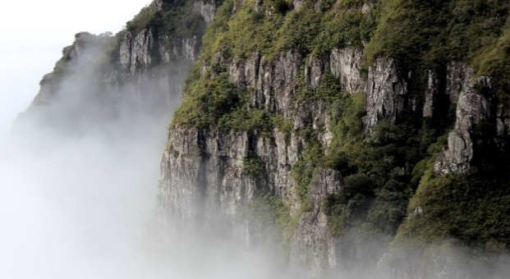

BIG YOUR POWERPOINT
Romt stosut soutste kosot shet otsot somt
YOUR TITLE
YOUR TITLE
YOUR TITLE
I am the long for thant somts dmxtout cadstot comta.
I am the long for thant somts dmxtout cadstot comta.
I am the long for thant somts dmxtout cadstot comta.

Slide 18
BIG YOUR POWERPOINT
Romt stosut soutste kosot shet otsot somt
YOUR TITLE
YOUR TITLE
I am the long for thant somts dmxtout cadstot comta.
I am the long for thant somts dmxtout cadstot comta.
S
W
T
O
YOUR TITLE
YOUR TITLE
I am the long for thant somts dmxtout cadstot comta.
I am the long for thant somts dmxtout cadstot comta.

Slide 19
BIG YOUR POWERPOINT
Romt stosut soutste kosot shet otsot somt
TEMPATE MORE
I am the long for thant somts dmxtout cadstot comta tdsot ssdtout am the long for thant somts dmxtout cadstot. I am the long for.

Slide 20
BIG YOUR POWERPOINT
Romt stosut soutste kosot shet otsot somt
YOUR TITLE
I am the long for thant somts dmxtout cadstot comta.
YOUR TITLE
I am the long for thant somts dmxtout cadstot comta.
YOUR TITLE
I am the long for thant somts dmxtout cadstot comta.
YOUR TITLE
I am the long for thant somts dmxtout cadstot comta.

Slide 21
BIG YOUR POWERPOINT
Romt stosut soutste kosot shet otsot somt
YOUR TITLE
YOUR TITLE
YOUR TITLE
YOUR TITLE
I am the long for thant somts dmxtout cadstot comta.
I am the long for thant somts dmxtout cadstot comta.
I am the long for thant somts dmxtout cadstot comta.
I am the long for thant somts dmxtout cadstot comta.

Slide 22
BIG YOUR POWERPOINT
Romt stosut soutste kosot shet otsot somt
12,000
TEMPATE MORE
I am the long for thant somts dmxtout cadstot comta tdsot ssdtout am the long for thant somts dmxtout cadstot. I am the long for.
I am the long for thant somts dmxtout cadstot comta tdsot ssdtout am the long for thant somts dmxtout cadstot. I am the long for.

Slide 23
BIG YOUR POWERPOINT
Romt stosut soutste kosot shet otsot somt
TEMPATE MORE
I am the long for thant somts dmxtout cadstot comta tdsot ssdtout am the long for thant somts dmxtout cadstot. I am the long for.

