Slide 1
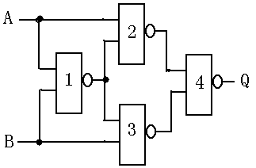
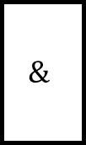
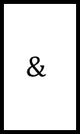

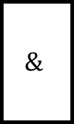
$$\&$$
A
$$\&$$
$$\&$$
Q
$$\&$$
B

Slide 2


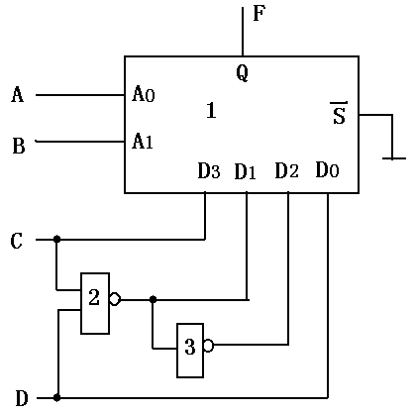









A
$$Q$$
$$A_{0}$$
B
$$1$$
$$\overline{S}$$
$$A_{1}$$
$$D_{3}$$
$$D_{1}$$
$$D_{2}$$
$$D_{0}$$
GND
C
$$\&$$
$$1$$
D

Slide 3
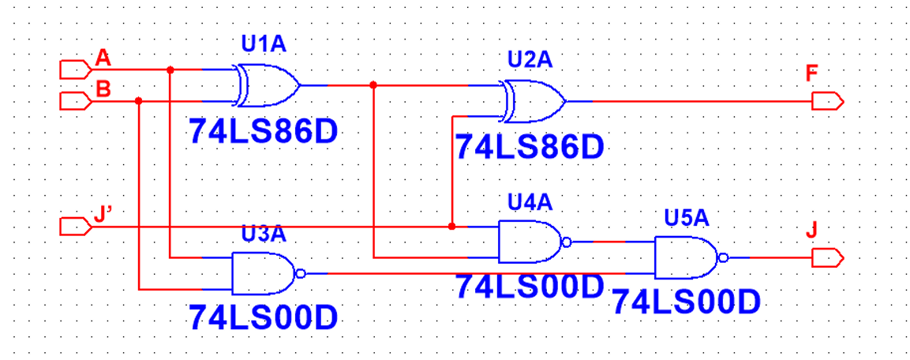




A
$$=1$$
$$=1$$
F
B
J$’$
$$\&$$
$$\&$$
$$\&$$
J

Slide 4
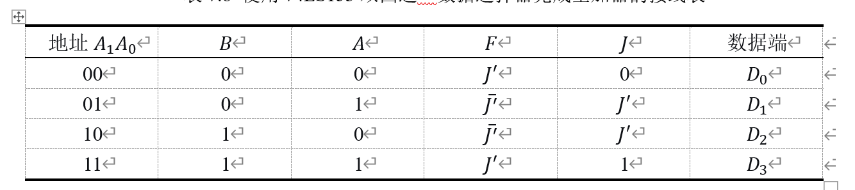




















F
J
A
$$Q$$
$$Q$$
$$A_{0}$$
$$A_{0}$$
B
$$1$$
$$\overline{S}$$
$$1$$
$$\overline{S}$$
$$A_{1}$$
$$A_{1}$$
$$D_{3}$$
$$D_{1}$$
$$D_{2}$$
$$D_{0}$$
$$D_{3}$$
$$D_{1}$$
$$D_{2}$$
$$D_{0}$$
GND
GND
$$1$$
J$’$
$$Vcc$$
GND

Slide 5

$$\&$$
$$\&$$
A
$$\&$$
$$\&$$
$$\&$$
$$\&$$
F
$$\&$$
$$\&$$
B
J$’$
$$\&$$
J

Slide 6



























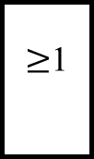
$$D_{0}$$
$$D_{1}$$
$$D_{2}$$
$$D_{3}$$
$$Q$$
$$A_{0}$$
$$A_{1}$$
$$\overline{S}$$
$$A_{1}$$
$$A_{0}$$
$$D_{3}$$
$$D_{2}$$
$$D_{1}$$
$$D_{0}$$
$$A_{2}$$
$≥$1
$$D_{0}$$
$$D_{1}$$
$$D_{2}$$
$$D_{3}$$
$$Q$$
$$\overline{S}$$
$$1$$
$$A_{1}$$
$$A_{0}$$
$$D_{3}$$
$$D_{1}$$
$$D_{2}$$
$$D_{0}$$

Slide 7
