Slide 1
Chapter 6 Database Design (Part Ⅰ)

Slide 2
Ch6 Database Design
Logical Database Design
also known as
Database Design
Database Modeling

Slide 3
Ch6 Database Design
Database design is the process of producing a detailed data model of a database.
This logical data model contains all the needed logical and physical design choices and physical storage parameters needed to generate a design in a Data Definition Language, which can then be used to create a database.
A fully attributed data model contains detailed attributes for each entity.

Slide 4
Ch6 Database Design
how do we?
analyze an enterprise
list the data items for a database
decide how to place these data items columns in relational tables

Slide 5
Ch6 Database Design
For example: student-course database
attributes of student: sno, sname, dept, sage
attributes of course: cno, cname
attribute of student&course: grade
we can put them all in the same table.
R(sno, sname, dept, sage, cno, cname, grade)
consider the SCG database (next slide), see any problems with that ?

Slide 6
The SCG Database

Slide 7
Ch6 Database Design
Problems
redundency（数据冗余）
abnormity of update（修改异常）
abnormity of delete（删除异常）
abnormity of insert（插入异常）

Slide 8
redundency（数据冗余）
waste of disk space

Slide 9
abnormity of update（修改异常）
waste of time
user might get it wrong
因为数据的冗余存储，导致update操作被重复执行，既增加了执行上的时间开销，也可能因为修改不彻底而导致数据不一致性。

Slide 10
abnormity of delete（删除异常）
might lose some informations
执行元组删除操作，可能连带删除掉一些本不该被删除的信息！

Slide 11
abnormity of delete（cont.）
might lose some informations
假设需要删除学生元组：“S0003, Zhang Yimou, CS, 17”

Slide 12
abnormity of delete（cont.）
might lose some informations
删除该学生元组，结果会导致C107这门课程的信息也一起被删除！

Slide 13
abnormity of delete（cont.）
might lose some informations

Slide 14
abnormity of insert（插入异常）
unsuccessful insert
可能因为违反实体完整性约束而导致元组插入失败！
例如：“插入一条没有选课信息的学生元组” 将执行失败！
Notes:
在该关系中，cno是其关键字的组成部分。如果允许插入一条还没有选课信息的学生元组，那么该新元组的cno取值为空，这违反了关系上的实体完整性约束！

Slide 15
The SCG Database (another approach)
Notes:
如果采用本页所显示的3个关系的模式设计方案，那么前述的几个问题都不存在了！

Slide 16
the two approaches to logical design of a RDB
approach one (E-R model)
all data items
E-R
model
logical design of a relational database
modeling
transform
approach two (Normalization)
all data items (as columns) in the same table
logical design of a relational database
normalization

Slide 17
the two approaches to logical design of a RDB
The two approaches (Normalization & E-R model) reinforce each other.
Part Ⅰ
all data items
E-R
model
set of tables
logical design of a RDB
建模
转换
规范化
Part Ⅱ

Slide 18
Contents
Part Ⅰ
Part Ⅱ
6.1 Introduction to E-R Concepts
6.2 Further Details of E-R Diagrams
6.3 Additional E-R Concepts
6.4 Case Study
6.5 Normalization: Preliminaries
6.6 Functional Dependencies
6.7 Lossless Decompositions
6.8 Normal Forms

Slide 19
6.1 Introduction to E-R Concepts
An Entity-Relationship(ER) model is an abstract way to describe a database.
A design approach, called Entity-Relationship modelling, is more intuitive, less mechanical, but basically leads to the same end design.

Slide 20
6.1 Introduction to E-R Concepts
Entity-Relationship Model
Proposed by Peter Chen (1976):
The Entity-Relationship Model: Toward a Unified View of Data
Peter Chen (Pin-shan Chen)

Slide 21
6.1 Introduction to E-R Concepts
E-R Model
three fundamental data classification objects
entity
attribute
relationship
the contents of this section
Entities, Attributes, and Simple E-R Diagrams
Transforming Entities and Attributes to Relations
Relationships among Entities

Slide 22
6.1 Introduction to E-R Concepts
Entity (实体)
Attribute (属性)
E-R diagram
Transformation Rule 1 & 2

Slide 23
6.1 Introduction to E-R Concepts
Entities, Attributes, and Simple E-R Diagrams
Def. 6.1.1 Entity
An entity is a collection of distinguishable real-world objects with common properties.
an entity instance is a real-world object.
in other books
an entity is a real-world object
an entity set is a collection of distinguishable real-world objects
Notes:
‘实体’是现实世界中的客观对象在ER模型中的抽象表示，一个实体具有若干方面的信息特征，每一个信息特征又被抽象表示为该实体上的一个‘属性’。
一个实体拥有哪些方面的信息特征，这被称为实体的‘实体型’；由一个实体在各个信息特征上的取值所构成的‘值的集合’，被称为实体的‘实体值’。
一组具有相同‘实体型’的实体所构成的集合被称为‘实体集’。在一个实体集中，所有实体都具有相同的‘实体型’，相互之间的区别只在于‘实体值’的不同。
在有些参考文献中，用‘entity’来表示现实世界中那些具有相同实体型的实体所构成的实体集，其中的每一个实体被称为是该实体集中的一个实体实例（entity instance）；而在另外一些参考书中，‘entity’仅仅是指现实世界中的一个客观对象，而由一组具有相同实体型的实体所构成的实体集则被称为‘entity set’。
在本课程的参考教材中，采用的是前一种描述方法，即：用‘entity’（中文称之为‘实体集’）来指代现实世界中由一组具有相同实体型的实体所构成的实体集合；用‘entity instacne’或‘entity occurrence’来指代现实世界中特定的某个客观对象。

Slide 24
6.1 Introduction to E-R Concepts
An entity is a thing that exists either physically or logically.
physical object: a house, a car, ......
an event: a house sale, a car service, ......
a concept: an order, a match, ......
other ways
a house sale can be treat as a relationalship between a house and peoples
an order can be treat as a relationalship between customer, agent and product

Slide 25
6.1 Introduction to E-R Concepts
【Example of Entity】college registration database
Students, Instructors, ......
Class_rooms
Courses
Course_sections (different offerings of a single course, generally at different times by different instructors)

Slide 26
6.1 Introduction to E-R Concepts
Normally
an entity such is mapped to a relational table
represents a set of objects
each row is an entity occurrence, or entity instance
represents a particular object

Slide 27
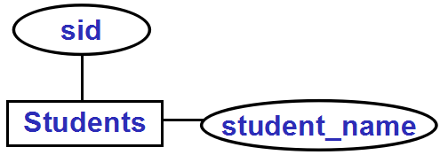
6.1 Introduction to E-R Concepts
Def. 6.1.2 Attribute （属性）
An attribute is a data item that describes a property of an entity or a relationship (defined below).
Example of E-R Diagrams
Notes:
ER Diagrams （ER图）是E-R模型的图形化表示法。
E-R模型中有三个基本概念：实体（集），属性，联系，在ER图中分别对应着三种不同的图形符号：长方形，椭圆形，菱形；这些基本概念之间的组成连接关系，可通过他们之间的无向线段进行相连。
在后面的扩充ER模型中，引入了一些新的概念，并扩展了对应的扩充ER图（EER Diagram）的表示符号。

Slide 28
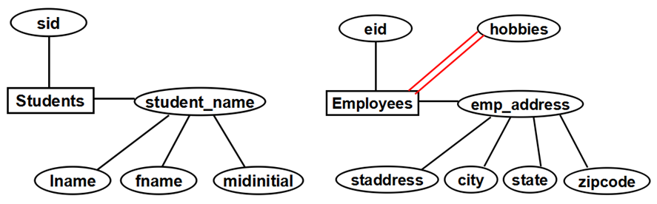
6.1 Introduction to E-R Concepts
special terminology for special kinds of attributes
identifier
descriptor
single-valued attribute
composite attribute
multi-valued attribute
Figure 6.2 Example of E-R Diagrams with Entities and Attributes
Notes:
对属性的细分：
一、根据一个属性的取值是否能用于“标识该实体集中的实体”，我们可以将其划分为identifier（标识属性）和descriptor（描述属性）两大类；在一个entity中，能够起到 identifier 作用的属性子集（即实体集的关键字）可能不只一个，在每一个entity上，我们只能选择其中的一个关键字（通常是后面被选择作为关系表的 primary key 的那一个）并在ER图中通过为属性名加下划线的方式来表示，其他的关键字只能在附加的需求文件中用文字来进行描述。
二、根据一个属性的属性值的取值情况，我们也可以将实体的属性划分为以下的三类：
（1）single-valued attribute（单值属性）：其取值是一个不可分割的原子值
（2）composite attribute（组合属性）：其取值是一个由若干个成员属性值所构成的‘结构化’值（record-value）
（3）multi-valued attribute（集合属性）：其取值是一个由若干个具有相同类型的值所构成的集合值（set-value）
其中，composite attribute 和 multi-valued attribute 又被统称为是 ‘多值属性’。
在ER图中，composite attribute的表示方法相对简单，只需要在composite attribute和其各个成员属性之间用‘无向线段’直接相连即可。
而对于 multi-valued attribute 则提供了两种表示方法：
（1）在 multi-valued attribute 和 实体集（长方形）之间用无向的双线段进行连接（如图，hobbies和Employees之间的双线段）；
（2）在扩充ER模型中，引入了 Cardinality of Attributes （属性基数）的定义，可用于描述一个属性的取值特征（单值 or 集合值）。

Slide 29
6.1 Introduction to E-R Concepts
identifier
An identifier is an attribute or set of attributes that uniquely identifies an entity instance.
There might be more than one identifier for a given entity. Primary identifier is a single key identified by DBA.
Identifier/primary identifier are the analog of the relational concept of candidate key/primary key.
descriptor
A descriptor is a non-key attribute, descriptive.
Notes:
identifier 相当于是关系数据模型中的关键字的概念

Slide 30
6.1 Introduction to E-R Concepts
entity | primary identifier | descriptor
Customers | cid | cname, city, discnt
Agents | aid | aname, city, percent
Products | pid | pname, city, price, ...
Students | sid | name, age, ...
Employees | eid | name, salary, ...
... | ... | ...
Notes:
identifier 相当于是关系数据模型中的关键字的概念

Slide 31
6.1 Introduction to E-R Concepts
single-valued attribute
take on simple values from a domain (representing as a oval).
Students.age, Products.pname, ......
composite attribute
a group of simple attributes that together describe a property.
Students.student_name
Employees.emp_address
multi-valued attribute
can take on multiple values for a single entity instance.

Slide 32
Attributes of 'Students'
sid
Students
student_name
Entity
单线段表示：属性student_name是实体Students的一个single-valued attribute
Figure 6.2 Example of E-R Diagrams with Entities and Attributes

Slide 33
sid
student_name is a composite attribute
primary
identifier
Students
student_name
lname
fname
midinitial
Attributes of 'student_name'
Figure 6.2 Example of E-R Diagrams with Entities and Attributes

Slide 34
eid is primary identifier
hobbies
'hobbies' is a multi-valued attribute, and others are single-valued attributes
eid
Employees
emp_address
staddress
city
state
zipcode
Employees has three attributes
emp_address is composed of the four attributes
Figure 6.2 Example of E-R Diagrams with Entities and Attributes

Slide 35
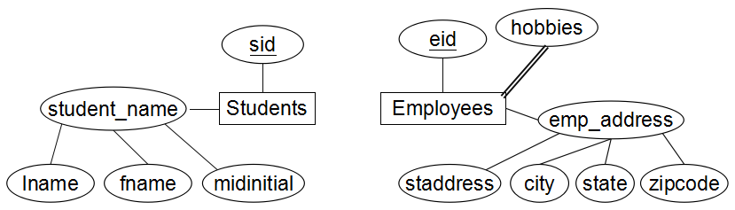
(Figure 6.2)

Slide 36
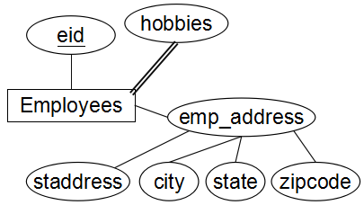
Review1: Entity&E-R diagrams
a entity
representing as a rectangle
primary identifier
a single-valued attribute
representing as a oval
attached by a straight line to the entity.
a composite attribute
is also in an oval attached directly to the entity
the simple attributes that make up the composite are attached to the composite oval.
a multi-valued attribute
is attached by a double line to the entity it describes.

Slide 37
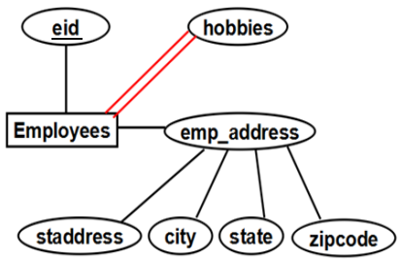
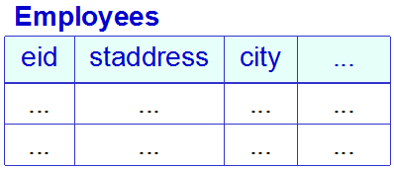
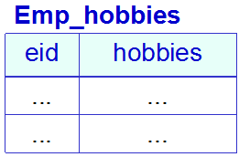
6.1 Introduction to E-R Concepts
Transforming Entities and Attributes to Relations
rule 1: An entity is mapped to a single table.
rule 2: A multi-valued attribute must be mapped to its own table.

Slide 38
6.1 Introduction to E-R Concepts
Transforming Entities and Attributes to Relations - Transformation Rule 1
An entity is mapped to a single table.
E-R concepts | Relational Database
entity name | table name
attribute name | column name
the single-valued attributes | columns of the table
the composite attributes | multiple simple columns
an identifier for the entity | a candidate key for the table
primary identifier | primary key
entity instance | row
mapping
Notes:
转换后得到的table和column的命名，可以直接使用对应实体的实体名和属性的属性名。
组合属性将被替换为它的所有成员属性。
在转换后的table中，如果存在column的‘重名’问题，可以对其进行适当的重命名（rename）

Slide 39
Transformation Rule 1 (example 6.1.1)
Figure 6.2 Example of E-R Diagrams with Entities and Attributes
Students(sid, lname, fname, midinitial)
Employees(eid, staddress, city, state, zipcode)

Slide 40
6.1 Introduction to E-R Concepts
Transforming Entities and Attributes to Relations - Transformation Rule 2
A multi-valued attribute must be mapped to its own table.
E-R concepts | Relational Database
the plural multi-valued attribute | name for the new table
primary identifier | column for the new table
the multi-valued attribute | column for the new table
primary identifier + the multi-valued attribute | primary key
entity instance + an element of the multi-valued attribute | row
mapping

Slide 41
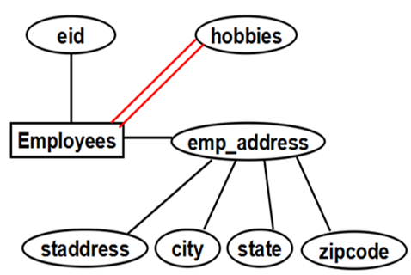

Transformation Rule 2 (example 6.1.2)
Employees(eid, staddress, city, state, zipcode)
hobbies ( hobby, eid )
hobbies
eid | hobby
197 | chess
197 | painting
197 | science fiction
221 | reading
303 | bicycling
303 | chess
... | ......

Slide 42
6.1 Introduction to E-R Concepts
Relationship (联系)
Attribute for relationship (联系上的属性)
E-R diagram for relationship

Slide 43
6.1 Introduction to E-R Concepts
Relationships（联系）among Entities
A relationship captures how entities are related to one another.
Relationships can be thought of as verbs, linking two or more nouns (entity instances).
own, compose, ......
manage, sale, match, ......
teach, works_on, ......

Slide 44
6.1 Introduction to E-R Concepts
Def. 6.1.3. Relationship (pg. 335)
Given an ordered list of m entities (E₁,E₂,...,E_{m}), a relationship R defines a rule of correspondence between the instances of these entities.
the same entity may occur more than once in the list.
Examples:
teach: teacher, course
order: customer, agent, product
match: player1, player2, referee, ...
Specifically, R represents a set of m-tuples, a subset of the Cartesian product of entity instances.

Slide 45
6.1 Introduction to E-R Concepts
Def. 6.1.3. Relationship: (E₁,E₂,...,E_{m})
a relationship occurrence or a relationship instance
A particular occurrence of a relationship, corresponding to a tuple of entity occurrences (e₁,e₂,...,e_{m}), where e_{i} is an instance of E_{i} in the relationship.
degree of the relationship
the number of entities m in the defining list.
binary relationship:
a relationship between two entities
ring, or recursive relationship
a binary relationship that relates an entity to itself.
N-ary relationship
a relationship on more than two entities.

Slide 46
6.1 Introduction to E-R Concepts
Def. 6.1.3. Relationship (cont.)
A relationship can also have attached attributes.
Examples:
Relationship | Entities | Attributes
teach | teacher course | year semester
order | customer agent product | orddate quantity ...
match | player 1 player 2 referee ... | result match-date ......

Slide 47
Figure 6.3: Examples of Relationships
联系(relationship)在E-R图中用菱形符号来表示。
在相关实体集(entity)与联系之间用‘无向线段’相连接。
Instructors teaches Course_sections
teaches
Instructors
Course_sections

Slide 48

Figure 6.3: Examples of Relationships
因‘联系’而产生的信息，可以抽象为‘联系’上的属性，并用无向线段连接到对应的联系上。
works_on
Employees
Projects
percent

Slide 49
Figure 6.3: Examples of Relationships
在有些联系中，可能需要多次使用到同一个实体(例如ring or recursive relationship)，为了区分它们在联系中所担当的‘角色’(role)，可以通过在连线上加‘文字’来标注一个‘实体’在一个‘联系’中的角色。
Employees manages Employees
manager_of
manages
Employees
reports_to
(ring, or recursive relationship)
Notes:
为了描述一个实体在一个联系中所担当的角色，可以在它们之间的连线上添加适当的有意义的‘文字标注’。

Slide 50
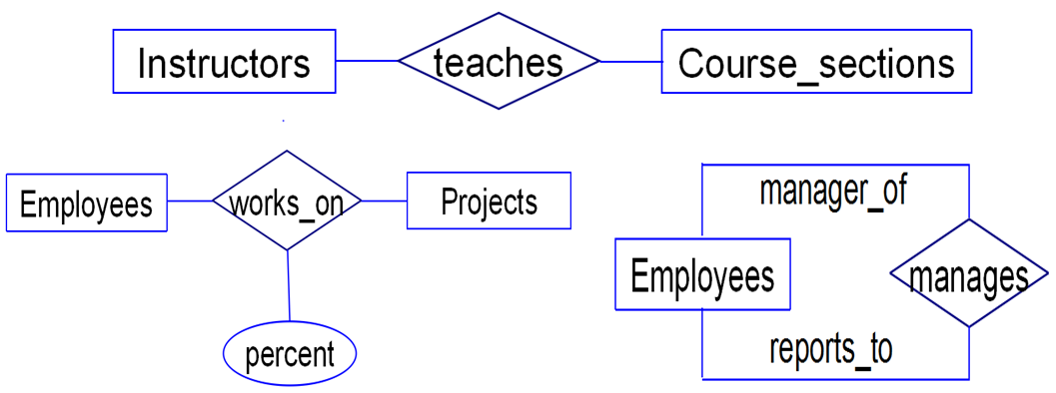
Figure 6.3: Examples of Relationships
Instructors teaches Course_sections
Employees works_on Projects(percent of time)
Employees manages Employees
Figure 6.3: Examples of E-R Diagrams with Relationships

Slide 51
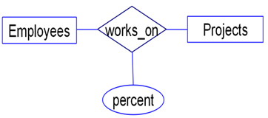
works_on has the connected attribute ‘percent’
Note:
percent is a value with each relationship instance.
The relationship instance represents a specific pairing of an Employees instance with a Projects instance;
percent represents the percent of time an employee instance works on that project.

Slide 52
N-ary relationship
example 6.1.3
orders on (customers, agents, products)
products
orders
customers
agents
ordno
month
qty
dollars
在orders联系中，给定一个客户、供应商和商品并不能唯一确定一条销售记录！因此，在orders联系上人为添加了一个ordno属性，用于作为orders-relationship-instance的identifier.

Slide 53
N-ary relationship
Example 6.1.4: 统计当年的累计销售数量和销售金额
curyear (customers, agents, products)
products
curyear
customers
agents
sum of qty
sum of dollars
由于只统计当年的销售结果，确定的一个客户、一个供应商和一种商品对应着唯一的一条统计结果(relationship instance)，在联系curyear上就不需要添加其他的identifier属性了。

Slide 54
N-ary relationship
Example 6.1.4: 统计每年的累计销售数量和销售金额
yearlies (customers, agents, products)
products
yearlies
customers
agents
year
sum of qty
sum of dollars
如果每一个年度都需要有一个统计结果，在联系yearlies上就需要增加一个属性year.

Slide 55
Figure 6.5(a) Basic E-R Concepts: Entities and Attributes
Classification | Description | Example
Entity | A collection of distinguishable real-world objects with common properties. | Customers, Agents, ... Employees, Projects, ...
Attribute | A data item that describes a property of an entity or a relationship. | See below
Identifier (set of attributes) | Uniquely identifies an entity instance or relationship occurrence. | cid for customer (eid,proid) for works_on
Descriptor | Non-key attribute, describing an entity or relationship. | city for customer percent for works_on
Composite attribute | A group of simple attributes that together describe a property of an object. | student_name emp_address
Multi-valued attribute | An entity attribute that takes on multiple values for a single entity instance. | hobbies

Slide 56
Figure 6.5(b) Basic E-R Concepts: Relationships
Classification | Description | Example
Relationship | Named set of m-tuples, identifies subset of the Cartesian product E₁×E₂×...×E_{m}
Binary relationship | A relationship on two distinct entities | teachs works_on
Ring, recursive relationship | A relationship relating an entity to itself | manages
N-ary (N>2) relationship | A relationship on more than two entities | yearlies

Slide 57
6.2 Further Details of E-R Modeling
Cardinality of Entity Participation in a Relationship
One-to-One, Many-to-Many, Many-to-One Relationships
Transforming Binary Relationships to Relations

Slide 58
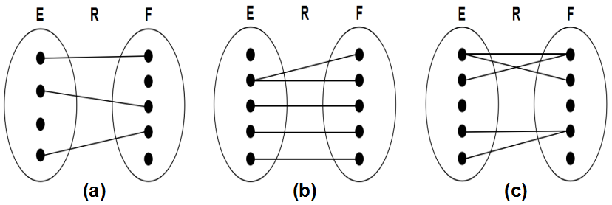
6.2 Further Details of E-R Modeling
Cardinality of Entity Participation in a Relationship
Figure 6.6: Entities E and F, relationship R.
Dots are entity instances.
Lines between dots are relationship instances.

Slide 59
Cardinality of Entity Participation in a Relationship
max-card(E,R)=1 | If all dots in the entity E have AT MOST one line coming out
max-card(E,R)=N | If some dots might have more than one lines coming out
min-card(E,R)=1 | If all dots in the entity E have AT LEAST one line coming out
min-card(E,R)=0 | If some dots might not have a line coming out
Relationship instance
min-card(E,R)= ?
max-card(E,R)= ?
e₂ | f₁
e₃ | f₂
e₄ | f₄
e₄ | f₅
e₆ | f₃
0
N
min-card(F,R)= ?
max-card(F,R)= ?
1
1
E R F

Slide 60
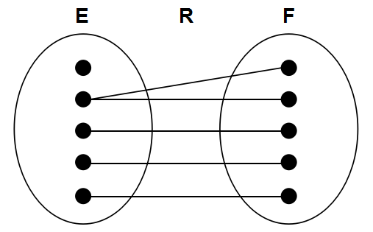
6.2 Further Details of E-R Modeling
N
1
max-card(E, R) = ?
min-card(E, R) = ?
max-card(F, R) = ?
min-card(F, R) = ?
0
1

Slide 61
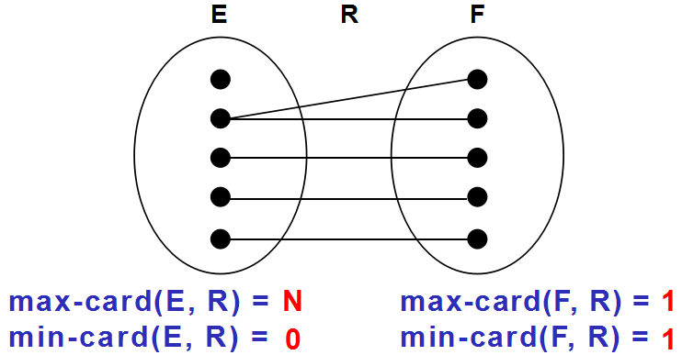
6.2 Further Details of E-R Modeling
Def. 6.2.1 Card(E, R) = (x, y)
We combine these if min-card(E, R) = x and max-card(E, R) = y
x is either 0 or 1, and y is either 1 or N
card(E,R)=(0,N)
card(F,R)=(1,1)

Slide 62
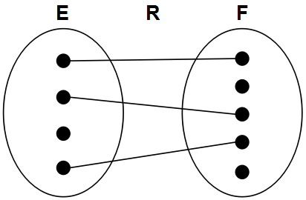
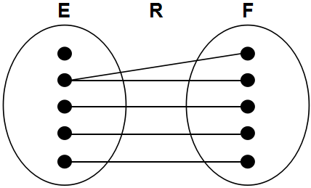
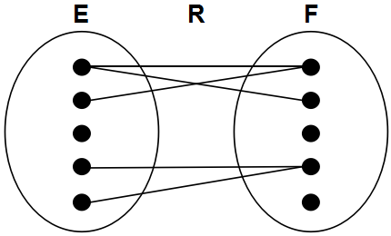
Figure 6.6 Examples of Relationships R between Two Entities E and F
(a)
min-card(E,R) = 0
max-card(E,R) = 1
min-card(F,R) = 0
max-card(F,R) = 1
(b)
min-card(E,R) = 0
max-card(E,R) = N
min-card(F,R) = 1
max-card(F,R) = 1
(c)
min-card(E,R) = 0
max-card(E,R) = N
min-card(F,R) = 0
max-card(F,R) = N
card(E, R) = (0, 1)
card(F, R) = (0, 1)
card(E, R) = (0, N)
card(F, R) = (1, 1)
card(E, R) = (0, N)
card(F, R) = (0, N)

Slide 63
(0, N)
(1, 1)
(?, ?)
teaches
(?, ?)
Instructors
Course_sections
(1, N)
(0, N)
(?, ?)
works_on
(?, ?)
Employees
Projects
percent
(0, N)
(?, ?)
manager-of
Employees
manages
reports-to
(?, ?)
(0, 1)
Figure 6.7: An E-R Diagrams with Labels(x,y) on Entity-Relationship Connections
Notes:
card(Instructors, teaches)=(0, N): 允许有一些老师在teaches联系中没有出现过（从未担任过授课任务），也允许一些老师在teaches联系中出现过多次（担任过多次授课任务）
card(Course_sections, teaches)=(1, 1): 每一个Course_sections都应该安排且只安排一位授课老师
card(Employees, works_on)=(1, N): 每一位员工，至少要参与到一个项目中去，允许一个员工参与到多个项目中去
card(Projects, works_on)=(0, N): 一个项目可以暂时没有参与的员工，也允许一个项目中有多位参与的员工
card(Employees(report_to), manages)=(0, 1) card(Employees(manager_of), manages)=(0, N)
一位员工以reports_to角色（被管理者）在manages联系中“最多出现一次，也可以不出现’； 而一位员工以manager_of角色（管理者）在manages联系中“可以出现多次，也可以不出现”。manages联系上的这次参与方式的定义，反映了在现实世界的企业管理制度中，严格的‘树’状上下级层次关系。

Slide 64
6.2 Further Details of E-R Modeling
manager-of
reports-to
Manages
Emps_One
Emps_Two
(0, N)
(0, 1)
Employee1 in Emps_One is a manager of Employee2 in Emps_Two.
Notes:
可以将图6.7中的manages联系拆成如图所示的二元联系，只不过其中的Emps_One和Emps_Two是同一个Entity

Slide 65
6.2 Further Details of E-R Modeling
Def 6.2.2 single-valued & multi-valued participation
if max-card(E,R) = 1 then E is said to have single-valued participation (单值参与) in the relationship R.
If max-card(E,R) = N, then E is said to be multi-valued participation (多值参与) in this relationship.
Def 6.2.3 mandatory & optional participation
If min-card(E,R) = 1, E is said to have mandatory participation (强制参与) in the relationship R
if min-card(E,R) = 0, then E is said to be optional participation (可选参与) in this relationship.
Notes:
单值参与 Vs 多值参与：根据最大参与基数的取值来区分
可选参与 Vs 强制参与：根据最小参与基数的取值来区分

Slide 66
6.2 Further Details of E-R Modeling
在联系R中
E是多值参与
F是单值参与
E是可选参与
F是强制参与

Slide 67
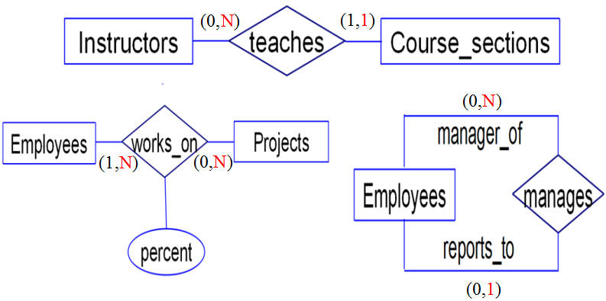
(0, 1)
single-valued participation:
Course_sections in teaches
Emoloyees (reports_to) in manages
multi-valued participation:
Instructors in teaches
Employees (manager_of) in manages
Employees and Projects in works_on

Slide 68
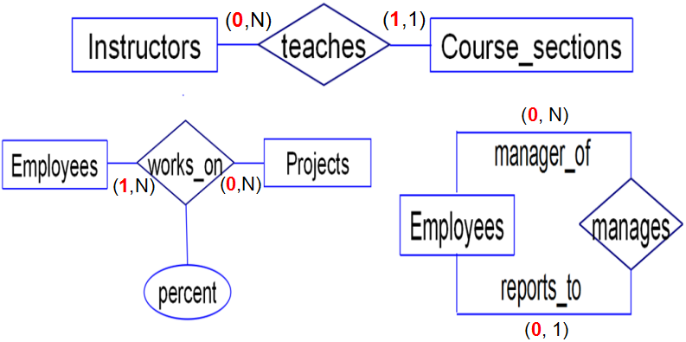
(0, 1)
mandatory participation:
Course_sections in teaches
Emoloyees in works_on
optional participation:
Instructors in teaches, Projects in works_on
Employees(manager_of) and Employees(reports_to) in manages

Slide 69
One-to-One, Many-to-Many, Many-to-One Relationships
(a)
min-card(E,R) = 0
max-card(E,R) = 1
min-card(F,R) = 0
max-card(F,R) = 1
(b)
min-card(E,R) = 0
max-card(E,R) = N
min-card(F,R) = 1
max-card(F,R) = 1
(c)
min-card(E,R) = 0
max-card(E,R) = N
min-card(F,R) = 0
max-card(F,R) = N
Which side is “One” ? Which side is “Many” ?

Slide 70
One-to-One, Many-to-Many, and Many-to-One Relationship
both entities are single-valued in the relationship (max-card concept only)
E
R
F
Figure 6.6 (a)
One-to-One relationship
min-card(E, R) = 0
max-card(E, R) = 1
min-card(F, R) = 0
max-card(F, R) = 1

Slide 71
One-to-One, Many-to-Many, and Many-to-One Relationship
one entity is multi-valued and one is single-valued
multi-valued participation is the 'one' side
single-valued participation is the 'many' side
E
R
F
Figure 6.6 (b)
One-to-Many relationship
min-card(E, R) = 0
max-card(E, R) = N
min-card(F, R) = 1
max-card(F, R) = 1
Notes:
Many-to-One 要注意方向性，区分清楚哪一端是 Many，哪一端是 One

Slide 72
One-to-One, Many-to-Many, and Many-to-One Relationship
both entities are multi-valued
E
R
F
Figure 6.6 (c)
Many-to-Many relationship
min-card(E, R) = 0
max-card(E, R) = N
min-card(F, R) = 0
max-card(F, R) = N

Slide 73
One-to-One, Many-to-Many, Many-to-One Relationships
(a)
min-card(E,R) = 0
max-card(E,R) = 1
min-card(F,R) = 0
max-card(F,R) = 1
(b)
min-card(E,R) = 0
max-card(E,R) = N
min-card(F,R) = 1
max-card(F,R) = 1
F is “Many” side in Figure 6.6 (b).
(c)
min-card(E,R) = 0
max-card(E,R) = N
min-card(F,R) = 0
max-card(F,R) = N
(a) One-to-One
(b) One-to-Many
(c) Many-to-Many

Slide 74
(0, N)
(1, 1)
(0, N)
(1, N)
(0, N)
(0, 1)
one-to-one:......
one-to-many:... Instructors to Course_sections, Employees(manager_of) to Employees(reports_to)
many-to-many:... Employees to Projects
Notes:
one-to-many 需要注意方向性

Slide 75
N-ary Relationships
在多元联系中，我们很难描述清楚one-to-one、many-to-many、many-to-one的关系，但描述实体在联系中的参与方式就要容易得多。
products
(0,N)
orders
customers
agents
(0,N)
(0,N)
ordno
month
qty
dollars

Slide 76
N-ary relationship
当前年度的累计销售数量和销售金额
curyear (customers, agents, products)
products
(0,N)
curyear
customers
agents
(0,N)
(0,N)
sum of qty
sum of dollars
各个entity在联系中的参与方式不变！

Slide 77
N-ary relationship
按年度统计的累计销售数量和销售金额
yearlies (customers, agents, products)
products
(0,N)
yearlies
customers
agents
(0,N)
(0,N)
year
sum of qty
sum of dollars

Slide 78
N-ary Relationships
在大宗商品的销售应用中，orders联系上的参与方式又有所不同
例：汽车销售的例子(新车销售，不考虑二手车市场)
vehicles
(0,1)
(?,?)
orders
customers
agents
(0,N)
(0,N)
(?,?)
(?,?)
ordno
orddate

Slide 79
N-ary Relationships
一个多元联系，也可以用若干个二元联系(binary relationship)来表示
customers
products
agents
(0,N)
(0,N)
(0,N)
R1
R2
R3
(1,1)
(1,1)
(1,1)
orders
如果在一份订单中允许销售多种商品，那么：card(orders, R2) = (1, N)

Slide 80
Transforming Binary Relationships to Relations
Rule 3. N-N Relationships
Rule 4. N-1 Relationships
Rule 5. 1-1 Relationships, Optional Participation
Rule 6. 1-1 Relationships, Mandatory Participation on Both Sides

Slide 81
Rule 3. N-N Relationships
When two entities E and F take part in a many-to-many binary relationship R, the relationship is mapped to a representative table T in the related relational database design.
E-R concepts | Relational Database
relationship name | table name
primary identifier of E | column of the table (foreign key)
primary identifier of F | column of the table (foreign key)
attribute attached to the relationship | column of the table
primary identifier of E + primary identifier of F | primary key *
relationship instance | row
*注: 关键字的定义也有可能会发生变化（例如MyCAP中的orders）

Slide 82
Example 6.2.2 for Rule 3. N-N Relationships
Employees(eid, straddr, city, ……)
Projects(proj_id, proj_name, due_date)
works_on(eid, proj_id, percent)
works_on
Employees
Projects
(1, N)
(0, N)
eid
proj_id
percent

Slide 83
Rule 4. N-1 Relationships
assume: relationship R between entity E and F
max-card(E, R)=N (entity E is 'one' side)
max-card(F, R)=1 (entity F is 'many' side)
relation F (transformed from entity F by rule 1)
should include columns constituting primary key for relation E (as foreign key in relation F)
should include columns of relationship R.
基本思想：将联系合并到 'many side' 一方所对应的关系F中去，即在根据规则1转换得到的关系F中添加以下属性：
关系E的主关键字属性（在关系F中作为 foreign key）
联系R上的所有属性

Slide 84
Example 6.2.3 for Rule 4. N-1 Relationships
results by rule 1
Instructors(insid, lname, office_no, ext)
Course_sections(secid, course, period)
(0, N)
teaches
(1, 1)
Instructors
Course_sections
insid
room
secid
results by rule 1 & 4
Instructors(insid, lname, office_no, ext)
Course_sections(secid, course, period, insid, room)

Slide 85
6.2 Further Details of E-R Modeling
Transformation Rule 5&6. 1-1 Relationships
Optional on both side
Represent as three tables
Optional on one side
Represent as two tables
foreign key column in one with mandatory participation (column defined to be NOT NULL)
Mandatory on both sides
never can break apart. It's appropriate to think of this as two entities in a single table.

Slide 86
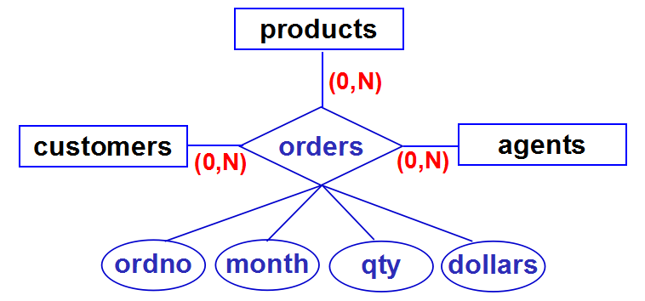
N-ary relationships的转换
可参照N-N二元联系的转换方式 (rule 3)，但转换后的关系关键字的定义需要重新再考虑（规范化设计）
orders(cid, pid, aid, ordno, month, qty, dollars)

Slide 87
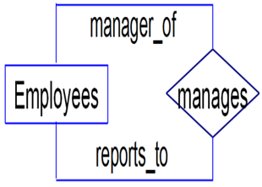
recursive relationship 的转换
可参照二元联系的处理方式进行转换
(0, N)
one side
(0, 1)
many side
转换结果为（参照 rule 4）
Employees ( eid, ename, ......, mgr_id )
eid of manager
数据库概论2018
Notes:
如果是 Many to Many，可参照 rule 3；
如果是 Many to One，可参照 rule 4；
如果是 One to One，可参照 rule 5 or 6。

Slide 88
6.3 Additional E-R Concepts
Cardinality of Attributes (属性基数)
Def 6.3.1 ( Figure 6.10, pg. 347 )
(0, ?) means don't have to say not null (optional)
midinitial, emp_address
(1, ?) means do (mandatory)
sid, student_name, lname, fname, city, ......
(?, 1) single valued attribute
sid, eid
(?, N) multi-valued attribute
hobbies

Slide 89
6.3 Additional E-R Concepts
sid
(1, 1)
(1, 1)
Students
student_name
(1, 1)
(1, 1)
(0, 1)
lname
fname
midinitial
Figure 6.10 (1) Students

Slide 90
6.3 Additional E-R Concepts
eid
hobbies
(1, N)
(1, 1)
Employees
emp_address
(0, 1)
(1, 1)
(1, 1)
(1, 1)
(1, 1)
staddress
city
state
zipcode
Figure 6.10 (2) Employees
Notes:
有了属性基数的标注后，就不再需要‘双线段’来表示 multi-valued attribute

Slide 91
6.3 Additional E-R Concepts
Weak Entities
Def 6.3.2
A weak entity is an entity whose occurrences are dependent for their existence, through a relationship R, on the occurrence of another (strong) entity.
Figure 6.11, pg. 347

Slide 92
6.3 Additional E-R Concepts
在现实世界中，更常见的是一份订单中可以订购多种商品，所订购的每一种商品就是该订单的一条 Line_item
每一个Line_item都必须依附于某个特定的order而存在 (because: card(Line_items, has_item)=(1,1) )，因此相对于order来说，Line_item就是一个弱实体(weak entity)
Figure 6.11
Notes:
在这里，没有为 weak entity 定义特定的表示符号，而是通过 card(Line_items, has_item)=(1,1) 来描述该语义。

Slide 93
6.3 Additional E-R Concepts
Generalization Hierarchies
Figure 6.12, pg. 349

Slide 94
6.4 Case Study
Figure 6.13 & 6.14
E-R Design for a Simple Airline Reservation Database
Entity
Passengers Flights
Seats Gates
Relationship
Travels_On ( Passengers, Flights )
Has_Seat ( Flights, Seats )
Seat_Assign ( Passengers, Seats )
Marshals ( Flights, Gates )

Slide 95
ticketno
gateno
(1, 1)
Passengers
Gates
(1, 1)
(0, N)
marshals
travels_on
seat_assign
(1, 1)
(0, N)
(0, 1)
has_seat
depart_time
Flights
Seats
(1, N)
(1, 1)
flightno
seatno
ddate
dtime
Figure 6.14 E-R Design with Cardinalities for a Simple Airline Reservation Database

Slide 96
6.4 Case Study
6.4.1 图书借阅管理
6.4.2 篮球联赛信息管理
6.4.3 聊天论坛管理
6.4.4 邮件信息管理

Slide 97
6.4 Case Study（例6.4.1）
设有一个图书借阅管理数据库，已知：图书的属性有书号（具有唯一性）、书名；读者的属性有借书证号（具有唯一性，每个读者只能有一个借书证号）、姓名、身份证号、住址、电话；出版社的属性有出版社名称（具有唯一性）、地址、联系电话。
其中：每本图书只能由一个出版社出版发行；每个读者可以同时借阅多本图书，也可以在不同时候借阅同一本图书；系统需要记录每本图书被借阅的借阅日期和归还日期。
请用E-R模型表示该数据库系统的概念模型，并将其转换成等价的关系模式。
模型设计

Slide 98
6.4 Case Study（例6.4.2）
假设需要设计一个用于NBA篮球比赛的数据库系统，需要记录的信息有：
每个球员的球衣号码、姓名、身高、体重和位置
每个球队的名称和主场使用的体育馆的名称
每场比赛的比赛日期和比分
其中：
每个球员只能效力于一个球队
比赛采用主客场多循环方式
请用E-R模型表示该数据库系统的概念模型，并将其转换成等价的关系模式。
模型设计

Slide 99
6.4 Case Study（例6.4.3）
假设需要设计一个用于网络论坛聊天信息管理的数据库系统，需要记录的信息有：
注册用户的用户名，email，电话，联系地址
帖子的帖子ID，标题，内容
每份帖子的发帖用户，帖子之间的回复关系
请用E-R模型表示该数据库系统的概念模型，并将其转换成等价的关系模式。
模型设计

Slide 100
6.4 Case Study（例6.4.4）
有一个邮件管理数据库，其信息如下：
联系人：用户名，email (关键字)，电话，联系地址
邮件：邮件ID，邮件标题，邮件内容，收信人集合，抄送人集合
邮件之间的回复关系
请用E-R模型表示该数据库系统的概念模型，并将其转换成等价的关系模式。
模型设计

Slide 101
6.4 Case Study
6.4.1 图书借阅管理

Slide 102
设有一个图书借阅管理数据库，已知：图书的属性有书号（具有唯一性）、书名；读者的属性有借书证号（具有唯一性，每个读者只能有一个借书证号）、姓名、身份证号、住址、电话；出版社的属性有出版社名称（具有唯一性）、地址、联系电话。
其中：每本图书只能由一个出版社出版发行；每个读者可以同时借阅多本图书，也可以在不同时候借阅同一本图书；系统需要记录每本图书被借阅的借阅日期和归还日期。
请用E-R模型表示该数据库系统的概念模型，并将其转换成等价的关系模式。

Slide 103
6.4.1 Case Study one
[例6.4.1]设有一个图书借阅管理数据库，已知：
图书的属性有书号（具有唯一性）、书名
读者的属性有借书证号(具有唯一性，每个读者只能有一个借书证号)、姓名、身份证号、住址、电话
出版社的属性有出版社名称（具有唯一性）、地址、联系电话。

Slide 104
6.4.1 Case Study one
[例6.4.1]设有一个图书借阅管理数据库，已知：
图书的属性有书号（具有唯一性）、书名
读者的属性有借书证号(具有唯一性，每个读者只能有一个借书证号)、姓名、身份证号、住址、电话
出版社的属性有出版社名称（具有唯一性）、地址、联系电话。

Slide 105
6.4.1 Case Study one
[例6.4.1]设有一个图书借阅管理数据库，已知：
图书的属性有书号（具有唯一性）、书名
读者的属性有借书证号(具有唯一性，每个读者只能有一个借书证号)、姓名、身份证号、住址、电话
出版社的属性有出版社名称（具有唯一性）、地址、联系电话。

Slide 106
6.4.1 Case Study one
其中：
每本图书只能有一个出版社出版发行
每个读者可以同时借阅多本图书，也可以在不同时候借阅同一本图书
系统需要记录图书被借阅的借阅日期和归还日期
(?,?)
(?,?)
(1,1)
(0,N)

Slide 107
6.4.1 Case Study one
其中：
每本图书只能有一个出版社出版发行
每个读者可以同时借阅多本图书，也可以在不同时候借阅同一本图书
系统需要记录图书被借阅的借阅日期和归还日期
借 阅
(?,?)
(?,?)
(0,N)
(0,N)

Slide 108
6.4.1 Case Study one
其中：
每本图书只能有一个出版社出版发行
每个读者可以同时借阅多本图书，也可以在不同时候借阅同一本图书
系统需要记录图书被借阅的借阅日期和归还日期
借阅日期
归还日期
借 阅
(0,N)
(0,N)

Slide 109
(1,1)
(1,1)
(1,1)
(1,1)
(1,1)
(0,N)
(1,1)
(0,N)
借阅日期
借 阅
(1,1)
(0,N)
(0,N)
归还日期
(0,1)
(0,1)
(1,1)
(1,1)
(1,1)
假设：读者的‘电话’是多值属性，其他都是单值属性.

Slide 110
(1,1)
(1,1)
(1,1)
(1,1)
(1,1)
(0,N)
(1,1)
(0,N)
借阅日期
借 阅
(1,1)
(0,N)
(0,N)
归还日期
(0,1)
(0,1)
(1,1)
(1,1)
(1,1)
请将上述的E-R模型转换为关系模型.

Slide 111
(1,1)
(1,1)
(1,1)
(1,1)
(1,1)
图书（书号，书名）
出版社（出版社名称，联系电话，地址）
转换得到的关系模式

Slide 112
(1,1)
(1,1)
(1,1)
(1,1)
(1,1)
(0,N)
(1,1)
图书（书号，书名）
出版社（出版社名称，联系电话，地址）
图书（书号，书名，出版社名称）
出版社（出版社名称，联系电话，地址）
‘图书’和‘出版社’实体集转换得到的关系模式
加入‘出版’联系后的关系模式

Slide 113
(0,N)
(0,1)
(1,1)
(1,1)
(1,1)
读者（借书证号，姓名，身份证号，地址）
读者电话（借书证号，电话）
‘读者’实体集转换得到的关系模式

Slide 114
借阅 ( 借书证号, 书号, 借阅日期, 归还日期 )
(1,1)
(1,1)
‘借阅’联系转换得到的关系模式
(0,N)
借阅日期
(1,1)
借 阅
(0,N)
(0,N)
归还日期
(0,1)
(0,1)
(1,1)
(1,1)
(1,1)

Slide 115
[例6.4.1] 转换得到的关系模式如下
图书（书号，书名，出版社名称）
出版社（出版社名称，联系电话，地址）
读者（借书证号，姓名，身份证号，地址）
读者电话（借书证号，电话）
借阅 ( 借书证号, 书号, 借阅日期, 归还日期 )
【思考题】如果一个读者一次可以同时借阅多本图书，也可以在不同时候借阅同一本图书，那么‘借阅’关系的关键字应该是什么？
（注：借阅日期和归还日期都是datetime类型）

Slide 116
6.4 Case Study
6.4.2 篮球联赛信息管理

Slide 117
假设需要设计一个用于NBA篮球比赛的数据库系统，需要记录的信息有：
每个球员的球衣号码、姓名、身高、体重和位置
每个球队的名称和主场使用的体育馆的名称
每场比赛的比赛日期和比分
其中：
每个球员只能效力于一个球队
比赛采用主客场多循环方式
请用E-R模型表示该数据库系统的概念模型，并将其转换成等价的关系模式。

Slide 118
签约
(0,1)
(0,N)
主队
客队
(0,N)
(0,N)

Slide 119
实体（Entity）向关系的转换（Rule 1）
球员（姓名, 球衣号码, 身高, 体重, 位置）
球队（名称, 体育馆名称）

Slide 120
签约
(0,1)
(0,N)
‘签约’联系向关系的转换（Rule 4）
球员（姓名, 球衣号码, 身高, 体重, 位置）
球队（名称, 体育馆名称）
, 名称）

Slide 121
‘比赛’联系向关系的转换（Rule 3）
比赛（主队名称, 客队名称, 日期, 比分）
主队
客队
(0,N)
(0,N)

Slide 122
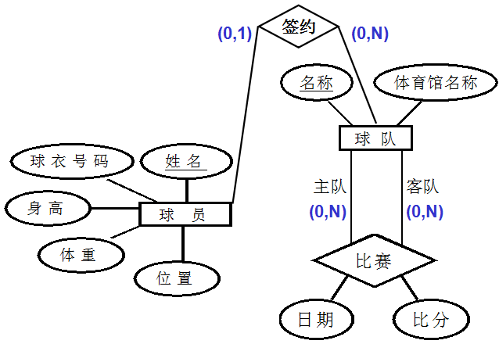
最终转换结果如下：
球员（姓名, 球衣号码, 身高, 体重, 位置, 名称）
球队（名称, 体育馆名称）
比赛（主队名称, 客队名称, 日期, 比分）

Slide 123
姓名
名称
球 员
(0,1)
签约
(0,N)
球 队
(0,N)
(0,N)
主队
客队
(1,1)
(1,1)
E-R模型的另一种设计方案(2)
日期
比 赛
m_id
比分
其中：m_id是新添加的关于比赛的标识符属性

Slide 124
姓名
名称
球 员
(0,1)
签约
(0,N)
球 队
(0,N)
(0,N)
方案(2)向关系的转换
球员 ( 姓名, ......, 名称 )
球队 ( 名称, ...... )
比赛 ( m_id, 日期, 比分,
主队名称, 客队名称 )
主队
客队
(1,1)
(1,1)
日期
比 赛
m_id
比分

Slide 125
6.4 Case Study
6.4.3 网络论坛聊天管理

Slide 126
假设需要设计一个用于网络论坛聊天信息管理的数据库系统，需要记录的信息有：
注册用户的用户名，email，电话，联系地址
帖子的帖子ID，标题，内容
每份帖子的发帖用户，帖子之间的回复关系
请用E-R模型表示该数据库系统的概念模型，并将其转换成等价的关系模式。

Slide 127
问题1：ER模型设计
用户：用户名，email，电话，联系地址
帖子：帖子ID，标题，内容
帖子的发表者（发帖用户）
帖子之间的回复关系
有哪些实体(Entity)？
有哪些联系(Relationship)？
联系上的函数对应关系（参与方式）？
有哪些属性？属性与实体/联系的依附关系？
Notes:
是3个实体集，还是2个实体集？‘回帖’也是一份‘帖子’，所有只有2个实体集：‘用户’和‘帖子’
有2个联系：‘用户’和‘帖子’之间的‘发表’联系，‘帖子’和‘帖子’之间的‘回复’联系（单个实体集内部的联系）
从‘用户’到‘帖子’之间的‘发表’联系是“一对多”，从‘帖子’到‘回帖’之间的‘回复’联系也是“一对多”的。（注意：在“一对多”的联系中，请关注‘谁’是‘一’，‘谁’是‘多’！）
（略）

Slide 128
1、有哪些实体(Entity)？
帖子ID
email
用 户
帖 子
用户名
电话
地址
标题
内容
Notes:
两个实体集及其各自的属性

Slide 129
2、有哪些联系(Relationship)？
帖子ID
email
原帖
用 户
帖 子
用户名
发表
回复
电话
回帖
地址
标题
内容
ER模型图-1
Notes:
两个联系
请关注‘回复’联系：因为是单个实体集内部的联系，因此必须知道与上下两根线段相关的两份‘帖子’在‘回复’联系中所担当的角色，之后才能标注上正确的函数对应关系。一般采用如图所示的‘文字标注’的方式。

Slide 130
3、联系上的函数对应关系（参与方式）？
帖子ID
email
原帖
?
用 户
帖 子
(0,N)
用户名
?
发表
?
回复
(0,N)
(1,1)
电话
?
回帖
(0,1)
地址
标题
内容
ER模型图-1
Notes:
我们可以通过在实体集与联系之间的线段上加上‘势’的标注来描述一个‘实体集’在一个‘联系’中的参与方式。
一个实体集E在一个联系R中的参与方式可以用一个二元组(x, y)来表示，其中：
x 表示实体集E在联系R中的“最小参与基数”，其取值只有0和1。其中：‘1’表示实体集E中的每一个实体都“至少”要参与到联系R中‘1’次，而‘0’则表示允许实体集E中的某个（些）实体没有参与到联系‘R’中去。
y 表示实体集E在联系R中的“最大参与基数”，其取值只有1和N(注：任意一个字母符号)。其中：‘1’表示实体集E中的每一个实体“最多”只能参与到联系R中‘1’次，而‘N’则表示允许实体集E中的某个（些）实体多次参与到联系‘R’中去。
注：一个实体E参与到联系R中‘1’次，意味着实体E与另外一个实体集中的某个实体具有联系R。如果说一个实体E参与到联系R中多次，则表明该实体E与另外一个实体集中的多个实体具有这样的联系R。（这里的‘另外一个实体集’也可能就是实体集E，即R是单个实体集内部的联系。）

Slide 131
(0,N)
原帖
用 户
帖 子
(0,N)
发表
(1,1)
回复
回帖
(0,1)
ER模型图-1（简化图）
1
？
原帖
用 户
帖 子
1
发表
N
回复
？
？
回帖
N
？
ER模型图-2（函数对应关系）
Notes:
联系上的‘参与方式’也可以被简化为‘函数对应关系’的表示。以‘用户’和‘帖子’之间的发表联系为例：
‘用户’是‘多值’参与的（最大参与系数为N），意味着允许一个用户发表多份帖子；
‘帖子’是‘单值’参与的（最大参与系数为1），意味着一份帖子最多只能有一位发帖者；
因此，在‘发表’联系中，一个用户可以对应着多份帖子，而一份帖子只能对应着一个用户（发帖者），所以，从‘用户’到‘帖子’之间的发表联系是‘1对多’的（或者说，从‘帖子’到‘用户’是‘多对1’）。
但是，仅仅使用‘函数对应关系’无法完整地描述清楚一个‘联系’上的语义关系！以这里的‘发表’联系为例：从‘用户’到‘帖子’的“一对多”联系，仅仅表示“一个用户可以发多份帖子”，但每一个用户是不是都必须‘发表’帖子？在‘函数对应’关系中并没有这样的语义（‘是’或‘否’）。

Slide 132
帖子ID
email
原帖
用 户
帖 子
(0,N)
用户名
发表
回复
(0,N)
(1,1)
电话
回帖
(0,1)
地址
标题
内容
ER模型图-1（参与方式）
Notes:
在该例子中，各个‘参与方式’的语义如下：
实体集‘用户’与联系‘发表’之间的(0,N)：‘0’表示有一个（些）用户没有发表过任何帖子；‘N’表示允许一个用户发表多份帖子。
实体集‘帖子’与联系‘发表’之间的(1,1)：第一个‘1’表示每一份‘帖子’都必须有发表它的‘用户’；第二个‘1’表示每一份‘帖子’只能有唯一的一个发帖者（用户）。
‘原帖’线段上(0,N)：‘0’表示有一些‘帖子’没有任何用户‘回复’过（一份没有人回复过的‘帖子’，它就不会以‘原帖’的身份参与到‘回复’这个联系中去）；‘N’表示有一些‘帖子’是有多份回复的（一份有多个回复的‘帖子’，它就会‘多次’以‘原帖’的身份参与到‘回复’联系中去）。
‘回帖’线段上(0,1)：‘0’表示有一些‘帖子’是原创的，并不是‘回复’其他帖子的（一份‘原创’的‘帖子’，它不会以‘回帖’的身份参与到‘回复’这个联系中去）；‘1’表示每一份回复的‘帖子’，只能回复唯一的一份‘原帖’（一份回复的‘帖子’，以‘回帖’的身份在‘回复’这个联系中只能出现一次）。

Slide 133
帖子ID
email
原帖
用 户
帖 子
1
用户名
发表
回复
1
N
电话
回帖
N
地址
标题
内容
ER模型图-2（函数对应关系）
Notes:
各‘函数对应关系’的语义如下：
‘发表’联系：一个用户可以发表多份帖子，但每一份帖子最多只能有一位‘发帖者’；
‘回复’联系：一份‘帖子’可能有多份回复（回帖），但每一份‘回帖’只能回复唯一一份‘原帖’；
‘1对多’包含着‘1对1’：在‘1对多’的‘发表’联系中，一个用户可以发表过多份帖子，当然也允许某些用户只发表过一份帖子，或者某些用户没有发表过帖子。

Slide 134
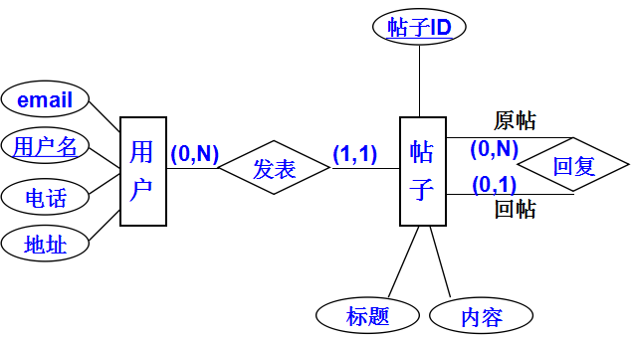
问题2：向关系模型的转换
实体的转换：
用户(用户名, 电话, 地址, email)
帖子(帖子ID, 标题, 内容)
Notes:
每个实体集都被转换成一个关系。

Slide 135
问题2：向关系模型的转换
'发表' 联系的转换：
用户(用户名, 电话, 地址, email)
帖子(帖子ID, 标题, 内容 , 用户名 )
Trans. Rule 4
)
Notes:
转换规则4：在‘1对多’的联系中，可以将‘联系’合并到‘多’那一端的关系中去。

Slide 136
问题2：向关系模型的转换
用户(用户名, 电话, 地址, email)
帖子(帖子ID, 标题, 内容 , 用户名 )
'回复' 联系如何向关系进行转换？
Notes:
单个实体集内部的联系，向关系模型的转换比较麻烦，可以参照规则3将其转换成单独的一个关系！

Slide 137
问题2：向关系模型的转换
可以将'回复'联系单独转换成一个关系！
回复 (原帖ID, 回帖ID)
该关系的关键字是什么？
回帖ID
Notes:
将一个‘二元’联系转换成关系时，其关键字的定义如下：
‘多对多’的二元联系：由两个实体集的标识属性联合起来构成关键字；
‘一对多’的二元联系：由‘多’那一端的实体集的标识属性构成关键字；
‘一对一’的二元联系：每一个实体集的标识属性都可以作为关系上的关键字。
单个实体集内部的联系，也可以参照上面的方式来确定其关系上的关键字。

Slide 138
问题2：到关系的转换结果
用户 ( 用户名, 电话, 地址, email)
帖子 ( 帖子ID, 标题, 内容, 用户名 )
回复 ( 原帖ID, 回帖ID )
Notes:
转换后的结果！

Slide 139
问题2：到关系的转换结果
另一种转换结果：
用户 ( 用户名, 电话, 地址, email)
帖子 ( 帖子ID, 标题, 内容, 用户名, 原帖ID )
Notes:
也可以按照规则4对‘回复’联系进行转换，即将上一页中的‘帖子’和‘回复’两个关系合并起来，形成这一页的设计结果
请注意：帖子关系用于存放每一份帖子的信息。如果一份帖子是用于‘回复’另外一份帖子的，那么被回复的那份帖子（即原帖）的ID将被记录在‘原帖ID’这个外关键字中。

Slide 140
6.4 Case Study
6.4.4 邮件信息管理

Slide 141
[例4]有一个邮件管理数据库，其信息如下：
联系人：用户名，email（关键字），电话，联系地址
邮件：邮件ID，邮件标题，邮件内容
每一封邮件有唯一的一个发信人，一个或多个收信人，以及可能有的一个或多个抄送人
邮件之间的回复关系
请用E-R模型表示该数据库系统的概念模型，并将其转换成等价的关系模式。

Slide 142
[例4]有一个邮件管理数据库，其信息如下：
联系人：用户名，email（关键字），电话，联系地址
邮件：邮件ID，邮件标题，邮件内容，收信人集合，抄送人集合
邮件之间的回复关系
有哪些实体（集）？
有哪些联系？
联系上的函数对应关系（参与方式）？
联系人，邮件
发送，接收，抄送，回复

Slide 143
邮件ID
发送
(?,?)
(0,N)
(?,?)
(1,1)
email
发送的邮件
联系人
邮 件
用户名
(?,?)
(0,N)
接收
(1,N)
(0,N)
回复
(?,?)
(?,?)
(?,?)
电话
(0,1)
回复的邮件
地址
抄送
(0,N)
(0,N)
(?,?)
(?,?)
邮件标题
邮件内容
例4：ER模型图

Slide 144
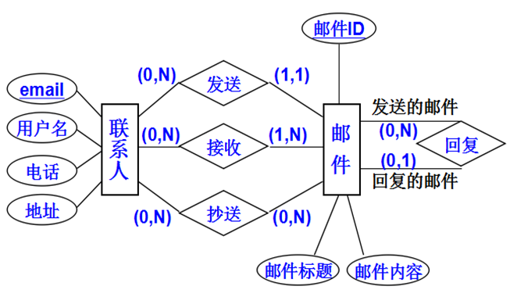
ER模型的设计结果

Slide 145
实体向关系的转换
邮件ID
发送
email
(0,N)
(1,1)
发送的邮件
联系人
邮 件
用户名
(0,N)
接收
(1,N)
(0,N)
回复
电话
(0,1)
回复的邮件
地址
抄送
(0,N)
(0,N)
邮件标题
邮件内容
联系人(email, 用户名, 电话, 地址)
邮 件(邮件ID, 邮件标题, 邮件内容)
Notes:
每个实体集被转换为一个关系

Slide 146
联系向关系的转换
邮件ID
发送
email
(0,N)
(1,1)
发送的邮件
联系人
邮 件
用户名
(0,N)
接收
(1,N)
(0,N)
回复
电话
(0,1)
回复的邮件
地址
抄送
(0,N)
(0,N)
邮件标题
邮件内容
联系人(email, 用户名, 电话, 地址)
邮 件(邮件ID, 邮件标题, 邮件内容, 发件人email)
)
Notes:
‘一对多’的联系，可以被合并到‘多’那一方（单值参与的实体）。

Slide 147
联系向关系的转换
邮件ID
发送
email
(0,N)
(1,1)
发送的邮件
联系人
邮 件
用户名
(0,N)
接收
(1,N)
(0,N)
回复
电话
(0,1)
回复的邮件
地址
抄送
(0,N)
(0,N)
邮件标题
邮件内容
联系人(email, 用户名, 电话, 地址)
邮 件(邮件ID, 邮件标题, 邮件内容,
发件人email, 被回复邮件的ID )
)
Notes:
道理同上。可以将一对多的‘回复’联系合并到‘多’的一方（即单值参与一方‘回复的邮件’）。

Slide 148
联系向关系的转换
邮件ID
发送
email
(0,N)
(1,1)
发送的邮件
联系人
邮 件
用户名
(0,N)
接收
(1,N)
(0,N)
回复
电话
(0,1)
回复的邮件
地址
抄送
(0,N)
(0,N)
邮件标题
邮件内容
联系人(email, 用户名, 电话, 地址)
邮件(邮件ID, 邮件标题, 邮件内容, ...... )
接收 ( 邮件ID, 收信人email )
Notes:
多对多的联系必须被单独转换成一个关系。

Slide 149
联系向关系的转换
邮件ID
发送
email
(0,N)
(1,1)
发送的邮件
联系人
邮 件
用户名
(0,N)
接收
(1,N)
(0,N)
回复
电话
(0,1)
回复的邮件
地址
抄送
(0,N)
(0,N)
邮件标题
邮件内容
联系人(email, 用户名, 电话, 地址)
邮件(邮件ID, 邮件标题, 邮件内容, ...... )
接收 ( 邮件ID, 收信人email )
抄送 ( 邮件ID, 抄送人email )

Slide 150
Case Study 4: 邮件管理
最终的关系模型如下：
联系人(email, 用户名, 电话, 地址)
邮件(邮件ID, 邮件标题, 邮件内容, 发件人email, 被回复邮件的ID )
接收 ( 邮件ID, 收信人email )
抄送 ( 邮件ID, 抄送人email )
Notes:
红色带下划线的是各个关系的‘关键字’

