Slide 1
Dynamic Programming
Data Structures and Algorithms
Nanjing University, Fall 2022
郑朝栋

Slide 2
Problem Solving Strategies
Divide and Conquer
Divide (reduce) the problem into one or more subproblems;
Recursively solve subproblems;
Combine partial solutions to obtain complete solution.
Example: merge-sort, quick-sort, binary-search, …
Greedy
Gradually generate a solution for the problem;
At each step: make an optimal choice, then compute optimal solution of the subproblem induced by the choice made.
Example: MST, Dijkstra, Huffman codes, …
Greedy choice property. (Could be hard to identify.)
Optimal substructure property.
What if a problem does not exhibit greedy choice property?

Slide 3
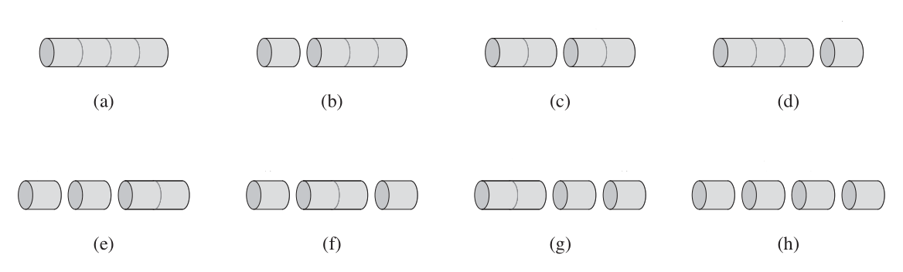

The Rod-Cutting Problem
Assume we are given a rod of length $n$. We sell length $i$ rod for a price of $p_{i}$, where $i∈ℕ^{+}$ and $1≤i≤n$.
How to cut the rod to gain maximum revenue?
Enumerate all possibilities?
There are $2^{n−1}$ ways to cut up a length $n$ rod…

Slide 4
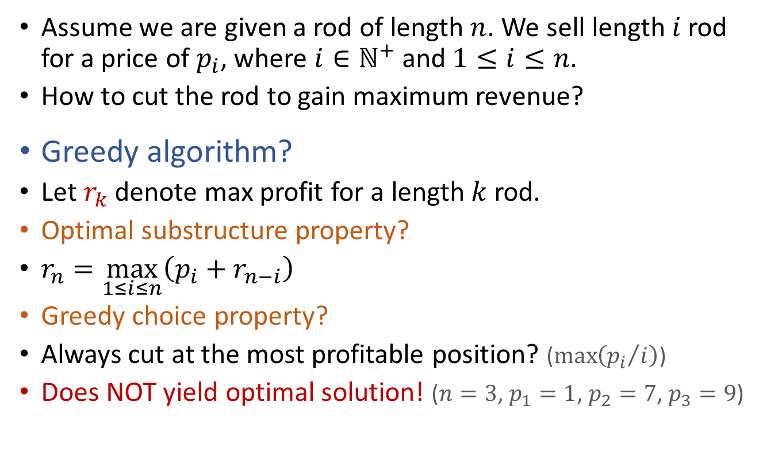
The Rod-Cutting Problem
Assume we are given a rod of length $n$. We sell length $i$ rod for a price of $p_{i}$, where $i∈ℕ^{+}$ and $1≤i≤n$.
How to cut the rod to gain maximum revenue?
Greedy algorithm?
Let $r_{k}$ denote max profit for a length $k$ rod.
Optimal substructure property?
$r_{n}=\max_{1≤i≤n}\left(p_{i}+r_{n−i}\right)$
Greedy choice property?
Always cut at the most profitable position? ($\max\left({p_{i}}/i\right)$)
Does NOT yield optimal solution! ($n=3$, $p_{1}=1$, $p_{2}=7$, $p_{3}=9$)

Slide 5

The Rod-Cutting Problem
Assume we are given a rod of length $n$. We sell length $i$ rod for a price of $p_{i}$, where $i∈ℕ^{+}$ and $1≤i≤n$.
How to cut the rod to gain maximum revenue?
Simple recursive algorithm.
Let $r_{k}$ denote max profit for a length $k$ rod.
Optimal substructure property holds. ($r_{n}=\max\left(p_{i}+r_{n−i}\right)$)
No greedy choice property…
Optimal substructure property already implies an algorithm!
At each step, enumerate all possible cut.
For each cut, (recursively) find optimal solution. (Find all $r_{n−i}$)
Find optimal solution for original problem. (Find $\max\left(p_{i}+r_{n−i}\right)$)
CutRodRec(prices,n):
if (n==0)
return 0
r = -INF
for (i=1 to n)
r = Max(r, prices[i]+CutRodRec(prices,n-i))
return r
Performance of this algorithm?

Slide 6

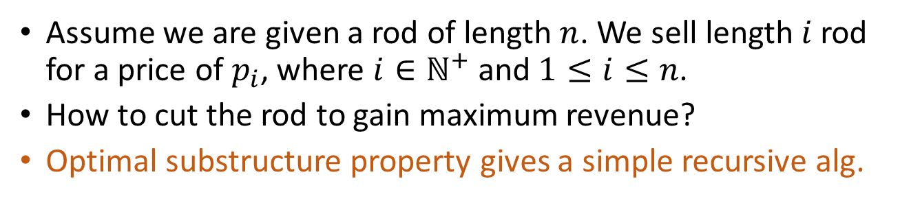
The Rod-Cutting Problem
CutRodRec(prices,n):
if (n==0)
return 0
r = -INF
for (i=1 to n)
r = Max(r, prices[i]+CutRodRec(prices,n-i))
return r
Assume we are given a rod of length $n$. We sell length $i$ rod for a price of $p_{i}$, where $i∈ℕ^{+}$ and $1≤i≤n$.
How to cut the rod to gain maximum revenue?
Optimal substructure property gives a simple recursive alg.
4
1+3
2+2
3+1
4+0
1+2
2+1
3+0
1+1
2+0
1+0
Can we do better?!
1+1
2+0
1+0
1+0
This algorithm enumerates all $2^{n−1}$ possibilities!
1+0
Each path from root to a leaf denotes a way to cut the rod.

Slide 7

The Rod-Cutting Problem
CutRodRec(prices,n):
if (n==0)
return 0
r = -INF
for (i=1 to n)
r = Max(r, prices[i]+CutRodRec(prices,n-i))
return r
Assume we are given a rod of length $n$. We sell length $i$ rod for a price of $p_{i}$, where $i∈ℕ^{+}$ and $1≤i≤n$.
How to cut the rod to gain maximum revenue?
Optimal substructure property gives a simple recursive alg.
4
1+3
2+2
3+1
4+0
1+2
2+1
3+0
1+1
2+0
1+0
For each subproblem, only need to solve it once!
1+1
2+0
1+0
1+0
Each node denotes a subproblem of certain size.
1+0
Some subproblems appear multiple times.

Slide 8

The Rod-Cutting Problem
Assume we are given a rod of length $n$. We sell length $i$ rod for a price of $p_{i}$, where $i∈ℕ^{+}$ and $1≤i≤n$.
How to cut the rod to gain maximum revenue?
Optimal substructure property gives a simple recursive alg.
Simple recursion solves same subproblem multiple times.
Solve each subproblem once and remember solution!
CutRodRecMemAux(prices,r,n):
if (r[n]>0)
return r[n]
if (n==0)
q = 0
else
q = -INF
for (i=1 to n)
q = Max(q, prices[i]+CutRodRecMemAux(prices,r,n-i))
r[n] = q
return q
CutRodRecMem(prices,n):
for (i=0 to n)
r[i] = -INF
return CutRodRecMemAux(prices,r,n)

Slide 9

The Rod-Cutting Problem
Runtime of this algorithm?
Each subproblem (optimal revenue for length $i$ rod) is solved once.
When actually solving the size $i$ problem, optimal solutions of subproblems are known. (Otherwise we would recurse first.)
Thus solving size $i$ problem needs $Θ\left(i\right)$ time.
Total runtime is $Θ\left(1+2+⋯+n\right)=Θ\left(n^{2}\right)$.
CutRodRecMemAux(prices,r,n):
if (r[n]>0)
return r[n]
if (n==0)
q = 0
else
q = -INF
for (i=1 to n)
q = Max(q, prices[i]+CutRodRecMemAux(prices,r,n-i))
r[n] = q
return q
CutRodRecMem(prices,n):
for (i=0 to n)
r[i] = -INF
return CutRodRecMemAux(prices,r,n)

Slide 10
4
1+3
2+2
3+1
4+0
1+2
2+1
3+0
1+1
2+0
1+0
1+1
2+0
1+0
1+0
Overlapping subproblems
1+0
4
Runtime = $Θ\left(\# of lines and nodes in subproblem graph\right)$
3
CutRodRecMemAux(prices,r,n):
if (r[n]>0)
return r[n]
if (n==0)
q = 0
else
q = -INF
for (i=1 to n)
q = Max(q, prices[i]+CutRodRecMemAux(prices,r,n-i))
r[n] = q
return q
CutRodRecMem(prices,n):
for (i=0 to n)
r[i] = -INF
return CutRodRecMemAux(prices,r,n)
2
1
0

Slide 11
The Rod-Cutting Problem The Top-Down Approach
The subproblem graph is a DAG! (WHY?)
Solving the problem using recursion is like DFS.
Convert recursion to iteration?
CutRodRecMemAux(prices,r,n):
if (r[n]>0)
return r[n]
if (n==0)
q = 0
else
q = -INF
for (i=1 to n)
q = Max(q, prices[i]+CutRodRecMemAux(prices,r,n-i))
r[n] = q
return q
CutRodRecMem(prices,n):
for (i=0 to n)
r[i] = -INF
return CutRodRecMemAux(prices,r,n)
4
3
2
1
0

Slide 12

The Rod-Cutting Problem The Bottom-Up Approach
Convert recursion to iteration?
The subproblem graph is a DAG.
A problem cannot be solved until all subproblems it depends upon are solved.
Consider subproblems in reverse topo order!
4
3
CutRodIter(prices,n):
r[0] = 0
for (i=1 to n)
q = -INF
for (j=1 to i)
q = Max(q, prices[j] + r[i-j])
r[i] = q
return r[n]
Runtime is $Θ\left(n^{2}\right)$
2
1
0

Slide 13

The Rod-Cutting Problem The Bottom-Up Approach
Convert recursion to iteration?
Consider subproblems in reverse topo order!
Or, inspect the recurrence more carefully!
$r_{n}=\max_{1≤i≤n}\left(p_{i}+r_{n−i}\right)$
CutRodIter(prices,n):
r[0] = 0
for (i=1 to n)
q = -INF
for (j=1 to i)
q = Max(q, prices[j] + r[i-j])
r[i] = q
return r[n]
4
3
2
1
0

Slide 14

The Rod-Cutting Problem Reconstructing optimal solution
Assume we are given a rod of length $n$. We sell length $i$ rod for a price of $p_{i}$, where $i∈ℕ^{+}$ and $1≤i≤n$.
How to cut the rod to gain maximum revenue?
Algorithm gives optimal revenue, but how to cut?
4
CutRodIter(prices,n):
r[0] = 0
for (i=1 to n)
q = -INF
for (j=1 to i)
if (q < prices[j] + r[i-j])
q = prices[j] + r[i-j]
cuts[i] = j
r[i] = q
return r[n]
PrintOpt(cuts,n):
while (n>0)
Print cuts[n]
n = n – cuts[n]
3
2
1
0

Slide 15
Dynamic Programming (DP)
Consider an (optimization) problem:
Build optimal solution step by step.
Problem has optimal substructure property.
We can design a recursive algorithm.
Problem has lots of overlapping subproblems.
Recursion and memorize solutions. (Top-Down)
Or, consider subproblems in the right order. (Bottom-Up)
We have seen such algorithms previously!

Slide 16

APSP via Dynamic Programming The Floyd-Warshall Algorithm
Strategy: recuse on the set of node the shortest paths use.
Define $dist\left(u,v,r\right)$ be length of shortest path from $u$ to $v$, s.t. only nodes in $V_{r}=\left\{x_{1},x_{2},⋯,x_{r}\right\}$ can be intermediate nodes in paths.
$dist\left(u,v,r\right)=\left\{\begin{matrix}w\left(u,v\right) & if r=0 and \left(u,v\right)∈E \\ ∞ & if r=0 and \left(u,v\right)∉E \\ \min\left\{\begin{matrix}dist\left(u,v,r−1\right) \\ dist\left(u,x_{r},r−1\right)+dist\left(x_{r},v,r−1\right)\end{matrix}\right\} & otherwise\end{matrix}\right.$
Bottom-up Approach.
FloydWarshallAPSP(G):
for (every pair (u,v) in V*V)
if ((u,v) in E) then dist[u,v,0]=w(u,v)
else dist[u,v,0]=INF
for (r=1 to n)
for (each node u)
for (each node v)
dist[u,v,r] = dist[u,v,r-1]
if (dist[u,v,r] > dist[u,x_{r},r-1] + dist[x_{r},v,r-1])
dist[u,v,r] = dist[u,x_{r},r-1] + dist[x_{r},v,r-1]

Slide 17
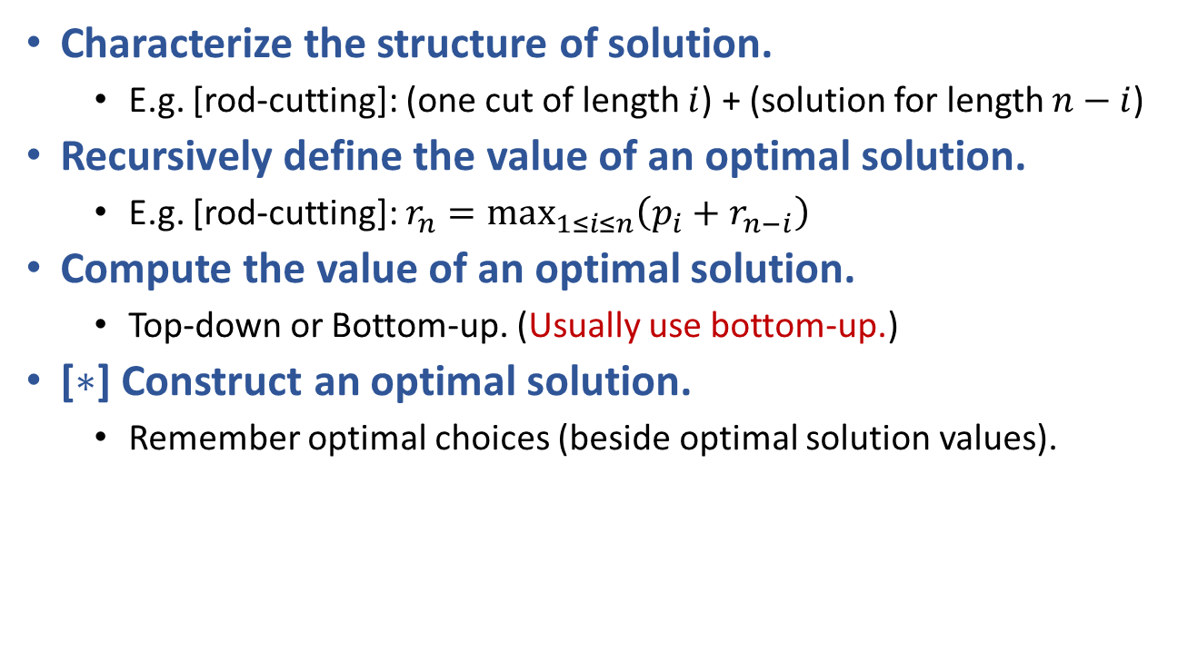
Developing a DP algorithm
Characterize the structure of solution.
E.g. [rod-cutting]: (one cut of length $i$) + (solution for length $n−i$)
Recursively define the value of an optimal solution.
E.g. [rod-cutting]: $r_{n}=\max_{1≤i≤n}\left(p_{i}+r_{n−i}\right)$
Compute the value of an optimal solution.
Top-down or Bottom-up. (Usually use bottom-up.)
[$∗$] Construct an optimal solution.
Remember optimal choices (beside optimal solution values).

Slide 18
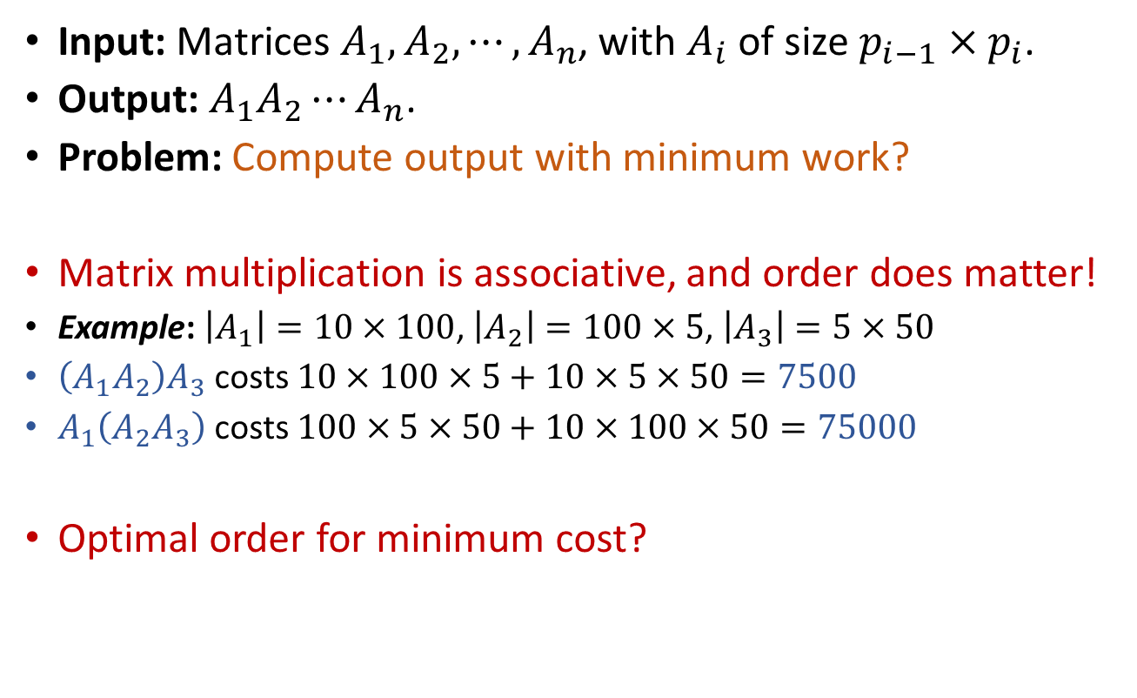
Matrix-chain Multiplication
Input: Matrices $A_{1}, A_{2},⋯,A_{n}$, with $A_{i}$ of size $p_{i−1}×p_{i}$.
Output: $A_{1}A_{2}⋯A_{n}$.
Problem: Compute output with minimum work?
Matrix multiplication is associative, and order does matter!
Example: $\left|A_{1}\right|=10×100$, $\left|A_{2}\right|=100×5$, $\left|A_{3}\right|=5×50$
$\left(A_{1}A_{2}\right)A_{3}$ costs $10×100×5+10×5×50=7500$
$A_{1}\left(A_{2}A_{3}\right)$ costs $100×5×50+10×100×50=75000$
Optimal order for minimum cost?

Slide 19
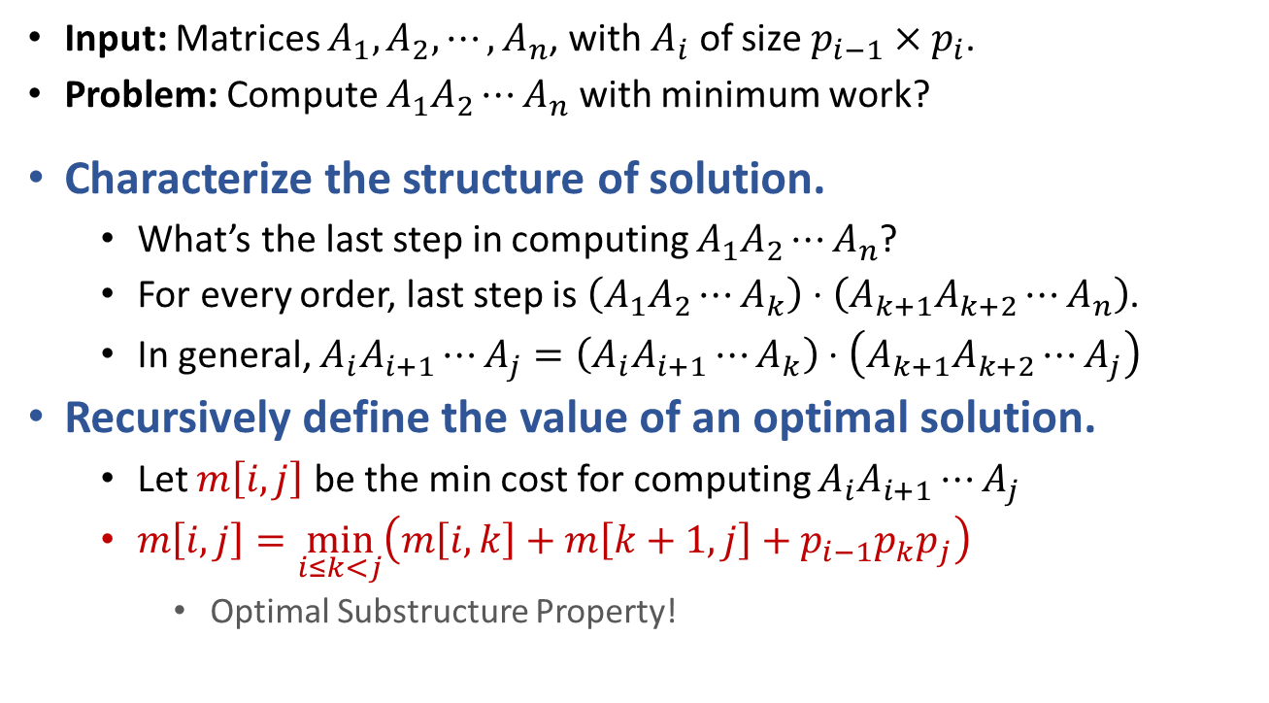
Matrix-chain Multiplication Developing a DP algorithm
Input: Matrices $A_{1}, A_{2},⋯,A_{n}$, with $A_{i}$ of size $p_{i−1}×p_{i}$.
Problem: Compute $A_{1}A_{2}⋯A_{n}$ with minimum work?
Characterize the structure of solution.
What’s the last step in computing $A_{1}A_{2}⋯A_{n}$?
For every order, last step is $\left(A_{1}A_{2}⋯A_{k}\right)⋅\left(A_{k+1}A_{k+2}⋯A_{n}\right)$.
In general, $A_{i}A_{i+1}⋯A_{j}=\left(A_{i}A_{i+1}⋯A_{k}\right)⋅\left(A_{k+1}A_{k+2}⋯A_{j}\right)$
Recursively define the value of an optimal solution.
Let $m\left[i,j\right]$ be the min cost for computing $A_{i}A_{i+1}⋯A_{j}$
$m\left[i,j\right]=\min_{i≤k<j}\left(m\left[i,k\right]+m\left[k+1,j\right]+p_{i−1}p_{k}p_{j}\right)$
Optimal Substructure Property!

Slide 20

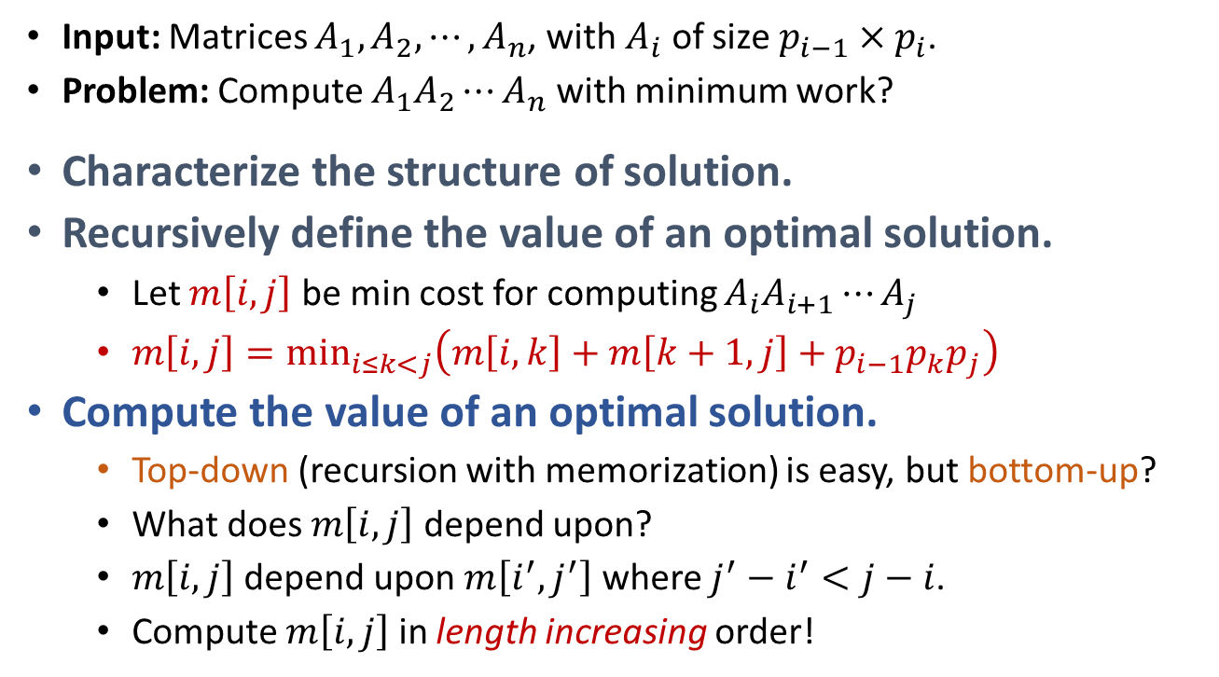

Matrix-chain Multiplication Developing a DP algorithm
MatrixChainDP(A₁, A₂,…,A_{n}):
for (i=1 to n)
m[i,i] = 0
for (l=2 to n)
for (i=1 to n-l+1)
j = i+l-1
m[i,j] = INF
for (k=i to j-1)
cost = m[i,k] + m[k+1,j] + p_{i-1}*p_{k}*p_{j}
if (cost < m[i,j])
m[i,j] = cost
return m
Runtime is $O\left(n^{3}\right)$.
Space cost is $O\left(n^{2}\right)$.
Input: Matrices $A_{1}, A_{2},⋯,A_{n}$, with $A_{i}$ of size $p_{i−1}×p_{i}$.
Problem: Compute $A_{1}A_{2}⋯A_{n}$ with minimum work?
Characterize the structure of solution.
Recursively define the value of an optimal solution.
Let $m\left[i,j\right]$ be min cost for computing $A_{i}A_{i+1}⋯A_{j}$
$m\left[i,j\right]=\min_{i≤k<j}\left(m\left[i,k\right]+m\left[k+1,j\right]+p_{i−1}p_{k}p_{j}\right)$
Compute the value of an optimal solution.
Top-down (recursion with memorization) is easy, but bottom-up?
What does $m\left[i,j\right]$ depend upon?
$m\left[i,j\right]$ depend upon $m\left[i^{′},j^{′}\right]$ where $j^{′}−i^{′}<j−i$.
Compute $m\left[i,j\right]$ in length increasing order!

Slide 21

Matrix-chain Multiplication Developing a DP algorithm
MatrixChainDP(A₁, A₂,…,A_{n}):
for (i=1 to n)
m[i,i] = 0
for (l=2 to n)
for (i=1 to n-l+1)
j = i+l-1
m[i,j] = INF
for (k=i to j-1)
cost = m[i,k] + m[k+1,j] + p_{i-1}*p_{k}*p_{j}
if (cost < m[i,j])
m[i,j] = cost
s[i,j] = k
return <m,s>
Input: Matrices $A_{1}, A_{2},⋯,A_{n}$, with $A_{i}$ of size $p_{i−1}×p_{i}$.
Problem: Compute $A_{1}A_{2}⋯A_{n}$ with minimum work?
Characterize the structure of solution.
Recursively define the value of an optimal solution.
Let $m\left[i,j\right]$ be min cost for computing $A_{i}A_{i+1}⋯A_{j}$
$m\left[i,j\right]=\min_{i≤k<j}\left(m\left[i,k\right]+m\left[k+1,j\right]+p_{i−1}p_{k}p_{j}\right)$
Compute the value of an optimal solution.
Compute $m\left[i,j\right]$ in length increasing order!
Construct an optimal solution.
For each $\left(i,j\right)$ pair, remember the position of the optimal “split”.
MatrixChainPrintOpt(s,i,j):
if (i==j)
Print(“A_{i}”)
else
Print(“(”)
MatrixChainPrintOpt(s,i,s[i,j])
MatrixChainPrintOpt(s,s[i,j]+1,j)
Print(“)”)

Slide 22
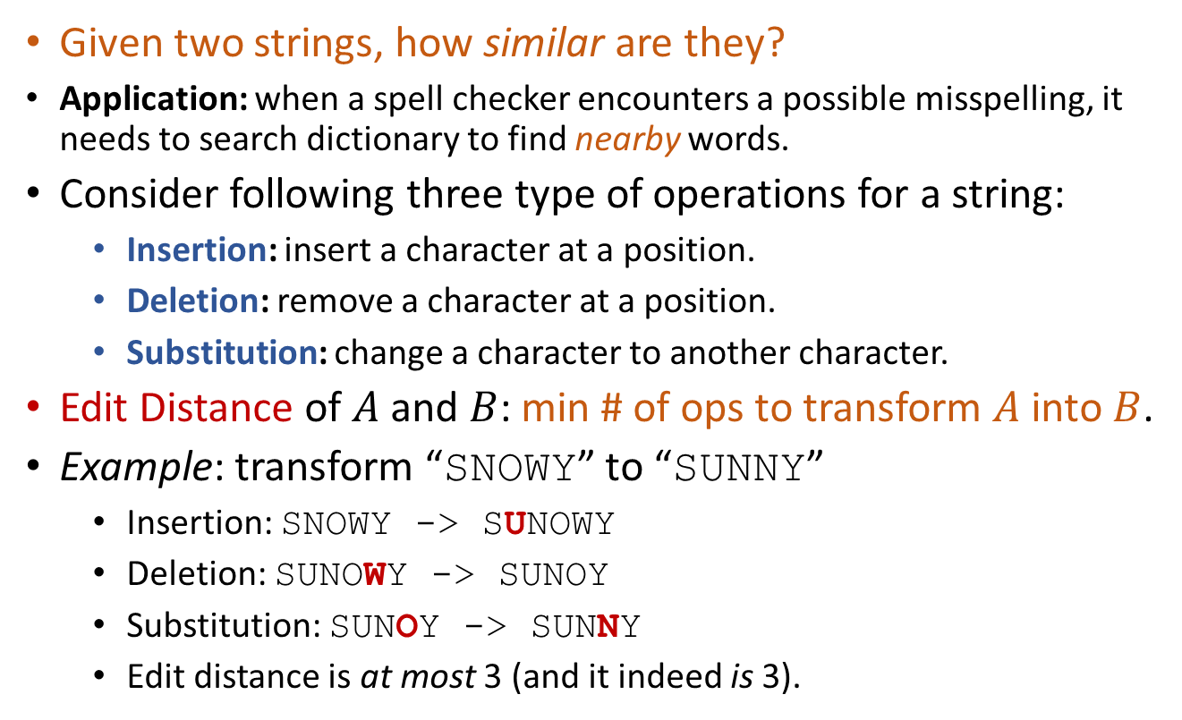
Edit Distance
Given two strings, how similar are they?
Application: when a spell checker encounters a possible misspelling, it needs to search dictionary to find nearby words.
Consider following three type of operations for a string:
Insertion: insert a character at a position.
Deletion: remove a character at a position.
Substitution: change a character to another character.
Edit Distance of $A$ and $B$: min # of ops to transform $A$ into $B$.
Example: transform “SNOWY” to “SUNNY”
Insertion: SNOWY -> SUNOWY
Deletion: SUNOWY -> SUNOY
Substitution: SUNOY -> SUNNY
Edit distance is at most 3 (and it indeed is 3).

Slide 23
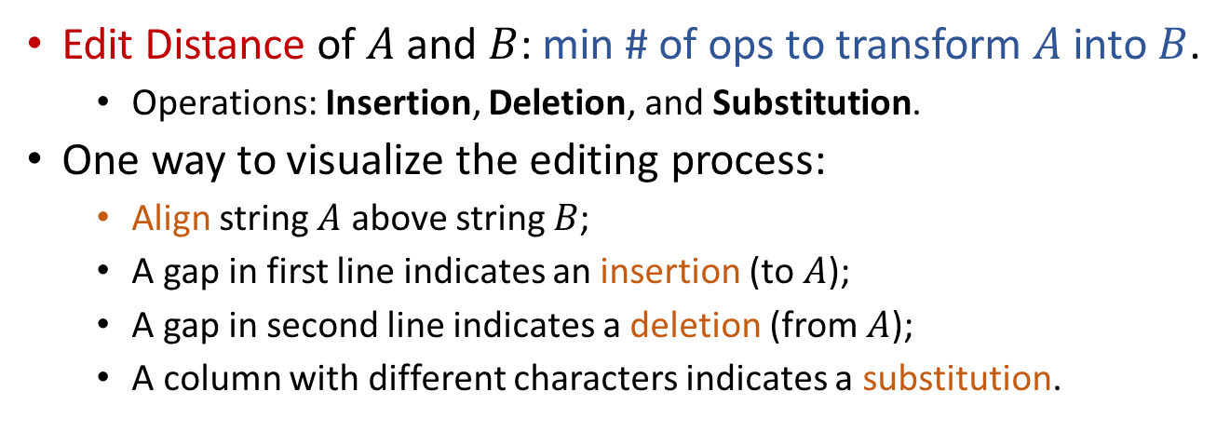
Edit Distance
Edit Distance of $A$ and $B$: min # of ops to transform $A$ into $B$.
Operations: Insertion, Deletion, and Substitution.
One way to visualize the editing process:
Align string $A$ above string $B$;
A gap in first line indicates an insertion (to $A$);
A gap in second line indicates a deletion (from $A$);
A column with different characters indicates a substitution.
S
U
N
O
W
Y
S
U
N
N
W
Y

Slide 24
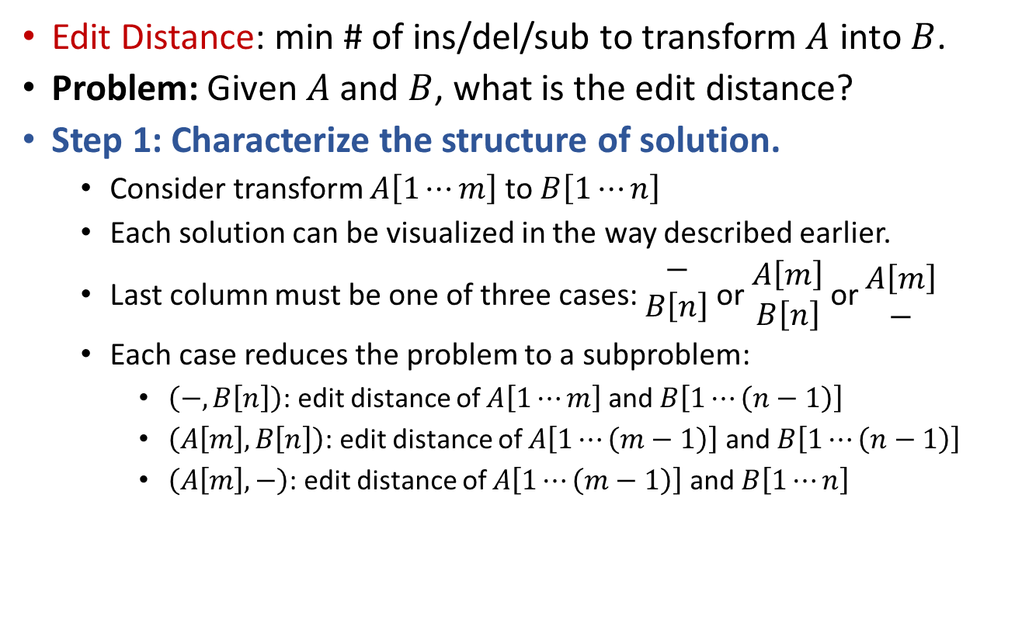
Edit Distance
Edit Distance: min # of ins/del/sub to transform $A$ into $B$.
Problem: Given $A$ and $B$, what is the edit distance?
Step 1: Characterize the structure of solution.
Consider transform $A\left[1⋯m\right]$ to $B\left[1⋯n\right]$
Each solution can be visualized in the way described earlier.
Last column must be one of three cases: $\begin{matrix}− \\ B\left[n\right]\end{matrix}$ or $\begin{matrix}A\left[m\right] \\ B\left[n\right]\end{matrix}$ or $\begin{matrix}A\left[m\right] \\ −\end{matrix}$
Each case reduces the problem to a subproblem:
$\left(−,B\left[n\right]\right)$: edit distance of $A\left[1⋯m\right]$ and $B\left[1⋯\left(n−1\right)\right]$
$\left(A\left[m\right],B\left[n\right]\right)$: edit distance of $A\left[1⋯\left(m−1\right)\right]$ and $B\left[1⋯\left(n−1\right)\right]$
$\left(A\left[m\right],−\right)$: edit distance of $A\left[1⋯\left(m−1\right)\right]$ and $B\left[1⋯n\right]$
S
-
N
O
W
Y
S
U
N
N
-
Y

Slide 25
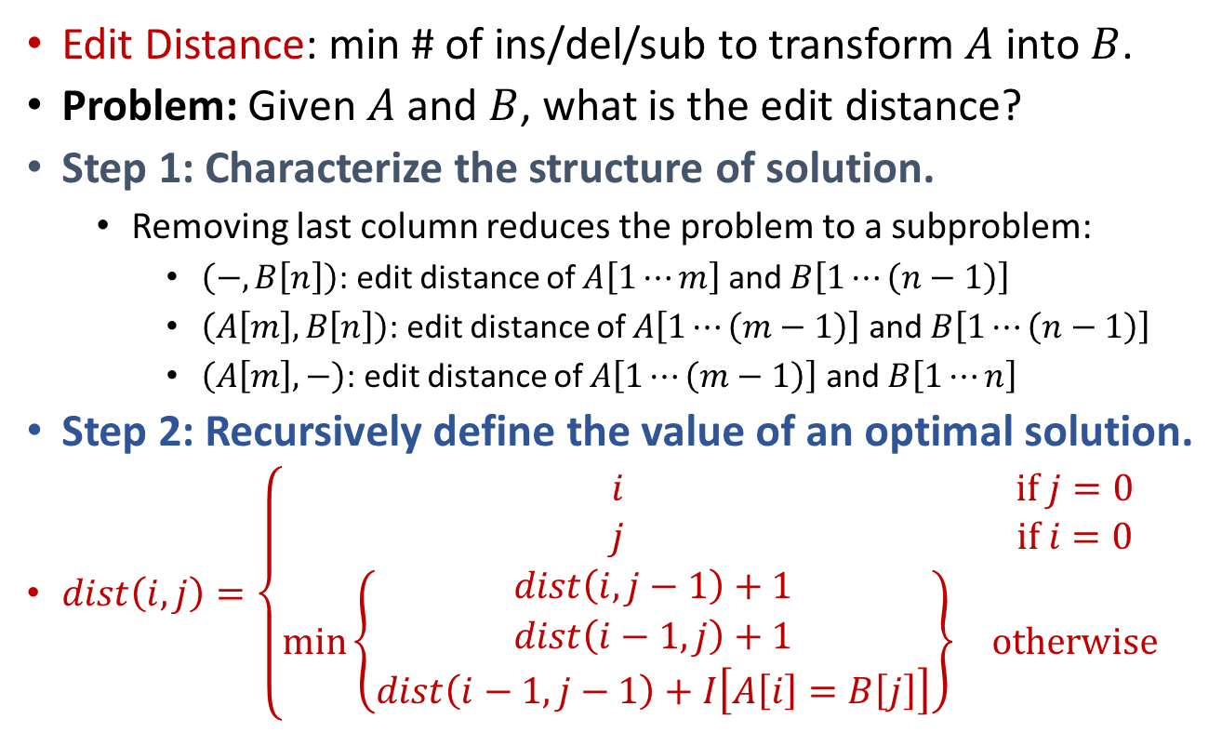
Edit Distance
Edit Distance: min # of ins/del/sub to transform $A$ into $B$.
Problem: Given $A$ and $B$, what is the edit distance?
Step 1: Characterize the structure of solution.
Removing last column reduces the problem to a subproblem:
$\left(−,B\left[n\right]\right)$: edit distance of $A\left[1⋯m\right]$ and $B\left[1⋯\left(n−1\right)\right]$
$\left(A\left[m\right],B\left[n\right]\right)$: edit distance of $A\left[1⋯\left(m−1\right)\right]$ and $B\left[1⋯\left(n−1\right)\right]$
$\left(A\left[m\right],−\right)$: edit distance of $A\left[1⋯\left(m−1\right)\right]$ and $B\left[1⋯n\right]$
Step 2: Recursively define the value of an optimal solution.
$dist\left(i,j\right)=\left\{\begin{matrix}i & if j=0 \\ j & if i=0 \\ \min\left\{\begin{matrix}dist\left(i,j−1\right)+1 \\ dist\left(i−1,j\right)+1 \\ dist\left(i−1,j−1\right)+I\left[A\left[i\right]=B\left[j\right]\right]\end{matrix}\right\} & otherwise\end{matrix}\right.$

Slide 26
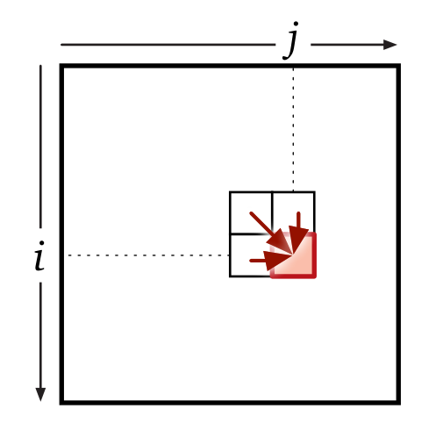
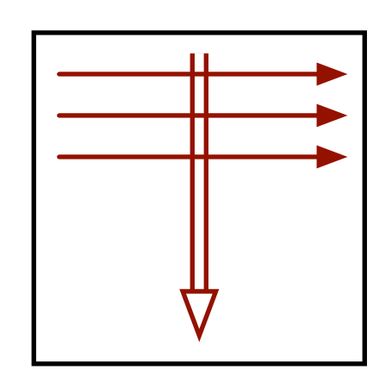

Edit Distance
Edit Distance: min # of ins/del/sub to transform $A$ into $B$.
Problem: Given $A$ and $B$, what is the edit distance?
Step 1: Characterize the structure of solution.
Step 2: Recursively define the value of an optimal solution.
$dist\left(i,j\right)=\left\{\begin{matrix}i & if j=0 \\ j & if i=0 \\ \min\left\{\begin{matrix}dist\left(i,j−1\right)+1 \\ dist\left(i−1,j\right)+1 \\ dist\left(i−1,j−1\right)+I\left[A\left[i\right]=B\left[j\right]\right]\end{matrix}\right\} & otherwise\end{matrix}\right.$
Step 3: Compute the value of an optimal solution (Bottom-Up).
What does $dist\left(i,j\right)$ depend upon?
Outer-loop: increasing $i$; Inner-loop: increasing $j$.
EditDistDP(A[1…m],B[1…n]):
for (i=0 to m)
dist[i,0] = i
for (j=0 to n)
dist[0,j] = j
for (i=1 to m)
for (j=1 to n)
delDist = dist[i-1,j] + 1
insDist = dist[i,j-1] + 1
subDist = dist[i-1,j-1] + Diff(A[i],B[j])
dist[i,j] = Min(delDist,insDist,subDist)
return dist
Step 4: Construct an optimal solution.

Slide 27
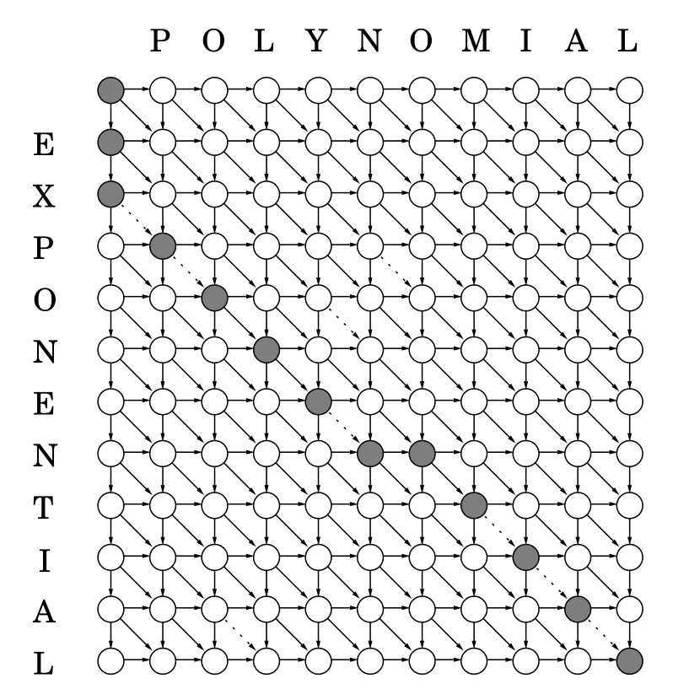
Subproblem graph (DAG) Transform “EXPONENTIAL” to “POLYNOMIAL”
Insertion (costs 1)
Deletion (costs 1)
Substitution [diff] (costs 1)
Substitution (costs 0)
Edit distance: Shortest path from top-left to right-bottom.
E
X
P
O
N
E
N
-
T
I
A
L
-
-
P
O
L
Y
N
O
M
I
A
L
1
1
1
1
1
1

Slide 28

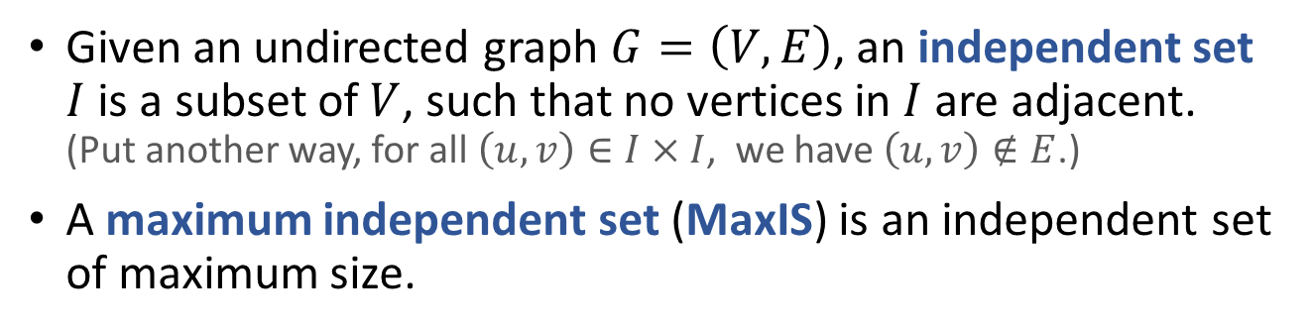


Maximum Independent Set
Given an undirected graph $G=\left(V,E\right)$, an independent set $I$ is a subset of $V$, such that no vertices in $I$ are adjacent. (Put another way, for all $\left(u,v\right)∈I×I$, we have $\left(u,v\right)∉E$.)
A maximum independent set (MaxIS) is an independent set of maximum size.
A
B
C
A
B
C
A
B
C
A
B
C
D
E
D
E
D
E
D
E
$\left\{B,D,E\right\}$ is NOT IS
$\left\{B,D\right\}$ is IS
$\left\{A,C,E\right\}$ is IS
It is NOT MaxIS
It is also MaxIS

Slide 29
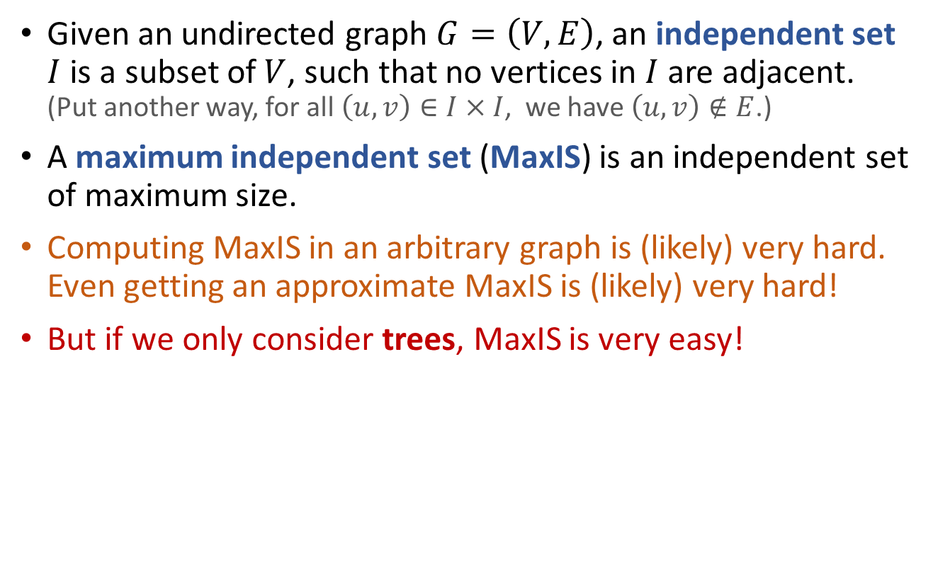
Maximum Independent Set
Given an undirected graph $G=\left(V,E\right)$, an independent set $I$ is a subset of $V$, such that no vertices in $I$ are adjacent. (Put another way, for all $\left(u,v\right)∈I×I$, we have $\left(u,v\right)∉E$.)
A maximum independent set (MaxIS) is an independent set of maximum size.
Computing MaxIS in an arbitrary graph is (likely) very hard. Even getting an approximate MaxIS is (likely) very hard!
But if we only consider trees, MaxIS is very easy!

Slide 30
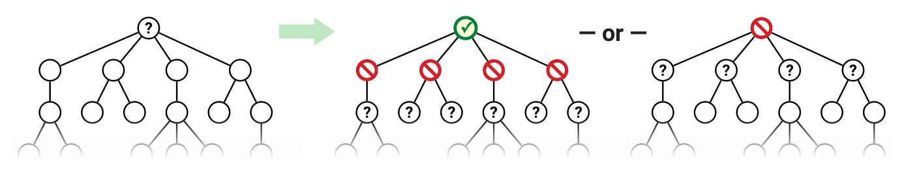
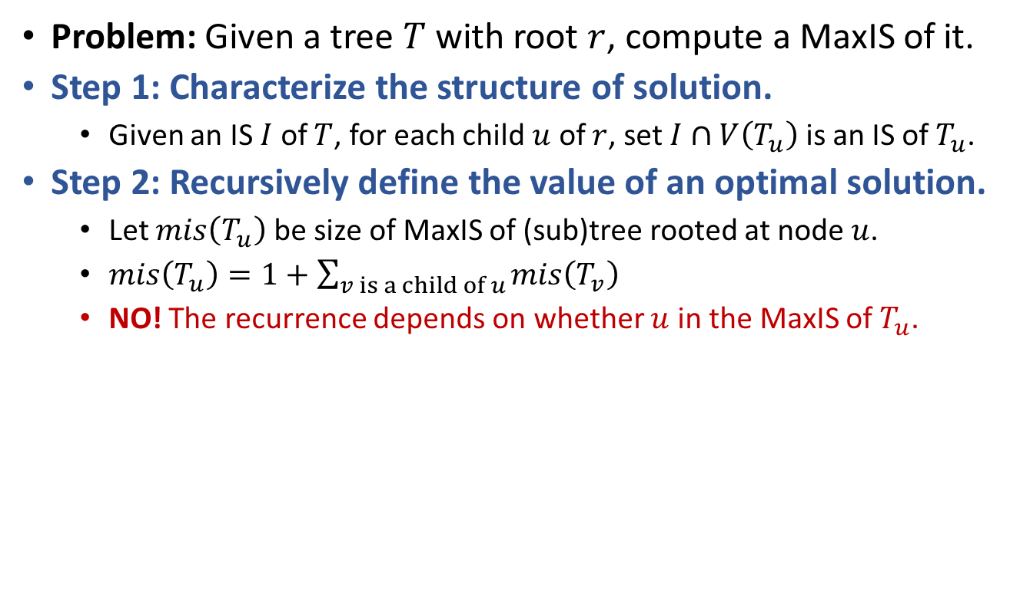
MaxIS of Trees
Problem: Given a tree $T$ with root $r$, compute a MaxIS of it.
Step 1: Characterize the structure of solution.
Given an IS $I$ of $T$, for each child $u$ of $r$, set $I∩V\left(T_{u}\right)$ is an IS of $T_{u}$.
Step 2: Recursively define the value of an optimal solution.
Let $mis\left(T_{u}\right)$ be size of MaxIS of (sub)tree rooted at node $u$.
$mis\left(T_{u}\right)=1+\sum_{v is a child of u}{mis\left(T_{v}\right)}$
NO! The recurrence depends on whether $u$ in the MaxIS of $T_{u}$.

Slide 31

MaxIS of Trees
Problem: Given a tree $T$ with root $r$, compute a MaxIS of it.
Step 2: Recursively define the value of an optimal solution.
Let $mis\left(T_{u}\right)$ be size of MaxIS of (sub)tree rooted at node $u$.
The recurrence depends on whether $u$ in the MaxIS of $T_{u}$.
Let $mis\left(T_{u},1\right)$ be size of MaxIS of $T_{u}$, s.t. $u$ in the MaxIS.
Let $mis\left(T_{u},0\right)$ be size of MaxIS of $T_{u}$, s.t. $u$ NOT in the MaxIS.
$mis\left(T_{u},1\right)=1+\sum_{v is a child of u}{mis\left(T_{v},0\right)}$
$mis\left(T_{u},0\right)=\sum_{v is a child of u}{mis\left(T_{v}\right)}$
$mis\left(T_{u}\right)=\max\left\{mis\left(T_{u},0\right),mis\left(T_{u},1\right)\right\}$

Slide 32


MaxIS of Trees
Problem: Given a tree $T$ with root $r$, compute a MaxIS of it.
Step 2: Recursively define the value of an optimal solution.
Let $mis\left(T_{u}\right)$ be size of MaxIS of (sub)tree rooted at node $u$.
Let $mis\left(T_{u},1\right)$ be size of MaxIS of $T_{u}$, s.t. $u$ in the MaxIS.
Let $mis\left(T_{u},0\right)$ be size of MaxIS of $T_{u}$, s.t. $u$ NOT in the MaxIS.
$mis\left(T_{u},1\right)=1+\sum_{v is a child of u}{mis\left(T_{v},0\right)}$
$mis\left(T_{u},0\right)=\sum_{v is a child of u}{mis\left(T_{v}\right)}$
$mis\left(T_{u}\right)=\max\left\{mis\left(T_{u},0\right),mis\left(T_{u},1\right)\right\}$
Step 3: Compute the value of an optimal solution.
MaxIsDP(u):
mis1 = 1
mis0 = 0
for (each child v of u)
mis1 = mis1 + MaxISDP(v).mis0
mis0 = mis0 + MaxISDP(v).mis
mis = Max(mis0,mis1)
return <mis,mis0,mis1>
Runtime is $O\left(V+E\right)=O\left(V\right)$

Slide 33
Dynamic Programming (DP)
Consider an (optimization) problem:
Build optimal solution step by step.
Problem has optimal substructure property.
We can design a recursive algorithm.
Problem has lots of overlapping subproblems.
Recursion and memorize solutions. (Top-Down)
Or, consider subproblems in the right order. (Bottom-Up)

Slide 34
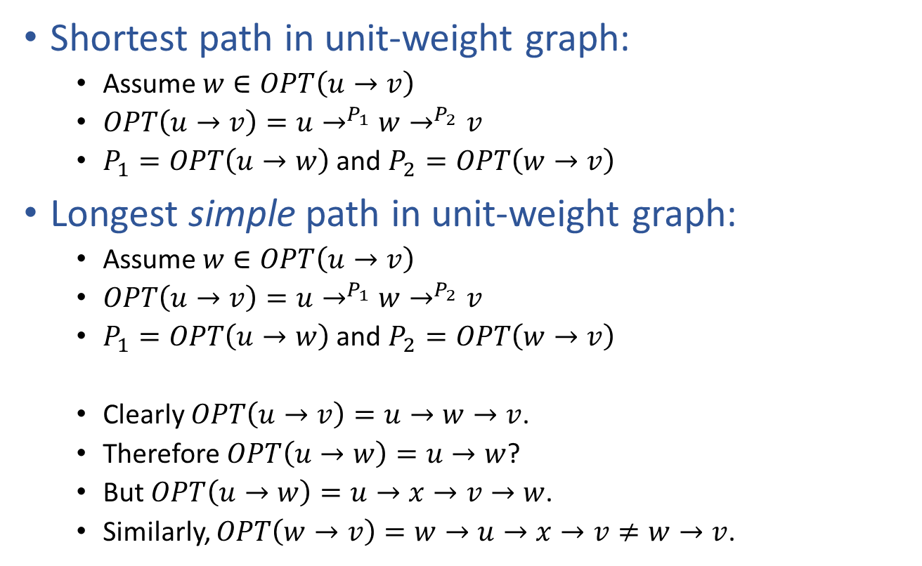
Optimal substructure not always true
Shortest path in unit-weight graph:
Assume $w∈OPT\left(u→v\right)$
$OPT\left(u→v\right)=u→^{P_{1}}w→^{P_{2}}v$
$P_{1}=OPT\left(u→w\right)$ and $P_{2}=OPT\left(w→v\right)$
Longest simple path in unit-weight graph:
Assume $w∈OPT\left(u→v\right)$
$OPT\left(u→v\right)=u→^{P_{1}}w→^{P_{2}}v$
$P_{1}=OPT\left(u→w\right)$ and $P_{2}=OPT\left(w→v\right)$
Clearly $OPT\left(u→v\right)=u→w→v$.
Therefore $OPT\left(u→w\right)=u→w$?
But $OPT\left(u→w\right)=u→x→v→w$.
Similarly, $OPT\left(w→v\right)=w→u→x→v≠w→v$.
Optimal substructure property!
Subproblems are independent!
NO optimal substructure property!
u
x
Subproblems are NOT independent!
w
v

Slide 35
Dynamic Programming (DP)
Consider an (optimization) problem:
Build optimal solution step by step.
Problem has optimal substructure property.
We can design a recursive algorithm.
Problem has lots of overlapping subproblems.
Recursion and memorize solutions. (Top-Down)
Or, consider subproblems in the right order. (Bottom-Up)

Slide 36
Top-Down vs Bottom-Up
Dynamic programming trades space for time.
Save solutions for subproblems to avoid repeat computation.
[Top-Down] Recursion with memorization.
Very straightforward, easy to write down the code.
Use array or hash-table to memorize solutions.
Array may cost more space, but hash-table may cost more time.
[Bottom-Up] Solve subproblems in the right order.
Finding the right order might be non-trivial. (Subproblem graph?)
Usually use array to memorize solutions.
Might be able to reduce the size of array to save even more space.
Top-down vs Bottom-up
Top-down often costs more time in practice. (Recursion is costly!)
But not always! (Top-down only considers necessary subproblems.)

Slide 37
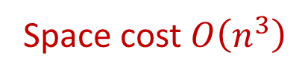

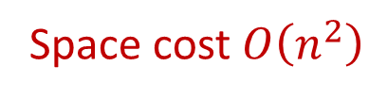
APSP via Dynamic Programming The Floyd-Warshall Algorithm
Strategy: recuse on the set of node the shortest paths use.
Define $dist\left(u,v,r\right)$ be length of shortest path from $u$ to $v$, s.t. only nodes in $V_{r}=\left\{x_{1},x_{2},⋯,x_{r}\right\}$ can be intermediate nodes in paths.
$dist\left(u,v,r\right)=\left\{\begin{matrix}w\left(u,v\right) & if r=0 and \left(u,v\right)∈E \\ ∞ & if r=0 and \left(u,v\right)∉E \\ \min\left\{\begin{matrix}dist\left(u,v,r−1\right) \\ dist\left(u,x_{r},r−1\right)+dist\left(x_{r},v,r−1\right)\end{matrix}\right\} & otherwise\end{matrix}\right.$
FloydWarshallAPSP(G):
for (every pair (u,v) in V*V)
if ((u,v) in E) then dist[u,v]=w(u,v)
else dist[u,v]=INF
for (r=1 to n)
for (each node u)
for (each node v)
if (dist[u,v] > dist[u,x_{r}] + dist[x_{r},v])
dist[u,v] = dist[u,x_{r}] + dist[x_{r},v]
Space cost $O\left(n^{2}\right)$
Space cost $O\left(n^{3}\right)$
FloydWarshallAPSP(G):
for (every pair (u,v) in V*V)
if ((u,v) in E) then dist[u,v,0]=w(u,v)
else dist[u,v,0]=INF
for (r=1 to n)
for (each node u)
for (each node v)
dist[u,v,r] = dist[u,v,r-1]
if (dist[u,v,r] > dist[u,x_{r},r-1] + dist[x_{r},v,r-1])
dist[u,v,r] = dist[u,x_{r},r-1] + dist[x_{r},v,r-1]

Slide 38

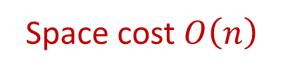
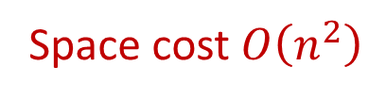
Edit Distance
EditDistDP(A[1…m],B[1…n]):
for (j=0 to n)
distLast[j] = j
for (i=1 to m) //distLast[j] = dist[i-1,j]
distCur[0] = i //distCur[j] = dist[i,j]
for (j=1 to n)
delDist = distLast[j] + 1
insDist = distCur[j-1] + 1
subDist = distLast[j-1] + Diff(A[i],B[j])
distCur[j] = Min(delDist,insDist,subDist)
distLast = distCur
return distCur[n]
Space cost $O\left(n\right)$
Edit Distance: min # of ins/del/sub to transform $A$ into $B$.
$dist\left(i,j\right)=\left\{\begin{matrix}i & if j=0 \\ j & if i=0 \\ \min\left\{\begin{matrix}dist\left(i,j−1\right)+1 \\ dist\left(i−1,j\right)+1 \\ dist\left(i−1,j−1\right)+I\left[A\left[i\right]=B\left[j\right]\right]\end{matrix}\right\} & otherwise\end{matrix}\right.$
EditDistDP(A[1…m],B[1…n]):
for (i=0 to m)
dist[i,0] = i
for (j=0 to n)
dist[0,j] = j
for (i=1 to m)
for (j=1 to n)
delDist = dist[i-1,j] + 1
insDist = dist[i,j-1] + 1
subDist = dist[i-1,j-1] + Diff(A[i],B[j])
dist[i,j] = Min(delDist,insDist,subDist)
return dist
Space cost $O\left(n^{2}\right)$

Slide 39
Analysis of DP Algorithms
Correctness:
Optimal substructure property.
Bottom-up approach: subproblems are already solved.
Complexity:
Space complexity: obvious with array. (Hash table?)
Time complexity [bottom-up]: usually obvious.
Time complexity [top-down]:
How many subproblems in total? (# of nodes in the subproblem DAG.)
Time to solve a problem, given subproblem solutions? (# of edges in the subproblem DAG.)
4
3
2
1
0

Slide 40
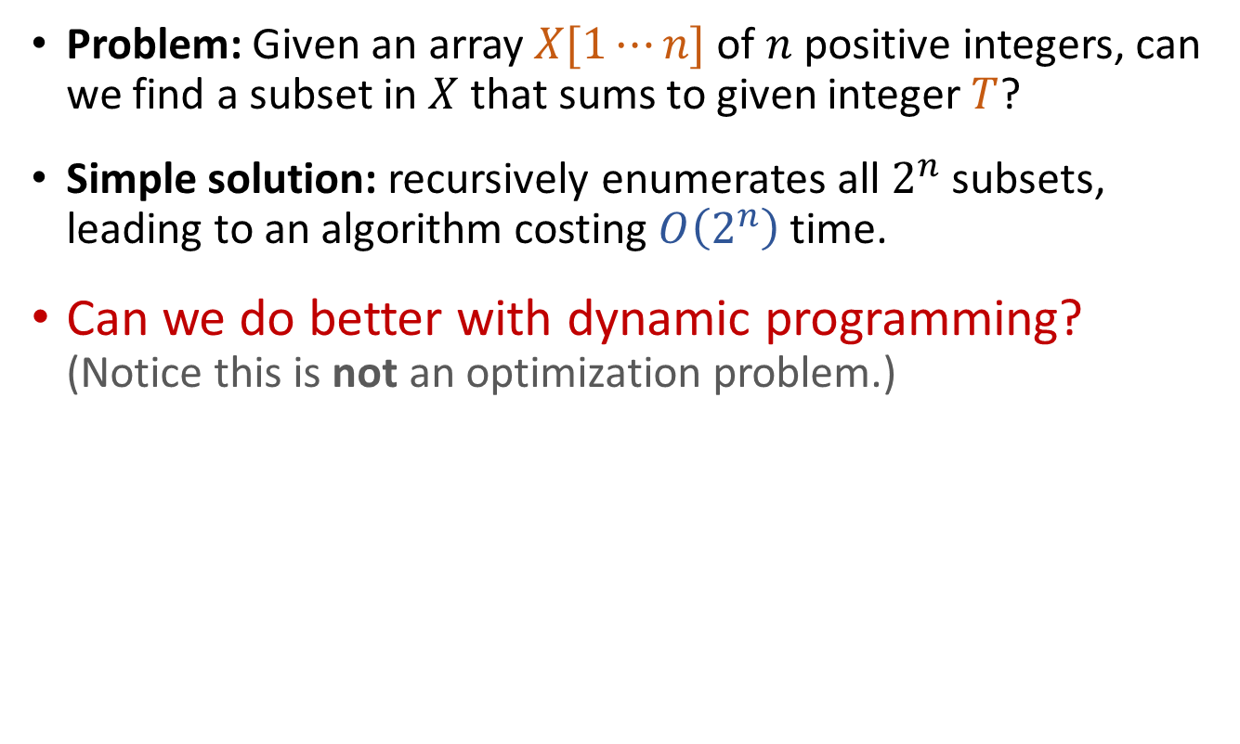
Subset Sum
Problem: Given an array $X[1⋯n]$ of $n$ positive integers, can we find a subset in $X$ that sums to given integer $T$?
Simple solution: recursively enumerates all $2^{n}$ subsets, leading to an algorithm costing $O\left(2^{n}\right)$ time.
Can we do better with dynamic programming? (Notice this is not an optimization problem.)

Slide 41
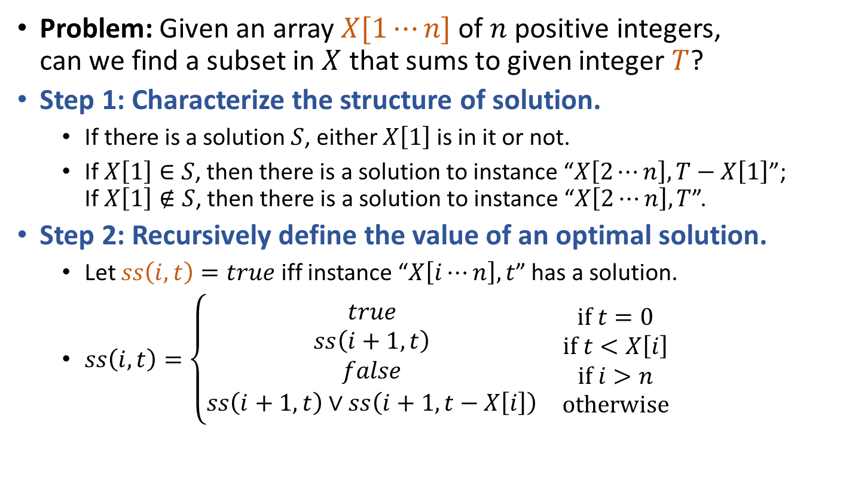
Subset Sum
Problem: Given an array $X[1⋯n]$ of $n$ positive integers, can we find a subset in $X$ that sums to given integer $T$?
Step 1: Characterize the structure of solution.
If there is a solution $S$, either $X\left[1\right]$ is in it or not.
If $X\left[1\right]∈S$, then there is a solution to instance “$X\left[2⋯n\right],T−X\left[1\right]$”; If $X\left[1\right]∉S$, then there is a solution to instance “$X\left[2⋯n\right],T$”.
Step 2: Recursively define the value of an optimal solution.
Let $ss\left(i,t\right)=true$ iff instance “$X\left[i⋯n\right],t$” has a solution.
$ss\left(i,t\right)=\left\{\begin{matrix}\begin{matrix}\begin{matrix}true \\ ss\left(i+1,t\right)\end{matrix} \\ \begin{matrix}false \\ ss\left(i+1,t\right)∨ss\left(i+1,t−X\left[i\right]\right)\end{matrix}\end{matrix} & \begin{matrix}\begin{matrix}if t=0 \\ if t<X\left[i\right]\end{matrix} \\ \begin{matrix}if i>n \\ otherwise\end{matrix}\end{matrix}\end{matrix}\right.$

Slide 42
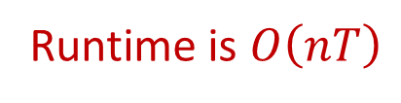

Subset Sum
SubsetSumDP(X,T):
ss[n,0] = True
for (t=1 to T)
ss[n,t] = (X[n]==t)?True:False
for (i=n-1 downto 1)
ss[i,0] = True
for (t=1 to X[i]-1)
ss[i,t] = ss[i+1,t]
for (t=X[i] to T)
ss[i,t] = Or( ss[i+1,t], ss[i+1,t-X[i]] )
return ss[1,T]
Runtime is $O\left(nT\right)$
Problem: Given an array $X[1⋯n]$ of $n$ positive integers, can we find a subset in $X$ that sums to given integer $T$?
Step 1: Characterize the structure of solution.
Step 2: Recursively define the value of an optimal solution.
Let $ss\left(i,t\right)=true$ iff instance “$X\left[i⋯n\right],t$” has a solution.
$ss\left(i,t\right)=\left\{\begin{matrix}\begin{matrix}\begin{matrix}true \\ ss\left(i+1,t\right)\end{matrix} \\ \begin{matrix}false \\ ss\left(i+1,t\right)∨ss\left(i+1,t−X\left[i\right]\right)\end{matrix}\end{matrix} & \begin{matrix}\begin{matrix}if t=0 \\ if t<X\left[i\right]\end{matrix} \\ \begin{matrix}if i>n \\ otherwise\end{matrix}\end{matrix}\end{matrix}\right.$
Step 3: Compute the value of an optimal solution (Bottom-Up).
Build an 2D array $ss\left[1⋯n,0⋯T\right]$
Evaluation order: bottom row to top row; left to right within each row.

Slide 43
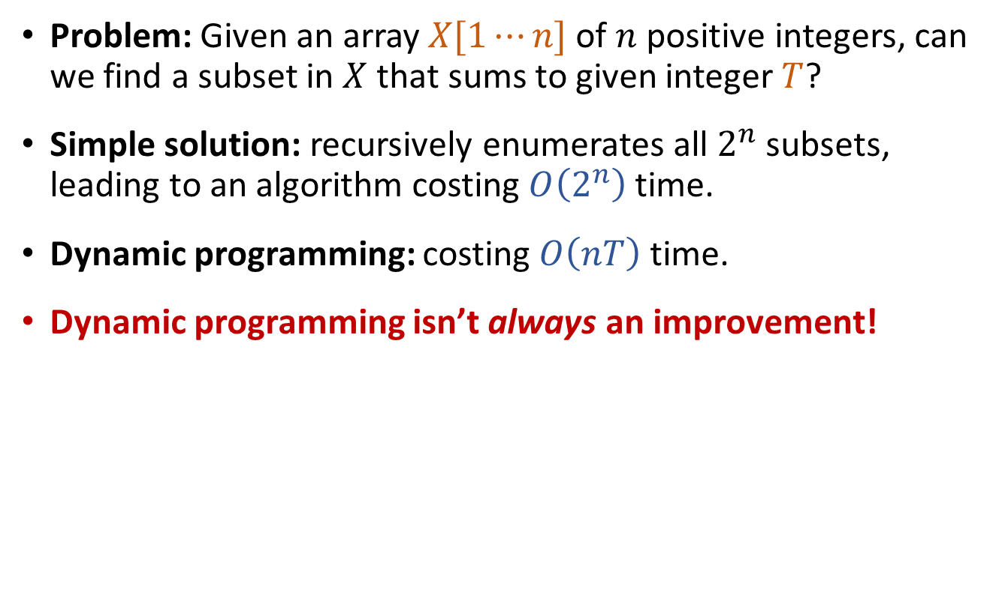
Subset Sum
Problem: Given an array $X[1⋯n]$ of $n$ positive integers, can we find a subset in $X$ that sums to given integer $T$?
Simple solution: recursively enumerates all $2^{n}$ subsets, leading to an algorithm costing $O\left(2^{n}\right)$ time.
Dynamic programming: costing $O\left(nT\right)$ time.
Dynamic programming isn’t always an improvement!

Slide 44
Dynamic Programming vs Greedy
Common strategies for solving optimization problems.
Gradually generates a solution for the problem.
Dynamic Programming
At each step: multiple potential choices, each reducing the problem to a subproblem, compute optimal solutions of all subproblems and then find optimal solution of original problem.
Optimal substructure + Overlapping subproblems.
Greedy
At each step: make an optimal choice, then compute optimal solution of the subproblem induced by the choice made.
Optimal substructure + Greedy choice.
Try DP first, then check if greedy works! (If does, prove it!) (Come up with a working algorithm first, then develop a faster one.)

Slide 45
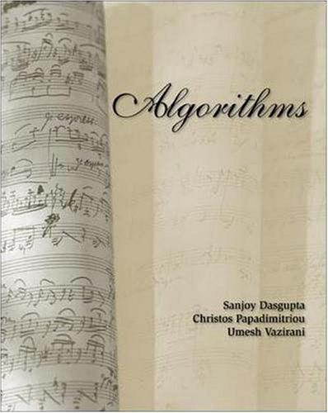
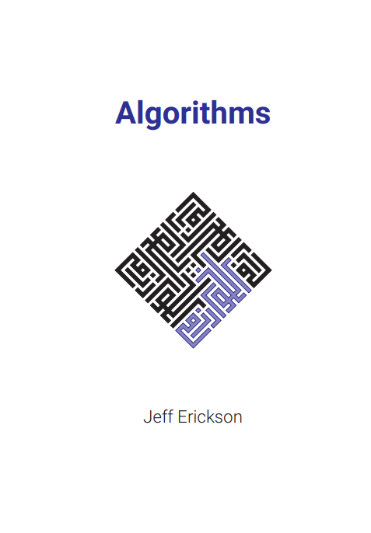
Reading
[CLRS] Ch.15
Optional reading: [DPV] Ch.6; [Erickson v1] Ch.3

