Slide 1
Computability and Complexity
Data Structures and Algorithms
Nanjing University, Fall 2022
郑朝栋

Slide 2
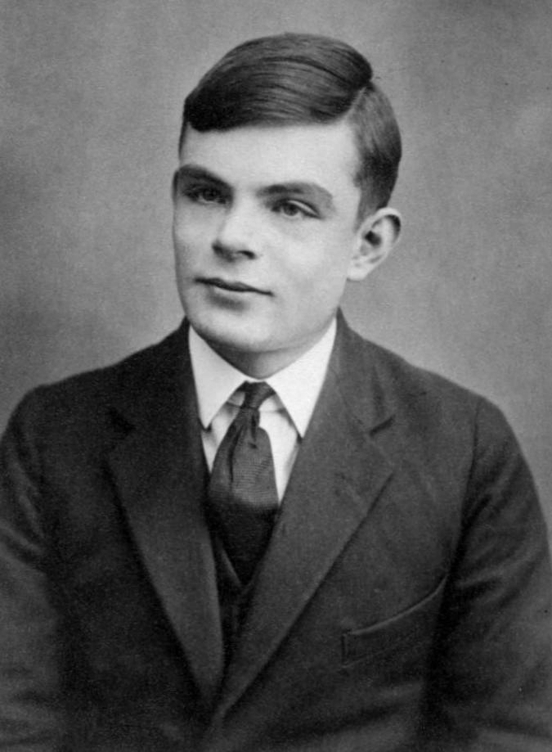
Can computers solve all problems?
Alan Turing

Slide 3
Model for Computation Turing Machine
An infinite tape divided into cells.
A head that can read or write symbols on the tape, and move the tape left or right one cell at a time.
A state register storing current state of the machine, among finitely many states.
A finite table of instructions:
Given current state and current read symbol: Either erase or write a symbol; Move the head (left, right, or remain stationary); Assume the same or a new state.

Slide 4
Can computers solve all problems?
For each problem, there exist a TM to solve it?

Slide 5
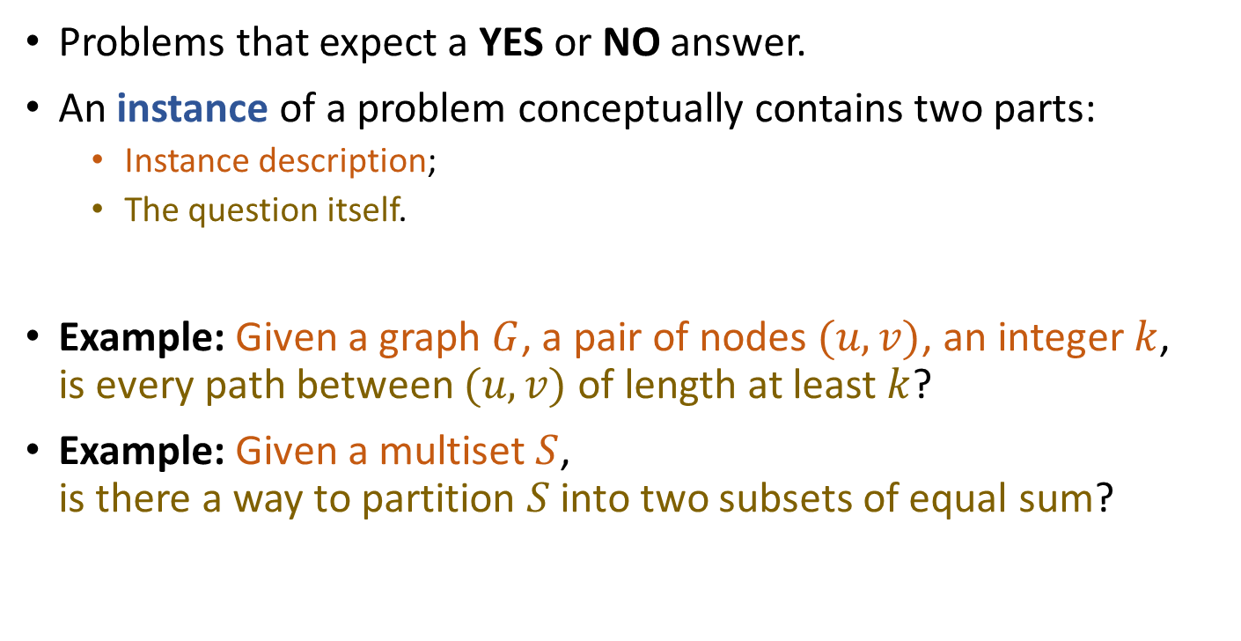
Decision Problem
Problems that expect a YES or NO answer.
An instance of a problem conceptually contains two parts:
Instance description;
The question itself.
Example: Given a graph $G$, a pair of nodes $(u,v)$, an integer $k$, is every path between $(u,v)$ of length at least $k$?
Example: Given a multiset $S$, is there a way to partition $S$into two subsets of equal sum?

Slide 6
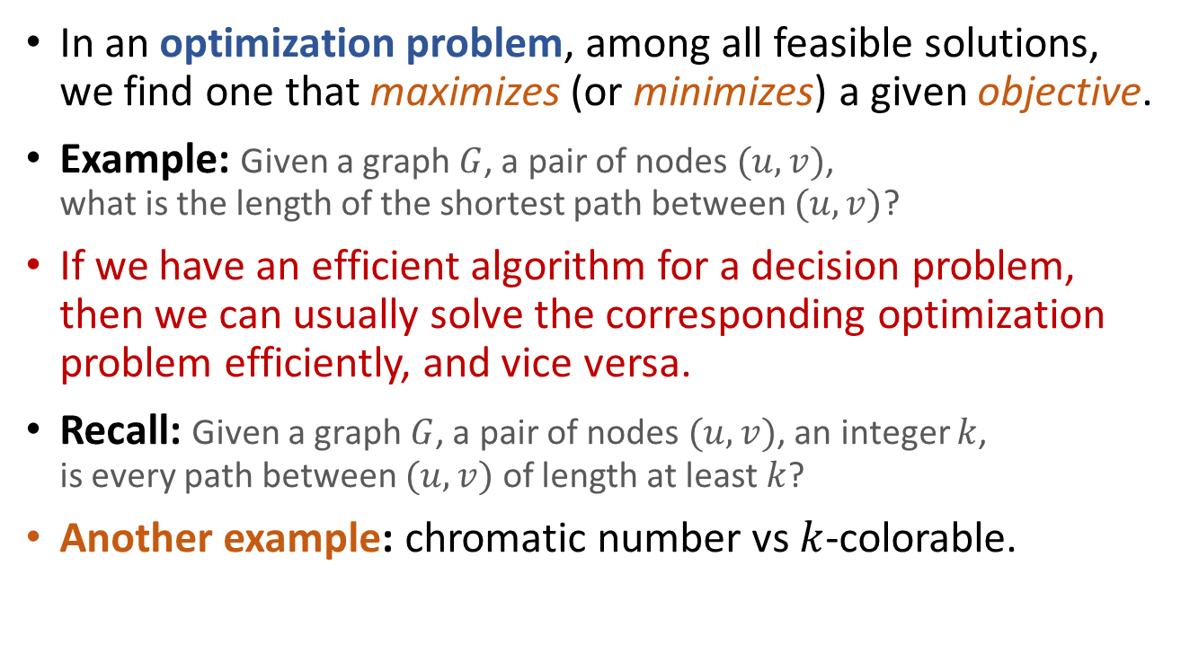
Optimization vs Decision
In an optimization problem, among all feasible solutions, we find one that maximizes (or minimizes) a given objective.
Example: Given a graph $G$, a pair of nodes $(u,v)$, what is the length of the shortest path between $(u,v)$?
If we have an efficient algorithm for a decision problem, then we can usually solve the corresponding optimization problem efficiently, and vice versa.
Recall: Given a graph $G$, a pair of nodes $(u,v)$, an integer $k$, is every path between $(u,v)$ of length at least $k$?
Another example: chromatic number vs $k$-colorable.

Slide 7
Can computers solve all problems?
For each decision problem, there exists a TM to solve it?

Slide 8
Turing Machine
An infinite tape divided into cells.
A head that can read or write symbols on the tape, and move the tape left or right one cell at a time.
A state register storing current state of the machine, among finitely many states.
A finite table of instructions.
Informally, we say a TM solves (decides) a decision problem if for each instance of the problem, within finite steps, the TM correctly outputs “yes” or “no” and then halts.

Slide 9
Can computers solve all problems?
For each decision problem, there exists a TM to decide it?
NO!

Slide 10
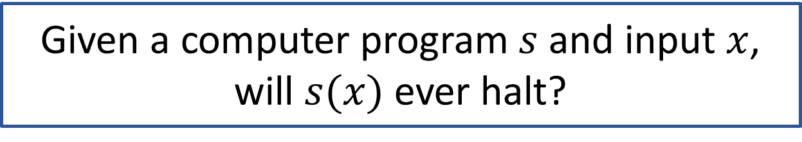
The Halting Problem
Given a computer program $s$ and input $x$, will $s(x)$ ever halt?
No TM can decide the halting problem!

Slide 11
computational difficulty of decision problems
?
undecidable
How fast can computers solve a problem?
For a given decision problem, how fast can a TM decide it?

Slide 12
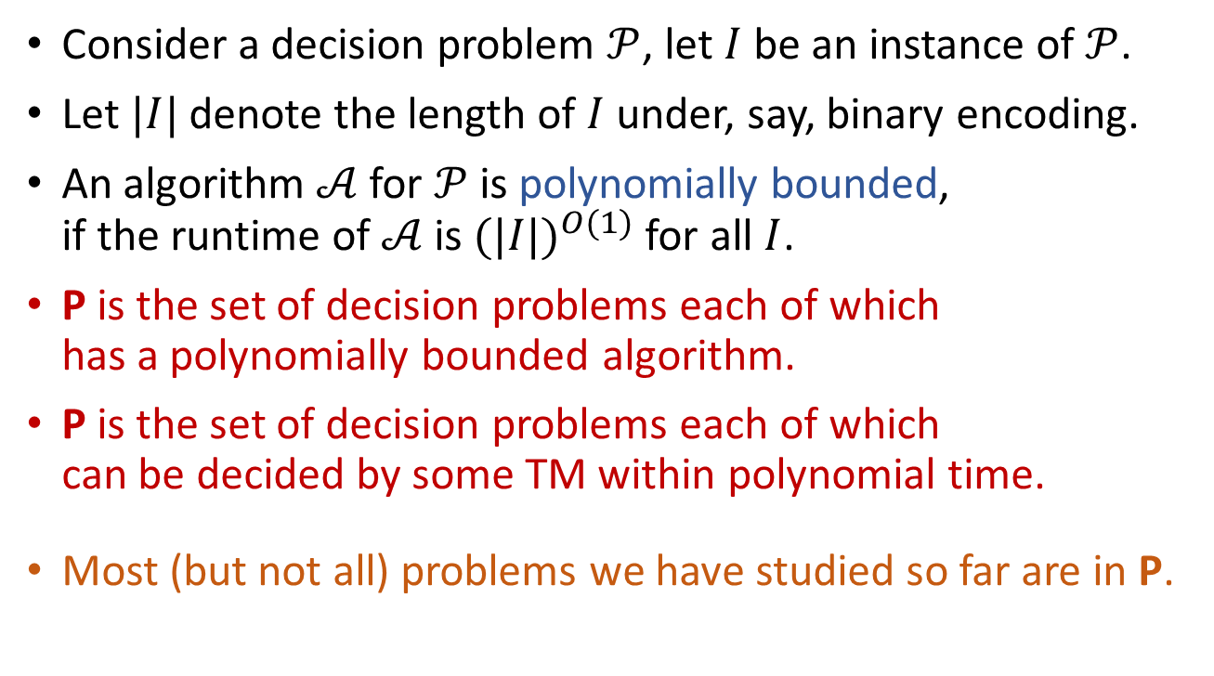
The Class P
Consider a decision problem $𝒫$, let $I$ be an instance of $𝒫$.
Let $|I|$ denote the length of $I$ under, say, binary encoding.
An algorithm $𝒜$ for $𝒫$is polynomially bounded, if the runtime of $𝒜$ is ${(|I|)}^{O(1)}$ for all $I$.
P is the set of decision problems each of which has a polynomially bounded algorithm.
P is the set of decision problems each of which can be decided by some TM within polynomial time.
Most (but not all) problems we have studied so far are in P.

Slide 13
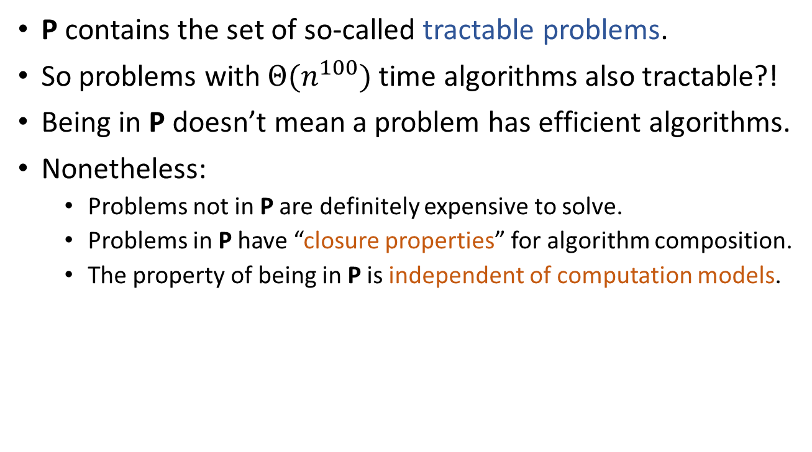
Some notes on P
P contains the set of so-called tractable problems.
So problems with $Θ(n^{100})$ time algorithms also tractable?!
Being in P doesn’t mean a problem has efficient algorithms.
Nonetheless:
Problems not in P are definitely expensive to solve.
Problems in P have “closure properties” for algorithm composition.
The property of being in P is independent of computation models.
Notes:
Tractable: 听话的，容易处理的

Slide 14

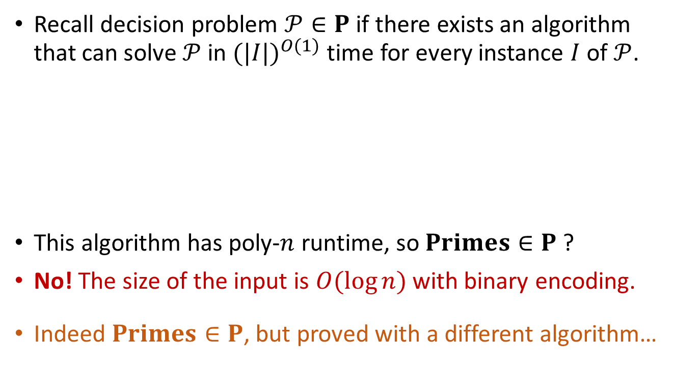
A note on size of input
Recall decision problem $𝒫∈P$ if there exists an algorithm that can solve $𝒫$ in ${(|I|)}^{O(1)}$ time for every instance $I$ of $𝒫$.
This algorithm has poly-$n$ runtime, so $Primes∈P$ ?
No! The size of the input is $O(\log{n})$ with binary encoding.
Indeed $Primes∈P$, but proved with a different algorithm…
IsPrime($n$):
for (i=2 to n-1)
if (n%i == 0)
return false
return true

Slide 15
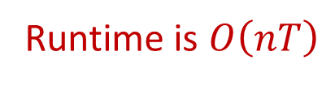
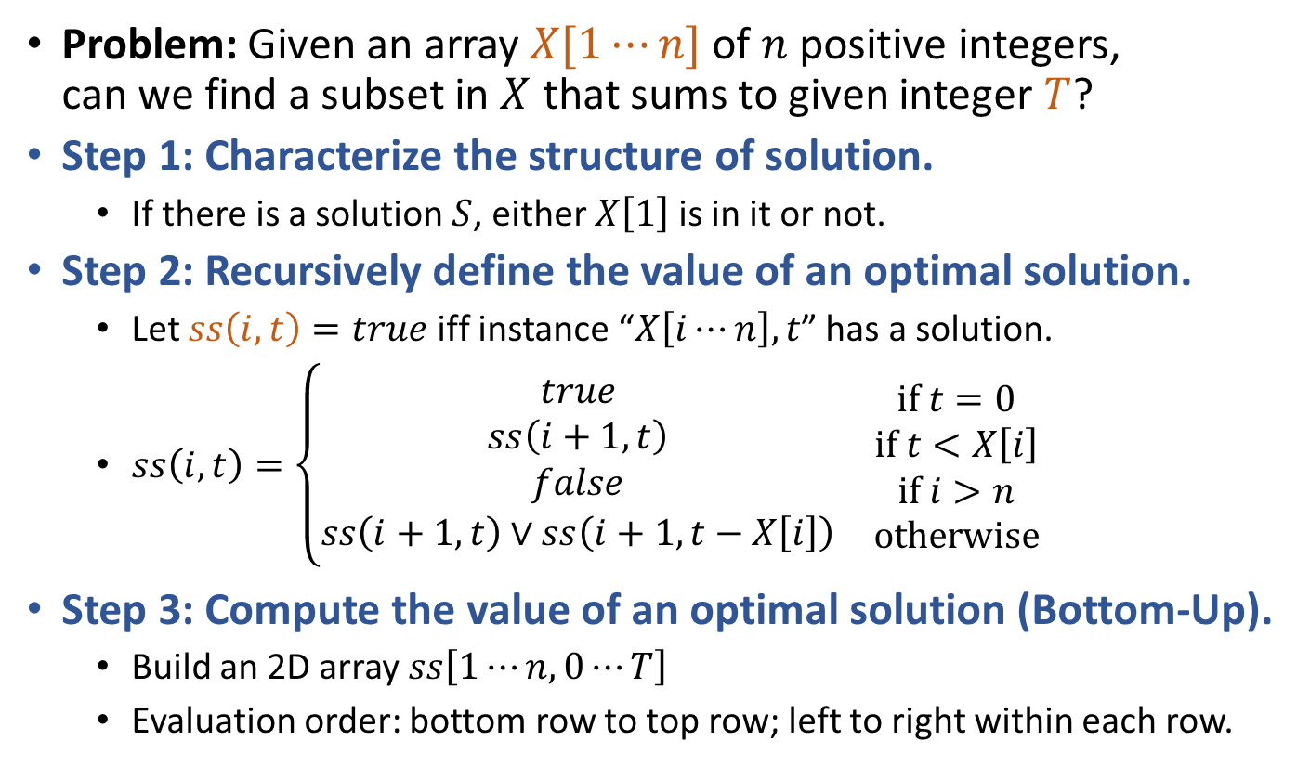
Subset Sum
SubsetSumDP(X,T):
ss[n,0] = True
for (t=1 to T)
ss[n,t] = (X[n]==t)?True:False
for (i=n-1 downto 1)
ss[i,0] = True
for (t=1 to X[i]-1)
ss[i,t] = ss[i+1,t]
for (t=X[i] to T)
ss[i,t] = Or( ss[i+1,t], ss[i+1,t-X[i]] )
return ss[1,T]
Runtime is $O\left(nT\right)$
Problem: Given an array $X[1⋯n]$ of $n$ positive integers, can we find a subset in $X$ that sums to given integer $T$?
Step 1: Characterize the structure of solution.
If there is a solution $S$, either $X\left[1\right]$ is in it or not.
Step 2: Recursively define the value of an optimal solution.
Let $ss\left(i,t\right)=true$ iff instance “$X\left[i⋯n\right],t$” has a solution.
$ss\left(i,t\right)=\left\{\begin{matrix}\begin{matrix}\begin{matrix}true \\ ss\left(i+1,t\right)\end{matrix} \\ \begin{matrix}false \\ ss\left(i+1,t\right)∨ss\left(i+1,t−X\left[i\right]\right)\end{matrix}\end{matrix} & \begin{matrix}\begin{matrix}if t=0 \\ if t<X\left[i\right]\end{matrix} \\ \begin{matrix}if i>n \\ otherwise\end{matrix}\end{matrix}\end{matrix}\right.$
Step 3: Compute the value of an optimal solution (Bottom-Up).
Build an 2D array $ss\left[1⋯n,0⋯T\right]$
Evaluation order: bottom row to top row; left to right within each row.

Slide 16
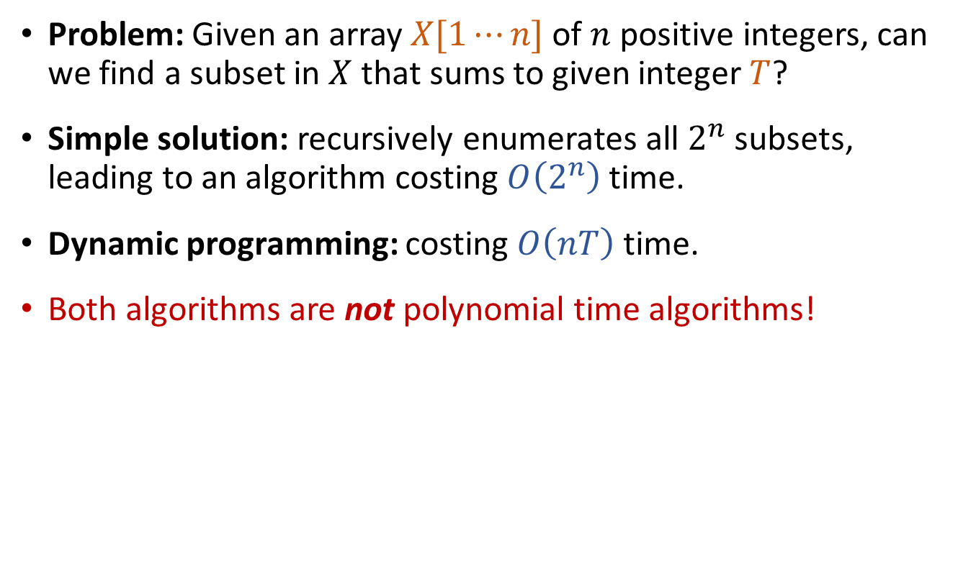
Subset Sum
Problem: Given an array $X[1⋯n]$ of $n$ positive integers, can we find a subset in $X$ that sums to given integer $T$?
Simple solution: recursively enumerates all $2^{n}$ subsets, leading to an algorithm costing $O\left(2^{n}\right)$ time.
Dynamic programming: costing $O\left(nT\right)$ time.
Both algorithms are not polynomial time algorithms!

Slide 17
computational difficulty of decision problems
?
P
undecidable
decidable
P

Slide 18
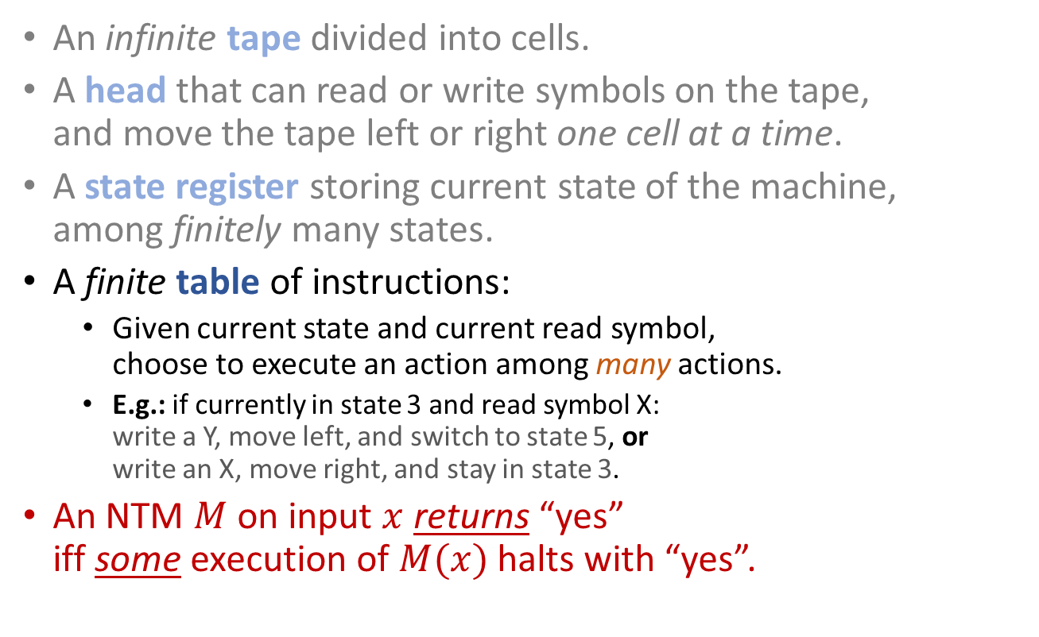
Non-deterministic Turing Machine
An infinite tape divided into cells.
A head that can read or write symbols on the tape, and move the tape left or right one cell at a time.
A state register storing current state of the machine, among finitely many states.
A finite table of instructions:
Given current state and current read symbol, choose to execute an action among many actions.
E.g.: if currently in state 3 and read symbol X: write a Y, move left, and switch to state 5, or write an X, move right, and stay in state 3.
An NTM $M$ on input $x$ returns “yes” iff some execution of $M(x)$ halts with “yes”.
…
…
…
YES
NO
NO
NO
NO

Slide 19
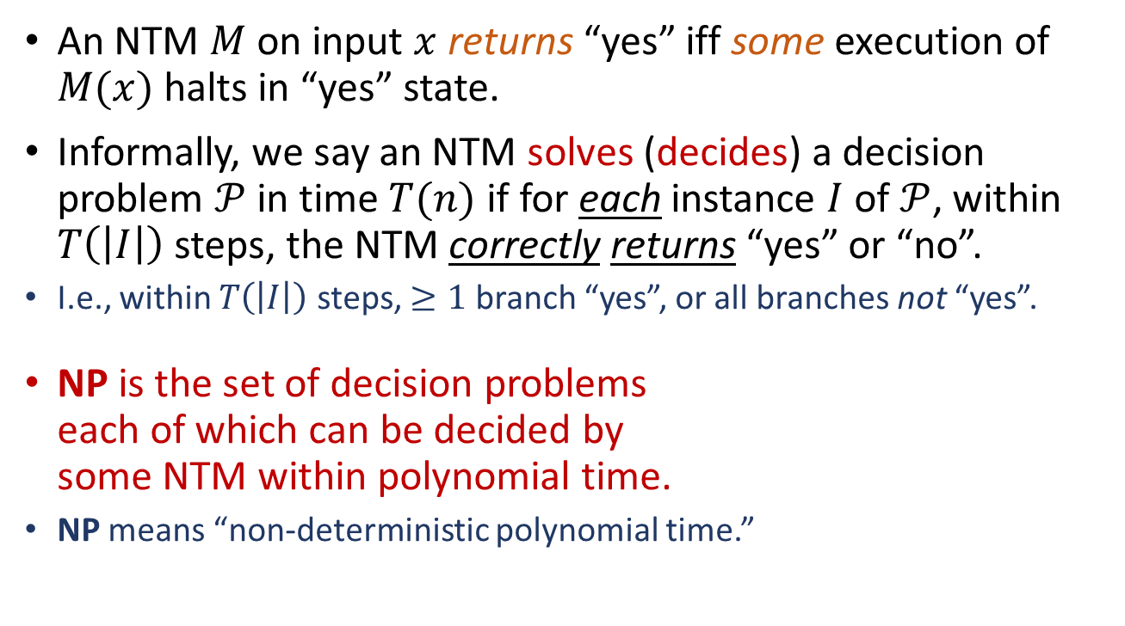
The Class NP
An NTM $M$ on input $x$ returns “yes” iff some execution of $M(x)$ halts in “yes” state.
Informally, we say an NTM solves (decides) a decision problem $𝒫$ in time $T(n)$ if for each instance $I$ of $𝒫$, within $T\left(\left|I\right|\right)$ steps, the NTM correctly returns “yes” or “no”.
I.e., within $T\left(\left|I\right|\right)$ steps, $≥1$ branch “yes”, or all branches not “yes”.
NP is the set of decision problems each of which can be decided by some NTM within polynomial time.
NP means “non-deterministic polynomial time.”
…
…
…
YES
NO
NO
NO
NO

Slide 20
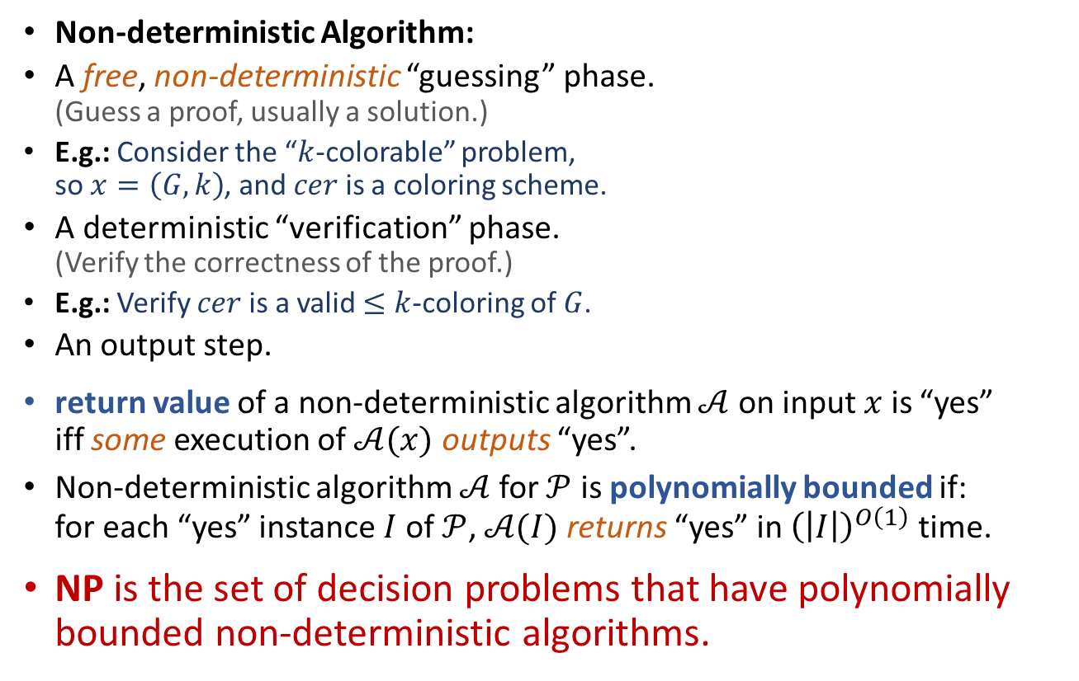
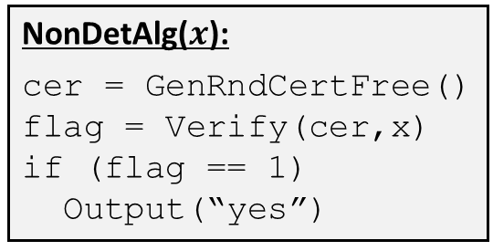
The Class NP, Take Two
Non-deterministic Algorithm:
A free, non-deterministic “guessing” phase. (Guess a proof, usually a solution.)
E.g.: Consider the “$k$-colorable” problem, so $x=\left(G,k\right)$, and $cer$ is a coloring scheme.
A deterministic “verification” phase. (Verify the correctness of the proof.)
E.g.: Verify $cer$ is a valid $≤k$-coloring of $G$.
An output step.
return value of a non-deterministic algorithm $𝒜$ on input $x$ is “yes” iff some execution of $𝒜(x)$ outputs “yes”.
Non-deterministic algorithm $𝒜$for $𝒫$ is polynomially bounded if: for each “yes” instance $I$ of $𝒫$, $𝒜(I)$ returns “yes” in ${\left(\left|I\right|\right)}^{O\left(1\right)}$ time.
NP is the set of decision problems that have polynomially bounded non-deterministic algorithms.
NonDetAlg($x$):
cer = GenRndCertFree()
flag = Verify(cer,x)
if (flag == 1)
Output(“yes”)
Notes:
Use coloring as an example. Problem “Is graph G k colorable?” x=(G,k). A valid cert is a coloring assignment to all nodes using at most k colors.

Slide 21
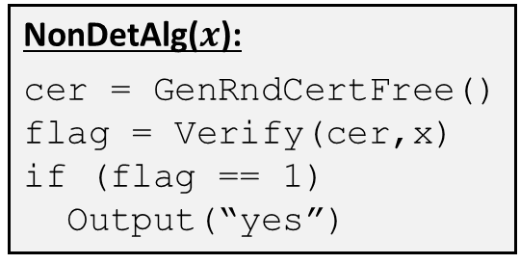
Different faces of NP
The NTM Approach
The Non-deterministic Algorithm Approach
NonDetAlg($x$):
cer = GenRndCertFree()
flag = Verify(cer,x)
if (flag == 1)
Output(“yes”)
…
…
…
YES
NO
NO
NO
NO
NP is the set of decision problems that can be decided by NTM within polynomial time.
NP is the set of decision problems that have polynomially bounded non-deterministic algorithms.
NP is the set of decision problems that “yes” instances have short proofs that are efficiently verifiable.

Slide 22

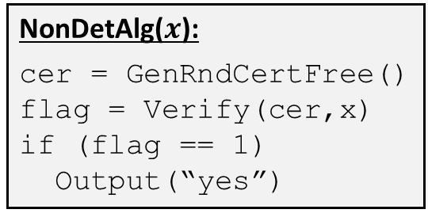
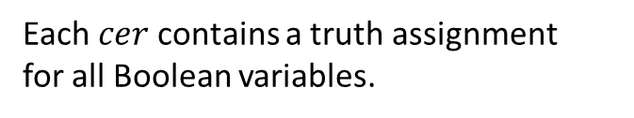
SAT: A Problem in NP
Given a Boolean formula $φ$ in CNF, is $φ$ satisfiable?
Example: $φ=\left(x_{1}∨x_{2}\right)∧\left(x_{3}∨\overline{x_{1}}\right)∧\left(x_{2}∨\overline{x_{1}}∨\overline{x_{2}}\right)∧\left(x_{4}\right)$
The NTM Approach
The Non-deterministic Algorithm Approach
NonDetAlg($x$):
cer = GenRndCertFree()
flag = Verify(cer,x)
if (flag == 1)
Output(“yes”)
…
…
…
YES
NO
NO
NO
NO
Each branch is a truth assignment for a Boolean variable.
Each $cer$ contains a truth assignment for all Boolean variables.
Correctness of truth assignment can be verified in polynomial time.
NP is the set of decision problems that “yes” instances have short proofs that are efficiently verifiable.
Notes:
CNF: 合取范式

Slide 23

$P⊆NP$
P is the set of decision problems that have polynomially bounded algorithms.
P is the set of decision problems that can be decided by (deterministic) TM within polynomial time.
NP is the set of decision problems that have polynomially bounded non-deterministic algorithms.
NP is the set of decision problems that can be decided by NTM within polynomial time.
Any algorithm is also a special non-deterministic algorithm, any TM is also a special NTM.

Slide 24
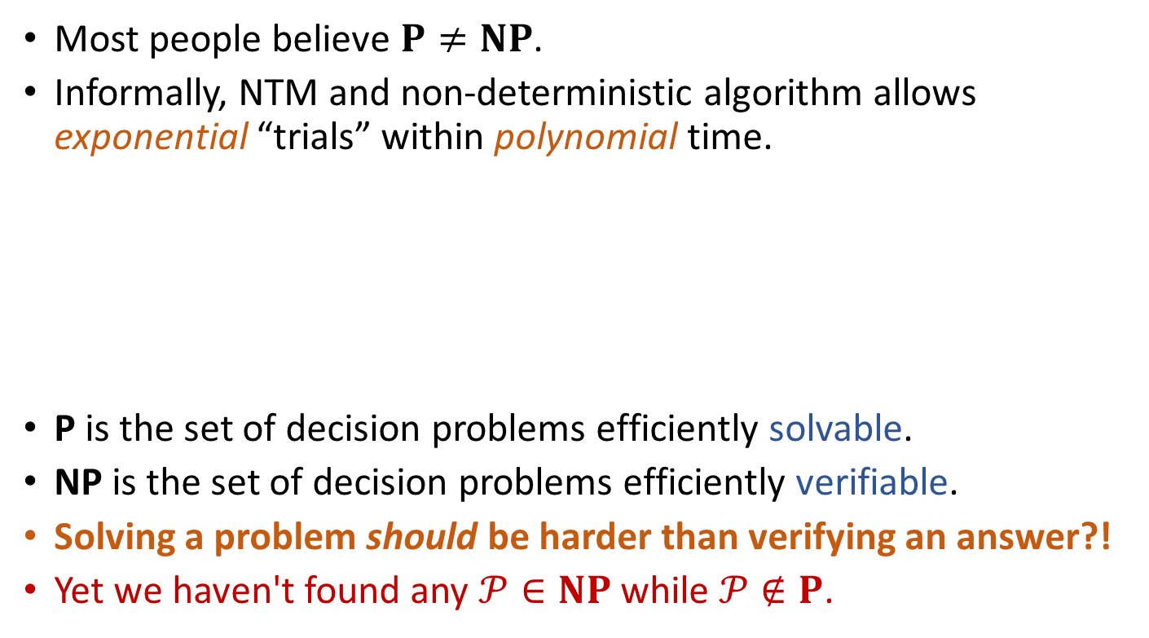

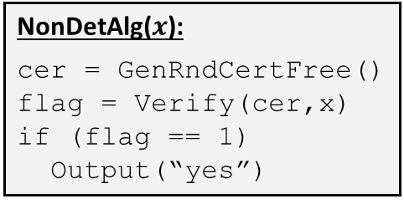
The big question: $P≠NP$?
Most people believe $P≠NP$.
Informally, NTM and non-deterministic algorithm allows exponential “trials” within polynomial time.
P is the set of decision problems efficiently solvable.
NP is the set of decision problems efficiently verifiable.
Solving a problem should be harder than verifying an answer?!
Yet we haven't found any $𝒫∈NP$ while $𝒫∉P$.
NonDetAlg($x$):
cer = GenRndCertFree()
flag = Verify(cer,x)
if (flag == 1)
Output(“yes”)
…
…
…
YES
NO
NO
NO
NO

Slide 25

If indeed $P≠NP$ …
computational difficulty of decision problems
P
???
undecidable
NP
decidable
NP
P

Slide 26
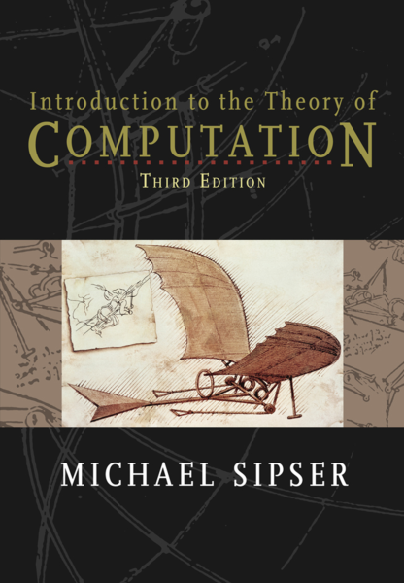
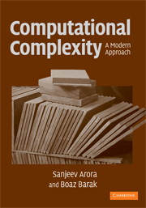
Reading
[CLRS] Ch.34 (34.1-34.2)
Other great books:
Michael Sipser, Introduction to the Theory of Computation (3ed)
Arora and Barak, Computational Complexity: A Modern Approach

Slide 27
(Very) Brief Review
Some important data structures
list, stack, queue, heap, graph, …
hash tables, search trees, disjoint sets, …
Some classical algorithms
sorting and selection, tree/graph traversal, …
MST, shortest paths, …
Basic algorithm design and analysis techniques
induction, asymptotic notations, amortized analysis, …
recursion, divide-and-conquer, greedy, dynamic programming
Basic complexity theory
upper bounds and lower bounds (decision tree, adversary argument)
computability and complexity (P, NP)
Use computers to efficiently solve practical problems.
(Analytical and problem-solving skills.)

