Slide 1





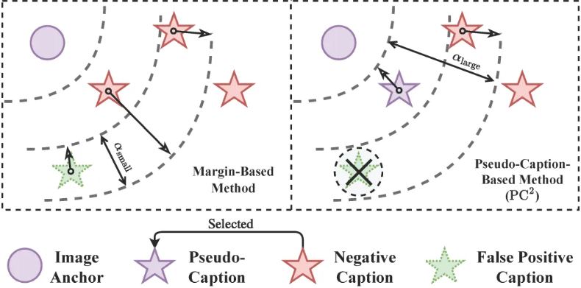
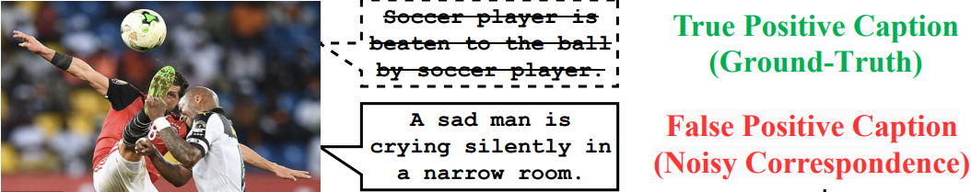

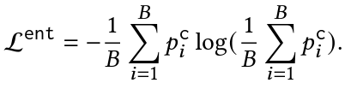


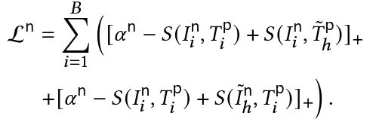
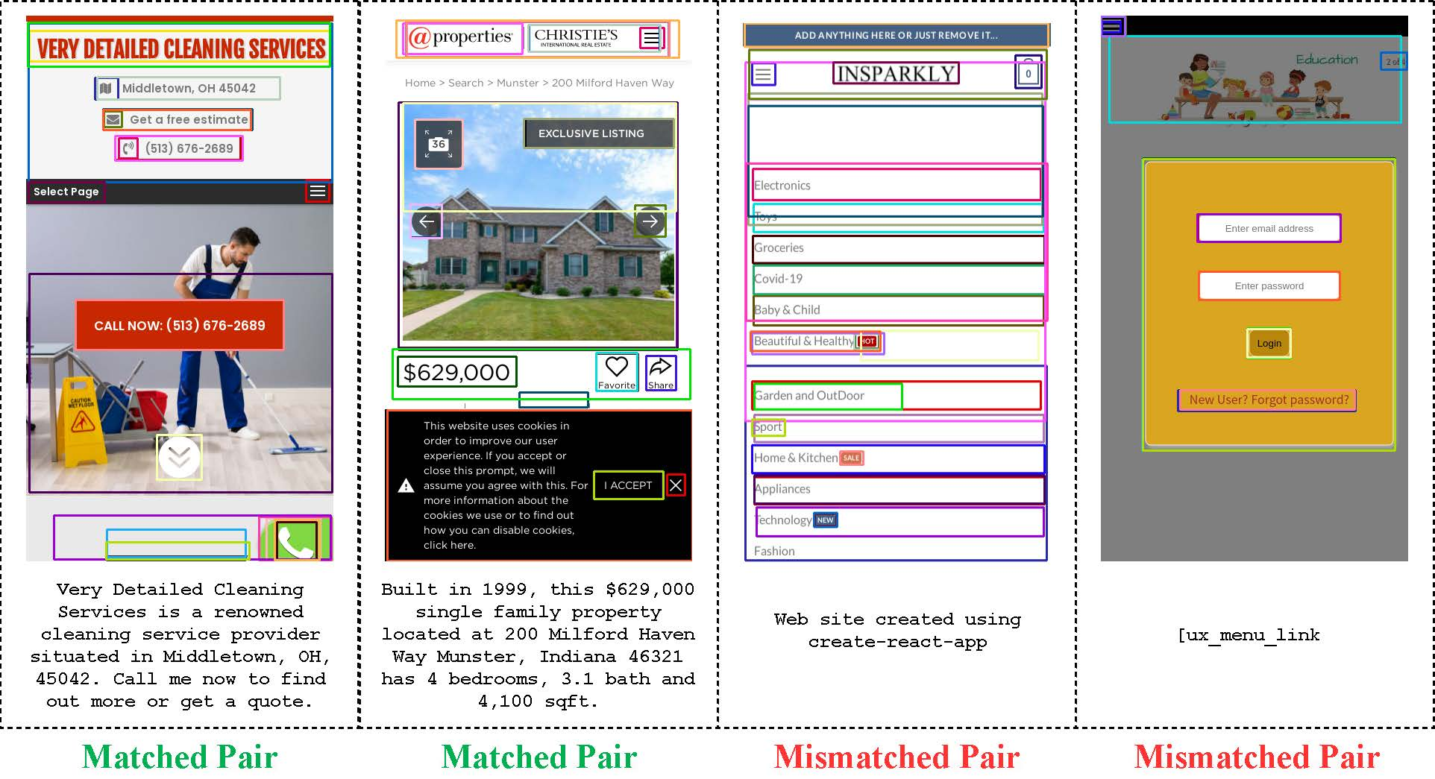
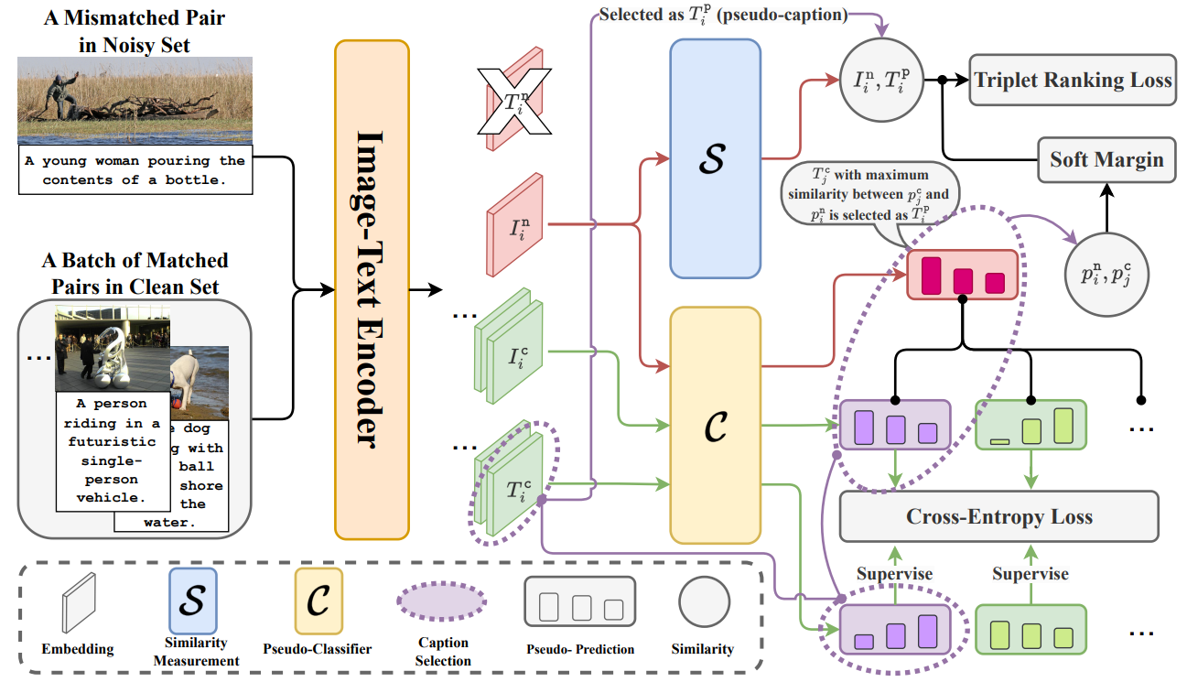
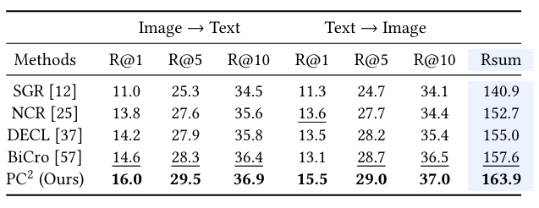
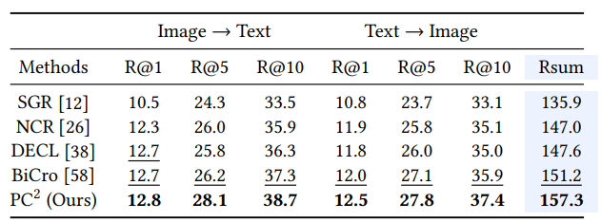
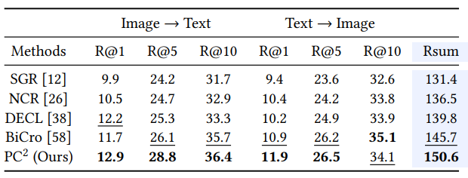





PC²: Pseudo-Classification Based Pseudo-Captioning for
Noisy Correspondence Learning in Cross-Modal Retrieval
Yue Duan¹², Zhangxuan Gu², Zhenzhe Ying², Lei Qi³, Changhua Meng², and Yinghuan Shi¹
¹Nanjing University, China ²Ant Group, China ³Southeast University, China
Motivation: Margin vs. Pseudo-Caption
Noisy Correspondence Learning (NCL)
Previous NCL solutions mostly adopt the soft margin based triplet ranking loss to mitigate the negative impact of mismatched data in the training process.
Current cross-modal retrieval models rely on training on precisely matched data pairs.
Manually annotating images-text pair is laborious, while automatically collected data has noisy correspondence.
NCL aims to train robust cross-modal retrieval models in the presence of noisy correspondence.
They fail to directly provide beneficial supervision for false positive pairs, but only weaken the negative effects of false supervision.
Proposed Method: PC²
Pseudo-classification: Use the pseudo-classifier to group visual semantic clusters into K pseudo-classes with images as anchors.
Pseudo-classification based pseudo-captioning: Use the pseudo-classifier to assign pseudo-captions based on the similarity of the pseudo-predictions of clean images and noisy images.
Prediction oscillation based correspondence rectification: Oscillating pseudo-predictions indicate low correspondence.
New Dataset: Noise of Web (NoW)
Previous NCL benchmarks are mainly artificially simulated based on Flickr30K, MS-COCO, etc.
Propose the first benchmark dedicated to NCL, collected in a real industrial environment.
NoW contains 100,000 [webpage screenshot (image)-meta description (text)] data pairs obtained from the web page and HTML source code.
Contribution and Conclusion
We introduce a pseudo-caption-based NCL framework: PC², offering a threefold strategy all rooted in pseudo-classification.
PC² shows promising NCL performance on both the simulated and the realistic datasets, outperforming both popular cross-modal retrieval approaches and NCL-robust methods across a variety of NCL settings.
We introduce a realistic dataset NoW, which can serve as a powerful benchmark for NCL evaluations.
Experiments on NoW
Jieba
BPE
Bert
Paper&Dataset&Code&Zhihu&Video
NoW is a multilingual dataset.We provide results with Jieba, BPETokenizer and pre-trained BertTokenizer for tokenizing text.

