Slide 1
“Insert Creative Name Here”
An App By
Nick WaterWorth, Jasper Harrison, Austin Kreulach,
Ignacio Montes de Oca and Gabriel Priest

Slide 2
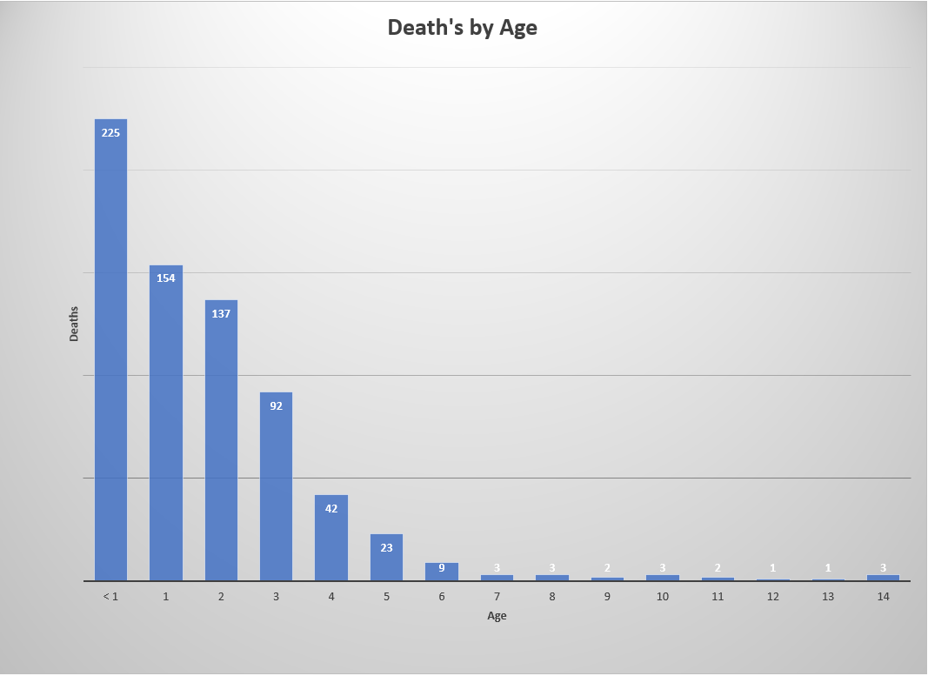
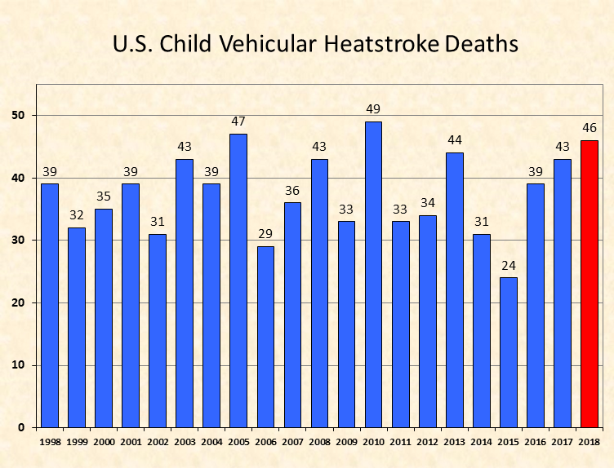
Hot Car Death statistics(*3)

Slide 3
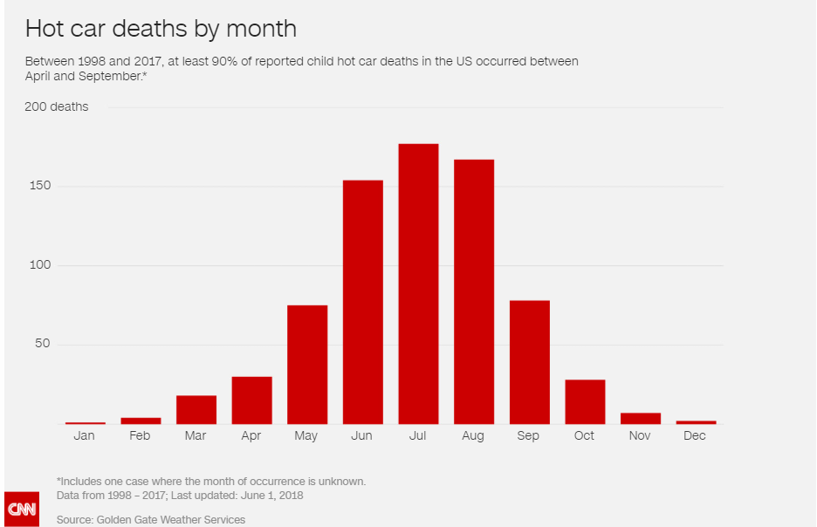
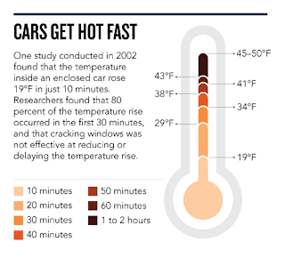
Risk Statistics
(*4)
(*1)

Slide 4
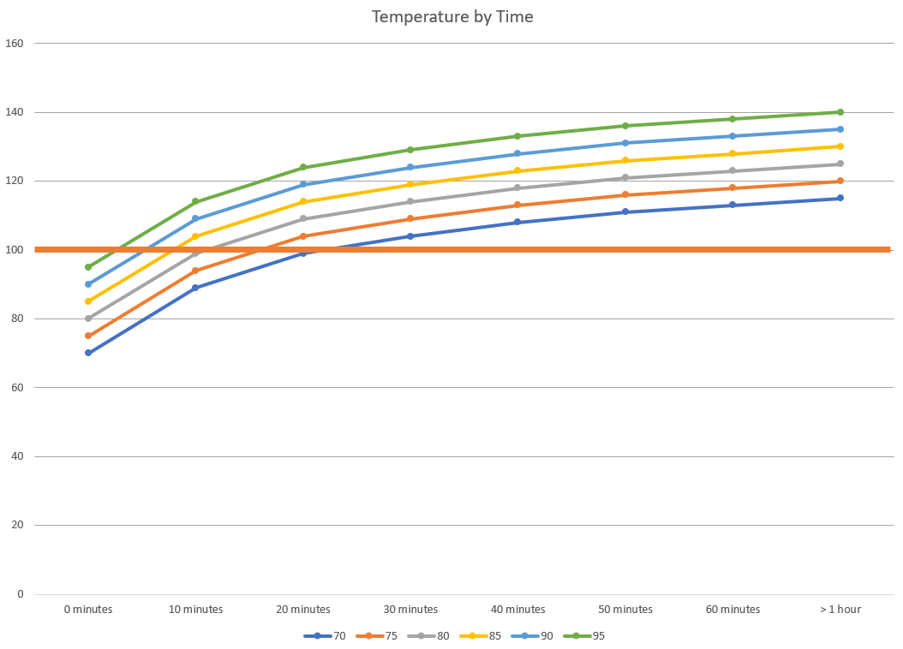
(*2)

Slide 5
Pros of kotlin
Has null in its type system, handy as Android uses null to represent absence of value
More concise than Java, leaving less room for errors
Can compile to JavaScript or Native allowing for code that can run on iOS

Slide 6
Bibliography
(*1)Children are at serious risk of death if left in hot cars — don’t do it in any circumstance (2018, March 30). In Northern Kentucky Tribune. Retrieved September 21, 2018.
(*2)Null, J. (n.d.). Pets in Vehicles. In AVMA. Retrieved September 21, 2018.
(*3)Null, J. (2018, September 12). Heatstroke Deaths of Children in Vehicles. In noHeatStroke.org. Retrieved September 22, 2018.
(*4)Willingham, A. (2018, July 20). More than 36 kids die in hot cars every year and July is usually the deadliest month. In CNN Health+. Retrieved September 21, 2018

