Slide 1

















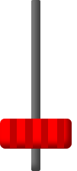


Click on TODO items will
put a red dot on the item
information section will show
related info
Click twice on TODO items will
move the item to DONE rack
Likewise for the items in DONE rack
TODO
DONE
Priority : High/ Mid/ Low
Deadline : 2021/10/10
Priority
Detail : CRID..... Condition...
Deadline
Sort the TODO rack based on
different attribute
Click on the draw button will
switch the term (cycling)
Combined
Next : Next... move...
Add new item to the rack
Press once will clear the info column
Type the info to the info column
Press again will add a new item
Can be directly modified
in the info column here

Slide 2
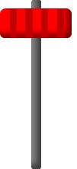
Click on TODO items will
put a red dot on the item
information section will show
related info
Click twice on TODO items will
move the item to DONE rack
Likewise for the items in DONE rack
TODO
DONE
Priority : High/ Mid/ Low
Deadline : 2021/10/10
Priority
Detail : CRID..... Condition...
Deadline
Sort the TODO rack based on
different attribute
Click on the draw button will
switch the term (cycling)
Combined
Next : Next... move...
Add new item to the rack
Press once will clear the info column
Type the info to the info column
Press again will add a new item
Can be directly modified
in the info column here

