Slide 1


7B Unit 4
Finding your way
Revision
Rudong Minghai Middle School Xu Xiaohong

Slide 2

内容大纲
1
词汇训练营
句型大闯关
2
语法加油站
3
写作大练兵
4

Slide 3
1
词汇训练营

Slide 4
Task 1 Revision: Words
词汇训练营
一、快速说出下列单词或短语。
1. 跟随；效仿 v. ________
2. 北方，北 n./adj./adv. _________
3. 旅行 n. ________
4. 千米，公里 n. _________
5. 每人，人人 pron. ___________
6. 径直地 adv. ____________
7. 整天 _______________
8. 沿着，顺着 prep. ___________
follow
north
trip
kilometre
everybody
straight
all day long
along

Slide 5
词汇训练营
快速回忆所学单词，看谁说得又快又准！
dangerous
9. 危险的 adj. _____________
10. 记得；记住 v. ___________
11. 森林 n. ________
12. 大笑 v. __________
好笑的，滑稽的 adj. _______
叶子 n. _________
穿过，横过 prep. _________
在……里面 prep. _________
桥 n. _______
remember
remember to do sth. 记得去做某事
remember doing sth. 记得做过某事
forest
laugh
funny
leaf
复数形式：leaves
across
inside
反义词：outside
bridge

Slide 6
词汇训练营
快速回忆所学单词，看谁说得又快又准！
sign
18. 指示牌 n. _________
19. 准备 v. ________
20. 拐角；街角 n. __________
21. 红绿灯_______________
22. 大量，充足 ____________
prepare
prepare…for…
corner
traffic lights
plenty of

Slide 7
词汇训练营
易错音标
[bentʃ]
[ðət]
[dʒəʹrɑːf]
[ʹeksɪt]
[əʹlɒŋ]
[ʹəʊvə(r)]
[ʹevrɪbɒdi]
[kwaɪt]
[lɑːf]
[liːf]
[ʹplenti]
[prɪʹpeə(r)]
bench
that
giraffe
exit
along
over
everybody
quite
laugh
leaf
plenty
prepare

Slide 8


词汇自主测
重点单词
1. __________ n.,adj. & adv. 西，西方
2. __________ n. 旅行，旅游
*________________ 去旅行
3. __________ n. 竹
4. __________ n. 路，道路
5. __________ n. 国王
west
trip
go on a trip
bamboo
road
king

Slide 9
6. __________ n. 森林
7. __________ n. 长颈鹿
8. __________ n. 脖子
9. __________ n. 桥
10. __________ n. 指示牌
11. __________ n. 宝藏
12. __________ n. 交通，来往车辆
13. __________ n. 拐角，街角；角落
forest
giraffe
neck
bridge
sign
treasure
traffic
corner

Slide 10
14. __________ n. 银行
15. __________ vt. 跟随，仿效
16. __________ vt. 记得，记住
*____________________________ 记得要关灯(未做)
*___________________________ 记得关了灯(已做)
17. __________ vi. 笑，大笑
*________________ 嘲笑
bank
2 次
follow
remember
remember to turn off lights
remember turning off lights
laugh
laugh at

Slide 11
18. __________ adv. 径直地 adj. 笔直的
*________________ 直走
19. __________ adv. 相当，非常
20. __________ prep.沿着，顺着
21. __________ prep.在……对面；穿过，横过
22. __________ prep.在……里面
23. __________ prep.在……外面
straight
go straight
quite
along
across
inside
outside

Slide 12
24. __________ prep.在……上面
25. __________ prep.在……下面
26. __________ prep.在……上面
27. __________ prep.在另一边，到另一侧
28. __________ pron. 每人，人人
29. __________ pron. 大量，充足
above
below
over
past
2 次
everybody
plenty

Slide 13
词汇拓展
30. danger (n.)危险
→__________ (adj.)危险的
31. fun (n.) 享乐，乐趣；有趣的事
→__________ (adj.)好笑的，滑稽的
*_______________________ 玩得高兴
*________________________ 不要拿他开玩笑。
32. leaf (n.)(树、菜)叶
→__________ (pl.)
dangerous
funny
have fun(=enjoy oneself)
Don’t make fun of him.
leaves

Slide 14
33. cross (vt.) 穿过，横过
→__________ (n.) 交叉路口
*________________ 过马路
*___________________ 在第一个十字路口
34. prepare (vt.) 准备
→_____________ (n.)准备
35. north (n., adj. & adv.)北，北方
→__________ (adj.)北方的，北部的
crossing
cross the road
at the first crossing
2 次
preparation
northern

Slide 15
36. south (n., adj. & adv.)南，南方
→__________ (adj.)南方的，南部的
37. east (n., adj. & adv.)东，东方
→__________ (adj.)东部的，东方的
southern
eastern

Slide 16
重点词块
1. 不得不，必须________________
2. 向左/右转(2022.1)________________
3. 去公园________________
4. 看起来像她的妈妈___________________
5. 为家人准备食物_____________________
have to
turn left/right
go to the park
look like her mother
prepare food for family

Slide 17
6. 在你的左边________________
7. 大量水，足够的水________________
8. 整天地________________
9. 红绿灯________________
10. 户外运动________________
on your left
plenty of water
all day long
traffic lights
outdoor sports

Slide 18
I. Words of direction: 方向词
II. 表示方向位置的介词
in, on, to
词汇训练营
north
north-west
north-east
west
east
south-west
south-east
south
在…内部
与…接壤
与…不相邻（外部）

Slide 19
海南在中国南部
Hainan is in the south of China.
俄罗斯在中国北部
Russia is on the north of China.
日本在中国东部
Japan is (to the) east of China.
动物园在阳光中学西北部
The zoo is (to the) north-west of Sunshine Middle School.

Slide 20
Signs
turn left
traffic lights
turn right
straight on
crossroads
zebra crossing

Slide 21
词汇训练营
单词填空，考查综合运用能力！
二、根据提示填空。
1. You must remember _________ (clean) the classroom.
2. Come in. It’s cold o .
3. You go first and I will f_________ you later.
4. Xiamen is in the ___________ (东北)of China..
5. The light shines _________ (穿过) the eyes of the lanterns.
6. In Spring, we can see green _______ （树叶）and grass everywhere.
7. It’s d_________ to play football in the street.
to clean
utside
ollow
northeast
through
leaves
angerous

Slide 22
词汇训练营
1. Li Tao's hometown is in the （西南）of China.
2. You have to do all the exercises before you open the_______（宝藏）box.
3. Look at the_______ (指示牌). They show the ways to the zoo.
4. Don’t worry. We have p _________of time to finish the job.
5. Could you tell me the way to the b_______, I want to get some money.
6. Excuse me, how can I get to the museum?-Just f_______ me.
southwest
treasure
signs
lenty
ank
ollow

Slide 23


remember的用法（4次）
高频考点2
9. We should always remember ________ the more careful we are, the fewer mistakes we will make.
A. which B. that C. where D. what
10. Remember ________(say) thanks to those who helped you and pass the kindness down.
11. Jack remembers ___________(put) the dictionary on my desk, but I can't find it anywhere now.
B
to say
putting

Slide 24
【延伸训练】
12. Don't forget ___________(prepare) a present for your uncle before his birthday.
13. We regret ________(tell) you that you didn't win the competition. Come on！We believe you will get better grades next time.
14. It's no use regretting ________________(waste) too much time on the computer games. Instead, you should set up a new goal and have a new start.
to prepare
to tell
wasting

Slide 25
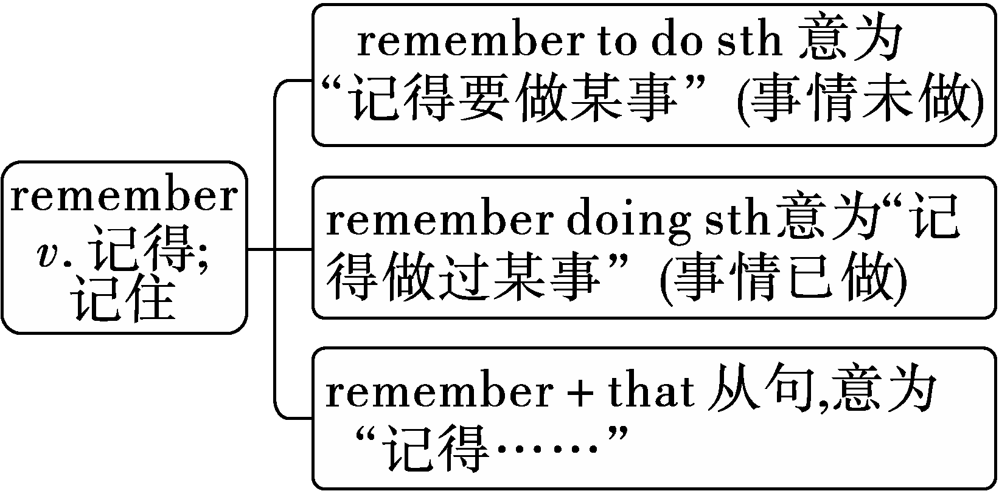

Slide 26

拓展
常见此类用法的单词还有forget, stop, regret
forget to do sth忘记去做某事
forget doing sth忘记曾经做过某事
stop to do sth停下来去做另一件事
stop doing sth停止正在做的事
regret to do sth对未做某事感到遗憾
regret doing sth后悔做了某事

Slide 27

一言辨异
My mother said, “Remember to post the letter today.”But I remember posting it yesterday.

Slide 28
高频考点3
prepare的用法（9次）
15. Today is my mother's birthday, and I have prepared a birthday cake ________ her.
A. for B. from C. with D. about
16. The Greens prepare __________ their holiday in the countryside to enjoy the peaceful life.
A. spend B. spending C. to spend D. spent
17. The social workers prepare ___________ an activity to call on more people to care for the old. (hold)
A
C
to hold

Slide 29
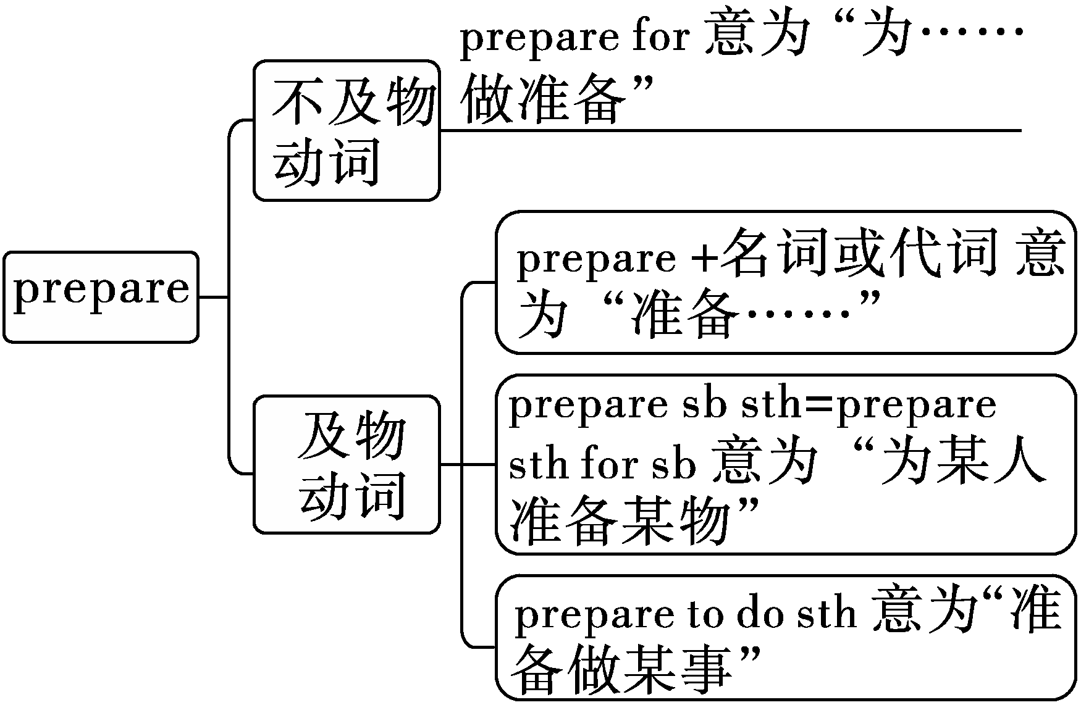
如：① To prepare a report, I have read many articles about the subject.
②I can't wait to go to the birth-day party that my mom has pre-pared for me.

Slide 30
词汇语境练
[素材选自人教八(上)Unit 1 P5改编]
Last morning, I went on a vacation to Penang in Malaysia with my family. I still 1. ____________ (remember) our trip there when I was a child. It was so 2. __________ (attract) that we wanted to go there again. We arrived there on Monday morning. For lunch, we 3. _____________ (provide) with special and delicious Malaysian yellow noodles.
remembered
attractive
were provided

Slide 31
In the afternoon, we rode bicycles to Georgetown. There were both new buildings and old buildings. I was curious about everything there, 4. __________ (especial) what this town was like in the past.
On the second day, 5. ________ (I) father and I decided to go to Penang Hill. There were many 6. ___________ (sign) with words “No Smoking”. We wanted to walk to the top, but it was so long that I kept 7. ___________ (follow) my father closely all the time. But then it started raining a little so we decided to take the train.
especially
my
signs
following

Slide 32
When we got to the top, it 8. ___________ (rain) heavily. We were wet and cold because we forgot 9. __________ (prepare) an umbrella. What's 10. ________ (bad), we didn't bring enough money, so we only had a bowl of rice and some fish. Though we experienced something bad, it was still a fun and unusual trip!
was raining
to prepare
worse

Slide 33
Task 2 Revision: Phrases
Work in groups
去旅行
径直往前走
沿着这条路走
躺下
整天
上蹿下跳
过桥
go on a trip
go/walk straight on
go/walk along the road
lie down
all day (long)
jump around
cross the bridge
go/walk across the bridge

Slide 34

在第二个路口左转（2种）
躺在草地上
旅行愉快
看起来像某人的妈妈
在右面
在……的北面
发出优美的声音
turn left at the second turning
take the second turning on the left
lie on the grass
have a nice trip
look like one’s mother
on the right
be (to the) north of

Slide 35
2
句型大闯关

Slide 36
Read in groups then complete the passage.根据课文内容填空。
Welcome to Sunshine Zoo. Let me show you aroud the zoo. Here is South Gate. __________________, and you’ll find the Panda House. ___________________.To the ________ of the Panda House, you’ll find lions. ____________, and to the___________ of the Lion’s Area, _______find the World of Birds. _______ the north of the World of Birds is the Monkeys’ Forest. Then _____________, and to the ______ of Monkeys’ Forest, you’ll see the ________. _______________ of the giraffes there is a bridge. __________________, and you’ll see the ___________. Have a nice trip!
Go straight on
Walk along the road
north
Turn left
west
you’ll
To
turn right
east
giraffes
North-east
Cross the bridge
elephants

Slide 37
Passage 2
[素材选自 Unit 4 P44 Reading A]
The Sunshine Zoo is located in the north of the school, about three kilometres away. We can go there by bus.
Our class is going to the Sunshine Zoo for our class trip. Can you find the way if you are in the zoo? Now we are at the gate of the Sunshine Zoo. 1.F_______ me to see different animals.
Go 2.s_______ , and you will find the Panda House. Pandas are cute.
ollow
traight

Slide 38
They like to eat bamboo and lie down all day 3. l_______. Every year, lots of visitors come here to see them. To the north of the Panda House, you will find the lions. Lions are the kings of the animal world. Remember not 4. ________ (go) near them. They're 5. _________(danger). Turn left, and to the west of the Lions' Area, you'll find the World of Birds. Birds make beautiful 6. s_______ when they sing. To the north of the World of Birds is Monkeys' Forest. Monkeys are clever and 7. ________(fun).
ong
to go
dangerous
ounds
funny

Slide 39
They jump around and make people laugh. Then turn right and to the east of the Monkeys' Forest, you will see the 8.________(giraffe). They're quite tall. Their long necks help them eat the leaves from trees. In the northeast of the giraffes, there's a bridge. Cross the bridge, and you'll see the elephants. Their large ears are like open fans.
Here you can see all kinds of animals. Have a nice trip!
giraffes

Slide 40
句型大闯关
本单元重点句子有哪些？看谁说得多！
1. 直走，你们会发现熊猫馆。
Go straight on, and you’ll find the Panda House.
这是“祈使句+and+陈述句”的句型，相当于一个条件状语从句。
如：Listen carefully and you’ll understand it.
=__ you listen carefully, you’ll understand it.
If
其中and表示顺承，如果用or，则表示转折。
如： 早点起床，否则你会错过早班车。
Get up early,or you'll miss the early bus.

Slide 41
句型大闯关
本单元重点句子有哪些？看谁说得多！
2.它们喜欢吃竹子和整天躺着。
They like to eat bamboo and lie down all day long.
1）lie down “躺下”。
2) all day long “整天”，其中long是副词，用在时间名词之后，起强调作用。
Remember that they’re dangerous.
3.记住，它们是危险的。
句中remember后接that从句， remember还有其他用法：
remember to do sth. 记得去做某事（还没有做）
remember doing sth. 记得做过某事（已经做过）

Slide 42
句型大闯关
本单元重点句子有哪些？看谁说得多！
4. 在第二个拐弯处向右转。
Take the second turning on the right.
“take the+序数词+turning on the right/left”相当于“turn right/left at the+序数词+ turning”。
5. 我怎么到那里去？
How do I get there?
此句是问路用语，问路的方式还有：
(1)Which is the way to．．．?
(2)Where is the．．．?
(3)Could you tell me the way to…．?
(4)Could you tell me how to get to…?
(5)Could you tell me how I can get to…?

Slide 43


The Way to the zoo
The zoo
park
bridge
Bank
traffic lights
school
along
Walk _________ the road.
Turn _______ at the second crossing.
Turn _______ at the traffic lights.
Turn ______ at the corner of the street.
_______ the bridge, and you will find the zoo.
right
left
right
Cross

Slide 44
句型大闯关
本单元重点句子有哪些？看谁说得多！
6. 我的父母将会为我们准备许多食物和饮料。
My parents will prepare plenty of food and drinks for us.
plenty of “许多的，大量的”，修饰可数名词或不可数名词。
prepare …for… 为……准备……
7. 这是去我家的路。This is the way to my home.
在去......的路上
顺便问一下
在某些方面
on the/one's way to..
by the way
in some ways

Slide 45
句型大闯关
本单元重点句子有哪些？看谁说得多！
8. 我期望在聚会上见到你们。
I am looking forward to seeing you at the party.
look forward to doing sth. 盼望/期望做某事

Slide 46
句型大闯关
学以致用，你掌握了吗？
一、根据提示完成句子。
1. 一直往前走，在第二个路口右转。
Walk ______ _____, and turn right ___ ____ _____ ________.
2．我们很期待参观长城。
We are ________ _________ ______ _________ the Great Wall.
3. 不要着急！还有很多时间。
No hurry! There is ______ _____ time left.
请问你能告诉我去邮局的路吗？
Could you tell me ______ _____ ______ the post office?
5. 努力学习，你就会通过考试。
_______ ______, ______ you will pass the exam.
straight on at the second turning
looking forward to visiting
plenty of
the way to
Work hard and

Slide 47
3
语法加油站

Slide 48
语法加油站
总结本单元的语法知识，你掌握了吗
一、冠词
冠词分_____和_________两大类。______特指一特定名词，
_________泛指一般普通名词。
定冠词
不定冠词
定冠词
不定冠词
定冠词 ( the )
冠词
a
不定冠词
an

Slide 49
小试身手：用a或an填空
a
a
an
___ lion ___bird ___orange
___“L” ___giraffe ___ old man
___ “u” ___umbrella
___ interesting book ___ hour
an
a
an
a
an
an
an
注意：an是放于元音音素前，而不是元音字母前。
26个字母中以开头为元音音素发音的字母有：a, e, i, o, f [ef], h [eitʃ], l [el], m [em], n [en], r [a:], s [es], x [eks] 。

Slide 50
语法加油站
不定冠词的用法如下：
Work in groups
1.第一次提到某人或某物，不是特指。
如：桌子上有一个苹果。
2. 表示“一个”的意思，与数词one相同。
如：Rome was not built in a day.
3. 表示一类人或事物。
如：猴子是一种聪明的动物。
4.表示“每一”，相当于per，用于某些表示时间、重量、长度等单位前。
如：我们每天有六节课。
5. 用在某些固定的短语中
如：once upon a time从前； have a rest； have a good time
There is an apple on the table.
罗马不是一天建成的。
A monkey is a clever animal.
We have six lessons a day.

Slide 51
语法加油站
定冠词的用法如下：
Work in groups
特指某人或某物。
桌子上的那本书是我的。
指代双方都知道的人或物。
看黑板！
3. 指上文提到过的人或物。
I bought _ bike yesterday. ___ bike is blue.
用在世界上独一无二的东西前，
如:太阳______, 月亮________, 天空_______, 地球_______等
5.用在序数词或最高级前面。
如：This is ____ biggest apple of all the apples.
用在姓氏复数之前，表示一家人。
如： 格林一家人
7.用在某些形容词前，表示某一类人。
如：我们应该帮助老人。
8.用在乐器前。
如：弹钢琴/拉小提琴
The book on the desk is mine.
Look at the blackboard.
a
The
the sun
the moon
the sky
the earth
the
the Greens
We should help the old.
play the piano/violin

Slide 52
语法加油站
名词前不加冠词的情况：
Work in groups
月份 ，季节，星期，国家，体育运动，一日三餐，
语言，节日，人名，地名，专有名词
一些固定短语中
eg. by plane, play basketball,
at night, at work

Slide 53
用冠词填空，在不需要的地方填“/”.为什么？
1.We live on ___third floor of the tall building.
2.____Whites are preparing for the coming Thanksgiving Day.
3.My cousin ,Amy,like playing ____violin.
4.___earth goes around ____sun.
5.I believe you are ____best singer .
6.____rich should try their best to help ____poor.
the
序数词前
The
用于姓氏复数形式前，表示某一家人
the
乐器前
The
the
世界上独一无二的事物
the
形容词最高级前
The
the
某些形容词前，表示某一类人
Work in groups

Slide 54
7.There is ___ orange in the fridge.
8.Dad often goes fishing in ____ summer.
9. Who is good at playing ______
football in your class?
10.It is panda .
panda is eating bamboo.
元音音素之前
an
/
季节前不用冠词
/
球类前面不用冠词
a
The
首次提到某物用a，再次提到某物在前面 “the”。
Work in groups

Slide 55
语法加油站
二、方位介词
on
1.
1.The dog is ______ the box.
behind
2.
2.The dog is ______ the box.
beside
3.
3. The dog is ______ the box.
4.
4.The dog is ______ the boxes.
between
under
5. The dog is ______ the box.
5.
6. The dog is _______ the box.
6.
in front of

Slide 56
Prepositions of place（方位介词）
Work out the rules
方位介词 | 含义 | 注意
at
in
on
above
below
over
under
在…处
指在某一点,常用于较小的地点
相对于at,常用于较大的地点
在…处
在…上
在某一平面上
表示“高于某物”
在…上方
在…下方
表示“低于某物”
在…上方
在垂直正上方,不接触表面
在…下方
在垂直正下方,不接触表面
Work in groups

Slide 57
方位介词 | 含义 | 注意
in front of
behind
inside
outside
beside
next to
between
在…前面
在某物外部的前面，注意
与in the front of的区别,
后者指“在某物内部的前面”
在…后面
在某物的后面
在…里面
在…外面
在…旁边
在…旁边
相当于beside
between表示在两者之间，
among表示“在三者
（或以上）之间”
在…中间

Slide 58

分层练讲重难点
辨析cross, over, through, across与past(2017. 3)
考点
1.（2019河南单选改编）A：Shall I help you __________ the street， Grandpa？
B：No，thanks. I can manage it myself.
2. My mom always reminds me to be careful when I ①___________ the street. And I always try to keep this in mind. Sometimes I am really a person who is easily distracted（分心的）！
cross across over through past
cross
cross

Slide 59
Yesterday I went to the supermarket on foot to buy some things. In order to get to the supermarket quickly, I decided to go ②_______ a tunnel（地下通道） first. And then I needed to go ③_______ a crossing. Suddenly, something happened. I hit a passenger when I received a phone call from my friend. I said sorry to him and told myself that I must be careful. But when I walked ④___________ the bank beside the supermarket， I fell down. Because there was a cute bird flying ⑤____ the bank and I looked up.
cross across over through past
through
across
past
over

Slide 60
词汇 | 词性、含义及用法
cross | 动词，意为“穿过；横过”，强调动作。
over | 介词，意为“横过；越过”，指从正上方经过、跨越。
through (2017.3) | 介词，常与go/walk连用，表示“穿过；通过；经过”，指从空间内部通过。
across | 介词，常与go/walk连用，表示“横过；穿过”，着重指从一边到另一边，指从表面通过。
past | 介词，意为“经过”，指从旁边经过。

Slide 61
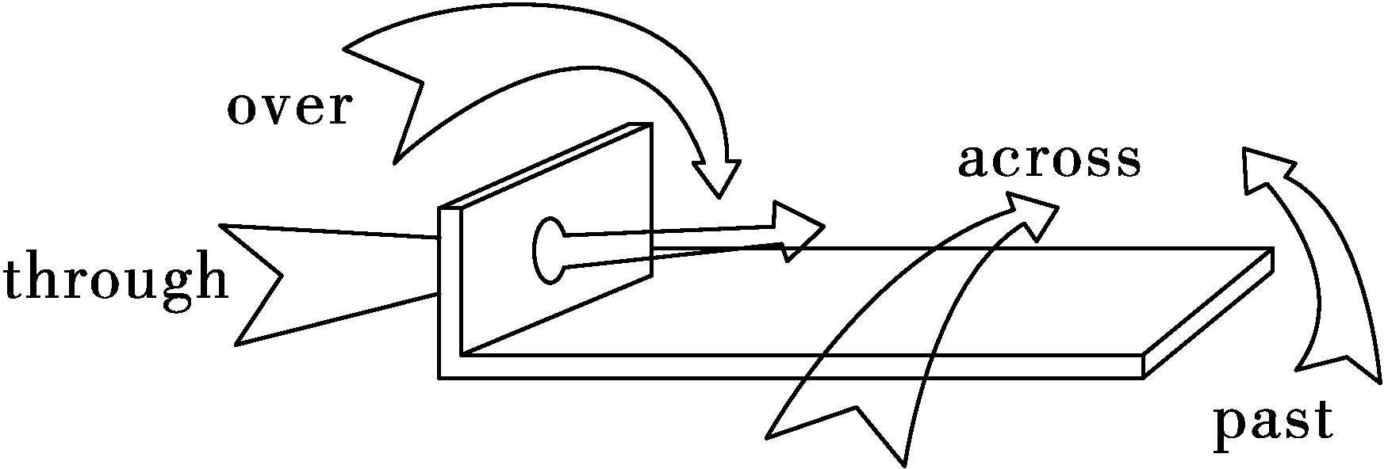
如: ①When the little kid saw his mother, he quicklypushed his way through the crowd to get to her.
②The bridge was built over the river five years ago, and it was more convenient for the local students to go to school.

Slide 62
2.There is a bird singing ___the tree.
There are some apples ____ the tree.
in
（外界到树上的）
on
（长在树上的）
3.above/ below
如：他住在我楼上/楼下二层楼。
He lives two floors above/ below me.

Slide 63
语法加油站
学以致用，各个击破语法点
一、单项选择。
1. — Mom, where is my soccer ball?
—It’s ____ the floor ____ your bed.
A. under; on B. on; under
C. in; on D. at; in
2. Look at the wall. There are some pictures ____ it.
A. in B. on C. to D. at
3. Are they ________ a factory or _______ a farm?
A. in; in B. on; on C. in; on D. on; in

Slide 64
4.Uncle Lee lives two floors_____ me. I live on the 7th floor, and he lives on the 9th.
A. under B. over C. above D. below
5.To get to the town, you have to walk ____ seven bridges _____ the rivers.
A. across, over B. over, past
C. over, across D. across, cross

Slide 65
6.What a sunny day! Let’s go boating ___ the lake, shall we? A. on B. in C. over D. above
7. Don’t stand __________ us, or we can’t see the film clearly.
A. in front of B. in the front of
C. beside D. behind

Slide 66
4
写作大练兵

Slide 67
写作大练兵
An invitation letter for a birthday party
Lucy will have a party in Hongmei Park. She wants to write an invitation letter .
Who ? | 朋友 同学
When ? | 四月二十六日 周六上午8点
What ? | 准备饮料和食物 划船、野餐、做游戏
Where ? | Hongmei 公园

Slide 68
How to write an invitation letter
1.Greetings.
Beginning:
We are going to have a…party ./ I’m happy to… /I’d like to…
Main body:
Time of the party/ Place of the party / What to do / eat at the party / Something else about the party
2.
Ending:
We hope …./ I am looking forward to…
3. signature

Slide 69
Class 8 , Grade 7 Minghai Middle School
Rudong
21th April
Dear_______
We are happy to invite you to ____________________________________________________________________________________________________________________________________________________________________________________________________________________________
Yours faithfully
____________
写作大练兵

Slide 70

This is how you get to Hongmei Park from my school.
My school
Tongjiang Road
Tongjiang Road
Hongmei Park
Darenfa
supermarket
Guanhe Road
Yanling Road
Hongmei Park
Hongmei Bridge

Slide 71
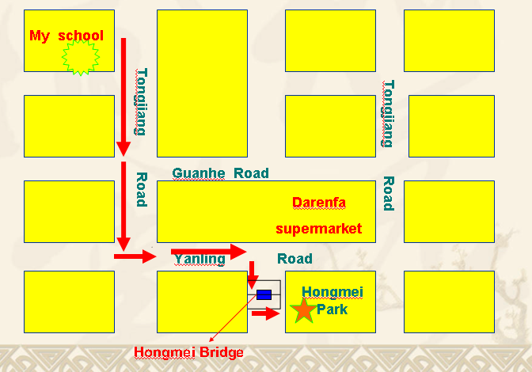
An invitation letter as a whole
This is how we get there.
Class 8 , Grade 7 Minghai Middle School Rudong
21th April
Dear _____
We are happy to invite you…
……………………………………
……………………………………
……………………………………
……………………………………
Yours faithfully
________
This is the way to Hongmei Park.
……………………………………………………………………………………
………………………………………………………………………………………………………………………………………………………………………….
.
main body
the route

Slide 72
写作大练兵
Writing Tips:
1.审题要仔细，行文要正确；
2.语言要严谨，发挥要适当；
3.时态要准确，人称多注意;
4.书写要规范，成文多查看；

Slide 73

Show time

Slide 74
写作： 你叫王冰，你将与本周六在家中举办生日宴会，你想邀请你的同学李宁来你家做客。请根据以下信息写一封邀请函，并告诉他怎么到你家。 1.时间：周六下午2点,M ay 20; 地点:王冰家
2.准备了许多美食；歌舞 游戏 活动
3.路线：从你家出来，右转，一直向前走，在第二个路口向右转，继续走，经过一个公交汽车站台，你会看到一个银行，我家就在银行旁边。
Dear Li Ning :
I’m happy to invite you to my birthday party at home. ______ ______ ______ ______ ______ ______ ______ ______ ________ ______ ______ ______ _______________________
I’m looking forward to seeing you at the party .
Best wishes
Wang Bing

Slide 75




Show your invitation letter.

Slide 76
Dear Li Ning :
I’m happy to invite you to my birthday party at home . The party starts at 2 on Saturday afternoon of May 20 . My parents will prepare plenty of nice food and drinks for us. We will also dance and play games .
This is the way to my home. Get out of your home ,turn right and walk straight on. Take the second turning on the right and walk on .walk past a bus stop and you will see a bank .My home is next to the bank.
I’m looking forward to seeing you at the party
Best wishes
Wang Bing

Slide 77


1.Finish your invitation.
2. Finish your worksheet.

