Slide 1

NUTRIPLAN– AN AI ENABLED NUTRITION ANALYZER
GE19612 – PROFESSIONAL READINESS FOR INNOVATION,
EMPLOYABILITY AND ENTREPRENEURSHIP
Submitted by :
JANANI A 2116210701085
JANANI PRIYA N 2116210701086
KANIMOZHI A 2116210701104
Supervisor :
Dr . K.Anand M.E.,Ph.D.,
Professor
Department of Computer Science and Engineering
Rajalakshmi Engineering College
Thandalam,
Chennai-602105.

Slide 2
ABSTRACT
This project aims to create an AI-driven Nutrition Analyzer using Python's flask framework. The primary objective is to develop an adaptive AI agent capable of autonomously learning and improving the UI for the fitness enthusiasts. Embark on your personalized fitness journey with our AI-enabled Nutrition Analyzer, designed for enthusiasts striving towards their wellness goals. Utilizing Python with the Flask framework, our platform seamlessly integrates nutritional data analysis and personalized fitness recommendations, empowering users to regulate and achieve their overall fitness objectives. Through a single-page interface, users access comprehensive reports outlining recommended meals, portion sizes, nutrient breakdowns, and suggested exercise routines. Our intuitive design ensures accessibility and ease of navigation, allowing users to seamlessly integrate our recommendations into their daily lives. With AI-driven analysis, our Fitness Nutrition evolves alongside users, adapting to their progress and preferences over time. Whether a beginner or seasoned fitness enthusiast, our platform provides the guidance and motivation needed to unlock your full potential and achieve lasting fitness success.

Slide 3
PROBLEM STATEMENT
The challenge at hand is to develop an AI-enabled Nutrition Analyzer tailored for fitness enthusiasts aiming to regulate their overall fitness goals. In an increasingly health-conscious society, individuals encounter significant hurdles in navigating the myriad of information and recommendations available. The lack of personalized guidance often leads to confusion and frustration, hindering progress towards achieving optimal fitness levels. Leveraging the capabilities of Python with the Flask framework, the objective is to create a robust platform capable of seamlessly gathering nutritional details from users and generating tailored recommendations for diet and exercise. This project aims to address the pressing need for a comprehensive and user-friendly solution that empowers individuals to make informed decisions and successfully navigate their fitness journeys with efficacy and confidence.

Slide 4
AIM AND OBJECTIVES
Aim:
The aim of the AI-driven Nutrition Analyzer using Python's Flask framework project, is to develop an primary objective of creating an adaptive AI agent capable of autonomously learning and improving the user interface for fitness enthusiasts.
Objectives:
Nutrition Analyzer
Adapting to their progress
Preferences over time

Slide 5
LITRETURE SURVEY
(Zhou et al., 2012)This study examined how dietary vitamin C levels affect juvenile cobia's growth, immune responses, and health. Fish on the basal diet, lacking vitamin C, showed signs of deficiency and poorer growth compared to those on supplemented diets. Survival rates correlated with vitamin C levels, with higher rates in supplemented groups. Liver vitamin C levels rose with dietary intake, but liver health, indicated by TBARS, wasn't affected. Immune markers like lysozyme and SOD were higher in supplemented groups. Glucose, triglycerides, and hematologic parameters improved with vitamin C. Survival against Vibrio harveyi increased with vitamin C up to 96.6 mg/kg, plateauing after. These results highlight the crucial role of dietary vitamin C in cobia's growth, immunity, and survival.
(W. J. MAENG and R. L. BALDWIN et al., 2019)In a study conducted on a fistulated Jersey cow fed a purified diet with urea as the sole nitrogen source, ruminal fermentation dynamics were elucidated. With an estimated rumen volume of 59.8 liters, turnover time and rate of passage of rumen contents were calculated at 33.4 hours and 1.8 liters per hour, respectively. Glucose, starch, and cellulose exhibited distinct turnover and fermentation times, with glucose disappearing rapidly within an hour, while starch and cellulose displayed longer durations of 4.7 and 14.2 hours, respectively.

Slide 6
(Lucy et al., 1917)This study reviewed probiotics for dairy calves using data from 90 manuscripts (97 trials) retrieved from five electronic databases up to October 2018. Most studies were conducted in Asia between 2008 and 2018. Lactobacillus spp., Bacillus spp., and Saccharomyces spp. were the most evaluated genera. Probiotics were administered to calves via various methods depending on age, with a focus on preweaned calves. Despite consistent evaluation of calf performance, health outcomes varied widely across studies. Standardized health measurement guidelines are needed for future research. Funding was provided by CDFA–AUS project.
This study(Ferreira-Santos et al., 2020) aimed to assess the impact of a lycopene-supplemented diet on fructose-induced metabolic syndrome in male Wistar rats. Rats consuming a normal diet with 20% fructose (F) experienced increased blood pressure, cardiac hypertrophy, endothelial dysfunction, and metabolic disturbances. Those concurrently treated with 0.01% lycopene (FL) showed significant attenuation of hypertension, endothelial dysfunction, and cardiac hypertrophy. Lycopene treatment did not affect rats on a standard diet (C, L groups). Additionally, lycopene improved insulin resistance, dyslipidemia, liver enlargement, intraperitoneal fat accumulation, and oxidative stress. These findings suggest that lycopene may effectively mitigate the pathophysiological effects of fructose-induced metabolic syndrome.

Slide 7
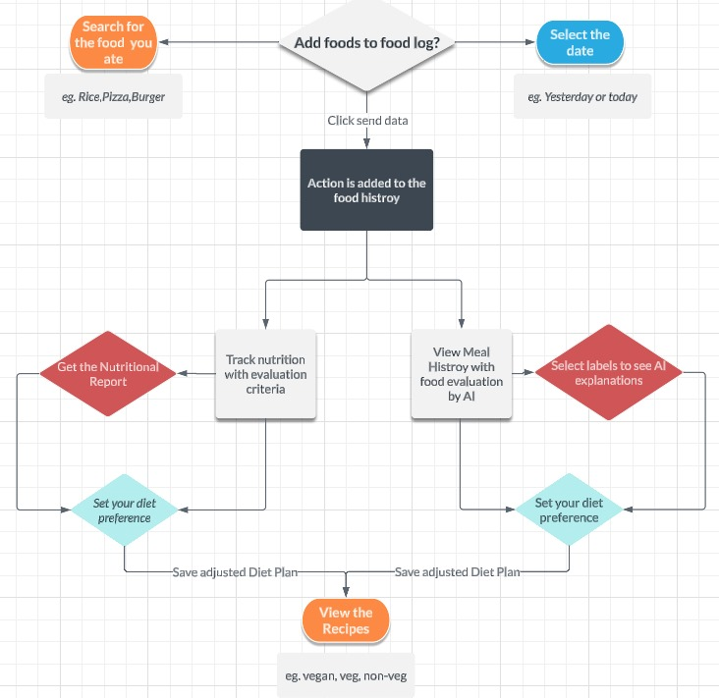
ARCHITECTURE DIAGRAM

Slide 8
Framework Used
FLASK
Why Flask?
Light weight
Easy to learn
Develops web applications in Python

Slide 9
NLP(NATURAL LANGUAGE PROCCESING) API
How It Works?
User Input:The user enters a query containing multiple food items into a form on your website.
API Call: Your application sends this query to the Nutritionix NLP API.
Parsing and Response: The API processes the query, extracts the food items, and returns their nutritional information.
Logging the Data: The application then logs this information into the user's food log.

Slide 10
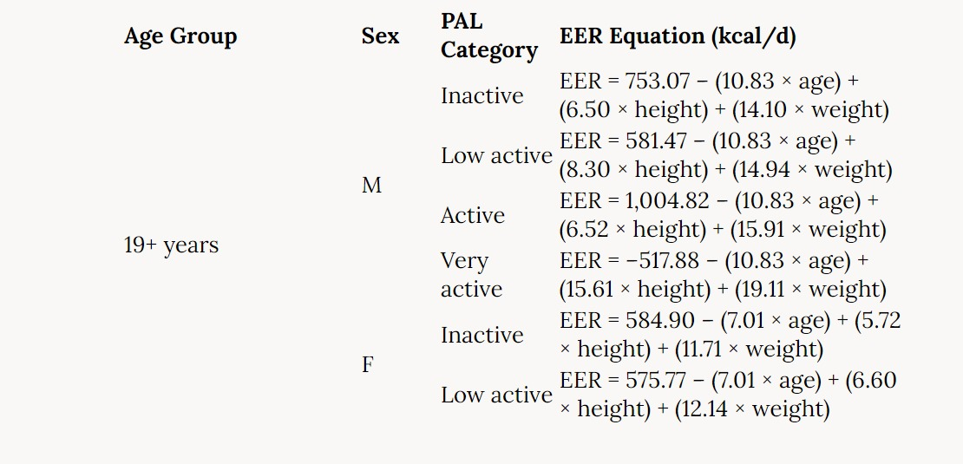
EER EQUATION
EER(Estimated Energy Requirement)
The EER equation, which considers a person's age, weight, height, and amount of physical activity, is used to determine how much energy is needed to maintain their present body weight. The formula is as follows:
EER is equal to 354 - 6.91 x age + [PA x 9.361 x weight + 726 x height] (PA).

Slide 11
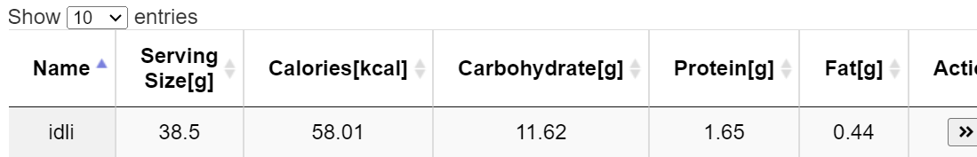
MODULE DESCRIPTION
User Interface Module:
This page allows users to add foods to their food log.
This will then add the food items to the results datatable.

Slide 12
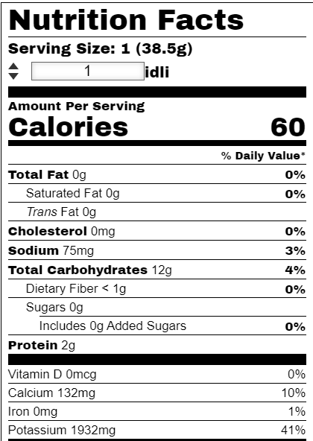
Finally, clicking the double arrow icon will propogate the nutrition facts to the nutrition label, and the user can select the time and date to add the food to the food log.
When searching for foods, it will also
add the food to our local database.
A feature extraction algorithm is run to
label the foods as High/Low in its
macronutrient contents.

Slide 13
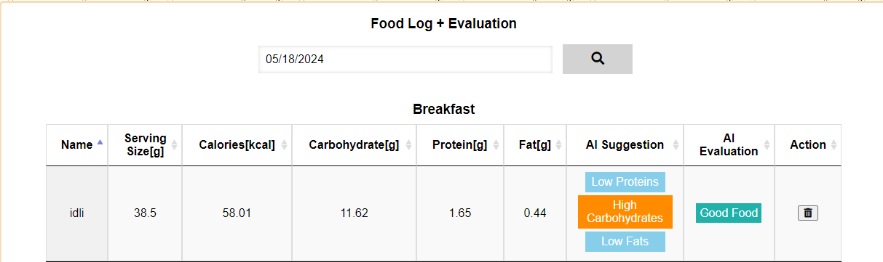
MODULE DESCRIPTION
Nutritional Data Analysis Module:
This page shows the user food history for the selected day. After loading the data, the user can also delete items from their history by pressing the delete icon.
Feedback is incorporated by adding the labels in the history tab. When clicking on the labels, the decision tree algorithm is displayed to show the user how it came upon this label to incorporate explainable AI.

Slide 14
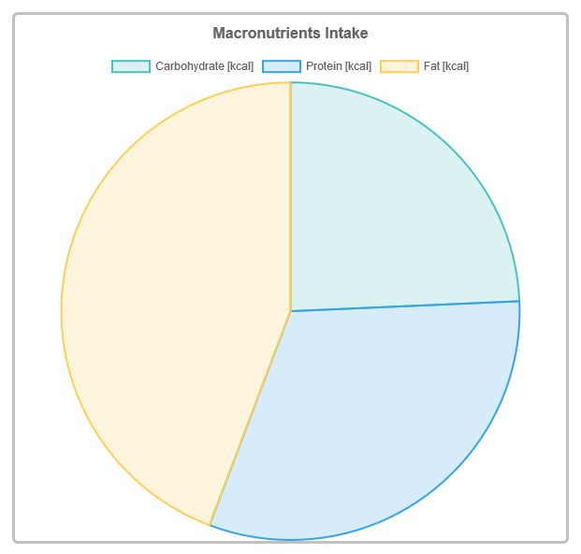
MODULE DESCRIPTION
Evolutionary Learning Module:
This page shows the macronutrient breakdown for the selected day. For example, the user can select a day and then a type of graph[8] to show the macronutrient breakdown for that day.

Slide 15
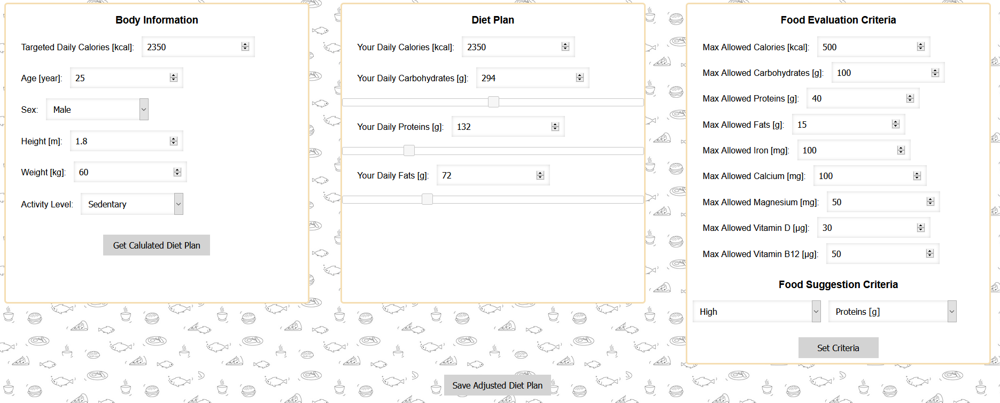
MODULE DESCRIPTION
AI Agent Module:
This page allows the user to develop their own user preferences/diet plan. Recommended values are given, and the user can adjust macronutrient needs as necessary using the sliders.

Slide 16
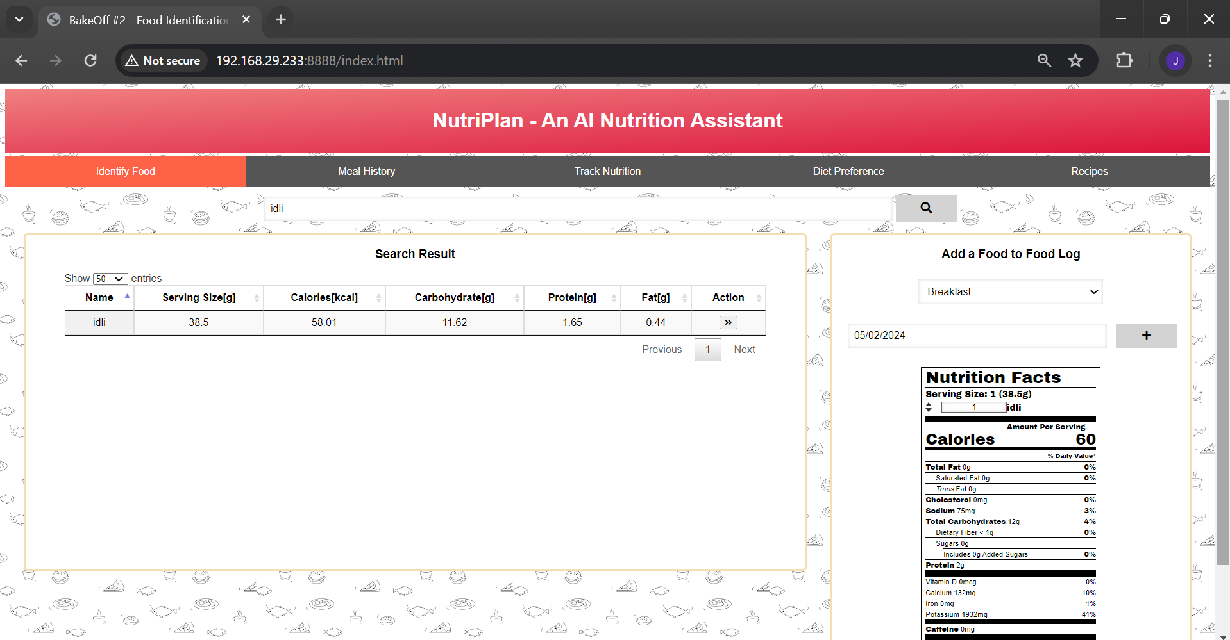
RESULTS
INDEX PAGE

Slide 17
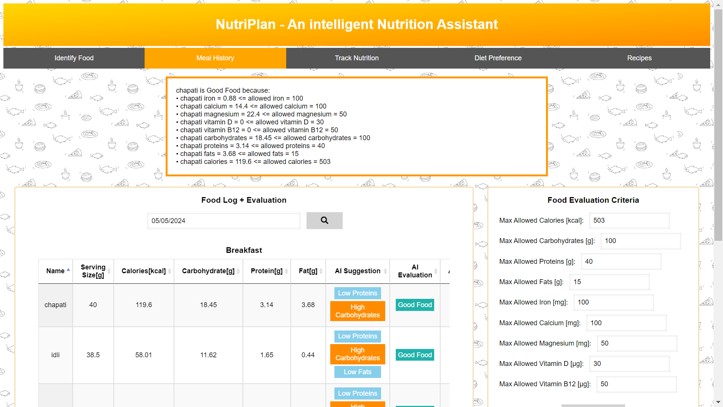
RESULTS
MEAL HISTORY

Slide 18
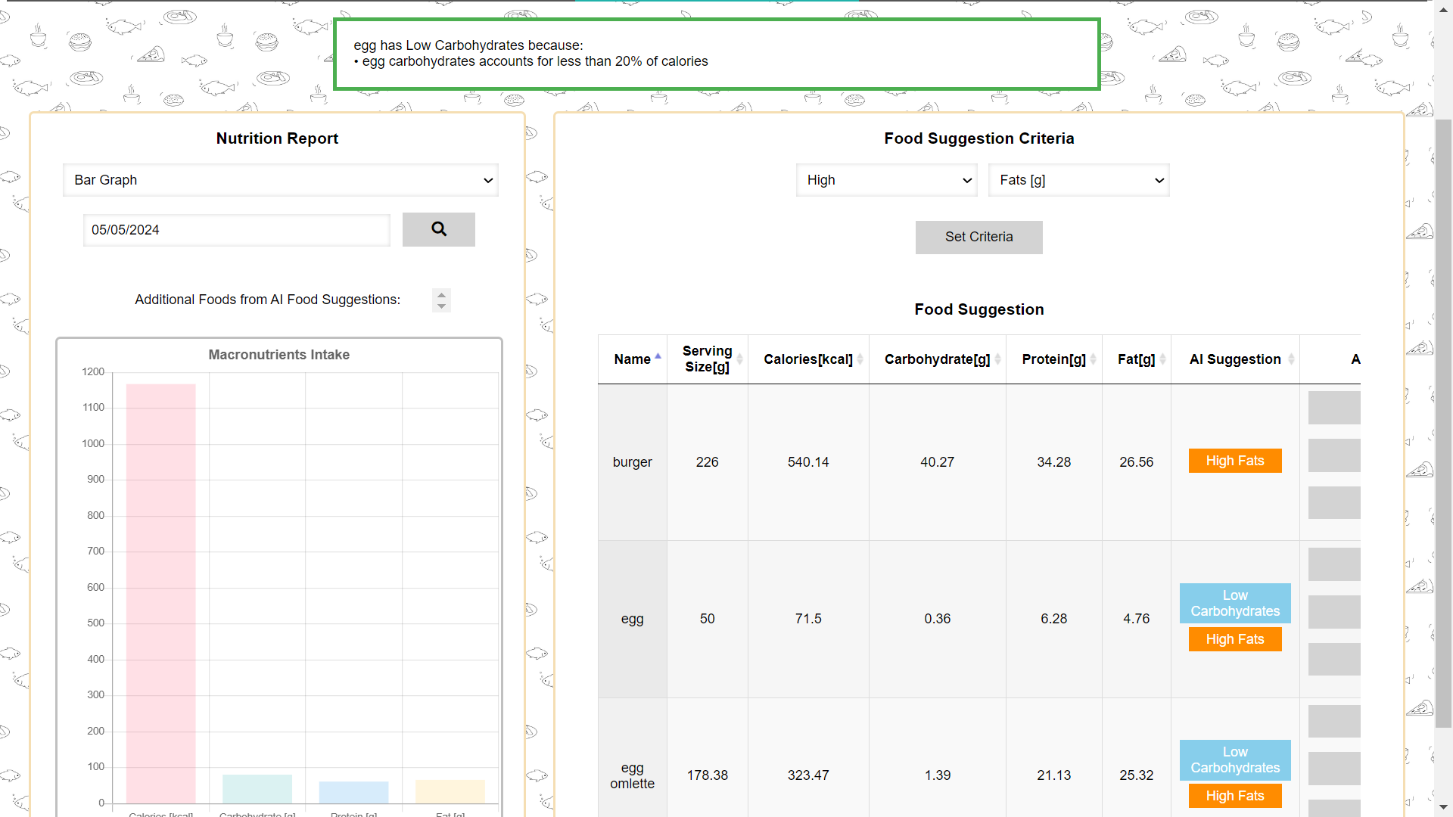
RESULTS
TRACK NUTRITION

Slide 19
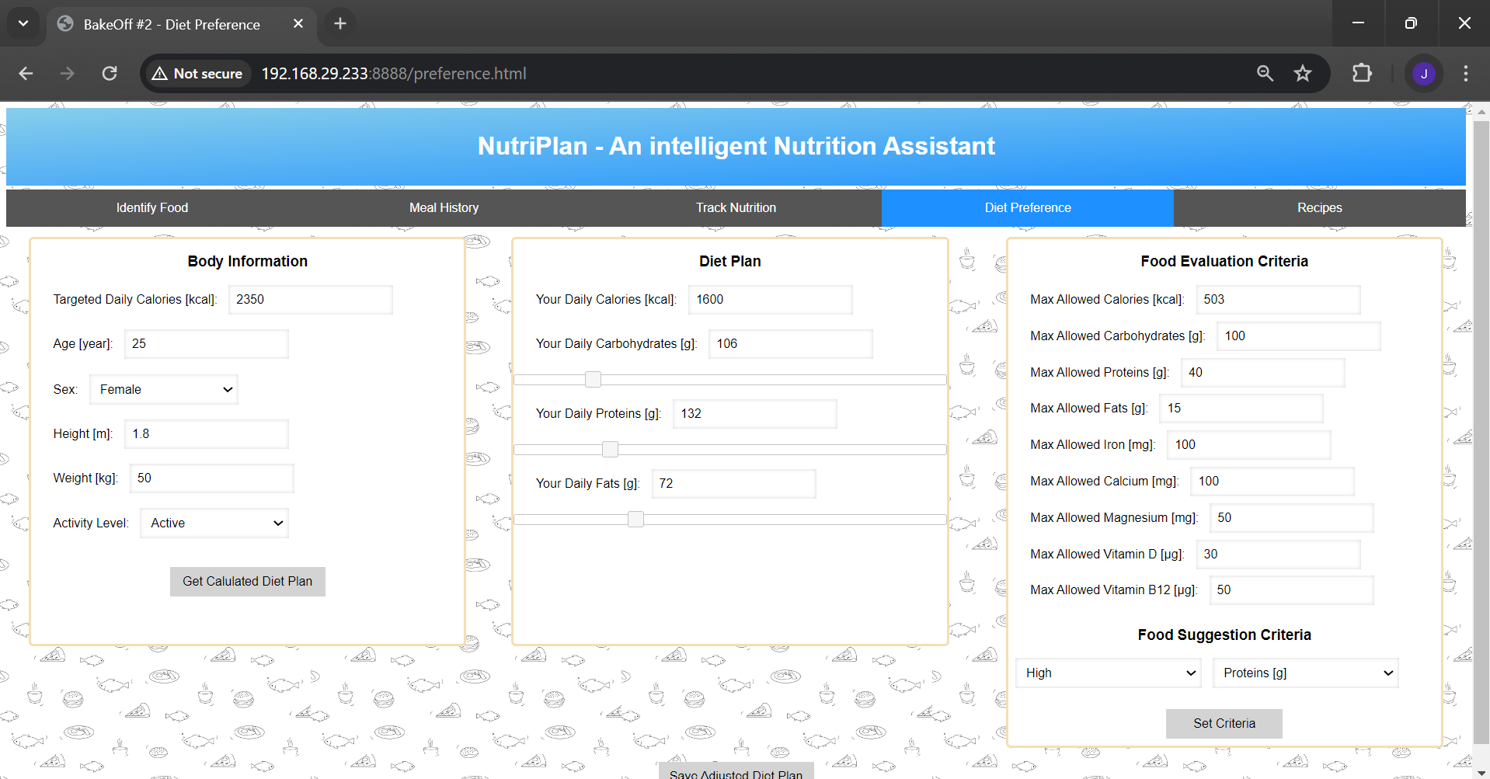
RESULTS
DIET PREFERENCES

Slide 20
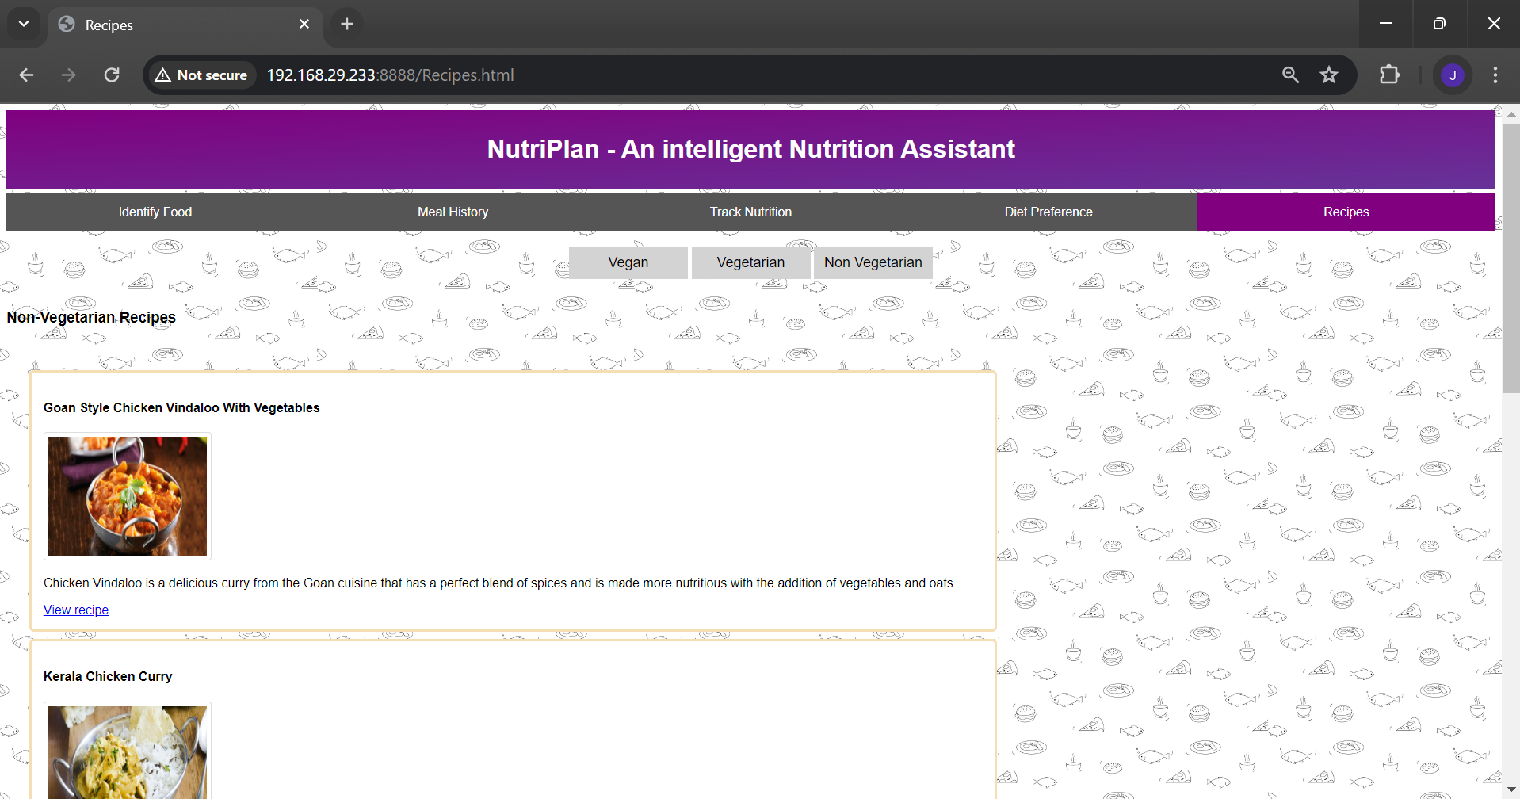
RESULTS
RECIPES

Slide 21
CONCLUSION
The adaptive nature of the AI agent ensures that the platform evolves alongside users, continually learning and improving based on their progress and preferences. Whether someone is just starting their fitness journey or is a seasoned enthusiast, the Fitness Analyzer provides the guidance and motivation needed to achieve lasting success. Overall, this project embodies the intersection of technology and wellness, offering a powerful tool to support individuals in reaching their fitness goals and optimizing their overall well-being.

Slide 22
REFERENCES
1.Aldian, D., Harisa, L. D., Mitsuishi, H., Tian, K., Iwasawa, A., & Yayota, M. (2023). Diverse forage improves lipid metabolism and antioxidant capacity in goats, as revealed by metabolomics. Animal, 17(10). https://doi.org/10.1016/j.animal.2023.100981
2.Chen, X., Duan, R., Shen, Y., & Jiang, H. (2024). Design and evaluation of an intelligent physical examination system in improving the satisfaction of patients with chronic disease. Heliyon, 10(1). https://doi.org/10.1016/j.heliyon.2023.e23906
3.Elis, S., Desmarchais, A., Freret, S., Maillard, V., Labas, V., Cognié, J., Briant, E., Hivelin, C., Dupont, J., & Uzbekova, S. (2016). Effect of a long-chain n-3 polyunsaturated fatty acid–enriched diet on adipose tissue lipid profiles and gene expression in Holstein dairy cows. Journal of Dairy Science, 99(12), 10109–10127. https://doi.org/10.3168/jds.2016-11052

Slide 23
Thank You

