Slide 1
Note: The data and information in this document is reflective of a hypothetical situation and client. This document is to be used for KPMG Virtual Internship purposes only.
Sprocket Central Pty Ltd
Data analytics approach
Jaya Devi Naraharisetty
Data Analyst Virtual Intern

Slide 2
Note: The data and information in this document is reflective of a hypothetical situation and client. This document is to be used for KPMG Virtual Internship purposes only.
Agenda
Introduction
Data Exploration
Model Development
Interpretation

Slide 3
Note: The data and information in this document is reflective of a hypothetical situation and client. This document is to be used for KPMG Virtual Internship purposes only.
Introduction
Data Quality Assessment
 | Customer Demographic | Customer Address | Transaction Data
Accuracy | DOB: Inaccuracy Job Industry Category: Misspelling |  | Standard Cost: $ missing
Completeness | Last Name: Blanks DOB: Blanks Job Title: Blanks Job Industry Category: Blanks Tenure: Blanks Customer Id: Not sync | Customer Id: Not sync | Online Order: Blanks Brand: Blanks Product Line: Blanks Product Class: Blanks Product Size: Blanks Standard Cost: Blanks Product First Sold Date: Blanks Customer Id: Not sync
Consistency | Gender: Inconsistency | State: Inconsistency
Currency | Deceased Customers: Filter Out
Relevancy | Default: Exclude field |  | Order Status: Exclude Cancelled
Validity |  |  | Product First Sold Date: Format

Slide 4
Note: The data and information in this document is reflective of a hypothetical situation and client. This document is to be used for KPMG Virtual Internship purposes only.
Introduction
Data Cleaning
Data with missing fields has been dropped
Age class, last purchase (Days ago) and profit fields have been added.
Records pertaining to deceased customers have been dropped.
Transactions more than a year have been dropped.
Join keys between tables are considered.

Slide 5
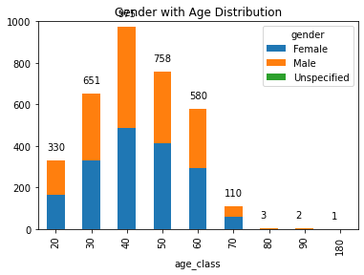
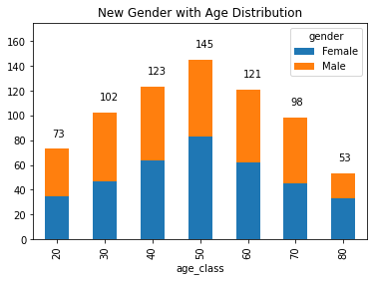
Note: The data and information in this document is reflective of a hypothetical situation and client. This document is to be used for KPMG Virtual Internship purposes only.
Data Exploration
Gender with Age Distribution

Slide 6
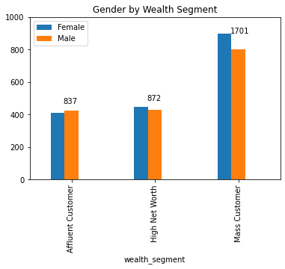
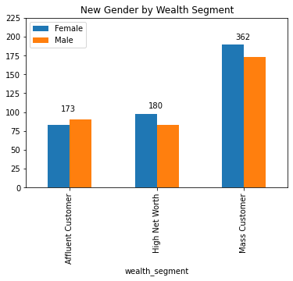
Note: The data and information in this document is reflective of a hypothetical situation and client. This document is to be used for KPMG Virtual Internship purposes only.
Data Exploration
Gender with Wealth Segment

Slide 7
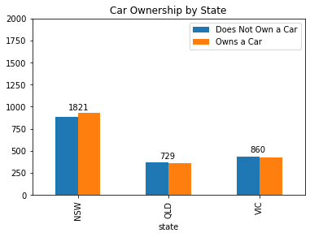
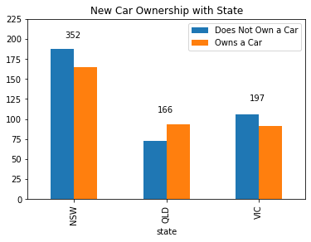
Note: The data and information in this document is reflective of a hypothetical situation and client. This document is to be used for KPMG Virtual Internship purposes only.
Data Exploration
Car Ownership with State

Slide 8
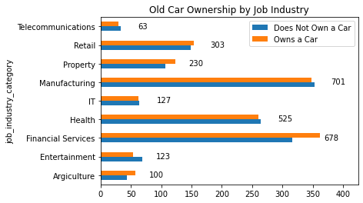
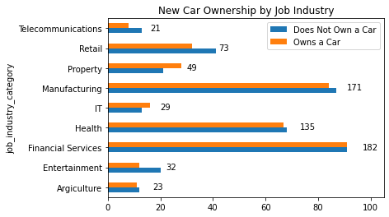
Note: The data and information in this document is reflective of a hypothetical situation and client. This document is to be used for KPMG Virtual Internship purposes only.
Data Exploration
Car Ownership with Job Industry

Slide 9
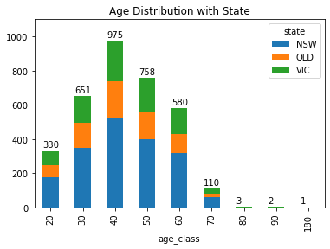
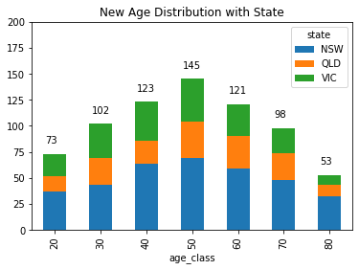
Note: The data and information in this document is reflective of a hypothetical situation and client. This document is to be used for KPMG Virtual Internship purposes only.
Data Exploration
Age Distribution with state

Slide 10
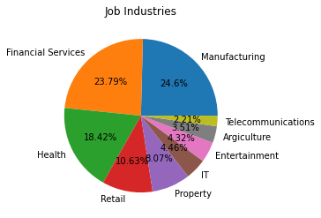
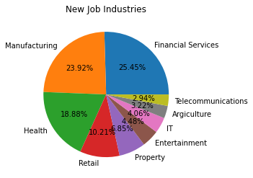
Note: The data and information in this document is reflective of a hypothetical situation and client. This document is to be used for KPMG Virtual Internship purposes only.
Data Exploration
Job Industry Diversity

Slide 11
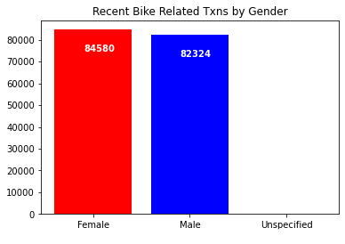
Note: The data and information in this document is reflective of a hypothetical situation and client. This document is to be used for KPMG Virtual Internship purposes only.
Data Exploration
Recent Transaction

Slide 12
Note: The data and information in this document is reflective of a hypothetical situation and client. This document is to be used for KPMG Virtual Internship purposes only.
Model Development
RFM Analysis
Recency
The last day on which the customer performed a transaction was taken as the recency parameter.
Customers are divided into 4 quartiles and given a r_score.
Frequency
The frequency of transactions done by a customer was taken as frequency parameter.
Customers are divided into 4 quartiles and given a f_score.
Monetary_Value
The average profit per customer was taken as the monetary value parameter.
Customers are divided into 4 quartiles and given a m_score.

Slide 13
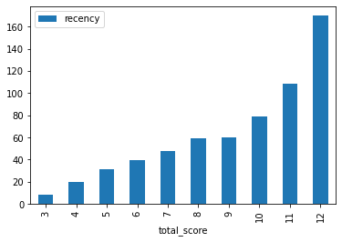
Note: The data and information in this document is reflective of a hypothetical situation and client. This document is to be used for KPMG Virtual Internship purposes only.
Model Development
RFM Analysis

Slide 14
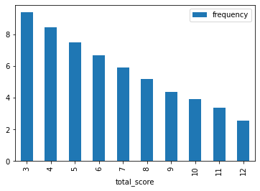
Note: The data and information in this document is reflective of a hypothetical situation and client. This document is to be used for KPMG Virtual Internship purposes only.
Model Development
RFM Analysis

Slide 15
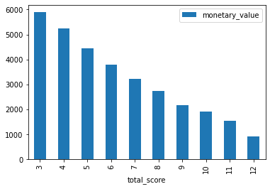
Note: The data and information in this document is reflective of a hypothetical situation and client. This document is to be used for KPMG Virtual Internship purposes only.
Model Development
RFM Analysis

Slide 16
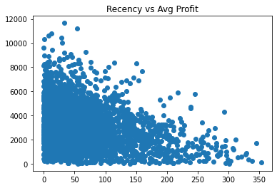
Note: The data and information in this document is reflective of a hypothetical situation and client. This document is to be used for KPMG Virtual Internship purposes only.
Model Development
RFM Analysis

Slide 17
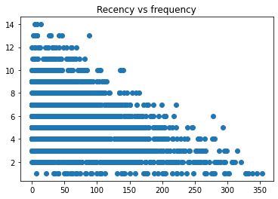
Note: The data and information in this document is reflective of a hypothetical situation and client. This document is to be used for KPMG Virtual Internship purposes only.
Model Development
RFM Analysis

Slide 18
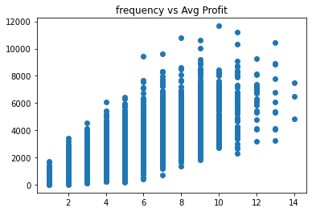
Note: The data and information in this document is reflective of a hypothetical situation and client. This document is to be used for KPMG Virtual Internship purposes only.
Model Development
RFM Analysis

Slide 19
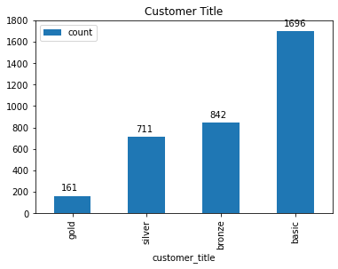
Note: The data and information in this document is reflective of a hypothetical situation and client. This document is to be used for KPMG Virtual Internship purposes only.
Model Development
RFM Analysis
Based on the RFM Class, four customer tiers were identified
Gold Class: These customers have recently made a purchase, are frequent and most profitable.
Silver Class
Bronze Class
Basic Class: These customers have not made any recent purchases and do not contribute majorly

Slide 20
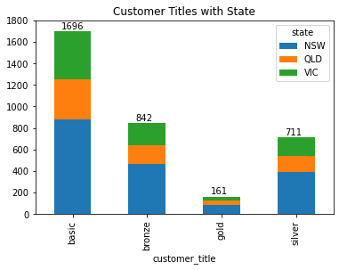
Note: The data and information in this document is reflective of a hypothetical situation and client. This document is to be used for KPMG Virtual Internship purposes only.
Interpretation
Customer Tiers by state

Slide 21
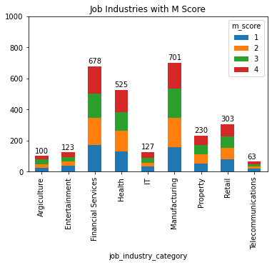
Note: The data and information in this document is reflective of a hypothetical situation and client. This document is to be used for KPMG Virtual Internship purposes only.
Interpretation
Profitable Job Industries

Slide 22
Note: The data and information in this document is reflective of a hypothetical situation and client. This document is to be used for KPMG Virtual Internship purposes only.
Interpretation
Customer Segments
Segment | RFM Score | Cumulative
Platinum | 3 | 161
Very Loyal | 4 | 291
Becoming Loyal | 5 | 358
Recent | 6 | 432
Average | 7 | 415
High Risk | 8 | 416
Evasive | 9 | 393
Losing | 10 | 343
Inactive | 11 | 303
Lost | 12 | 298

Slide 23
Note: The data and information in this document is reflective of a hypothetical situation and client. This document is to be used for KPMG Virtual Internship purposes only.
Interpretation
Targeting Methodology
Customers having high RFM score can be filtered and targeted
The customers who have made recent purchases are frequent and drive the most profits.

