Slide 1
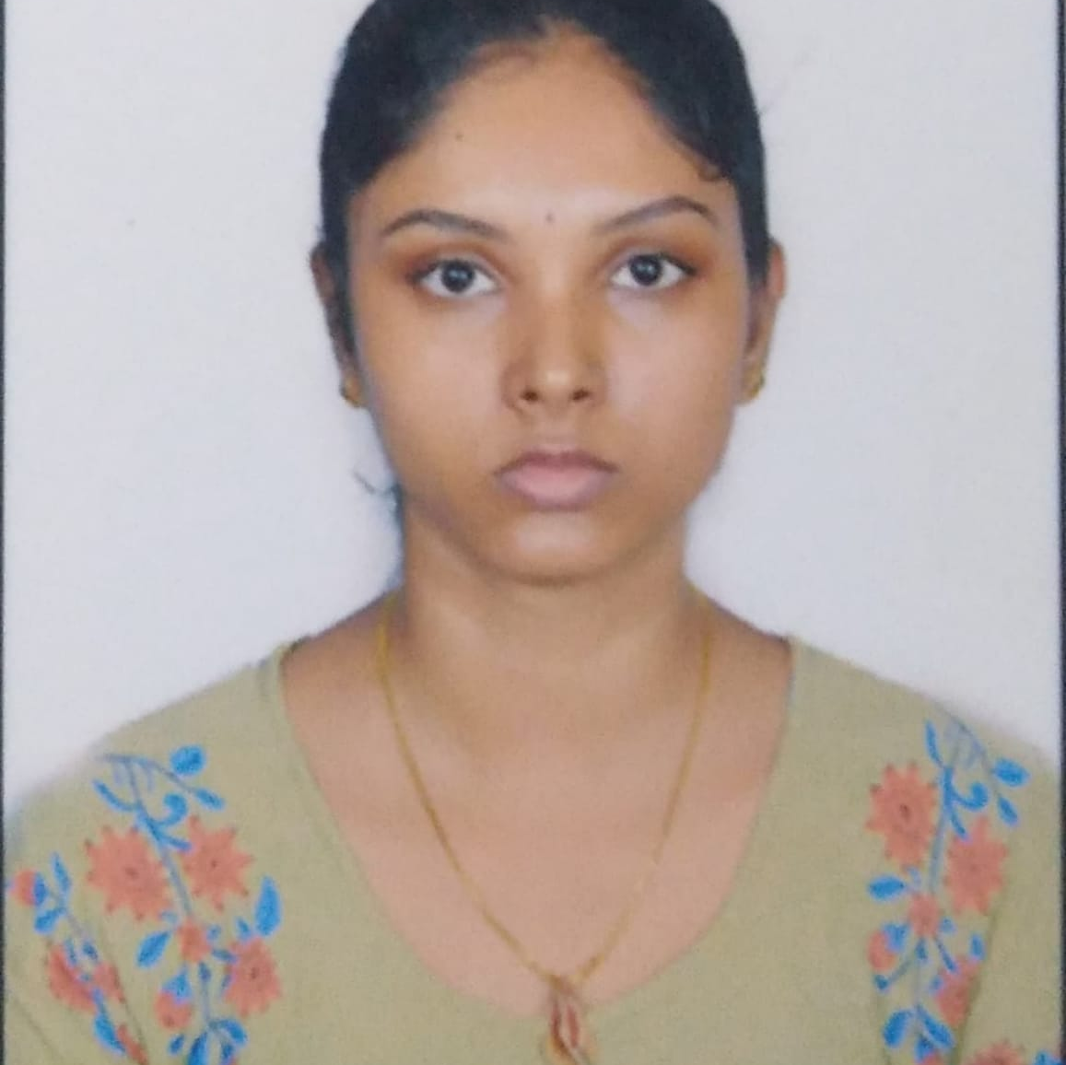



Nandini Jampala
Analyst/Software Engineer
Master of Computer Applications
Computer Science : 2017 – 2020
Bachelor of Sciences
Computer Science : 2014 - 2017
Skills Java 8 /J2EE
Spring Boot
Spring MVC
MERN Stack
NodeJS
MongoDB
Database
SQL database – MySQL
No SQL database – MongoDB
Web Technologies
HTML5
CSS3
Javascript
AddOns
Github
Maven
Postman
Additional Details
Leadership
Quick Learner
Team management
Bangalore
nandini.jampala@capgemini.com
9676800482
A4
Software Engineer who is Strong in design and integration with intuitive problem-solving skills. Passionate about implementing and launching new projects.
Ready to learn new technologies and implement them to further improve my knowledge.
Eager to work in a team of dedicated people and serve a key role in the enhancement and development of the project.
Has working knowledge on Angular and Java Microservice Development using Spring framework on an intermediate level.
Deals and Coupons Web Application
Completed end to end case study of Deals and Coupons Web Application along with JWT authentication, Swagger and payment testing using Braintree in MERN Stack. Material-UI and React Bootstrap used for user interface.
Check out my work on GitHub & Video Profile

