Slide 1

● FIRSTSELFIE STRATEGIC BRIEFING // 2026
FIRSTSELFIE // 2026
The End of Copycat Personal Branding
The 3-Star Architecture to engineer an uncopyable, compounding Identity Brand.
Your First Frame to a Million Faces.
99% of founder personal branding fails because it copies templates instead of engineering proprietary authority. This blueprint presents the systematic methodology proven across healthcare, wealth advisory, enterprise SaaS, and AI.
IDENTITY BRAND ARCHITECTURE
3-Star System · 26 Strategic Modules Engineered for Category Dominance @FIRSTSELFIE.IN
01 / 26
Notes:
Slide 01: Welcome the viewer. Introduce FirstSelfie 2026 Edition. Emphasize that generic, copycat personal branding is dead. We are presenting the 3-Star Architecture to engineer an uncopyable Identity Brand.

Slide 2
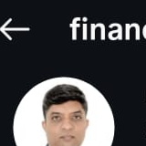
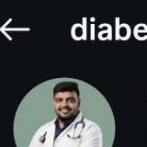

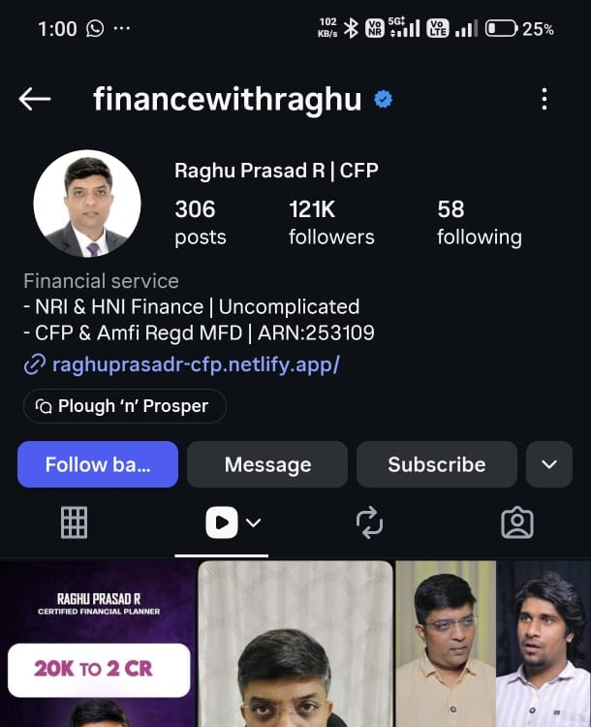
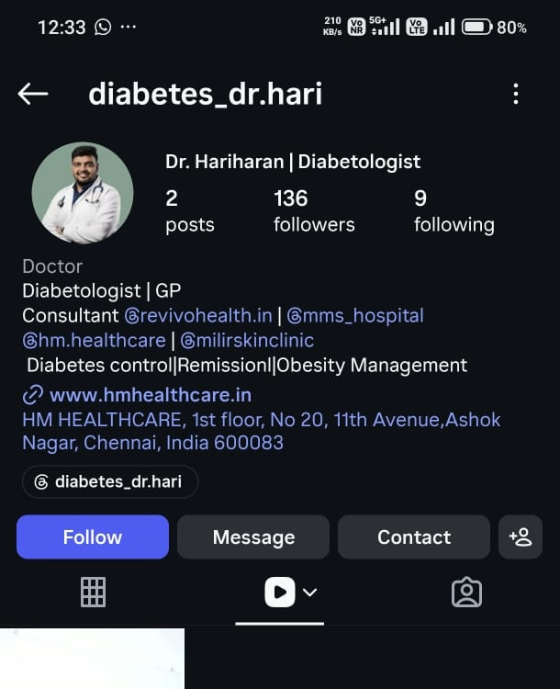
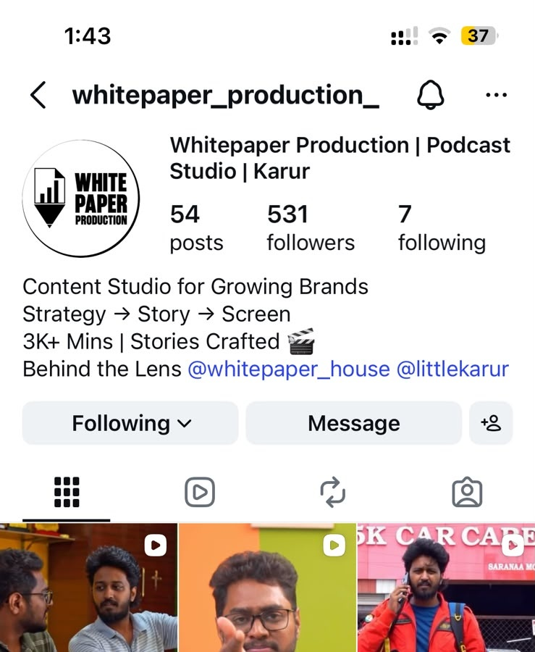
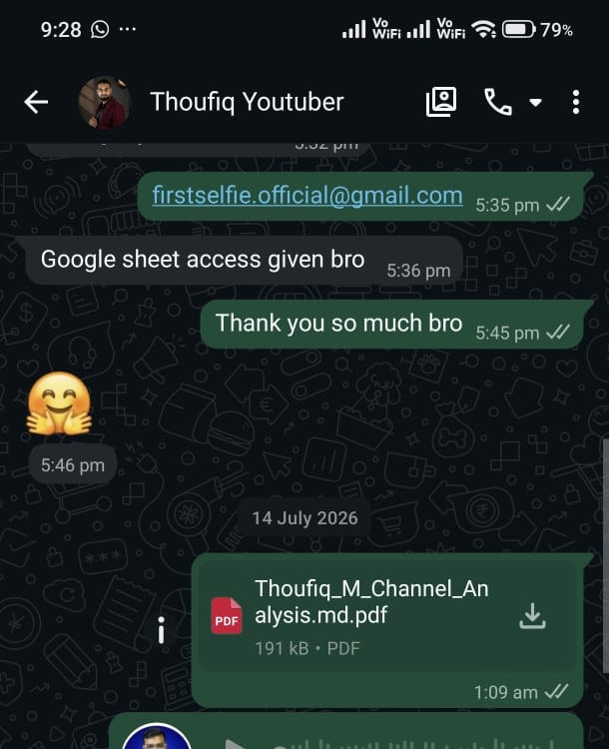
● CROSS-INDUSTRY PROOF OF CONCEPT
FIRSTSELFIE // 2026
Validated Across High-Ticket B2B, Tech, and Services
Scaled authority profiles proven across wealth, healthcare, enterprise AI, media, SaaS & luxury B2C.
Finance With Raghu
WEALTH ADVISORY
Dr. Hariharan
HEALTHCARE & SURGERY
White Paper House
CREATIVE AGENCY
WD
Wedding Dhanushya
LUXURY B2C
+45K HNW Followers · Retainers
Orthopedic Authority · Zero Ads
₹0 Ad Spend · 100% Inbound B2B
Viral Video IP · Premium Clients
NK
Nuke Code ✓
AI SYSTEMS & AUTOMATION
Founder-led media scaled pipeline for enterprise AI contracts.
SR
Sarathi ✓
TECH SAAS & PLATFORMS
Turnkey founder video engine replacing outbound SDRs.
DP
Deepan ✓
ENTERPRISE B2B ADVISORY
Polarizing category thesis positioning that commands retainers.
100%
INBOUND B2B
2 hrs
WEEKLY LOAD
Zero
COLD OUTREACH
02 / 26
Notes:
Slide 02: Walk through the multi-niche proof matrix. Highlight Finance With Raghu (+45K HNW followers), Dr. Hariharan (orthopedic surgeon authority), White Paper House (₹0 ad spend, 100% inbound B2B deals), and Wedding Dhanushya. Then touch on AI Systems (Nuke Code), SaaS (Sarathi), and B2B (Deepan).

Slide 3
● THE COMMODITY TRAP
FIRSTSELFIE // 2026
99% of Founder Content Looks Identical
The macro collapse of generic personal branding and why templates kill conversion.
PROBLEM 01
The Template Trap
Founders copy viral hooks, carousel layouts, and generic talking points. They gain superficial views but zero qualified inbound enterprise pipeline.
PROBLEM 02
Algorithm Volatility
Chasing trend audio and entertainment formats makes you hostage to algorithmic swings. You build an audience of spectators, not decision-makers.
SOLUTION: THE CODEX
Category Monopoly
An Identity Brand anchors to proprietary frameworks, polarizing conviction, and cinematic video proof that competitors cannot replicate.
03 / 26
Notes:
Slide 03: The Macro Shift. 99% of founder content looks identical. Explain the commodity trap and why attention without category authority produces zero pipeline.

Slide 4
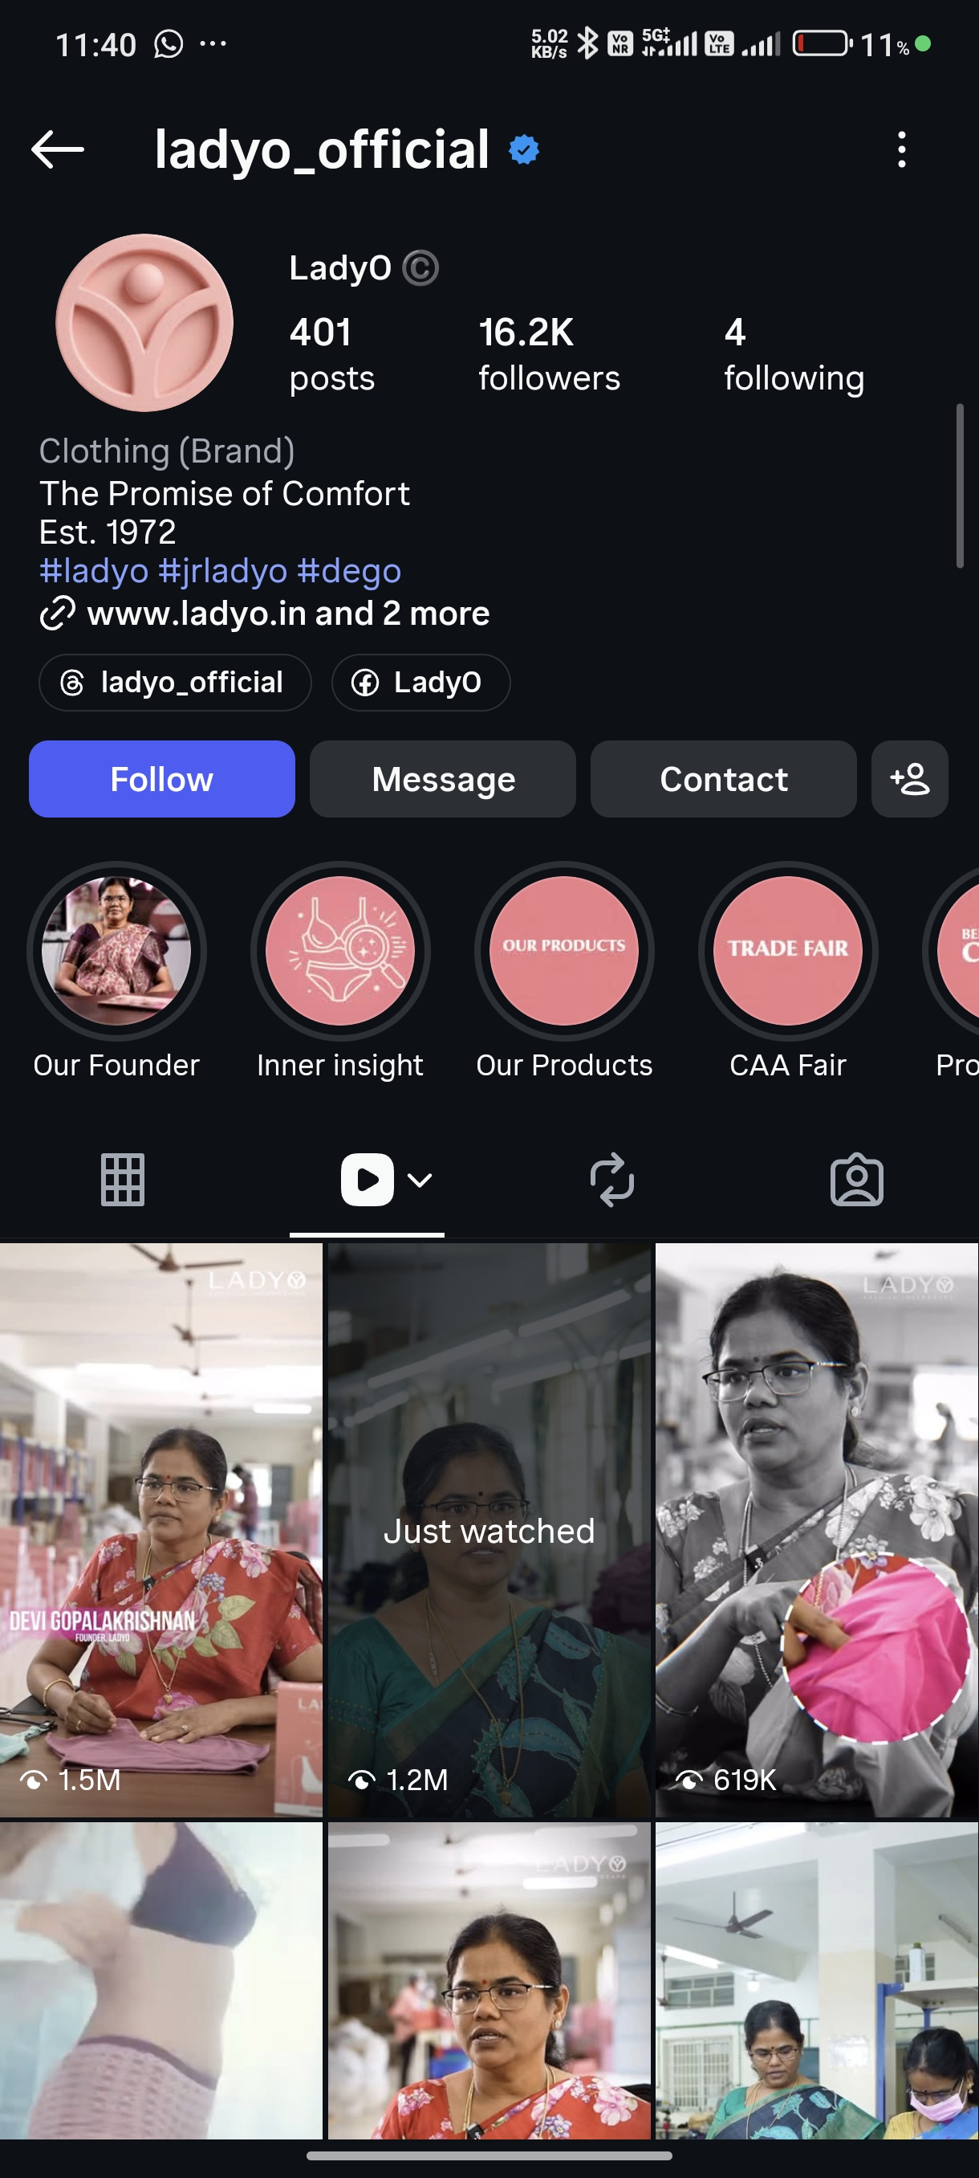
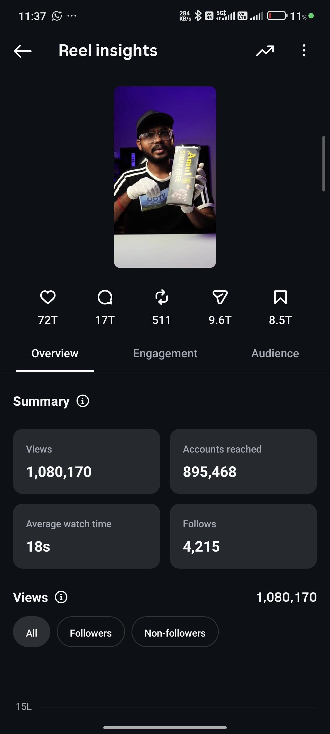
● ORIGINAL VS COPYCAT
FIRSTSELFIE // 2026
Plagiarism Is Everywhere. Identity Cannot Be Copied.
ORIGINAL THOUGHT LEADER
CHEAP COPYCAT DUPLICATOR
Original Category Position: • Engineered narrative structure • Real client results cited • Commands respect & high ticket sales • Zero template dependency
Shallow Repurposed Noise: • Word-for-word plagiarized hooks • Disconnected from actual operations • Audience sees right through it • ZERO business enterprise impact
04 / 26
Notes:
Slide 04: The Plagiarism Problem. Side-by-side comparison of genuine viral thought-leadership versus the cheap copycat carousels that flood feeds today.

Slide 5
● THE IDENTITY BRAND FORMULA
FIRSTSELFIE // 2026
Audience + Perception + Conversion = Category Monopoly
STAR 01
AUDIENCE ENGINE
Proprietary Video Distribution
High-velocity cinematic video assets tailored for organic reach across YouTube Shorts, Instagram Reels, and LinkedIn.
STAR 02
PERCEPTION CODEX
Uncopyable Belief Architecture
Polarizing category POVs, founder conviction frameworks, and executive positioning that commands immediate category authority.
STAR 03
APA CONVERSION MATRIX
Inbound Pipeline Funnels
Systematic comment & DM automation that transforms passive viewers directly into pre-sold discovery calls and retainers.
05 / 26
Notes:
Slide 05: The FirstSelfie Thesis. The Identity Brand Formula. Audience + Perception + Conversion = Category Monopoly.

Slide 6
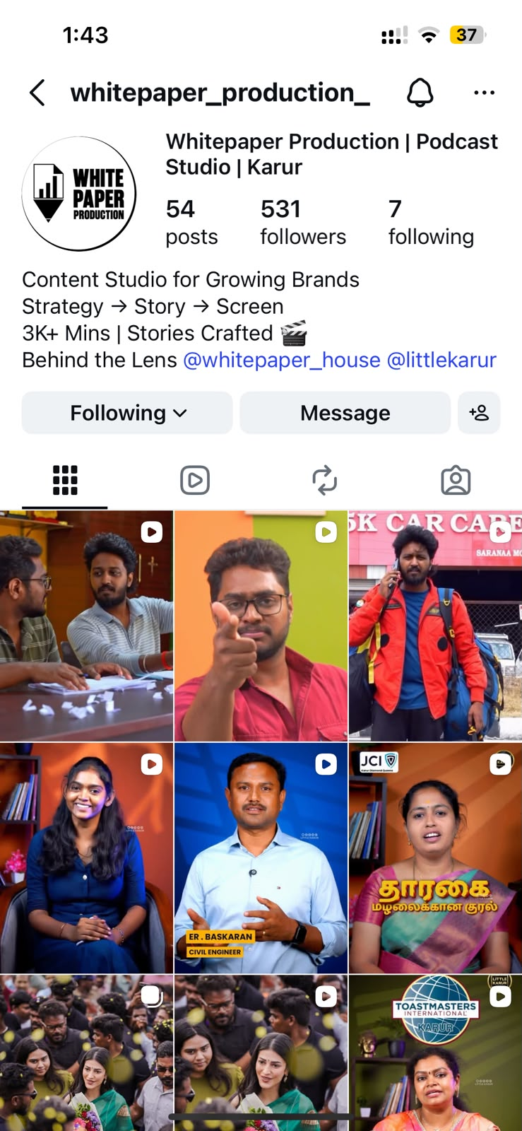
● AGENCY CASE STUDY
FIRSTSELFIE // 2026
How White Paper House Generated 100% Inbound B2B Deals
Scaling authority from 531 to 7,000+ followers with zero paid ads.
EXECUTIVE CASE STUDY
White Paper Production Agency
• ₹0 Paid Ad Spend: 100% of pipeline generated through founder video • High-Ticket Retainers: Converted enterprise production contracts • Authority Proof: Positioned as the premier content studio in Tamil Nadu • Turnkey Video Engine: Scaled output without founder burnout
₹0
AD SPEND REQUIRED
100%
INBOUND B2B PIPELINE
06 / 26
Notes:
Slide 06: Proof Case Study: White Paper House. Detail the 531+ to 7,000+ scaling journey, zero ad spend, and how founder authority drives enterprise contracts.

Slide 7
● 30-DAY EXECUTION ROADMAP
FIRSTSELFIE // 2026
Phase 1: Brand Codex & Visual Foundation
Days 01–15: Engineering uncopyable positioning and visual assets.
DAY 01–03
Positioning & Category Wedge
Identify the unique enemy, polarizing industry belief, and category claim.
DAY 04–07
Brand Identity & Visual Codex
Cinematic color grading, typographic hierarchy, lower-thirds, and visual signatures.
DAY 08–11
Narrative Pillar Architecture
Formulate the 4 core content pillars: Origin, Paradigm, Proof, and Mechanism.
DAY 12–15
Scripting & Studio Setup
Complete batch scripting for 15 high-impact reels and initial studio calibration.
07 / 26
Notes:
Slide 07: The 30-Day Launch Roadmap. Phase 1 Foundation: Visual identity, content codex, and positioning framework.

Slide 8
● 30-DAY EXECUTION ROADMAP
FIRSTSELFIE // 2026
Phase 2: Production Engine & Inbound Pipeline
Days 16–30: Scaling high-converting distribution and automated funnels.
DAY 16–18
Turnkey Film Shoot
A 2-hour high-efficiency recording sprint yielding 30+ pieces of syndicated video IP.
DAY 19–23
Cinematic Post-Production
Motion graphics, retention pacing, sound design, and micro-hook engineering.
DAY 24–27
Distribution Syndication
Deploying omni-channel across Instagram Reels, YouTube Shorts, and LinkedIn.
DAY 28–30
APA Lead Capture Matrix
Deploying comment triggers, direct DM qualification, and discovery call bookings.
08 / 26
Notes:
Slide 08: The 30-Day Roadmap Phase 2: Production, multi-platform syndication, and high-converting inbound funnels.

Slide 9
● PILLAR 1: THE IDENTITY CODEX
FIRSTSELFIE // 2026
The Belief Architecture That Makes You Immune to Competition
Why Most Founder Content Dies in the Algorithm:
When you post generic tips ('3 ways to scale your business'), you are indistinguishable from 10,000 other creators. The Identity Codex creates a distinct worldview that forces prospective clients to either strongly agree or disagree—eliminating lukewarm attention.
Key Codex Principles: • Uncopyable Perspective: Built around your specific operating scars and contrarian convictions. • Category Monopoly: Redefining the buying criteria so competitors appear obsolete. • Executive Presence: Speaking as a category architect, not a freelance vendor.
09 / 26
Notes:
Slide 09: Pillar 1 Introduction: The Identity Codex. Why your core belief system and category point-of-view must be uncopyable.

Slide 10
● CODEX ARCHITECTURE
FIRSTSELFIE // 2026
The 4 Pillars of Uncopyable Founder Narrative
PILLAR 01
The Common Enemy
Call out the broken industry status quo that your buyers are suffering from.
PILLAR 02
Proprietary Mechanism
Name and explain your unique framework that delivers predictable client ROI.
PILLAR 03
Operational Proof
Behind-the-scenes teardowns, client wins, and real metrics that validate authority.
PILLAR 04
Future Vision
Inspiring predictions on where the category is heading in 2026 and beyond.
10 / 26
Notes:
Slide 10: Codex Architecture. Breakdown of the 4 narrative pillars that make founder perspectives immune to commoditization.

Slide 11
● PERSUASION DYNAMICS
FIRSTSELFIE // 2026
Belief Shift Engineering: Turning Viewers Into Clients
OLD BELIEF (Prospect Friction)
• 'I can just run more paid ads to get customers.' • 'Cold outreach and SDR teams are enough.' • 'Personal branding is just for influencers and YouTubers.' • 'I don't have time to create daily content.'
NEW BELIEF (FirstSelfie Breakthrough)
• Paid ads CAC is skyrocketing; authority media has zero marginal ad cost. • Inbound founders command 3x higher retainers without chasing. • Founder Identity is the greatest asset an enterprise company holds. • With FirstSelfie, founders invest only 2 hours per week total.
11 / 26
Notes:
Slide 11: Belief Shift Engineering. Transforming passive scrollers into passionate brand advocates through polarizing industry truths.

Slide 12
● DISTRIBUTION RATIO
FIRSTSELFIE // 2026
The 40 / 30 / 20 / 10 Content Publishing Cadence
40%
Category Authority
Teardowns, operational conviction, and thought leadership.
30%
Proof & Validation
Client results, revenue case studies, and WhatsApp receipts.
20%
Belief Shift & POVs
Contrarian takes that dismantle competitor approaches.
10%
Founder Culture
High-taste lifestyle and behind-the-scenes building.
12 / 26
Notes:
Slide 12: Content Matrix & Formats. The exact distribution ratio: 40% Authority, 30% Proof/Case Study, 20% Category Shift, 10% Culture.

Slide 13
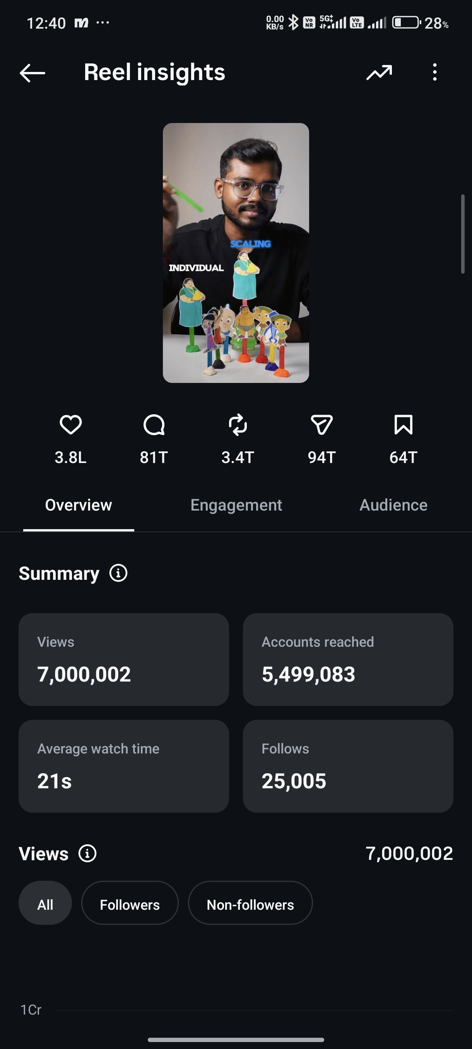
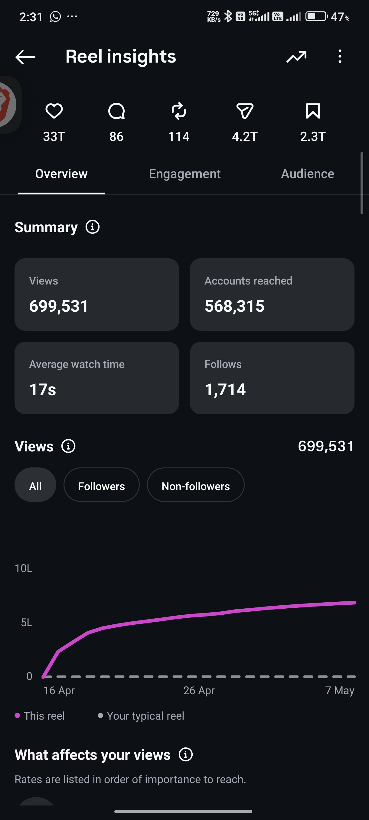
● PILLAR 2: THE MEDIA ENGINE
FIRSTSELFIE // 2026
Instagram Scaling Proof: 40.9K Followers & 11.0L Reach
High-velocity distribution calibrated for compounding organic audience.
13 / 26
Notes:
Slide 13: Pillar 2 Introduction: The Media Engine. Instagram and YouTube scaling proof: 40.9K followers, 11 Lakh accounts reached.

Slide 14
● ENGINE ARCHITECTURE
FIRSTSELFIE // 2026
HUD Status: Pillar 1 Codex Locked → Transitioning to Engine
01 CODEX
SYSTEM ENGINE PROTOCOL
From Belief System to High-Volume Video Production
Having codified your uncopyable worldview in Pillar 1, Pillar 2 turns your brand into a high-output media machine. We engineer high-retention video assets that capture attention at scale while demanding near-zero time from you as a founder.
02 ENGINE
03 APA
14 / 26
Notes:
Slide 14: Engine HUD Status: Pillar 1 Codex Locked. Now transitioning into Pillar 2 Engine execution.

Slide 15
● PRODUCTION PROTOCOL
FIRSTSELFIE // 2026
The 2-Hour Weekly Founder Load
How FirstSelfie eliminates the operational burden of content creation.
01 CODEX
STEP 01
Curated Topic Selection
You review and approve pre-scripted high-converting frameworks (15 min).
STEP 02
Remote / On-Site Shoot
Our director coaches your delivery through rapid batch recording (90 min).
STEP 03
Full Turnkey Hand-Off
Our editing studio handles cutting, audio mastering, and syndication (0 min).
02 ENGINE
03 APA
15 / 26
Notes:
Slide 15: Production Protocol. Turnkey filming workflows requiring only 2 hours of founder time per week.

Slide 16
● CINEMATIC VIDEO STANDARDS
FIRSTSELFIE // 2026
Visual Framing, Lighting, and Retention Editing
01 CODEX
HIGH-TASTE CINEMATIC BLUEPRINT
The 5 Pillars of FirstSelfie Visual Quality:
1. Cinematic Studio Lighting: Deep black contrast ratios with subtle warm rim lighting. 2. Audio Mastering: Broadcast-grade vocal clarity eliminating background echo. 3. Micro-Hook Editing: Visual state shifts every 3.5 seconds to maximize completion rates. 4. Custom Lower-Thirds: Bespoke typography and identity badges, avoiding cheap generic captions. 5. Color Grading: Rich obsidian black and warm amber tones engineered for premium authority.
02 ENGINE
03 APA
16 / 26
Notes:
Slide 16: Cinematic Video Standards. Visual framing, lighting, micro-hooks, and retention-engineered editing.

Slide 17
● OMNICHANNEL SYNDICATION
FIRSTSELFIE // 2026
One Recording Sprint → Distributed to 4 Major Channels
01 CODEX
CHANNEL 01
YOUTUBE SHORTS
High-intent search & algorithmic recommendation engine.
CHANNEL 02
INSTAGRAM REELS
High-velocity virality, direct DM engagement & social proof.
CHANNEL 03
LINKEDIN
Enterprise B2B buyer targeting and professional authority.
CHANNEL 04
X (TWITTER)
Rapid thought leadership feedback and industry dialogue.
02 ENGINE
03 APA
17 / 26
Notes:
Slide 17: Multi-Platform Syndication. Taking one core recording and syndicating to YouTube Shorts, Reels, LinkedIn, and X.

Slide 18
● SCALE & VELOCITY
FIRSTSELFIE // 2026
Consistency at Scale: The Compounding Flywheel
01 CODEX
THE COMPOUNDING EFFECT
Why Most Brands Never Reach the Inflection Point
Most creators burn out after 30 days because they lack a turnkey system. The FirstSelfie Media Engine guarantees 15–20 high-fidelity posts per month with zero operational drag on the founder. Every video compounds as a permanent digital salesperson working 24/7.
02 ENGINE
03 APA
18 / 26
Notes:
Slide 18: Pillar 2 Summary: Consistency at Scale. Never missing an upload while maintaining executive production value.

Slide 19
● PILLAR 3: APA MATRIX
FIRSTSELFIE // 2026
The APA Conversion Matrix: Audience → Perception → Action
01 CODEX
CONVERSION ARCHITECTURE
Attention Without Conversion Is a Vanity Metric
A million views means nothing if it doesn't translate into high-ticket pipeline. The APA Matrix engineers specific call-to-actions, keyword triggers in comments, and direct DM conversations that qualify and book enterprise buyers while you sleep.
02 ENGINE
03 APA
19 / 26
Notes:
Slide 19: Pillar 3 Introduction: The APA Conversion Matrix. Audience, Perception, Action.

Slide 20
● APA ARCHITECTURE
FIRSTSELFIE // 2026
The 3 Stages of Inbound Lead Qualification
01 CODEX
STAGE 01
AUDIENCE CAPTURE
Attracting verified decision-makers using targeted industry problem hooks.
STAGE 02
PERCEPTION SHIFT
Establishing premium authority so price resistance is eliminated before sales calls.
STAGE 03
ACTION INITIATION
Keyword trigger automation sending prospective clients straight to your booking link.
02 ENGINE
03 APA
20 / 26
Notes:
Slide 20: APA Architecture. Mapping viewer attention directly into high-ticket inbound sales pipeline.

Slide 21
● HIGH-TICKET FUNNEL
FIRSTSELFIE // 2026
DM & Comment Automation Engine
01 CODEX
THE AUTOMATED INBOUND PIPELINE
Turn Every Reel Into a Direct Sales Channel
• Comment Trigger: Viewers comment 'BLUEPRINT' on any post to unlock your case study. • Instant DM Handshake: ManyChat API delivers the resource and initiates a 3-question qualification. • Calendar Integration: High-intent prospects are automatically handed off to your executive calendar.
02 ENGINE
03 APA
21 / 26
Notes:
Slide 21: High-Ticket Lead Funnel. How DMs and comment triggers qualify prospective enterprise buyers automatically.

Slide 22
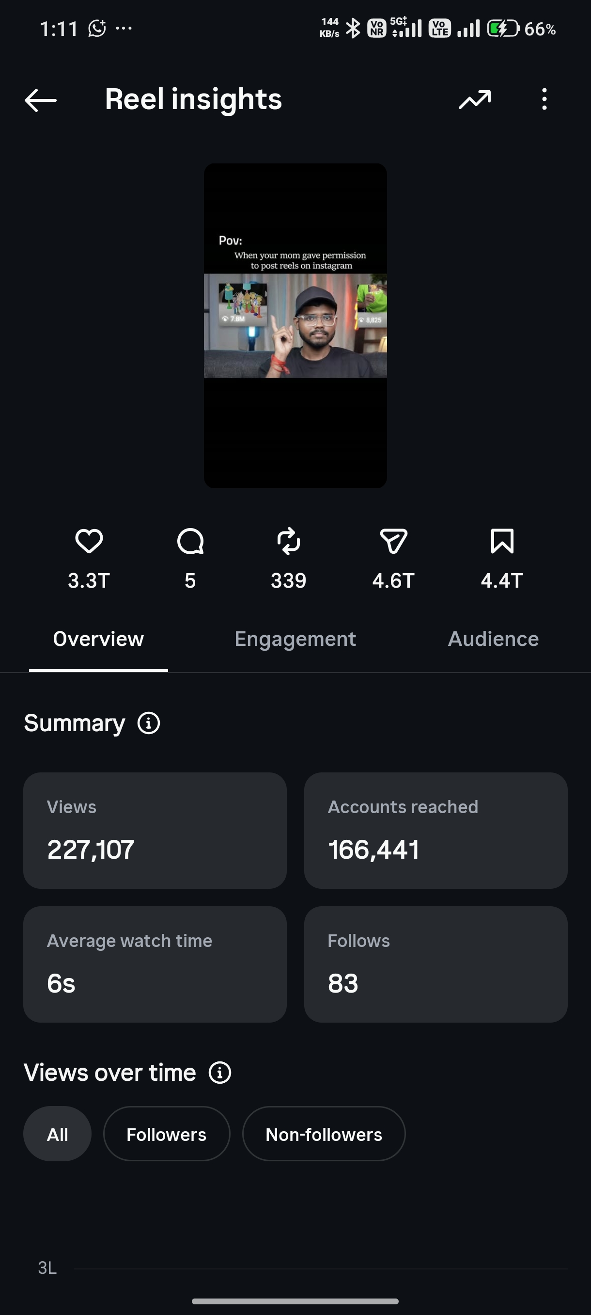
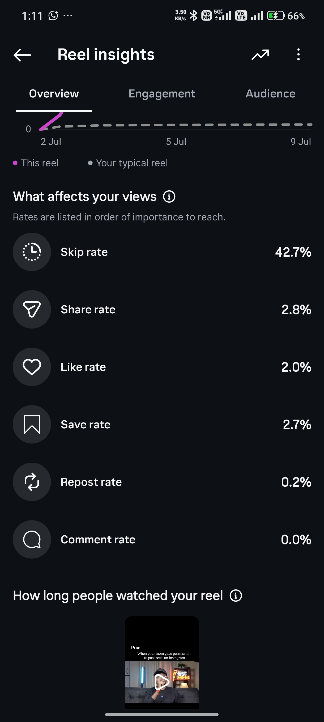
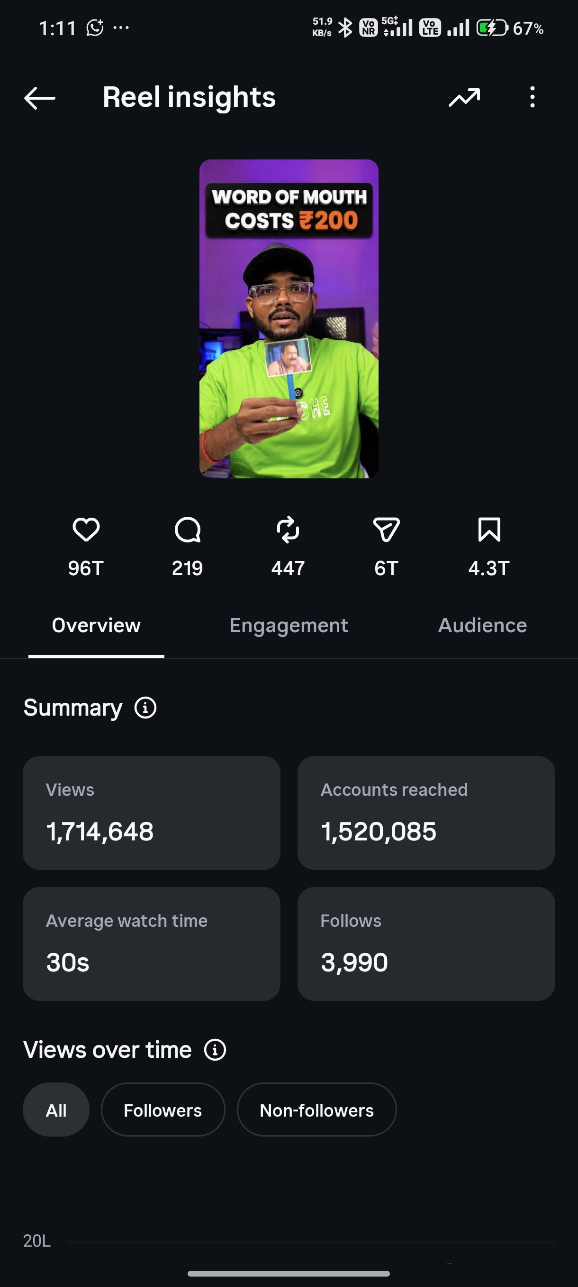
● OMNICHANNEL PROOF
FIRSTSELFIE // 2026
Viral Video IP: 7.0M Reel Reach & Community Dominance
22 / 26
Notes:
Slide 22: Omnichannel Distribution Proof. 7.0M Reel reach, 2.7K comments, and engaged founder community.

Slide 23
● THE 3-STAR FRAMEWORK
FIRSTSELFIE // 2026
The Complete FirstSelfie System Working in Unison
STAR 01
THE CODEX
Identity & Belief Architecture
• Contrarian positioning • Category definition • Narrative pillars • Immune to copycats
STAR 02
THE ENGINE
High-Velocity Media Machine
• 2 hrs/week founder time • 15–20 high-fidelity reels • Cinematic lighting & grade • 4-platform syndication
STAR 03
THE APA MATRIX
Automated Inbound Funnel
• Comment keyword triggers • DM qualification bot • Pre-sold discovery calls • Zero cold outreach needed
23 / 26
Notes:
Slide 23: Complete 3-Star Architecture Summary. Pillar 1 Codex + Pillar 2 Engine + Pillar 3 APA Matrix working in unison.

Slide 24
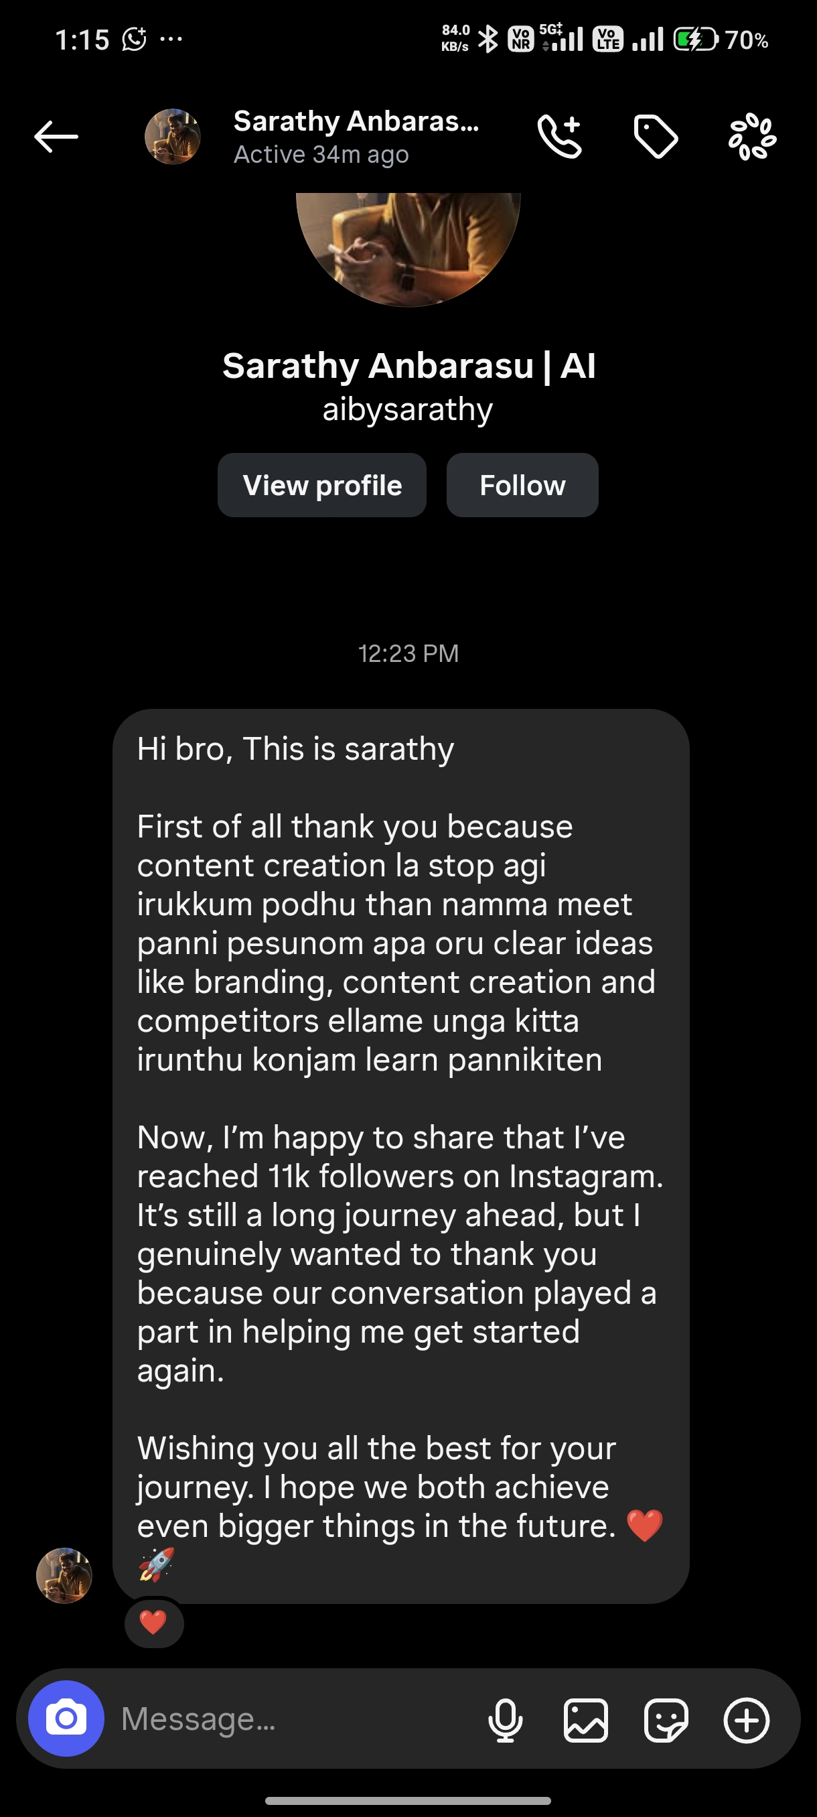
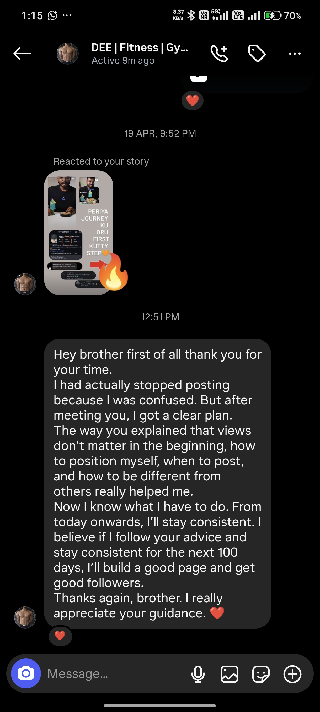
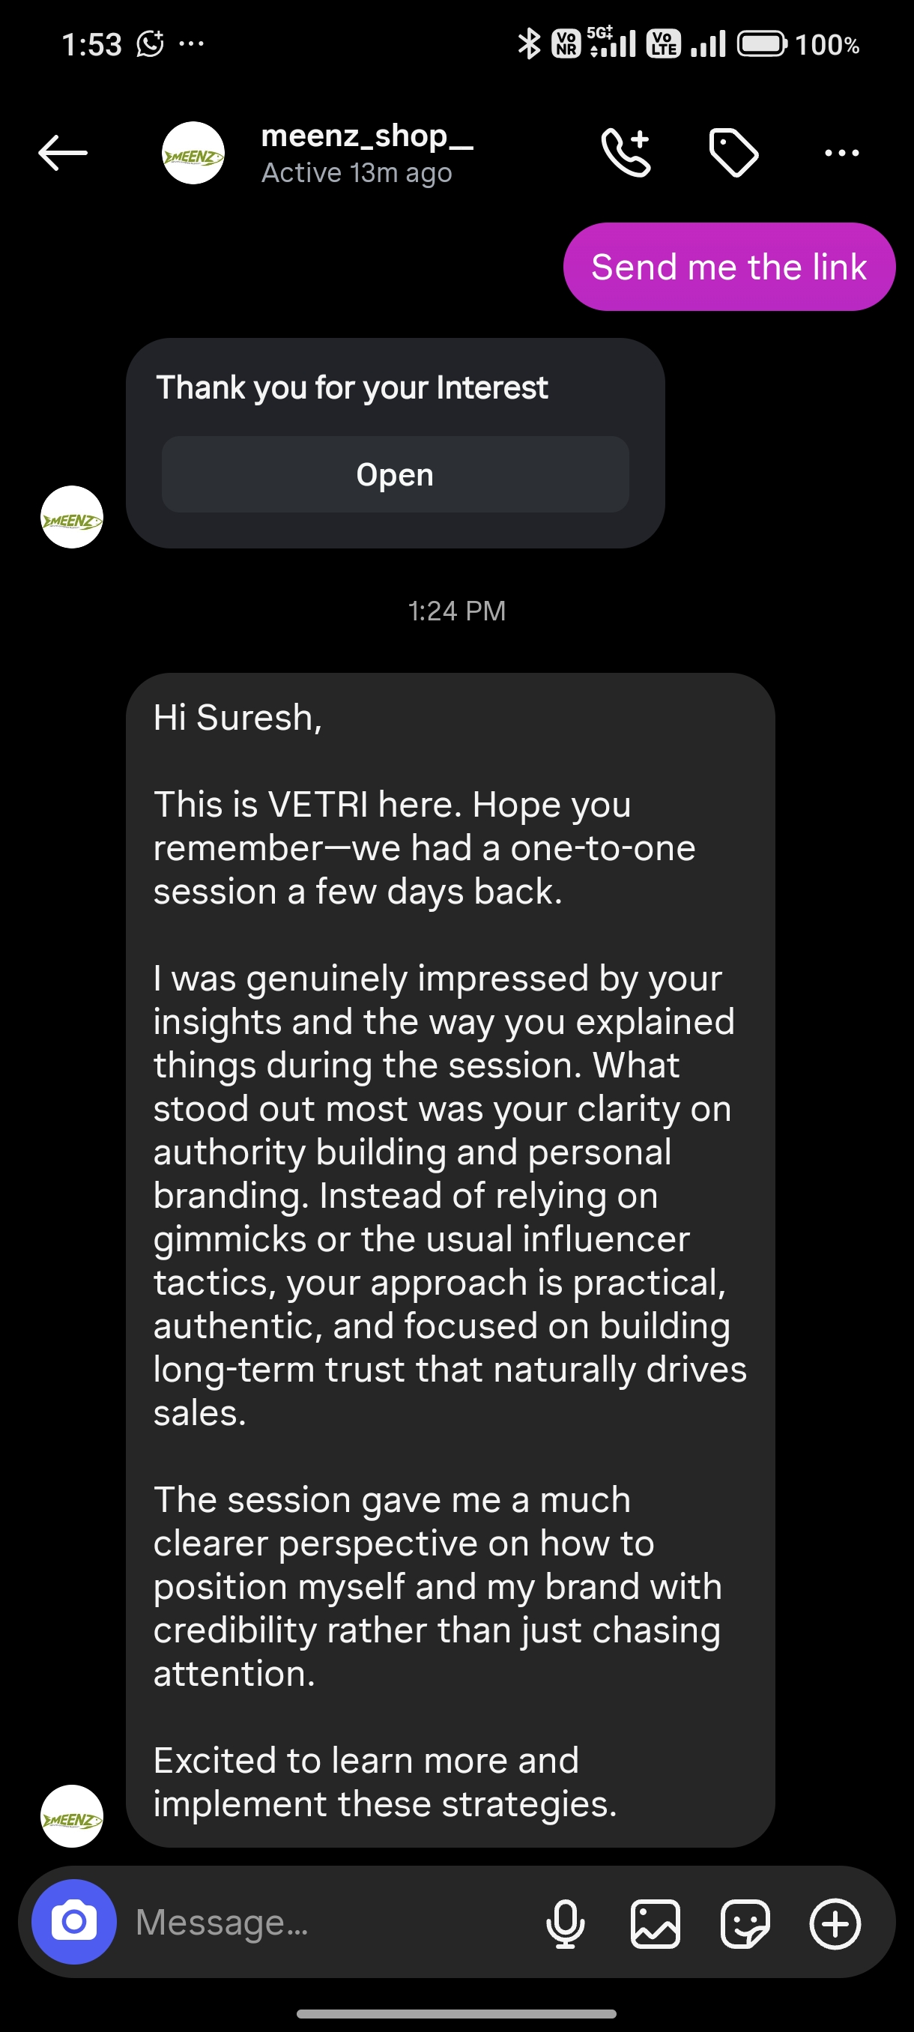
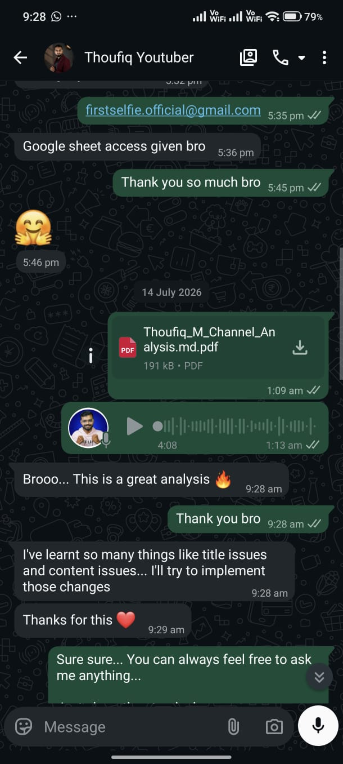
● INBOUND PROOF
FIRSTSELFIE // 2026
Pre-Sold Client Inquiries & WhatsApp DM Proof
24 / 26
Notes:
Slide 24: Inbound Validation & DMs. Real client conversations, bookings, and verified inbound inquiries.

Slide 25
● PARTNERSHIP MODEL
FIRSTSELFIE // 2026
The 90-Day Identity Sprint Engagement
WHAT WE DELIVER (Turnkey)
• Complete Identity Codex & positioning architecture • High-velocity batch recording sessions (2 hrs/week) • Studio cinematic editing, sound design, and color grade • Daily multi-platform publishing and syndication • Automated ManyChat APA conversion funnels
CLIENT QUALIFIERS
• Established Founders & Executives with proven market traction • High-Ticket Offer ($2,000+ to $50,000+ contract values) • Willingness to invest 2 hours per week in rapid batch recording • Looking to build long-term category monopoly, not overnight hype
25 / 26
Notes:
Slide 25: Investment & Partner Model. Exclusive 90-day sprint engagement with dedicated executive team.

Slide 26
● CATEGORY DOMINANCE // 2026
FIRSTSELFIE // 2026
Build Your Uncopyable Category Monopoly Today
Schedule Your Private Strategy Session
We engineer 5 new Identity Brands per quarter to ensure white-glove executive delivery. Secure your category wedge before your closest competitor does.
APPLY AT FIRSTSELFIE.IN
26 / 26
Notes:
Slide 26: Final Call to Action. Secure your category monopoly for 2026. Schedule your Private Strategy Session.

