Slide 1

YOUR FIRST FRAME TO A MILLION FACES.
01

Slide 2
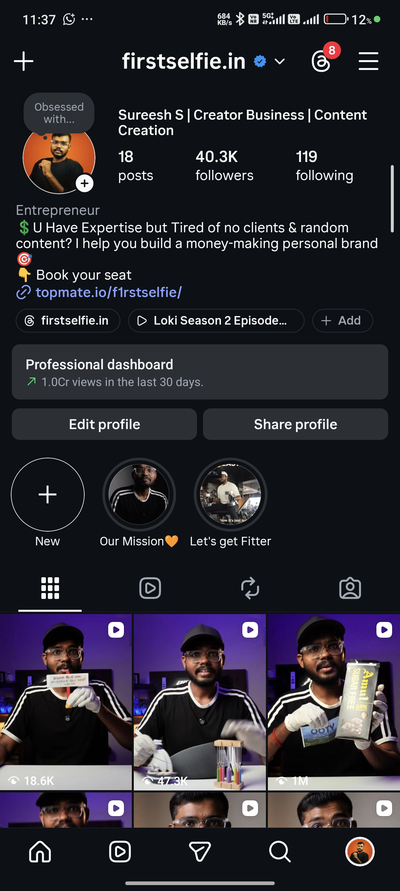
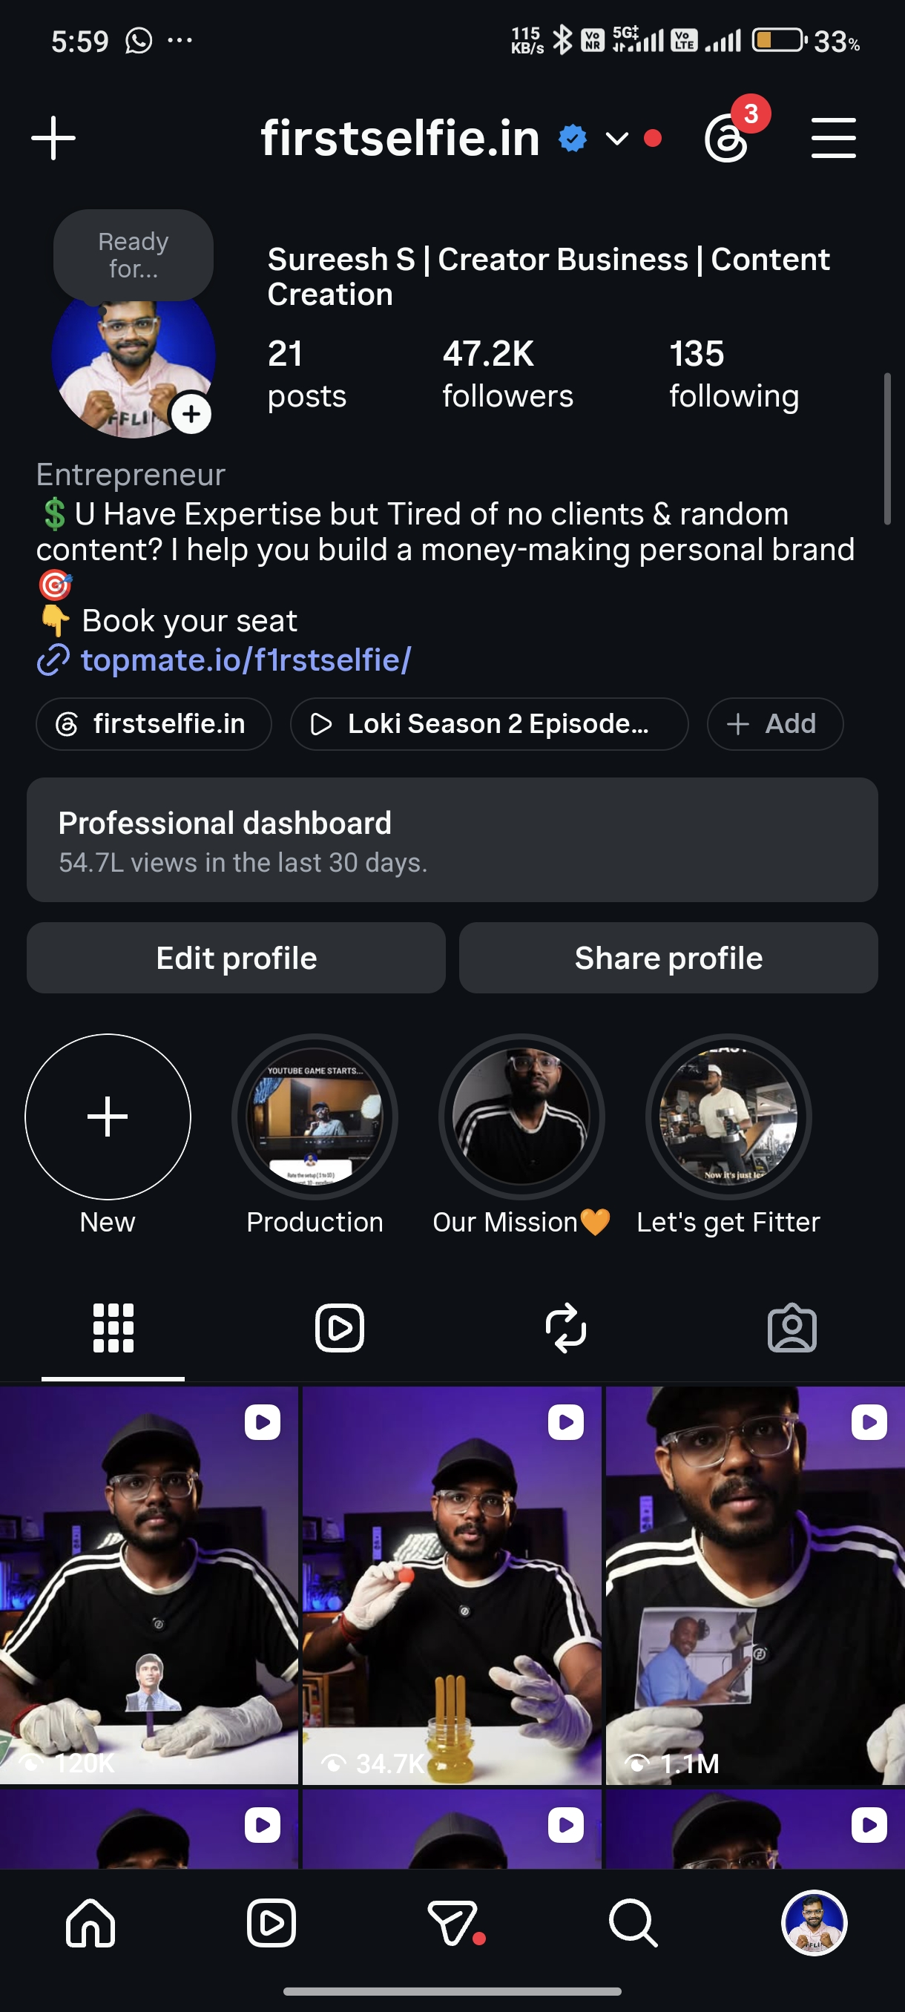
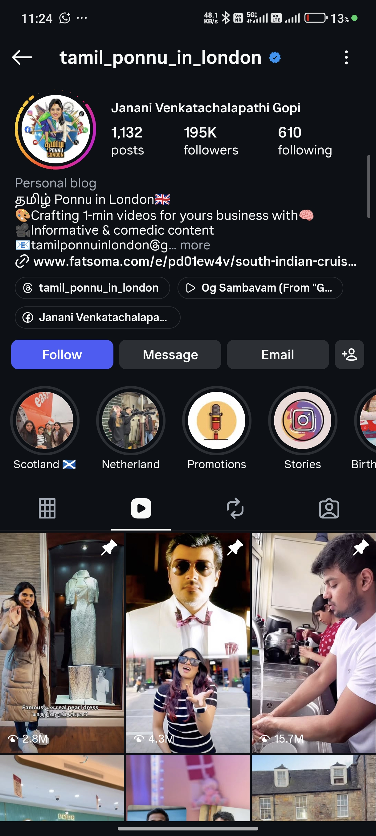
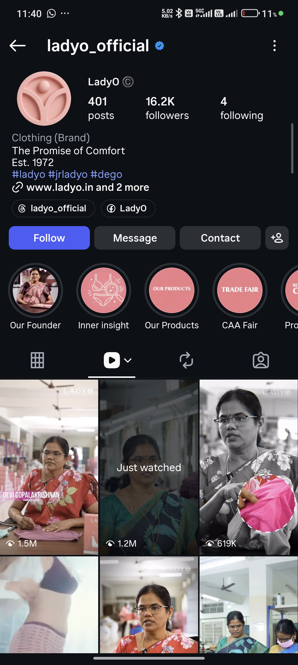
PROOF, NOT PROMISES
Real accounts. Real growth. Real screenshots.
40.3K followers
>1 Cr views / 30 days
47.2K followers
54.7L views / 30 days
Client: Tamil Ponnu in London
195K followers
Client: LadyO (Clothing brand)
16.2K followers
02

Slide 3
18 MONTHS AGO WE CAUGHT A WAVE.
Then everyone copied it — and the wave died.
Whoever went viral first got copied. Nobody innovates — the format just gets diluted until it dies.
03

Slide 4
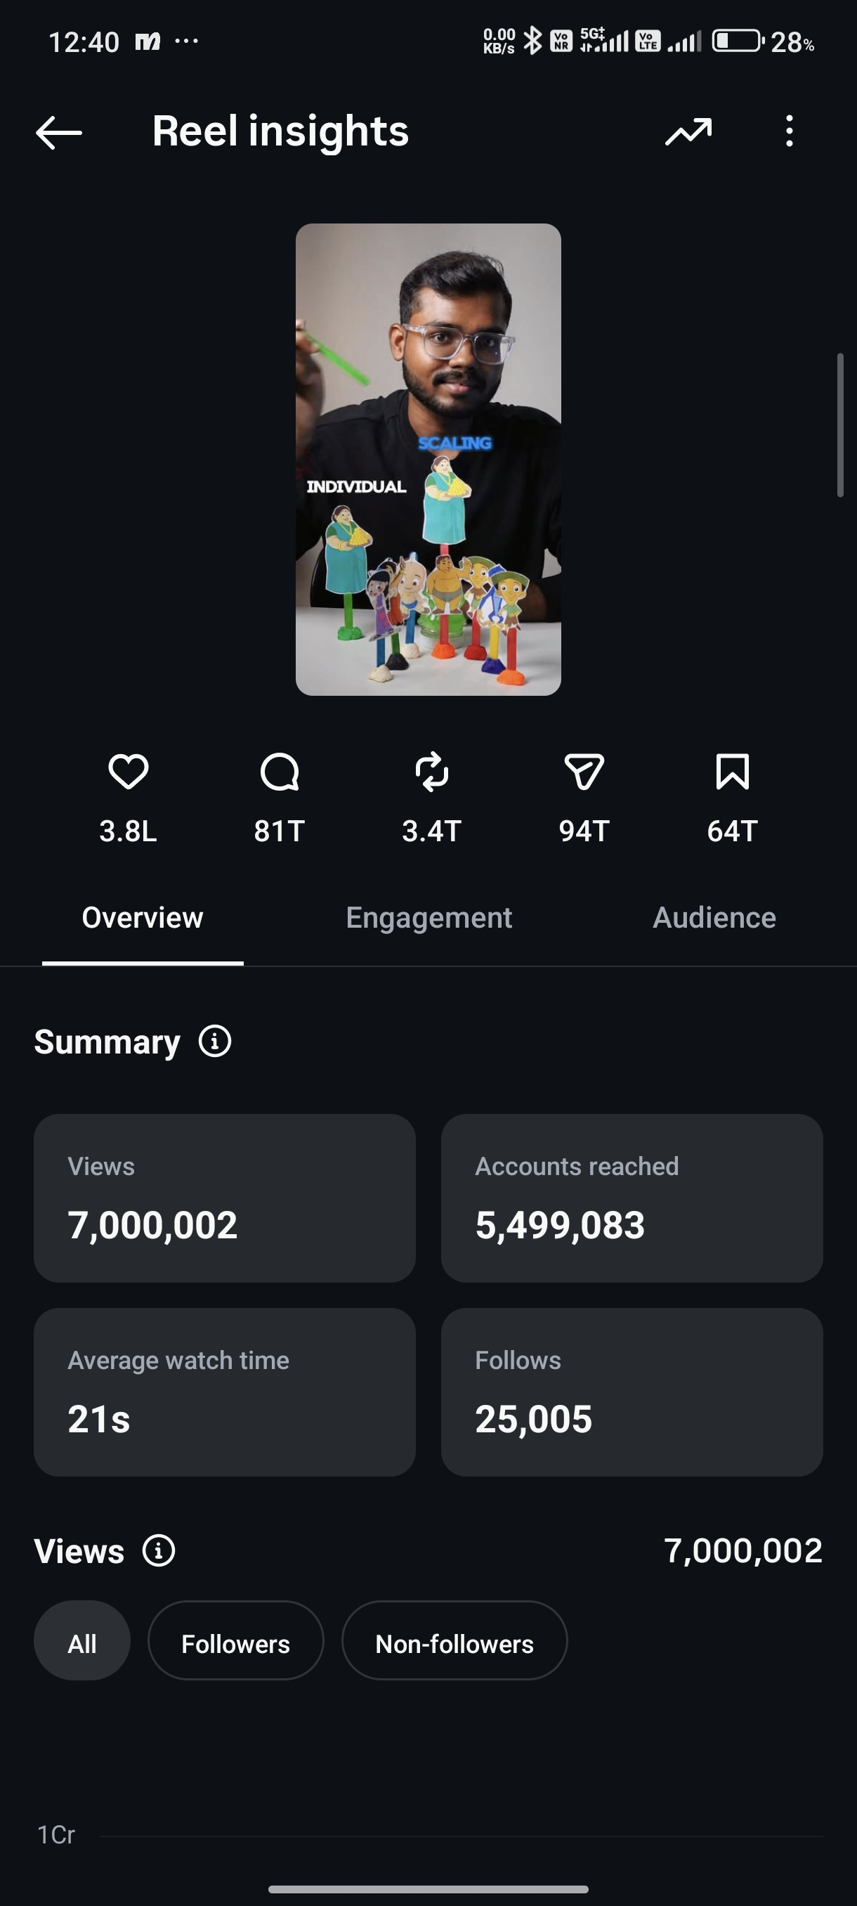
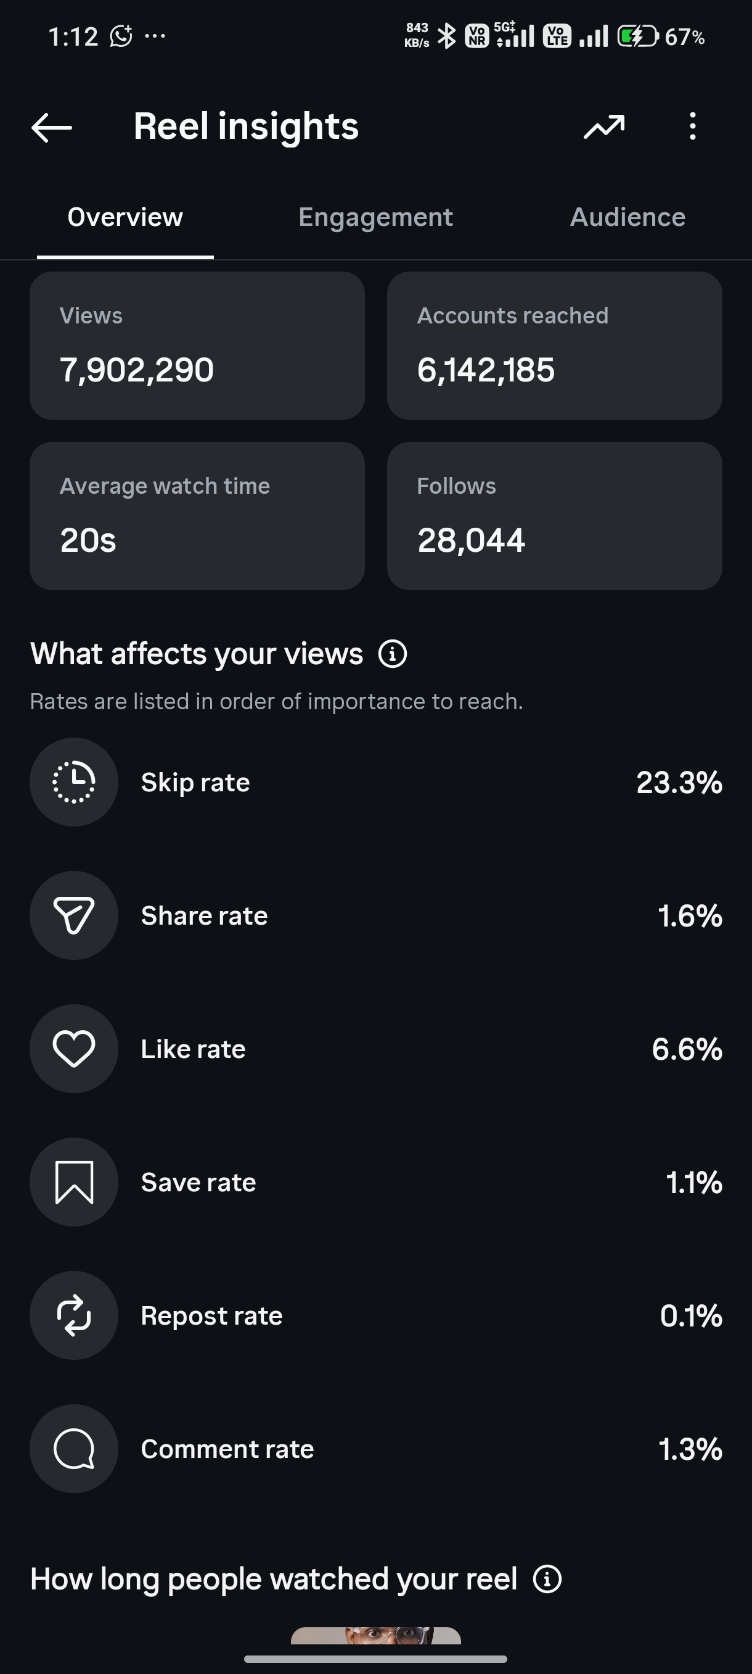
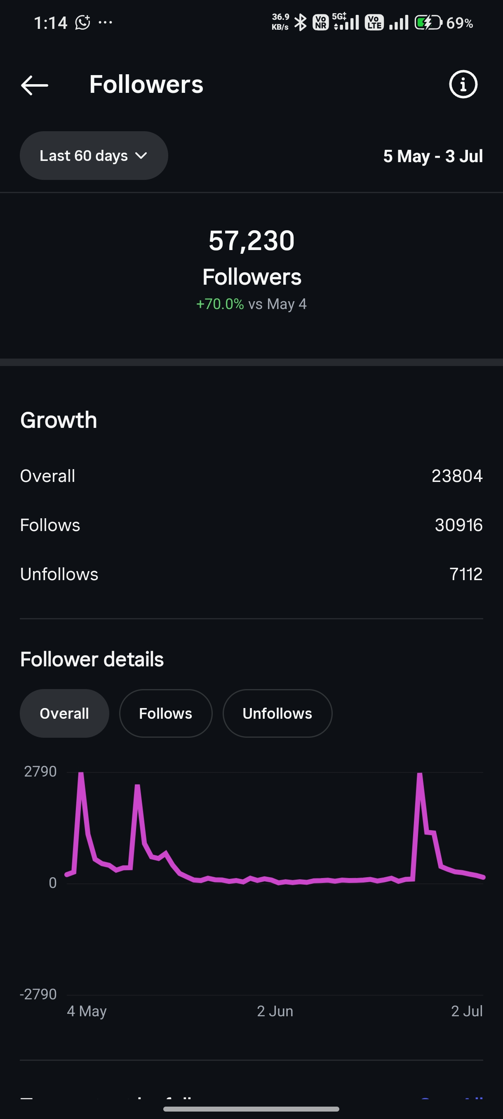
THE FORMAT THAT CHANGED EVERYTHING
One content format. A measurable spike in every metric.
7,000,002 views · 1 reel
7,902,290 views · 1 reel
57,230 followers · +70% in 60 days
04

Slide 5
“BRO, THEY’RE COPYING YOUR STYLE.”
Within 9 months of launch, multiple creators had copied our format. We didn't find most of them — our own followers did.
The question isn't whether people will copy you. It's whether you'll be the one building — or the one copying.
05

Slide 6
NOT JUST INDIVIDUALS
We've even trained agencies on their own personal branding.
Agencies build brands for their clients all day — but most founders inside those agencies have zero personal brand of their own. We've closed that gap for them too. That's how deep our specialization runs.
06

Slide 7
THE SYSTEM BEHIND ALL OF IT
The Three Star Framework
01
02
03
Creator Codex Method
Brain-First Engine System
After-Post APA Matrix
Strong positioning + a clean system so you're never stuck wondering what to post.
The engine that takes you from 3 hours per script to 15 ideas in 2 days.
Turn views and analytics into your next move — every single post.
07

Slide 8
WHO THIS VIDEO IS FOR
This is for you if...
You want an Identity Brand, not just a personal brand — people follow how you say it, not just what you say.
You're playing the long game: building a team, a real business, not chasing one viral post.
You take action. You're not a procrastinator — you just need the roadmap.
You don't want to burn 6 months and ₹5 lakh figuring this out solo.
You see content as a system that plugs directly into your sales process.
08

Slide 9
This takes 20 minutes.
If you can't spend 20 minutes on the thing that grows your business, this isn't for you — and that's fine.
“You don't find time for what matters. You make it — everything else was never a priority to begin with.”
09

Slide 10
SET THE RIGHT EXPECTATION
This is not overnight success. It's the Creator Valley.
There's no shortcut to a winning system on par with global brands — you put in the work.
This is for brand-building, not quick money.
You spend time and effort going down before the hockey-stick up.
Effort & Time →
10

Slide 11
HOW WE WORK WITH YOU
This is NOT Done-For-You. It's Done-With-You.
Done-For-You
Done-With-You ✓ This is us
You say “take my money, handle it.”
For businesses at ₹1 Cr+ revenue.
Zero interest in building an in-house team.
Under ₹1 Cr, can't pay agencies lakhs/month.
Solopreneurs, or those training/managing their own team.
₹1 Cr+ businesses that want an in-house team but lack clarity on how.
11

Slide 12
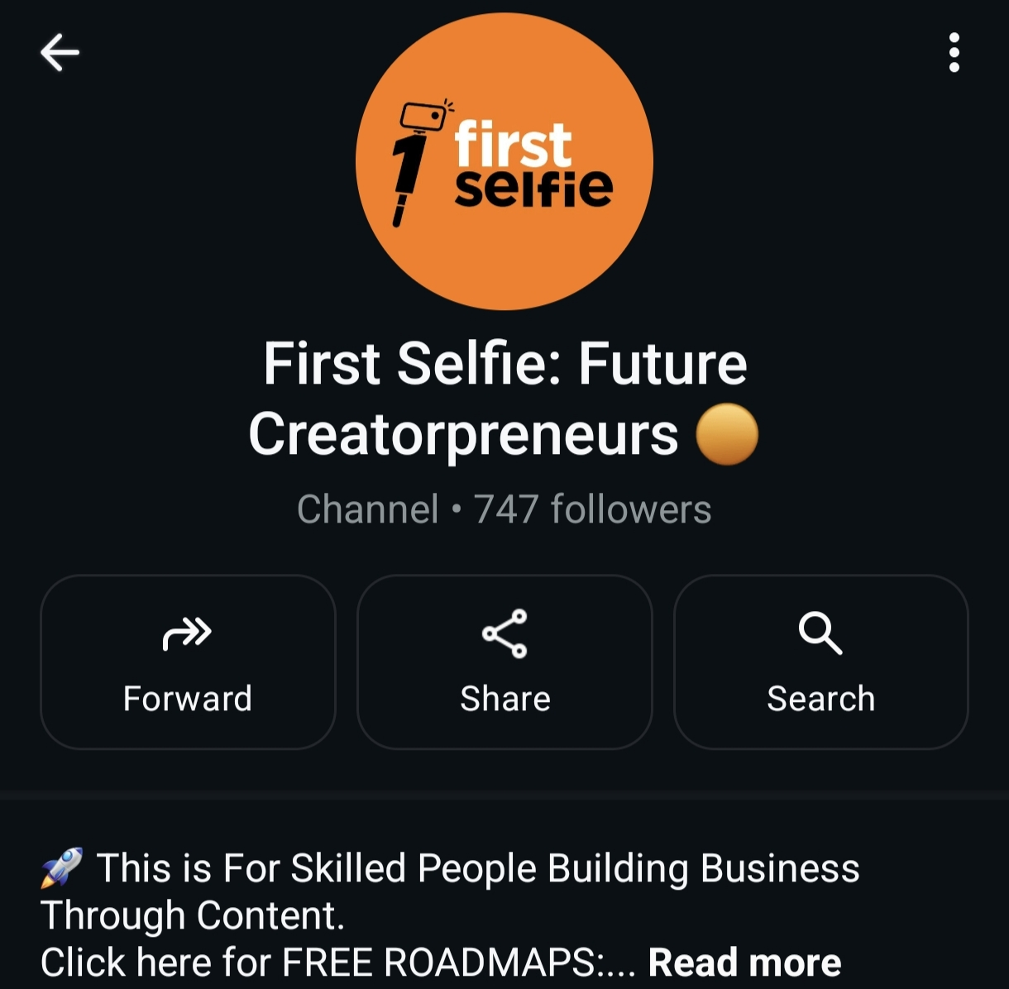
India hasn't tapped 0.5% of content's potential.
Especially for business owners and experts. We built this to close that gap.
The Creatorpreneur Mission
By 2033: 1 Crore Creatorpreneurs, each built toward ₹1 Crore in revenue.
You're now part of it.
12

Slide 13
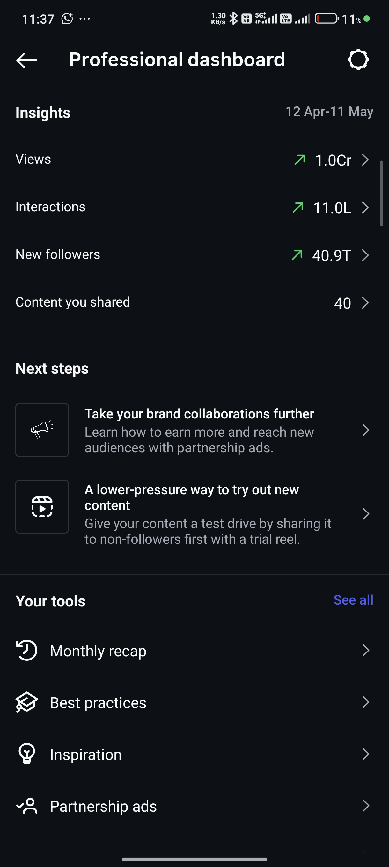
TRACK RECORD
What we actually did, in plain numbers.
2 yrs
48 days
1 Cr+
Backend content learning before ever posting
To 50K followers — pure positioning
Views in 30 days, purely educational content
13
Actual Instagram dashboards — 30-day views, interactions & follower growth

Slide 14
LET'S BE BLUNT
Who this is NOT for.
✕
You don't want to learn — you just want a magic button.
✕
You want quick results and nothing else.
✕
You want to run the same race as everyone else with zero innovation.
14

Slide 15
WHERE THIS IS ALL HEADING
This is the future. You decide if you're in it.
2010
2025
2030
Company → Roadmap → Ads
Founder → Personal Brand
Company → Media Company
Companies needed advertisements.
Company founders need personal branding.
Companies become media companies (e.g. Cookd).
Example: Cookd — a food brand that became a media company. Content IS the business now.
15

Slide 16
SOUND FAMILIAR?
You are here.
You run an offline business.
You're an expert in your field.
You tried content creation — and you're on the verge of burnout.
BURNOUT
We pivot you away from this curve — before you hit the wall.
16

Slide 17
FRAMEWORK 01
The Creator Codex Method — 7 steps before you shoot a single frame.
Strong positioning — so nobody can copy you
Never get stuck in the “what to post” loop
Clean, conversion-ready profile setup
A repeatable content strategy
+ 3 more steps covered live on your call
60-Day Path
Days 1–15: Build the foundation (Codex Method)
Days 16–60: Execute — your first 10 videos live
After that: you scale without needing us.
17

Slide 18
FRAMEWORK 02
The Brain-First Engine System
3 hours per script → 15 content ideas mapped in 2 days.
2–5 Reels / day across IG + YouTube
Regular carousels
2× 20-min long-form videos / week
Daily story sequences
3 communities, 1,300+ members
18

Slide 19
UNIQUE POSITIONING
The formula behind a winning content format.
Content Format + You + Ownership = Winning Asset
“Rating content” went viral in Tamil and nobody remembers who started it — because nobody owned it. If that creator had claimed it as their signature, the entire trajectory changes.
19

Slide 20
FRAMEWORK 03
The After-Post APA Matrix
Views and analytics only matter if you know what to do with them next.
“Format copied by competitors” isn't a risk. It's a certainty. In the next 6–12 months you have two options:
Build & own a unique format. Become the industry leader. Let others copy you — we build it with you.
Go it alone. Fine — but if someone else in your niche builds that winning format first, you'll be the one copying them.
20

Slide 21

THIS IS WHAT WE DO
The 60-Day Personal Branding Sprint.
Full breakdown, pricing & onboarding walkthrough — shown live on your call.
21

Slide 22
The next wave is coming.
Ride it early — or watch someone else succeed first and jump in late.
We take 7–12 clients / month.
If we're full, you'll be waitlisted.
If you watched this far, you're already in the top 1% of the Tamil creator space.
@firstselfie · firstselfie.com
22

