Slide 1

CS 232 Microprocessors and Microcontrollers
School of Computer Engineering AND TECHNOLOGY

Slide 2

Course Objective and Outcomes
Examination scheme:
Continuous Assessment: 50 Marks, End Semester: 50 Marks
Course Objectives:
To learn the architecture and programming of Pentium Microprocessor.
To study the protected memory management Mechanism.
To provide insight to multitasking environment.
To learn the architecture and programming of 8051 Microcontroller
Course Outcomes:
After completion of the course the students will be able to :
List and elaborate the advanced architectural features of Pentium processors, correlate these features with design criterions and performance of processor.
Develop programs using 80x86 assembly language.
Describe the theory of protected memory management .
Comprehend the concept of multitasking environment .
Illustrate architectural features and basic building blocks of 8051 microcontroller.
Develop basic programs using 8051 assembly language.

Slide 3
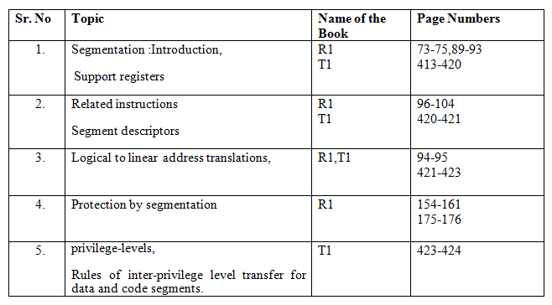
References
T1: James Antonakos , “The Pentium Microprocessor” , 2004, Pearson Education ISBN – 81-7808-545-3.
R1: Intel architecture software developer's manual volume 3.
Chapter 3 of R1 for segmentation

Slide 4
Memory Management in Protected Mode
Segmentation: Introduction
Support Registers Related Instructions
Segment Memory Descriptors
Logical To Linear Address Translations
Protection By Segmentation
Privilege Levels
Rules Of Inter-privilege Level Transfer For Data And Code Segments .

Slide 5

Protected Mode Memory Management
Overview
Managing Memory in different parts instead of continuous allocation of locations
Divided into two parts : Segmentation and Paging
Memory get divided into segment (Small parts)
Segmentation Provides isolation of each code/data/stack, so that multiple program can run on same processor without interfacing.
While operating in Protected Mode, Segmentation is not optional, some form of Segmentation must be used.
There is No Bit available to Disable segmentation

Slide 6

Protected Mode Memory Management
Segmentation Provides mechanism for dividing Processor’s Addressable Memory Space (Linear Address Space) into smaller protected address space called Segments.
Segments are used to hold :
Code
Data
Stack
TSS
LDT

Slide 7

Protected Mode Memory Management
Segmentation allows memory to be unstructured and simple
Each Segment is an independent protected address space.
A Complex system of Program can make efficient use of segmentation
Segmentation hardware translates a segmented (logical) address into an address for a continuous, unsegmented address space, called a linear address.

Slide 8

Segment
All the segments are Fitted in Linear address Space.
Segment has a segment Descriptor, it specifies
Size of Segment
Access Right
Privilege Level
Segment type
Location of first byte of the segment in the linear address space.

Slide 9

Segment
To locate any Byte in the Segment the logical address must be provided
Logical address consist of Segment Selector and Offset called as Pointer.
Segment Selector is a unique Identifier for Segment
It Provides Offset in Descriptor Table (GDT) to a data structure called as Segment Descriptor
Each Segment Descriptor specifies Base Address of Segment, offset part of logical address is added to locate byte within Segment.
Thus, Base Address + Offset forms Linear Address

Slide 10
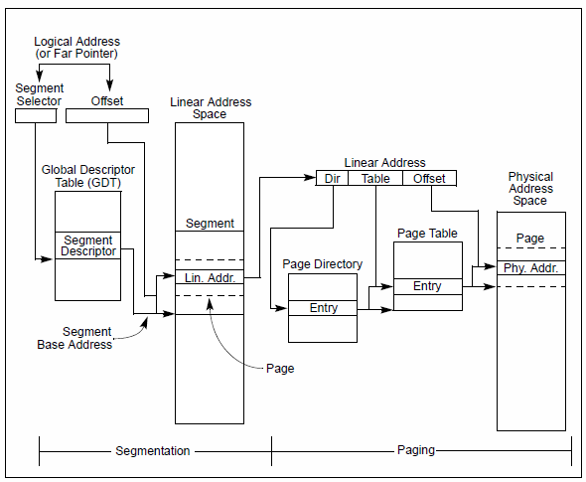
Segmentation and Paging

Slide 11
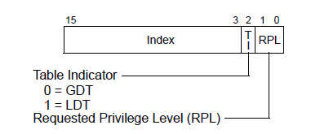
Segment Selector
Is a 16 bit identifier, it does not point directly to the segment but, point to the segment descriptor
Index: Bit 3 to 15, selects one of 8192 descriptor from GDT/LDT. Processor multiples index value by 8 and add to base address of GDT/LDT
TI: Table Indicator: specifies use of GDT or LDT.
TI = 0 selects GDT & TI = 1 select LDT
RPL(Request Privilege Level) : having value form 0 to 3, with o as highest Privilege

Slide 12
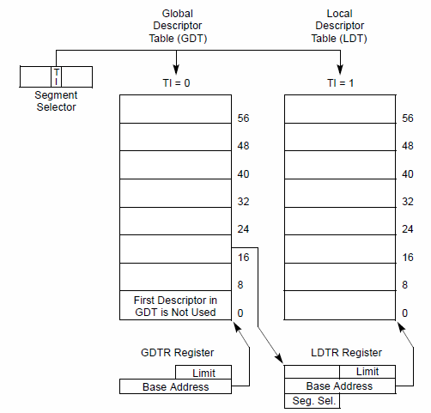
Segment Descriptor Table
Descriptor table is variable in length and can contain up to 8192 ( 2¹³ )
8 byte descriptors
Types are
GDT – Global Descriptor Table
LDT – Local Descriptor Table

Slide 13
Null Segment Selector.
First entry of GDT is not used by Processor. A segment selector which points to entry of GDT is called as Null Segment Selector.
Loading unused data-segment registers with a null segment selector is a useful method of detecting accesses to unused segment registers.
and/or preventing unwanted accesses to data segments.

Slide 14
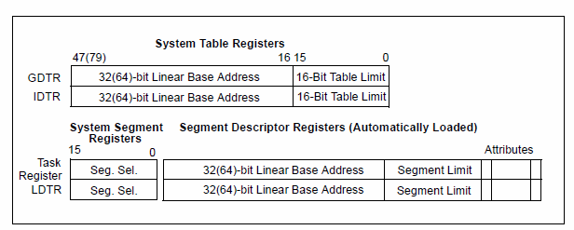
Memory Management Registers
System provided 4 memory management registers GDTR, LDTR, IDTR and TR

Slide 15
GDTR & IDTR
GDTR Global Descriptor Table Register
Holds the base address of 32 bit in protected mode and 64 bit in IA 32 mode along with 16bit table limit for the GDT.
LGDT and SGDT instructions load and store the GDTR Register
On power ON default value is set to 0 with limit 0FFFFH
IDTR Interrupt Descriptor Table Register
Holds base address and limit for IDT
LIDT and SIDT instructions are used to load and store IDTR register
On power ON default value is set to 0 with limit 0FFFFH

Slide 16
LDTR
Holds 16 bit segment selector, base address, limit and descriptor attributes for the LDT(An LDT is accessed with its segment selector. To eliminate address translations when accessing the LDT, the segment selector, base linear address, limit, and access rights of the LDT are stored in the LDTR register)
LLDT and SLDT instructions are used to load and store LDTR Register
The segment that contains LDT must have its segment descriptor in the GDT.
During Task switch, LDTR is loaded automatically
Content of LDTR are not automatically saved prior to writing new LDT
On power ON default value is set to 0 with limit 0FFFFH

Slide 17
TR
Task Register
Holds 16 bit segment selector, base address, limit , descriptor attribute for the TSS of the current task
Selector refers the TSS descriptor in GDT
LTR and STR instructions are used to store and load values in TR register
On power ON default value is set to 0 with limit 0FFFFH
On task switch TR is loaded automatically, it cant save its prior content automatically

Slide 18
Segment Registers
To reduce address translation time and coding complexity, processor provides 6 register for holding segment selectors.
Each one supports specific type of memory reference
CS: Code Segment
DS: Data Segment
SS: Stack Segment
Virtually to execute any program at least 1 CS, 1DS and 1SS must be loaded with valid addresses.
Processor provided additional 3 data segment registers as : ES, FS and GS

Slide 19
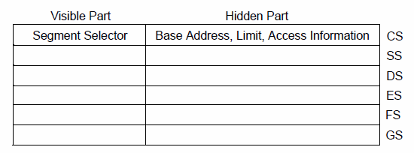
Segment Registers
Six Segment Registers available
Instructions used to load registers are either direct load (MOV,LDS) or implied load instruction (CALL,JMP).

Slide 20
Segment Descriptor
Is a data structure in GDT/ LDT that provides the size and location of the segment as well control status information
Segment descriptors are created by compiler, linker , loader or operating system

Slide 21
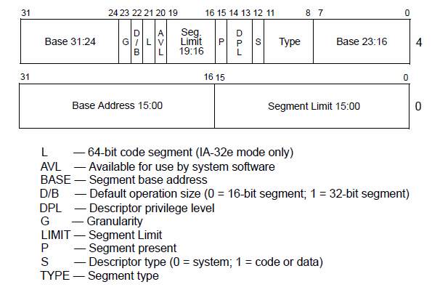
Segment Descriptor Format

Slide 22
Segment Descriptor Format
Segment limit field: specifies the size of segment. Processor puts together two segment limit fields to form 20 bit value
If Granularity bit is 0, segment size can range from 1 byte to 1 Mbyte, in byte increment
If Granularity bit is 1, segment size can range from 4Kbytes to 4 Gbytes , in 4Kbytes increment
Base Address field: defines location of the byte 0 of the segment within 4Gbytes linear address space. The processor puts together 3 base address field to form 32 bit value.

Slide 23
Segment Descriptor Format
Type Field: specifies the access that can be made and direction of growth
S flag (Descriptor type): specified that descriptor is for a system segment ( S=0) or code/data segment ( S= 1)
DPL (Descriptor Privilege Field): Specifies the privilege level of segment. It can range from 0 to 3, with 0 at highest privilege and 3 as lowest privileged
P (Segment Present) Flag: indicates whether segment is present in the memory (1) or not (0)

Slide 24
Segment Descriptor Format
D/B ( default operational size) flag: performs different functions depending on type. This flag should be set to 1 for 32 bit code/data segment and set to 0 for 16 bit code/data segment.
Executable code segment: flag is called as D flag and indicates default length for effective addressing and operand referenced by instruction
If set then 32 bit address and 32 or 8 bit operands are assumed
If clear 16 bit address and 16 or 8 bit operands are assumed
Stack segment : flag is called as B (big) flag it specifies the size of the stack pointer used for implicit stack operation.
If set 32 bit stack pointer is used
If clear 16 bit stack pointer is used
Expand down data segment: it specifies upper bound of the segment. If flag is set the upper bound is FFFFFFFF H 4 Gbytes and if clear upper bound is FFFF H (64Kbytes)

Slide 25
Segment Descriptor Format
Granularity flag : determines the scaling of the segment limit field
L (64 Bit code segment) flag: set indicates, instruction in this code segment are executed in 64 bit mode. Zero value indicates, instructions are executed in compatibility mode
Available or reserved bit: bit 20 is available for use by system software

Slide 26
System Descriptor type
Types of system descriptor are :
Local descriptor table (LDT) segment descriptor
Task State Segment Descriptor (TSS)
Call gate Descriptor
Interrupt gate descriptor
Task Gate descriptor
Trap gate descriptor

Slide 27
Segment Descriptor Table
Descriptor table is variable in length and can contain up to 8192 ( 2¹³ ) 8 byte descriptors
Types are
GDT – Global Descriptor Table
LDT – Local Descriptor Table

Slide 28
Segment Descriptor Table
Each system must have one GDT defined , which may be used for all program and tasks
GDT is not a segment itself but, data structure in linear address space
The base address and limit of GDT must be loaded in GDTR register
LDT is located in the system segment of the LDT type. The GDT must contain a segment descriptor for the LDT segment.

Slide 29
Physical Address Space
In protected mode architecture provided physical address space of 4Gbytes (2³² ), which is addressable on its address bus
Physical Address space is Flat (Un-segmented) ranging from 0 to FFFFFFFFH

Slide 30
Logical and Linear Address
In protected mode, processor uses two stage of address translation to arrive at physical address:
Logical address translation
Linear address translation
A logical address consist of 16 bit segment selector and 32 bit offset
A Linear address is 32 bit address, it is flat similar to physical address. It contains all segments and system tables.

Slide 31
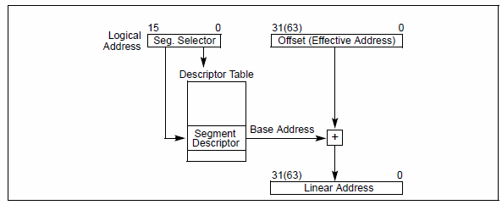
Logical to Linear Address Translation

Slide 32
GDT and GDTR
Segment base address (32 bit)
GDT
Segment Descriptor n
Segment Descriptor 2
Segment Descriptor 1
NULL Descriptor
Offset
(32/64bit)
Segment register 15 bit
+
Selector
GDTR
Linear address
(32/64bit)
Base Address | Limit - 1

Slide 33
Logical to Linear Address Translation
Steps
Uses offset in the segment selector to locate the segment descriptor for the segment in GDT/LDT and reads it into processor.
Checks the access right and range of segment to insure segment is accessible
Adds base address of the segment from segment descriptor with offset to form Linear address

Slide 34
Protection
Why ?
Users from interfering one another
Users from examining secure data
Program bugs from damaging other programs
Program bugs from damaging data
Malicious attempts to compromise system integrity
Accidental damage to data

Slide 35
Protection
Each reference to memory is checked by the hardware to verify that it satisfies the protection criteria.
All these checks are made before the memory cycle is started
Any violation prevents that cycle from starting and results in an exception.
Invalid attempts to access memory result in an exception.

Slide 36
Privilege
Pentium checks that the application is privileged enough to:
Execute certain instructions
Reference data other than its own
Transfer control to code other than its own

Slide 37
Field and Flag in Protection system
Different filed and flags are used in segment level and page level protection mechanism
Descriptor type (S) flag: Bit no 12, defines is it a system segment or Code/Data segment
Type Field: Bit 8-11, determines type of code/data or system segment ( Read/write)
Limit Filed: Bit 0-19, determine size of segment along with G and E flag
G flag: Bit 23, E flag : bit 10
Descriptor Privilege level (DPL): bit 13-14, determines the privilege level of the segment
Requested Privilege level (RPL): bit 0-1, of any segment selector, Specifies the RPL of segment selector
Current Privilege Level(CPL): bit 0-1 of CS segment, indicates the privilege level of currently executing program or procedure

Slide 38
Field and Flag in Protection system
Different filed and flags are used in segment level and page level protection mechanism
User/ Supervisor flag(U/S): bit 2 of paging structure , determines type of page – user or supervisor
Read/write flag (R/W) : bit 1 of paging structure , type of access allowed to page- read only or read- write
Execute Disable flag (XD): bit 63 of certain page structure, determines the type of access allowed, executable or non-executable.

Slide 39
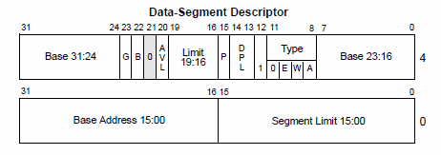
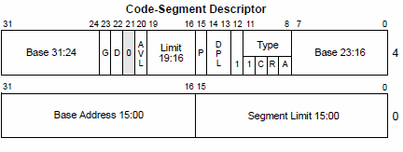
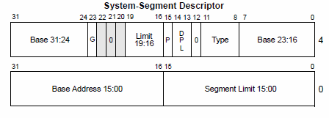
Field and Flag in Protection system

Slide 40
Data Segment Descriptor
Base Addr. 31:24 | G | D/B | O | AVL | Seg. Limit 19:16 | P | DPL | S ‘1’ | 0 | E | W | A | Base Addr 23:16
TYPE
Code Segment Descriptor
Base Addr. 31:24 | G | D/B | O | AVL | Seg. Limit 19:16 | P | DPL | S ‘1’ | 1 | C | R | A | Base Addr 23:16
TYPE
System Segment Descriptor
Base Addr. 31:24 | G | D/B | O | AVL | Seg. Limit 19:16 | P | DPL | S ‘0’ | TYPE | Base Addr 23:16

Slide 41
Segment Level Protection
All five aspects of protection apply to segment translation:
1. Type checking
2. Limit checking
3. Restriction of addressable domain
4. Restriction of procedure entry points
5. Restriction of instruction set
The segment is the unit of protection, and segment descriptors store protection parameters.
Protection checks are performed automatically by the CPU when the selector of a segment descriptor is loaded into a segment register and with every segment access.
Segment registers hold the protection parameters of the currently addressable segments.
The protection parameters are placed in the descriptor by systems software at the time a descriptor is created.

Slide 42
Type Checking
Segment descriptors contain type information in two places:
The S (descriptor type) flag.
The type field.
Some examples of typical operations where type checking is performed.
- The CS register only can be loaded with a selector for a code segment
The LDTR can only be loaded with a selector for an LDT.
No instruction may write into an executable segment.
The LLDT instruction must reference a segment descriptor for an LDT.

Slide 43
Limit Checking
The limit field of a segment descriptor is used by the processor to prevent programs from addressing outside the segment.
The processor's interpretation of the limit depends on the setting of the G (granularity) bit.
When G=0, the actual limit is the value of the 20-bit limit field as it appears in the descriptor.
When G=1, the actual limit may range from 0FFFH (2¹²-1 or 4 kilobytes) to 0FFFFFFFFH(2³²-1 or 4 gigabytes).
Limit checking catches programming errors such as runaway subscripts and invalid pointer calculations.

Slide 44
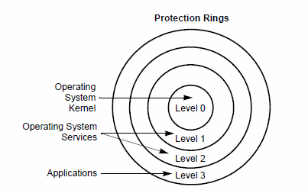
Privilege Levels
Processor segment protection Mechanism recognizes 4 privilege levels form 0 to 3. with 0 as high and 3 as low privilege

Slide 45
Privilege Levels
The center is reserved for most privilege code/data and stacks, used in critical software, usually kernel of operating system
Outer rings are less critical section
Processor limits the access from low privilege program or task to access high privilege program, except under controlled situation.
When processor detects privilege level violation is generates General-Protection exception (#GP)

Slide 46
Terminology
PL: Privilege Level
RPL: Requestor Privilege Level
DPL: Descriptor Privilege Level
CPL: Current Privilege Level
Task:
One instance of the execution of a program.
Tasks are also referred to as processes.

Slide 47
CPL- Current Privilege Level
is the level of currently executing program or task. It is stored in bit 0 and 1 of CS and SS.
CPL is equal to the privilege level of CS from which instruction is executed
Processor changes the CPL when program control is transferred to CS with Different privilege level
A task's CPL may only be changed by control transfers through gate descriptors to a code segment with a different privilege level.

Slide 48
CPL
An application program running at PL = 3 may call an operating system routine at PL = 1 (via a gate) which would cause the task's CPL to be set to 1 until the operating system routine was finished.
In case of Conforming code segment (CCS), it is treated differently, CCS can be accessed from any privilege level and CPL
Conforming code segments can be accessed from any privilege level that is equal to or numerically greater (less privileged) than the DPL of the conforming code segment.
Also, the CPL is not changed when the processor accesses a conforming code segment that has a different privilege level than the CPL.

Slide 49
Confirming Code Segments
Can be defined with different privilege levels
Do not impart additional privileges
Do not remove existing privileges
Do not alter RPL bits in the Code segment register
Can be shared by code at all privilege levels

Slide 50
DPL -Descriptor Privilege level
is a privilege level of segment or gate.
It is stored in DPL field of the segment descriptor.
DPL is interpreted separately depending on the type of the segment / gate access
Data Segment-indicates the numerical highest privilege level that a program can have to be allowed to access the segment. Ex if DPL of data is 1 then only programs running at a CPL 0 or 1 can access the segment
Non-Conforming Code Segment (without CALL Gate)- DPL indicates the privilege level that program must be at to access the segment. Ex DPL of non-conforming code segment is 0 then programs running at CPL 0 can access it
CALL Gate- DPL indicates numerically highest privilege level that the currently executing program can be and still able to access the call gate Ex if DPL of data is 1 then only programs running at a CPL 0 or 1 can access the Call gate

Slide 51
DPL
Conforming and non-conforming CS through CALL gate
DPL indicates numerically lowest privilege level that program can have to be allowed to access the segment. EX-if DPL of Conforming CS is 2 and program running at CPL of 0 or 1 cannot access the segment
TSS
DPL indicates numerically highest privilege level that the currently executing program can be at and still be able to access TSS. Ex if DPL of data is 1 then only programs running at a CPL 0 or 1 can access the TSS

Slide 52
Requestor privilege level (RPL)
The privilege level of the original supplier of the selector.
RPL is determined by the least two significant bits of a selector of data or code segment to be accessed
The processor checks the RPL along with the CPL to determine if access to a segment is allowed.
If the RPL > CPL, then the RPL overrides the CPL and vice versa.
RPL is used to insure that privilege code does not access a segment on behalf of Application program, unless the program itself has access privilege to that segment.

Slide 53
RPL
RPL of a segment selector for a data segment is under software control.
For example, an application program running at a CPL of 3 can set the RPL for a data segment selector to 0. With the RPL set to 0, only the CPL checks, not the RPL checks, will provide protection against deliberate, direct attempts to violate privilege-level security for the data segment.
To prevent these types of privilege-level-check violations, a program or procedure can check access privileges whenever it receives a data-segment selector from another procedure.(ARPL)

Slide 54
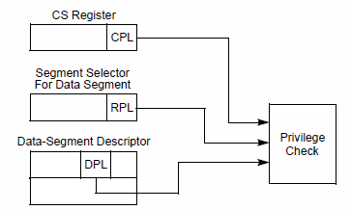
Privilege Level check for DS
PL Check for accessing data segment

Slide 55
Privilege Level check for DS
To access operand in DS, the segment selector must be loaded into the data segment register (DS,ES,FS or GS) or SS
Processor performs privilege check ( CPL,RPL,DPL)
Processor loads segment selector into segment register if the DPL is numerically greater than or equal to both the CPL and RPL, otherwise General Protection fault is generated and segment register is not loaded
DPL >= Max(CPL and RPL)

Slide 56
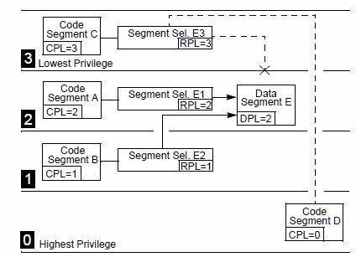
Data Segment : Privilege Access
CS – A able to access DS E using E1 selector as,
CPL of A and RPL of E1 = DPL E
CS- B able to access DS E using selector E2 as,
CPL of B and RPL of E2 < DPL of E

Slide 57
Data Segment : Privilege Access
CS C is unable to access DS E using selector E3 as,
CPL of CS C and RPL of E3 > DPL of DS E
CS D is able to access DS E as
CPL of CS D < DPL of DS E

Slide 58
Privilege Level check
When CPL 0: DS at all PL are accessible
When CPL 1: DS at PL 1 through 3 are accessible
When CPL 2: DS at PL 2 to 3 are accessible
When CPL 3: DS at PL 3 is only accessible
RPL of segment selector can always override the addressable domain of program

Slide 59
Accessing Data in CS
Possible methods are,
Load a DS register with segment selector for a non-conforming , readable code segment
Load a DS register with segment selector for conforming readable code segment
Use a CS override prefix to read a readable CS, whose selector is already loaded in CS register
Same rules for accessing DS apply to 1.
Method 2 is always valid because PL of CCS is effectively same as CPL
Method 3 is always valid because DPL of CS selected by CS register is same as CPL.

Slide 60
Privileged Instructions
Some instruction are protected from use by application program.
They can be executed with PL 0
LGDT- load GDT Register
LLDT- Load LDT Register
LTR- load task register
LIDT- load IDT register
MOV (Control Registers)
LMSW- load Machine Status Word
CLTS- clear task switch flag in CR0
MOV ( Debug registers)
INVD- invalidate cache, without writeback

Slide 61
Privileged Instructions
WBINVD-invalidate cache with write back
INVLPG- invalidate TLB entry
HLT- halt Processor
RDMSR-read model specific register
WRMSR- write model specific register
RDPMC-read performance monitoring counter
RDTSC-read time stamp counter

Slide 62
System Registers
Memory management Registers
Control registers
Debug Registers
Test Registers

Slide 63
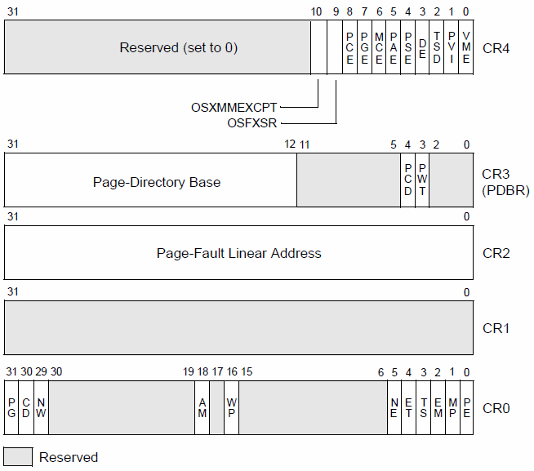
Control Registers
CR4:- Contains a group of flags that enable several architectural extensions
CR3:- Contains the physical address of the base of the page directory and two flags (PCD and PWT). This register is also known as the page-directory base register (PDBR). Only the 20 most-significant bits of the page-directory base address are specified; the lower 12 bits of the address are assumed to be 0.
CR2 :- Contains the page-fault linear address (the linear address that caused a page fault)
CR1:- Reserved
CR0:- Contains system control flags that control operating mode and states of the processor.

Slide 64
CR0
PG Paging (bit 31 of CR0). Enables paging when set;
CD Cache Disable
NW Not Write-through
AM Alignment Mask
WP Write Protect
NE Numeric Error
ET Extension Type
TS Task Switched
EM Emulation
MP Monitor Coprocessor
PE Protection Enable
Machine status word MSW- Lower 16 bits of CR0

Slide 65
Debug Registers
8 Debug registers
Used to support program debugging
by indicating the address at which a program breakpoint was generated.
The size of the breakpoint data or instruction
Whether it was a read/write request
What kind of bus cycle(instruction fetch, data ,I/O access) to generate breakpoints on.

Slide 66
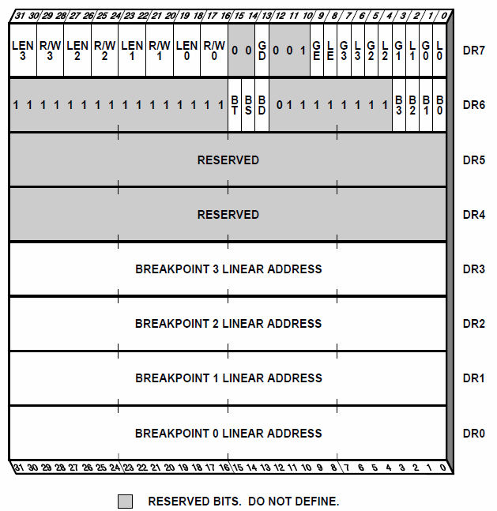
Debug Registers
DR0-DR3- hold linear address for 4 breakpoint.
DR4-DR5- Reserved
DR6-Reports which breakpoint generates Exception
DR7- Specify type of memory & I/O access
associated with each breakpoint

