Slide 1

CS232 Microprocessors and Microcontrollers
Department of Computer Science and Engineering

Slide 2

CS232 Microprocessor and Microcontrollers
Examination scheme:
Continuous Assessment: 50 Marks, End Semester: 50 Marks
Course Objectives:
To learn the architecture and programming of Pentium Microprocessor.
To study the protected memory management Mechanism.
3. To provide insight to multitasking environment.
4. To learn the architecture and programming of 8051 Microcontroller
Course Outcomes:
After completion of the course the students will be able to :-
List and elaborate the advanced architectural features of Pentium processors and basic assembly language programming.
Describe the theory of protected memory management.
Comprehend the concept of multitasking environment.
Illustrate architectural features of 8051 microcontroller and basic assembly language programming

Slide 3
Module III paging and Task Management
Paging Unit: support registers, related data structures, linear to physical address translation, TLB , page level protection.
Task Management -support registers, related data structures, Task switching.

Slide 4
Syllabus
Text Books:
1. James Antonakos , “The Pentium Microprocessor” , 2004, Pearson Education ISBN – 81-7808-545-3.
2. K.J.Ayala" The 8051 Microcontroller " ISBN 9788131511053.
Reference Books:
1. Intel architecture software developer's manual volume 3.
2. Intel architecture software developer's manual volume 1.
3. Intel 8051 datasheet.
4. Pentium® Processor Family Developer’s Manual

Slide 5
CS232 Microprocessor and Microcontrollers
Sr. No | Topic | Name of the Book | Page Numbers
1 | Paging Unit: support registers, related data structures | T1 R1 | 424-426 3-18 to 3-21
2 | linear to physical address translation , TLB , Page level protection. | T1 R1 | 426-431 3-21 to 3-29
3 | Task Management -support registers, related data structures | R1 T1 | 6-1 to 6-9 431 - 434
4 | Task switching. | R1 T1 | 6-10 to 6-13 435

Slide 6

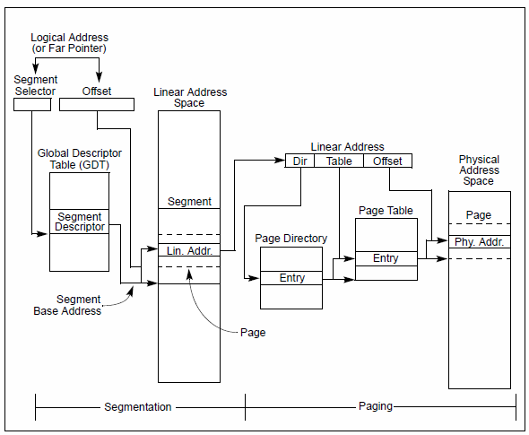
Segmentation and Paging

Slide 7
Page Translation
In the second phase of address transformation, the Pentium transforms a linear address into a physical address.
It is needed for page-oriented virtual-memory systems and page-level protection.
The page-translation step is optional.

Slide 8
Paging
When operating in protected mode, the Intel Architecture permits the linear address space to be mapped directly into a large physical memory (for example, 4 GBytes of RAM) or
indirectly (using paging) into a smaller physical memory and disk storage. This method of mapping the linear address space is commonly referred to as virtual memory or demand-paged virtual memory.
When paging is used, the processor divides the linear address space into fixed-size pages (generally4 KB in length) that can be mapped into physical memory and/or disk storage.
Paging is different from segmentation through its use of fixed-size pages.
If segmentation is the only form of address translation used, a data structure present in physical memory will have all of its parts in memory.
If paging is used, a data structure can be partly in memory and partly in disk storage.
To minimize the number of bus cycles required for address translation, the most recently accessed page-directory and page-table entries are cached in the processor in devices called translation lookaside buffers (TLBs).

Slide 9
Virtual memory to each task
GDT- 8191 descriptors
LDT-8192 descriptors
Each descriptor can define a segment up to 4GB
Total memory = 4GB (8191+8192)
= 4GB x 16381
= 64 Tera Bytes

Slide 10
Paging Options
Paging is controlled by three flags in the processor’s control registers:
1. PG (paging) flag, bit 31 of CR0 :
Enables the page-translation mechanism. The operating system or executive usually sets this flag during processor initialization.
2. PSE (page size extensions) flag, bit 4 of CR4 :
Enables large page sizes: 4-MByte pages or 2-MByte pages. When the PSE flag is clear, the more common page length of 4 KBytes is used.
3. PAE (physical address extension) flag, bit 5 of CR4:
enables 36-bit physical addresses

Slide 11
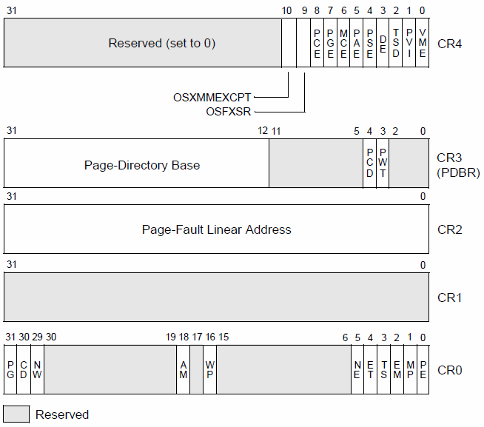
Control Registers
CR4:- Contains a group of flags that enable several architectural extensions
CR3:- Contains the physical address of the base of the page directory. This register is also known as the page-directory base register (PDBR).
CR2 :- Contains the page-fault linear address (the linear address that caused a page fault)
CR1:- Reserved
CR0:- Contains system control flags that control operating mode and states of the processor.

Slide 12
Components of the paging mechanism
1. Page directory
An array of 32-bit page-directory entries (PDEs) contained in a 4-Kbyte page.
Up to 1024 page-directory entries can be held in a page directory.
Page Directory Entry points to Page Table
2. Page table
An array of 32-bit page-table entries (PTEs) contained in a 4-KByte page.
Up to 1024 page-table entries can be held in a page table.
Page Directory Entry points to Page Frame
3. Page
- A 4-KByte, 2-MByte, or 4-MByte flat address space.
4. Page-Directory-Pointer Table
An array of four 64-bit entries, each of which points to a page directory. This data structure is only used when the physical address extension is enabled

Slide 13
Continued..
one page directory can address 1M pages (2²⁰).
Because each page contains 4K bytes(2¹² )bytes, the tables of one page directory can span the entire physical address space (2²⁰ times 2¹² = 2³²).
The physical address of the current page directory is stored in the CPU register CR3, also called the page directory base register (PDBR).
Memory management software has the option of using one page directory for all tasks, one page directory for each task, or some combination of the two.

Slide 14
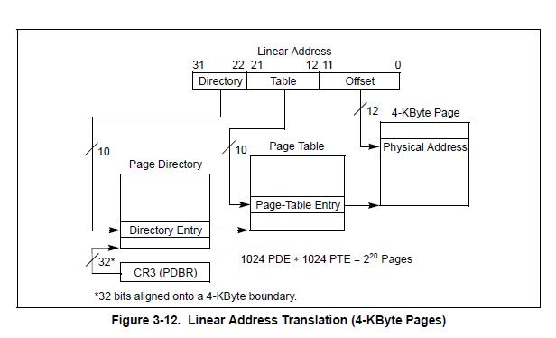
Linear Address Translation

Slide 15
PAGE DIRECTORY BASE REGISTER
The physical address of the current page directory is stored in the CR3 register (also called the page directory base register or PDBR).
CR2 is the Page Fault Linear Address register. It holds the 32-bit linear address which caused the last page fault detected.
If paging is to be used, the PDBR must be loaded as part of the processor initialization process (prior to enabling paging).
The PDBR can then be changed either explicitly by loading a new value in CR3 with a MOV instruction or implicitly as part of a task switch.

Slide 16
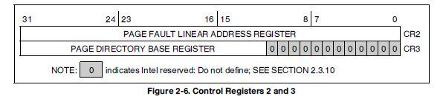
CR2,CR3
CR2 holds the 32-bit linear address that caused the last page fault detected. It is used for handling page faults when PG is set.
CR3 contains the physical base address of the page directory table.
Since the page directory table is always 4 Kbyte-aligned, the lowest twelve bits of CR3 are ignored .

Slide 17
Linear Address Translation
To select the various table entries, the linear address is divided into three sections:
Page-directory entry
Bits 22 through 31 provide an offset to an entry in the page directory.
The selected entry provides the base physical address of a page table.
Page-table entry
Bits 12 through 21 of the linear address provide an offset to an entry in the selected page table.
This entry provides the base physical address of a page in physical memory.
Page offset
Bits 0 through 11 provides an offset to a physical address in the page.

Slide 18
P2.1
0
P1.0
P1.0
HDD
P3.0
1
P2.0
P1.1
HDD
P2.0
2
P1.1
P1.2
P2.1
3
P3.0
RAM
PMT : P3 process
P2.2
4
Page No. | Base address
0 | 3
P2.3
5
P1.2
PMT : P2 process
6
P2.1
Page No. | Base address
0 | 1
1 | 4
2 | 6
3 | 7
PMT : P1 process
Page No. | Base address
0 | 0
1 | 2
2 | 5
7
P2.2
RAM
RAM
8
FREE Page Frame

Slide 19
Linear Address to Physical Address
Linear Address
Index to Directory | Index to Table | Offset in Page
31 22 | 21 12 | 11 0
4KB page
Directory Entry
Page Table Entry
Base address
Page
PDBR
CR3
Page Table Directory
Page Table

Slide 20
Example
PDBR:25000H
Linear Address:48E03005H
Ignore lowest 12 bits
123H (Offset) 203H (Offset)
Entry No. in Entry no. in
Page Directory Page table
0 | 1 | 0 | 0 | 1 | 0 | 0 | 0 | 1 | 1
1 | 0 | 0 | 0 | 0 | 0 | 0 | 0 | 1 | 1

Slide 21
Linear Address to Physical Address
Linear Address
Index to Directory | Index to Table | Offset in Page
123H | 203H | 005
123rd Hex or 291st Directory Entry holding base address of page table 25000H
203rd in Hex or 515th Page Table Entry Holding base address of page 12CD5 H
4KB page
Base address
Page
Page
PDBR 25000H
Page Table Directory
Page Table
CR3

Slide 22
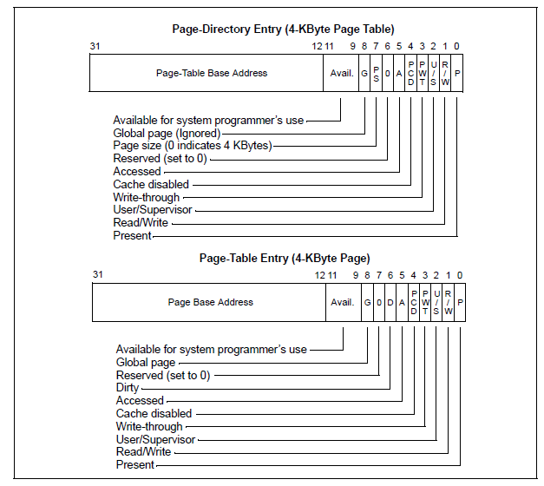
Page-Directory and Page-Table Entries

Slide 23
Page Level Protection
The paging mechanism distinguishes between two levels of protection:
User which corresponds to level 3 of the segmentation based protection,
and supervisor which encompasses all of the other protection levels (0, 1, 2).
Programs executing at Level 0, 1 or 2 bypass the page protection,although segmentation based protection is still enforced by the hardware.
The U/S and R/W bits are used to provide User/Supervisor and Read/Write protection for individual pages or for all pages

Slide 24
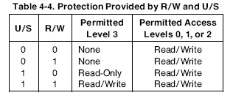
Page Level Protection

Slide 25
Translation Lookaside Buffer
Pentium keeps a cache of the most recently accessed pages, this cache is called the Translation Lookaside Buffer (TLB).
To minimize the number of bus cycles required for address translation, the most recently accessed page-directory and page-table entries are cached in the processor in devices called translation lookaside buffers (TLBs).
It is a four-way set associative 32-entry page table cache.
Most paging is performed using the contents of the TLBs.
The TLBs are inaccessible to application programs and tasks (privilege level greater than 0); that is, they cannot invalidate TLBs. Only operating system or executive procedures running at privilege level of 0 can invalidate TLBs or selected TBL entries.
The INVLPG instruction is provided to invalidate a specific page-table entry in the TLB.

Slide 26
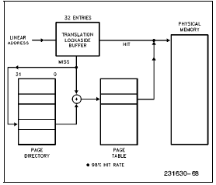
Translation Lookaside Buffer

Slide 27
TLB Hit
The paging unit hardware receives a 32-bit linear address from the segmentation unit.
The upper 20 linear address bits are compared with all 32 entries in the TLB to determine if there is a match.
If there is a match (i.e. a TLB hit), then the 32-bit physical address is calculated and will be placed on the address bus.
TLB Miss
If P = 1 on the Page Directory Entry indicating that the page table is in memory, then the Pentium will read the appropriate Page Table Entry.

Slide 28
Who is responsible?
The operating system is responsible for setting up the initial page tables, and handling any page faults.
The operating system also is required to invalidate (i.e. flush) the TLB when any changes are made to any of the page table entries.
It is done by loading CR3 with the address of the Page Directory, and allocating space for the Page Directory and the Page Tables.

Slide 29
Multitasking

Slide 30
Multitasking
Multitasking is one computer is shared by many users for different purposes at a time.
e.g. payroll, inventory, design…
How is one computer able to serve many people?
Since a digital computer runs at very high speed, time sharing is used for multitasking.
Each user is allotted a time slice(a small fraction of second).
Computer will attend another user after that time slice.
At the end it will come back to the first user, pick up where it left off the cycle is repeated.

Slide 31
Timesharing
Allows multiple users to use the same computer
Provides economical use of processing resources
Is invisible to the users
Can work for any number of users

Slide 32
Elements required to maintain timesharing
When to change from one user to the next?
When a user’s time slice expires, computer must store the current state of the program and restart the next user’s program as it was left when its time slice expired.
To save the current state of program is called context and changing to next user’s program is called context switch.

Slide 33
A context switch
Is necessary to perform timesharing Saves the state of the current program.
Loads the state of the program
Allows any program to be restarted at any time.
The basic unit of multitasking is the task.

Slide 34
What is a Task?
A program or a group of program defined by OS as a task.
For Multiuser system, a task can be assigned to each user.
A task is a unit of work that a processor can dispatch, execute, and suspend.
When operating in protected mode, all processor execution takes place from within a task.
A task is invoked by an interrupt, exception, jump, or call.
Even simple systems must define at least one task.

Slide 35
Task structure
A task is made up of two parts: a task execution space and a task-state segment (TSS).
The task execution space consists of a code segment, a stack segment, and one or more data segments.
The TSS specifies the segments that make up the task execution space and provides a storage place for task state information. In multitasking systems, the TSS also provides a mechanism for linking tasks.
A task is identified by the segment selector for its TSS. When a task is loaded into the processor for execution, the segment selector, base address, limit, and segment descriptor attributes for the TSS are loaded into the task register.
If paging is implemented for the task, the base address of the page directory used by the task is loaded into control register CR3.

Slide 36
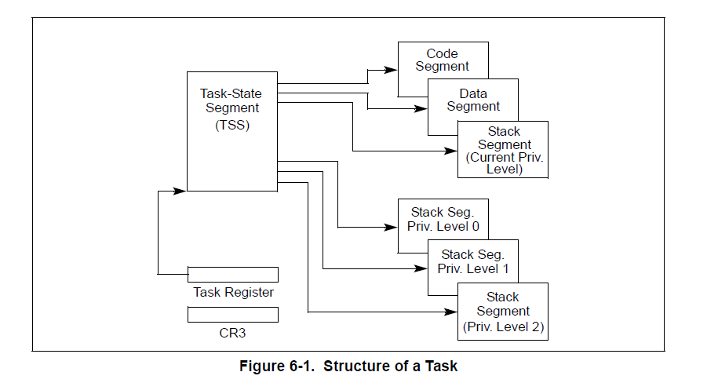
Task structure

Slide 37
Task State
The task’s current execution space, defined by the segment selectors in the segment
registers (CS, DS, SS, ES, FS, and GS).
• The state of the general-purpose registers.
• The state of the EFLAGS register.
• The state of the EIP register.
• The state of control register CR3.
• The state of the task register.
• The state of the LDTR register.
• The I/O map base address and I/O map (contained in the TSS).
• Stack pointers to the privilege 0, 1, and 2 stacks (contained in the TSS).
• Link to previously executed task (contained in the TSS).

Slide 38
Executing a Task
An explicit call to a task with the CALL instruction.
• An explicit jump to a task with the JMP instruction.
• An implicit call (by the processor) to an interrupt-handler task.
• An implicit call to an exception-handler task.
• A return (initiated with an IRET instruction) when the NT flag in the EFLAGS register is set.

Slide 39
Executing a Task
When a task is dispatched for execution, a task switch automatically occurs between the currently running task and the dispatched task.
During a task switch, the execution environment of the currently executing task (called the task’s state or context) is saved in its TSS and execution of the task is suspended. The context for the dispatched task is then loaded into the processor and execution of that task begins with the instruction pointed to by the newly loaded EIP register
If the currently executing task (the calling task) called the task being dispatched (the called task), the TSS segment selector for the calling task is stored in the TSS of the called task to provide a link back to the calling task.

Slide 40
TASK MANAGEMENT DATA STRUCTURES
Task state segment(TSS)
Task state segment descriptor
Task register
Task gate descriptor
NT flag in the EFLAGS register.
In protected mode,
a TSS and TSS descriptor must be created for at least one task,
and the segment selector for the TSS must be loaded into the task register (using the LTR instruction).

Slide 41
TSS- Task State Segment
Each task must have a TSS associated with it.
TSS stores all the information the processor needs in order to manage a task.
The current TSS is identified by a special register the Task State Segment Register(TR).
This register contains a selector referring to the task state segment descriptor that defines the current TSS.
The fields of a TSS are divided into two main categories: dynamic fields and static fields.

Slide 42
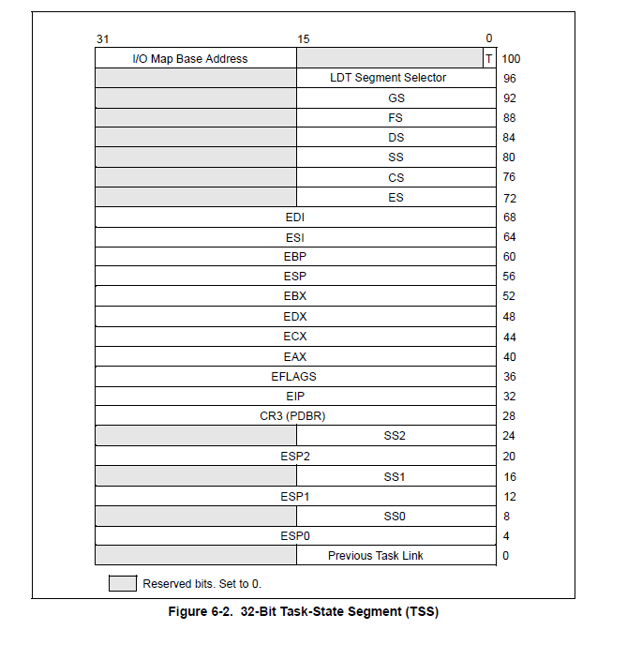

Slide 43
TSS
1. A dynamic set that the processor updates with each switch from the task. This set includes the fields:
The general registers (EAX, ECX, EDX, EBX, ESP, EBP, ESI, EDI).
These are saved in the same order in which PUSHAD instruction saves them.
The segment registers (ES, CS, SS, DS, FS, GS).
The flags register (EFLAGS).
The instruction pointer (EIP).
Previous task link field (back link field):
Contains the segment selector for the TSS of the previous task permits a task switch back to the previous task to be initiated with an IRET instruction.

Slide 44
TSS
2. A static set that the processor reads but does not change. The fields of this set are:
The selector of the task's LDT.
The CR3 register(PDBR): contains the base address of the task‘s page directory (read only when paging is enabled).
Pointers to the stacks for privilege levels 0-2.
The T-bit (debug trap bit) which causes the processor to raise a debug exception when a task switch occurs.

Slide 45
Static set
The I/O map base address
Contains a 16-bit offset from the base of the TSS to the I/O permission bit map and interrupt redirection bitmap.
When present, these maps are stored in the TSS at higher addresses.
The I/O map base address points to the beginning of the I/O permission bit map and the end of the interrupt redirection bit map.

Slide 46
Two classes of TSS format
Static set
It is that where processor reads but does not change.
This set includes the fields that store:
Dynamic set
where processor updates with each switch from the task.
This set includes the fields that store:
The selector of the task's LDT.
The register (PDBR) that contains the base address of the task's page directory (read only when paging is enabled).
Pointers to the stacks for privilege levels 0-2.
The T-bit (debug trap bit) which causes the processor to raise a debug exception when a task switch occurs.
The I/O map base
The general registers (EAX, ECX, EDX, EBX, ESP, EBP, ESI, EDI).
The segment registers (ES, CS, SS, DS, FS, GS).
The flags register (EFLAGS).
The instruction pointer (EIP).
The selector of the TSS of the previously executing task (updated only when a return is expected).

Slide 47
TSS Descriptor
The TSS, like all other segments, is defined by a segment descriptor It holds base address of TSS assigned to that task.
TSS descriptors may only be placed in the GDT; they cannot be placed in an LDT or the IDT.
An attempt to identify a TSS with a selector that has TI=1 (indicating the current LDT) results in an exception.

Slide 48
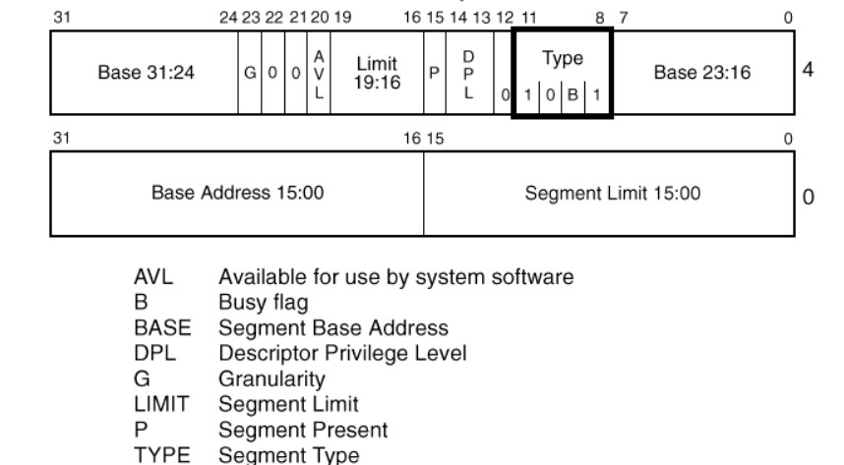
Task state segment descriptor
Fig. 2 :TSS Descriptor(32 bit)

Slide 49
TSS Descriptor
The B-bit in the type field indicates whether the task is busy. A type code of 9 indicates a non-busy task; a type code of 11 indicates a busy task.
The processor uses the Busy bit to detect an attempt to call a task whose execution has been interrupted.
Tasks are not reentrant/recursive.
The BASE, LIMIT, and DPL fields and the G-bit and P-bit have functions similar to their counterparts in data- segment descriptors.
The Limit field must have a value equal to or greater than 103(67H), one byte less than the minimum size of a task state. An attempt to switch to a task whose TSS descriptor has a limit less than 67H generates an exception.
Max(CPL,RPL) <= TSS DPL

Slide 50
How does Processor know which TSS to save the old task in?
In case of a Task switch, processor saves its complete context in a TSS and load a new context from another TSS.
When a new task begins, Task Register is updated with a selector to new task’s TSS.
Current context is saved in the TSS pointed to by Task Register.

Slide 51
TR: Task Register
It holds 16 bit selector pointing to TSS descriptor (in GDT ) of current task being executed by processor.
The task register has both a "visible" portion and an "invisible" portion.
The selector in the visible portion selects a TSS descriptor in the GDT.
The processor uses the invisible portion to cache the base and limit values from the TSS descriptor.

Slide 52
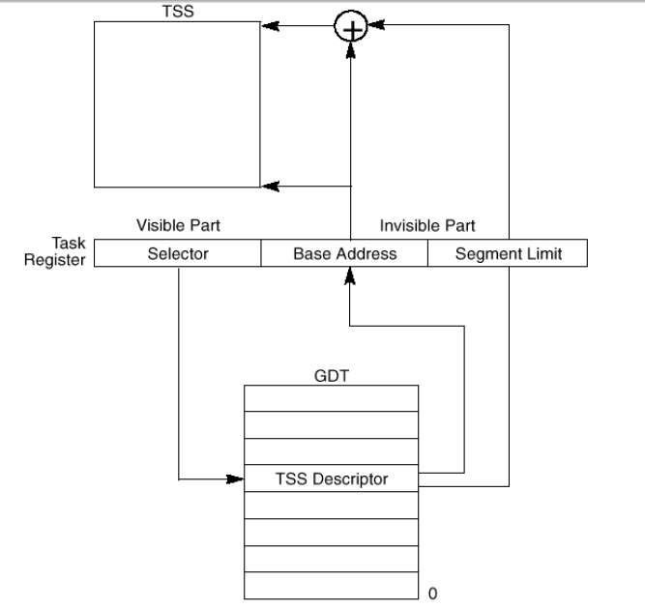
Task Register
Fig. 3 :Task Register

Slide 53

Task Register
LTR (Load task register) :
Loads the visible portion of the task register with the operand, which must index to a TSS descriptor in the GDT.
The LTR instruction also loads the invisible portion with information from the TSS descriptor.
The LTR instruction is a privileged instruction; it may be executed only when the CPL is 0.
The LTR instruction generally is used during system initialization to put an initial value in the task register; afterwards, the contents of the TR register are changed by events which cause a task switch.
STR (Store task register):
stores the visible portion of the task register in a general register or memory.
STR is not privileged.

Slide 54
Virtual memory to each task
GDT- 8191 descriptors
LDT-8192 descriptors
Each descriptor can define a segment up to 4GB
Total memory = 4GB (8191+8192)
= 4GB x 16381
= 64 Tera Bytes

Slide 55
Task Gate
In Task switch, a program is deliberately putting itself to sleep and awakening another.
The new task receives no parameters from the old task.
Two tasks are totally separate.
Task Switch can take place either through TSS descriptor or through Task Gate.

Slide 56
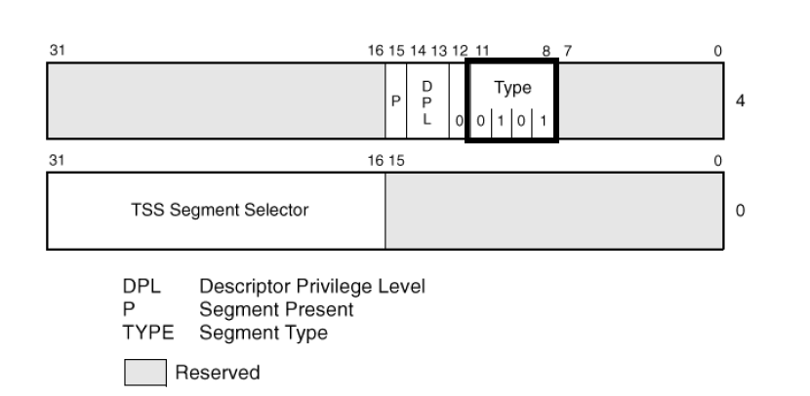
Task gate descriptor
Fig. 5 :Task Gate Descriptor

Slide 57
Task gate descriptor
A task gate descriptor provides an indirect, protected reference to a TSS. Figure 5 illustrates the format of a task gate descriptor.
The SELECTOR field of a task gate must refer to a TSS descriptor. The value of the RPL in this selector is not used by the processor.
The DPL field of a task gate controls the right to use the descriptor to cause a task switch.
A procedure may not select a task gate descriptor unless the maximum of the selector's RPL and the CPL of the procedure is numerically less than or equal to the DPL of the descriptor.
Max(CPL,RPL) <= TSS DPL
Task gate can reside anywhere in GDT, LDT or IDT.

Slide 58
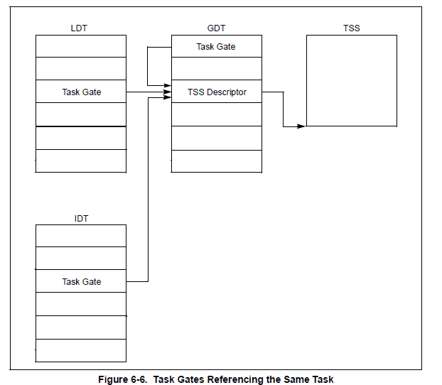
Figure 6 illustrates How both a task gate in an LDT and a task gate in the IDT can identify the same task.

Slide 59
Task Switching
The Processor switches execution to another task in any of four cases:
The current task executes a JMP or CALL that refers to a TSS
descriptor.
The current task executes a JMP or CALL that refers to a task gate.
An interrupt or exception vectors to a task gate in the IDT.
The current task executes an IRET when the NT flag is set.

Slide 60
A task switching operation involves these steps:
Checking that the current task is allowed to switch to the designated task(New task).
Checking that the TSS descriptor of the new task is marked present and has a valid limit.
Saving the state of the current task.
Loading the task register with the selector of the incoming (New) task’s TSS descriptor
Loading the incoming(New) task’s state from its TSS and continue execution

Slide 61
NT : Nested Task
The previous task link field of the TSS (sometimes called the “back link”) and the NT flag in the
EFLAGS register are used to return execution to the previous task.
The NT flag indicates whether the currently executing task is nested within the execution of another task.
The previous task link field of the current task's TSS holds the TSS selector for the higher-level task .

Slide 62
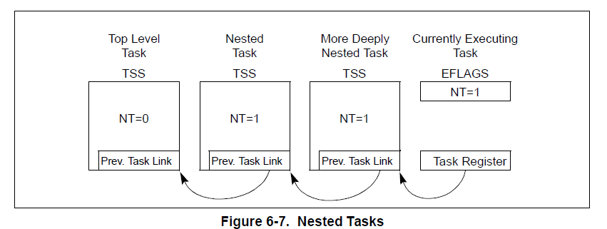
Task Linking

Slide 63
IOPL flag
This two-bit field applies to Protected Mode.
IOPL indicates the numerically maximum CPL value permitted to execute I/O instructions without generating an exception fault or consulting the I/O Permission Bitmap.
Task switches can always alter the IOPL field, when the new flag image is loaded from the incoming task's TSS.
I/O instructions can be unconditionally performed when CPL <= IOPL.
The I/O instructions are IN, OUT, INS, OUTS, REP INS, and REP OUTS.
When CPL > IOPL, and the current task is associated with a TSS, the I/O Permission Bitmap (TSS) is consulted on whether I/O to the port is allowed for that task.

