Slide 1
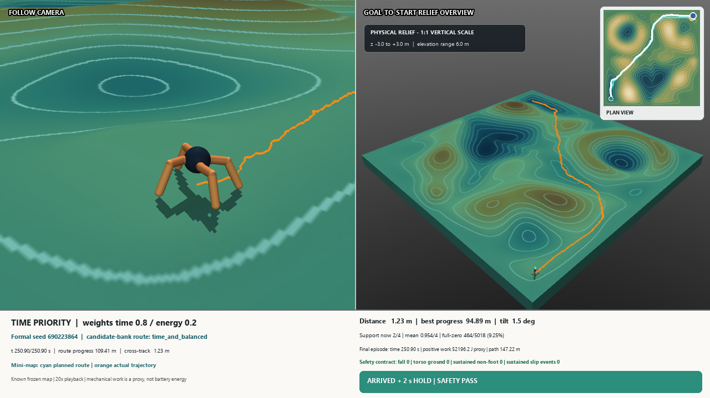
[Speaker A Pinyin]
From reward shaping to verified terrain navigation
A two-stage PPO–Ant study
6 / 6 formal completions
0 falls
0 sustained slip events
Known frozen map · candidate-bank near-optimal · not unseen-map generalisation
Project formal result, 20 Aug 2026; video manifest 60498def…c024.
01
Notes:
Speaker notes: see docs/FINAL_PRESENTATION_CONTENT_DESIGN_V2_20260820_CN.md for the timed script and evidence boundaries.

Slide 2
[Speaker A Pinyin]
Two stages increased task complexity while retaining one baseline
1
2
3
Legacy V1
Stage 1 / Project V2
Stage 2 / Project V3
Early control-cost and reward attempts
Problem discovery
Directed flat locomotion
Reward, posture and contact diagnostics
Continuous terrain mission
PAIR0, slopes, turning, planning and preferences
Research question
Can a locomotor progress from stable direction control to safe, preference-aware completion on continuous terrain?
Project reward history; terrain protocols; final V3 system report.
02
Notes:
Speaker notes: see docs/FINAL_PRESENTATION_CONTENT_DESIGN_V2_20260820_CN.md for the timed script and evidence boundaries.

Slide 3
[Speaker A Pinyin]
The defensible baseline is locally reproduced Ant-v5 + PPO
Ant-v5
PPO
Project baseline
Environment definition
8 torque actions
Standard forward-locomotion objective
Algorithmic provenance
Clipped surrogate policy-gradient family
Matched budgets and seeds
Local Ant-v5 + PPO reproduction
Numerical comparator for Stage 1
Controller lineage for Stage 2
Key distinction
Farama is documentation, not the baseline paper. Published studies anchor method choices; matched local runs support numerical claims.
Farama Foundation (n.d.); Schulman et al. (2016, 2017); Fu et al. (2022).
03
Notes:
Speaker notes: see docs/FINAL_PRESENTATION_CONTENT_DESIGN_V2_20260820_CN.md for the timed script and evidence boundaries.

Slide 4
[Speaker B Pinyin]
Human intent was separated from the reward optimised by PPO
1 Optimised reward
speed · direction · posture · action rate · landing · support
2 Independent diagnostics
path efficiency · heading error · tilt · contact sequence · mechanical proxies
3 Hard mission gate
arrival 1.5 m → 2 m dwell for 2 s → finite + no fall/torso/sustained non-foot/slip
Only trajectories that passed validity and safety were ranked by time and work proxy.
Ng, Harada and Russell (1999); Pan, Bhatia and Steinhardt (2022); Skalse et al. (2022).
04
Notes:
Speaker notes: see docs/FINAL_PRESENTATION_CONTENT_DESIGN_V2_20260820_CN.md for the timed script and evidence boundaries.

Slide 5
[Speaker B Pinyin]
Stage 1 reshaped locomotion without changing the 8-D action space
Target motion
Posture
Action quality
Contact
speed and forward-direction tracking
vertical, angular and signed-pitch terms
action-rate and saturation diagnostics
foot-landing and support diagnostics
Ant body · 8 torque actions · matched PPO environment and budget
Retained
The external action limiter is a controller intervention, not a learned biological gait mechanism.
Project Stage-1 reward history; Raffin, Kober and Stulp (2022); Aractingi et al. (2023).
05
Notes:
Speaker notes: see docs/FINAL_PRESENTATION_CONTENT_DESIGN_V2_20260820_CN.md for the timed script and evidence boundaries.

Slide 6
[Speaker B Pinyin]
Stage 1 improved selected diagnostics—not a biologically verified gait
Direction and smoothness
Contact coordination
Action roughness 0.0139 → 0.00985
Mean speed 0.844 → 0.918 m/s
Path efficiency 0.809 → 0.857
Mean take-offs 21.1 → 3.77
No-floor fraction 0.526 → 0.465
Mean speed 0.961 → 0.931 m/s
The walk looked more coordinated, but duty factor, phase and contact ordering were not frozen as biological validation metrics.
Boundary
Project Stage-1 development reports; Fu et al. (2022).
06
Notes:
Speaker notes: see docs/FINAL_PRESENTATION_CONTENT_DESIGN_V2_20260820_CN.md for the timed script and evidence boundaries.

Slide 7
[Speaker C Pinyin]
Stage 2 exposed three different failure layers
Low level
Mid level
High level
Contact and locomotion
135-D observation = 122-D locomotion + 13-D local terrain preview
PAIR0 improved distal support
Turning and waypoint following
V5: slope PASS, turn FAIL
Reliable left/right response remained checkpoint-dependent
Global route selection
Direct-goal PAIR0 best progress: 14.51 m in 600 s
Low-level policy never saw the full map
Improving support did not automatically solve steering or route choice.
Miki et al. (2022); PAIR0 V3, V5 turn and post-seal map evaluations.
07
Notes:
Speaker notes: see docs/FINAL_PRESENTATION_CONTENT_DESIGN_V2_20260820_CN.md for the timed script and evidence boundaries.

Slide 8
[Speaker C Pinyin]
PAIR0 improved support and tested slope safety—but airborne gait remained
24.04%
→ 3.21%
Slope boundary (tested grid)
Uphill: contiguous pass through 12°
16°: first tested failure
Downhill: non-monotonic
55 / 55 episodes: 0 fall, torso-ground, sustained non-foot or sustained corrected-slip events
full-control zero-foot
0.353
→ 1.344
mean supporting feet
12° is not a physical maximum, and PAIR0 is not a claim that MuJoCo was “fixed”.
Project PAIR0 L2b V3 and slope-boundary manifests; Lee et al. (2020).
08
Notes:
Speaker notes: see docs/FINAL_PRESENTATION_CONTENT_DESIGN_V2_20260820_CN.md for the timed script and evidence boundaries.

Slide 9
[Speaker C Pinyin]
The successful solution was hierarchical—not another reward term
Frozen 1025×1025 map
15 route / speed candidates
3 m waypoint lookahead
Archived V4 expert
8 joint torques
Full map
Global structure
Local command
135-D local sensing
Rejected en route
Naïve V4 / PAIR0 action blending fell after 15.3 s; the final architecture kept contact and planning roles explicit.
Project checkpoint screen, slope screen and waypoint-route evidence.
09
Notes:
Speaker notes: see docs/FINAL_PRESENTATION_CONTENT_DESIGN_V2_20260820_CN.md for the timed script and evidence boundaries.

Slide 10
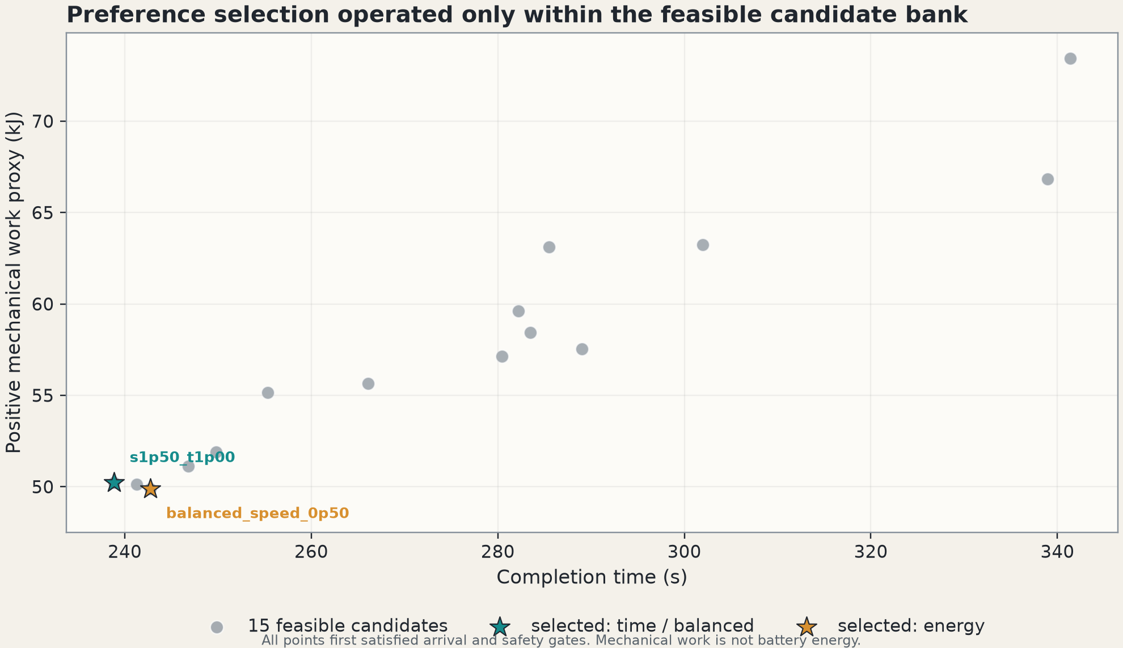
[Speaker D Pinyin]
Three preferences selected two routes from 15 feasible candidates
Time 0.8 / 0.2
s1p50_t1p00
Balanced 0.5 / 0.5
same route contract
Energy 0.2 / 0.8
balanced_speed_0p50
J = wT(T/Tmin) + wE(W+/W+min)
Near-optimal within the candidate bank; not a global optimum.
Project candidate-selection JSON 212b7886…f20b; Fu et al. (2022) for mechanical-energy context.
10
Notes:
Speaker notes: see docs/FINAL_PRESENTATION_CONTENT_DESIGN_V2_20260820_CN.md for the timed script and evidence boundaries.

Slide 11
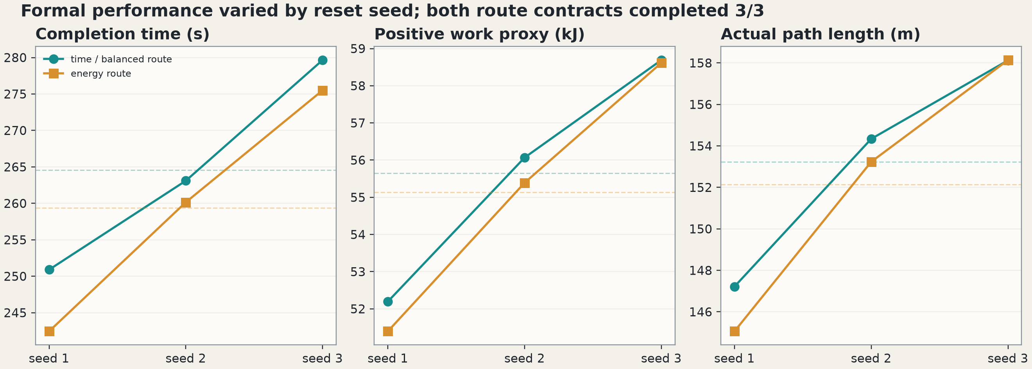
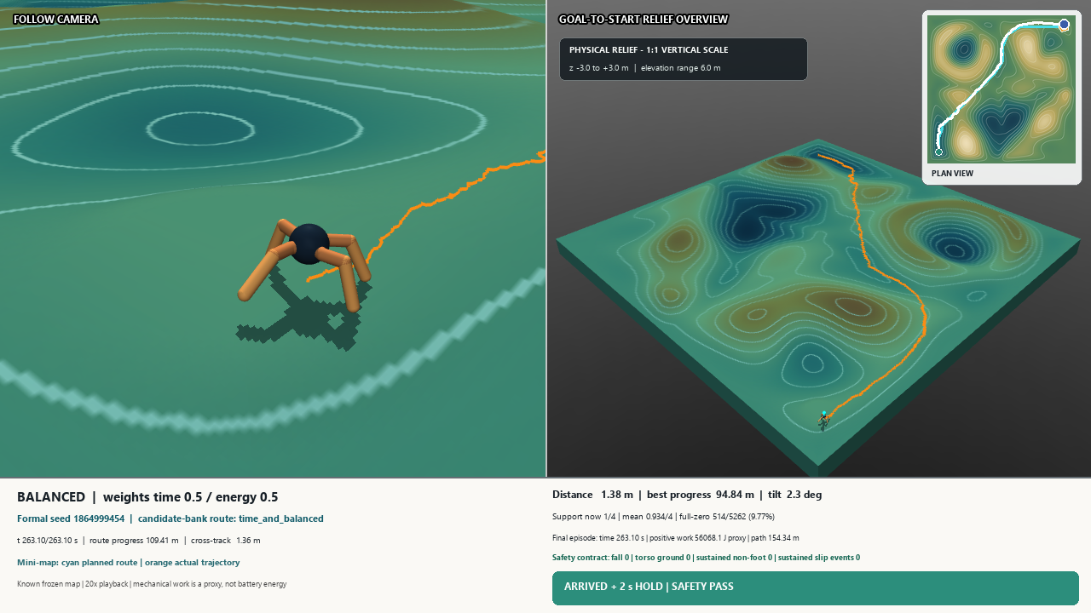
[Speaker D Pinyin]
All six formal episodes reached the goal without sustained slip events
Video 2: balanced route · exact formal replay
time / balanced
3/3 · 264.55 s · 55.65 kJ proxy · 153.23 m
energy
3/3 · 259.37 s · 55.13 kJ proxy · 152.14 m
0 falls · 0 sustained slip events
Airborne exposure remained: representative runs had 9.25–10.02% full-control zero-foot intervals.
Project formal manifest 0bf2817c…8d83; video manifest 60498def…c024.
11
Notes:
Speaker notes: see docs/FINAL_PRESENTATION_CONTENT_DESIGN_V2_20260820_CN.md for the timed script and evidence boundaries.

Slide 12
[Speaker D Pinyin]
Method provenance and comparator literature
Aractingi et al. (2023) Scientific Reports 13, 11945. doi:10.1038/s41598-023-38259-7.
Farama Foundation (n.d.) Ant. Gymnasium Documentation.
Fu et al. (2022) PMLR 164, pp. 928–937.
Lee et al. (2020) Science Robotics 5(47), eabc5986.
Miki et al. (2022) Science Robotics 7(62), eabk2822.
Ng, Harada and Russell (1999) ICML, pp. 278–287.
Pan, Bhatia and Steinhardt (2022) ICLR 2022.
Raffin, Kober and Stulp (2022) PMLR 164, pp. 1634–1644.
Schulman et al. (2016) ICLR.
Schulman et al. (2017) arXiv:1707.06347.
Skalse et al. (2022) NeurIPS 35.
Project configurations, raw traces, videos and SHA-256 manifests are listed in the evidence appendix.
Full URLs/DOIs are retained in the report bibliography; accessed 20 Aug 2026 where applicable.
12
Notes:
Speaker notes: see docs/FINAL_PRESENTATION_CONTENT_DESIGN_V2_20260820_CN.md for the timed script and evidence boundaries.

Slide 13
[Speaker D Pinyin]
What is established—and where does the evidence stop?
Established
Not established
• selected Stage-1 motion diagnostics
• PAIR0 support under the frozen model
• tested slope boundaries
• 6/6 known-map completion
• exact replay and full video decode
• biologically natural gait
• unseen-map generalisation
• independent training-seed robustness
• electrical energy
• a continuous global optimum
The result is architectural: auditable failures revealed the layers required for reliable completion.
Questions
Project final report and evidence manifests, 20 Aug 2026.
13
Notes:
Speaker notes: see docs/FINAL_PRESENTATION_CONTENT_DESIGN_V2_20260820_CN.md for the timed script and evidence boundaries.

