Slide 1
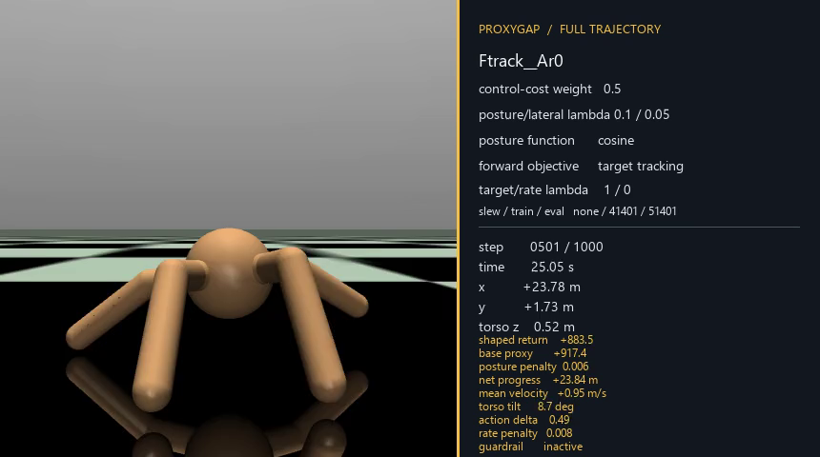
ProxyGap
Auditing reward misspecification and developing a bounded mitigation in Ant-v5 locomotion
Team progress update | 16 August 2026
Project-generated frame · fixed midpoint · complete 50 s episode
Notes:
The cover frame is qualitative context only. It was selected deterministically as the fixed 25.05 s midpoint of the first entry in the public video index, rather than by visual outcome.
[Sources]
- Project visual: Ftrack__Ar0__tr41401__ev51401__t1000000.png; step 501/1000; 25.05 s; training seed 41401; evaluation seed 51401; 1,000,000 training steps; PNG SHA-256 F937FD06C91BB9E4D4259753371CAD5728A841CF43EFA2065E8342C1D2CDF099.
- Public provenance: results/development_20260816/target_and_action_rate_1m/8_16_trials_3__VIDEO_INDEX.json; source MP4 SHA-256 89CF97B2F513196573F3B9E84D35874190FE5F92A8119BBC4343BC0D2FFB60B0.
[/Sources]

Slide 2
The study now audits the default reward first
02
A coefficient sweep compares alternative scalar proxies without first establishing whether the default proxy represents the intended-behaviour contract.
Earlier lens
Current question
Vary ctrl_cost_weight.
Audit the default reward against a declared contract.
Compare proxy return and diagnostics.
Seek a reproducible proxy–diagnostic disagreement.
Risk: one incomplete scalar proxy versus another.
Test one bounded mitigation only after protocol freeze.
Historical weight sweep
Retained as retrospective exploratory evidence—not discarded and not the central experiment.
Project evidence: RESEARCH_DIRECTION_20260816; CURRENT_DEVELOPMENT_SYNTHESIS_20260816.
Notes:
The project direction changes from coefficient comparison to construct audit, followed by bounded mitigation development.
[Sources]
- Project source: docs/RESEARCH_DIRECTION_20260816.md.
- Project source: reports/CURRENT_DEVELOPMENT_SYNTHESIS_20260816.md.
[/Sources]

Slide 3
One scalar proxy can miss a behavioural vector
03
01
02
03
Platform task
Training proxy
Diagnostic vector
Ant-v5 coordinates four legs to move in +x for up to 1,000 steps.
PPO maximises expected return: forward reward + healthy reward − control cost − clipped contact cost.
A project-defined contract audits speed, posture, termination, direction, path, action quality and body dynamics. It is not a true reward.
Key question
Can higher default return coexist with failure of a predeclared minimum requirement or a practically important deterioration in the diagnostic vector?
Sources: Farama Foundation (n.d.); Skalse et al. (2022); project diagnostic contract.
Notes:
The slide separates the task, the optimiser-facing scalar proxy and researcher-facing external diagnostics.
[Sources]
- Farama Foundation (n.d.), Ant documentation: https://gymnasium.farama.org/environments/mujoco/ant/ (accessed 16 August 2026).
- Skalse et al. (2022): https://proceedings.neurips.cc/paper_files/paper/2022/file/3d719fee332caa23d5038b8a90e81796-Paper-Conference.pdf.
- Project source: docs/INTENDED_BEHAVIOUR_CONTRACT_V2_20260816.md.
[/Sources]

Slide 4
Intended behaviour is a diagnostic vector
04
Project-defined evaluation contract—not an invented “true reward” and not an Ant-v5 default target.
Minimum requirements
Full horizon; no unhealthy termination; no sustained inversion.
1.0 m/s
forward command
Quality diagnostics
Torso tilt; direction error; path efficiency; action roughness; saturation; take-offs and floor contact.
1,000 steps
50 s fixed horizon
Fair comparison
Identical evaluation seeds pair initial-state disturbances across policies; training runs remain the independent replication unit.
STATUS Development-frozen; not yet formally frozen
Thresholds are flat-ground project criteria—not universal robot-safety standards.
Project evidence: hybrid_intent_constraint_design_v1; INTENDED_BEHAVIOUR_CONTRACT_V2.
Notes:
The intended behaviour is operationalised through a project-specific vector. Equal evaluation seeds pair initial conditions but do not add independent training replications.
[Sources]
- Project source: configs/hybrid_intent_constraint_design_v1_20260816.json.
- Project source: docs/INTENDED_BEHAVIOUR_CONTRACT_V2_20260816.md.
[/Sources]

Slide 5
The default reward omits key dimensions
05
The project-defined contract is broader than the scalar supplied to PPO.
Directly represented
Not directly required
Forward velocity
Target-speed tracking
Broad health state
Upright orientation
Action magnitude
Straight and efficient travel
Clipped contact cost
Smooth actions or a gait pattern
Contact clipping
Contact-force components are clipped before squaring; increases beyond the clipping bound do not further increase that component of the penalty.
Replicate an ordering disagreement → test a mechanism-specific candidate
Sources: Farama Foundation (n.d.); Pan, Bhatia and Steinhardt (2022); project contact diagnostic.
Notes:
The default reward has a narrower construct than the project-specific intended-behaviour contract. Mitigation testing follows replicated divergence, rather than replacing detection.
[Sources]
- Farama Foundation (n.d.), Ant documentation: https://gymnasium.farama.org/environments/mujoco/ant/ (accessed 16 August 2026).
- Pan, Bhatia and Steinhardt (2022): https://arxiv.org/abs/2201.03544.
- Project source: results/development_20260816/hybrid_guardrail/analysis__jump_contact_gait__jump_contact_gait_summary.json.
[/Sources]

Slide 6
Six rounds narrowed the development question
06
EXPLORATORY DEVELOPMENT PATHWAY — NOT CONFIRMATORY EVIDENCE
1
2
3
Orientation
Slew projection
Observable lateral term
Screened inversion behaviour.
Tested applied versus proposed actions.
Replaced hidden absolute y with lateral velocity.
4
5
6
Target + action rate
Contact diagnosis
Body shaping + gSDE
Tested target tracking and proposal smoothness.
Documented residual take-off and flight.
Screened body dynamics and frequency-8 generalised State-Dependent Exploration.
Project evidence: TEAM_PROGRESS_UPDATE_20260816; CURRENT_DEVELOPMENT_SYNTHESIS_20260816.
Notes:
Each development round changed a limited declared factor set and retained negative results. The slide uses neutral verbs because these are exploratory screens.
[Sources]
- Project source: docs/TEAM_PROGRESS_UPDATE_20260816.md.
- Project source: reports/CURRENT_DEVELOPMENT_SYNTHESIS_20260816.md.
[/Sources]

Slide 7
One replay documented repeated flight
07
Rt0p1_Rvy0__K1p1 | training seed 41301 | evaluation seed 51301 | 300,000 training steps | 50 s
15
52.9%
2.540 m/s
take-offs with root vertical
velocity ≥ 1.25 m/s
steps without floor contact
maximum root vertical velocity
In this episode, low action roughness coexisted with repeated flight.
Boundary: one deterministic replay identifies a candidate failure mode; it is not a prevalence estimate, mechanism proof or causal result.
Source · jump_contact_gait_summary.json · replay error ≤ 7.2 × 10⁻¹⁵
Notes:
The exact replay matches the logged episode within floating-point tolerance. The take-off definition is root vertical velocity at least 1.25 m/s.
[Sources]
- Project source: results/development_20260816/hybrid_guardrail/analysis__jump_contact_gait__jump_contact_gait_summary.json.
- Project source: results/development_20260816/hybrid_guardrail/8_16_trials_1__VIDEO_INDEX.json.
[/Sources]

Slide 8
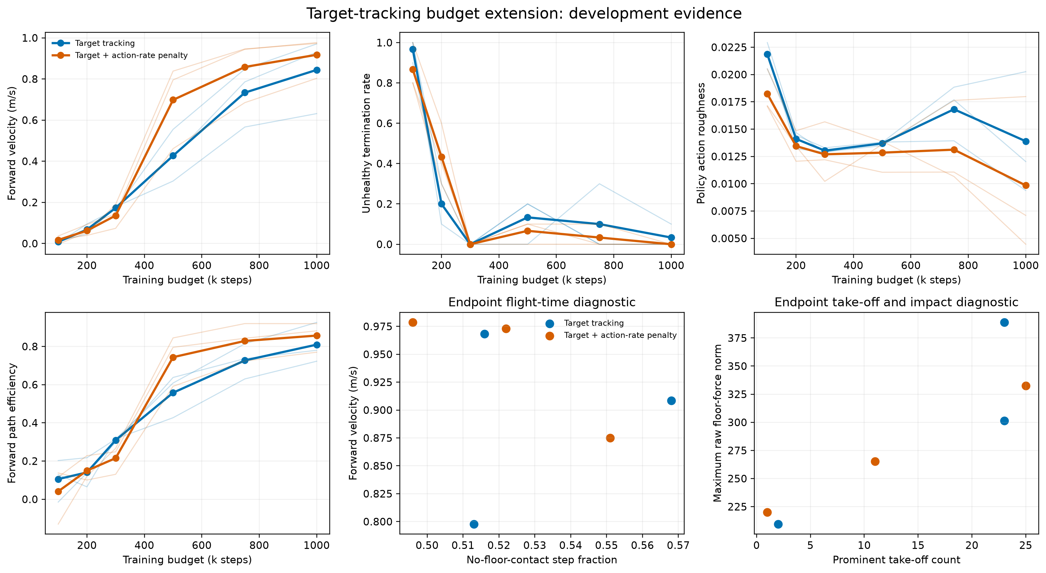
Action-rate shaping left major trade-offs
08
Speed 0.844 → 0.918 m/s | roughness 0.0139 → 0.00985 | path efficiency 0.809 → 0.857
Direction error 6.40° → 10.65° | intent compliance 23.3% → 6.7% | exploratory hopping flag 100% in both
Development means: n=3 independent policies/condition; 10 core episodes/policy; contact diagnostic used one fixed replay seed/policy.
Notes:
Both conditions used target-speed tracking; the comparison factor is the action-rate shaping weight. Some diagnostics improved while others deteriorated, and repeated flight remained.
[Sources]
- Project source: results/development_20260816/target_and_action_rate_1m/analysis__target_budget_extension_summary.json.
- Project visual: results/development_20260816/target_and_action_rate_1m/analysis__target_budget_extension_summary.png; SHA-256 A111D66D81245866641052D743133EC734AC2B874EA582491200231F25FA8F9F.
[/Sources]

Slide 9
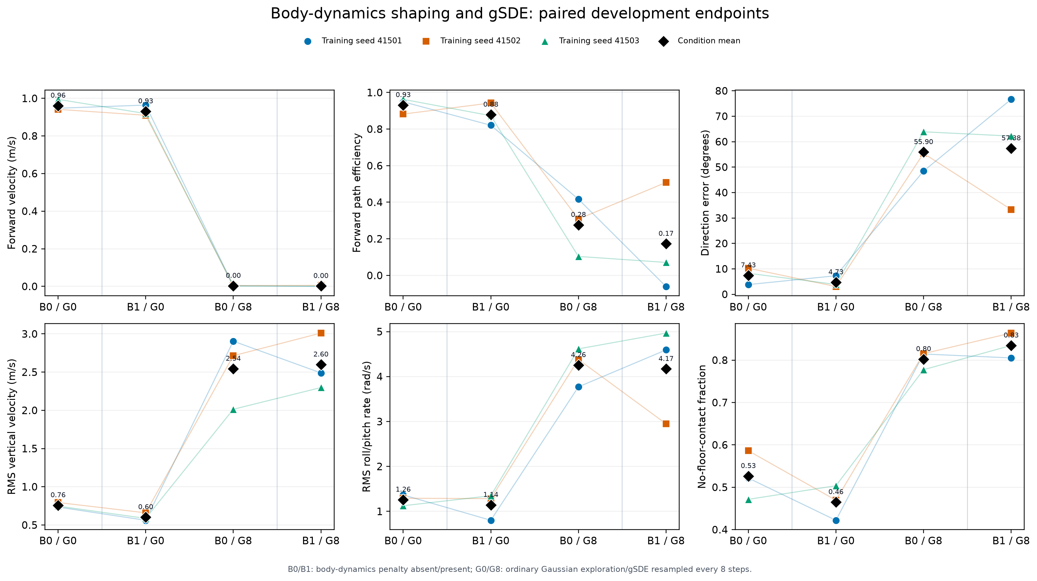
Body shaping helped; frequency-8 gSDE failed
09
Gaussian exploration: speed 0.961 → 0.931 m/s | no-floor 0.526 → 0.465 | take-offs 21.1 → 3.77
Path efficiency 0.931 → 0.879 | intent compliance 0% in both | gSDE G8: 100% unhealthy termination
Partial development candidate only: n=3 independent policies/cell; 10 endpoint episodes/policy; rejects only this gSDE setting.
Notes:
Body-dynamics shaping reduced several hopping diagnostics under ordinary Gaussian exploration, but it did not satisfy the complete intent contract. The gSDE conclusion is restricted to the tested frequency-8 configuration.
[Sources]
- Raffin, Kober and Stulp (2022): https://proceedings.mlr.press/v164/raffin22a.html.
- Project source: configs/body_smoothness_gsde_matrix_v1_20260816.json.
- Project source: results/development_20260816/body_dynamics_gsde_1m/analysis__body_smoothness_gsde_summary.json.
- Project visual: results/development_20260816/body_dynamics_gsde_1m/analysis__body_smoothness_gsde_endpoint_summary.png; SHA-256 89A14D4FDE89A2435CC2350934886FA4F544F1161882665A0B27566B7ADE6F40.
[/Sources]

Slide 10
Two scientific definitions remain open
10
These definitions determine what the final experiment can legitimately claim.
01
02
Biological gait has not been operationalised
Applied-action smoothness is not learned-policy smoothness
Current metrics describe stability, direction, action quality and contact behaviour—not a frozen crawl, trot, pace or bound classifier.
The external projection intervened on approximately 98.4–98.7% of steps. Smooth applied actions therefore did not establish smooth PPO proposals.
Implication
Report proposed and applied actions separately; make no biological-gait claim without a predeclared contact-phase or validated gait-classification protocol.
Sources: Aractingi et al. (2023); observability-correction config; TEAM_PROGRESS_UPDATE; CURRENT_DEVELOPMENT_SYNTHESIS.
Notes:
The first open problem is construct definition. The second is attribution between a learned policy proposal and a downstream projection layer.
[Sources]
- Aractingi et al. (2023): https://doi.org/10.1038/s41598-023-38259-7.
- Project source: configs/hybrid_guardrail_observability_correction_v1_20260816.json.
- Project source: docs/TEAM_PROGRESS_UPDATE_20260816.md.
- Project source: reports/CURRENT_DEVELOPMENT_SYNTHESIS_20260816.md.
- Machine-readable local evidence retained in authoring archive: endpoint_condition_summary.csv; SHA-256 11D74296C055506AF7D497952B7B6535C099B8554A9587186B381FF06E8554BC.
[/Sources]

Slide 11
The next gate is protocol freeze
11
Development analyses completed; the formal candidate is not yet engineering-validated; the scientific claim remains unresolved; held-out training is not authorised.
STAGE 1
STAGE 2
Freeze the audit
Implement, test, then authorise
Freeze behaviour and default-reward audit
Select one reward package and constraint
Freeze seeds, checkpoints, metrics and reruns
Implement wrapper; pass engineering tests
Freeze uncertainty, exclusions and stopping
Authorise the formal 2 × 2 only after freeze
TEAM DECISIONS
Gait scope
Candidate
Summary
General stable locomotion or a specified gait family?
Is body shaping coherent enough for the final development gate?
Use a percentage matrix only as a secondary view beside continuous metrics.
Project evidence: RESEARCH_DIRECTION_20260816; hybrid_intent_constraint_design_v1; PUBLIC_RELEASE_CONTENTS_20260816.
Notes:
The verified execution state records that the candidate constraint wrapper is not implemented, engineering tests have not passed and held-out training is not authorised. The current formal design is a reward-by-constraint 2 × 2 ablation after candidate selection and freeze.
[Sources]
- Project source: docs/RESEARCH_DIRECTION_20260816.md.
- Project source: configs/hybrid_intent_constraint_design_v1_20260816.json.
- Project source: docs/PUBLIC_RELEASE_CONTENTS_20260816.md.
[/Sources]

Slide 12
References and project evidence
12
External sources
External and project sources
Farama Foundation (n.d.) ‘Ant’. Gymnasium documentation.
gymnasium.farama.org/environments/mujoco/ant/ (Accessed: 16 August 2026).
Skalse, J., Howe, N.H.R., Krasheninnikov, D. and Krueger, D. (2022) ‘Defining and Characterizing Reward Hacking’, NeurIPS, 35, pp. 9460–9471.
proceedings.neurips.cc/paper/2022/
Pan, A., Bhatia, K. and Steinhardt, J. (2022) ‘The Effects of Reward Misspecification: Mapping and Mitigating Misaligned Models’, ICLR.
arxiv.org/abs/2201.03544
Raffin, A., Kober, J. and Stulp, F. (2022) ‘Smooth Exploration for Robotic Reinforcement Learning’, PMLR, 164, pp. 1634–1644.
proceedings.mlr.press/v164/raffin22a.html
Aractingi, M. et al. (2023) ‘Controlling the Solo12 quadruped robot with deep reinforcement learning’, Scientific Reports, 13, 11945.
doi.org/10.1038/s41598-023-38259-7
Project snapshot · 16 August 2026 · base 2aa18d8
docs/
RESEARCH_DIRECTION_20260816.md
INTENDED_BEHAVIOUR_CONTRACT_V2_20260816.md
reports/
CURRENT_DEVELOPMENT_SYNTHESIS_20260816.md
results/development_20260816/
The project snapshot is development evidence—not held-out confirmation.
Notes:
Complete source URLs and project paths used across the deck are collected here and in the slide-level [Sources] blocks.
[Sources]
- Farama Foundation (n.d.): https://gymnasium.farama.org/environments/mujoco/ant/ (accessed 16 August 2026).
- Skalse et al. (2022): https://proceedings.neurips.cc/paper_files/paper/2022/file/3d719fee332caa23d5038b8a90e81796-Paper-Conference.pdf.
- Pan, Bhatia and Steinhardt (2022): https://arxiv.org/abs/2201.03544.
- Raffin, Kober and Stulp (2022): https://proceedings.mlr.press/v164/raffin22a.html.
- Aractingi et al. (2023): https://doi.org/10.1038/s41598-023-38259-7.
- Project snapshot: docs/RESEARCH_DIRECTION_20260816.md; docs/INTENDED_BEHAVIOUR_CONTRACT_V2_20260816.md; reports/CURRENT_DEVELOPMENT_SYNTHESIS_20260816.md; results/development_20260816/.
[/Sources]

