Slide 1
RESTURANTS

Slide 2



Slide 3
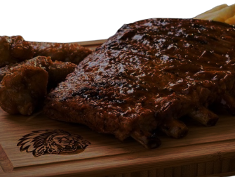



Slide 4



Slide 5




Slide 6
GROCERY STORES

Slide 7

Checkers

Slide 8
CLOTHING STORES

Slide 9



Slide 10

MR PRICE

Slide 11

EDGARS
SPECIALS

Slide 12
TECH AND MUSIC

Slide 13

