Slide 1
Group 2 Project IST 722
Customer Feedback for FudgeMart and FudgeFlix
Members:
Nithin Kumar Hadhge Girish Kumar

Slide 2
Goal: Focus on a particular Business
Process to be integrated with
FudgeMart and FudgeFlix
Resolution: Determining the Business Process of Customers
providing ratings for various titles and products
Process: Merged common attributes in FudgeMart and
FudgeFlix into one dimension/fact

Slide 3
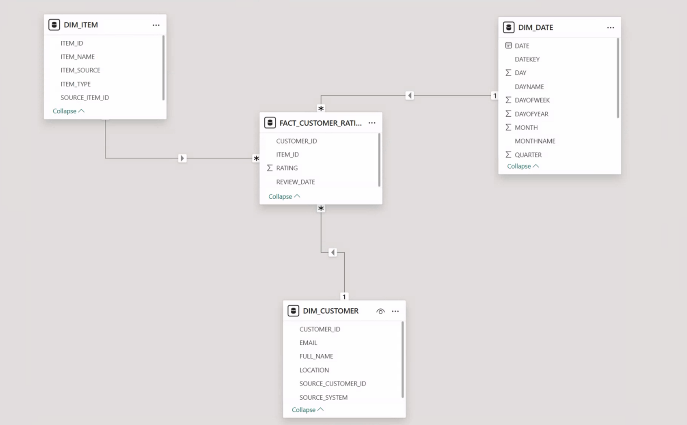
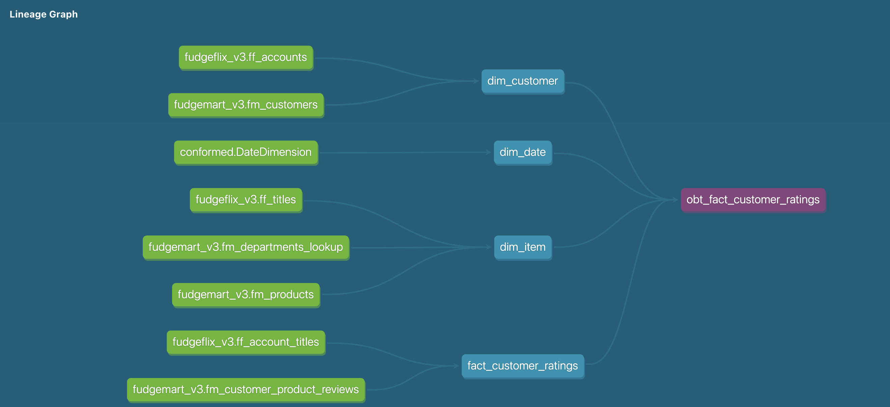
Linage graph
Star Schema – Merged Data Assumptions
Assumptions:-
Queue Date is Assumed as Review Date in FudgeFlix

Slide 4
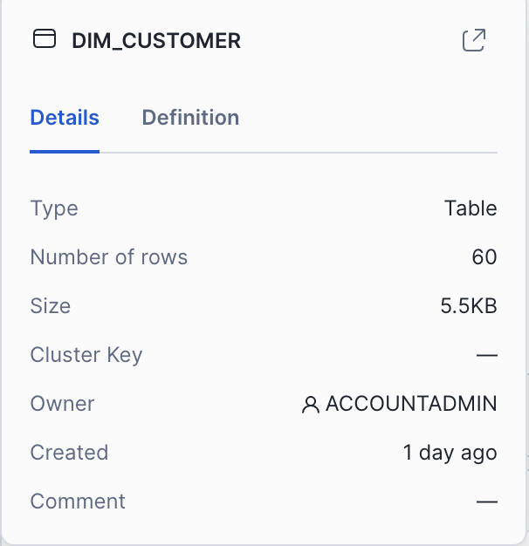
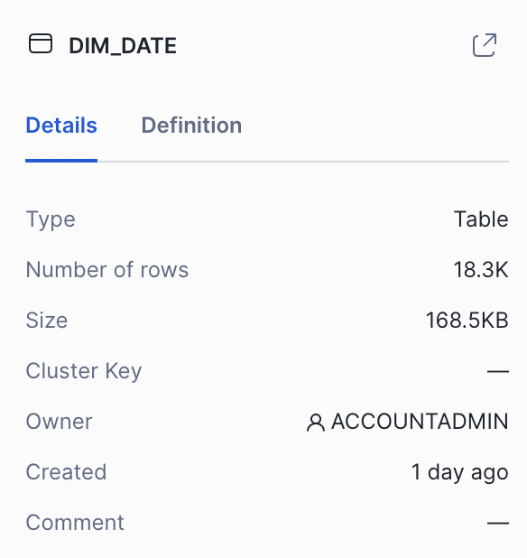
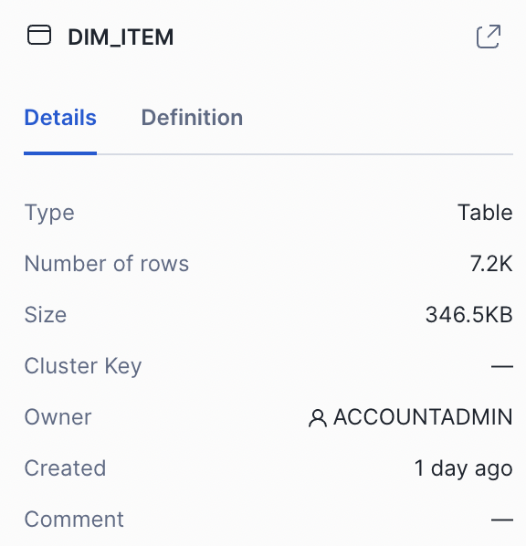
Table and Row Summary
DIM_CUSTOMER FM=25, FF=35
DIM_DATE
From 1970-2019
DIM_ITEM FM=53, FF= 7185

Slide 5
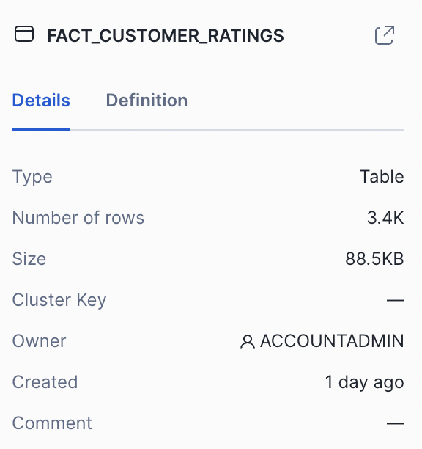
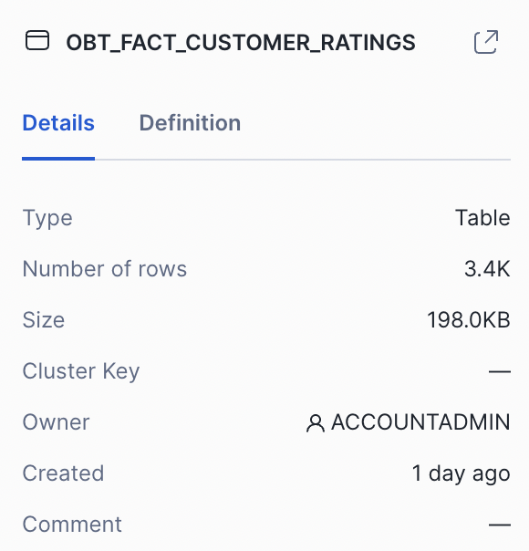
Table and Row Summary
FACT_CUSTOMER_RATINGS
FM=1039, FF=2368
OBT_FACT_CUSTOMER_RATINGS
FM=1039, FF=2368

Slide 6
Analysis of measure of Merged Level and 2 other levels
Average
Average Rating by Year
Average
Average rating By Category
Total
Total Rating By Customer
Total
Total Ratings by item_type

Slide 7
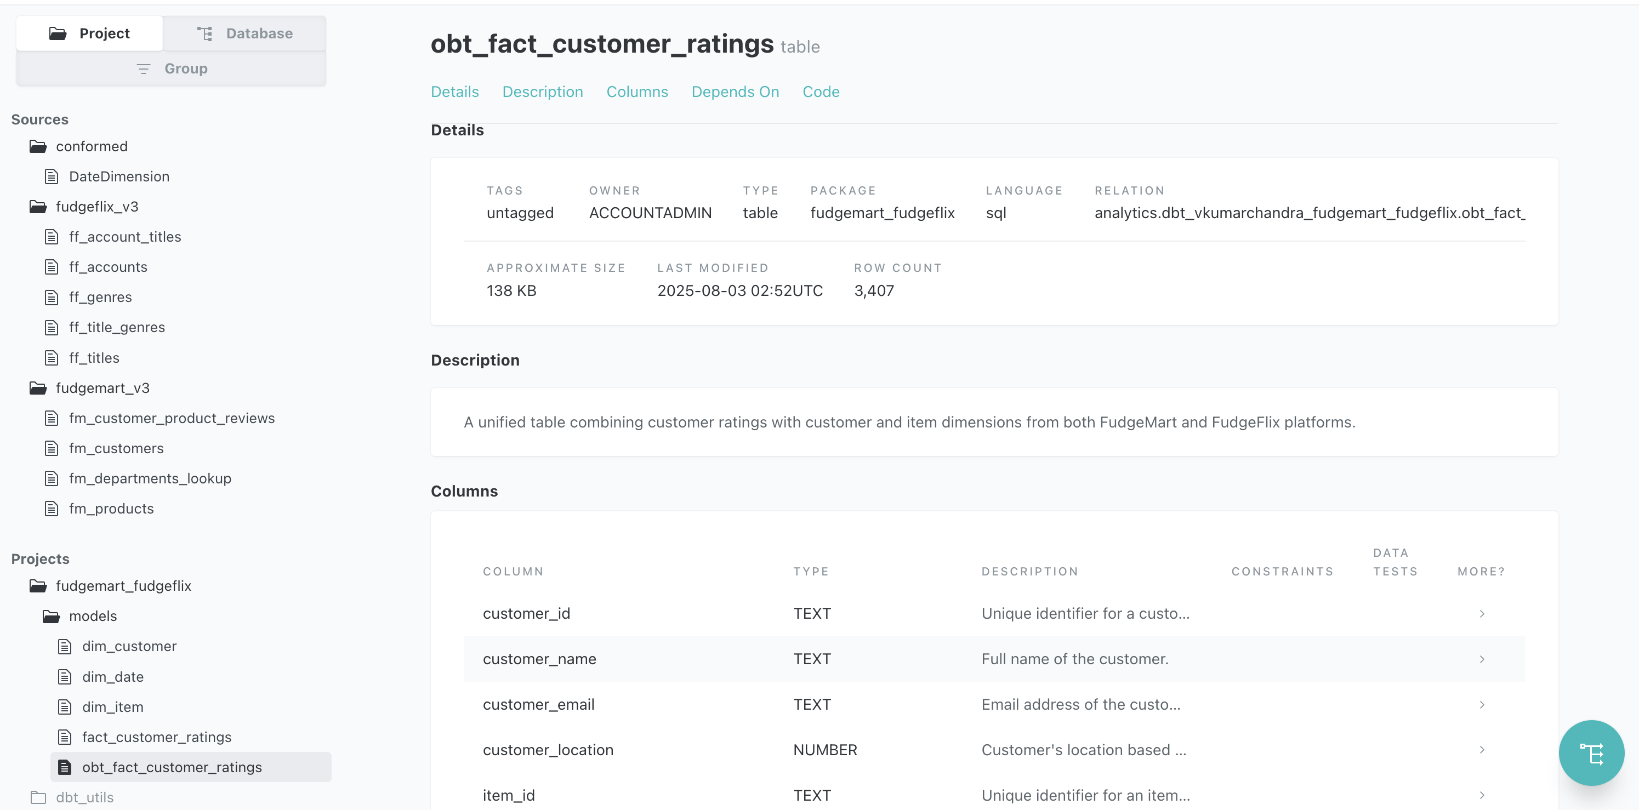
DBT

Slide 8
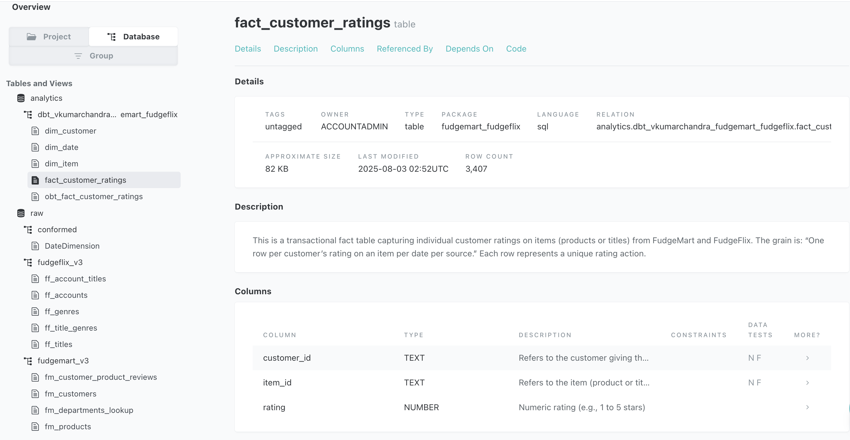
DBT

Slide 9
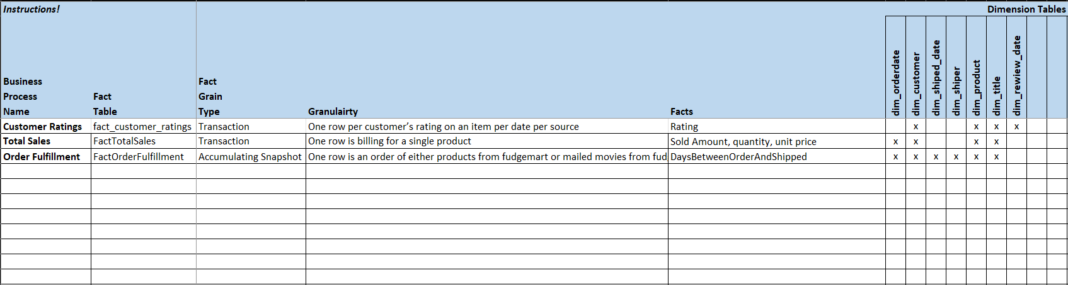
Solution Dimensional – HL design

Slide 10
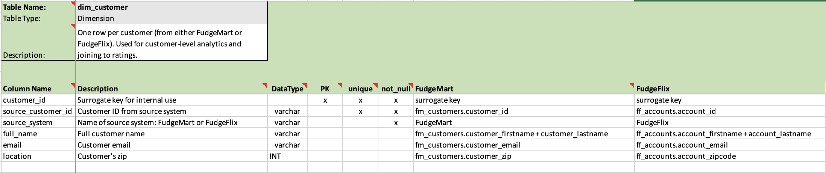
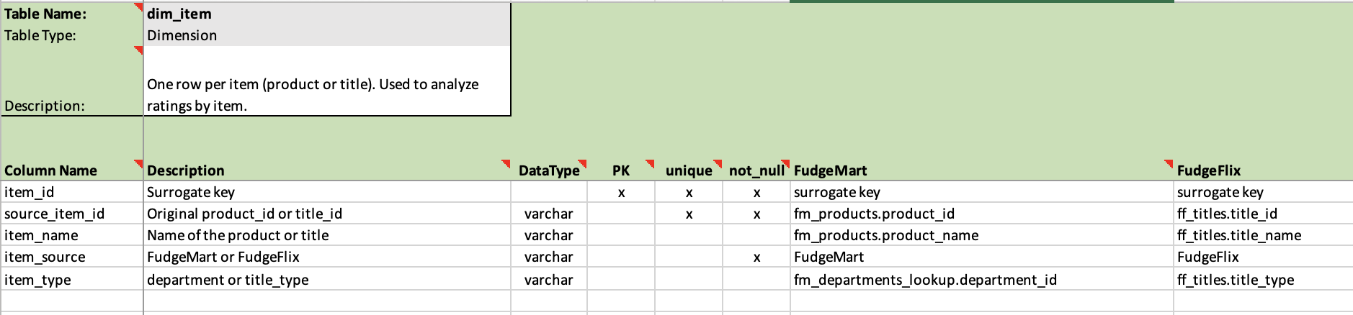
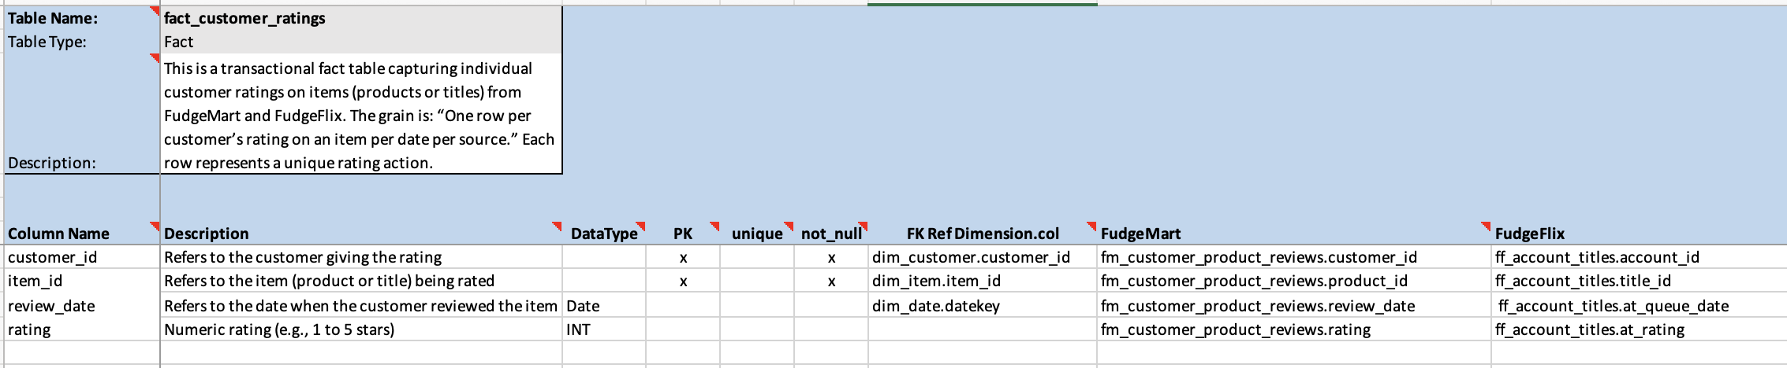
Detailed Design- dim_customer, dim_item, fact_customer_ratings

Slide 11
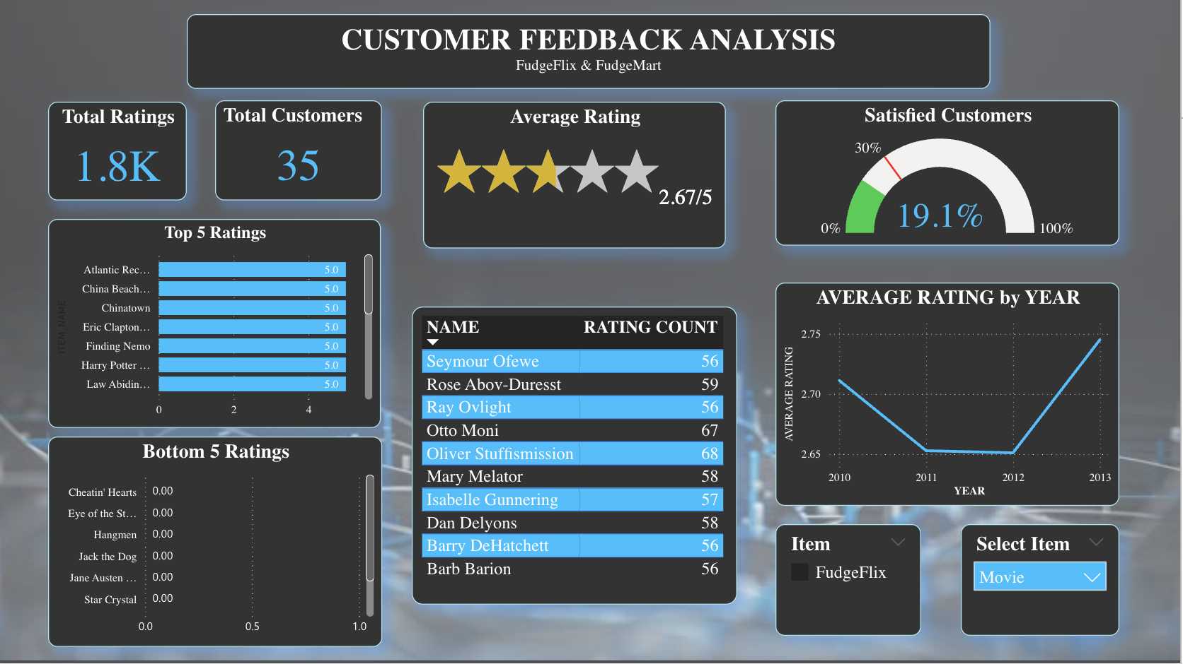
Power Bi - Customer Feedback Analysis FudgeFlix

Slide 12
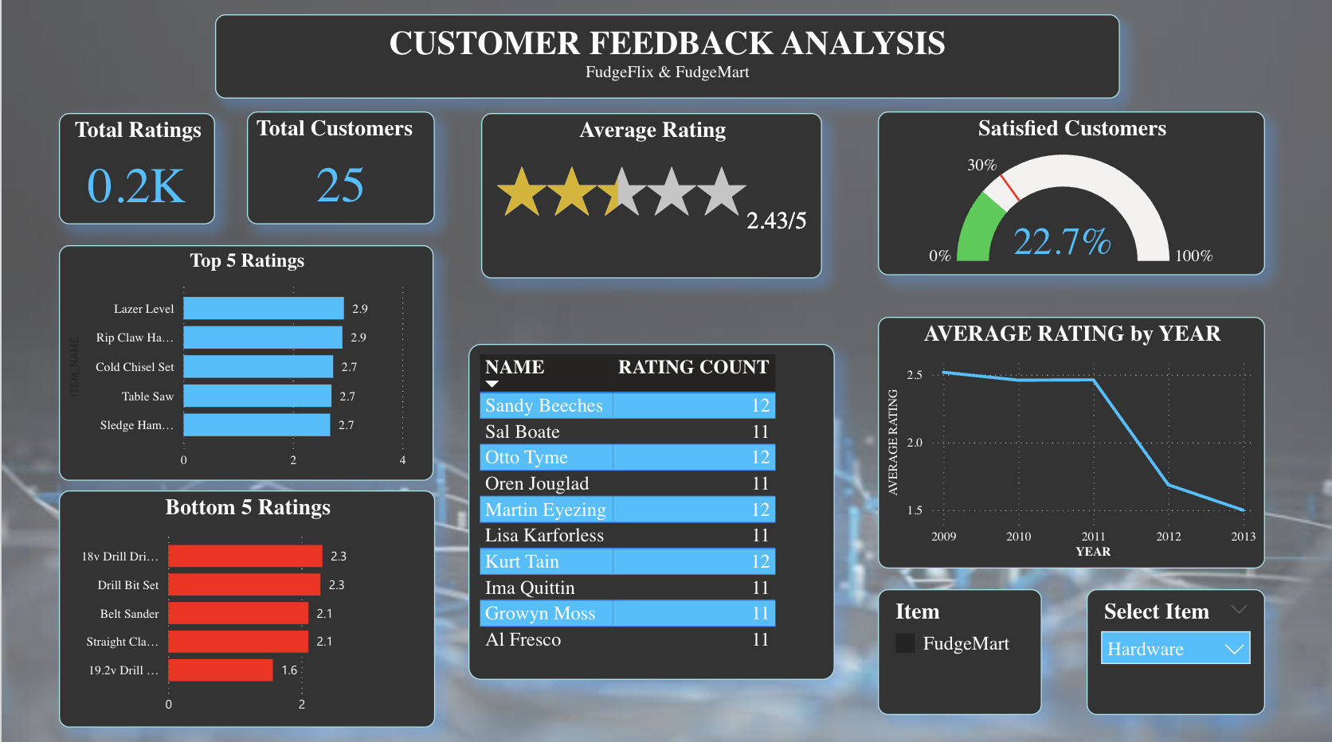
Power Bi - Customer Feedback Analysis FudgeMart

Slide 13
Recommendations
Add a type_genre attribute to the Item dimension table to better classify content categories.
Add a constraint on review ratings in the FudgeFlix dataset to ensure a minimum value of 1, preventing null or invalid ratings.
Enhance the customer location details in FudgeFlix by including fields for city, country, and region instead of relying solely on a postal code.
Challenges
Data creation at first went smoothly, however there was a missing
attribute in each table as to where the data originated from; FudgeMart or FudgeFlix

Slide 14
Questions?
Thank you !

