Slide 1

Speech Emotion Recognition on Augmented Data
Aristeidis Kalokyris (dit2106)
Nikolaos Katsimpras (dit2108)
Instructor:
T. Yannakopoulos

Slide 2



Project Outline
Selection of the Data Corpus (RAVDESS Data Set)
Exploration of the Feature Extraction techniques
Data Augmentation strategies
DL Model architectures selection
Model deployment and Hyper-parameter tuning
Comparison between the validation results of selected DL architectures

Slide 3




RAVDESS Data Set
The RAVDESS is a validated database of emotional speech and song, using face-and-voice, face-only, and voice-only formats, developed in 2018
Is gender balanced consisting of 24 (12 males & 12 female) professional actors, expressing several emotions
Statements are in a neutral North American accent, and emotions are balanced with 192 samples on average of each emotion
For our experiment we excluded the neutral emotion speech samples and kept: calm, sad, disgust, happy, angry, surprised and fearful

Slide 4
Feature Extraction
Zero Crossing Rate
Chroma standard Furrier transfer
Mel Frequency Cepstral Coefficients
The rate at which a signal is transitioned from positive to negative. Important for audio classification
Computes chromagram from a waveform spectrogram
Chromagram captures harmonic and melodic characteristics
Well-acclaimed characteristic for speech signal spectrum representation
The output of this feature is between the optimum frequencies, in order to get as much “dense” information about the audio sample
MFCC is filtering the audio signal by sampling energy in various sound zones
Root Mean Square Value
Mel-Spectogram
Metering tool that measures the average loudness of an audio
Can track within a range of 300 millisecond
Spectrograms distributed in the Mel scale
Mel scale: assigning an additional pitch to the existing frequency of an audio sample

Slide 5
Data Augmentation
Noise Insertion
Stretch
Pitch and shift
Relatively simple technique multiplying the max signal freq. values with random numbers and
Adding the results on initial sample and creates a new “noisy” audio sample
Helps the model to assume better generalization on higher frequencies
Changing duration or speed of an audio signal, without affecting pitch
The simplest way is to perform sample rate conversion
Sample Rate Conversion: changing the sampling rate or sampling frequency of a discrete signal
Applying random shift, on original audio data within a given spectrum, so the numerical values extracted by signals are different
Pitch is transposing the audio sample while keeping speed and duration constant
The second augmentation technique is a join between Stretch, Shift & Pitch

Slide 6
Simple LSTM
Designed to overcome the long-term dependency problem faced by other RNNs, due to the vanishing gradient problem
Feedback connections: process entire sequences of data, without treating each point independently, retaining only useful information
Cell State: current long-term memory Hidden State: previous point in time output Current input on next step
Step 0
Data tuple input in a shape compatible for the model
Step 1
Forget Gate: decision over which bits of the cell state are useful
Step 2
New memory network: combination of previous hidden layers with new data input, using activation function (Relu in this case)
Step 3
Step 4
Output gate: decides new hidden state, using updated cell state, previous hidden state and new data
Input Gate: checks if the new data is worth remembering, using a sigmoid function

Slide 7
Deep CON2D CNN
We extracted the MFCC from our samples, we chose as size to be 3.1 seconds.
Those 3.1 sec produce a matrix of float values with size 223x20.
Then we designed 4 different CNNs, where we combined different numbers of 2d convolution layers, and with different combination of filter number on each convolution. We tried to fix overfitting with l1 and l2 regularization, as well as with dropout layer but the performance dropped significantly.
Step 0
Data tuple input in a shape compatible for the model
Step 1
2DCLayers: each C layer is proceeded with a max pooling operation
Step 2
Flatten
Step 3
Step 4
Output shape: 8 nodes (including neutral)
Dense layer: where the model is actually trained

Slide 8
CNN + LSTM
The CNN LSTM architecture involves using Convolutional Neural Network (CNN) layers for feature extraction on input data combined with LSTMs to support sequence prediction
Using one-dimensional convolutional layers as the initial step of iteration, using a Kernel filtering method and padding + pooling in the same manner among layers
Dimensionality among layers: 256 dimensions 128 dimensions 64 dimensions 32 dimensions
Step 0
Data tuple input in a shape compatible for the model
Step 1
Initiation of CNN: high level feature extraction to enhance training and predictions
Step 2
Convolution: the most important step as at the end of this face the input for LSTM is provided
Step 3
Step 4
Hyperparameters: tuning regarding the learning rate reduction among epochs, monitoring value for each set of epochs, patience, etc.
LSTM model: using the recursive nature of the network that is fed with high level features

Slide 9
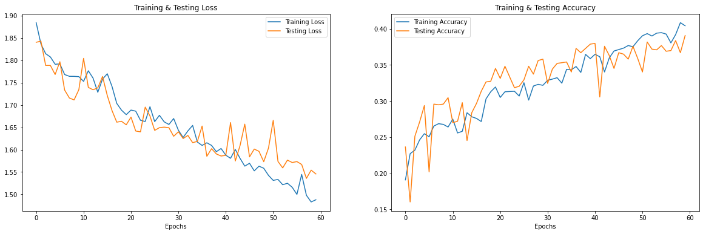
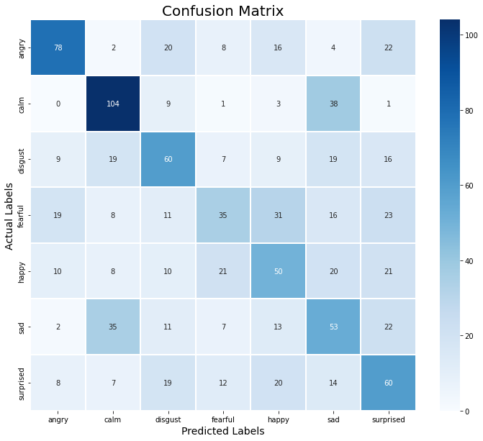
Simple LSTM results
The learning rate was following a linear trend
The 60 epochs seem to be a little bit too short, maybe needed more to reach the max potential
The first set of 60 epochs was built around the minimizations of training loss, while keeping the best checkpoints in every epoch with patience of three epochs
The next three epoch sets were trying to optimize training accuracy, validation loss and validation accuracy respectively
The final result of validation accuracy was 44%, a good start build uppon

Slide 10
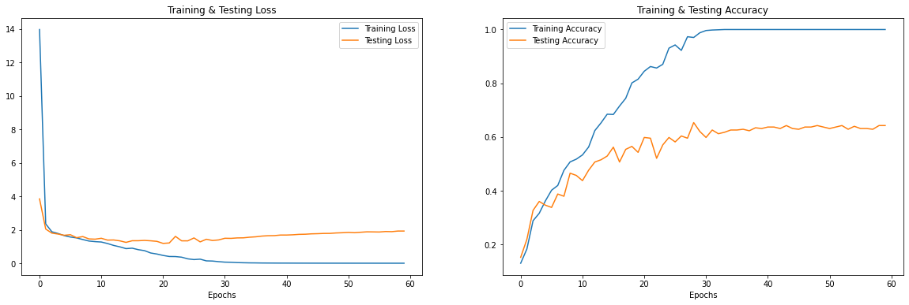
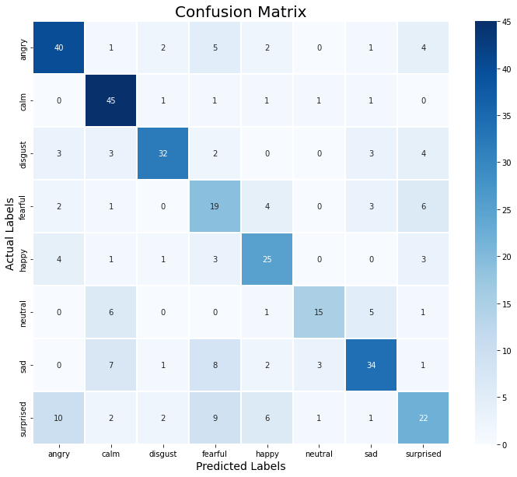
Deep CON2D CNN Results
The learning rate seems to be avoiding but stays almost intact after 20 epochs
The 60 epochs seem to be a little bit too long, in opposition to the simple LSTM architecture
The validation accuracy though seems to improve until the first 35 epochs
The difference between the most successful model deployed and the lesser successful ones is that it has more convolution layers
The final result of validation accuracy was 64.27

Slide 11
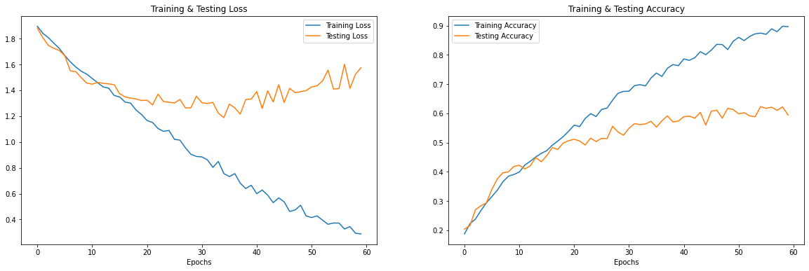
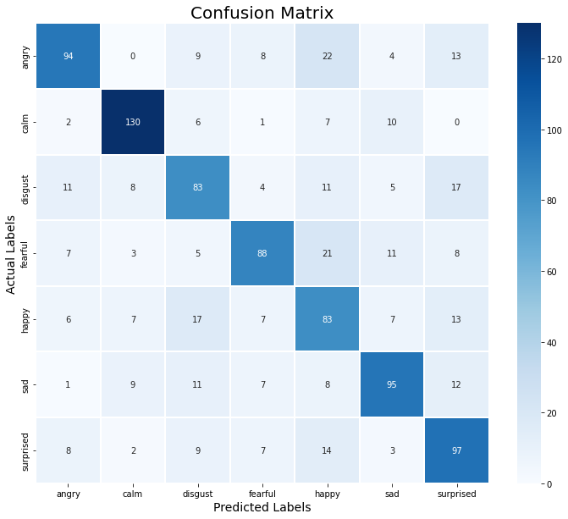
CNN+LSTM results
The learning rate and testing loss are showing a form of overfitting after a number of epochs
The callback functions used played a crucial role to avoid this and keep only the best results
The additional convolutional layers in the beginning seem to enhance the training process
After trying different number of layers, the 3-CONV1D and 3-CONV1D were the most promising
The final result of validation accuracy was 63.99%, a fair score comparing to other state-of-the-art examples

Slide 12

Thank you

