Slide 1
StreamBeat: Real-Time Music Streaming Platform
Group no : 5
Project Guide - Anay Tamhankar
Project Mentor - Dr. Prasad Sir
Group Member:
Arpita Munale – 230943025007
Nikita Shendge - 230943025033
Saurab Pawar - 230943025043
Vedant Kawade - 230943025053

Slide 2
Introduction
StreamBeat is revolutionizing the way you listen to music. Our platform offers real-time streaming, bringing you closer to your favorite artists, live performances, and trending tracks.
StreamBeat is a dynamic platform designed for music enthusiasts of all kinds. It offers a vast library of genres, artists, and live performances, curated to cater to diverse tastes and preferences.
Streambeat aims to provide a seamless and enjoyable streaming experience for music and audio enthusiasts, offering a diverse selection of content and features to meet the needs of its users.

Slide 3
Abstraction
In the age of data-driven decision-making, our project dives into the world of real-time data analysis, focusing on music streaming. By employing simulated data, we replicate the complexities of online music consumption, including user interactions, genre preferences, and playlist dynamics, enabling us to develop and evaluate advanced analytics solutions tailored to the music industry.
Through the integration of Apache Kafka, Apache Spark, MongoDB, and cutting-edge machine learning techniques, we construct an end-to-end data processing pipeline capable of handling large-scale streaming data. This project explores data generation, storage, analysis, and visualization, providing valuable insights into listener behavior , music consumption patterns, and the effectiveness of various promotional strategies.

Slide 4
Description
The project will stream events generated from a music streaming service (like Spotify) and create a data pipeline that consumes the real-time data. The data coming in would be similar to an event of a user listening to a song, navigating on the website, authenticating.
The data would be processed in real-time and stored to the data lake periodically (every two minutes).
The hourly batch job will then consume this data, apply transformations, and create the desired tables for our dashboard to generate analytics. We will try to analyze metrics like popular songs, active users, user demographics etc.

Slide 5
About Data
User Id - This could be a unique identifier assigned to each user on a particular music platform or service. User IDs help track individual user interactions, such as listening history, playlist creation, and preferences.
Artist Name - The name of the artist or musical group associated with a particular song. This information is crucial for identifying the creators of the music.
Songs - The title of the song or musical composition. This serves as a unique identifier for each piece of music and helps users locate specific tracks.
Platform Rank - The ranking of a song or artist within a specific music platform or service.
Popularity Score - A metric indicating the popularity or relative popularity of a song. Popularity scores can be based on various factors, including the number of streams, downloads, likes, shares, and user ratings.

Slide 6
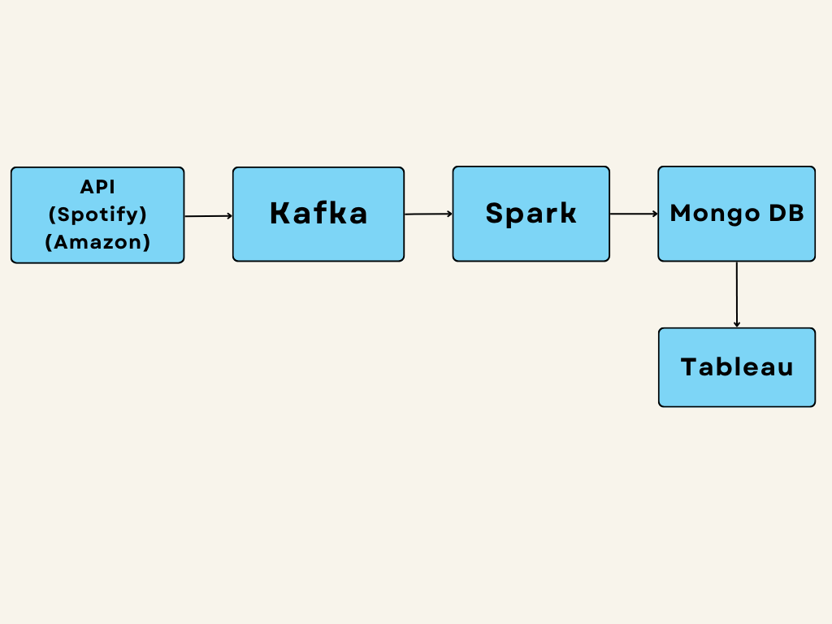
Data-Flow Diagram

Slide 7
Conclusion
In conclusion, our live streaming project marks a significant leap forward in how we connect, engage, and share experiences in real-time. Throughout this purposeful effort, we've witnessed the transformative power of live streaming the ability to go beyond, bridge communities, and amplify voices.
Through our project, we've accepted the directness and interactivity that live streaming offers, supporting meaningful connections between creators and audiences, performers and fans, educators and learners. We've seen how live streaming has become a catalyst for creativity, enabling individuals and organizations to showcase their talents, share their expertise, and inspire others around the globe.

Slide 8
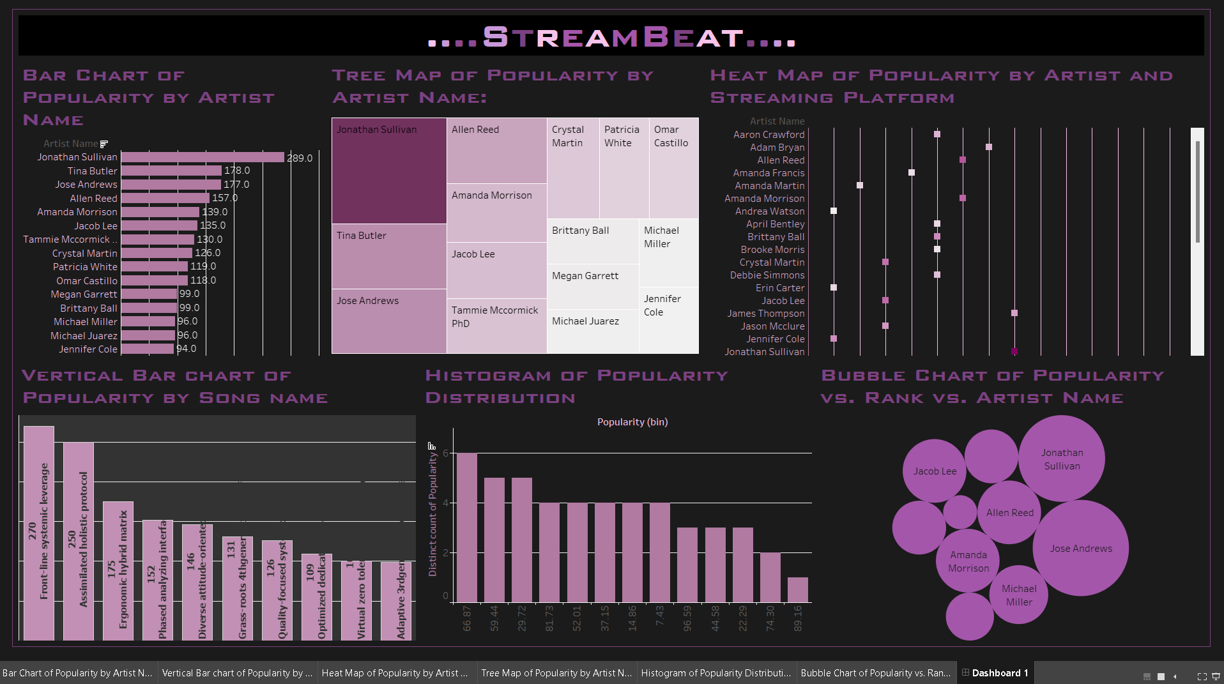
Visualization

Slide 9
THANK YOU

