Slide 1
RL MINI-PROJECT · PART I (CO1–CO3) & PART II (CO4–CO5)
Teaching a Biped Robot to Walk with Reinforcement Learning
12-joint bipedal robot
Team member
Nandhith Karthikeyan · RAE23027
Course
Reinforcement Learning: Mini-Project Assessment
Faculty
Amudha Mam
Academic year
2026
Institution
Amrita School of Engineering
Simulation work carried out during an internship at Xterra Robotics Pvt. Ltd. (IHFC, IIT Delhi)

Slide 2





PART I · CO1 · PROBLEM UNDERSTANDING
Problem Statement
Problem
Make a 12-joint bipedal robot, walk without falling at any speed we ask for.
Objective
Follow the commanded forward, sideways and turning speed (up to 2.5 m/s) with smooth, natural steps.
Environment
A physics simulator (MuJoCo Warp via mjlab) holding the model on flat ground.
Decision
At every control step, choose a target angle for each of the 12 joints.
In plain words: We do not tell the robot how to walk. We give it a goal (follow the speed, stay upright) and let it discover the walking itself.
RL Mini-Project Biped walking
Notes:
upright and smooth.

Slide 3



PART I · CO1 · RL JUSTIFICATION
Why Reinforcement Learning?
Interaction
Sequential decisions
The robot must act in the world and see what happens. There is no ready-made dataset to learn from.
A wrong step now can make the robot fall a few steps later, so every decision affects the future.
Actions have consequences
Feedback is a reward
12 joints at every step means an enormous number of possible movements. Each choice changes the next situation.
Nobody can label the "correct" torque for each joint. We only score the result: did it follow the speed and stay upright?
In plain words: It is like learning to ride a bicycle. Nobody gives you the exact muscle force for each moment. You try, wobble, get feedback and improve.
RL Mini-Project · Biped walking

Slide 4
PART I · CO1 · COMPARISON
RL vs Other Machine Learning
Aspect | Supervised / conventional ML | Reinforcement learning | In our project
Learning signal | Label or target value | Reward / return | Reward for following the speed command and staying upright
Interaction | Normally no action–environment loop | Agent interacts with environment | Robot acts in the simulator and sees the result
Decision | Prediction | Action selection | Picks 12 joint targets at each step
Temporal structure | Often independent samples | Sequential decisions | Each step affects balance in the next one
Objective | Prediction loss | Expected cumulative return | Maximise total reward until the episode ends
Versus a fixed rule-based controller: a hand-coded walking routine must be re-tuned for every speed, floor and push. RL learns one policy that adapts. We train with random pushes (every 1–3 s), random friction and random start poses.
In plain words: Supervised learning answers "what is this?". Reinforcement learning answers "what should I do next, so things turn out well later?".
RL Mini-Project · Biped walking

Slide 5

PART I · CO1 / CO2 · INTERACTION LOOP
Agent–Environment Model
AGENT
Action a_{t}: 12 target joint angles
ENVIRONMENT
repeat until the robot falls or 20 s pass
PPO neural network
Actor + Critic: the robot’s "brain"
Simulated Angad + floor
MuJoCo Warp physics
State s_{t+1} (48 numbers) + Reward r_{t}
As a Markov Decision Process M = (S, A, P, R, γ)
S state
A action
P dynamics
R reward
γ discount
48 continuous numbers
12 continuous joint targets
MuJoCo physics + random pushes
weighted sum of reward terms
0.99
In plain words: Think of a game player (agent) pressing buttons (actions) inside a game world (environment) and collecting points (reward).
RL Mini-Project · Biped walking

Slide 6

PART I · CO2 · DATA FLOW
System Architecture
1 Input / observation
2 State s_{t}
3 RL agent
4 Action a_{t}
5 Environment
6 Reward r_{t}
Speed command + noisy sensors: body velocity, tilt, joint angles and speeds
48 numbers, normalised, fed to the network
Actor network (256-256-128) picks the action
12 target joint angles (continuous)
PD controller → motors → MuJoCo physics (4 sub-steps)
One score for this step, plus the next state s_{t+1}
next state feeds back → the loop repeats at every control step
Training only: a Critic network (the "coach") scores every situation using extra privileged information such as foot contact and foot height. PPO compares what happened with the Critic’s guess and updates the Actor and the Critic after every batch of 24 steps.
In plain words: Sensors go in, joint commands come out, the simulator says how well it went. This one loop is repeated millions of times.
RL Mini-Project · Biped walking
Notes:
.

Slide 7
PART I · CO2 · WHAT THE AGENT SEES
State Space
Variable | Size | Meaning | Range
Velocity command (x, y, yaw) | 3 | requested speed and turn | Vx up to 2.5 m/s
Base linear velocity | 3 | how fast the body moves | m/s, continuous
Base angular velocity | 3 | how fast the body rotates | rad/s, continuous
Projected gravity | 3 | which way is "down" (tilt) | unit vector, −1 to 1
Joint positions | 12 | angle of each joint | within joint limits
Joint velocities | 12 | speed of each joint | rad/s, continuous
Previous action | 12 | what we did last step | same as action
Total | 48 | 12-joint model | all continuous
EXAMPLE STATE s_t (illustrative)
command = [1.00, 0.00, 0.00]
lin vel = [0.92, 0.01, -0.02]
ang vel = [0.01, -0.03, 0.02]
gravity = [0.03, -0.01, -0.99]
joint pos = 12 angles (rad)
joint vel = 12 speeds (rad/s)
last act. = 12 values
Observation vs state
Actor sees the noisy sensor values above (observation). Critic also sees exact foot height, air-time, contact and forces (full state), used only in training.
All values are real numbers, so a neural network is used instead of a table.
In plain words: The state is the robot’s "dashboard": what speed was asked, how it is moving, how tilted it is, and where every joint is.
RL Mini-Project · Biped walking

Slide 8
PART I · CO2 · WHAT THE AGENT DOES
Action Space
Joint (left + right) | What it does | Range | Motor · torque limit
Hip pitch × 2 | swings the leg forward / back | ±150° | QDD O120 · 120 N·m
Hip roll × 2 | moves the leg sideways | −120° to 20° * | QDD O120 · 120 N·m
Hip yaw × 2 | twists the leg left / right | ±60° | QDD O120 · 120 N·m
Knee × 2 | bends the leg | 0° to 130° | QDD O120 · 120 N·m
Ankle pitch × 2 | tips the foot up / down | −30° to 27° | QDD 34 · 34 N·m
Ankle roll × 2 | tilts the foot sideways | ±17° | QDD 34 · 34 N·m
12
continuous actions per step (one per joint)
Actor output
a_{t}: 12 numbers
Target angle
default pose + a_{t} × scale
* left leg is mirrored
Continuous actions: each action is a real number, not a menu of choices like {left, right}.
PD controller
gains KP, KD → motor torque
In plain words: The robot has 12 "dials". At every step the agent decides where to turn each dial; the motors then try to reach those positions.
RL Mini-Project · Biped walking

Slide 9
PART I · CO2 · WHAT COUNTS AS GOOD
Reward Function
r_{t} = Σ w_{i} · r_{i,t} weighted sum of the terms below. Episode ends if the robot tilts > 70° or a knee touches the ground.
REWARDS (score goes up)
PENALTIES (score goes down)
Follow the speed command — exp(−error² / σ²) for forward, sideways and turning speed
Keep the torso upright — exp(−(gx² + gy²) / σ²)
Step in a walking rhythm — foot air-time and alternating feet
Stay near the reference gait — exp(−‖q − q_ref‖² / σ²)
Jerky motor commands — change in action between steps
Joint limits and self-collision — hitting mechanical limits, legs touching
Foot slipping — Σ‖v_xy‖² while the foot is on the ground
Hard landings — Σ‖F‖ at the moment of touchdown
Dragging feet — foot clearance and swing height
Values between 0 and 1: highest when the error is zero, and smooth for the network to learn from.
Keeps the motion smooth, safe for the motors and natural looking. Falling ends the episode, so it also costs all future reward.
RL Mini-Project · Biped walking

Slide 10


PART I · CO2 · WHY THIS ALGORITHM
Algorithm Selection: PPO
Algorithm | Fit? | Reason
Q-learning / DQN | No | Needs a finite list of actions. Angad has 12 continuous joint targets.
DDPG / SAC | Partly | Handles continuous actions, but replay-buffer methods are less common with thousands of parallel GPU simulators.
PPO | Yes | Continuous actions, works with parallel simulators, and clipped updates keep learning stable.
Why PPO fits Angad
12 continuous actions and a continuous state, handled by a neural-network policy
Thousands of simulated robots train in parallel on the GPU
Clipping stops one bad update from ruining the walking policy
Used in RSL-RL for legged robots such as ANYmal parkour and Spot at 5.2 m/s
Actor = the player
Chooses the joint angles
Critic = the coach
Scores the situation
Why not simpler? A Q-table cannot store a 48-number continuous state.
In plain words: PPO is a two-part team. The Actor tries moves, the Critic acts like a coach that says "that was better (or worse) than I expected".
RL Mini-Project · Biped walking

Slide 11
PART I · CO2 · THE MATHS
Core Equations Used in Training
1 TD error
2 Advantage (GAE)
δ_{t} = r_{t} + γ · V(s_{t+1}) − V(s_{t})
A_{t} = Σ_{l≥0} (γλ)^{l} · δ_{t+l}
Was the outcome better or worse than the Critic expected? (γ = 0.99)
How much better was this action than average? (λ = 0.95)
3 Actor loss (PPO clip)
4 Critic loss
L^{CLIP} = E[ min( ρ_{t}·A_{t} , clip(ρ_{t}, 0.8, 1.2)·A_{t} ) ]
L^{V} = (1/n) Σ ( V(s_{t}) − V_{target} )²
ρ = new policy ÷ old policy probability of the action. Clip ε = 0.2 stops big jumps.
Make the Critic’s prediction match the reward actually collected.
Full loss minimised each update: −L^CLIP + 1.0 × L^V − 0.01 × entropy bonus
In plain words: The Actor asks "was that move better than usual?". If yes, do it more often, but only by a small step so the walking does not collapse.
RL Mini-Project · Angad biped walking
Notes:
CORE EQUATIONS (CO2/CO3). These are the exact quantities the RSL-RL PPO code computes. 1) TD error: reward now + discounted value of next state minus the Critic's guess for now. 2) Advantage: a smoothed sum of TD errors (GAE); lambda trades noise against bias. 3) Actor loss: PPO's clipped objective; rho is new-policy / old-policy probability; clipping to [0.8, 1.2] (epsilon 0.2) limits how far one update can move the policy. 4) Critic loss: mean squared error between predicted value and the actual discounted return. Total loss = -L_clip + 1.0*L_V - 0.01*entropy (value_loss_coef 1.0, entropy_coef 0.01). VIVA: "What does the discount factor do?" -> gamma = 0.99 makes the agent care about future rewards (not falling in the next second) while still preferring sooner rewards. "How does the agent learn from reward?" -> reward -> return -> advantage -> actor update.

Slide 12
PART I · CO3 · CODE & SETTINGS
Implementation
Rubric evidence | Where it happens in the code
State handling | observations.py + velocity_env_cfg.py build s_t (Actor: with noise, Critic: clean)
Action selection | Actor MLP (RSL-RL ActorCritic) outputs 12 joint targets: mean + Gaussian noise
Environment interaction | ManagerBasedRLEnv step: PD control + MuJoCo Warp physics → next state and reward
Learning / update | RSL-RL PPO update(): clipped actor loss + critic loss, 5 epochs × 4 minibatches
Training evidence | W&B logs, model_*.pt saved every 50 iterations, policy exported to ONNX
Key hyperparameters
Actor / Critic MLP | 256-256-128, ELU
Discount γ | 0.99
GAE λ | 0.95
Clip ε | 0.2
Learning rate | 1e-3, adaptive (KL 0.01)
Epochs × minibatches | 5 × 4
Steps per env / update | 24
Entropy / value coef. | 0.01 / 1.0
Initial noise std | 1.0
Max iterations | 30,000
Our work: Angad environment, rewards, reference gaits, tuning and training. From libraries: PPO and runner (RSL-RL), simulator (mjlab / MuJoCo Warp).
In plain words: We wrote the rules of the game (environment and rewards). A well-tested library supplies the learning engine that plays it.
RL Mini-Project · Biped walking

Slide 13
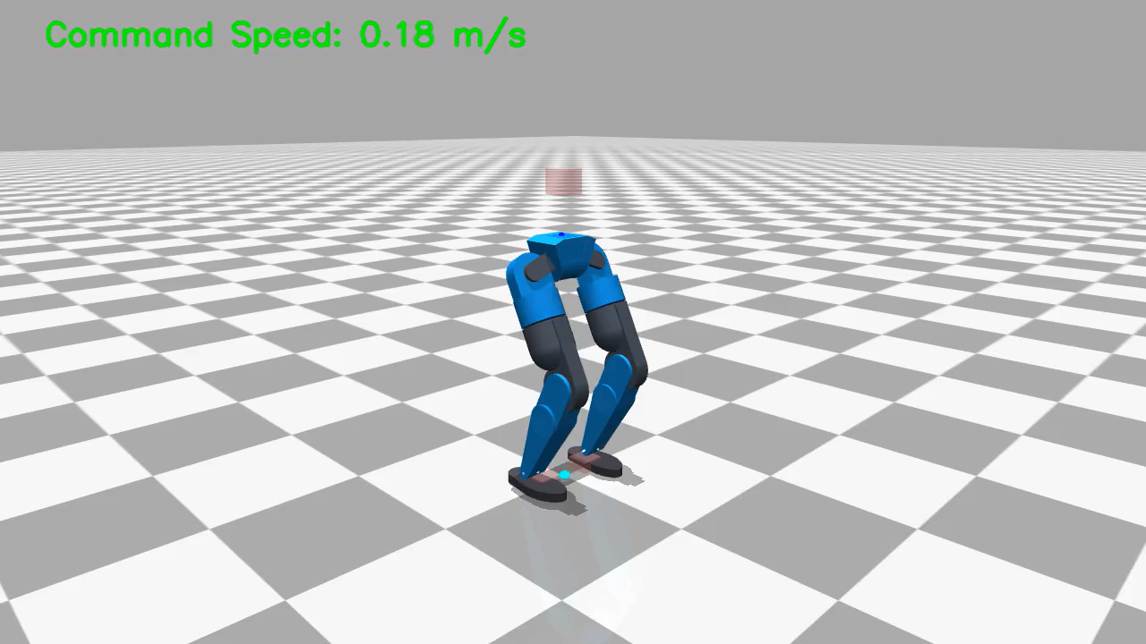
PART I · CO3 · STATE → ACTION → REWARD → NEXT STATE
Demo: One Complete Cycle
1
State s_{t}
Command + sensors → 48 numbers
2
Action a_{t}
Actor outputs 12 target joint angles
3
Environment
PD controller + physics move the robot
4
Reward r_{t}
One score: speed ✓ upright ✓ smooth ✓
5
Next state s_{t+1}
Repeat; PPO learns every 24 steps
Trained policy (Method 4), isometric view. The green text is the command speed the robot must follow.
In plain words: Watch the robot follow the changing command. Behind every frame the same five steps are repeated many times per second.
RL Mini-Project · Biped walking

Slide 14
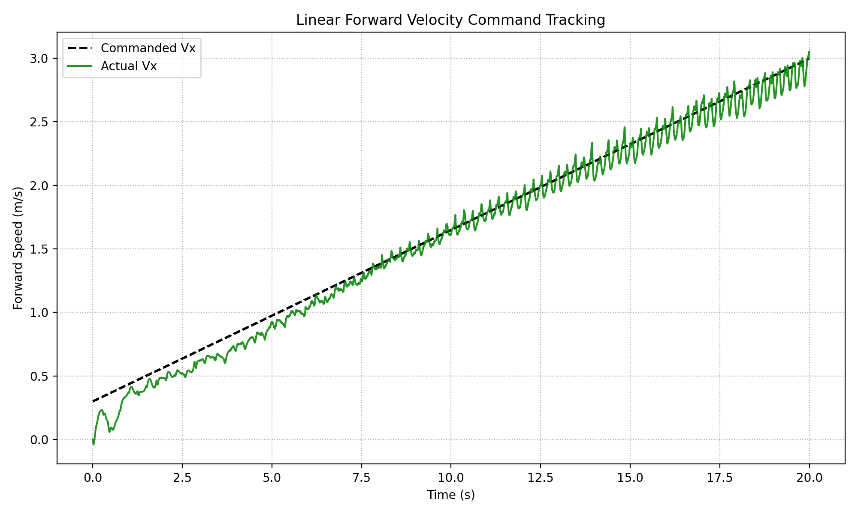

PART I · CO3 · LEARNING & PERFORMANCE
Results
Learning curve: insert from W&B
Mean reward vs training iteration (Method 4, 15,200 iterations). Chart name in W&B: Train/mean_reward
Learning curve: the score should rise, then flatten as walking is learned.
Task performance: dashed = commanded speed, green = actual speed. Closer is better.
≈ 3.0 m/s
15,200
≈ 2.3 m
≈ 650 N
speed reached when 3.0 m/s is commanded (Method 2: ≈ 1.8 m/s)
training iterations (Method 2: 350)
sideways drift over 31 m walked (Method 2: ≈ 13 m over 17 m)
peak foot impact at 1.0 m/s, about 3.5× body weight
RL Mini-Project · Biped walking

Slide 15
PART I · CO3 · WHAT THE RESULTS MEAN
Analysis
Experiment | What changed | Iters | Outcome
1 Direct Asimov gait | Copy a reference gait (sign flips) | 1,250 | Extra hip-yaw motion
2 2-D kinematic gait | Custom gait for Angad’s legs | 350 | Too rigid, no hip motion
3 + Hip sway | 3 cm sideways sway added | 350 | Faster steps, not longer ones
4 Dynamic stride | Stride grows with speed | 15,200 | Follows speed to ≈ 3 m/s
5 CoT-optimised stride | Stride from cost of transport | 2,100 | Tracks to ≈ 2.8 m/s
6 + Torso yaw joint | 13-joint model | 2,100 | Similar; impacts still high
7 Raw RL, no reference | No imitation reward | 2,100 | Impacts high, feet clash
Learning
Speed tracking rose from about 60% of the command (Method 2) to about 100% (Method 4): the policy learned to lengthen its stride with speed.
Success rate
Success = stays upright for the full 20 s episode. Rate from W&B (time_out vs fell_over): [ fill in ]
Stability
Speed follows the command without diverging; the small ripple is the step cycle. Foot impacts (≈ 630–940 N) remain the weak point.
In plain words: Each experiment fixed the problem seen in the previous one. That step-by-step fixing is how the final walking style emerged.
RL Mini-Project · Biped walking
Notes:
ANALYSIS (CO3). Left: seven training experiments in order; each row states the change and what was observed. Iterations and outcomes come from your weekly slides and plots. Right: interpretation. LEARNING: compare Method 2 (about 1.8 m/s reached when 3.0 m/s commanded) with Method 4 (about 3.0 m/s). Note Method 4 also used a better gait reference, so the gain is not from iterations alone. SUCCESS RATE: fill the number from W&B (termination statistics such as time_out vs fell_over) - or remove that sentence. STABILITY: tracking is stable; the biggest remaining problem is foot impact force (peaks about 630-940 N versus about 185 N body weight). VIVA: "How do you know whether the agent has learned?" -> (1) reward curve rises and flattens, (2) actual speed follows commanded speed, (3) robot stays upright for whole episodes.

Slide 16


PART I · HONEST LIMITS, REALISTIC NEXT STEPS
Limitations & Future Work
Limitations
Future work
High foot impacts
Peaks of ≈ 630–940 N against ≈ 185 N body weight; feet clash at high speed.
Landing penalties
Stronger soft-landing term and a foot-collision penalty.
Domain randomisation
Randomise motor strength, mass and delays.
Still leans on reference gaits
Raw RL without imitation (Method 7) is not yet good enough.
Sim-to-real
Measure the real actuators, improve the motor model, deploy the ONNX policy on Angad.
Simulation only
Real motors, friction and delays differ: the sim-to-real gap.
Better statistics
Multi-seed runs; sweep entropy, learning rate and γ.
Few experiments
Each method was trained once: no multi-seed averages or parameter sweeps yet.
More tasks
Rough-terrain and balance tasks (already configured).
RL Mini-Project · Biped walking

Slide 17
PART I · SUMMARY
Conclusion
Formulation
Implementation
Demonstration
Walking cast as an MDP: 48-number state, 12 continuous actions, weighted reward, γ = 0.99.
PPO Actor–Critic in mjlab / RSL-RL with a custom Angad environment, rewards and gait references.
The trained policy follows speed commands up to ≈ 3 m/s in simulation (Method 4).
CO1
Why RL?: Slides 2–4: problem, RL justification, RL vs supervised ML
CO2
Formulation & algorithm: Slides 5–11: agent–environment, MDP, state, action, reward, PPO, equations
CO3
Implementation & demo: Slides 12–15: code, hyperparameters, video demo, results and analysis
Part II (CO4–CO5) follows: performance, convergence, exploration. →
RL Mini-Project · Angad biped walking

Slide 18


PART II
CO4
How well and how efficiently does it learn?
How well does it learn?
Performance and convergence → slide 19
Computational cost, sample efficiency, regret → slide 20
Analysis of performance, convergence, cost and exploration (CO4 and CO5)
CO5
How does it balance trying new things and using what works?
Exploration vs exploitation → slide 21
Parameter sensitivity → slide 22
RL Mini-Project · Angad biped walking

Slide 19
PART II · CO4 · RESULTS TABLE
Performance & Convergence
Metric | Baseline: Method 2 | Final: Method 4 | Interpretation
Average reward | [ fill in ] | [ fill in ] | Did cumulative performance improve? (W&B mean reward)
Success rate | [ fill in ] | [ fill in ] | Episodes that stay upright for the full 20 s
Convergence iteration | [ fill in ] | [ fill in ] | When the reward curve flattens
Training time | [ fill in ] | [ fill in ] | GPU-hours needed
Iterations trained | 350 | 15,200 | 43× more experience
Speed reached (3.0 m/s command) | ≈ 1.8 m/s | ≈ 3.0 m/s | Follows the command over the whole range
Sideways drift | ≈ 13 m in 17 m | ≈ 2.3 m in 31 m | Walks almost straight
Exploration noise (std) | 1.0 (start) | [ fill in ] | Should shrink as the policy settles
Regret / sample efficiency | — | — | See next slide
Amber cells: read the value from your W&B run (Train/mean_reward, episode length, termination stats, run duration) and type it in. Other values are read from the evaluation plots.
RL Mini-Project · Angad biped walking

Slide 20



PART II · CO4 · HOW EFFICIENT IS LEARNING?
Cost, Sample Efficiency & Regret
Computational cost
Sample efficiency
Regret
Small network: Actor ≈ 0.11 M parameters (48 → 256 → 256 → 128 → 12).
Training: thousands of simulated robots run in parallel on the GPU; several GPUs can share the job.
Running it: cheap. The policy is exported to ONNX for the robot.
Time: [ fill in ] h on [ fill in ] GPU
Per iteration: 24 steps × N robots.
Method 4: 15,200 × 24 × N samples (N = num_envs).
On-policy: each batch is used once, then thrown away, so PPO is data-hungry.
Cheap in simulation, but a real robot could not afford this.
Method 4 used 43× the iterations of Method 2 (with a better gait reference).
Meaning: reward lost while still learning, compared with acting perfectly from the start (area between the ideal reward and the learning curve).
Not computed exactly: the ideal reward for walking is unknown.
Proxy: iterations needed to reach a good walking speed. A 4-stage curriculum (easy speeds first) keeps early failures cheap.
RL Mini-Project · Angad biped walking

Slide 21

PART II · CO5 · TRY NEW vs USE WHAT WORKS
Exploration vs Exploitation
Where to eat tonight? Try a new restaurant (explore) or go to your favourite (exploit)? A learner needs both.
Basic Q-learning: ε-greedy
With probability ε pick a random action, otherwise the best-known one.
PPO (ours): a bell curve per joint
The Actor outputs, for every joint, a centre (best-known angle = exploit) and a width (how far it experiments = explore). The action is sampled from this bell curve.
Illustrative shape: the noise shrinks as the policy improves.
EXPLORE
EXPLORE
EXPLORE
EXPLOIT
Initial noise std = 1.0 (start wide)
Entropy bonus 0.01 keeps some randomness
Random pushes every 1–3 s, random start pose and friction
At test time the noise is off: the best-known action is used
RL Mini-Project · Angad biped walking

Slide 22
PART II · CO5 · WHAT IF WE CHANGE IT?
Parameter Sensitivity
Parameter | Our value | If too high | If too low
Exploration noise (initial std) | 1.0 | Robot flails and falls; slow learning | Sticks with the first gait it finds
Entropy coefficient | 0.01 | Policy stays random, never settles | Explores too little, settles too early
Learning rate | 1e-3, adaptive (KL 0.01) | Unstable updates, forgets good walking | Very slow learning
Discount γ | 0.99 | Slow, noisy credit for which step mattered | Short-sighted: ignores a fall that comes later
Clip ε | 0.2 | Large, risky policy changes | Tiny steps, slow progress
GAE λ | 0.95 | Noisy advantage estimates (high variance) | Biased advantage (leans on Critic errors)
These are the values used in our runs. The effects listed are standard RL behaviour; a proper parameter sweep is listed under future work (slide 16).
RL Mini-Project · Angad biped walking

Slide 23

PART II · TEAM PROJECT REQUIREMENT
Individual Contribution
48-number observation for the Actor and privileged state for the Critic
slide 7
State
12 continuous joint targets converted by a PD controller
slide 8
Action
Nandhith Karthikeyan
Weighted reward terms and penalties, and why each is there
slide 9
Reward
Member 1
Reg. No. ________
PPO: studied the actor, critic, TD error, advantage and clipped update
slides 10–11
Algorithm
Assigned agent
Angad walking agent (PPO, velocity tracking)
Built Angad’s MJCF model, hand-tuned KP/KD, worked with the Angad task configs, designed reference gaits (Methods 1–7)
slides 12, 15
Code
Speed tracking, path drift and foot-force analysis
slides 14, 15, 19
Results
RL Mini-Project · Angad biped walking

Slide 24
PART II · THE COMPLETE CHAIN
Evidence Trail
1
2
3
4
5
6
Problem
RL justification
State
Action
Reward
Algorithm
slide 2
slides 3–4
slide 7
slide 8
slide 9
slides 10–11
7
8
9
10
11
Code
Learning
Performance
Exploration / exploitation
Conclusion
slide 12
slides 14–15
slides 19–20
slides 21–22
slide 17
Thank you. Questions?
Backup slides follow: robot model and gains, before-vs-after tracking, model validation, tools surveyed.
RL Mini-Project · Angad biped walking

Slide 25
BACKUP · VIVA REFERENCE
Backup: Robot Model & Controller Gains
Link | Mass (kg)
Base | 3.206
Hip pitch link (per leg) | 0.157
Thigh link (per leg) | 3.162
Knee link (per leg) | 1.876
Shank link (per leg) | 2.071
Ankle coupler (per leg) | 0.052
Foot link (per leg) | 0.537
Total mass (base + both legs) | 18.917
Joint (same on both legs) | KP | KD
Hip pitch | 800 | 40
Hip roll | 800 | 40
Hip yaw | 135 | 20
Knee pitch | 500 | 12
Ankle pitch | 282 | 0.8
Ankle roll | 290 | 0.6
KP is the spring stiffness and KD the damping of the PD controller that turns a target angle into motor torque. Both were tuned by hand.
RL Mini-Project · Angad biped walking

Slide 26
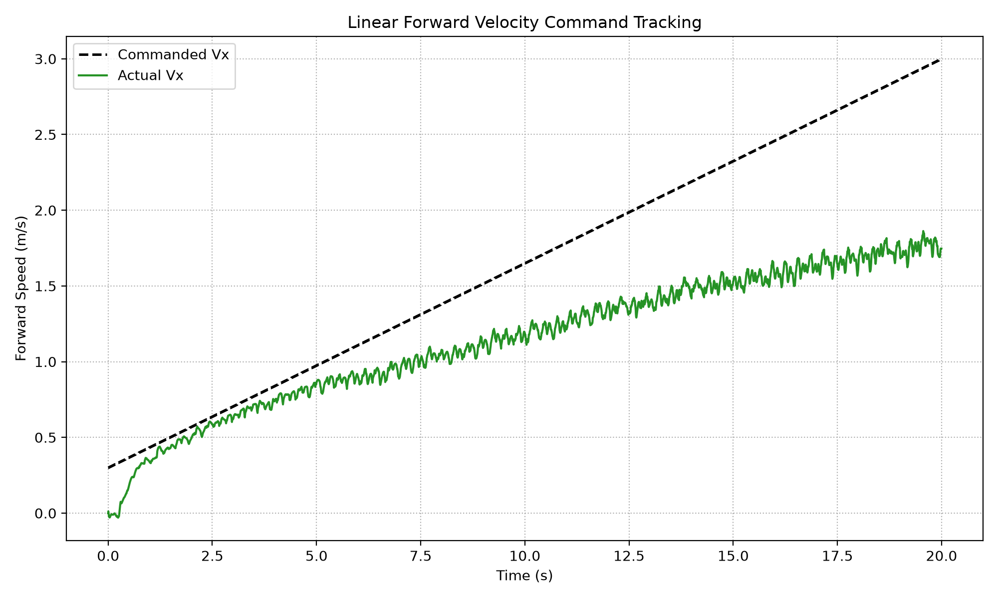
BACKUP · SPEED TRACKING
Backup: Before vs After
Method 2, 350 iterations. Reaches only ≈ 1.8 m/s when 3.0 m/s is commanded.
Method 4, 15,200 iterations. Follows the command up to ≈ 3.0 m/s.
In plain words: The closer the green line stays to the dashed line, the better the robot does what it is asked. This is the evidence that learning worked.
RL Mini-Project · Angad biped walking

Slide 27
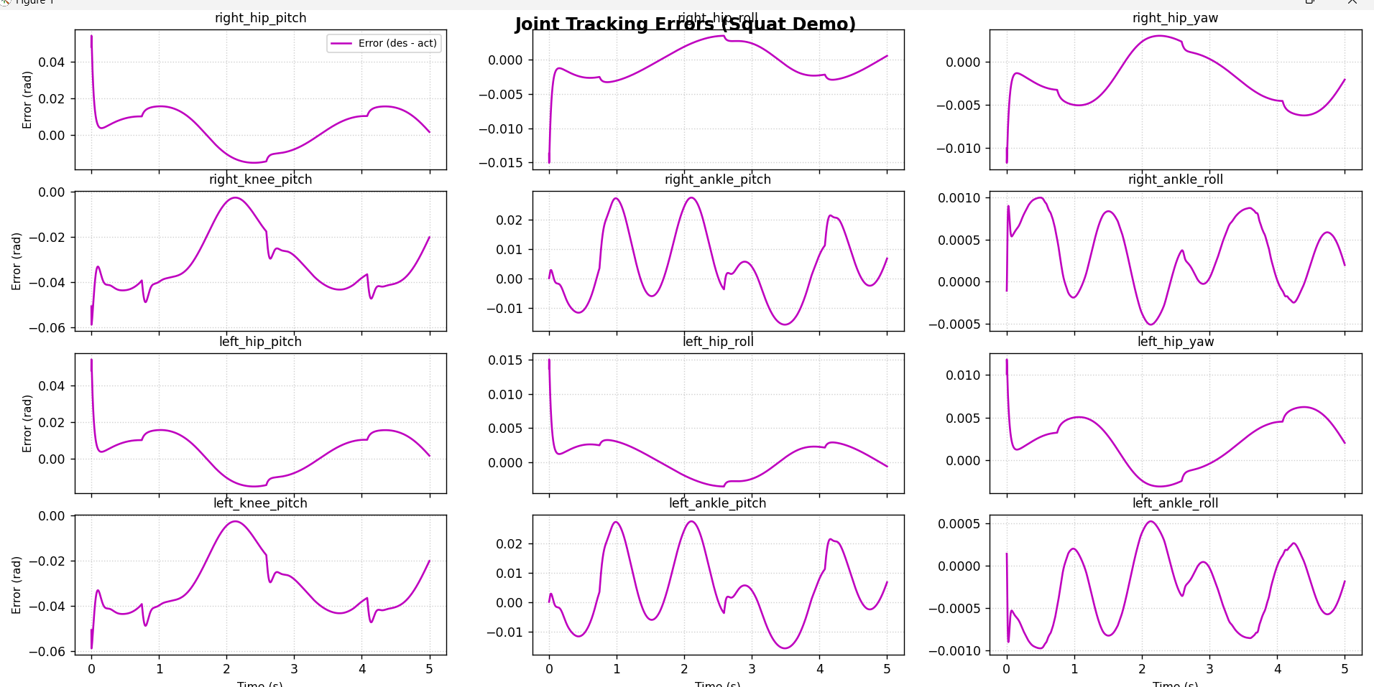
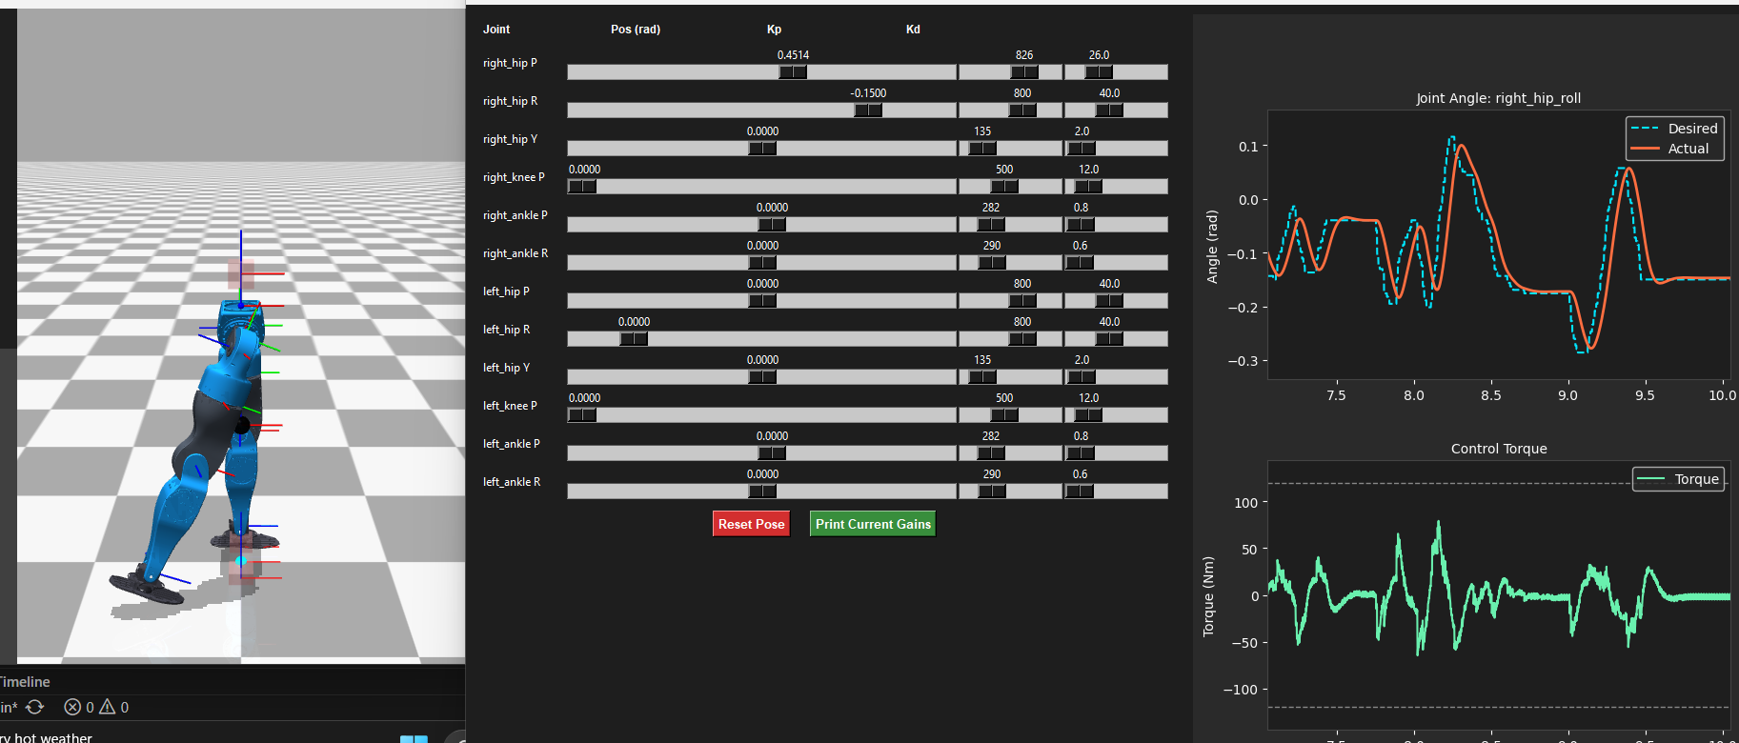
BACKUP · ENVIRONMENT CHECKS
Backup: Model Validation
Slider tool used to tune KP and KD by hand, watching desired vs actual joint angle and motor torque.
Why it matters: the RL agent only chooses target angles. If the PD controller cannot follow them, the physics the agent learns from would be wrong.
Squat test: joint angle error (desired − actual) for all 12 joints stays small, at most about 0.06 rad.
RL Mini-Project · Angad biped walking

Slide 28
BACKUP · WHY THIS STACK
Backup: Tools We Surveyed
Physics engines
RL libraries
MuJoCo / MuJoCo Warp — best contact model; Warp version runs on the GPU
MJX (JAX) — GPU and differentiable, but slow start-up compile
PyBullet — free and easy, can show jitter
Brax — all-JAX and fast, weaker contact physics
Isaac Gym / Isaac Lab — GPU PhysX; needs a huge Omniverse install
Genesis, RaiSim, Drake — multi-physics / very realistic / mathematically rigorous
Gymnasium — environment interface only, no algorithms
Stable-Baselines3 — reliable PPO, SAC, TD3, DQN, A2C
RSL-RL / rl_games — GPU PPO built for legged robots
skrl — modular, readable
RLlib — scales from CPU to GPU, many algorithms
Chosen stack: mjlab = MuJoCo Warp physics + an Isaac Lab-style manager API + RSL-RL PPO, without the 30 GB Omniverse install.
RL Mini-Project · Angad biped walking

