Slide 1
Document clustering using Kmeans algorithm
Nikhil Dhirmalani – B00775542
Khushboo siwal – B00781497

Slide 2
Introduction and motivation
Creating organizational value through Document Clustering
Document Clustering in information retrieval
Document Store (Taxonomy)

Slide 3
2 Big bang approaches
Document Clusters.
LDA (Latent Drichlet Allocation) Topic Modeling.

Slide 4
Dataset (20 Newsgroups)
The data is organized into 20 different newsgroups, each corresponding to a different topic. Some of the newsgroups are very closely related to each other (e.g. comp.sys.ibm.pc.hardware / comp.sys.mac.hardware), while others are highly unrelated (e.g misc.forsale / soc.religion.christian).
comp.graphics comp.os.ms-windows.misc comp.sys.ibm.pc.hardware comp.sys.mac.hardware comp.windows.x | rec.autos rec.motorcycles rec.sport.baseball rec.sport.hockey | sci.crypt sci.electronics sci.med sci.space
misc.forsale | talk.politics.misc talk.politics.guns talk.politics.mideast | talk.religion.misc alt.atheism soc.religion.christian

Slide 5
Libraries and Tools used
Pyspark for Tokenizing, Count Vectorizer and IDF (Inverse Document Frequency).
Sklearn for datasets, PCA (Principal Component Analysis), K-Means model.
Matplotlib and Plotly for Visualizations.
Apache Spark for data manipulations.
Python 2.7.

Slide 6
Text processing pipeline. (Sprint 1) executed by-(khushboo siwal)
Documents
Word Tokenizer and Stop words remover
 | word1 | word2 | word3
doc1 | 8 | 0 | 0
doc2 | 2 | 4 | 0
Makes Document term matrix with TF-IDF score
Count Vectorizer
Inverse Document Frequency
 | word1 | word2 | word3
doc1 | 4 | 0 | 0
doc2 | 1 | 4 | 0

Slide 7
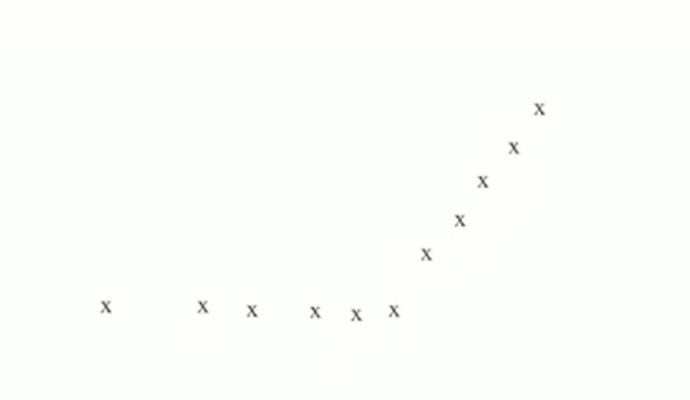
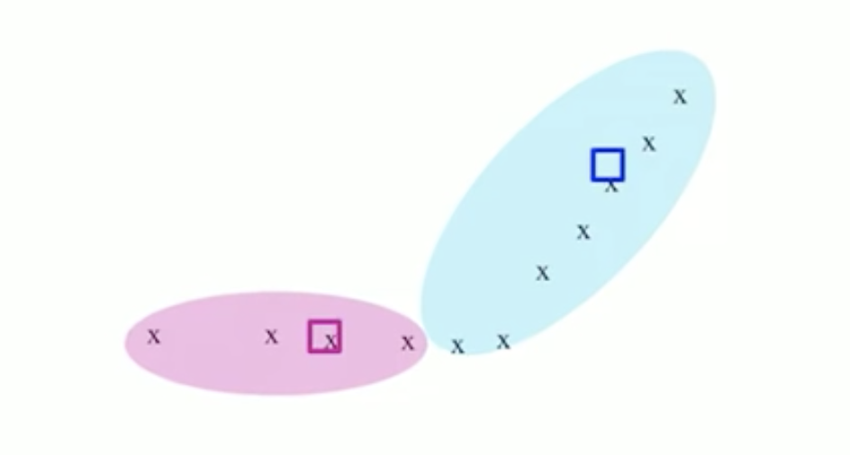
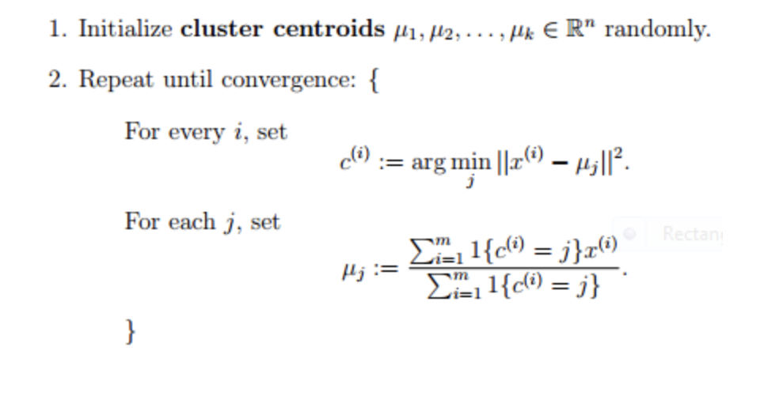
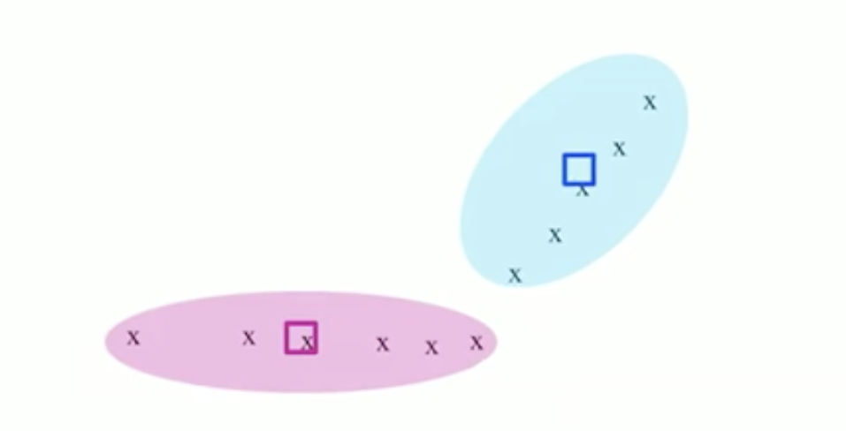
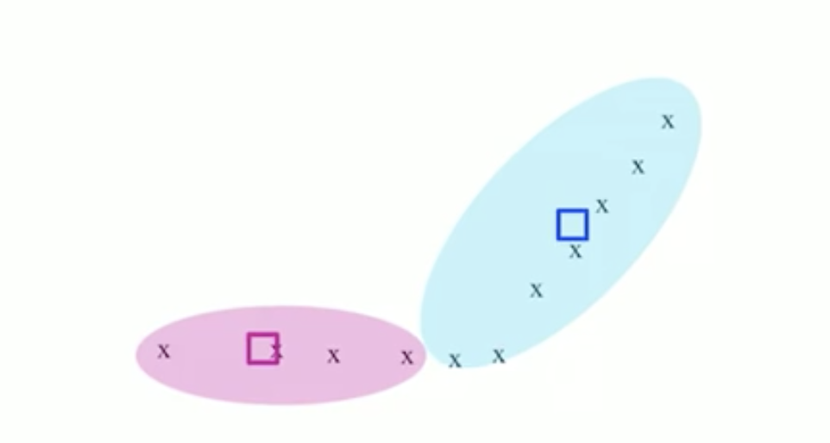
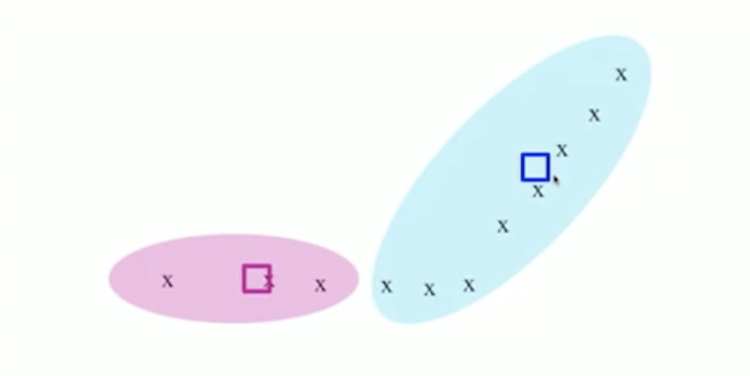
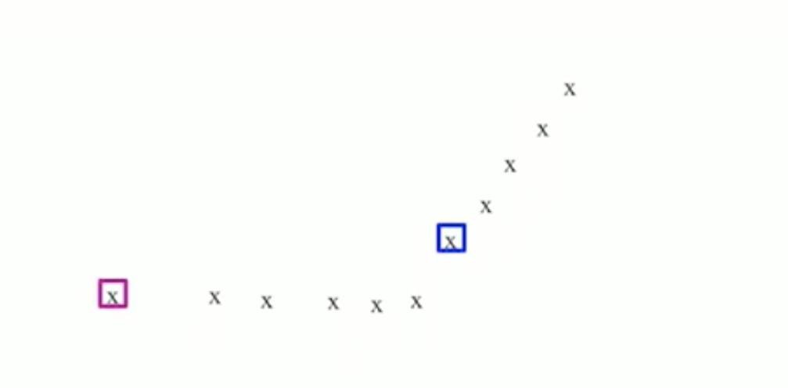
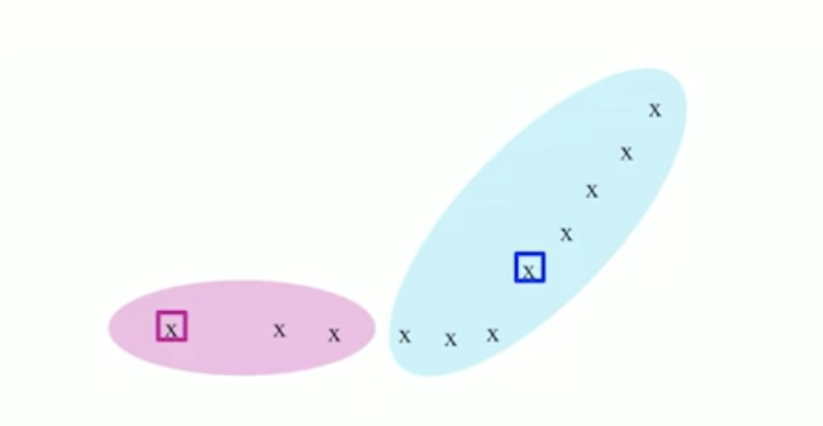
K-means algorithm implementation (sprint 2) executed by-(Nikhil dhirmalani)

Slide 8
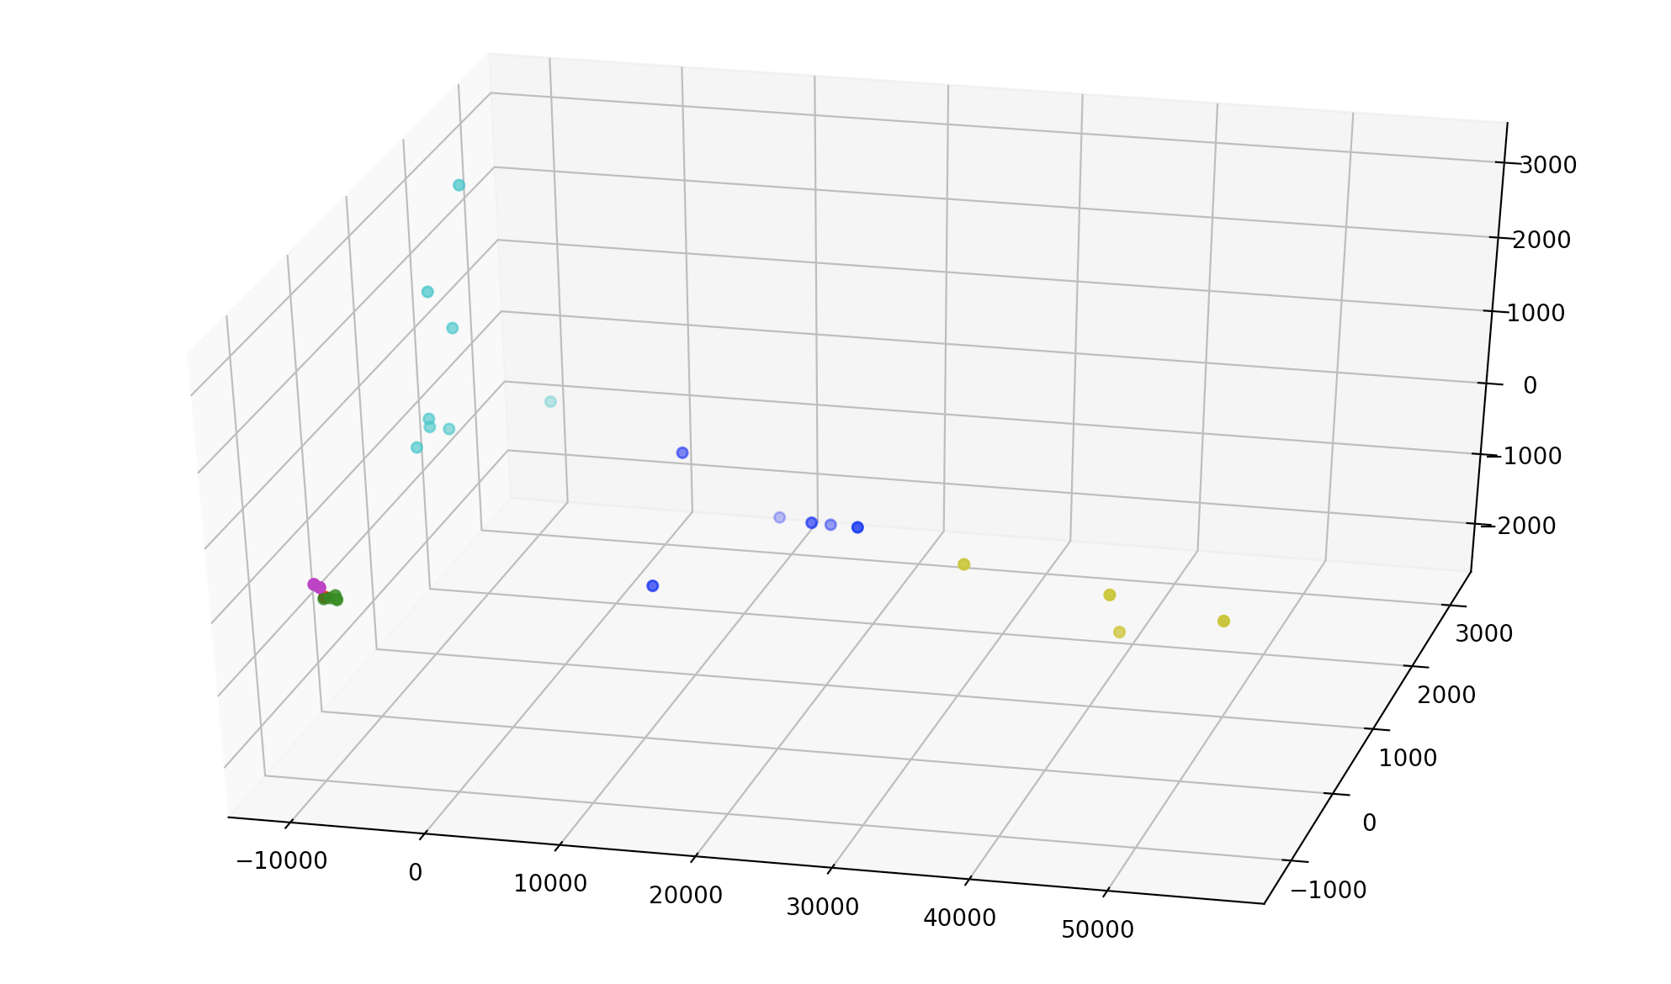
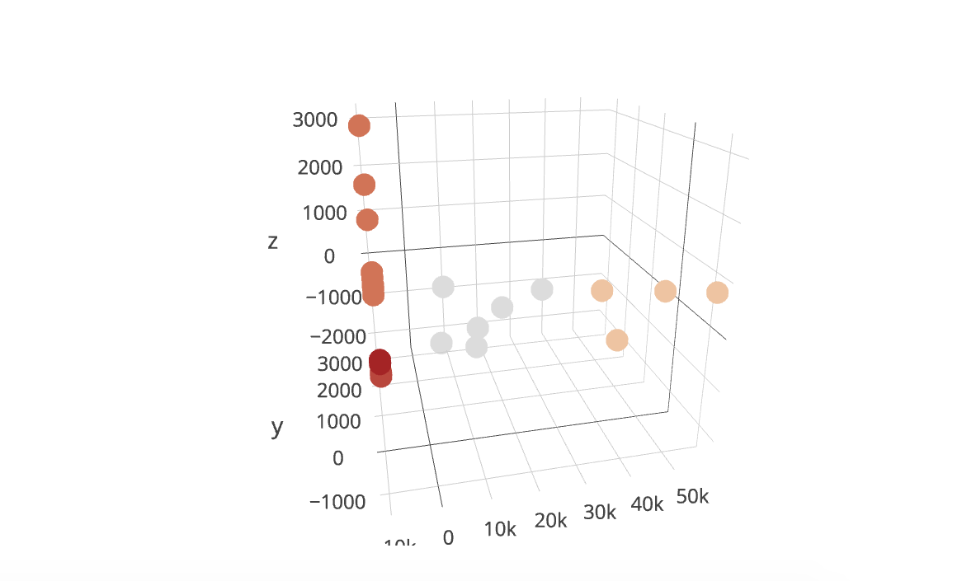
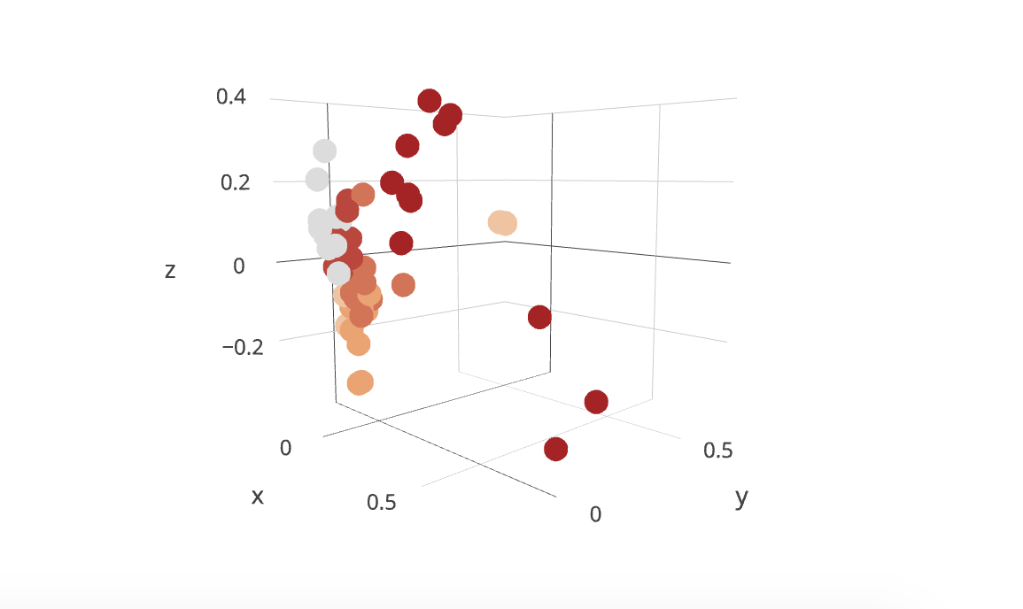
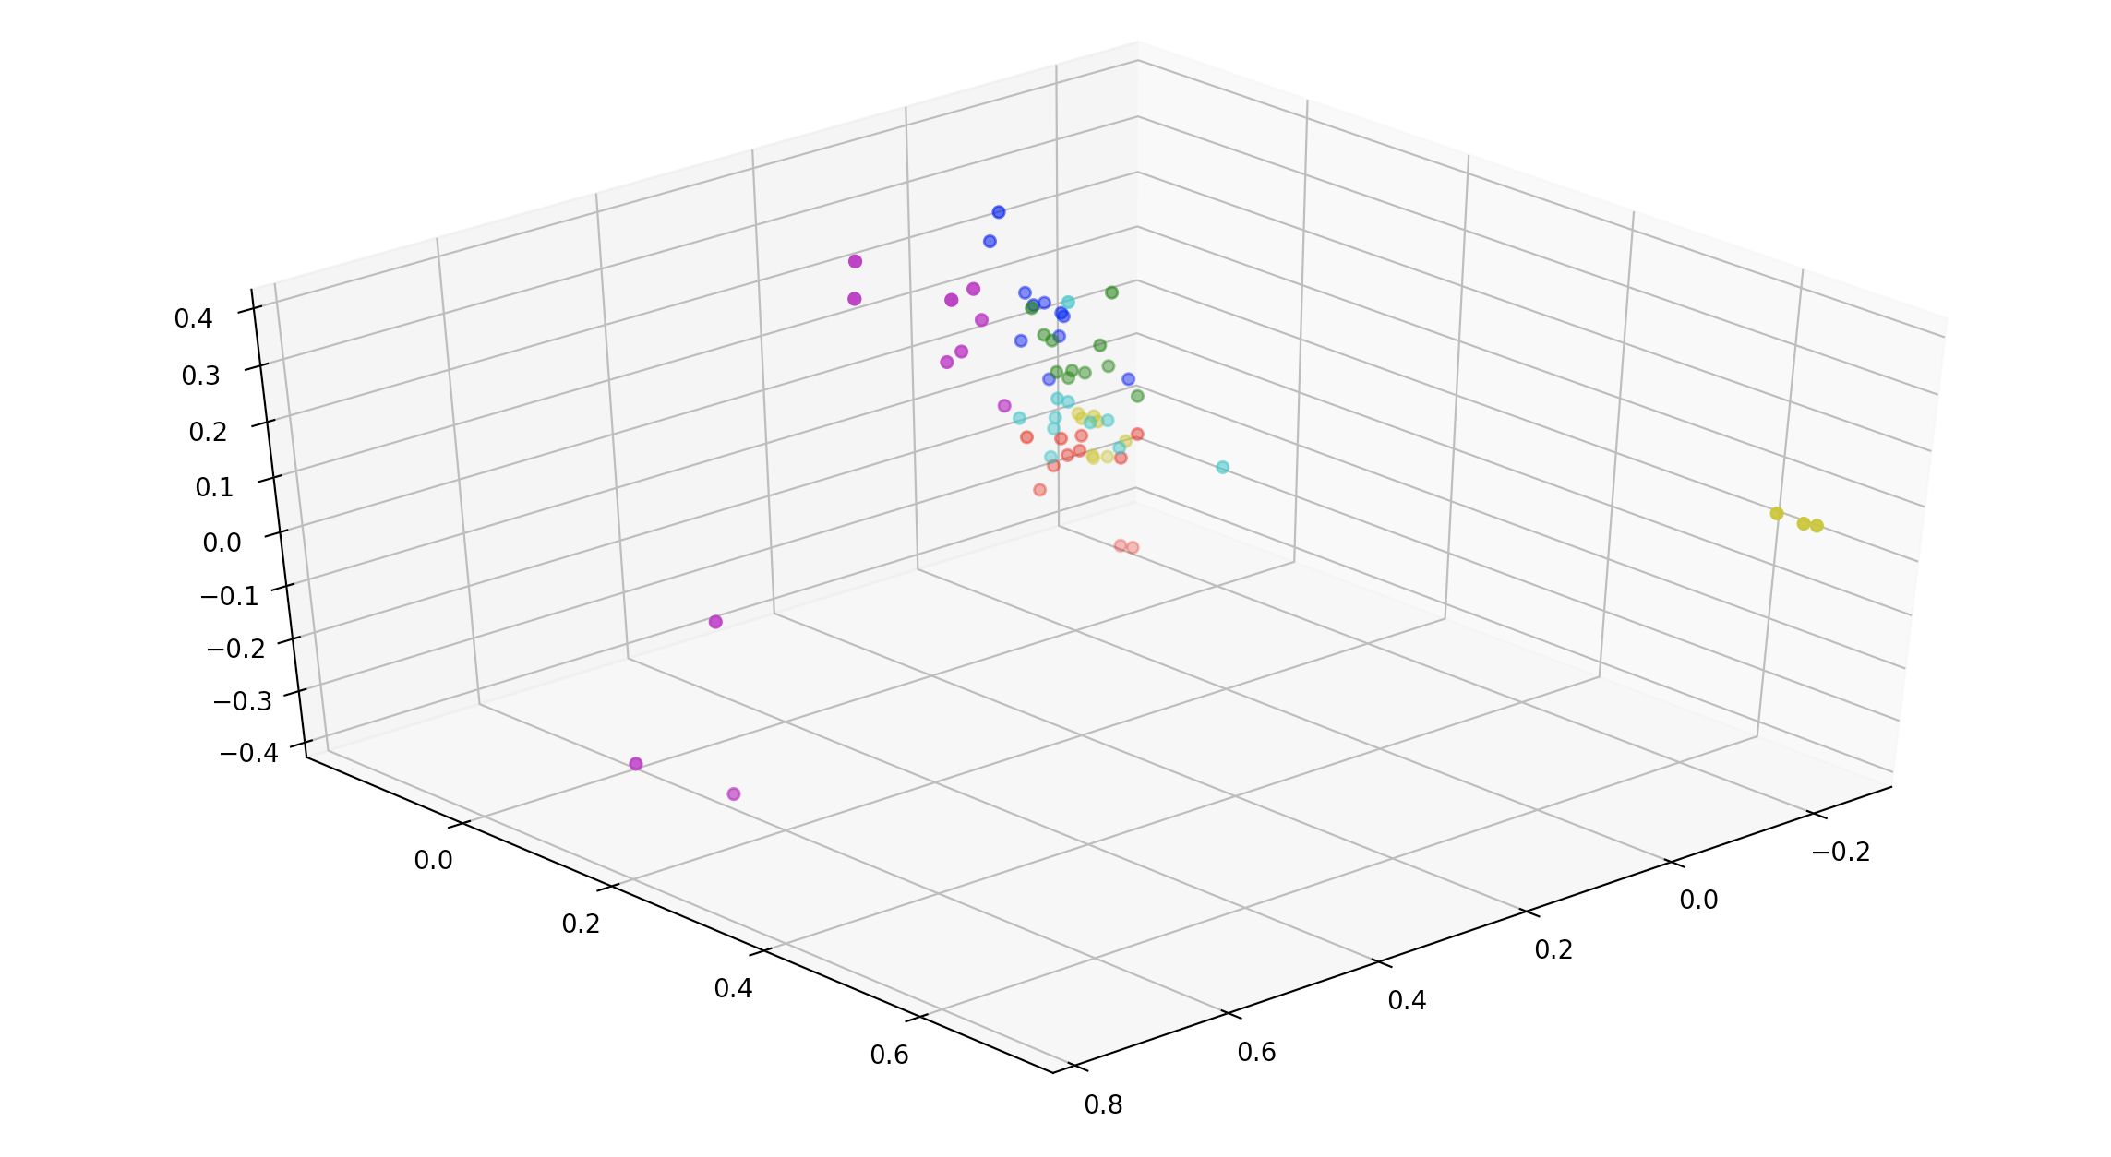
Our Results vs Sklearn results (Sprint 3)

Slide 9
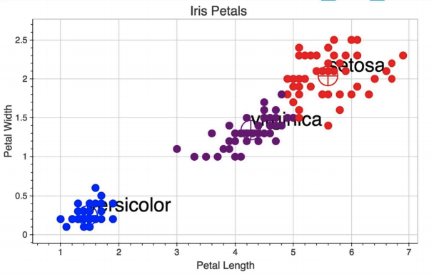
Clusters on iris dataset

Slide 10
Problems and future work
Very Simple approach would like to incorporate novel approaches such as Topic Modeling approach.
LDA based Topic models
A.J.B. Chaney and D.M. Blei, “Visualizing Topic Models,” Proc. Sixth Int’l AAAI Conf. Weblogs and Social Media (AAAI ICWSM), pp. 419-422, 2012.
http://www.princeton.edu/~achaney/tmve/wiki100k/browse/topic-presence.html

Slide 11
Questions ?

