Slide 1

BHARATHIAR UNIVERSITY, COIMBATORE
DEPARTMENT OF COMPUTER APPLICATIONS
VOICE BASED FOOD ORDERING SYSTEM
Under the guidance of , Project by,
Dr. S. GAVASKAR, MCA., Ph.D., NANDHAKUMAR S
Assistant Professor, 22CSEA19
Department of Computer Applications II MCA - BATCH I

Slide 2
INTRODUCTION
This project endeavors to revolutionize the food ordering experience by integrating Alan AI's advanced capabilities into a comprehensive system. Aimed at enhancing user engagement and efficiency, our AI-powered solution seeks to transform traditional ordering methods through voice-enabled interactions, personalized recommendations, and secure payment processing.
By focusing on improving customer satisfaction and optimizing restaurant operations, this innovative platform aims to set new benchmarks in the food industry, reshaping how users interact with food services while offering restaurants an opportunity to streamline their operations and engage customers more effectively.

Slide 3
OVERVIEW
The Voice-Enabled Food Ordering System represents an innovative and user-centric web application designed to revolutionize the food service industry. This system integrates cutting-edge technologies, including Alan AI for voice recognition capabilities, to create a seamless and interactive platform for users to place food orders. With a focus on user convenience and accessibility, the project employs a blend of frontend technologies like HTML, CSS, JavaScript, and backend scripting using PHP for session management and authentication.
The project's primary goal is to redefine the conventional food ordering process by amalgamating advanced voice recognition technologies with a user-friendly interface, aiming to set new standards in efficiency, accessibility, and technological innovation within the food service industry.

Slide 4
EXISTING SYSTEM
The current food ordering process involves traditional methods primarily reliant on manual interaction. Customers visit restaurants or use phone calls to place orders. There's limited visibility into available menus, and the ordering process lacks interactivity and personalization. Payments are often handled manually, causing potential delays and errors.
Challenges and Limitations:
Limited Interactivity
Manual Order Handling
Payment Inefficiencies
Lack of Personalization

Slide 5
PROPOSED SYSTEM
Overview of the Alan AI-Based Food Ordering System:
The proposed AI-based system aims to revolutionize the food ordering experience by integrating Alan AI. It offers:
Voice-Enabled Interaction: Customers can place orders and navigate menus through voice commands, ensuring a seamless and hands-free experience.
Personalized Recommendations: Alan AI utilizes customer data to suggest personalized menu items based on preferences and past orders.
Secure and Efficient Payment Processing: Integration with secure payment gateways ensures swift and accurate transactions.

Slide 6
HARDWARE SPECIFICATIONS
PROCESSOR : AMD Ryzen 5 4600H with Radeon Graphics 3.00 GHz
RAM : 8GB
HARD DISK : 500GB
SYSTEM TYPE : x64-based processor
SOFTWARE SPECIFICATIONS
OPERATING SYSTEM : windows 10
FRONTEND : HTML, CSS, Java Script, JQuery
SERVER SIDE SCRIPTING LANGUAGE : PHP
DATABASE : MYSQL,
DATABASE CONNECTIVITY : XAMPP Server

Slide 7
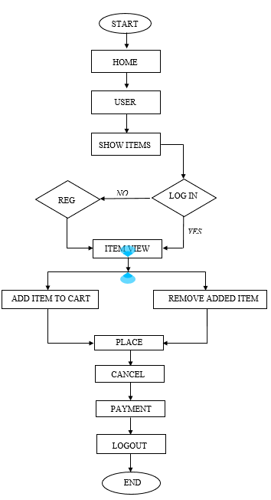
FLOW CHART

Slide 8
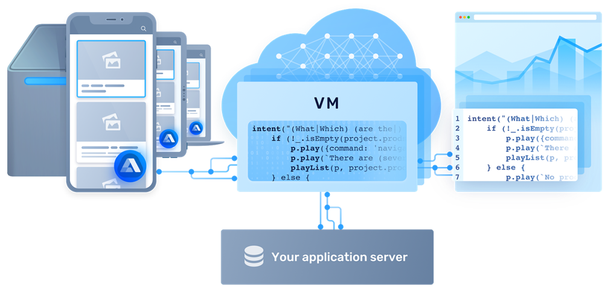
WORKFLOW REPRESENTATION

Slide 9
VOICE PROCESSING
In the Alan AI’s infrastructure, all voice processing is performed in the Alan AI Cloud. The Alan AI Cloud is the AI-backend of the Alan AI Platform. This is where dialog scripts are hosted and Spoken Language Understanding (SLU) and Natural Language Processing (NLP) tasks are accomplished.
Under the hood, the Alan AI Cloud engages a combination of voice AI tools and technologies to simulate human-like dialog between the user and the app. Together, they allow Alan AI to interpret human speech, generate responses and perform the necessary actions in the app. The main voice technologies used by Alan AI are:
Natural language processing (NLP)
Spoken Language Understanding (SLU)
Automatic Speech Recognition (ASR)
Machine Learning (ML)
Speech-to-Text (STT) and Text-to-Speech (TTS)

Slide 10
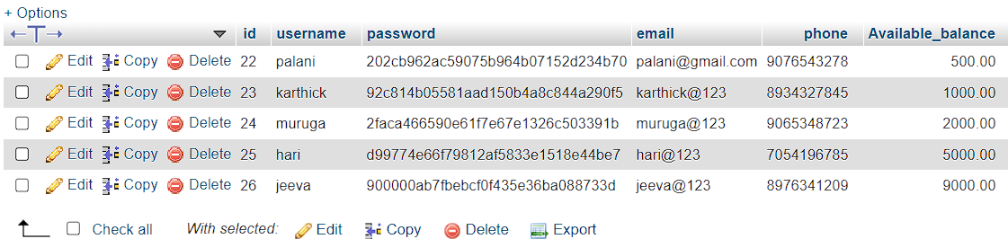
DATA BASE DESIGN

Slide 11
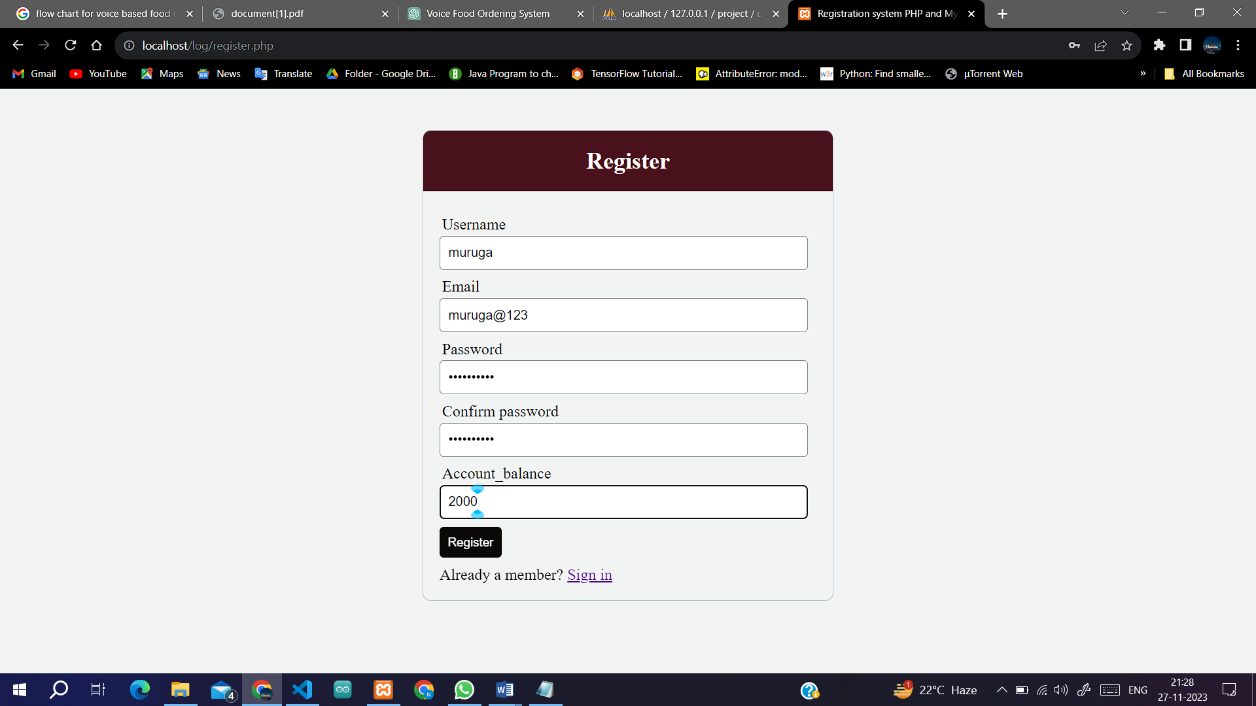
OUTPUT
REGISTER PAGE :

Slide 12
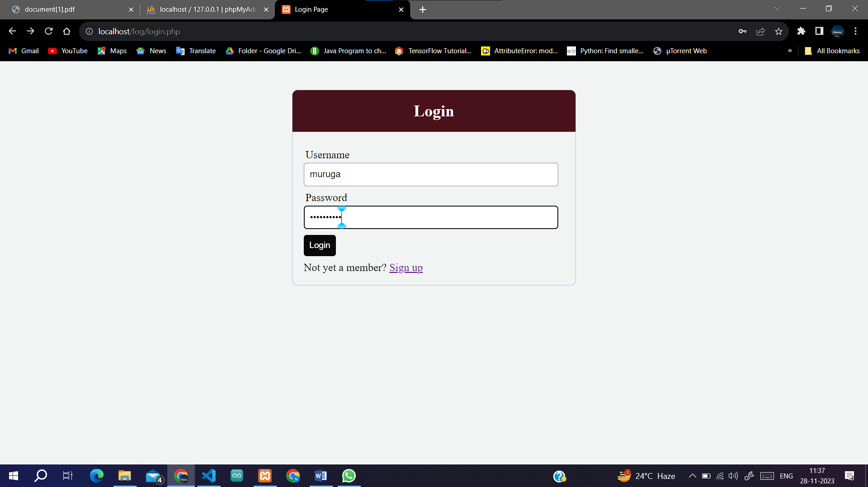
LOGIN PAGE :

Slide 13
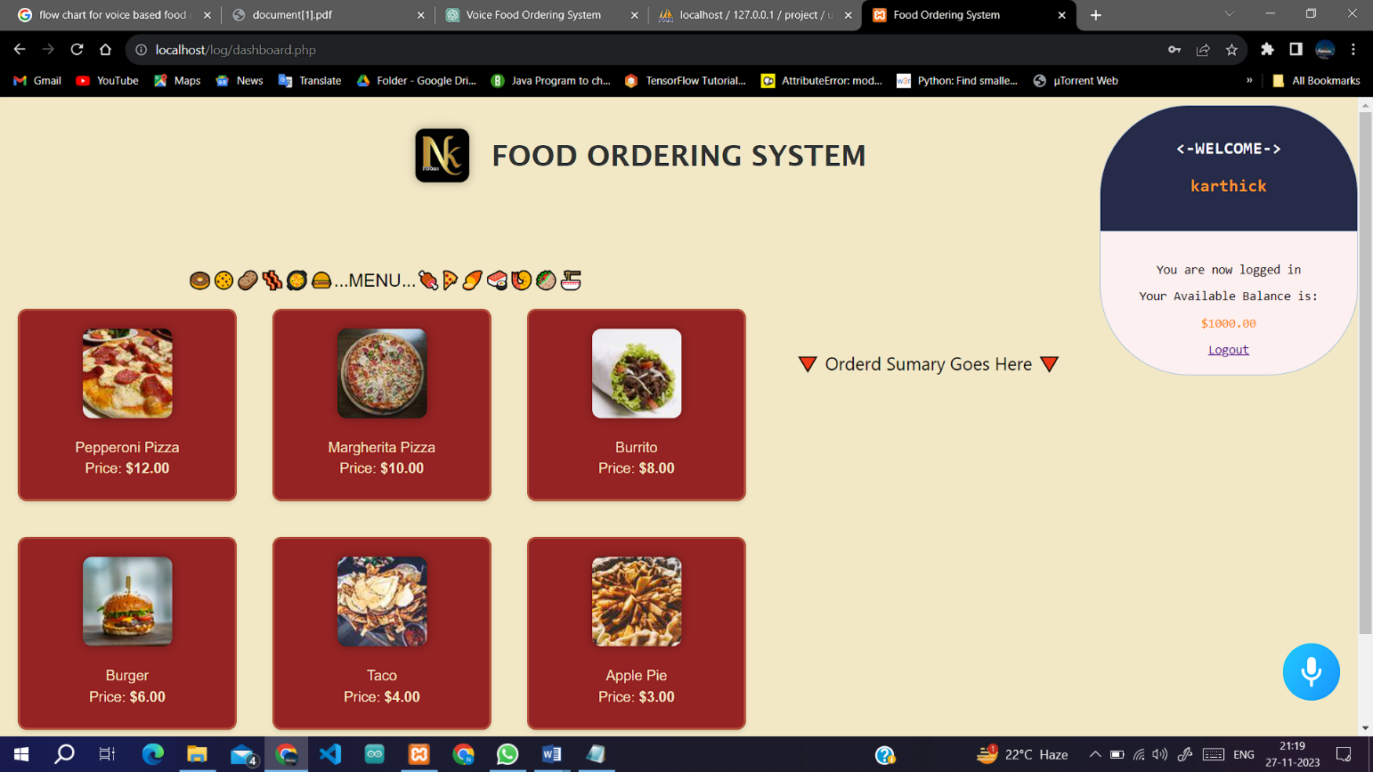
PRIOR TO PLACING YOUR ORDER :

Slide 14
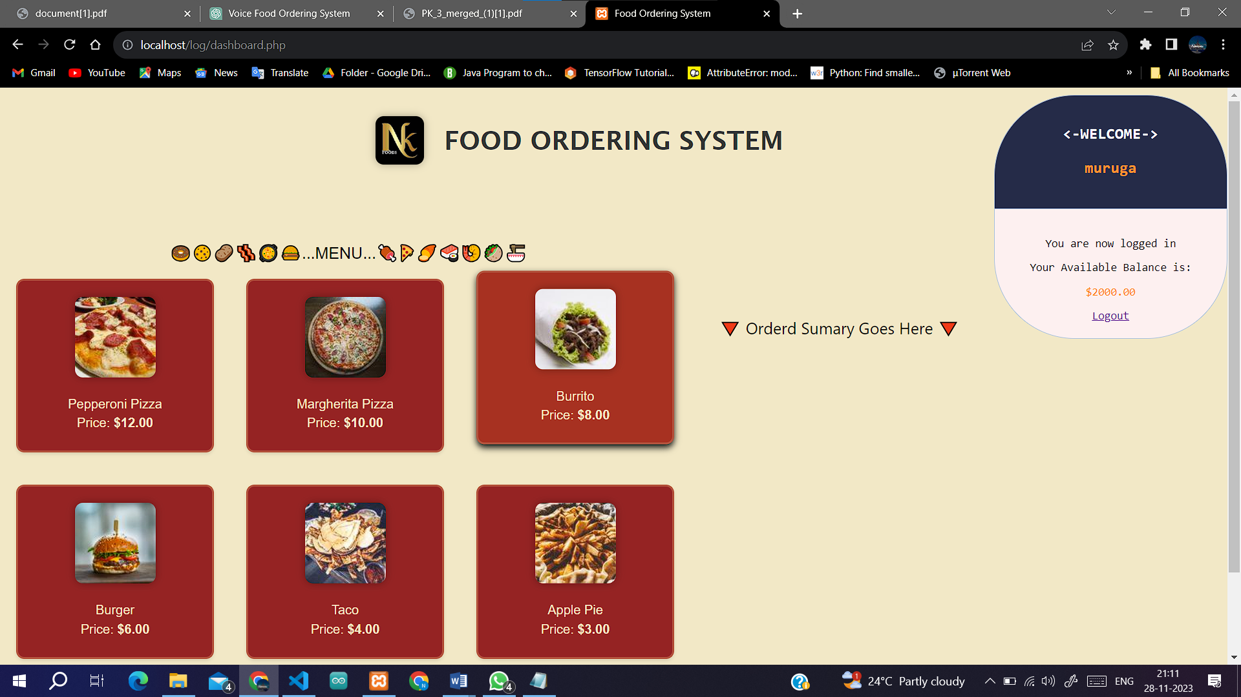
FOLLOWING THE ORDERING OF FOOD :

Slide 15
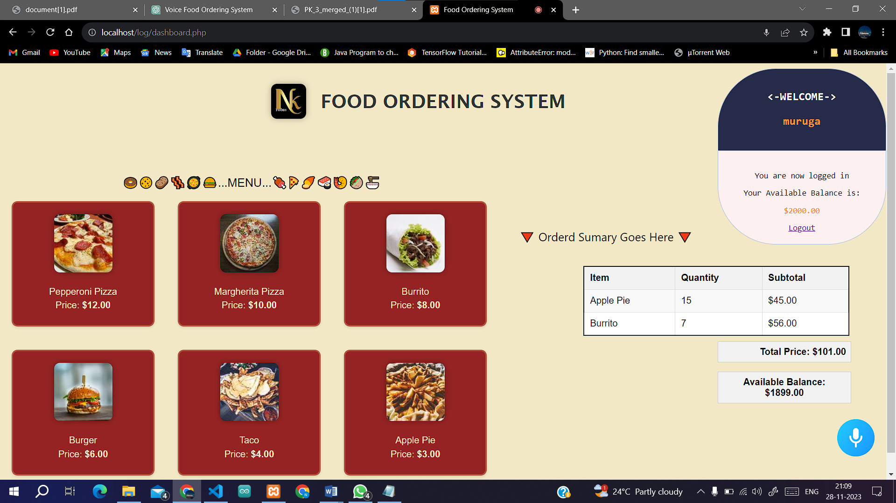
REMOVING OR UPDATING FROM ORDERED ITEMS :

Slide 16
CONCLUSION
The development of the Food Ordering System stands as a testament to the commitment to revolutionize the food service industry. Through meticulous requirement analysis and thoughtful input-output design considerations, this project endeavors to deliver a seamless user experience for both customers and restaurant owners. The system's focus on intuitive input designs and clear output interfaces aims to simplify the food ordering process, fostering a positive user experience. By emphasizing user-friendly navigation, robust security measures, and responsive design, this system bridges the gap between customers and restaurants, providing an efficient and accessible platform

Slide 17
FUTURE ENHANCEMENT
Multi-Restaurant Integration: Incorporate different restaurant categories and menus, allowing users to search based on preferences like cuisine, location, and ratings.
Geolocation and Localization: Customize the app based on users' locations and country-specific norms, languages, and currencies for a tailored experience.
Diverse Payment Methods: Integrate various secure payment gateways, digital wallets, cryptocurrencies, and international cards to accommodate global transactions.
Multi-Language Support: Implement language options for diverse users, ensuring an accessible interface in their preferred language.
Enhanced Review System: Allow users to rate and review restaurants, focusing on cuisine authenticity and service quality across different regions.
Dynamic Menu Display: Show menus with localized pricing and region-specific items,
ensuring a user-friendly display on all devices.

Slide 18
THANK YOU…

