Slide 1
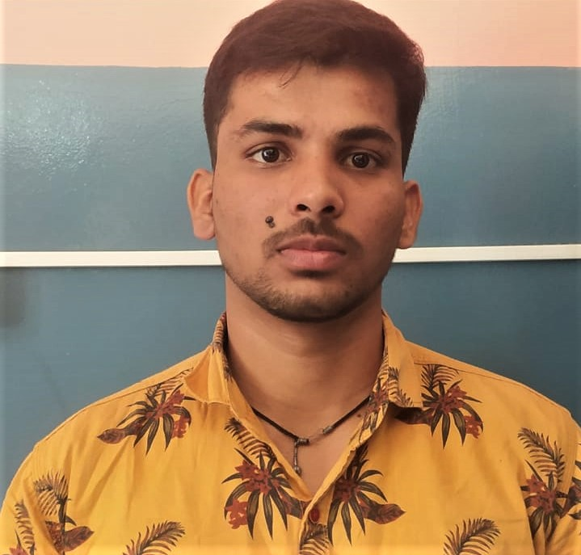

NAGIRI KARTHIK
Analyst/Software Engineer
Bachelor of Technology
Mechanical Engineering :2017-2021
Skills
Mumbai
JAVA | JAVA Basics, OOPS, ,Collections, Arrays, Loops, Data Types in JAVA.
SPRING | Spring microservices, Entity Framework Spring MVC Spring security
Spring Boot | Rest full services,h2databse, Spring web Entity frame work
UI Framework-React | Fundamentals components ,Java Script, Working with states & props in React , ,Working with HTTP in React.
React | Components, Services, Modules, Routing, Forms & Validation.
Database | Mysql ,postgrel.
UI Tech | HTML 5 & CSS 3,JavaScript,
Tools | Visual Studio 2019, Visual Studio code, Postman, Sts, Intellij.
Add On skills | Communications, Team management. Peer learning
n.a.karthik@capgemini.com
+91 9121509060
A4
Eager to work in a team of dedicated people and serve a key role in the enhancement and development of the project.
Software Engineer who is Strong in design and integration with intuitive problem-solving skills. Passionate about implementing and launching new projects.
Ready to learn new technologies and implement them to further improve my knowledge.
Has working knowledge on react and Java Microservice Development using Spring framework on an intermediate level.
Online personal photo products shoppe
Working on end to end case study of purchasing personal photo products Application along with authentication, and React used for user interface.
JavaScript and React for web developers in Degreed Platform
Completed this course with optimal Knowledge of MVC ,Web API , RESTful services , Components.

