Slide 1



MOVIE CLASSIFIER
Predict a movie based on an image uploaded by the user
Presented by Aaron Moya and Nicolás Mayoral

Slide 2
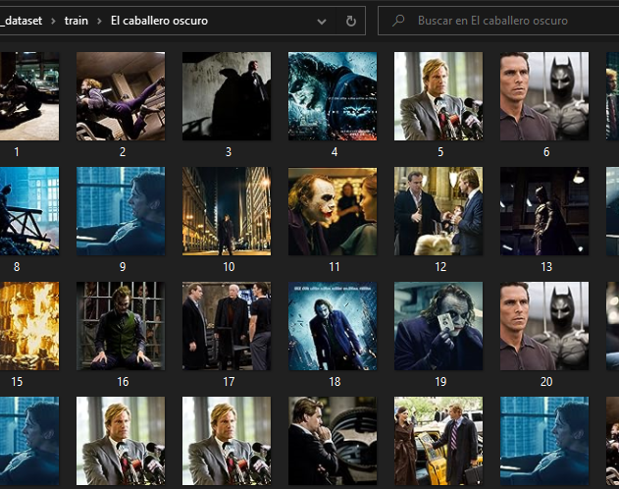

Movie Dataset
We build our own Movie Dataset with a Python Script.

Slide 3
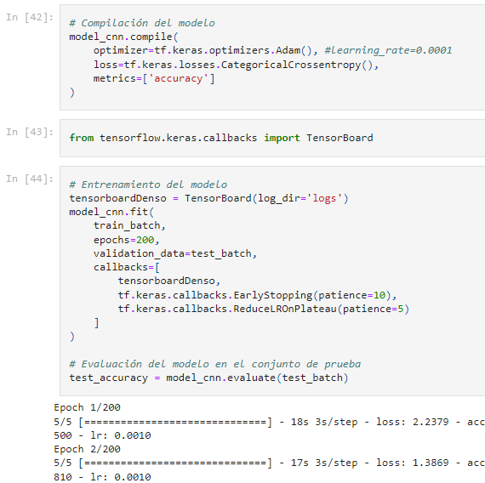


Pre-trained Model
We train our own model to be able to make specific predictions requested by the user.
Three types of models:
Specific model built with a CNN using TensorFlow.
Transfer learning model built with the MobileNetV2 CNN.
Logistic Regression Model built with ScikitLearn.

Slide 4
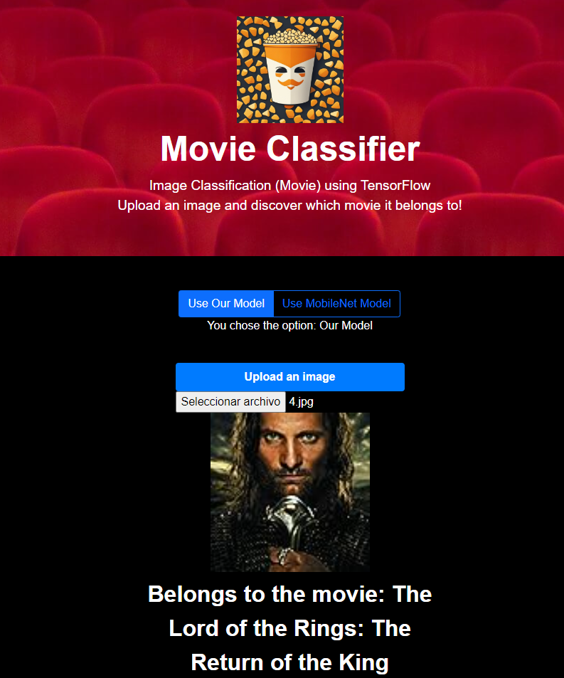


Web Page
Finally, we present our models on a web page developed in Flask, so that the user can choose the model that they like the most.

