Slide 1
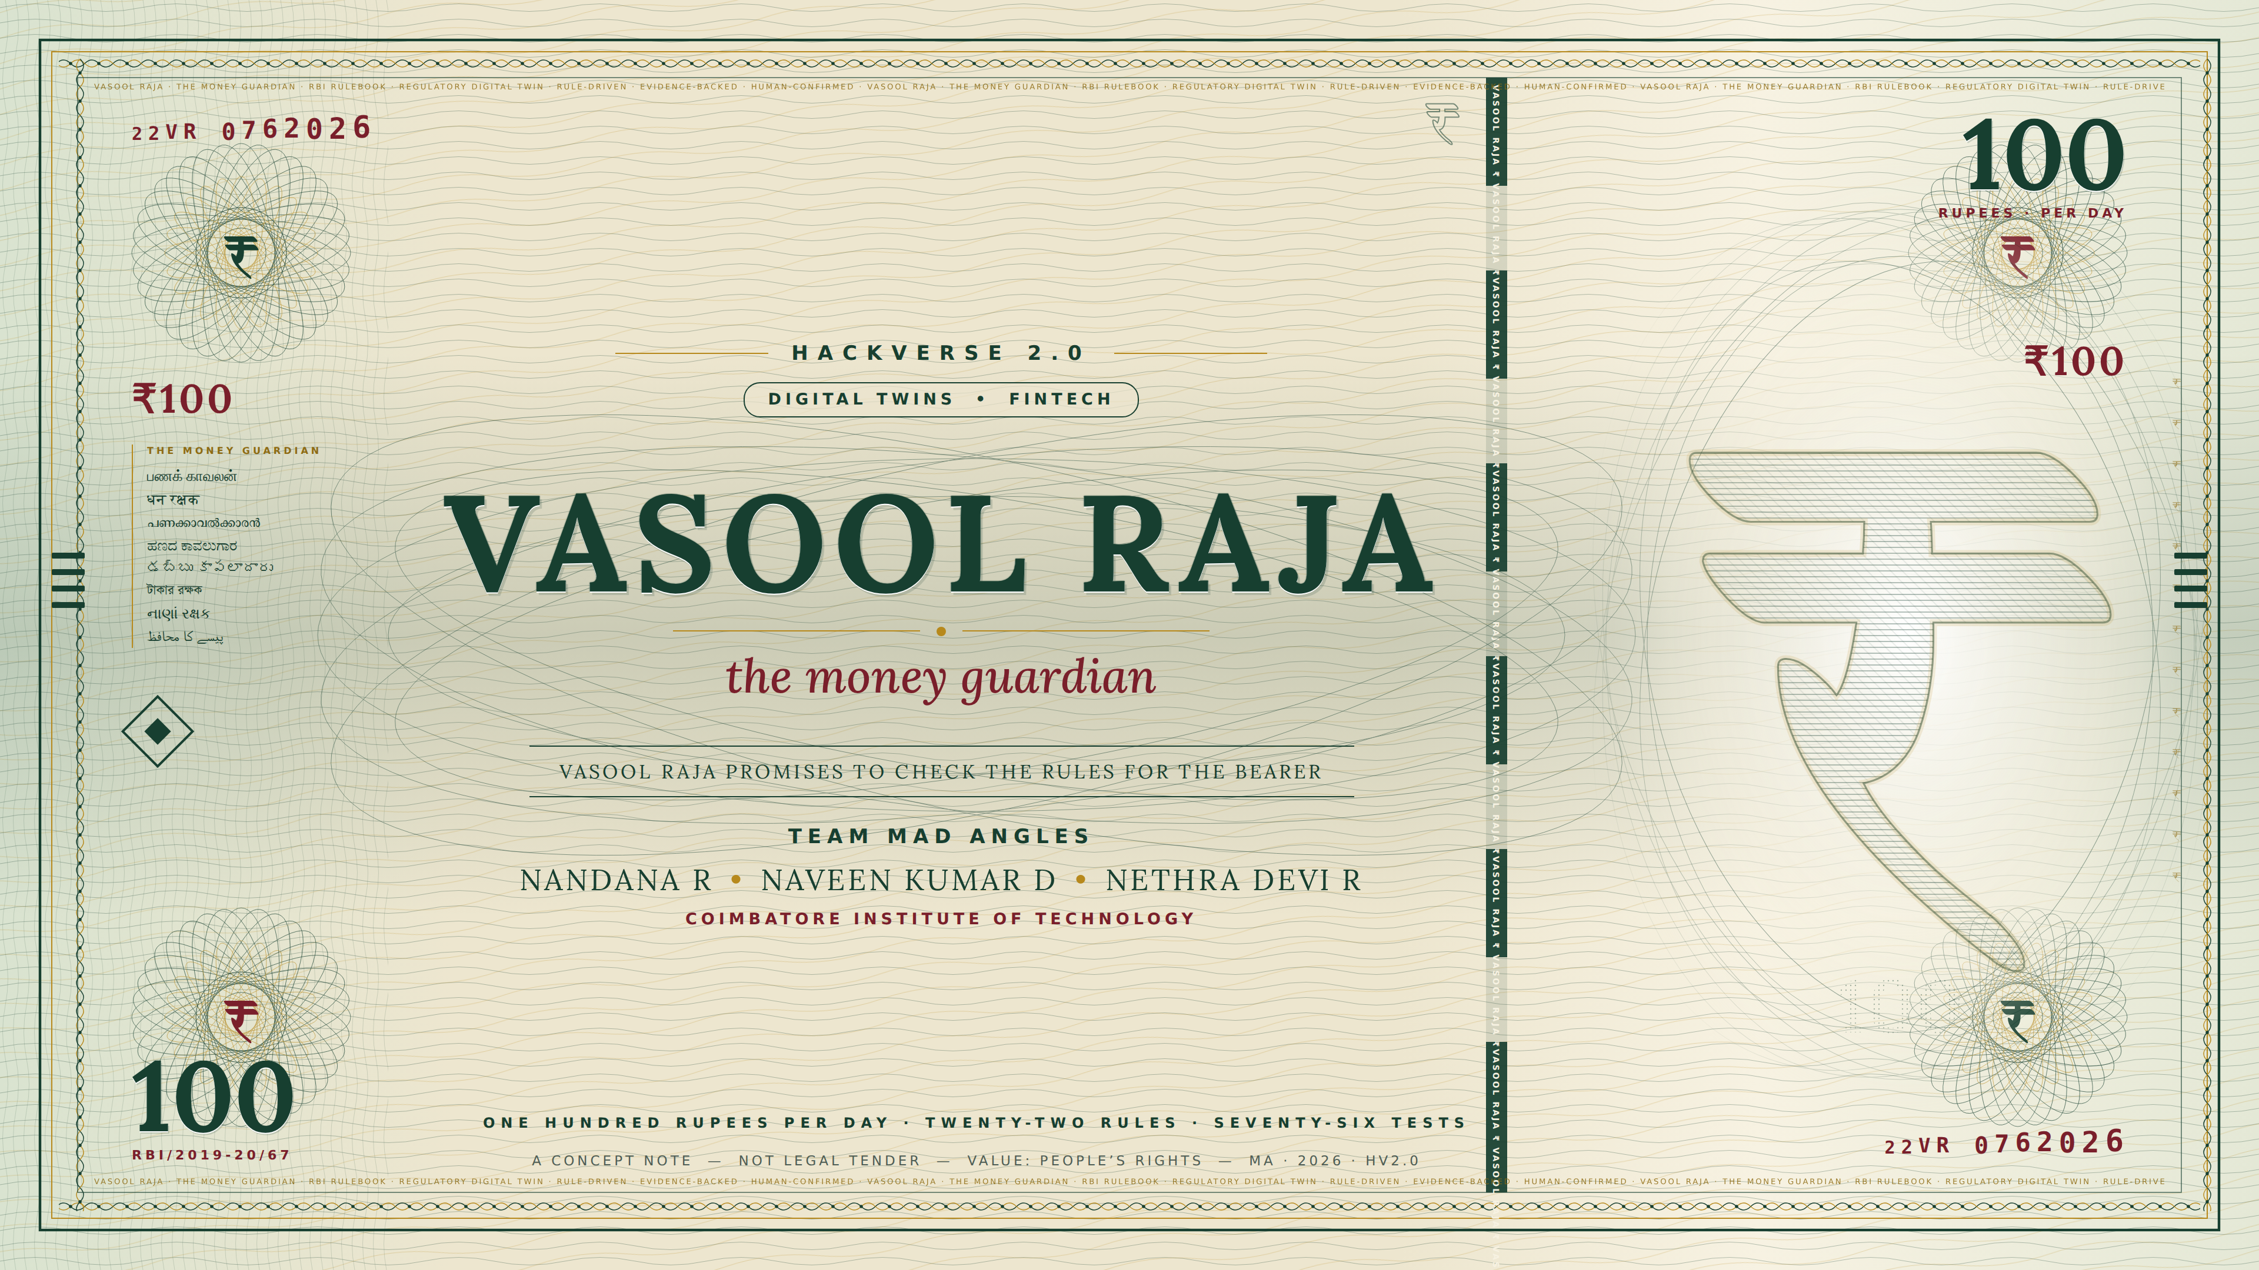
Notes:
Cover. A rupee-note-style engraving of the team's own design: guilloche rosettes, windowed security thread with micro-text, an engraved ₹ in the watermark window, denomination 100 = the ₹100/day hook, the tagline in eight Indian scripts, bleed lines and ID mark. Clearly marked 'not legal tender'; no issuer name, emblem or portrait.

Slide 2
PROBLEM
₹100/day compensation
When an eligible failed transaction is not reversed within the prescribed time.
RBI/2019-20/67 · in force since 15 Oct 2019 · eligibility and the T+1 / T+5 windows depend on the channel — not every failed transaction qualifies. Most customers never know to check.
Vasool Raja checks your statement against the RBI rule that applied on that date.
22 RBI rules implemented · 76 automated tests · ready to demo
Rule-driven. Evidence-backed. Human-confirmed.
Notes:
ABSTRACT. Problem. Indian banks operate under a detailed RBI rulebook on charges, failed-transaction reversal and compensation (₹100/day when an eligible failed transaction is not reversed within the prescribed time, RBI/2019-20/67), yet customers never read it. Banks collected ₹7,086 crore in minimum-balance penalties in FY26; 13.34 lakh Ombudsman complaints were filed in FY25. Solution. Vasool Raja is a Regulatory Digital Twin: the customer's actual financial state (transactions, balances, reversals) is compared with the expected regulatory state (the versioned RBI rule in force on that date, its required action, deadline and compensation formula); the delta is an evidence-backed potential claim. 22 RBI rules implemented as an open JSON rulebook (40 mapped), 76 automated tests; findings labelled recoverable / avoidable / unclear; complaint prepared and tracked on the statutory 30-day clock; no complaint is filed without human confirmation. A deterministic rule engine decides; an LLM only extracts, explains and communicates (Tamil voice, family Guardian). Feasibility. Built: FastAPI + rule engine + web app; CSV/PDF/passbook-photo OCR, multi-statement history, printed A4 complaint, real one-button guardian email. Impact. Every UPI user; free for consumers; bank-side use: detect regulatory exceptions before they become complaints. Keywords: Digital Twin, Regulatory Twin, RegTech, FinTech, RBI compliance, rule engine, evidence chain, grievance redressal, UPI, financial inclusion, Tamil.

Slide 3
PROBLEM · REGULATORY ENGINE
It's not one rule. It's a rulebook — versioned, tested, deterministic.
₹100/day is one of about forty RBI rules that decide what your bank may charge, what it must tell you first, and what it owes you when it fails. Your bank knows all of them. You know none.
40
→
22
→
76
→
✓
RBI rules mapped
fully implemented & tested
automated tests — all passing
deterministic decision
40 mapped does NOT mean 40 implemented. Each of the 22 implemented rules carries: RBI source / circular · effective date · conditions / formula · required evidence · automated tests. A rule engine, not an LLM guessing what RBI says.
Failed transaction
Minimum balance
ATM charges
Credit-card closure
Reversal by T+1 (UPI) or T+5 (ATM); ₹100/day after, paid without a complaint
Warning notice + one month to restore; penalty proportionate; never negative
5 free own-bank, 3/5 other-bank, enquiries count; max ₹23 after
Closed within 7 working days of request, else ₹500/day
RBI/2019-20/67 · 2019
RBI · 20 Nov 2014
RBI · eff. 1 May 2025
Card Directions · 2022
Unauthorised transaction
Loan charges
Inactive accounts
Bank lockers
Report within 3 working days → zero liability; shadow credit in 10 days
Nothing outside the Key Fact Statement; penal charges never capitalised
No minimum-balance penalty, no reactivation charge
Loss by negligence, fire, theft or staff fraud: up to 100× annual rent
RBI · 6 Jul 2017
RBI · eff. 1 Oct 2024
RBI · eff. 1 Apr 2024
RBI · Aug 2021
Vasool Raja · HackVerse 2.0 · Digital Twins & FinTech
2
Notes:
The rulebook slide: establishes that Vasool Raja is a rule engine over the RBI consumer rulebook, not an app for failed ATM transactions. 40 rules mapped; 22 implemented as open JSON (rulebook/rules.json), each with circular, effective window, formula, evidence, questions and automated tests (76 passing). Eight shown. Rules change (the ATM cap was ₹21 before 1 May 2025), so every rule is versioned by effective date. Rule-change pipeline: RBI notification → rule update → human verification → test cases → production.

Slide 4
PROBLEM
Amma's passbook: ₹295 gone. “System charge, ma’am.”
Date | Particulars | Withdrawal | Deposit | Balance
02/06/26 | NEFT PENSION JUN |  | 6,500.00 | 8,214.00
04/06/26 | ATM WDL CANARA RS PURAM | 3,000.00 |  | 5,214.00
11/06/26 | ATM WDL SBI GANDHIPURAM | 2,000.00 |  | 3,214.00
30/06/26 | CHRG MIN BAL NON MAINT ? | 295.00 |  | 2,919.00
30/06/26 | SMS ALERT CHRG Q1 ? | 17.70 |  | 2,901.30
SHE ASKS
“Why ₹295?”
COUNTER
“System charge, ma’am.” She leaves.
THE RULE
A minimum-balance penalty needs a warning and one month to restore. She got neither.
MONTHS LATER
Her phone rings, in Tamil: “Amma, unga account-la ₹590 thappa cut aagirukku. Kumar-ku sollirukkom.”
A printed passbook page, June 2026. The two lines she cannot explain.
HER SON
Gets one message: ₹590 potential claim · the RBI rule · evidence ready · one button. Nothing is filed until he confirms.
PASSBOOK PHOTO
→
TRANSACTION
→
RBI RULE
→
ENGINE CHECK
→
EVIDENCE
→
VERDICT
→
EXPLANATION
page photographed · OCR
CHRG MIN BAL ₹295 · 30 Jun
min-balance penalty · 20 Nov 2014
warning? ✗ · one month? ✗
2 statement lines
₹295 potentially recoverable
Tamil · guardian · human confirms
People have rights they don’t know they have, and the process to exercise them is too hard.
The rules are hidden knowledge. The statement is hidden evidence. The complaint is a process nobody finishes. Vasool Raja identifies the potential claim and prepares the recovery workflow — an actual financial event checked against the rule that applied to it. Nothing is filed until human confirmation.
Tamil voice + guardian = accessibility layer — same regulatory engine underneath.
Vasool Raja · HackVerse 2.0 · Digital Twins & FinTech
3
Notes:
Passbook table (text, not an image): NEFT pension 6,500; ATM withdrawals 3,000 and 2,000; minimum-balance charge 295.00 and SMS alert charge 17.70 on 30/06/26. Scene: she asks why; counter says system charge; the rule requires notice and one month; months later a Tamil voice call and one WhatsApp to her son. Spine: people have rights they don't know they have, and the process to exercise them is too hard.

Slide 5
IMPACT · PROBLEM SCALE
₹7,086 crore in penalties last year. 13.34 lakh complaints.
Regulatory-rule violations happen at massive scale, while customers must currently discover and pursue them manually. These are problem-scale figures from public sources — not Vasool Raja results, and not amounts Vasool Raja claims to recover.
₹7,086 cr
₹35,588 cr
minimum-balance penalties collected in FY26 alone
minimum-balance, ATM and SMS charges, FY18–FY23
SOURCE Rajya Sabha reply, 28 Jul 2026 — HDFC ₹1,798 cr, Axis ₹1,081 cr
SOURCE Rajya Sabha reply, 8 Aug 2023
13.34 lakh
₹59,600
complaints to the RBI Ombudsman in FY25
external documented case: awarded on a ₹10,000 ATM failure — ₹100/day for the 296 days until reversal, plus costs
SOURCE RBI Ombudsman Scheme annual report 2024–25
SOURCE Delhi consumer commission, 27 Aug 2026 (ANI) — the customer litigated for four years; not a Vasool Raja recovery
The customer in the ₹59,600 case got what RBI says should have been credited automatically — only because he litigated. Every UPI user in India is exposed to the same rules: 24.51 billion transactions a month (NPCI, Aug 2026).
Vasool Raja · HackVerse 2.0 · Digital Twins & FinTech
4
Notes:
Scale, all official: ₹7,086.63 crore minimum-balance penalties FY26 (Rajya Sabha, 28 Jul 2026); ₹35,587.68 crore FY18–FY23 (Rajya Sabha, 8 Aug 2023); 13.34 lakh complaints FY25 (RBI Ombudsman annual report); Punjab & Sind Bank ordered to pay ₹59,600 on a ₹10,000 failed ATM withdrawal (Delhi DCDRC, 27 Aug 2026). UPI volume: 24.51 billion transactions, August 2026 (NPCI).

Slide 6
INNOVATION
Existing solutions we evaluated each cover one step.
 | Finds the problem for you | Computes what RBI says you’re owed | Prepares evidence + complaint | Runs the 30-day clock, escalates | Tamil, voice, family helper
RBI CMS portal cms.rbi.org.in | — | — | — | — | 12 languages, web form
NPCI UPI Help status of a UPI transaction | — | — | — | — | —
ClaimBack.in statement scan, draft email | ✓ | — | draft only | — | —
Bank apps / CRED spend insights, hidden card charges | partly | — | — | — | —
Vasool Raja statement → rule → amount → evidence → priority → complaint → tracking | ✓ | ✓ | ✓ | ✓ | ✓
Existing solutions address individual steps. Vasool Raja connects the complete regulatory-checking chain. END-TO-END REGULATORY CHECKING ENGINE — not AI for the sake of AI. The innovation is the system design: financial state + time-aware regulation + deterministic rules + evidence + action.
STATEMENT
→
RULE
→
AMOUNT
→
EVIDENCE
→
PRIORITY
→
COMPLAINT
→
TRACKING
Vasool Raja · HackVerse 2.0 · Digital Twins & FinTech
5
Notes:
Competitor review, Sept 2026: RBI CMS portal (files a complaint you already know you have), NPCI UPI Help (per-transaction status, reactive), ClaimBack.in (scans a statement PDF and drafts an email; no failed-transaction compensation, no deadline tracking, English only), bank apps and CRED (insights, no recovery). We claim only what we found; the gap is the combination.

Slide 7
TECHNOLOGY · DIGITAL TWIN
DIGITAL TWIN = ACTUAL FINANCIAL STATE ↔ EXPECTED REGULATORY STATE
The account is reconstructed over time and compared with the RBI rule in force on each date. Expected − actual = regulatory delta = potential claim.
ACTUAL FINANCIAL STATE · from the statement
EXPECTED REGULATORY STATE · rule in force that day
EXPECTED under the rule
₹1,200
Transaction failed ATM withdrawal
Debit ₹1,200 · 3 Aug
Reversal credited 20 Aug
Compensation actually credited ₹0
Evidence 2 statement lines · ref NFS803110
Rule RBI/2019-20/67
Effective date 15 Oct 2019
Deadline T+5 → reversal by 8 Aug
Expected compensation ₹100 × 12 days late = ₹1,200
Credited automatically, no complaint needed
MINUS ACTUAL credited
₹0
vs
= REGULATORY DELTA
₹1,200
POTENTIAL CLAIM
₹1,200
Evidence attached · Confidence: confirmed · Complaint prepared · human confirms
SYSTEM ARCHITECTURE AS BUILT · green = deterministic decision path · gold = LLM / OCR explanation path (never decides)
Statement / passbook
Parser / OCR
Classification
Debit ↔ reversal pairing
Account state
Regulatory twin
Versioned rules
Expected vs actual
Delta
Evidence + confidence
Complaint + clock
LLM explanation
CSV · PDF · photo
lines → transactions
channel · kind · own-bank ATM
ref · amount · partial sums
balance path · monthly counts
rule in force per date
22 · effective windows
per transaction
₹ calculation
lines · label
human confirms · 30 days
Tamil · voice · guardian
Every potential claim = TRANSACTION + ACCOUNT STATE + APPLICABLE RULE + EFFECTIVE DATE + CALCULATION + EVIDENCE. Without all six: no claim. Versioned deterministic RBI rules decide; the LLM only extracts, explains and communicates.
Stateful: adding an earlier statement changes the reconstructed account state, and can change a verdict (slide 8). GUARDIAN (காப்பாளர்) — accessibility, not the engine: holder called first in Tamil; one trusted person, one button; no complaint is filed without human confirmation.
Vasool Raja · HackVerse 2.0 · Digital Twins & FinTech
6
Notes:
The twin is a continuously updated model of the customer's financial-rule state: transactions, balance path, account type, the RBI rules in force on each date, deadlines, claims and outcomes. Actual state (what the statement shows) is compared with expected state (what the rule required by when); the delta, with its evidence lines and confidence label, is the potential claim. ₹0 = compensation actually credited; ₹1,200 = compensation expected under RBI/2019-20/67 for 12 days of delay. The LLM never decides whether the bank owes money; it reads photos (OCR) and explains findings. Guardian: nominee-for-grievances; RBI Ombudsman Scheme permits authorised representatives.

Slide 8
FEASIBILITY · AI SAFETY
LLM ≠ DECISION MAKER
DETERMINISTIC RULE ENGINE = DECISION MAKER
The LLM extracts, explains and communicates. It cannot create a claim.
NO EVIDENCE → NO CLAIM
HOW IT WORKS
BANK DATA
→
PARSER / OCR
→
DETERMINISTIC RULE ENGINE
→
VERDICT + EVIDENCE
→
LLM EXPLANATION
NOT THIS
BANK DATA
→
LLM
→
MONEY CLAIM
1
“Isn’t this just ChatGPT?”
An LLM has no authoritative account state, no rule execution, no effective-date logic and no deterministic claim calculation. Vasool Raja supplies all four.
2
“What if the LLM hallucinates?”
It does not determine the claim; the deterministic rule engine does. Every finding requires transaction data + account state + effective-date rule + calculation + evidence.
3
“What if a rule changes?”
Rules are versioned by effective date. The engine applies the rule that was in force when the transaction occurred (e.g. ATM cap ₹21 before 1 May 2025, ₹23 after).
4
“What if evidence is incomplete?”
Do not claim. The finding is labelled “unclear” and the system asks for the missing information — it never presents an unclear finding as a claim.
Vasool Raja · HackVerse 2.0 · Digital Twins & FinTech
7
Notes:
Hallucination control by architecture: the LLM sits after the verdict, never before it. In reserve: 'Who cares about ₹20?' (lead with the ₹1,000s, combine small ones, never ask the user to act on one); 'Does the money actually come back?' (not always — labels recoverable / avoidable / unclear; recovery in the prototype is simulated); 'How does an illiterate person use an app?' (called in Tamil; guardian gets one message and one button — accessibility layer, same engine); false alarm on a big legitimate payment (no anomaly detection; a ₹50,000 fee matches no rule — automated test).

Slide 9
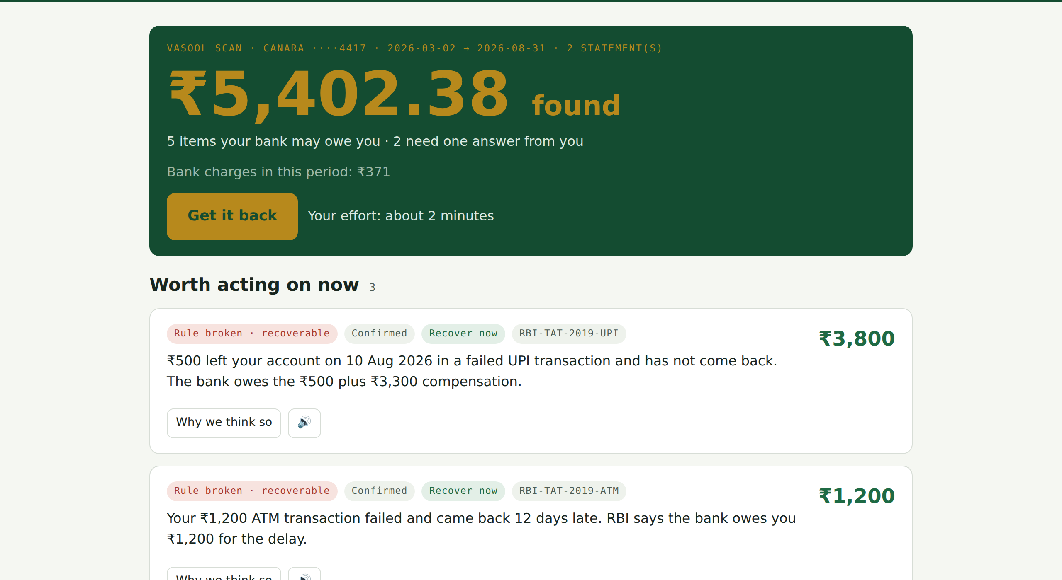
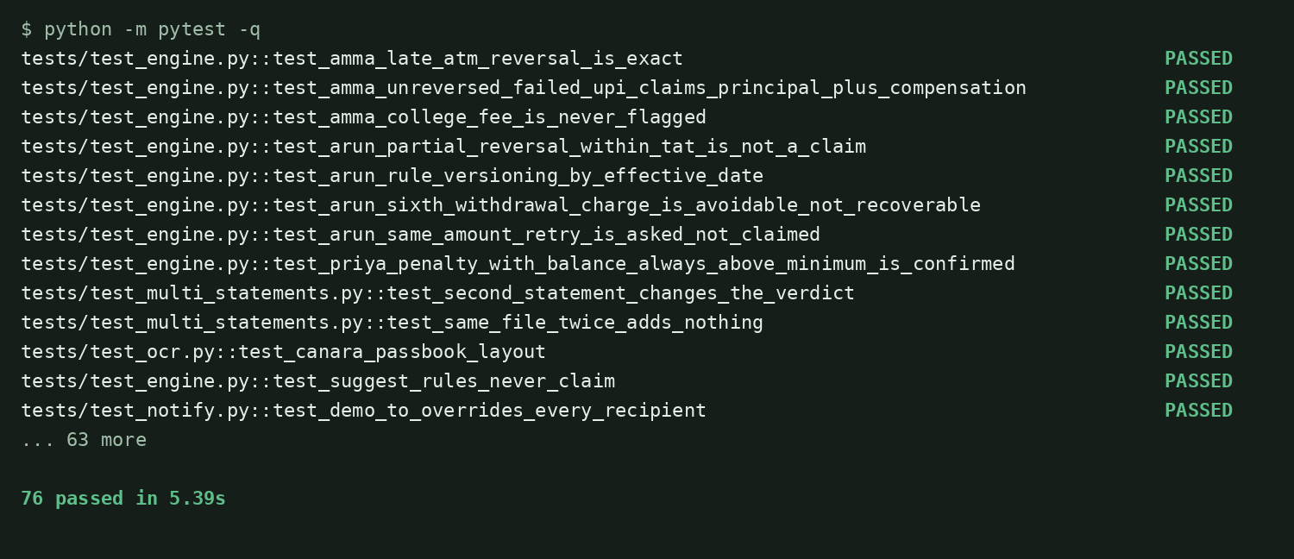
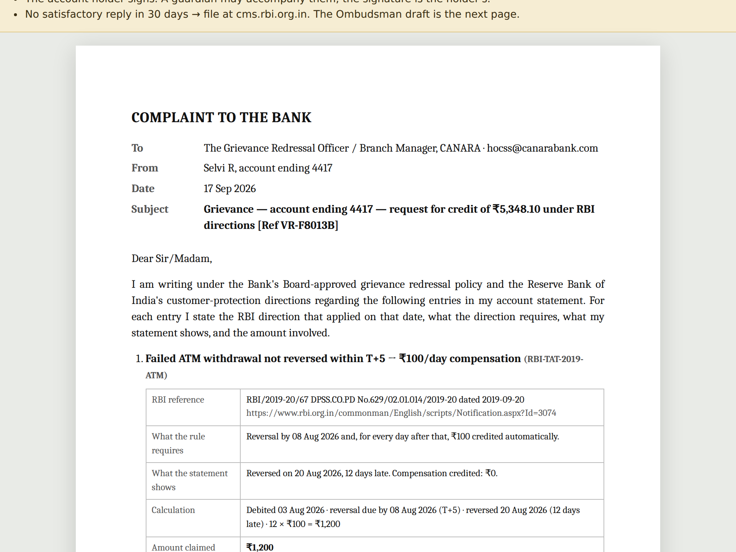
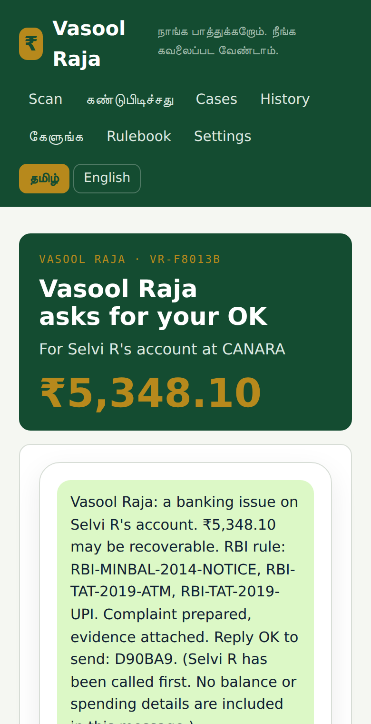
TEAM · WHAT EXISTS TODAY
NOT A PLAN. A WORKING ENGINE.
Mad Angles · Coimbatore Institute of Technology. Everything below is running code; screenshots from the prototype, 17 Sep 2026. Demo data is synthetic.
REPRESENTATIVE AUTOMATED TESTS · 3 of 76
Case | Expected | Result
Late ATM reversal — 12 days | Claim: 12 × ₹100 | PASS
Partial reversal within T+5 | No claim | PASS
₹50,000 college fee | Never flagged | PASS
76 automated tests, all passing (pytest)
Complaint generated, print-ready A4
letter, RBI references, Annexure A with the evidence lines
Guardian message — real email, one button
the laptop screen moves to “Sent” when the phone taps; no complaint without human confirmation
Open 22-rule JSON rulebook
circular · effective window · formula · evidence · tests. Code on the demo laptop, available to the panel.
₹5,402 potential claim value identified (sum of RECOVERABLE findings; synthetic demo data) · 2 Canara statements merged, Mar–Aug · 5 findings, each with rule id and confidence.
STATEFUL REGULATORY TWIN — not a one-shot LLM response
HONEST LIMITATION
Recovery is currently simulated. The prototype identifies potential claims and prepares the recovery workflow. It does not email a bank. No actual bank recovery has been demonstrated.
ADD LAST QUARTER
→
ACCOUNT STATE CHANGES
→
MAY BALANCES VISIBLE
→
JUNE VERDICT CHANGES
→
“NEEDS ONE ANSWER” → “CONFIRMED”
2nd statement merged
more history available
never below ₹500
min-balance penalty
recoverable
Vasool Raja · HackVerse 2.0 · Digital Twins & FinTech
8
Notes:
Proof slide, no placeholders. Screenshots from the running app (v0.4.1). Left: Found screen after merging two synthetic Canara statements — ₹5,402.38 is the sum of RECOVERABLE findings on that data. Stateful strip: with only Jun–Aug the June min-balance penalty is UNCLEAR (needs the notice question); merging Mar–May makes May's balances visible (never below ₹500) and the verdict becomes CONFIRMED recoverable — an automated test (test_second_statement_changes_the_verdict). Right: real pytest output (76 passed); three representative tests named as they exist in tests/test_engine.py. If asked for the repo: on the laptop; GitHub link the moment it is public. If asked about a real filed claim: none yet — we say so.

Slide 10
DEMO · 25 SEPTEMBER · BUSINESS MODEL
On 25 September you will see this journey live.
A · LIVE DEMO — every demonstrated step already works
1
2
3
4
5
6
Upload real statement (CSV · PDF · passbook photo)
→
Extract transactions
→
Detect potential issue
→
Identify applicable RBI rule
→
Show actual vs expected
→
Calculate ₹ amount
7
8
9
10
11
12
Show evidence lines
→
Show confidence label
→
Generate complaint (A4)
→
Explain in Tamil · guardian tap
→
Add historical statement
→
Verdict / state changes
Recovery is simulated. Nothing is emailed to a bank. No complaint without human confirmation. We say this before anyone asks.
B · BUSINESS MODEL — ONE ENGINE. TWO SIDES.
CONSUMER — FREE
the account holder and family
BANK — LICENSED PRODUCT
not a tool to reject claims — a tool to find exceptions first
Identify potential claims
→
Understand rule + evidence
→
Prepare recovery workflow
Detect regulatory exceptions
→
Resolve before escalation
→
Reduce avoidable complaints
Why a bank could have an incentive: earlier detection → earlier resolution → fewer escalations, under RBI’s Internal Ombudsman Directions (14 Jan 2026, auto-escalation of unresolved complaints). No bank is a customer today.
Bank rule theriyadhaa? Vasool Raja paathukkum.
Vasool Raja · HackVerse 2.0 · Digital Twins & FinTech
9
Notes:
Closing: the demo as a 12-step journey, every step implemented (v0.4.1). Say 'simulated' about recovery before anyone asks. Business model: consumer side free; bank side is the same engine used to find regulatory exceptions before they become complaints — explicitly not a claim-rejection tool. RBI Internal Ombudsman Directions 14 Jan 2026 (source slide 10) create the incentive. No bank customers today; no revenue; no partnerships claimed.

Slide 11
SOURCES
Every number, a link. Every rule, a circular.
PRIMARY REGULATORY SOURCES · RBI circulars · directions · Ombudsman / CMS
SUPPORTING SOURCES · NPCI · Rajya Sabha data · press / media
RBI/2019-20/67 — TAT and compensation for failed transactions (₹100/day)
rbi.org.in/commonman/English/scripts/Notification.aspx?Id=3074
NPCI UPI product statistics — 24.51 bn transactions, Aug 2026
npci.org.in/product/upi/product-statistics
RBI, 20 Nov 2014 — penal charges for non-maintenance of minimum balance
rbi.org.in/commonman/English/Scripts/Notification.aspx?Id=1500
₹7,086 crore minimum-balance penalties FY26 — Rajya Sabha reply, 28 Jul 2026
business-standard.com/finance/news/banks-collected-7-086-crore-as-minimum-balance-penalties-in-fy26
RBI, 28 Mar 2025 — ATM free transactions and ₹23 cap (eff. 1 May 2025)
rbi.org.in/scripts/NotificationUser.aspx?Id=12111
₹35,587 crore charges FY18–FY23 — Rajya Sabha reply, 8 Aug 2023
businesstoday.in (banks levied Rs 35,587 crore as service charge penalty since 2018)
RBI Master Circular on Customer Service in Banks, 2015 — disclosure, one month’s notice
rbi.org.in/Scripts/BS_ViewMasCirculardetails.aspx?id=9862
RBI Credit Card and Debit Card Directions, 2022 — closure within 7 working days, ₹500/day
rbi.org.in/Scripts/BS_ViewMasDirections.aspx?id=12300
Punjab & Sind Bank ordered to pay ₹59,600 on a failed ATM transaction — ANI, 10 Sep 2026
aninews.in (consumer commission orders Punjab & Sind Bank to pay Rs 59,600)
RBI, 6 Jul 2017 — limiting customer liability in unauthorised electronic transactions
rbi.org.in/Scripts/NotificationUser.aspx?Id=11040
Kasaragod consumer court — ₹2 SMS fee, ₹295 penalty, bank fined — Onmanorama, 23 Jul 2026
onmanorama.com/news/kerala/2026/07/23/bank-deducts-sms-fee
RBI Integrated Ombudsman Scheme 2026 (eff. 1 Jul 2026) — FAQs
rbi.org.in/commonman/Upload/English/FAQs/PDFs/RBIOS01072026.pdf
RBI Internal Ombudsman Directions, 14 Jan 2026 — auto-escalation, 30-day reply
reported by business-standard.com (RBI mandates auto-escalation of unresolved complaints)
RBI Ombudsman Scheme annual report 2024–25 — 13.34 lakh complaints
rbi.org.in — Annual Report of Ombudsman Scheme 2024-25
Every implemented rule in the rulebook links to a primary regulatory source and its effective window.
Vasool Raja · HackVerse 2.0 · Digital Twins & FinTech
10
Notes:
Every figure on slides 1–5 and every implemented rule traces to one of these. Before submission each URL is opened and the figure re-checked. Not used as a headline: '0.44% of complaints compensated' (Moneylife, FY24) — different denominator from the 13.34 lakh FY25 total; must not appear beside it without its own source line.

