Slide 1
Bank IQ
A Machine Learning Intelligence Layer for Bank-Statement Analytics — transaction classification, customer segmentation and spend forecasting on a Regulatory Digital Twin
Rules decide. Models learn. Both shown side by side.
22MDC56 Machine Learning Laboratory · Project Work
Sandhru D. · Register No. ____________ · M.Sc. Decision and Computing Sciences, V Semester
Guide: ____________________ · Coimbatore Institute of Technology · 2026–27
Notes:
One line: Bank IQ takes a bank statement, keeps the existing RBI rule engine, and adds a classical ML layer that categorises every line better than the regexes, segments the customer, forecasts next month and flags unusual debits — deployed as a dashboard.

Slide 2
Problem identification
A statement records everything and explains nothing — and the rule-based classifier cannot learn
🏷
Categorise
👥
Segment
📈
Forecast
🚩
Notice
Which line is a charge, a refund, income? Today: regular expressions — exact on known formats, silent on the long tail.
Which customers behave alike? Today: nothing — the engine works line by line.
What will next month cost? Today: nothing.
Which debit is unusual? Today: only what a rule names.
Problem statement
Given the transaction lines of a bank account (date, narration, debit, credit, balance), build, compare and deploy classical ML models that classify each line into ten categories more accurately than the existing regex classifier, predict next-month spend, segment customers by behaviour, flag unusual debits explainably, and present the results as business insights inside the existing app — with the rule engine still the only thing that files a claim.
Base: Vasool Raja (HackVerse 2.0, team Mad Angles) — parsers, digital twin, 19 RBI rules, Tamil/English app, 101 tests. Unchanged. Everything in bankiq/ is new.
Bank IQ · 22MDC56 Machine Learning Laboratory · 2
Notes:
Make the baseline concrete: the regex classifier is measured at 72% on labelled data. That number is the villain of the story.

Slide 3
Objectives — one per syllabus concept
All seven met, each against a baseline
1
1 Regression + CV
2
2 DT · NB · kNN
3
3 K-Means vs Ward
Next-month spend: Linear, Ridge, Lasso, Poly, DT, RF, GB — GroupKFold by customer; naive baseline
Transaction category (10 classes): + Logistic Regression; stratified 5-fold CV; regex baseline; per-class F1
Customer segments on 13 behavioural features — elbow, silhouette, dendrogram, ARI vs hidden type
4
4 PCA / SVD
5
5 Ensembles
6
6 LWR (from scratch)
PCA on profiles (variance, loadings, segment recovery); Truncated SVD on TF-IDF text
Bagging, Random Forest, AdaBoost, Gradient Boosting vs single tree; n-gram importances
Gaussian-kernel locally weighted regression of spend on income; bandwidth τ
7
7 End-to-end application
FastAPI endpoints + Intelligence dashboard in the existing Tamil/English app: KPIs, insights, category mix, monthly chart, segment, forecast, anomalies, model card
Bank IQ · 22MDC56 Machine Learning Laboratory · 3
Notes:
CO mapping if asked: CO1 techniques, CO2 compare by metrics, CO3 choose a model for the business, CO4 interpret, CO5 deploy with a front end.

Slide 4
Literature survey — 16 references, one gap
Text representation → learners → ensembles → non-parametric → clustering → evaluation → financial anomalies
Area | Key references | What we use
Text features | Salton & Buckley 1988 (TF-IDF); Cavnar & Trenkle 1994 (char n-grams); Rennie et al. 2003 (Complement NB) | TF-IDF word 1–2 + char 3–5 grams; Complement NB
Single learners | Quinlan 1986 (trees); Cover & Hart 1967 (kNN) | Decision Tree, kNN with sweeps
Ensembles | Breiman 1996, 2001; Freund & Schapire 1997; Friedman 2001 | Bagging, RF, AdaBoost, Gradient Boosting
Non-parametric | Cleveland 1979 (LOWESS) | LWR from scratch
Clustering + DR | MacQueen 1967; Ward 1963; Rousseeuw 1987; Jolliffe & Cadima 2016 | K-Means, Ward, silhouette, PCA/SVD
Evaluation / finance | Kohavi 1995 (CV); Ahmed et al. 2016 (financial anomaly survey) | Stratified & grouped CV; robust z-score flags
Gap
Each paper studies one technique; none is applied to bank-statement data against the regex rule systems banks actually run; classification, segmentation, forecasting and anomaly flags are never built on one pipeline; nothing is deployed beside a consumer-protection rule engine; and no public labelled statement dataset exists. Bank IQ addresses all four.
Bank IQ · 22MDC56 Machine Learning Laboratory · 4
Notes:
Ten of these are in the department-format summary; sixteen in the report.

Slide 5
System architecture
The rule engine and the intelligence layer share the parsers; only the rule engine files claims
1
Statement
2
Features
3
Models
4
Service
5
App
CSV · PDF · passbook photo → vasool.parsers → lines
clean narration → TF-IDF word + char n-grams + 9 numeric · customer-month panel (34) · customer profile (14)
LogReg / NB / DT / kNN / RF / GB classifiers · 7 regressors · K-Means / Ward · PCA / SVD · LWR
analyze(): categories (+ rule side by side) → mix → panel → segment → forecast → anomalies → insights
/api/ml/* + /api/accounts/{id}/intelligence · Intelligence screen (Tamil/English) · model card
→
→
→
→
⚖
Rule engine (unchanged)
✓
Reproducible
classify (regex) → twin → 19 RBI rules → findings → evidence pack → guardian → case. The ML layer never creates a finding.
make train → results/*.json, 15 figures, 6 joblib models (~25 min). Every table in the report, slides and model card is generated, not typed. 114 tests.
Bank IQ · 22MDC56 Machine Learning Laboratory · 5
Notes:
Emphasise separation of duties: models describe and predict; rules decide.

Slide 6
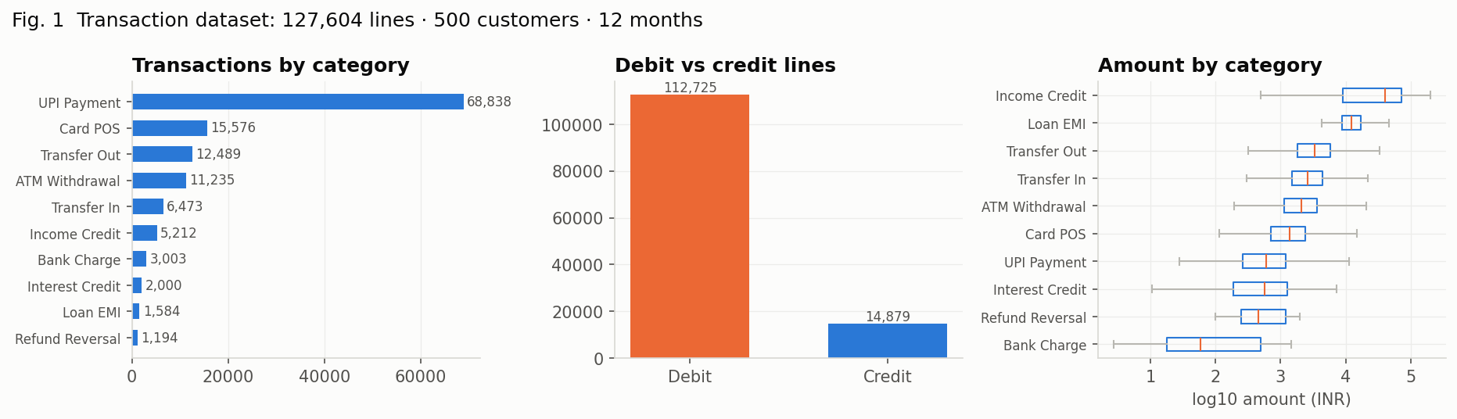
Dataset and preprocessing
1,27,604 labelled lines · 500 customers × 12 months · 10 categories · 5 hidden archetypes
No public labelled statement data (personal data) → documented, deterministic generator; label = generating category, never a function of the narration
35% long-tail narrations + noise (truncation, codes) — where regexes fail
Seasonality (festival ×1.25, school fees ×1.15) + one-off big-ticket months
Cleaning: letter–digit split, mask ≥2-digit runs → NUM
TF-IDF word 1–2 + char_wb 3–5 + 9 numeric → 2,789 sparse features; SVD-200 for kNN / boosting
Customer-month panel (34 features, target = next spend); 14-feature profile
Bank IQ · 22MDC56 Machine Learning Laboratory · 6
Notes:
Be explicit: synthetic but honest — labels independent of narration, so the regex baseline can be measured.

Slide 7
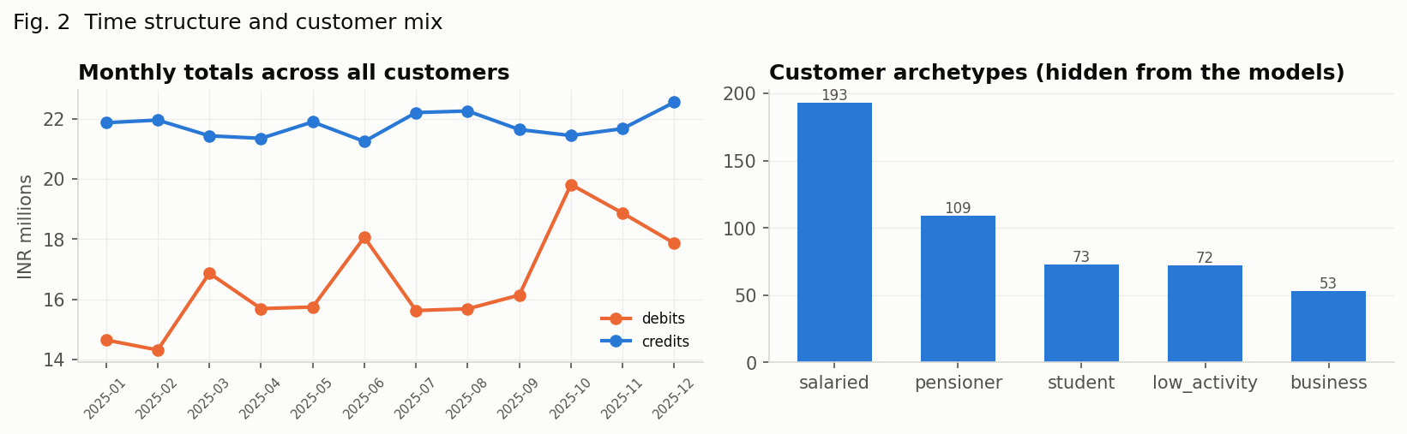
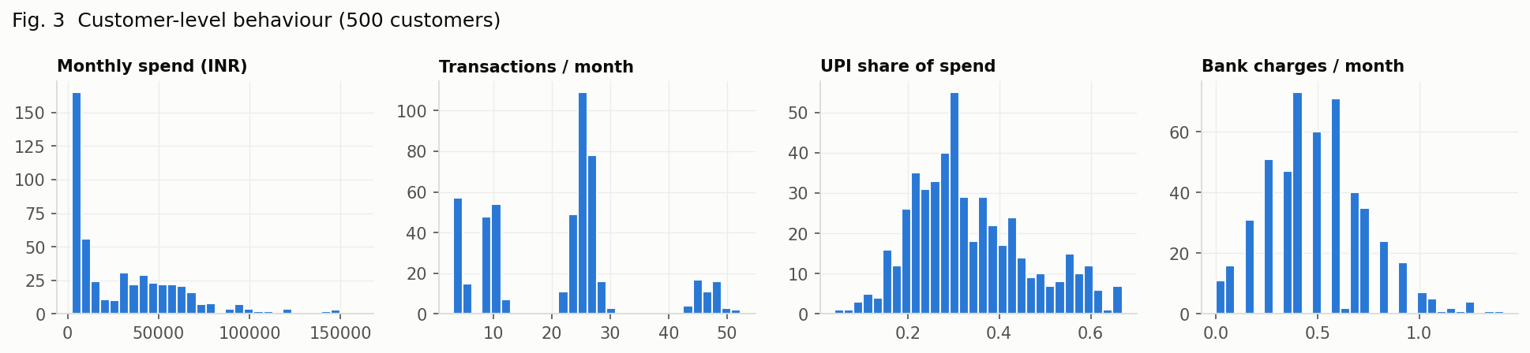
Exploratory data analysis
Spend is sticky and seasonal; UPI and ATM shares separate customer types; charges are rare but many-templated
88.3% of lines are debits; UPI is the most frequent category, bank charges and interest the rarest
Amounts span 4 orders of magnitude → log amount, is_round, has_paise carry signal
Monthly spend autocorrelated → naive forecast is a serious baseline
Festival-season bump in every archetype → calendar features
Students: UPI-heavy; pensioners: ATM-heavy; business: large transfers
Bank IQ · 22MDC56 Machine Learning Laboratory · 7
Notes:
Point at the seasonal bump: that's what makes regression beyond naive worthwhile.

Slide 8
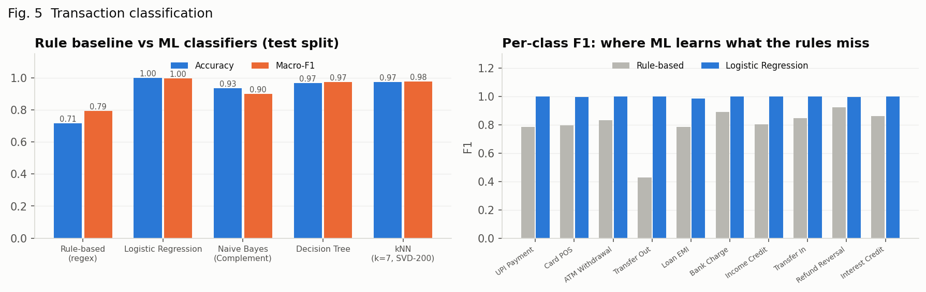
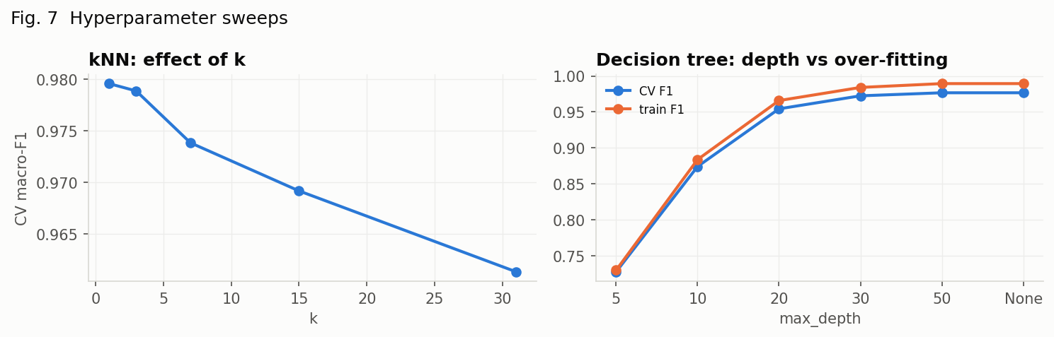
Concept 2 · DT, Naive Bayes, kNN vs the regex baseline
Stratified 5-fold CV on 32,000 train lines · 8,000 held-out · 10 classes · macro-F1 drives selection
Model | CV acc | Test acc | Macro-F1
Rule-based (regex) | – | 71.5% | 0.794
Logistic Regression | 99.9% | 99.9% | 0.997
Naive Bayes (Complement) | 93.5% | 93.4% | 0.899
Decision Tree | 97.0% | 96.7% | 0.972
kNN (k=7, SVD-200) | 97.3% | 97.4% | 0.977
Regex rules: 71.5% — perfect on known formats, blind on the long tail (lowest F1: Transfer out, Loan EMI)
Logistic Regression 99.9% / macro-F1 0.997 — deployed
Complement NB 93.4% in 0.4s (fastest, weakest) · tree 96.7% · kNN 97.4% on SVD-200 + cosine
Bank IQ · 22MDC56 Machine Learning Laboratory · 8
Notes:
Why Complement NB: TF-IDF counts and imbalanced classes. Why kNN on SVD: Euclidean distance in 2,800 sparse dims is meaningless.

Slide 9
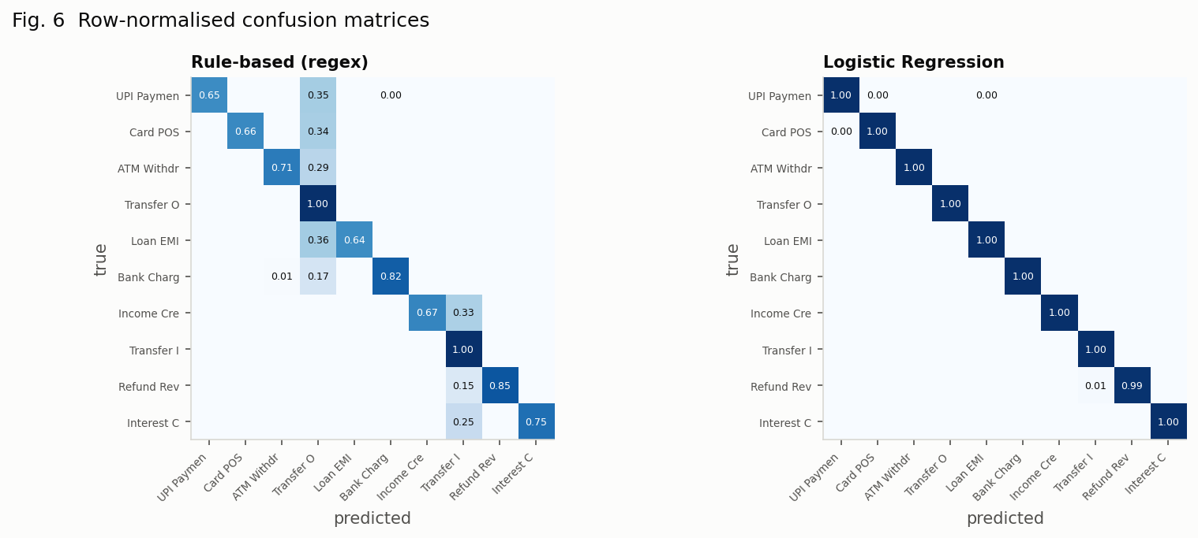
Where the learned model gains
Row-normalised confusion: rules vs best model — the rules fail where they were never written (transfers, EMIs, merchant lines)
Category | Rule F1 | ML F1 | Gain
Transfer out | 0.427 | 1.000 | +0.573
UPI | 0.785 | 0.999 | +0.214
Loan EMI | 0.783 | 0.985 | +0.202
Card/POS | 0.794 | 0.996 | +0.202
Income | 0.804 | 1.000 | +0.196
Rules: weakest on transfers out (F1 0.427), EMIs, UPI/card merchant lines; strongest on charges (0.888) — what they were built for. Model: every class ≥ 0.985
Rule-friendly sample statements: 99% agreement (validation). Long-tail sample (merchant-only, bank codes): 30 of 41 lines differ and the rules are the ones that fail — PAYROLL, BAJAJ FIN, SWIGGY CHENNAI, CSH WDL, QTRLY INT all become generic transfers
Real-format check: 94 sample-statement lines → numeric block down-weighted to 0.1 (agreement with rules 83.0% → 98.9%); direction mask: a credit line can only be a credit category
Bank IQ · 22MDC56 Machine Learning Laboratory · 9
Notes:
This slide is the business case for ML: better recall on charges feeds the rule engine's core purpose.

Slide 10
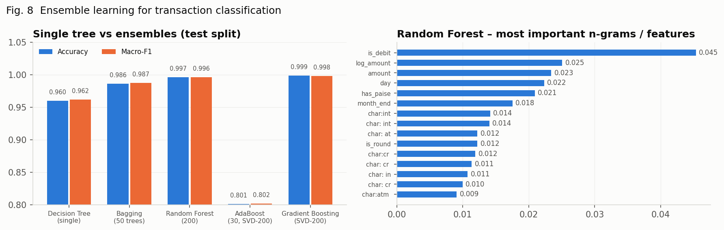
Concept 5 · Ensemble learning
Bagging · Random Forest · AdaBoost · Gradient Boosting vs one tree · best: Gradient Boosting (SVD-200)
Model | CV acc | Test acc | Macro-F1 | Fit s
Decision Tree (single) | 96.1% | 96.0% | 0.962 | 5.6
Bagging (50 trees) | 98.7% | 98.6% | 0.987 | 61
Random Forest (200) | 99.6% | 99.7% | 0.996 | 32.6
AdaBoost (30, SVD-200) | 84.4% | 80.1% | 0.802 | 143.3
Gradient Boosting (SVD-200) | 99.6% | 99.9% | 0.998 | 57.4
Bagging: 96.0% → 98.6% by averaging tree variance
Random Forest de-correlates trees too: 99.7%, macro-F1 0.996
Boosting on SVD-200: 99.9%; AdaBoost stumps weakest (80.1%) and slow on 10 classes
Forest's top n-grams are human-readable: is_debit, log_amount, amount, day
Bank IQ · 22MDC56 Machine Learning Laboratory · 10
Notes:
Bagging = variance reduction; RF = bagging + feature randomisation; boosting = sequential bias reduction.

Slide 11
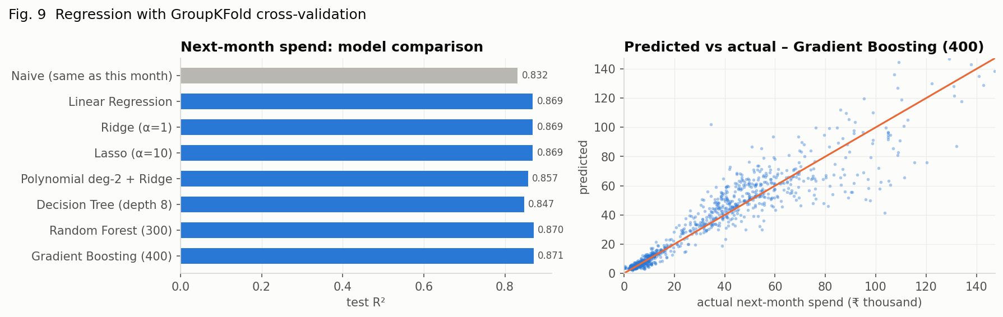
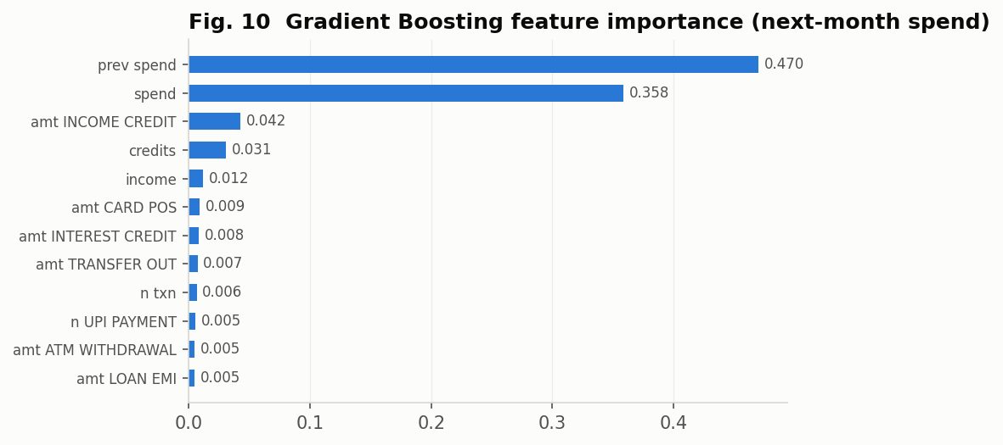
Concept 1 · Regression with cross-validation
Next-month spend from this month's behaviour · GroupKFold(5) by customer · best: Gradient Boosting (400)
Model | CV R² | Test R² | RMSE | MAE
Naive (same as this month) | – | 0.832 | ₹13,590 | ₹7,255
Linear Regression | 0.863 | 0.869 | ₹11,990 | ₹6,653
Ridge (α=1) | 0.863 | 0.869 | ₹11,990 | ₹6,652
Lasso (α=10) | 0.863 | 0.869 | ₹11,993 | ₹6,636
Polynomial deg-2 + Ridge | 0.852 | 0.857 | ₹12,529 | ₹6,654
Decision Tree (depth 8) | 0.839 | 0.847 | ₹12,929 | ₹6,944
Random Forest (300) | 0.875 | 0.870 | ₹11,915 | ₹6,313
Gradient Boosting (400) | 0.875 | 0.871 | ₹11,881 | ₹6,105
Naive "same as this month" already R² 0.832 — spend is sticky
Gradient Boosting (400): R² 0.871, RMSE ₹11,881 — 13% below naive
Ridge = Lasso = OLS: 4,400 rows support 34 coefficients; poly over-fits slightly
Importance: previous + current spend ≈ 80%; one year of data → calendar effects barely learnable (future: multi-year)
GroupKFold: a customer's months never split across folds — no identity leakage
Bank IQ · 22MDC56 Machine Learning Laboratory · 11
Notes:
If asked why R² is high: the target is autocorrelated; the honest comparison is against the naive baseline, which is why it is in the table.

Slide 12
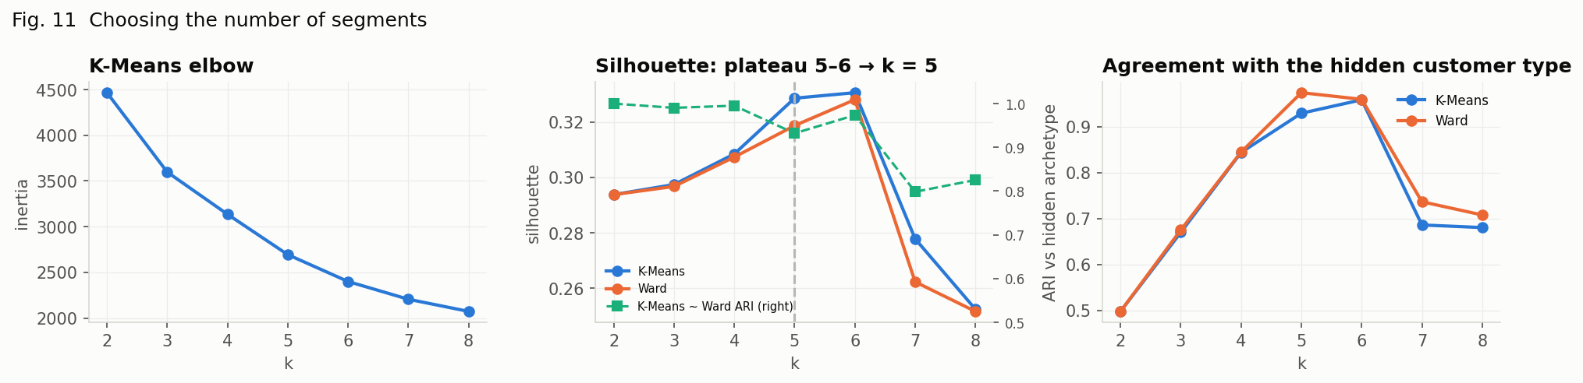
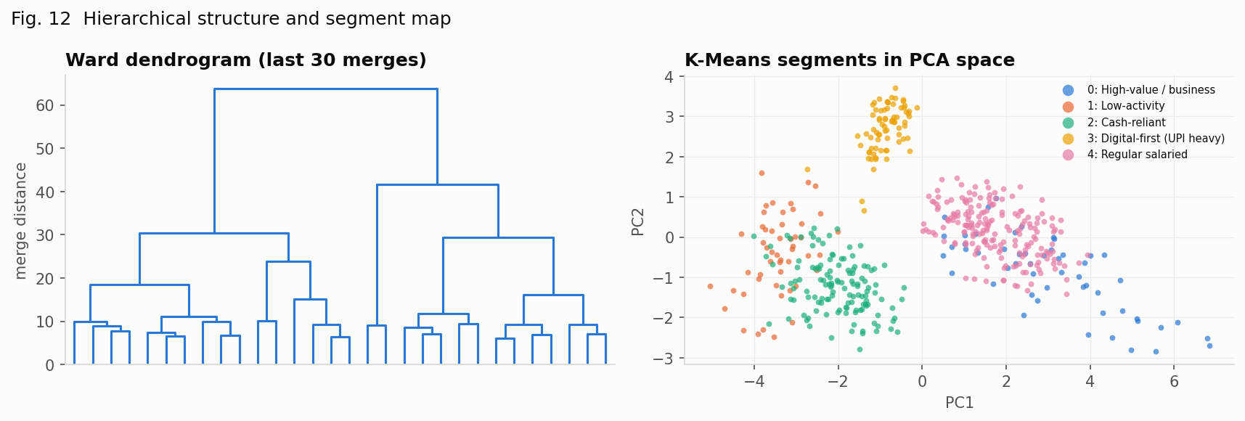
Concept 3 · K-Means vs hierarchical clustering
k = 5 (silhouette plateau 5–6, smallest kept) · K-Means vs Ward ARI 0.93 · recovers the hidden customer type: ARI 0.93
Segment | Size | Spend/mo | Type
High-value / business | 53 | ₹95,051 | business
Low-activity | 51 | ₹3,020 | low_activity
Cash-reliant | 129 | ₹8,160 | pensioner
Digital-first (UPI heavy) | 74 | ₹5,979 | student
Regular salaried | 193 | ₹45,227 | salaried
13 continuous behavioural features (median-month statistics), standardised; archetype used only to score
has_emi left out: a standardised binary dominates Euclidean distance and split every segment
Cash-reliant = pensioners (41% ATM) · Digital-first = students (56% UPI, no EMI) · Low-activity = most charges, dormancy risk
Bank IQ · 22MDC56 Machine Learning Laboratory · 12
Notes:
Silhouette chooses k; ARI validates against the truth the generator hid. Both algorithms agree.

Slide 13
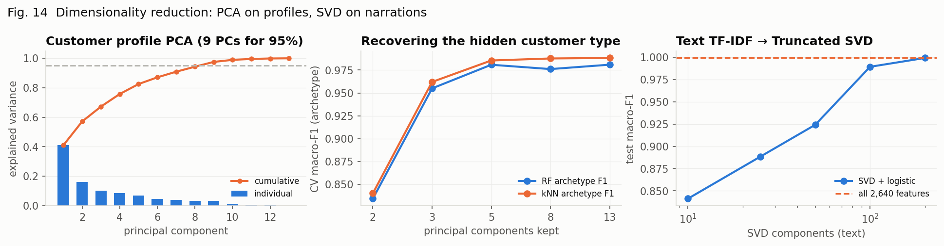
Concept 4 · Dimensionality reduction
PCA: 9 of 13 profile components for 95% variance — but 3 recover the segment · SVD on text
PCs kept | 2 | 3 | 5 | 8 | 13
RF archetype F1 | 0.834 | 0.955 | 0.981 | 0.976 | 0.981
kNN archetype F1 | 0.840 | 0.962 | 0.986 | 0.988 | 0.988
Profile features only mildly correlated → 9 PCs for 95% variance
3 PCs already give archetype F1 0.955 — the segment signal is 3-D
Text: SVD-100 keeps 87.6% variance, logistic F1 0.989 vs 0.999 on all 2,789 features — speed for kNN/boosting at small cost
Bank IQ · 22MDC56 Machine Learning Laboratory · 13
Notes:
Variance retained is not information retained — the archetype F1 row is the useful test.

Slide 14
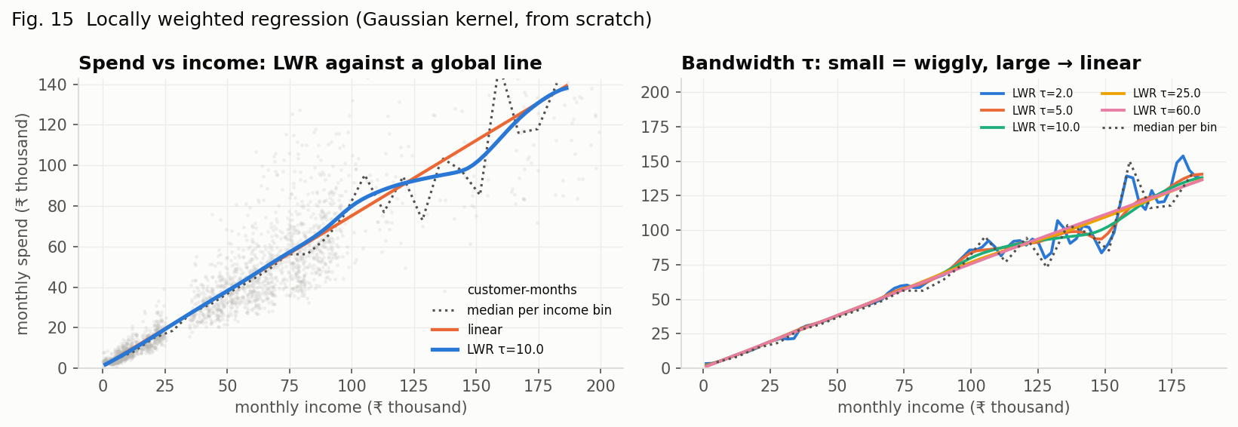
Concept 6 · Locally weighted regression (from scratch)
Gaussian kernel weights · weighted least squares at every query income · bandwidth τ sweep
Model | Test RMSE
Linear | ₹12,586
Polynomial deg-3 | ₹12,517
LWR τ=2.0 | ₹12,704
LWR τ=5.0 | ₹12,516
LWR τ=10.0 | ₹12,476
LWR τ=25.0 | ₹12,519
LWR τ=60.0 | ₹12,538
w_i = exp(−(x_i − x₀)² / 2τ²); θ = (XᵀWX)⁻¹XᵀWy; ŷ₀ = [1, x₀]·θ — NumPy only
Best LWR τ=10.0: RMSE ₹12,476 vs ₹12,586 for the global line
Spend rises steeply with income at the low end and flattens — one line cannot bend
Small τ chases noise in the sparse high-income tail; large τ → the global line (bias–variance)
Bank IQ · 22MDC56 Machine Learning Laboratory · 14
Notes:
Non-parametric: nothing is learned globally; each prediction re-fits. O(n) per query.

Slide 15
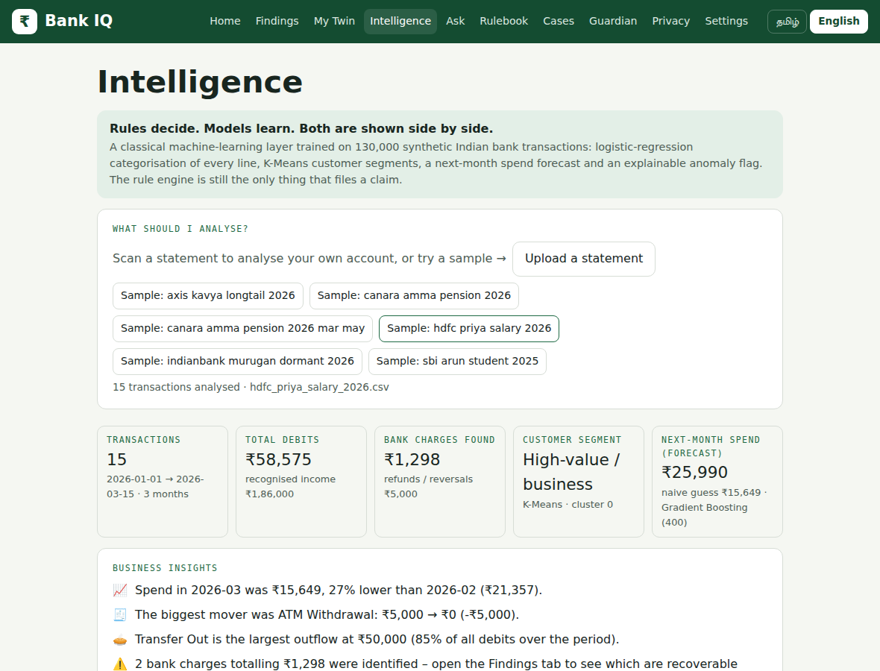
Concept 7 · The Intelligence dashboard
FastAPI endpoints + a screen in the existing Tamil/English app · models inform, rules decide
Source: my account · upload · samples
KPIs: debits, income, charges, segment, forecast vs naive
Insights engine: trend, biggest mover, largest outflow, charges → Findings, savings rate, segment, forecast, anomalies, rule disagreements
Every line: ML category + confidence + rule category; 'show disagreements only'
Unusual debits: robust z-score within category (log amount, 3 MADs)
Model card: live tables from results/*.json + all 15 figures
Endpoints: /api/ml/status · /results · /figures · /analyze · /analyze-json · /api/accounts/{id}/intelligence (session)
Bank IQ · 22MDC56 Machine Learning Laboratory · 15
Notes:
Demo this live if possible: sample → disagreements → model card.

Slide 16
Result analysis and business insights
What the numbers mean for a customer, a bank and the rule engine
₹
Where the money goes
👥
Segments as actions
📈
Expect next month
Every line now has a trusted category (rules: 71.5%; model: 99.9%). Charges still reach the rule engine: F1 0.888 → 1.000; the dashboard points them to Findings.
Cash-reliant pensioners: free-ATM rules. Low-activity: most charges, dormancy / reactivation charges. Digital-first students: failed-UPI reversals. Salaried: EMIs, forecast audience. High-value: widest forecast intervals.
Forecast shown beside the naive guess with the model named; 13% lower error on test; gains concentrate in seasonal months.
🚩
Unusual debits
!
What not to trust
Category-aware: ₹15,000 is normal for a transfer, abnormal for UPI. Insight says '4× the typical ATM withdrawal'. Hints, never claims.
99% on synthetic data = learned the generator's language; trust the per-class ordering and the sample-statement disagreements. Forecasts need ≥3 months. Nothing here is a claim.
Bank IQ · 22MDC56 Machine Learning Laboratory · 16
Notes:
The honest slide. Examiners like 'what not to trust'.

Slide 17
Deployment, testing and demo
One command to reproduce every number · one command to run the app
▶
Run
✓
Tested
⌥
Repository
make train → results/, models/ (~25 min)
uvicorn api.main:app → :8000 → Intelligence
docker compose up --build (trains at build)
101 Vasool Raja tests + 13 new: generator determinism, masking, featurizer, panel/profile, rule map, LWR exactness, service accuracy > 90%, endpoints, 415 on bad upload, 401/404 without session.
bankiq/ (data, features, rulemap, experiments, service, api) · notebooks/01–07 · results/ · models/ · tests/ · docs/ (Phase I, literature, report, slides, viva)
3-minute demo
Intelligence → Sample: hdfc priya salary → KPIs, insights, category mix (model and rules agree on every line)
Sample: axis kavya longtail → 'show disagreements only': 30 of 41 lines — the regexes see generic transfers, the model sees income, EMI, UPI, ATM, refund, interest, charge
Canara pension sample → Cash-reliant, five charges, ₹50,000 college fee flagged
Model card → Table live from results JSON → Fig 5, Fig 11, Fig 15
Findings tab → the rule engine's claims on the same statement
Bank IQ · 22MDC56 Machine Learning Laboratory · 17
Notes:
Keep the demo to five steps; the long-tail sample with the disagreement filter is the moment that shows what ML adds.

Slide 18
Conclusion and future scope
All seven syllabus techniques applied to one real product, each against a baseline, under cross-validation that respects the data (stratified; grouped by customer)
Transaction classifier: 71.5% (regex) → 99.9% (logistic) / 99.7% (forest); biggest gains on transfers, EMIs and merchant lines
Forecast 13% below naive; K-Means and Ward agree on 5 segments that recover the hidden types (ARI 0.93); PCA shows a 3-D segment signal; LWR exposes the bend in spend vs income
Deployed beside an untouched rule engine; reproducible; 114 tests
Future scope
Real consented statements (Account Aggregator) + active learning on model–rule disagreements
Multi-year histories; prediction intervals
Confirmed findings fed back as training labels
Tamil / Hindi tokens; OCR-specific character models
Isolation Forest once labelled anomalies exist
github.com/<your-user>/bank-iq · Thank you — questions?
Notes:
Close with the one-line summary and invite questions.

