Slide 1
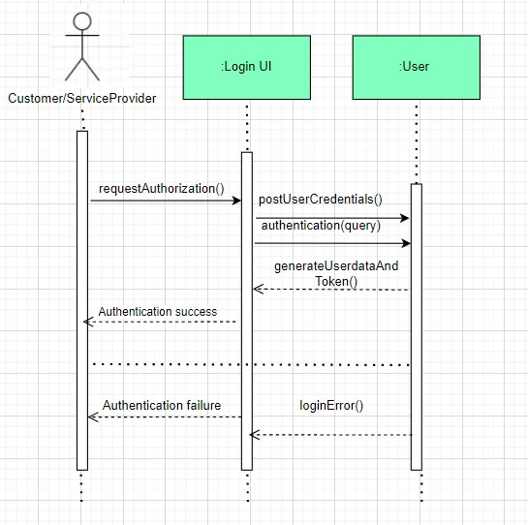
QUICKFEED SEQUENCE DIAGRAM
Use Case – 03.01 Authenticate the User
Use Case Scenario
This Use case begins when the actor enters the credentials and tries to log in.
System checks if the user credentials are correct or not.
System allows the Actor to log in if credentials are correct or will send a failure message.
The Use Case ends after this.

Slide 2
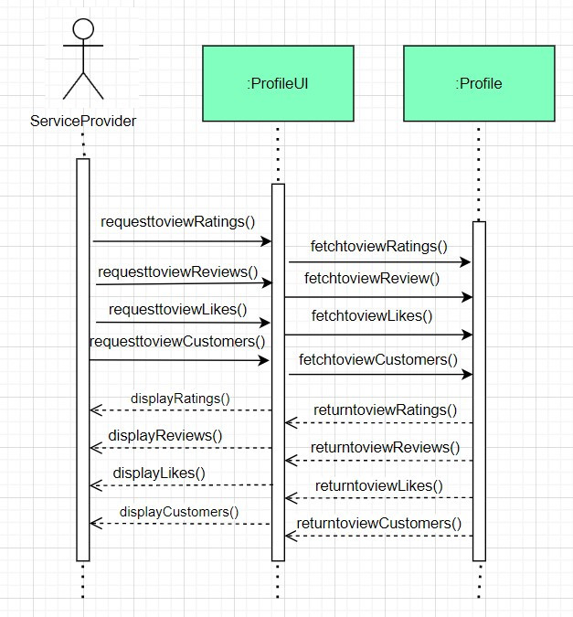
QUICKFEED SEQUENCE DIAGRAM
Use Case – 03.02 Summarize the Account Details
Use Case Scenario
This Use case begins when the actor tries to check his Account summary/ profile.
System displays the profile summary showing all the Ratings, Reviews, Likes, and Customers of that Actor.
The Use Case ends after this.

Slide 3
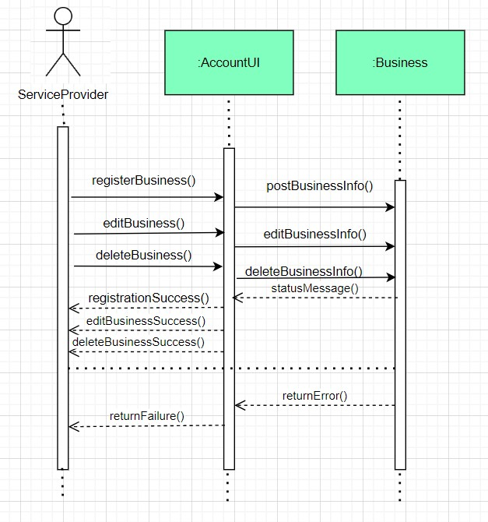
QUICKFEED SEQUENCE DIAGRAM
Use Case – 03.04 Register the Service Provider
Use Case Scenario
This Use case begins when the actor tries to register or make changes to his existing business in the system.
System checks if the user credentials are correct or not.
System allows the Actor to register, edit or delete the business and will send a failure message if it encounters an error.
The Use Case ends after this.

Slide 4
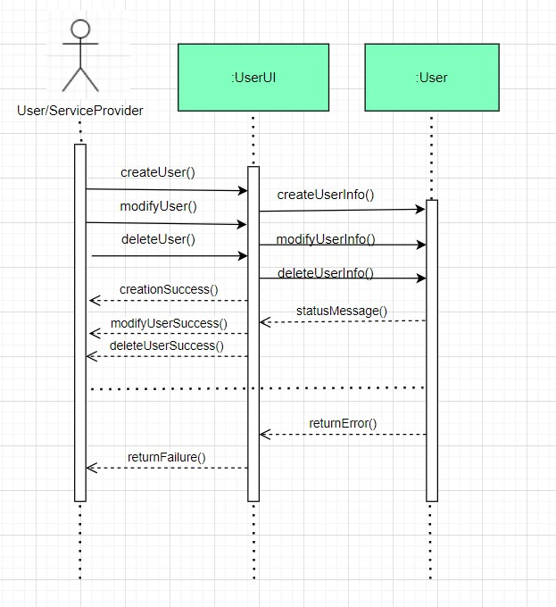
QUICKFEED SEQUENCE DIAGRAM
Use Case – 03.05 Create and Modify the Account
Use Case Scenario
This Use case begins when the actor tries to create or modify an Account.
System checks if the Actor already has an account and lets the Actor make modifications and if he doesn’t have an account already it will let the Actor create an Account.
It will display a failure message in case it gets an error.
The Use Case ends after this.

