Slide 1
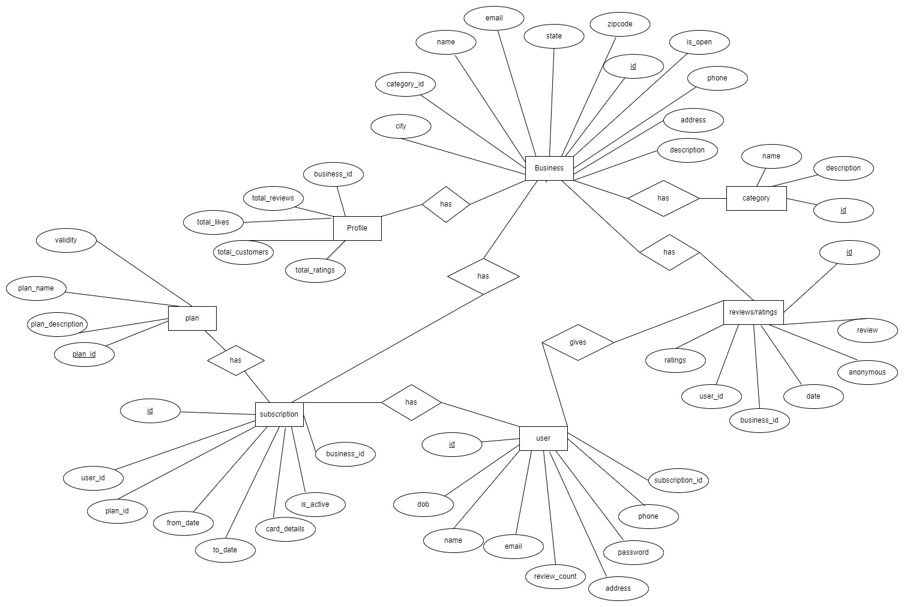
CONCEPTUAL DATABASE DESIGN

Slide 2
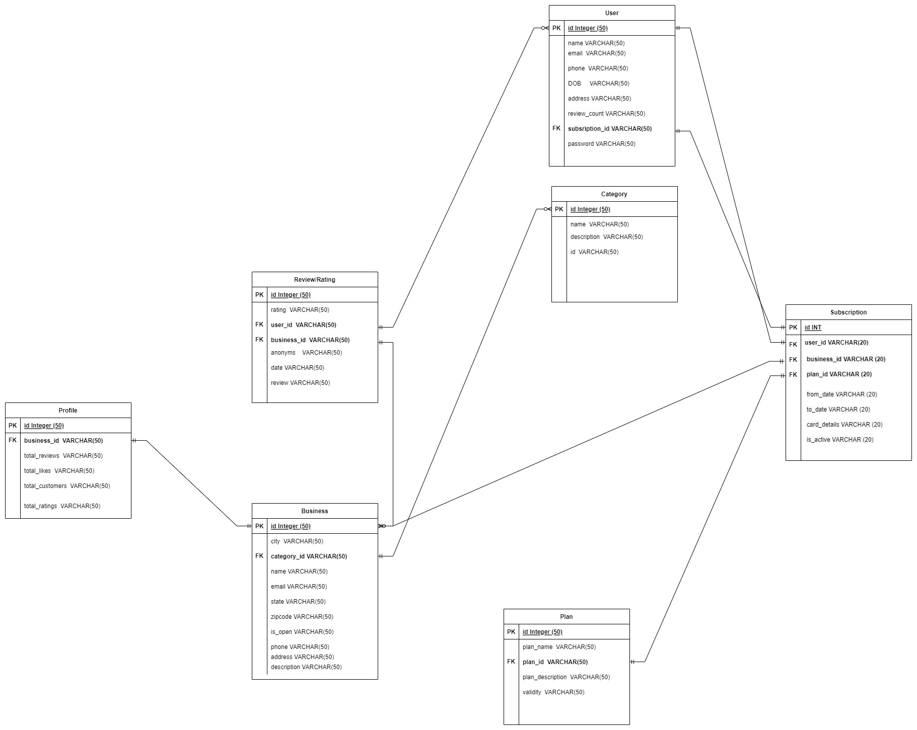
LOGICAL DATABASE DIAGRAM

