Slide 1
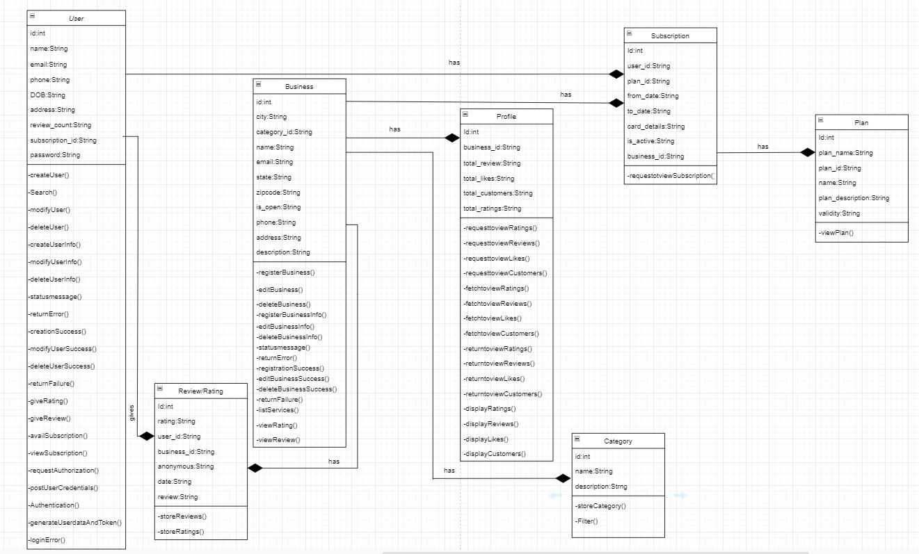
CLASS DIAGRAM (QUICKFEED)

