Slide 1
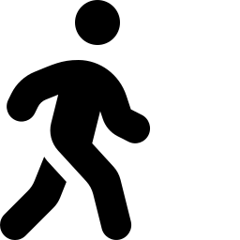
RehabAI
A phone that watches you recover, and tells tomorrow what to do differently.
iQOO HACKATHON 2026 · HEALTHTECH TRACK · ON-DEVICE AI
Why this is the idea

Slide 2



The gap is real, and it's growing
Rehab is a capacity problem. It needs a multiplier, not just more headcount.
2.4B
600K
<10
people worldwide live with a condition
that could benefit from rehabilitation
physiotherapists worldwide
(World Physiotherapy membership count)
skilled rehab practitioners per million
people, in many LMIC settings
Source: WHO Rehabilitation Fact Sheet · World Physiotherapy Annual Membership Census
RehabAI
2

Slide 3

The failure isn't the exercise sheet.
It's a muscle that won't fire.
After a knee replacement or ACL repair, the quad often stops firing correctly — a reflex response to joint pain and swelling called arthrogenic muscle inhibition (AMI).
What should happen
Knee-dominant rise — the patient pushes up through the knee, the injured leg does its share of the work.
Patients compensate without knowing it — standing up by leaning on their hips instead of pushing through the knee. A printed home-exercise sheet can't catch this. Nobody's watching between appointments.
What actually happens
Hip-dominant compensation — the patient leans forward and drives through the hips, the knee barely does any work at all.
RehabAI
3

Slide 4
Everyone measures depth. Nobody measures strategy.
The camera-based rehab space isn't empty — being honest about that shapes what we lead with.
Approach
Priced / built for
Measures strategy
(hip vs. knee)?
Kemtai
Real-time form correction, FDA-designated
Providers & digital health platforms
No
Sword / Hinge Health
Human coaches + telehealth
US employer health benefits ($2B+ valuation)
No
Resolve360 (Bengaluru)
Camera AI-AR, claims 3x capacity
India, direct
No
RehabAI
On-device compensation detection
Patient's own phone, no cloud
Yes
RehabAI
4

Slide 5

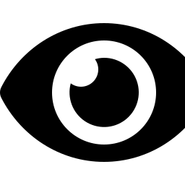
Two mistakes we didn't make
Don't score what a camera can't see
Don't overclaim what it can
An earlier version tried to grade knee swelling from a photo. Lighting fakes that — a dim room reads as “more swollen” no matter what the knee is actually doing.
A camera can't see muscle activation — that's electrical, EMG-only. And a left-right symmetry ratio has a known blind spot: both legs can weaken together and still look “fine.”
What's left: movement strategy — hip-dominant vs. knee-dominant. Physios already watch for it. Now the phone does too.
RehabAI
5

Slide 6






One 90-second loop, every day
Check in
Do the exercise
Detect
App can say no
Tomorrow adapts
pain + swelling,
tap or voice
sit-to-stand,
phone watching
hip- vs knee-
dominant strategy
loaded moves lock
on a bad day
plan regenerates
from today
Anytime: a printable recovery sheet — swelling trend, compensation frequency, blocked and unlocked dates — to bring to the surgeon.
RehabAI
6

Slide 7

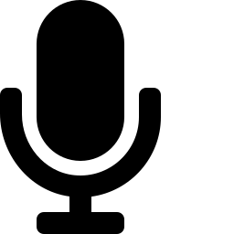

Three models. Three jobs. Nothing leaves the phone.
Vision
Voice
Language
LiteRT + Qualcomm QNN delegate
Whisper Tiny, on-device
Gemma 2B or Phi-3, on-device
Camera frames → keypoints. Perception only, no judgment.
Speech → the same structured check-in fields a tap would produce.
Phrases a decision already made deterministically. Never makes it.
Deterministic safety. Generative framing. The generative layer never touches the decision.
RehabAI
7

Slide 8
Architecture
Native Android · Kotlin · Snapdragon NPU inference throughout
Phone
camera
Vision
(LiteRT + QNN)
Compensation
detector
Policy
(deterministic)
Explain
(on-device LLM)
UI
(Compose)
Local Room / SQLite database — session summaries only, never raw video or audio
Office Kit (phone ↔ laptop): dev workflow during build, recovery-sheet export — never on the runtime critical path
RehabAI
8

Slide 9
Built to score, not just to demo
Same rubric, all four cities. This maps line by line — not by coincidence.
End product quality
30%
Jury
A complete, working daily loop — not a tech demo
Novelty & impact
20%
Jury
Strategy detection, not rep-counting or ROM
Creative phone use
15%
Device data
Real camera + voice + on-device AI, all telemetry-verified
Technical depth
15%
Jury
Real NPU inference via LiteRT + QNN, not a cloud wrapper
Office Kit usage
10%
Device data
Genuine dev workflow + recovery-sheet export
Demo & presentation
10%
Jury
A visible “aha”: the plan changes in front of you
RehabAI
9

Slide 10
The demo — three minutes
1
Stand up from a chair, phone propped up. On-device NPU inference is visibly running — no network, no spinner.
2
The camera catches a hip-dominant rep, live — a calm on-screen “noticed” cue, not an alarm.
3
Check in by voice: “pain's about a 4 today, a bit more swollen.” Whisper Tiny transcribes it on-device.
4
Tomorrow's plan visibly changes — a loaded exercise locks, with a plain-language reason.
The “aha” is the plan changing from what actually happened — plus the camera refusing to pretend when it isn't sure.
RehabAI
10

Slide 11
Roadmap
NOW — hackathon
NEXT
LATER
Sit-to-stand, phone-native
On-device vision, voice, language
Check-in → lock → adapt loop
Recovery sheet export
More exercises, same strategy lens
Richer end-of-session summaries
Multi-day trend view
Supervising-physio escalation queue
Hospital discharge pilot
Structured data only — still no raw video leaving the device
RehabAI
11

Slide 12
2.4 billion people.
600 thousand physiotherapists.
A phone every one of them already carries should be able to help close that gap.
RehabAI
Let's build it.
RehabAI · iQOO Hackathon 2026
12

