Slide 1
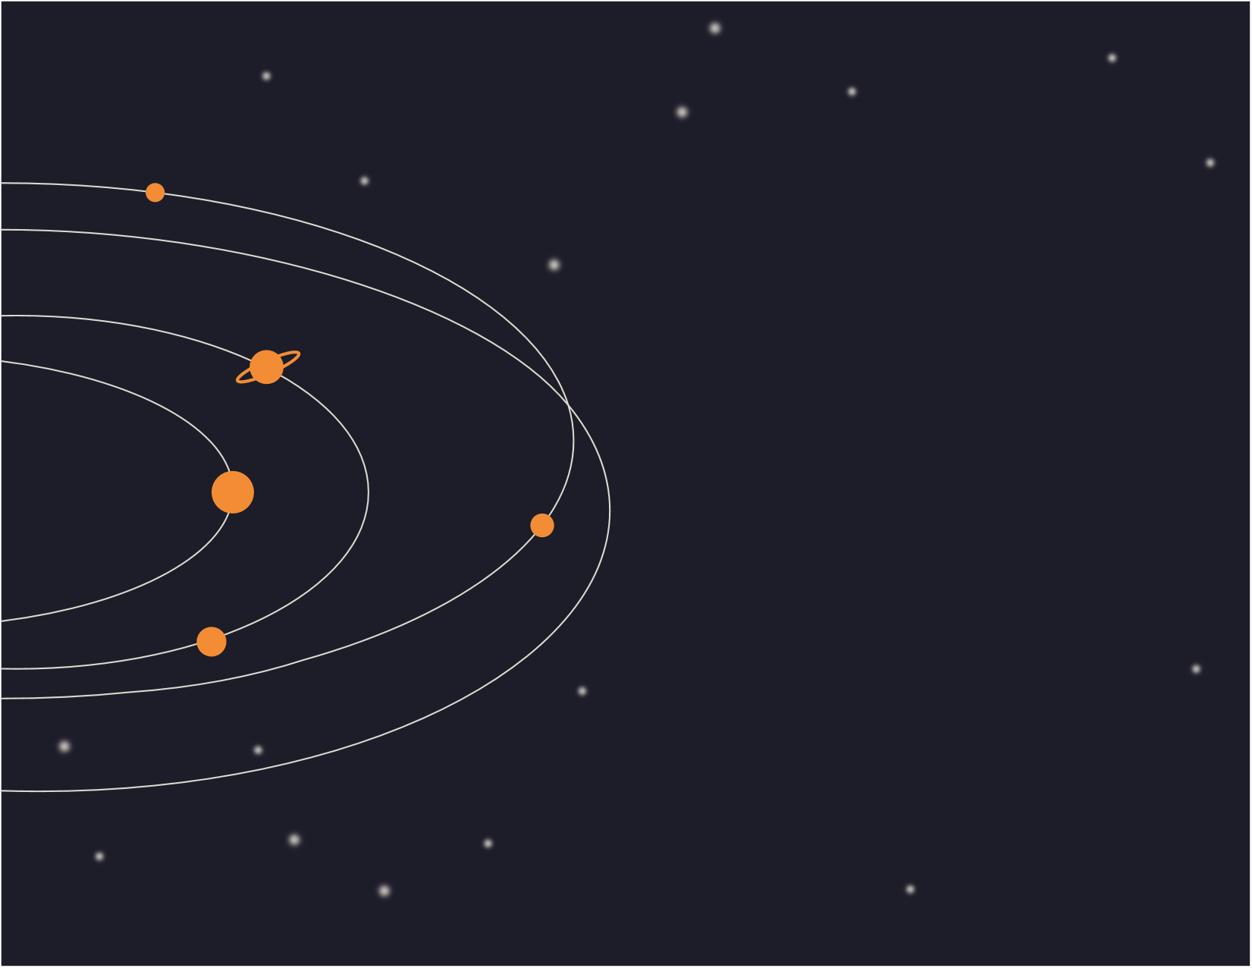
DATA ACQUISITON OF ASTRONOMICAL OBJECT

Slide 2
WHAT IS DATA ACQUISITION
Data acquistion is a method by which we acquire raw optical data of the astronomical object in concern.
The optical data collected by the telescopes is not usuable without processing.
Huge amount of data is captured by the sensors inorder to ensure utmost quality of the final project.
The data hence captured by the telescopes is first published and then made available to the general public. Inorder to acquire the data we need to follow certain procedure which is mentioned in the following slides.

Slide 3
STEPS OF ACQUIRING ASTRONOMICAL DATA
There are many sources of the data in concern. These include space telescopes like Hubble and James Webb as well as terresterial telescopes like Gran Telescopio Canaris.
The Data from these sources are available on the official websitre of Space Telescope Science Institute along with the sensors that are currently operating in the telescope.
The portal that we will be using inorder to demonstrate this process is Mikulski Archive For Space Telescopes.

Slide 4
HUBBLE SEARCH
The Hubble search portal is a place where you can search for astronomical data regarding the object in concern by providing basic information like the coordinates or the name along with the object size.
It provides data regarding the object captured by the diffrent sensors like WFC3, COS and STIS which are currently active along with inactive sensors like WFPC2, NICMOS and WFPC1.
It is an easy to use and simple website to fetch high quality astronomical data.

Slide 5
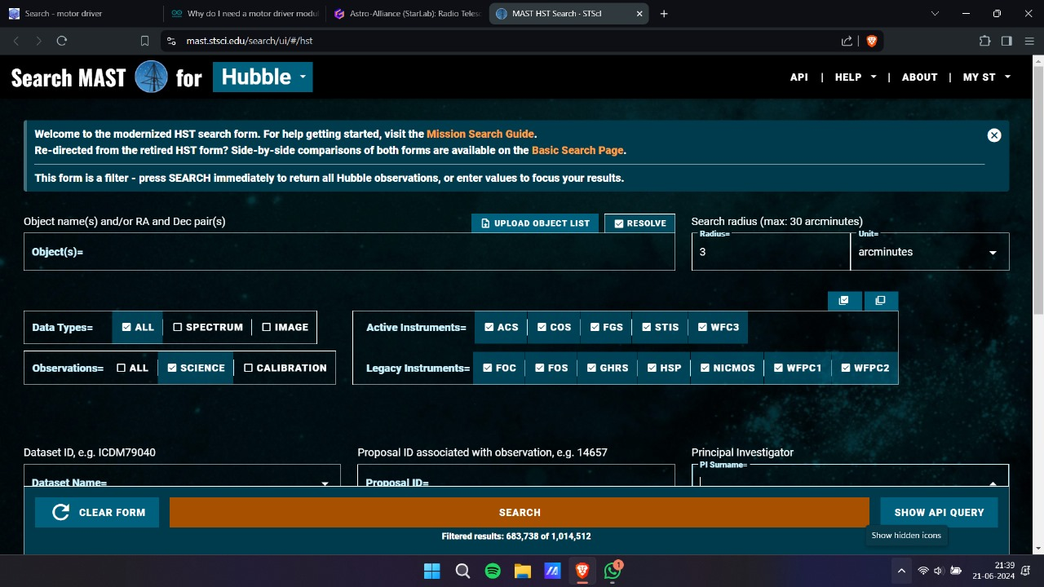
Following image shows the Hubble search portal interface.
Name of the celestial body goes under object name section. The name can be fetched from the wikipedia page of astronomical objects.
The search radius can be obtained from the wikipedia page of the object. It is the angular size of the body. exposure time can also be set.

Slide 6
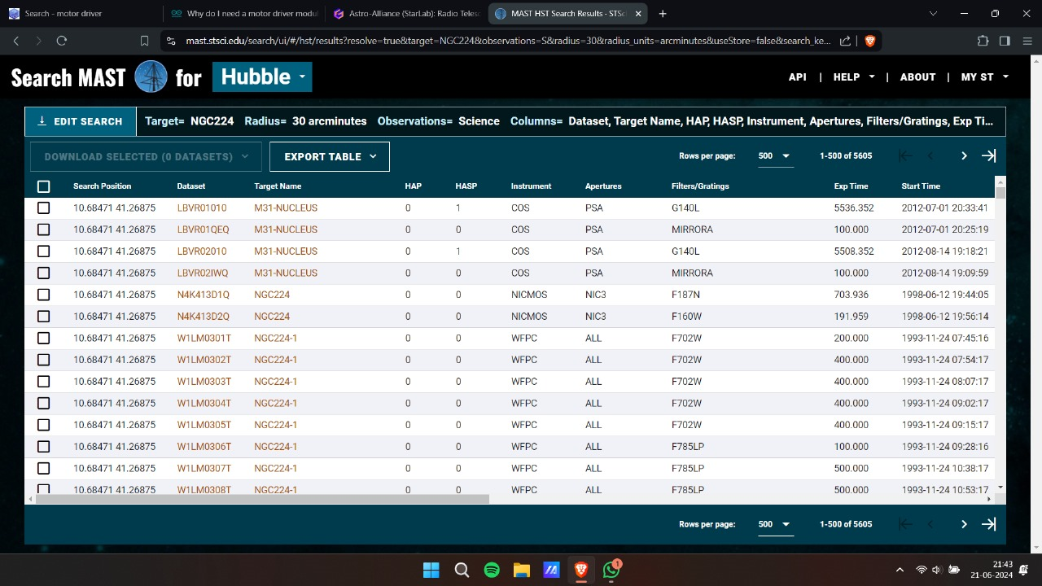
Rest of the settings can be left unaltered.
Following image shows the search results after entering the name of the object as NGC224 which is andromeda galaxy along with search radius as 30 arcminutes
The results sheet has the instrument name along with the target position and name. Checking the empty box will select the data folder.

Slide 7
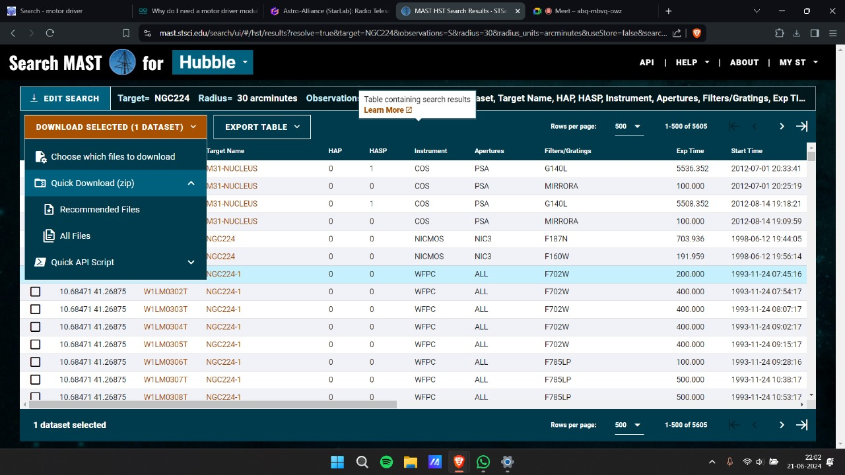
Following shows the menu after selecting the file and clicking on download selected option.
Clicking on all files will start the download automatically.
It is recommended to download all the files.
the file hence downloaded is a compressed zip file.

Slide 8
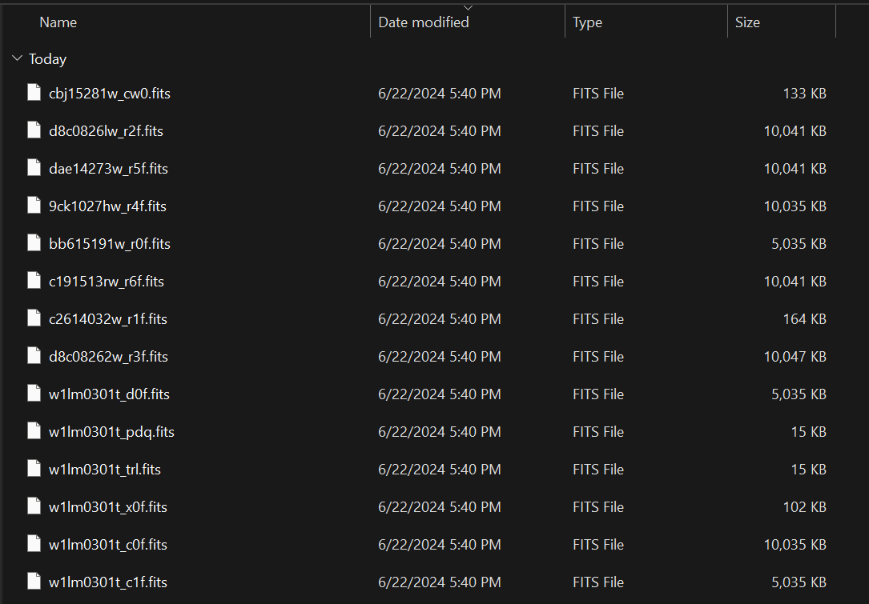
Following shows the content of file after extracting.
All the files hence acquired is in FITS format.

Slide 9
FITS FILE FORMAT
FITS stands or Flexible Image Transport System.
It is specifically designed for handling and transmission of astronomical data.
FITS have three filename extension .fits, .fit, .fts .
Inorder to open FITS file special softwares are needed. These files cannot be viewed in normal image viewer applications.
We can use softwares like TOPCAT and SAODS9 to open and process FITS file.

Slide 10
TYPES OF FRAMES
The image acquired by sensors are not perfect in nature. They have noise and additional unwanted elements. These irregularities can create error in scientific data extracted from the image.
Inorder to minimize these irregularities, we capture images via different processes other than the original picture which depending upon the processes followed helps to reduce irregularities resulting by the specific cause.
The following slides discuss these processes and frames in detail

Slide 11
LIGHT FRAME
The Images of the astronomical object captured by the camera sensor is known as light frames. These are captured with the proper iso settings and f ratio along with sharp focus to make sure that the image is of highest quality.
The number of frames captured plays a big role in the final quality of the image. capturing multiple frames and stacking them ensures high signal to noise ratio resulting in better quality image as the number of frames increases.
The details and qaulity of the frame is highly dependent on the exposure time.

Slide 12
BIAS FRAME
The camera sensor inherently has a base level of read-out noise as it reads the values of each pixel of the sensor. This is known as bias.
Bias frames are meant to capture this noise for its removal.
It is captured by totally covering the camera lens with the lens cap after putting it in a dark place inorder to prevent any light from falling on the sensor.
The camera is then set to the shortest exposure settings and multiple shots are taken which are then stacked.

Slide 13
DARK FRAME
Long exposure images causes the sensor chip to introduce thermal noise. This noise is dependent upon various facotrs like temperature,time and expsoure.
Dark frames capture this type of noise and helps to reduce it from the main image. It calso calibrate the chip so that all pixels give an equal reading when not being exposed to light
Dark frames are captured by placing the camera in dark with the lens cap on and putting it in the enviorment where the ambient temperature is equal to the temperature at which main image is captured. The images are taken at same exposure and settings

Slide 14
FLAT FRAME
When the sensor is being evenly lit by a source, it is not necessary that each and every pixel recieves the same amount of light.
This is due to the accumulation of dust or lens vignetting which is the gradual decrease in the image brightness while moving from the center to the edge. Dark frame helps to remove such irregularities to give an evenly lit image.
It is captured by evenly illuminating the lens of the camera and keeping the iso settings as well as f ratio same as the main image.

Slide 15
OBJECTS OF INTEREST
NGC 224(ANDROMEDA GALAXY)
NGC 4622(RING GALAXY)
NGC 6720(RING NEBULA)
NGC 1962(CRAB NEBULA)
NGC 6205(HERCULES STAR CLUSTER)
ABELL 2744(PANDORA’S CLUSTER)

Slide 16
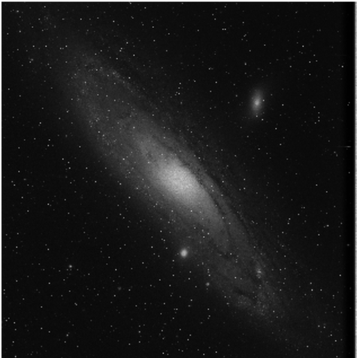
NGC 224
Andromeda galaxy is a barred spiral galaxy which is nearest to milky way at a distance of 2.5 million light years.
Apparent size of this galaxy is 3.167° x 1°.

Slide 17
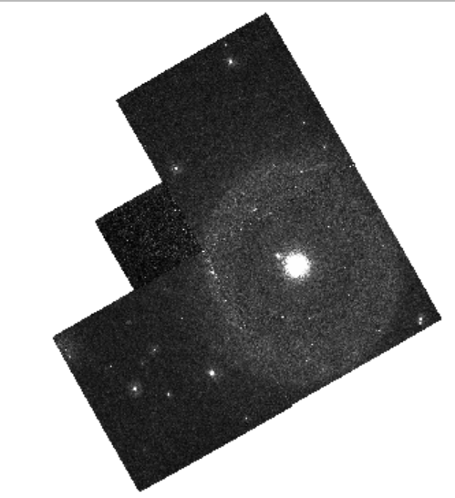
NGC 4622
Backward galaxy is an unbarred spiral galaxy located in the constellation of Centaurus and is a member of Centaurus galaxy.
Distance of this galaxy from earth is 111 million light years and the apparent size is 1’.7 x 1’.6.

Slide 18
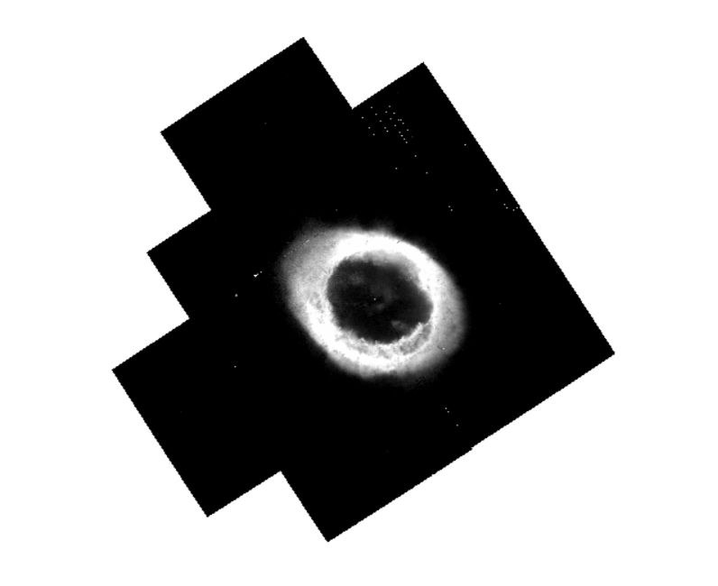
NGC 6720
The Ring Nebula is planetary nebula in the northern constellation of Lyra.
Also known as M57, its 2300 to 4100 light years away, and has a angular size of 1.5 x 1 arcminutes.

Slide 19
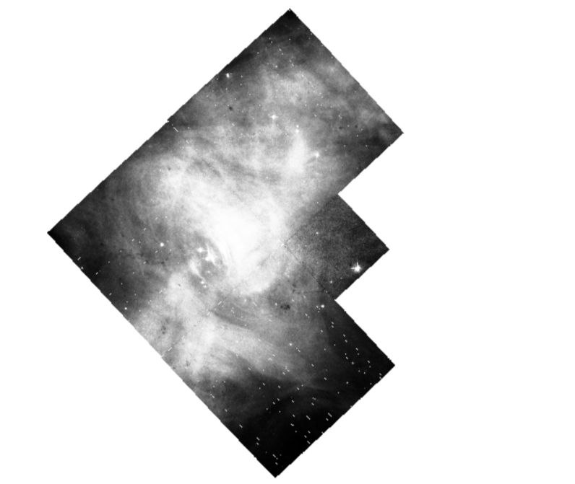
NGC 1952
The Crab Nebula is a supernova remnant and a pulsar wind nebula in the constellation of Taurus.
Its other name is M1, and it is located about 6500 light years away in the Perseus arm of Milky Way.

Slide 20
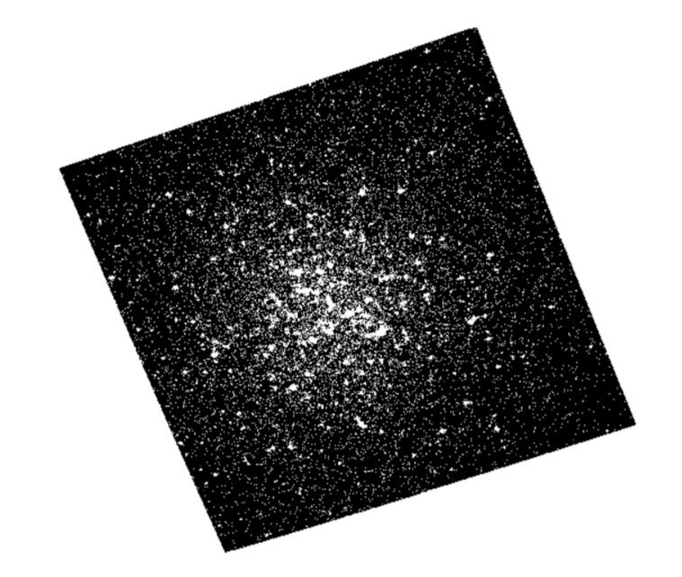
NGC 6205
The Great Hercules Cluster is a globular cluster in the constellation of Hercules.
Its diameter is about 23 arcminutes and it has a apparent magnitude of 5.8, its other name is M13.

Slide 21
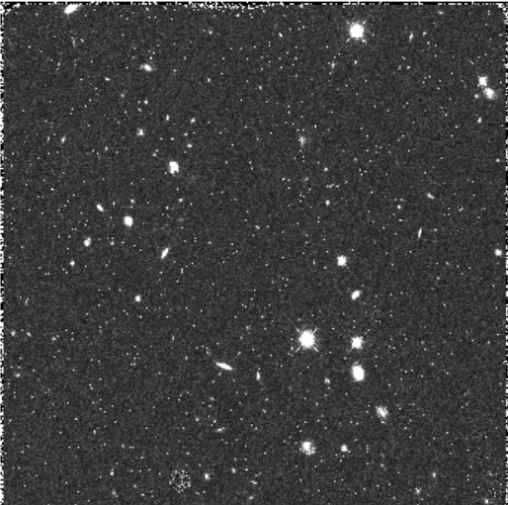
ABELL 2744
Abell 2744 nicknamed as Pandora's Cluster, is a giant galaxy cluster located at approximately 4 billion light years from earth
The galaxies in the cluster make up less than five percent of its mass

Slide 22
ANALYSIS OF REDUCED DATA
After acquiring the astronomical data and processing it to get the final image, we are now ready to extract useful information from it.
The image gives the basic information of the object like apparent size and its coordinates.
Inorder to extract further data we can use the following analytical methods:
Astronomical spectroscopy
Astrometry
Time-Series Analysis

Slide 23
ASTRONOMICAL SPECTROSCOPY
Astronomical spectroscopy is an astronomical study which is used to extract electromagnetic spectrum using spectroscopy techniques.
Its can be done on varied types of electromagnetic radiation including visible light, ultraviolet, infrared, radio waves and X-ray.
The stellar spectrum of a celestial object can reveal many properties of it including chemical properties like
Composition
Temperature
Density
Mass
Distance
luminosity

Slide 24
Velocity Calculation – Spectroscopy can show the velocity of motion of the object towards or away from the observer by measuring the doppler shift.
Temperature measurement – The tempertaure of a stellar object like star can be calculated using the theory of black body radiation. By using the relation between the Tempertature and peak emission wavelenght of the object we can derive the surface temperature of it
Size measurement – The luminosity of a star is a measure of the electromagnetic radiation output in a given amount of time. The luminosity of a star is directly proportional to the fourth power of its surface temperature and to the square of its radius hence the radius can be calcuated.

Slide 25
Astrometry
Measurement of the positions and motions of astronomical objects.
Like Time-Series Analysis, requires data collected over long periods of time.
Uses
Helps in figuring out the Origin and Kinematics of stars, galaxies and other celestial bodies.
Providing astronomers with a reference frame to report there observation
precise time keeping

Slide 26
Techniques for Astrometry
Proper Motion Analysis
Measuring and analysing the apparent angular motion of a star across the sky, relative to more distant background stars, as observed from Earth.
Can be done by analysing the data from Gaia Satellite using TOPCAT software.
Parallax Analysis
Measuring and analysing apparent shift in position of a nearby star against the distant background stars, observed as the Earth orbits around the Sun.
Gaia’s parallax measurements can be calculated and interpreted using Astropy.

Slide 27
TIME SERIES ANALYSIS
Time series analysis is a powerful tool used in astrometry to study the variations in the positions, brightnesses, or other properties of astronomical objects over time. Below are its applications –
Stellar Variability – Studying the brightness variations of stars reveals a lot of information, this includes –
Pulsating Variables – Stars like Cepheid variables and RR Lyrae stars exhibit periodic changes due to pulsations, which is used to determine the Period-Luminosity relationship.
Eclipsing Binary Stars – These systems shows minima in brightness when one star passes in front of other, which helps is determining the orbital period, inclination and potentially the radii of the binary components.

Slide 28
Active Galactic Nuclei Variability – Central regions of some galaxies harbor supermassive blackholes and are called AGN. These objects exhibit dramatic changes in brightness across various wavelengths, time series analysis can be used to study its accretion processes and jet formation within the AGN.
Exoplanet Detection – The transit method for exoplanet detection relies on time series data. A slight dip in star’s brightness suggest the passage of a planet in front of the star. Analysing the transit depth and duration helps determining the planet’s size and orbital period.
We need to take some considerations like Data Quality for precise measurements, High Sampling Rate for capturing the details and Hypothesis Testing for the assessing the confidence level of the derived parameters. Using Time Series Analysis allows to capture the information of the ever changing universe.

