Slide 1


Project on how router works ???
Made by : Nivesh Kumar Singh ( 3rd year COE DTU)

Slide 2
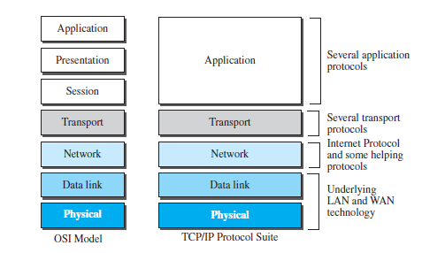
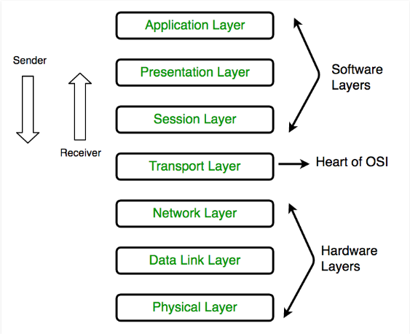
NETWORK MODELS

Slide 3
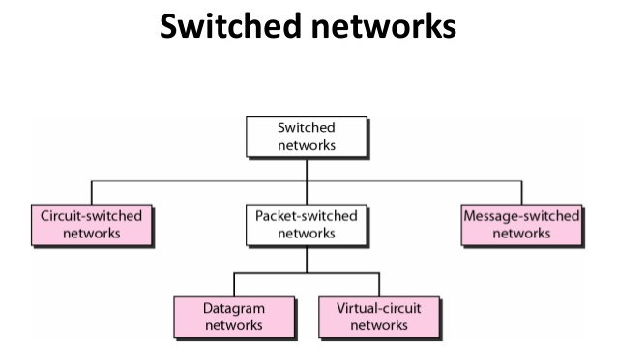

Slide 4
 | Circuit switched Networks | Virtual Circuit Network | Datagram Network
1. | Physical Layer | Data Link Layer | Network Layer
2. | Connection Oriented | Virtual Connection | Connection Less
3. | No Packets Formation | Packets (Frames) : Follow same path | Packets(Datagram) : Independent , not follow same path.
4. |  |  | At receiving end, packets arrive unordered.
5. | Resources Dedicated | Resources May or May not be Dedicated | On Demand Resources
6. | 3 Phases (Setup , Data Transfer , Teardown ) | 3 Phases (Setup , Data Transfer , Teardown ) | No Phases.
7. | Minimum Delay since resources are dedicated. |  | Have delays since resources are not dedicated.
8. | Not efficient since resource utilization is not efficient. |  | Efficient since proper utilization of resources.

Slide 5
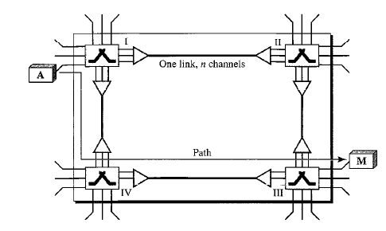
Circuit Switched Networks

Slide 6
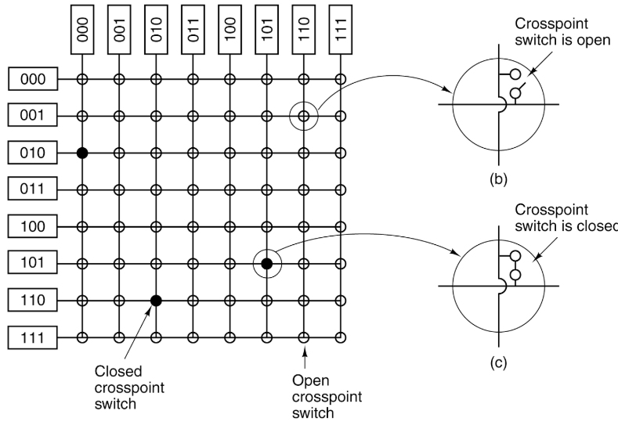
CROSSBAR SWITCH , MAY BE THIS IS USED IN MSR
N X M Switch
N sources.
M destinations.
Just have to close cross-point switch to send signals from any source to any destination.
A source can send to multiple destinations.
A destination can receive from multiple sources. ( using TDM or FDM )

Slide 7
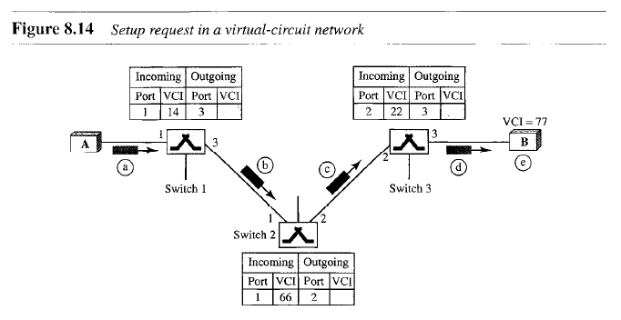
Virtual Circuit Network

Slide 8
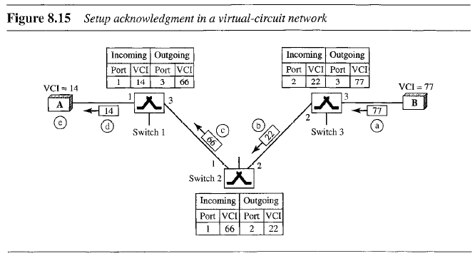
Virtual Circuit Network

Slide 9
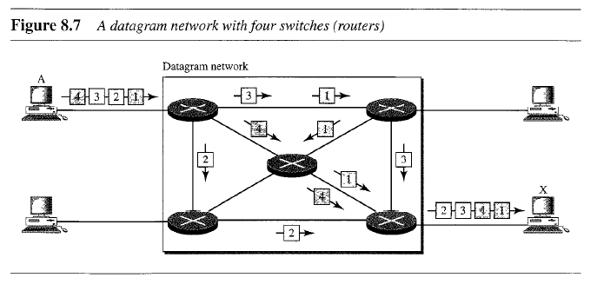
Datagram Network

Slide 10
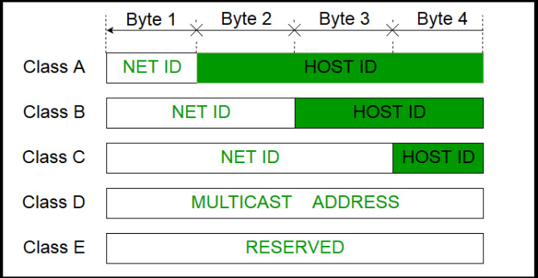
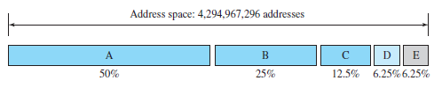
CLASSFULL ADDRESSING

Slide 11
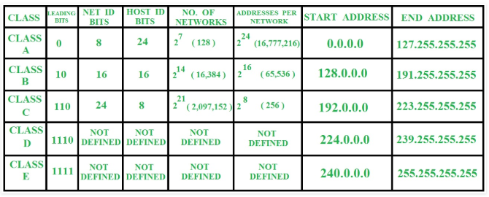

Slide 12
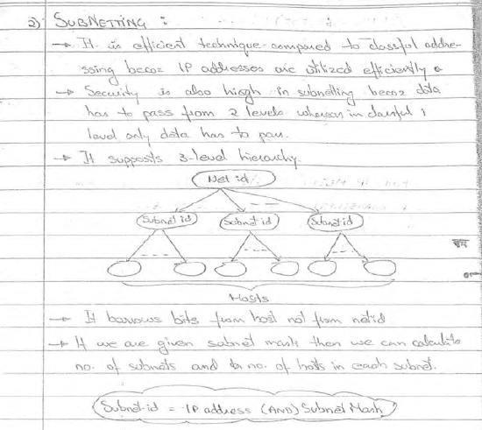

Slide 13
Subnetting
Drawbacks of big networks
Maintenance
Security
Subnetting : dividing large network into smaller network. All having continuous addresses.
Advantage : small network easier to maintain and can be secured.
Disadvantage :
levels of identification increases.
Number of useful hosts decreases, Since each subnet required 2 special address.
For subnetting bits are borrowed from host part not from NetID part.
SubnetID = IP address (AND) SubnetMask
If we are given subnet Mask than we can calculate number of subnets and number of hosts in each subnet.

Slide 14
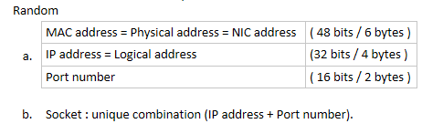
Classless Inter-Domain Routing (CIDR)
Classful networking was replaced by Classless Inter-Domain Routing (CIDR) in 1993.
To reduce the wastage of IP addresses in a block, we use sub-netting. What we do is that we use host id bits as net id bits of a classful IP address. We give the IP address and define the number of bits for mask along with it (usually followed by a ‘/’ symbol), like, 192.168.1.1/28. Here, subnet mask is found by putting the given number of bits out of 32 as 1, like, in the given address, we need to put 28 out of 32 bits as 1 and the rest as 0, and so, the subnet mask would be 255.255.255.240.

Slide 15
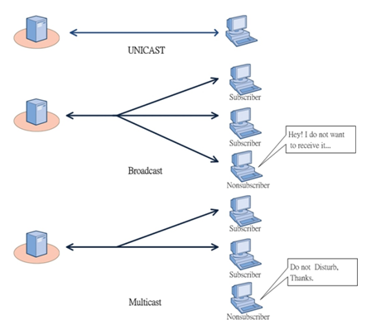
Unicast, Broadcast and Multicast
Unicast : ( One to one delivery )
Multicast : ( one to many delivery )
Broadcast : ( one to all delivery )
Limited Broadcast.
Directed broadcast.

Slide 16
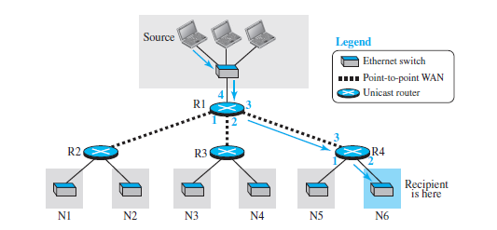
Unicasting

Slide 17
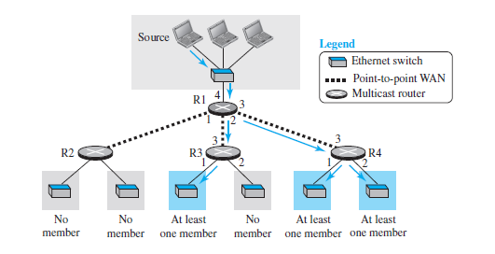
Multicasting
Multicast routers are used.
Use class d addresses as destination addresses

Slide 18
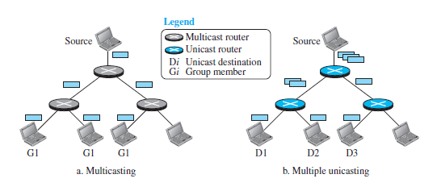
Multicasting vs multiple unicasting
In Multicasting ,Multicast router makes copies of packets whereas all copies are made by source in multiple unicasting .

Slide 19
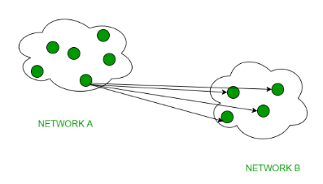
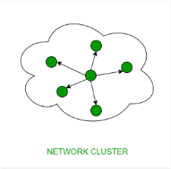
Broadcasting
Limited Broadcasting :
Suppose you have to send stream of packets to all the devices over the network that you reside, this broadcasting comes handy. For this to achieve,it will append 255.255.255.255 (all the 32 bits of IP address set to 1) called as Limited Broadcast Address in the destination address of the datagram (packet) header which is reserved for information tranfer to all the recipients from a single client (sender) over the network.
Directed Broadcasting :
This is useful when a device in one network wants to transfer packet stream to all the devices over the other network. This is achieved by translating all the Host ID part bits of the destination address to 1,referred as Direct Broadcast Address in the datagram header for information transfer.

Slide 20
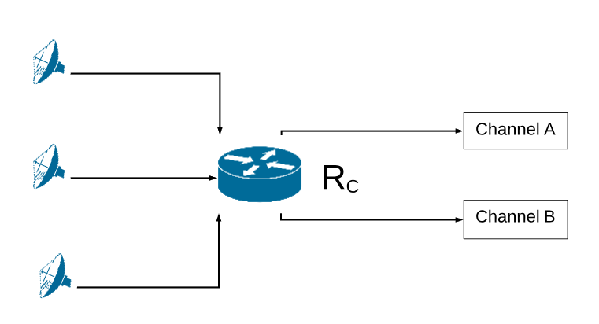
Demo Network for showing Unicasting and Broadcasting along with Subnetting.
NetID | NetMask | Interface
01 000 0000 | 11 000 0000 | A
10 000 0000 | 11 000 0000 | B
11 000 0000 | 11 000 0000 | D.B.
D.B. = Directed Broadcast
L.B. = Limited Broadcast ( 255:255:255:255 )
BACK = to parent router network ( 0:0:0:0 )

Slide 21

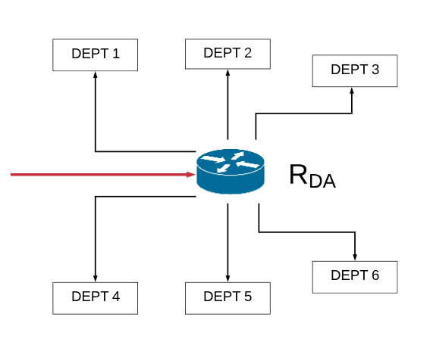
Inside Channel A Network
NetID | SubnetMask | Interface
01 001 0000 | 11 111 0000 | Dept 1
01 010 0000 | 11 111 0000 | Dept 2
01 011 0000 | 11 111 0000 | Dept 3
01 100 0000 | 11 111 0000 | Dept 4
01 101 0000 | 11 111 0000 | Dept 5
01 110 0000 | 11 111 0000 | Dept 6
01 111 0000 | 11 111 0000 | D.B.
0 : 0 : 0 : 0 | 0 : 0 : 0 : 0 | BACK

Slide 22
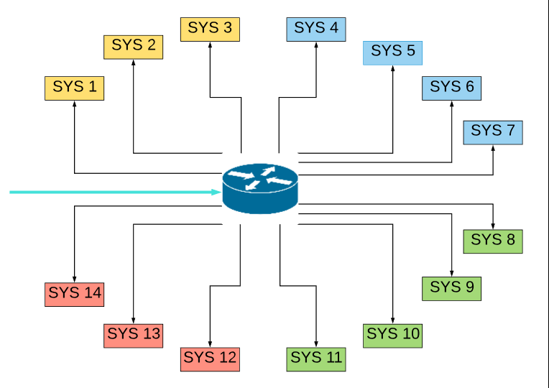
Inside Dept 1 of Channel A Network
NetID | SubnetMask | Interface
01 001 0001 | 11 111 1111 | Sys 1
01 001 0010 | 11 111 1111 | Sys 2
01 001 0011 | 11 111 1111 | Sys 3
01 001 0100 | 11 111 1111 | Sys 4
01 001 0101 | 11 111 1111 | Sys 5
01 001 0110 | 11 111 1111 | Sys 6
01 001 0111 | 11 111 1111 | Sys 7
01 001 1000 | 11 111 1111 | Sys 8
01 001 1001 | 11 111 1111 | Sys 9
01 001 1010 | 11 111 1111 | Sys 10
01 001 1011 | 11 111 1111 | Sys 11
01 001 1100 | 11 111 1111 | Sys 12
01 001 1101 | 11 111 1111 | Sys 13
01 001 1110 | 11 111 1111 | Sys 14
01 001 1111 | 11 111 1111 | D.B
255 : 255 : 255 : 255 | 255 : 255 : 255 : 255 | L.B.
0 : 0 : 0 : 0 | 0 : 0 : 0 : 0 | BACK
R_{SD1A}

Slide 23
Abilities of Demo Network
1. Data from any satellite to any channel to any department to any system.
2. Data to both channels. ( D.B. by Channel Router )
3. Data to all departments of a particular channel. ( D.B. by Department Router )
4. Data to all systems of a particular department of a particular channel. ( D.B. By System Router )
5. Any system can send to all systems within its network. (Limited Broadcast = 255:255:255:255 )
6. Any system can send to any other system in whole network. ( using BACK = 0:0:0:0 ).
7. Any System can Broadcast to any other subnetworks as in point 2,3 and 4.
8. And many more….

Slide 24
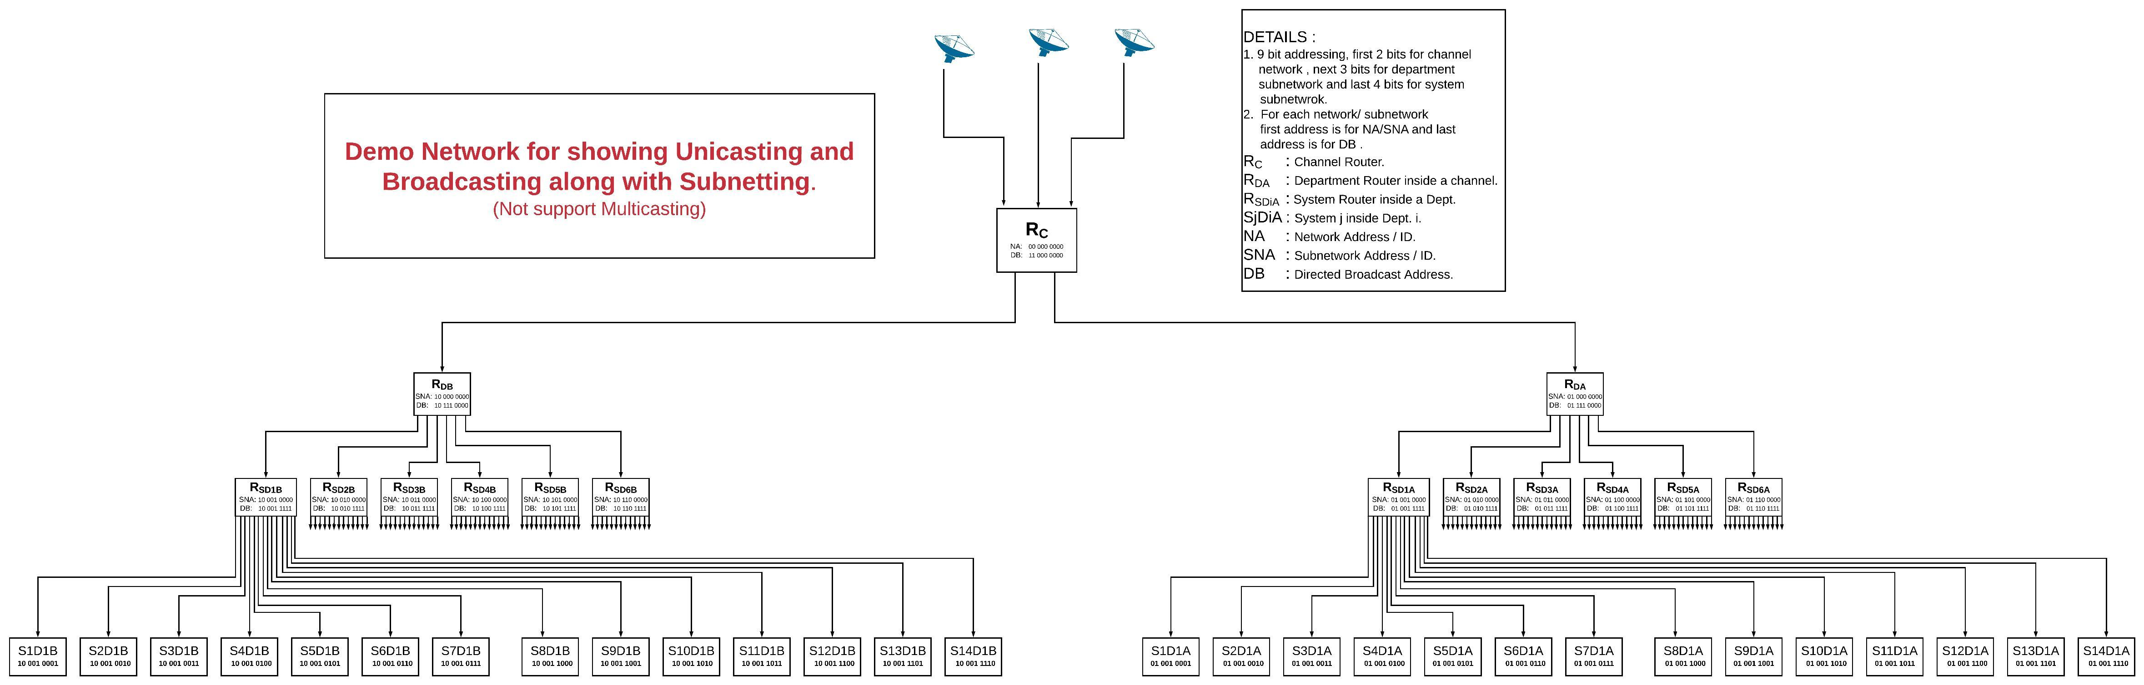

Slide 25
Routing Algorithms FOR UNICASTING
1. Distance vector Routing. (DVR)
2. Link state routing. (LSR)
3. Path vector routing . (PVR)
NOTE:
Both DVR and LSR have least cost goal whereas PVR goal is to use path decided by source.

Slide 26
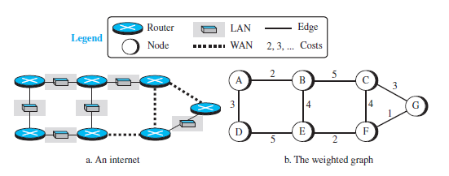
Distance vector Routing (DVR)

Slide 27
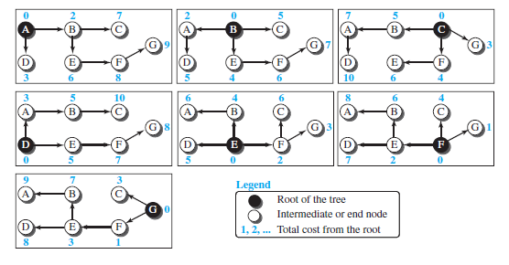
Least cost tree for each node

Slide 28
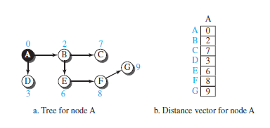
Distance vector corresponding to a tree

Slide 29
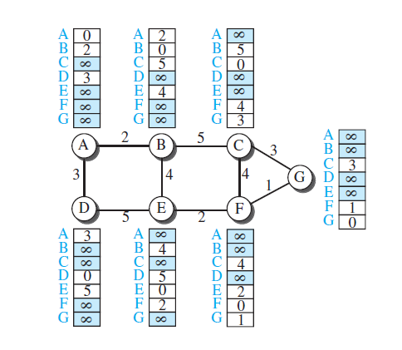
First distance vector for an internet

Slide 30
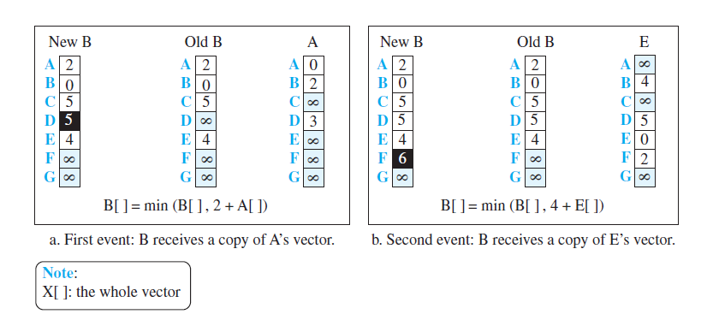
After each node has created its vector, it sends a copy of the vector to all its immediate neighbours. After a node receives a distance vector from a neighbour, it updates its distance vector using the Bellman-Ford equation.
AFTER A NODE IS UPDATED IT IMMEDIATELY SENDS IT UPDATED VECTOR TO ALL NEIGHBOURS.

Slide 32
References:
Data communications and networking / Behrouz A. Forouzan
https://www.geeksforgeeks.org/computer-network-tutorials/
Computer network lectures by ravindrababu ravula. link

Slide 33
THANK YOU

