Slide 1
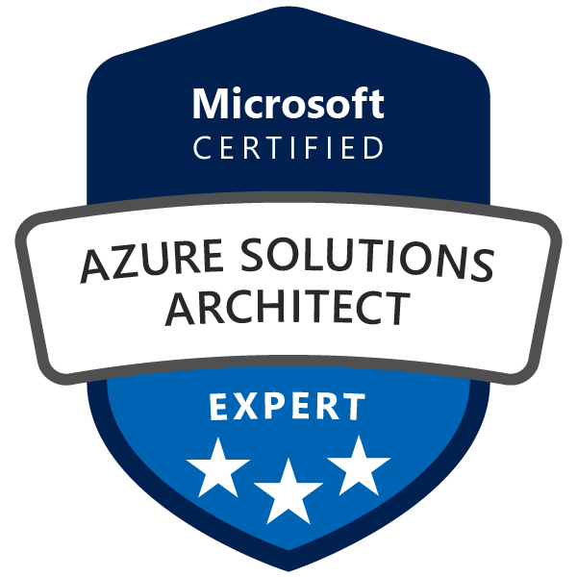
Exam AZ-300/303: Microsoft Azure Architect Technologies Crash Course
Tim Warner

Slide 2
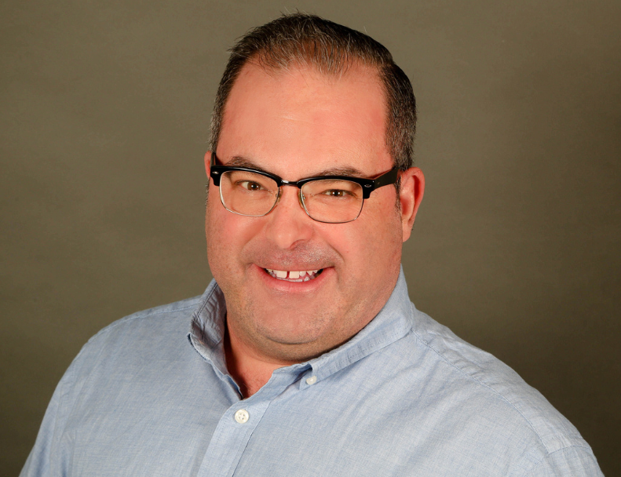

Tim Warner
Based in Nashville, TN, US
MCT, MVP
Twitter: @TechTrainerTim
Badge: timw.info/azarchcert

Slide 3
Session 2 of 2 Learning Goals
Sweep up the shavings from yesterday
SSPR & MFA
Azure Migrate & VM Backup
Network Load Balancing and Security
Governance
Application Infrastructure
Data Platform

Slide 4
Course Materials
timw.info/az300

Slide 5
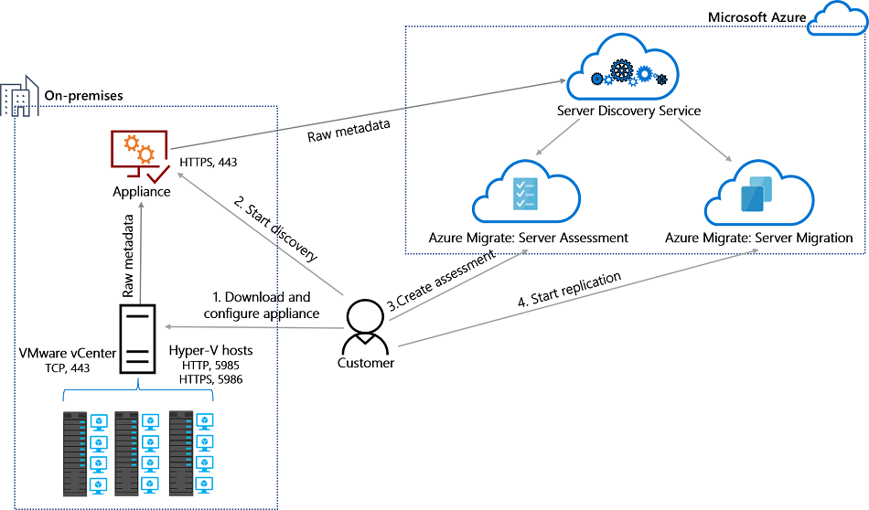
Azure Migrate

Slide 6
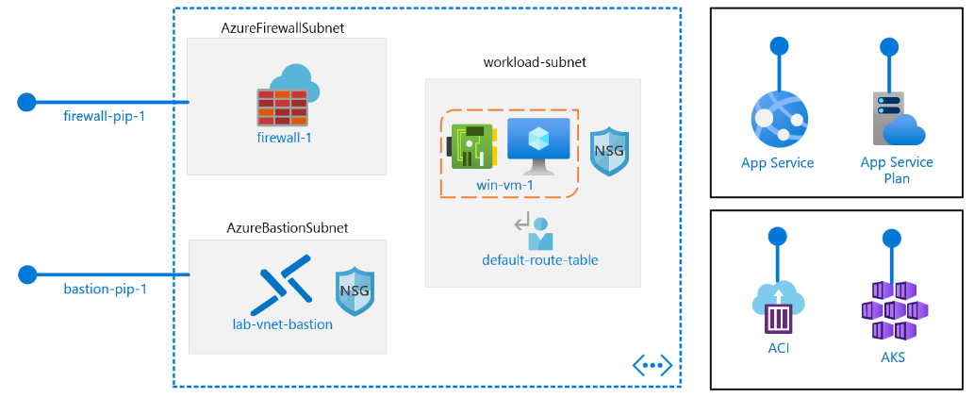
Core Networking

Slide 7
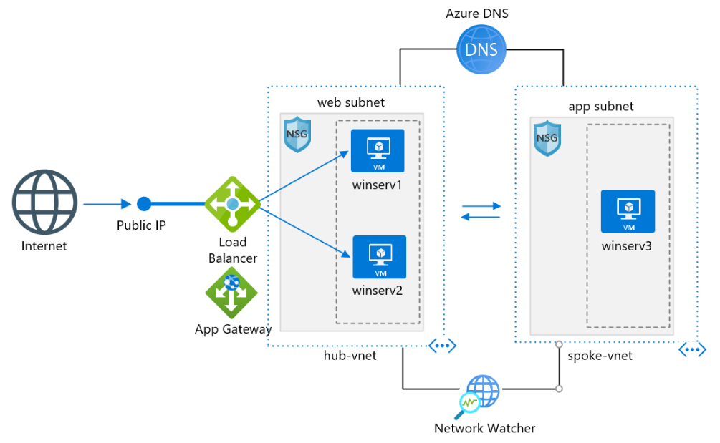
Core Networking

Slide 8
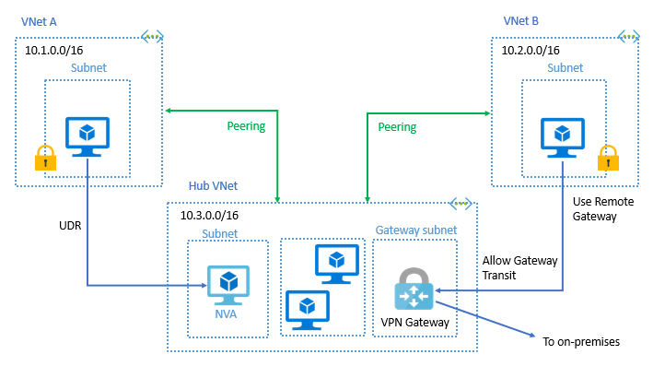
VNet Peering

Slide 9
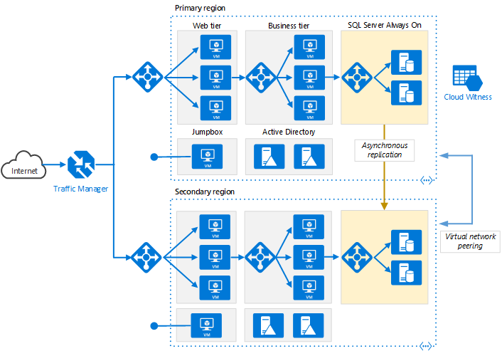
Load Balancing

Slide 10
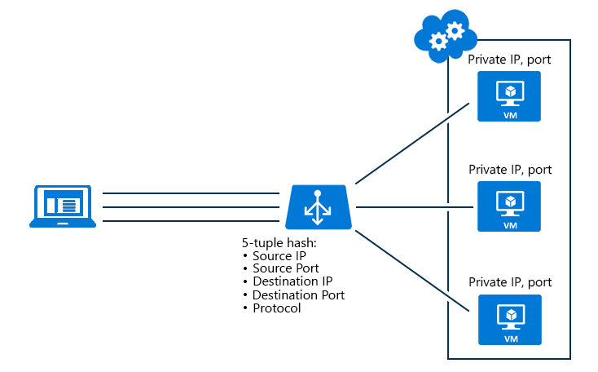
Azure Load Balancer

Slide 11
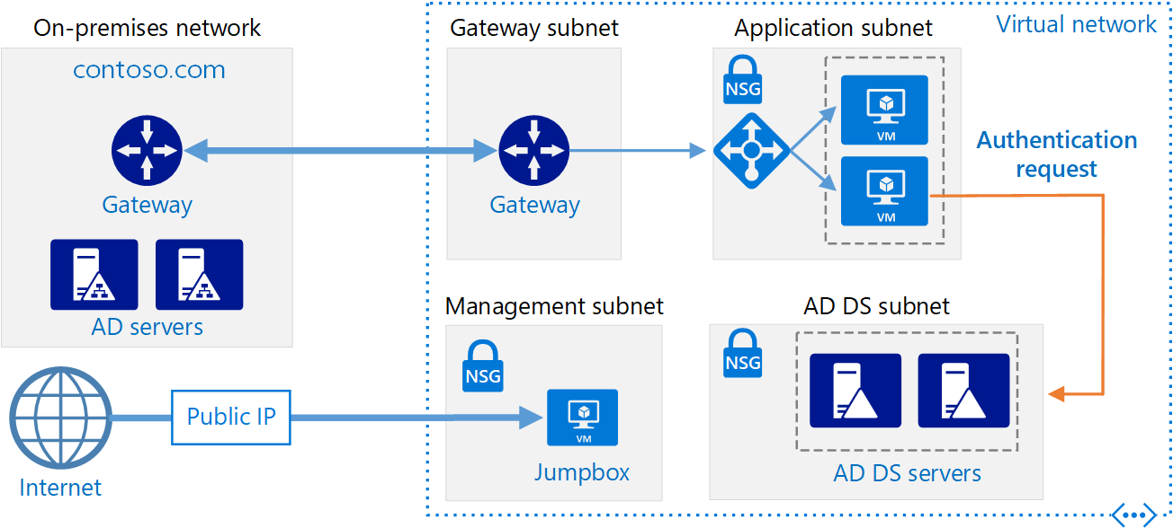
Hybrid Networking

Slide 12
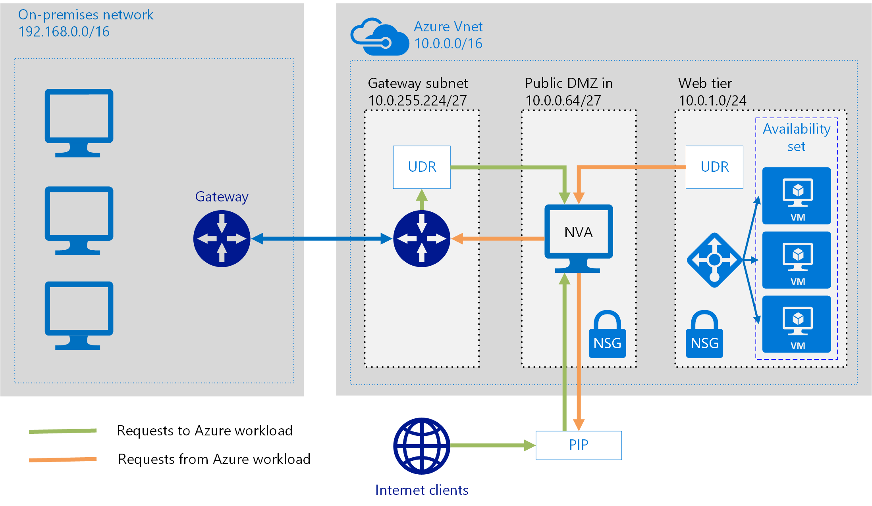
Network Virtual Appliance

Slide 13
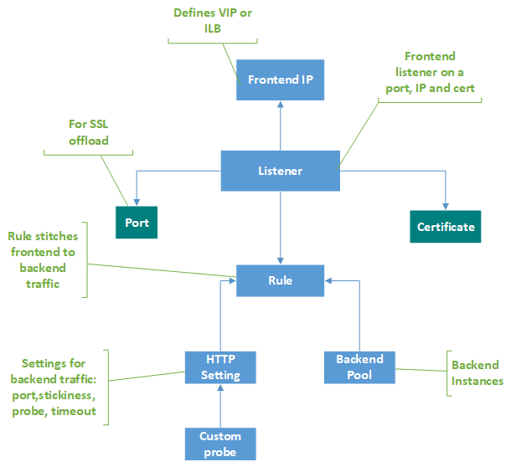
Application Gateway

Slide 14
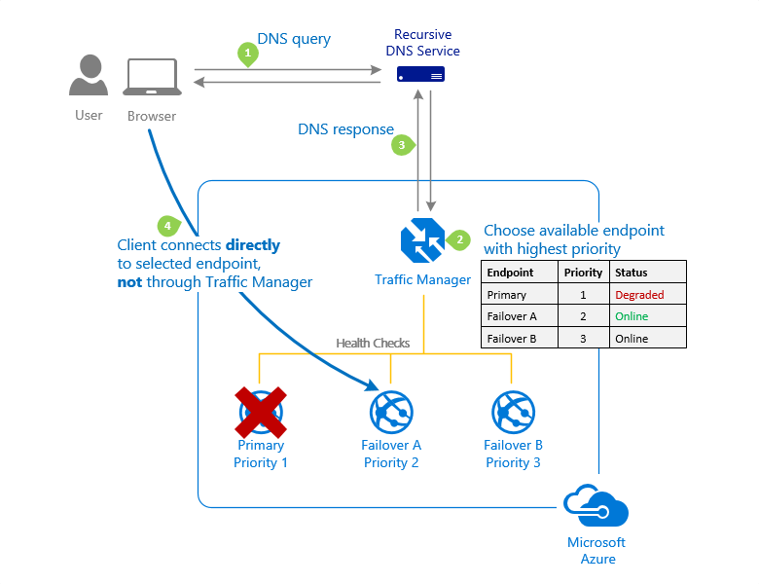
Traffic Manager

Slide 15
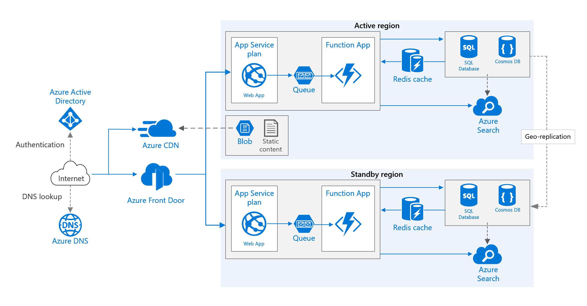
Front Door Service

Slide 16
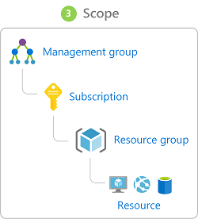
Azure Management Scopes
/ Tenant Root

Slide 17
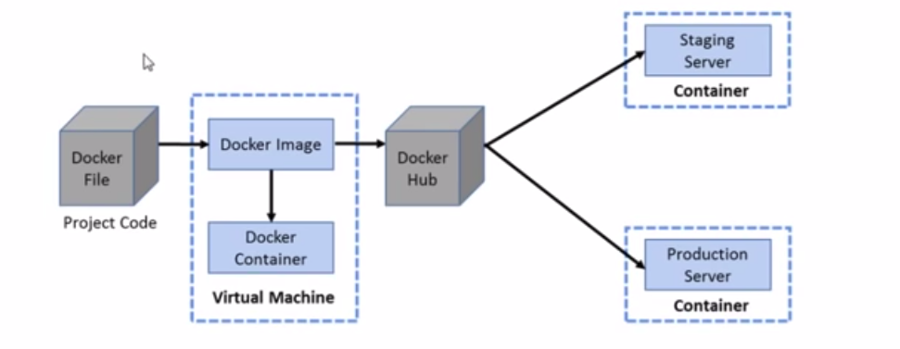

Docker Container Lifecycle
https://timw.info/3635f

Slide 18
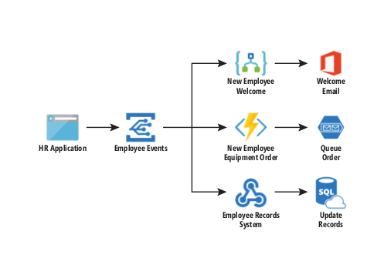
Event Architecture

Slide 19
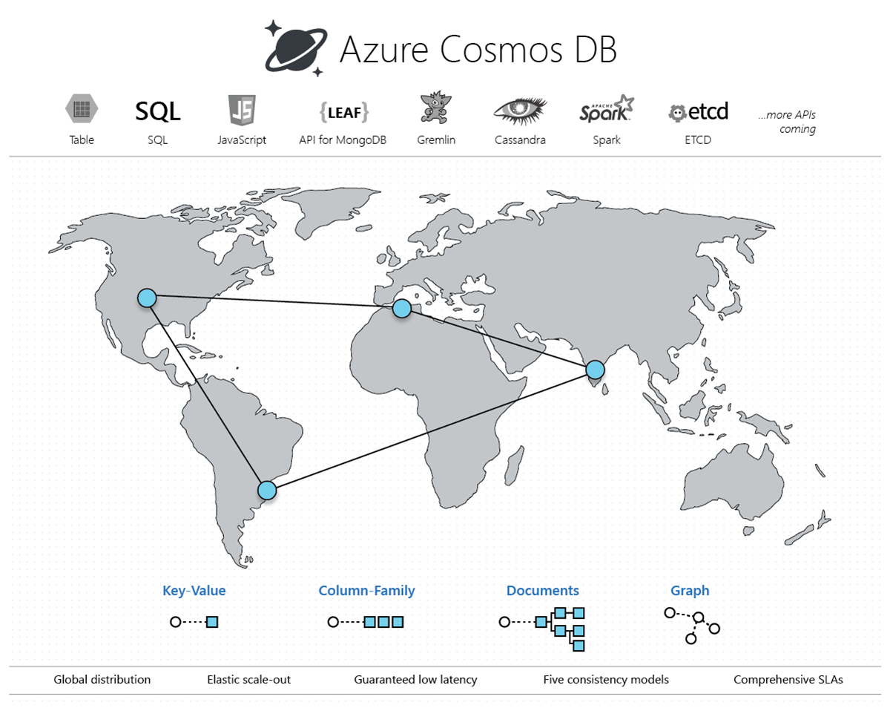
Cosmos DB

Slide 20
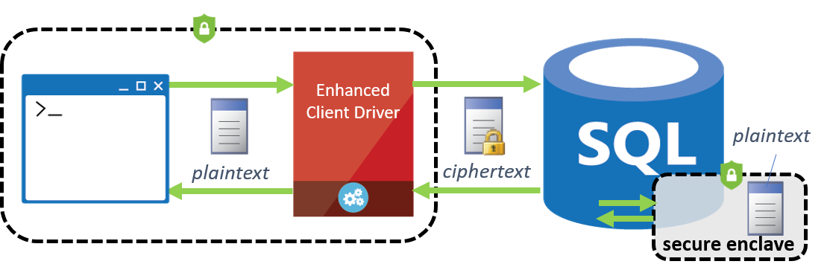
Always Encrypted

Slide 21
Module 6: Exam AZ-300 Exam Strategy

Slide 22
Module 6 Learning Objectives
Grasp the content
Acquire the hands-on skills
Master computer-based testing
Comprehend what to expect before, during, and after the exam

Slide 23
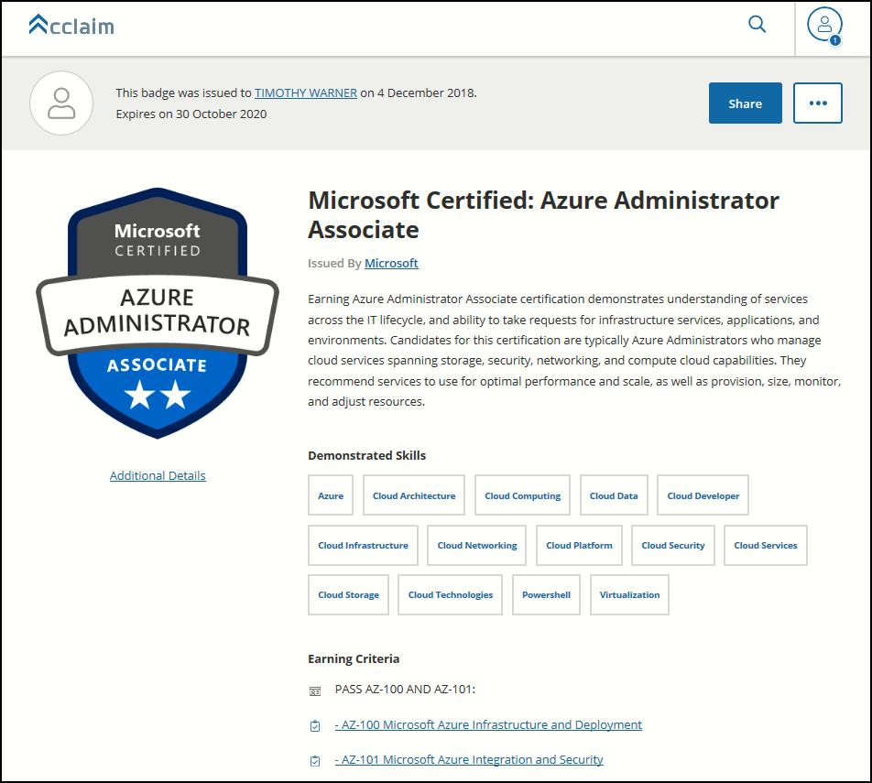
Digital Credentials by Credly/Acclaim

Slide 24
Microsoft Online Testing

Slide 25
Microsoft Online Testing Process
timw.info/online

Slide 26
AZ-300 Exam Strategy/Tips
Focus your skills accordingly:
60 percent Azure portal
20 percent Azure PowerShell
10 percent Azure CLI
10 percent KQL
Expect performance-based labs, but be thankful if you don't see 'em

Slide 27
Thank you!
Course materials: timw.info/az300
Twitter: @TechTrainerTim
Work: timw.info/ps
Web: TechTrainerTim.com

