Slide 1
2021.11.11
彭天祥

Slide 2
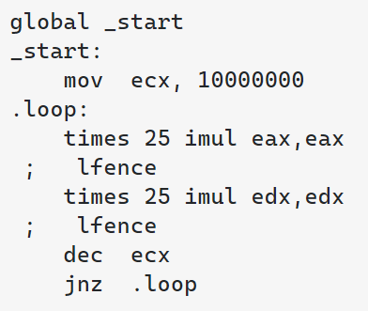
一个示例程序

Slide 3
一个示例程序
这意味着
- CPU是多发射的
- CPU在运行时对指令进行了动态调度，乱序执行

Slide 4
一个示例程序
imul %eax, %eax
imul %eax, %eax
…
imul %edx, %edx
imul %eax, %eax
…
RAW
第二个imul指令的执行依赖于前一个imul指令的结果，造成了数据依赖

Slide 5
Register & Memory Location Dependence
- 只存在相同reg/mem之间
- 通过相同reg/mem流通

Slide 6
Register & Memory Location Dependence
- 分为：
- data dependence: RAW(Read After Write)
■ addi x1, x1, -8
■ bne x1, x2, Loop
- name dependence(never happen if we have infinite registers)
- anti-dependence: WAR(Write After Read)
■ fadd.d f4, f0, f2
■ fld f0, 0(x1)
- output dependence: WAW(Write After Write)
■ addi x1, x4, x5
■ addi x2, x1, -8
■ addi x1, x7, x8
- not dependence
- RAR(Read After Read)
RAW
WAR
WAW

Slide 7
Register & Memory Location Dependence
依赖产生的方式：reg vs. mem（以RAW为例）
- 通过访问相同reg产生
- reg reg
■ addi x1, x1, -8
■ bne x1, x2, Loop
- mem reg
■ fld f0, 0(x1)
■ fadd.d f4, f0, f2
- reg mem
■ fadd.d f4, f0, f2
■ fsd f4, 0(x1)

Slide 8
Register & Memory Location Dependence
依赖产生的方式：reg vs. mem（以RAW为例）
- 通过访问相同mem产生
- mem mem
■ fsd f4, 0(x1)
■ fld f2, 0(x1)

Slide 9
Register & Memory Location Dependence
依赖产生的方式：reg vs. mem
- WAW & WAR类似，无法确保依赖意味着即使是单核，程序的正确性也会丧失
- 由什么指令（mem access、reg operation）产生不重要（reg的三种方式都一样）
- 重要的是媒介是reg还是mem：为什么？

Slide 10
Register & Memory Location Dependence
RAR：not dependence
- mem reg
■ fsd f0, 0(x1)
■ fadd.d f2, f0, f4
- reg mem
■ fadd.d f2, f0, f4
■ fsd f0, 0(x1)
- reg reg
■ addi x2, x1, x4
■ addi x3, x1, x5
- mem mem
■ fld f0, 0(x1)
■ fld f2, 0(x1)

Slide 11
Register & Memory Location Dependence
RAR：not dependence
- mem mem
■ fld f0, 0(x1)
■ fld f2, 0(x1)
- 单核：任意乱序，不影响程序正确性

Slide 12
Register & Memory Location Dependence
RAR：not dependence
- mem mem
■ fld f0, 0(x1)
■ fld f2, 0(x1)
- 多核：
program order：
■ fld f0, 0(x1)
■ fld f2, 0(x1)
reordered（static/dynamic）：
■ fld f2, 0(x1)
■ fld f0, 0(x1)
Memory Consistency
initial：mem[x1] = 0
---------another core writes mem[x1] = 1 ---------
f0 = 0, f2 = 1
f2 = 1, f0 = 0

Slide 13
Register & Memory Location Dependence
依赖产生的方式：reg vs. mem
- 差异：可见性
- 因为reg对外不可见，所以：
- 维护RAW、WAW、WAR是为了维护程序的正确性
- RAR不是一种依赖
- 因为mem对外可见，所以：
- 维护RAW、WAW、WAR依赖是为了维护程序的正确性，同时
在多核情景下维护了memory consistency
- 维护RAR是为了维护memory consistency
- 如果能确保reorder不会被观测到（从而对外部造成影响），可以
对RAR乱序（consistency speculation）

Slide 14
Hazard
Dependence一定会导致程序执行错误吗？
以五级流水线为例
■ addi x1, x1, -8
■ subi x2, x7, 2
■ sd x2, -12(x3)
■ ld x7, -16(x3)
■ addi x7, x7, -8
■ bne x1, x2, Loop
■ addi x1, x1, -8
■ bne x1, x2, Loop
■ subi x2, x7, 2
■ sd x2, -12(x3)
■ ld x7, -16(x3)
■ addi x7, x7, -8
RAW
RAW
not hazard
hazard：overlapping of execution

Slide 15
Hazard
Eliminate Hazard(in-order pipeline)
- RAW
- RAW from calculation：forwarding
■ addi x1, x1, -8
■ bne x1, x2, Loop
- RAW from memory access：stall
■ ld x1, 0(x2)
■ addi x1, x1, -8

Slide 16
Hazard
Eliminate Hazard(in-order pipeline)
- WAW & WAR & RAR
- never happen(due to in-order execution)
- Most hazards arise from out-of-order execution

Slide 17
Hazard
Eliminate Hazard(in-order pipeline)
- WAW & WAR & RAR
- never happen(due to in-order execution)
Most hazards arise from out-of-order execution

Slide 18
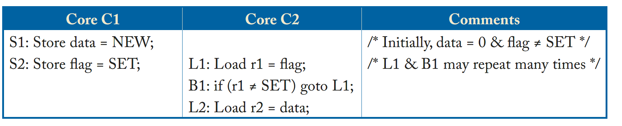
Sequential Consistency
（r1，r2）=（0，？）
（r1，r2）=（SET，NEW）

Slide 19
Sequential Consistency
L2
---------------
S1
---------------
S2
---------------
L1
（r1，r2）=（SET，0）
Load-Load reorder

Slide 20
Sequential Consistency
S2
---------------
L1
---------------
L2
---------------
S1
（r1，r2）=（SET，0）
Store-Store reorder

Slide 21
Sequential Consistency
SC：
permits（0，？），（SET，NEW）
forbids（SET，0）

Slide 22
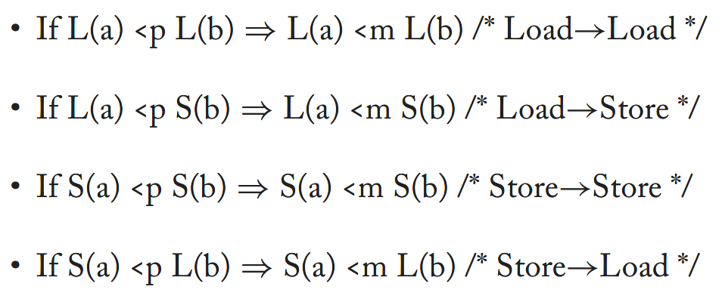
Sequential Consistency
Program order vs. Memory order
SC requires:

Slide 23
Sequential Consistency
Program order vs. Memory order
SC requires:

Slide 24
Sequential Consistency
Constraints:
S1 <m S2
L1 <m L2
Legal orders:
A(4, 4) / (2 * A(2, 2)) = 6

Slide 25
Sequential Consistency
L2
---------------
S1
---------------
S2
---------------
L1
volatile:
L1 <p L2 => L1 <m L2
（r1，r2）=（SET，0）
Load-Load reorder

Slide 26
Sequential Consistency
S2
---------------
L1
---------------
L2
---------------
S1
volatile:
S1 <p S2 => S1 <m S2
（r1，r2）=（SET，0）
Store-Store reorder

Slide 27
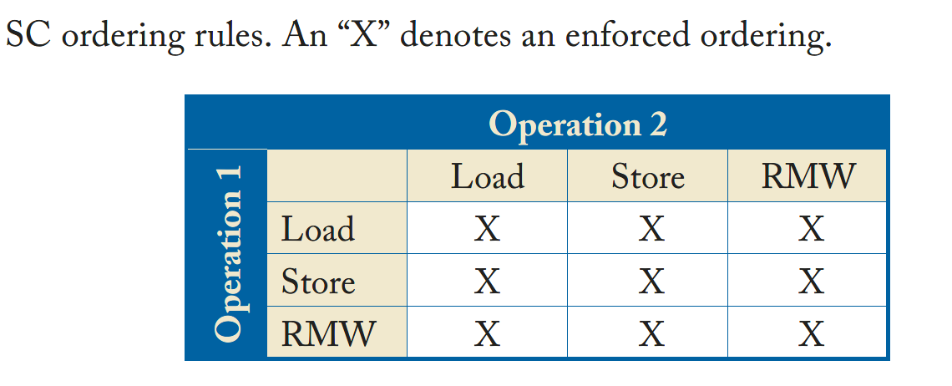
Sequential Consistency
In Summary

Slide 28
Sequential Consistency
Naïve Implementation: Multi-tasking Uniprocessor
1. On a context switch, any pending memory operations must be completed before switching to the new thread
2. Correctly honors memory dependencies
- all of the SC rules are enforced

Slide 29
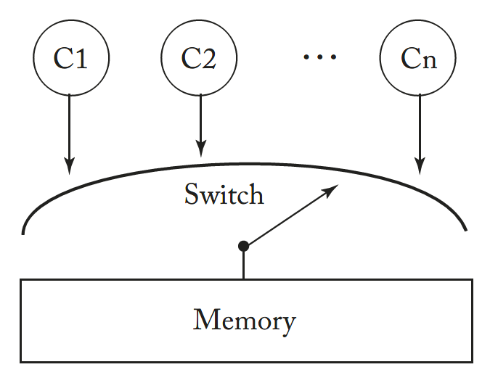
Sequential Consistency
Naïve Implementation: The Switch
1. Program-order request: Each core Ci seeks to do its next memory access in its program order <p. Each core can use any optimizations that do not aﬀect the order in which it presents memory operations to the switch.
2. Program-order completion: The switch selects one core, allows it to complete one memory access, and repeats; this deﬁnes memory order <m.
No cache, each memory access instruction initiates a request.

Slide 30
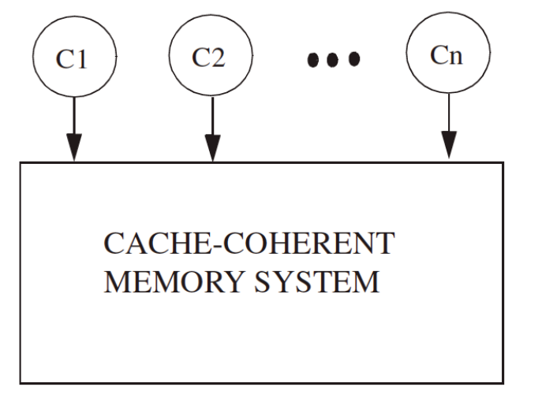
Sequential Consistency
Implementation with
Cache-Coherence System
1. Program-order request: Each core Ci seeks to do its next memory access in its program order <p. Each core can use any optimizations that do not aﬀect the order in which it presents memory operations to the switch.
2. Program-order completion: The memory system selects one core, allows it to complete one memory access, and repeats; this deﬁnes memory order <m.
Before cache, each memory access instruction initiates a request.

Slide 31
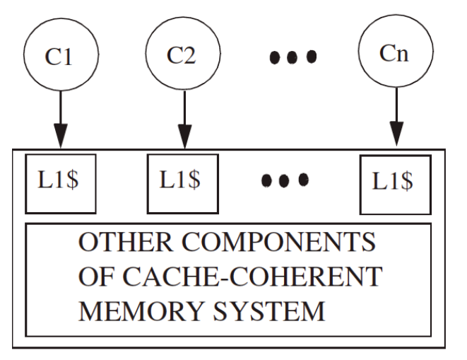
Sequential Consistency
Implementation with L1-cache
Cache-Coherence System
1. Program-order request: …
2. Program-order completion: the memory system can respond to requests from diﬀerent cores in parallel, provided that the corresponding L1 caches have the appropriate permissions. Completions may be placed into memory order in any logical order.
Before cache, each memory access instruction initiates a request.

Slide 32
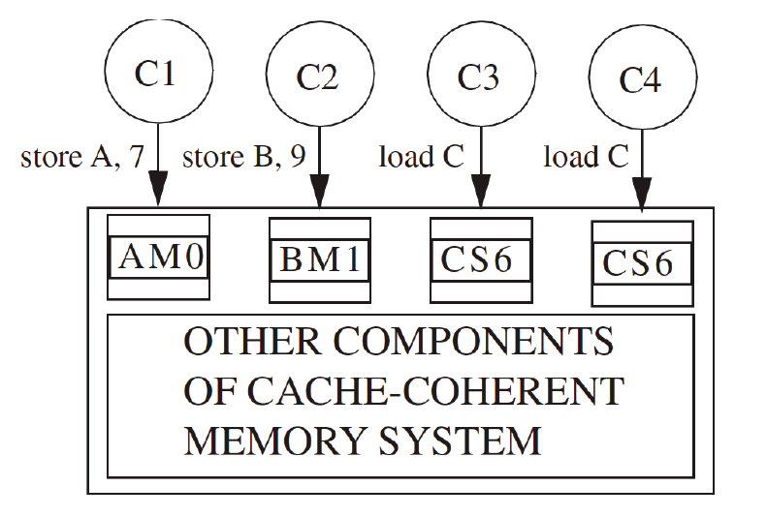
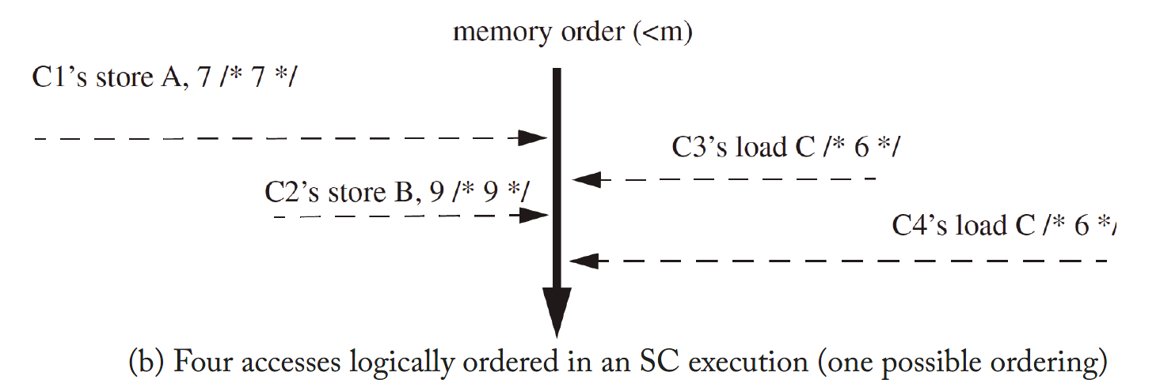
Sequential Consistency
Implementation with L1-cache
Cache-Coherence System

Slide 33
Out-of-Order
为什么会发生乱序？
编译器：static scheduling
CPU：dynamic scheduling

Slide 34
Out-of-Order: Compiler
- Motivation: two typical compiler optimizations
- Optimization goals & principles
- Problems & Solutions

Slide 35
Out-of-Order: Compiler
Motivation: two typical compiler optimizations
- Static Register Renaming
- Filling Stall

Slide 36
Out-of-Order: Compiler
Example：Static Register Renaming
Latency: addf - 3 cycles, mulf - 6 cycles, divf - 24 cycles
■ addf f0, f1, f2
■ mulf f3, f0, f2
■ addf f4, f3, f2
■ mulf f5, f4, f2
■ divf f5, f1, f2
■ addf f0, f1, f2
■ mulf f3, f0, f2
■ addf f4, f3, f2
■ mulf f5, f4, f2
■ divf f6, f1, f2
RAW
RAW
RAW
WAW

Slide 37
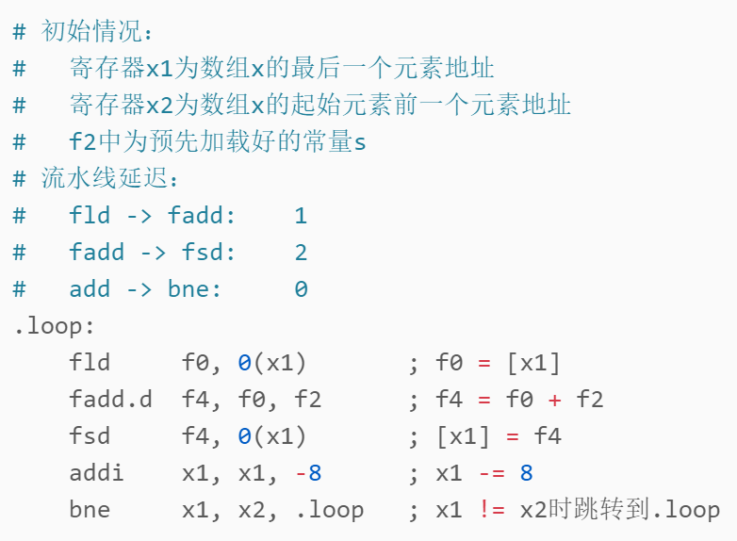
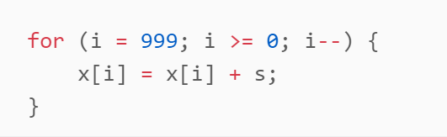
Out-of-Order: Compiler
Example：Filling Stall
8 cycles per loop element(assume bne 0 latency from predictor)

Slide 38
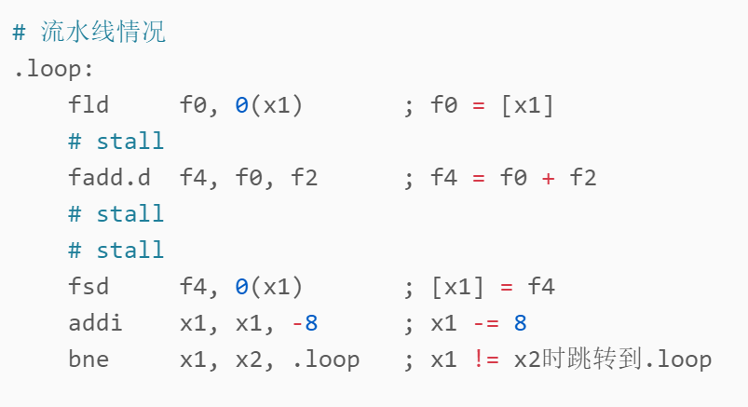
Out-of-Order: Compiler
Example：Filling Stall
8 cycles per loop element(assume bne 0 latency from predictor)

Slide 39
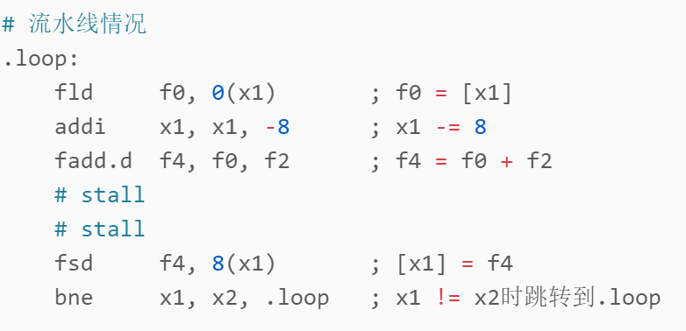
Out-of-Order: Compiler
Example：Filling Stall
Before:
After:
8 vs. 7 cycles per loop element

Slide 40
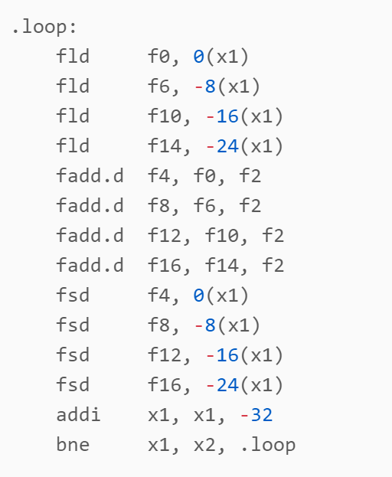
Out-of-Order: Compiler
Example：Filling Stall
Before:
After:
8 vs. 3.5 cycles per loop element

Slide 41
Out-of-Order: Compiler
为什么会发生对相同地址的Load-Load？
- 默认具有不变性
- volatile variable
- 寄存器压力（多余的值通过访问栈、共享变量进行）
Optimization goals & principles
- Register Renaming：
-（尽可能）消除name dependence（WAW、WAR）
- 因为并不是真正的依赖，只是因为我们资源不足
- Filling Stall：
- 对register：维持data dependence（RAR）以及可能的name dependence，尽可能
消除部件冲突带来的Stall（浮点mul、div）
- 对memory：
- 不同地址：默认假设没有依赖，随意乱序，掩盖访存延迟（cache hit、cache miss）
- 相同地址：禁止重排 => 保证单线程下的sequentiality

Slide 42
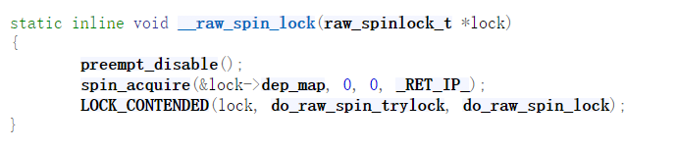
Out-of-Order: Compiler
Problems & Solutions: spinlock

Slide 43
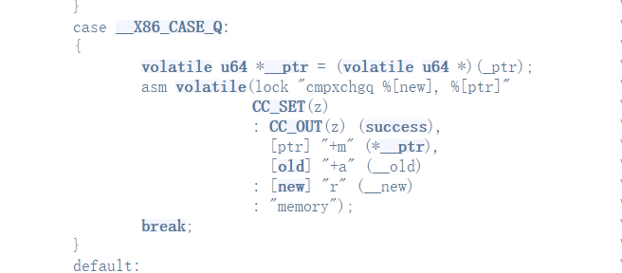
Out-of-Order: Compiler
Problems & Solutions: spinlock
禁止编译器重排

Slide 44
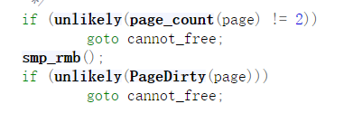
Out-of-Order: Compiler
Problems & Solutions: spinlock
Core2：
S2：mark dirty
S1：release ref
Core1：
L1：check other refs
L2：check dirty
other refs & clean/dirty => cannot_free
no other refs & dirty => cannot_free
no other refs & clean => free

Slide 45
Out-of-Order: Compiler
Problems & Solutions: remove_mapping
Core2：
S2：mark dirty
S1：release ref
Prevent compiler/CPU from reordering Load-Load
Core1（Reordered）：
L2：check dirty
L1：check other refs
L2 -> S2 -> S1 -> L1
no other refs & dirty => free!

Slide 46

Out-of-Order: Compiler
Problems & Solutions: remove_mapping
x86 employs TSO model, inherently forbidding Load-Load reordering, so compiler barrier is just enough.

Slide 47
Out-of-Order: CPU
- Motivation: reduce structural(stage) conflict
- Dynamic Scheduling: eliminate stalls from stage conflict
- Register Renaming: eliminate WAW/WAR dependence
- Speculation: reduce control dependence
- In Summary: Out-of-Order CPU execution model

Slide 48
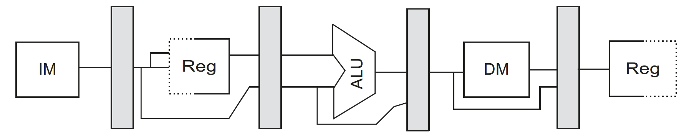
Motivation: reduce structural(stage) conflict
Basic five-stage pipeline

Slide 49
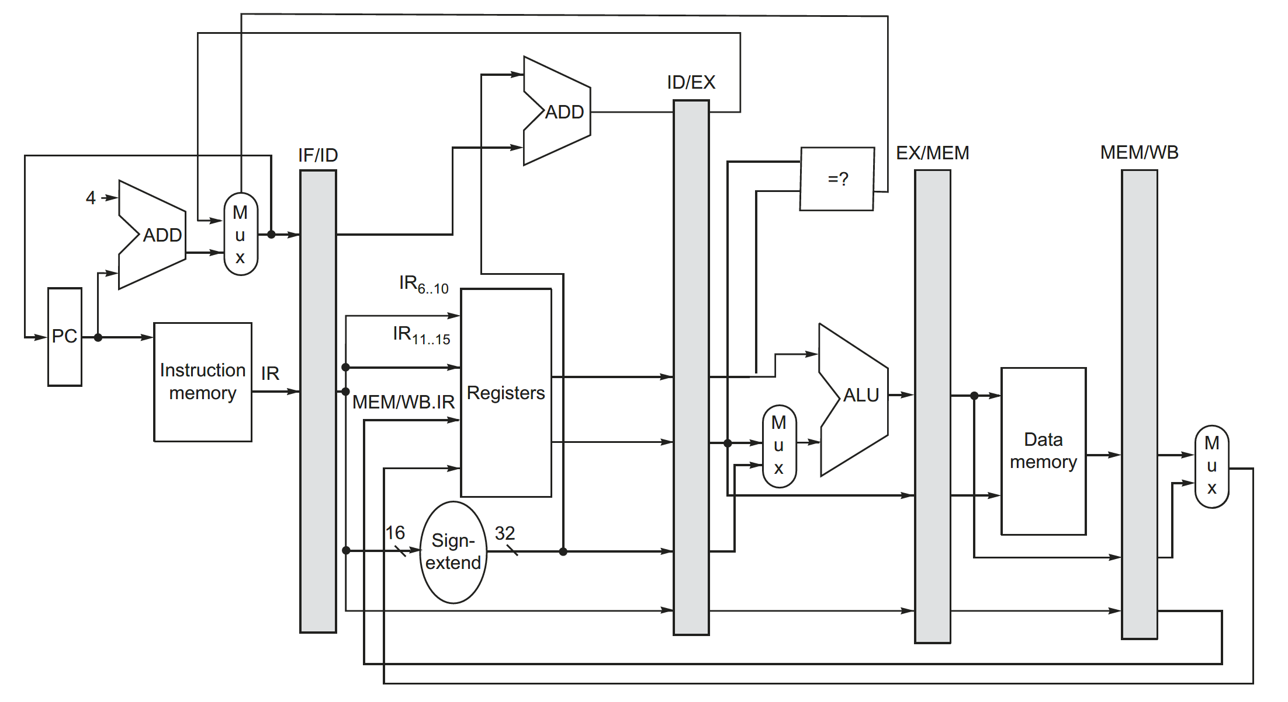
Motivation: reduce structural(stage) conflict
Basic five-stage pipeline

Slide 50
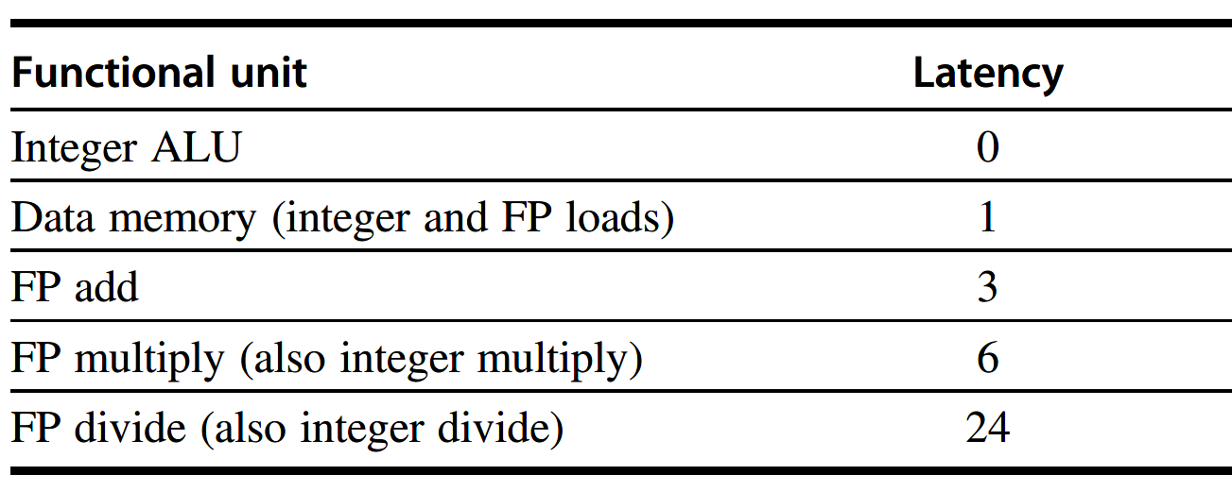
Motivation: reduce structural(stage) conflict
Problems for FP operations:
- Finish FP add/mul/div in single cycle
- High propagation delay => low clock frequency
- Finish FP add/mul/div in multiple cycles
- FP operations will block later instructions for a long time

Slide 51
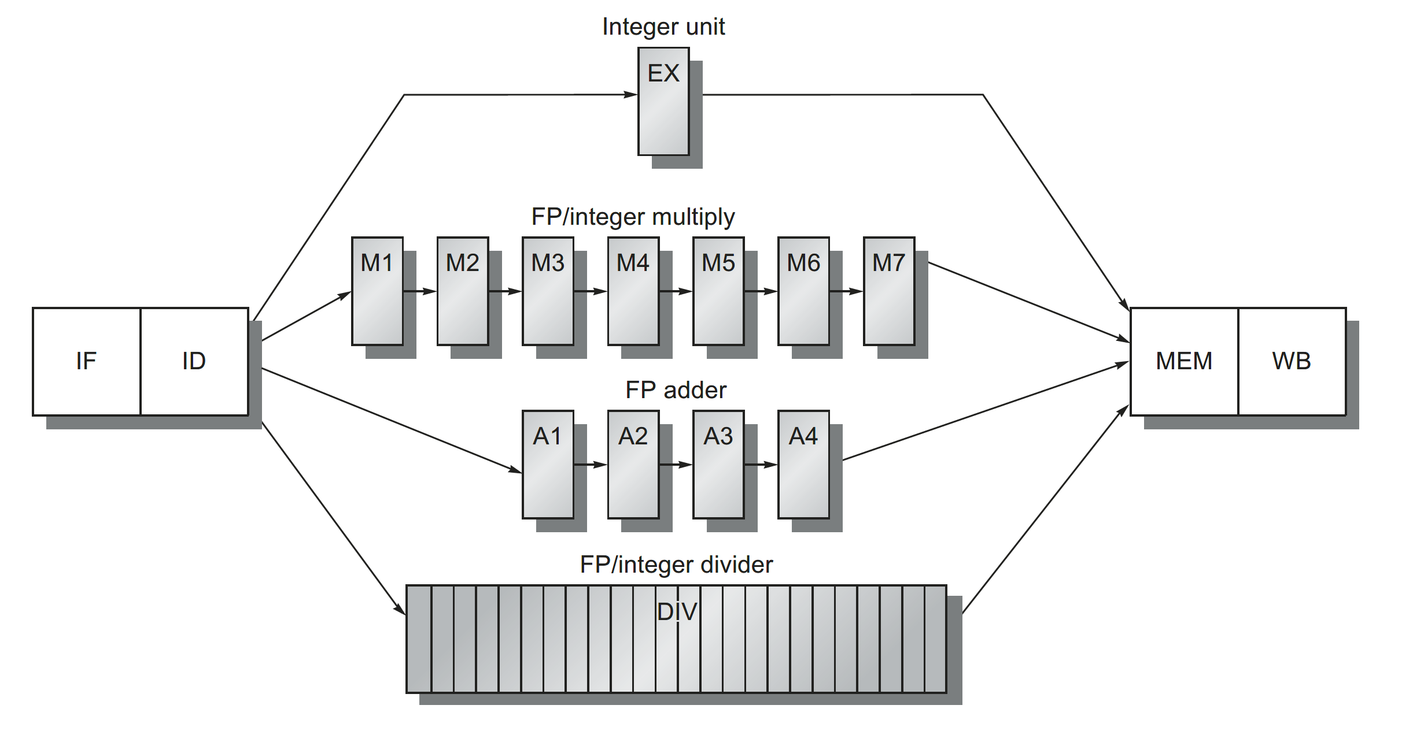
Motivation: reduce structural(stage) conflict
Extend pipeline for multi-cycles FP operations

Slide 52
Motivation: reduce structural(stage) conflict
Extend pipeline for multi-cycles FP operations
At most
- one outstanding integer execution/memory access
- seven outstanding FP/integer multiplies
- four outstanding FP adds
- one outstanding FP divide

Slide 53
Motivation: reduce structural(stage) conflict
Extend pipeline for multi-cycles FP operations
New problems
- register write port conflict
- WAW hazard

Slide 54
Motivation: reduce structural(stage) conflict
Extend pipeline for multi-cycles FP operations
New problems: register write port conflict
may arrive write-back stage at the same cycle

Slide 55
Motivation: reduce structural(stage) conflict
Extend pipeline for multi-cycles FP operations
New problems: register write port conflict
Solution:
(1) Detect at ID stage, stall
(2) Detect before write-back stage, stall
- will propagate to the whole pipeline

Slide 56
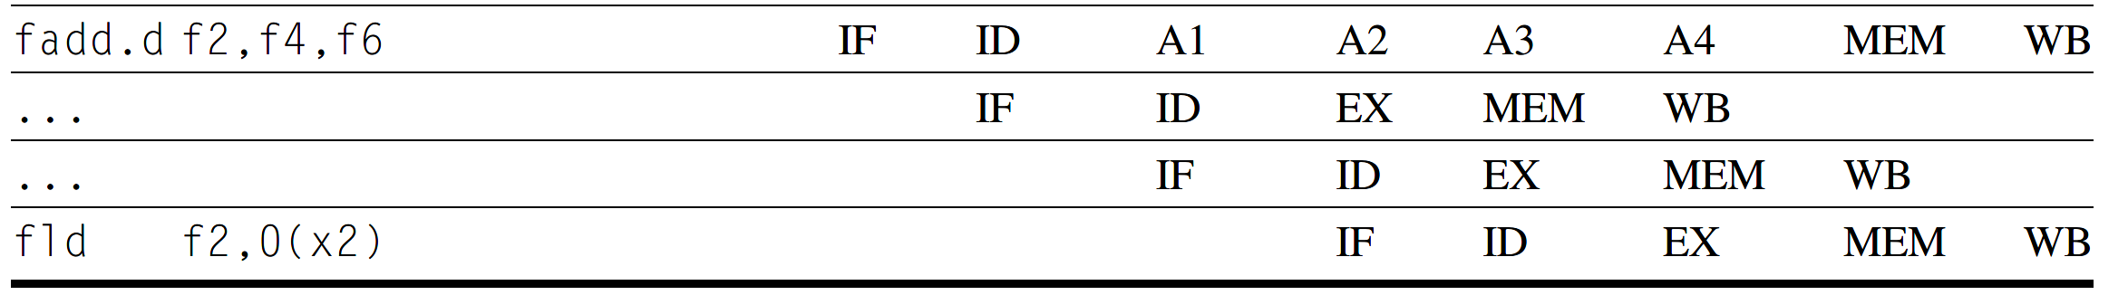
Motivation: reduce structural(stage) conflict
Extend pipeline for multi-cycles FP operations
New problems: WAW hazard
Solution:
(1) Detect at ID stage, stall
(2) Stamp out result of earlier write as NOP at write-back stage
- no impact on RAW forwarding at the end of execution stage
WAW

Slide 57
Motivation: reduce structural(stage) conflict
Extend pipeline for multi-cycles FP operations
In summary
- in-order issue
- in-order execution
- completion：
- in-order for Integer(memory access in order)
- out-of-order for FP

Slide 58
Motivation: reduce structural(stage) conflict
Extend pipeline for multi-cycles FP operations
Stall & Hazards preventing from starting execution
- RAW Hazard Detect
- Structural Conflict
- e.g. divide
- register write port
- WAW Hazard Detect
- Stage Conflict
Is WAR possible?
- No. Guaranteed by in-order execution.
■ fmul.d f1, f2, f4
■ fadd.d f4, f0, f2

Slide 59
Dynamic Scheduling: eliminate stalls from stage conflict
Motivation: eliminate stage conflict
■ fadd.d f2, f0, f1
■ fmul.d f4, f2, f3
■ fsub.d f7, f0, f1
RAW
fmul.d stalls for RAW hazard
fsub.d stalls for fmul.d stalling

Slide 60
Dynamic Scheduling: eliminate stalls from stage conflict
Simple dynamic scheduling with Scoreboarding technique
Scheduling later instructions into execution if earlier instructions stall
Requires two main changes:
- additional FIFO instruction queue at IF stage
- WAR hazard detect

Slide 61
Dynamic Scheduling: eliminate stalls from stage conflict
Simple dynamic scheduling with Scoreboarding technique
New problem: WAR hazard
WAR detect & stall
■ fdiv.d f2, f0, f1
■ fmul.d f4, f2, f3
■ fadd.d f3, f0, f1
RAW
WAR

Slide 62
Dynamic Scheduling: eliminate stalls from stage conflict
Simple dynamic scheduling with Scoreboarding technique
In summary
- in-order issue
- out-of-order execution
- completion：
- in-order for Integer(memory access in order)
- out-of-order for FP

Slide 63
Dynamic Scheduling: eliminate stalls from stage conflict
Simple dynamic scheduling with Scoreboarding technique
Consider:
- RAW/WAW Hazard Detect at ID stage
- Dynamic Scheduling at ID stage
- Structural Conflict
- e.g. divide
- register write port
- Stage Conflict
- WAR Hazard Detect at WB stage

Slide 64
Register Renaming: eliminate WAW/WAR dependence
Motivation: eliminate WAW/WAR dependence
- RAW/WAW Hazard Detect at ID stage
- Dynamic Scheduling at ID stage
- Structural Conflict
- e.g. divide
- register write port
- WAR Hazard Detect at WB stage
Not exist if we have infinite registers

Slide 65
Out-of-Order: CPU
Instruction Queue
Register File
Local Cache
Cache Coherence System
in-order issue
Issue Stage
Reorder Buffer
FU
…
FU
out-of-order execution
in-order
commit

Slide 66
Sequential Consistency
Problem of speculation
Issue Stage
Reorder Buffer
Local Cache
issue Load 1

Slide 67
Sequential Consistency
Problem of speculation
Issue Stage
Reorder Buffer
Local Cache
issue Load 2
Not ready: Load 1 cache miss

Slide 68
Sequential Consistency
Problem of speculation
Issue Stage
Reorder Buffer
Local Cache
Ready: Load 2 cache hit: 0
Not ready: Load 1 cache miss

Slide 69
Sequential Consistency
Problem of speculation
Issue Stage
Reorder Buffer
Local Cache
Store 1: data = NEW
Store 2: flag = SET
Ready: Load 2 cache hit: 0
Not ready: Load 1 cache miss

Slide 70
Sequential Consistency
Problem of speculation
Issue Stage
Reorder Buffer
Local Cache
Store 1: data = NEW
Store 2: flag = SET
Ready: Load 2 cache hit: 0
Ready: Load 1 cache hit: SET

Slide 71
Sequential Consistency
Problem of speculation
Issue Stage
Reorder Buffer
Local Cache
Store 1: data = NEW
Store 2: flag = SET
commit Load 1: SET
Ready: Load 2 cache hit: 0

Slide 72
Sequential Consistency
Problem of speculation
Issue Stage
Reorder Buffer
Local Cache
Store 1: data = NEW
Store 2: flag = SET
commit Load 1: SET
commit Load 2: 0

Slide 73
Sequential Consistency
Non-binding prefetch
Issue Stage
Reorder Buffer
Local Cache
issue Load 2
Not ready: Load 1 cache miss

Slide 74
Sequential Consistency
Non-binding prefetch
Issue Stage
Reorder Buffer
Local Cache
Not Ready: Load 2 prefetch
Not ready: Load 1 cache miss

Slide 75
Sequential Consistency
Non-binding prefetch
Issue Stage
Reorder Buffer
Local Cache
Store 1: data = NEW
Store 2: flag = SET
Not Ready: Load 2 prefetch
Ready: Load 1 cache hit: SET

Slide 76
Sequential Consistency
Non-binding prefetch
Issue Stage
Reorder Buffer
Local Cache
Store 1: data = NEW
Store 2: flag = SET
commit Load 1: SET
Not ready: Load 2 cache miss

Slide 77
Sequential Consistency
Non-binding prefetch
Issue Stage
Reorder Buffer
Local Cache
Store 1: data = NEW
Store 2: flag = SET
commit Load 1: SET
Ready: Load 2 cache hit: NEW

Slide 78
Sequential Consistency
Non-binding prefetch
Issue Stage
Reorder Buffer
Local Cache
Store 1: data = NEW
Store 2: flag = SET
commit Load 1: SET
commit Load 2: NEW

Slide 79
Sequential Consistency
Implementing Atomic RMW(Read-Modify-Write) Instructions
e.g.
1. fetch and increment - atomic add
2. atomic swap - xchg
3. compare and swap - cmpxchg

Slide 80
Sequential Consistency
Implementing Atomic
Instructions
1. Naïve implementation: Lock memory system
- prevent other cores from issuing memory accesses
- perform read-modify-write to memory
- unnecessary performance loss

Slide 81
Sequential Consistency
Implementing Atomic
Instructions
2. Exclusive cache ownership
- first obtain block RW ownership in its local cache
- local cache waits to service any incoming coherence request for the block until after the store

Slide 82
Sequential Consistency
Implementing Atomic
Instructions
3. Speculative execution
- Initially local cache owns read-only block
- load part: speculatively request RW ownership
- store part: first check local cache invalidation:
- still valid(which means RW): perform store immediately
- invalid: mis-speculation SC, reissue and execute

Slide 83
Total Store Order Consistency
Motivation: avoid stall Load after Store
- Because stores are common, being able to avoid stalling on most of them is an important beneﬁt.
- Moreover, it seems sensible to not stall the core because the core does not need anything, as the store seeks to update memory but not core state.
L(a) L(a)
L(b) S(b)
S(a) S(a)
S(b) L(b)

Slide 84
Total Store Order Consistency
Store into store buffer after commit.
Later Load may commit bypass earlier stores(before them drain to cache).
Instruction Queue
Register File
(FIFO)
Store
Buffer
Local Cache
Cache Coherence System
in-order issue
Issue Stage
Reorder Buffer
FU
…
FU
out-of-order execution
in-order
commit

Slide 85
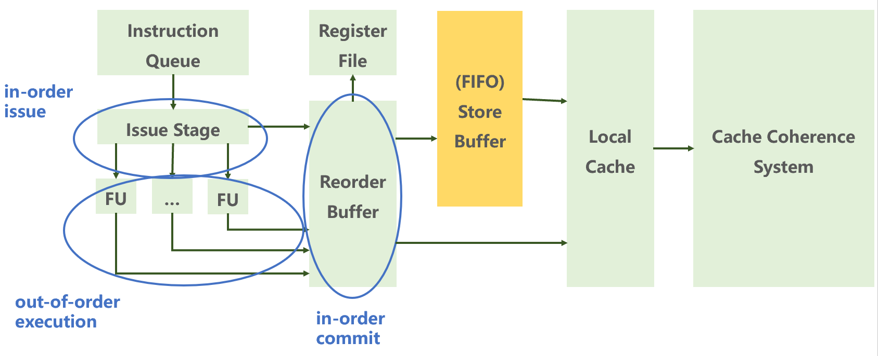
Total Store Order Consistency
For uniprocessor:
L-L/L-S remains ordered through ROB, /S-S remains ordered through Write Buffer
S(a)-L(b) reorder is not invisible i.e. execution appears to be SC
S(a)-L(a) reorder introduces RAW hazard, volatiles SC => local bypass from store buffer => execution appears to be SC

Slide 86
Total Store Order Consistency
When building a multicore processor, it seems natural to use multiple cores, each with its own bypassing write buﬀer, and assume that the write buﬀers continue to be architecturally invisible.

Slide 87
Total Store Order Consistency
This assumption is wrong.

Slide 88
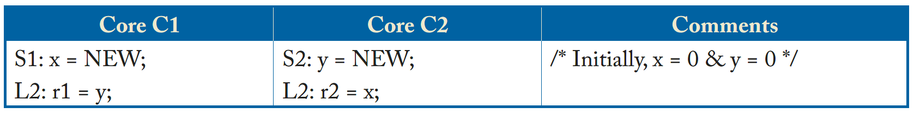
Total Store Order Consistency
1
According to SC, (r1, r2) = (0, 0) should never happens, because:
result implies: L1 <m S2 & L2 <m S1
program order: S1 <p L1 & S2 <p L2
chained: S1 <p L1 <m S2 <p L2 <m S1

Slide 89
Total Store Order Consistency
1
This may happen on multiprocessor system with their own bypassing write buffers.
How?

Slide 90
Total Store Order Consistency
1
Core1
Core2
Issue Stage
ROB
(FIFO)
Store
Buffer
Issue Stage
ROB
(FIFO)
Store
Buffer
L1
L2
S1
S2
issue
ready
cache miss

Slide 91
Total Store Order Consistency
1
Core1
Core2
Issue Stage
ROB
(FIFO)
Store
Buffer
Issue Stage
ROB
(FIFO)
Store
Buffer
L1
S1
L2
S2
issue
ready
cache miss

Slide 92
Total Store Order Consistency
1
Core1
Core2
Issue Stage
ROB
(FIFO)
Store
Buffer
Issue Stage
ROB
(FIFO)
Store
Buffer
S1
S2
issue
ready
commit: r1 = 0
commit: r2 = 0
cache miss

Slide 93
Total Store Order Consistency
1
Core1
Core2
Issue Stage
ROB
(FIFO)
Store
Buffer
Issue Stage
ROB
(FIFO)
Store
Buffer
S1
S2
issue
ready
commit: r1 = 0
commit: r2 = 0
cache miss

Slide 94
Total Store Order Consistency
1
Core1
Core2
Issue Stage
ROB
(FIFO)
Store
Buffer
Issue Stage
ROB
(FIFO)
Store
Buffer
issue
ready
commit: r1 = 0
commit: r2 = 0
cache miss
commit: x = NEW
commit: y = NEW

Slide 95
Total Store Order Consistency
1
Without write buﬀers, the hardware is SC, but with write buﬀers, it is not, making write buﬀers architecturally visible in a multicore processor.
- To hold SC: turn it off => potential performance impact
- To abandon SC: (r1, r2) = (0, 0) is permitted => TSO

Slide 96
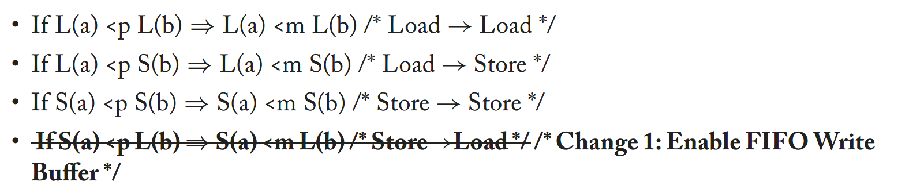
Total Store Order Consistency
TSO requires:

Slide 97
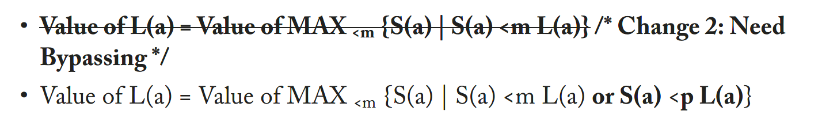
Total Store Order Consistency
TSO requires:

Slide 98
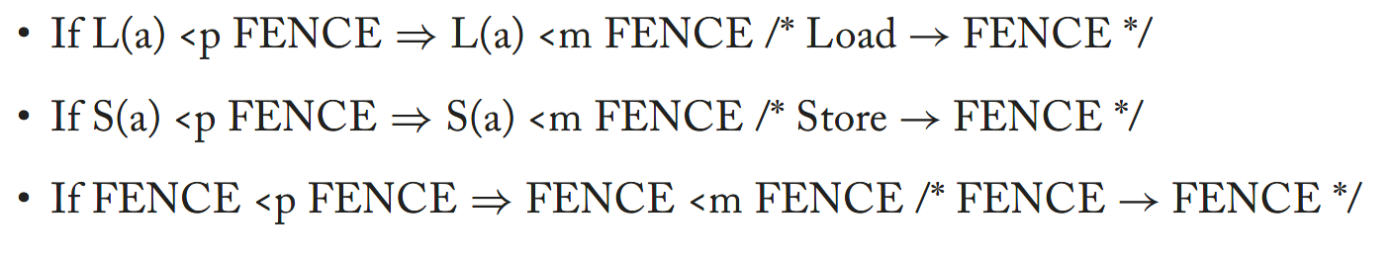
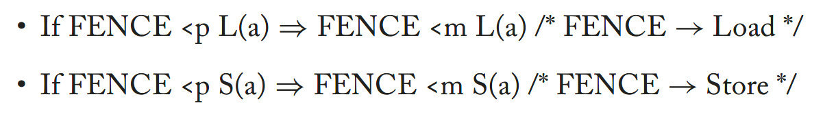
Total Store Order Consistency
TSO requires:

Slide 99
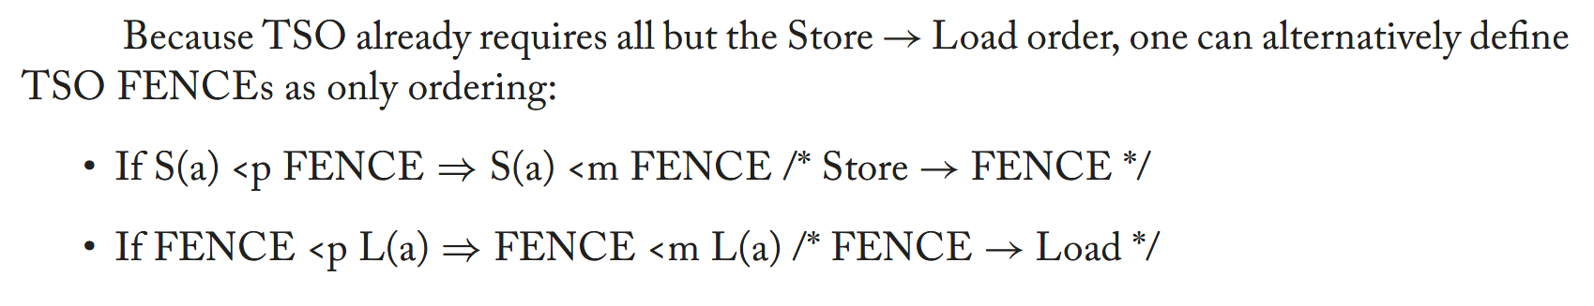
Total Store Order Consistency
TSO requires:

Slide 100
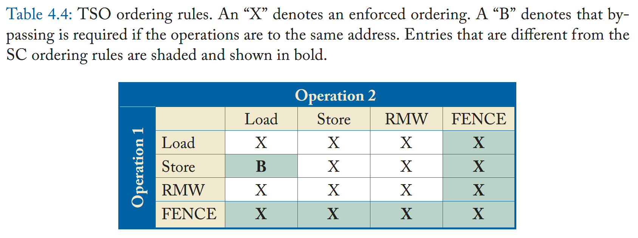
Total Store Order Consistency
In Summary

Slide 101
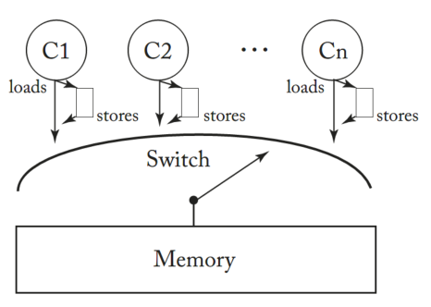
Total Store Order Consistency
Naïve Implementation:
The Switch
1. Loads and stores leave each core in that core’s program order <p.
2. A load either bypasses a value from the write buﬀer or awaits the switch as before.
3. A store enters the tail of the FIFO write buﬀer or stalls the core if the buﬀer is full.
4. When the switch selects core Ci, it performs either the next load or the store at the head of the write buﬀer.

Slide 102
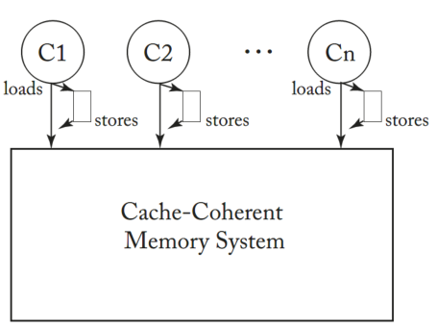
Total Store Order Consistency
Implementation with
Cache-Coherence System
1. Loads and stores leave each core in that core’s program order <p.
2. A load either bypasses a value from the write buﬀer or awaits the switch as before.
3. A store enters the tail of the FIFO write buﬀer or stalls the core if the buﬀer is full.
4. When the switch selects core Ci, it performs either the next load or the store at the head of the write buﬀer.

Slide 103
Total Store Order Consistency
Problem of speculation

Slide 104
Total Store Order Consistency
Implementing Atomic
Instructions
Key difference:
- RMW are written to write buffer
- We have to drain the store buffer before starting a RMW
- Why?

Slide 105
Total Store Order Consistency
Issue Stage
ROB
(FIFO)
Store
Buffer
Implementing Atomic
Instructions
RMW inst:
hold RW ownership
Store part
Load part
S0
View RMW as a load-store atomic instruction pair:
- load part never reorder with earlier load(TSO), guaranteed by ROB
- load part may reorder with earlier store(TSO) e.g. S0 in Store Buffer
- if load part reorders with earlier store, store part will also reorder with earlier store, which volatiles TSO

Slide 106
Total Store Order Consistency
Issue Stage
ROB
(FIFO)
Store
Buffer
Implementing Atomic
Instructions
RMW inst:
release RW ownership, write into Write Buffer
RMW
S0
View RMW as a load-store atomic instruction pair:
- load part never reorder with earlier load(TSO), guaranteed by ROB
- load part may reorder with earlier store(TSO) e.g. S0 in Store Buffer
- if load part reorders with earlier store, store part will also reorder with earlier store, which volatiles TSO
- relinquishing RW ownership volatiles atomicity

Slide 107
Total Store Order Consistency
Issue Stage
ROB
(FIFO)
Store
Buffer
Implementing Atomic
Instructions
RMW inst:
hold RW ownership
Store part
Load part
S0
View RMW as a load-store atomic instruction pair:
- drain store buffer before starting load part

Slide 108
Total Store Order Consistency
Issue Stage
ROB
(FIFO)
Store
Buffer
Implementing Atomic
Instructions
RMW inst:
hold RW ownership
Store part
Load part
View RMW as a load-store atomic instruction pair:
- drain store buffer before starting load part
- write into cache without relinquishing RW ownership

Slide 109
Total Store Order Consistency
Issue Stage
ROB
(FIFO)
Store
Buffer
Implementing Atomic
Instructions
RMW inst:
hold RW ownership
RMW
View RMW as a load-store atomic instruction pair:
- drain store buffer before starting load part
- write into cache without relinquishing RW ownership

Slide 110
Total Store Order Consistency
Implementing Fence
Fence:
- reserve Store-Load order explicitly
- protecting Load from reordering with earlier Store is enough

Slide 111
Total Store Order Consistency
Issue Stage
ROB
(FIFO)
Store
Buffer
Implementing Fence
Preparing operand(calculate effective address) and non-binding prefetch are permitted
Accessing memory(cache) is not permitted
load
fence
S0
Fence:
1. draining the write buﬀer when a FENCE is executed
2. not permitting subsequent loads to execute until an earlier FENCE has committed

Slide 112
感谢观看
彭天祥

