Slide 1
Optimizing Memory-mapped I/O for Fast Storage Devices
2021.09.30
彭天祥

Slide 2
Abstract
memory mapped I/O (MMIO) vs. read/write syscall
- reduce the syscall overhead
- almost zero overhead for data in memory(I/O cache hits)
- avoid copies between kernel and user space

Slide 3
Abstract
Not only read/write I/O cache in memory...
- allocate memory region for mmap() call
- page fault from I/O cache miss
- write back(flush) under memory pressure(dirty pages)
- reverse mapping to evict pages(clean pages)

Slide 4
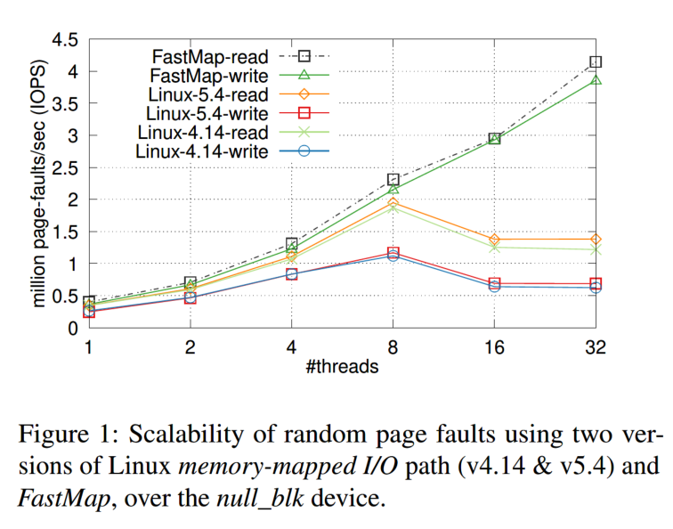
Abstract
Experiment Result
- v4.14 -> v5.4 improved little
- limited scalability
- low device queue depth

Slide 5
Contents
mmap details
- vma
- page fault
- page cache
- page eviction
- reverse mapping
- proposed method
- separated page cache tree
- full reverse mapping
- dedicated DRAM cache
- experiments

Slide 6
mmap details
mmap()
parameters:
- region size
- page-aligned
- access permission
- R/W/X
- flags
- private/shared/anonymous...
- device fd
- only for mmap I/O
return:
- start of allocated virtual memory region

Slide 7
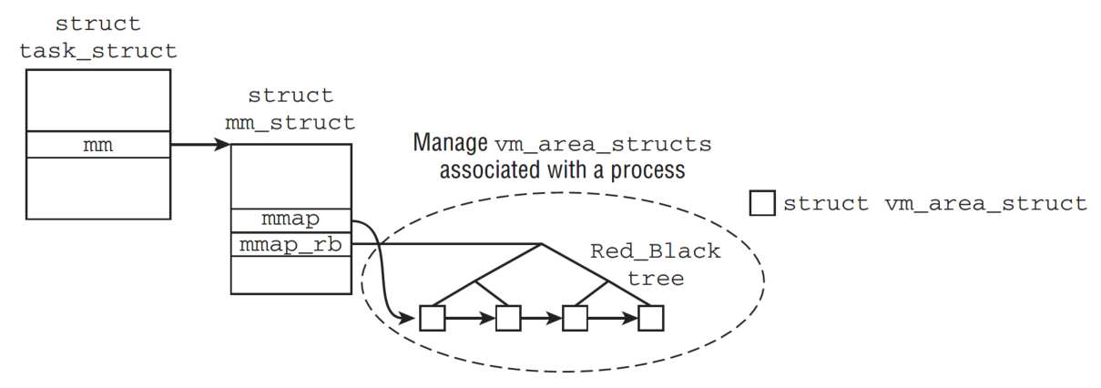
mmap details
Process VM area management

Slide 8
mmap details
each mmap() call
- insert a new vm_area_struct on current process
- list
- rbtree
- try to merge with
- preceding vma
- succeeding vma
- vmas never overlap
- no physical page allocated until page fault

Slide 9
mmap details
Page Fault
- search vma rbtree of current process, find the vma including the page fault address
- try to allocate physical page(may trigger page eviction)
- update the vma

Slide 10

mmap details
What about file-backed vma?
- each vma points to its mapped file
- each vma records its start file offset
- during page fault(I/O cache miss), we can calculate file offset corresponding to the page fault address:
- off = fault_address – vma_start_address + vma_start_file_offset
- load the file offset block into memory
- how to avoid the file content being loaded repeatly from different vma?

Slide 11
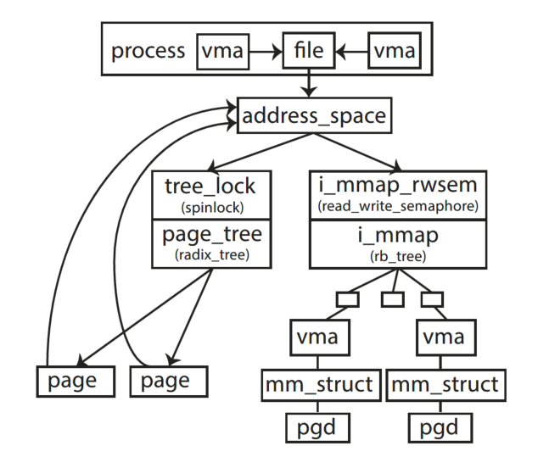
mmap details
Page cache management
- ensure only one memory image of file contents exist
- each file read operation will first look up the page radix tree
- page may be marked as clean or dirty
- insert/remove/mark all require holding the tree lock

Slide 12
mmap details
What about page eviction?
- we may evict physical page to secondary storage(for memory pressure)
- anonymous page(non-file-backed) -> swap area
- file-backed page -> remove from page cache tree(clean only)
- two problems
- which to evict(evict policy)
- how to evict
- how to evict file-backed page?
- find all vmas contain the page(reverse mapping)
- for each
- update page table entry(PTE)
- flush TLB & send IPI
- remove the page from the page cache radix tree

Slide 13
mmap details
Reverse mapping
i.e. how to identify all vmas containing the file offset?
- search the interval tree
- check the corresponding pte of each candidate vma
- if mapped, update the pte
- _mapcount in struct page to avoid traverse all vmas

Slide 14
profiling: lock contention
- tree lock of file address_space is by far the most contended lock
- tree_lock has 126× more contended lock acquisitions and 155× more time waiting to acquire the lock, compared to the second most contended lock
- The second more contended lock is a spinlock that protects concurrent modifications in PTEs

Slide 15
profiling: lock contention
insert/remove/mark dirty/mark clean
- insert: different thread may map and read different part of the file
- remove: evict clean page under memory pressure
- mark page dirty:
- write fault -> mark dirty
- read fault -> mark page RO, mark dirty at first write fault(two page fault each page)
- mark page clean: after flush page back to secondary storge, remark it clean

Slide 16
profiling: lock contention
- mixed page insert/remove and mark clean/dirty => longer holding time
- cross-cpu data involved => more lock acquisition

Slide 17
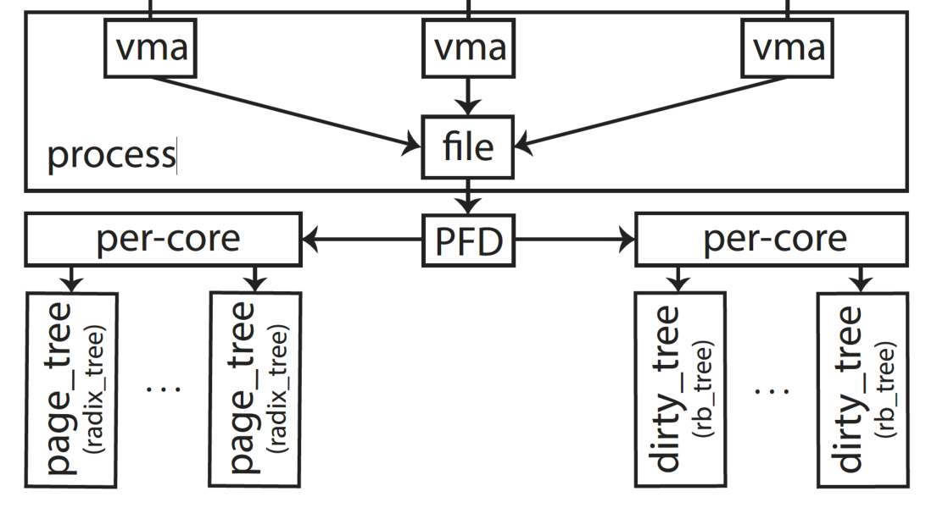
FastMap
- mixed page insert/remove and mark clean/dirty => longer holding time
- cross-cpu data involved => more lock acquisition
- separated all/dirty tree to reduce centralized lock contention
- per-cpu data to reduce cross-cpu data manipulation

Slide 18
FastMap
- separated all/dirty tree to reduce centralized lock contention
- per-cpu data to reduce cross-cpu data manipulation
PFD(per-file-data):
- all trees
- a radix tree&spinlock for each core
- core_id = page_offset % NR_CORE
- dirty trees
- a rbtree&spinlock for each core
- core_id = page_offset % NR_CORE
- sorted by page_offset

Slide 19
FastMap
- read in page from SSD
- core_id = page_offset % NR_CORE
- hold all_trees->spinlock[core_id]
- insert into all_trees
- mark page dirty
- core_id = page_offset % NR_CORE
- hold dirty_trees->spinlock[core_id]
- insert into dirty_trees

Slide 20
FastMap
- flush dirty page
- lock dirty_trees only
- never evict dirty pages => all_trees unchanged
- evict clean page
- lock (per-cpu)all_trees only
read in
mark
free
idle
clean
dirty
alloc
evict
flush

Slide 21
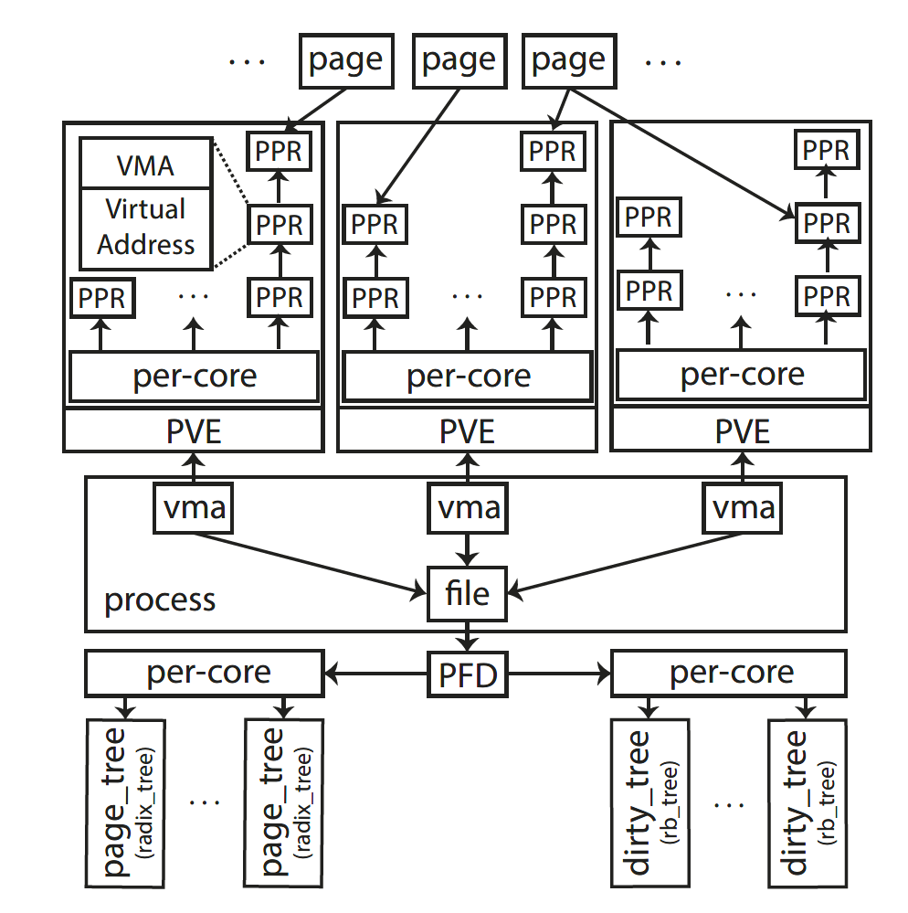
Rmap
- page eviction
- update all ptes of to non-present
- hold semaphore of i_mmap
- flush
- update all ptes to clean
- hold semaphore of i_mmap
- munmap
- for each page in vma...
- PVE(Per-VMA-Entry)
- a per-cpu list of PPR(Per-Pve-Rmap) linking all physical pages mapped in the vma
- ptr to vma
- virtual address in this VMA
- for each page, there is a list of PPRs(linked in different PVE), each of which corresponds a rmap

Slide 22
Rmap
How to perform rmap?
- Traverse the PPR list of the Page
- For each PPR
- get its vma ptr, such that
- we will get the mm_struct it belongs to(both eviction and flush)
- we may hold the per-cpu lock on the PVE(only eviction)
- get its rmap virtual address
- get corresponding pte to update(both eviction and flush)

Slide 23
DRAM cache
How does linux perform flush(write-back)?
- flusher threads
- global LRU list
- active list
- inactive list
- update statistical information each kmalloc/kfree
- wake up flusher threads under memory pressure
- balance active/inactive list
- reclaim from inactive list
- coupled with swapper
- page cache & swap cache
- manage write-back manually => so-called DRAM cache

Slide 24
DRAM cache
Per-cpu clean queue
- page fault & no free pages => evicts only clean pages
- evict a batch (currently set to 512) of clean pages
- invoke flush_tlb for the whole range
core0
core1
CQ
CQ
evict 512
mm_struct0
mm_struct1
mm_struct2

Slide 25
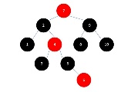
DRAM cache
core0
core1
DQ
DQ
Per-cpu dirty queue(tree)
- Sorted by device offset(rbtree)
- Merge multiple trees with mix-max heap
- the same TLB invalidation scheme
min-max heap merge
write-back
core0
core1
CQ
CQ

Slide 26
DRAM cache
Per-cpu free list(idle page)
- page fault => try to allocate from local free list
- if no local idle page => randomly steal from other cores’
- after NR_CORES unsuccessful tries => force page eviction
- return to the core where we stole the page => keep free list banlanced
core0
core1
FL
FL
req
steal
page fault
return
(balance)

Slide 27
Experiments
Experimental Methodology
1. How does FastMap perform compared to Linux mmap?
2. How much does FastMap improve storage I/O?
3. How sensitive is FastMap to false TLB invalidations?

Slide 28
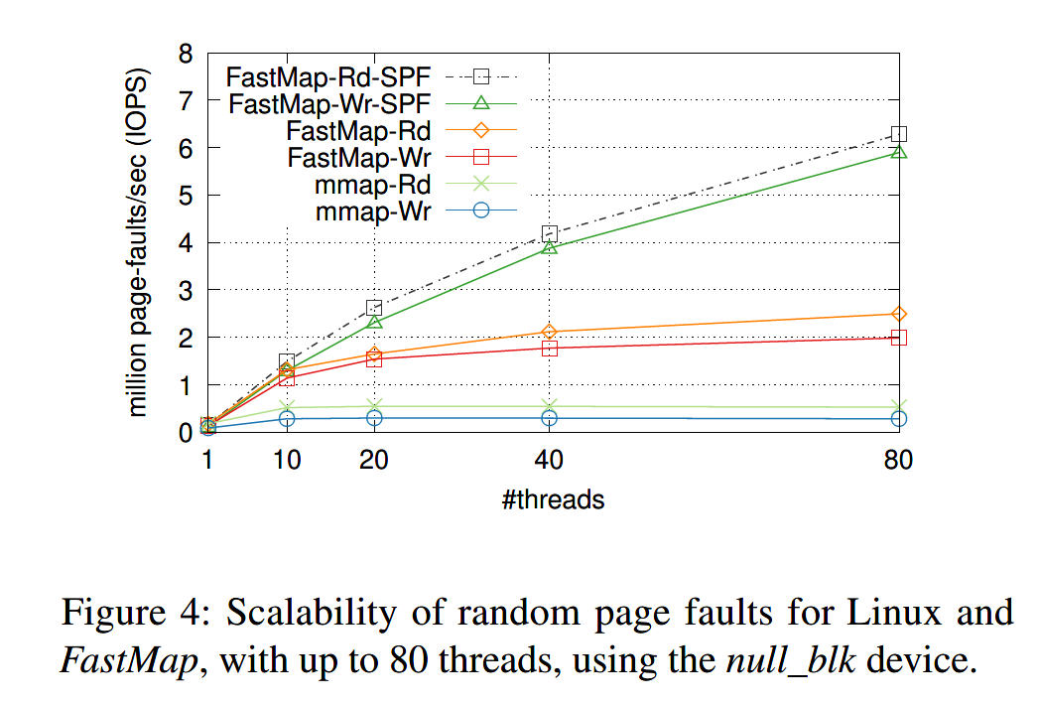
Experiments
How does FastMap perform compared to Linux mmap?
with 32 threads
- 3.7× read IOPS
- 6.6× write IOPS
with 80 threads
- 4.7× read IOPS
7× write IOPS
with single thread
- 38% more read&wirte IOPS

Slide 29
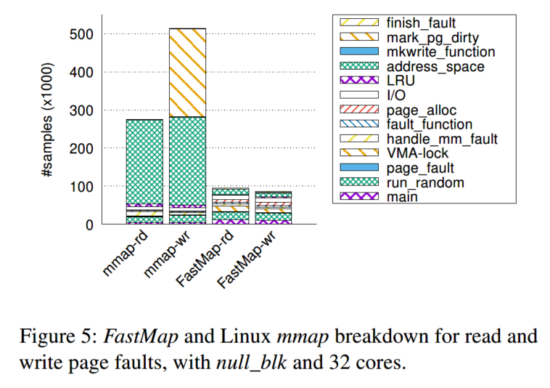
Experiments
Breakdown of the execution time for both random reads and writes
- for random reads Linux mmap spends almost 80% of the time in manipulating the address_space structure, specifically in the contented tree_lock that protects the radix_tree
- In FastMap we do not observe a single high source of overhead

Slide 30
Experiments
Breakdown of the execution time for both random reads and writes
- In the case of writes the overhead of this lock
is even more pronounced in Linux mmap, Linux has to acquire this lock again to set the tag
- FastMap removes this contention point, does not modify the radix_tree

Slide 31
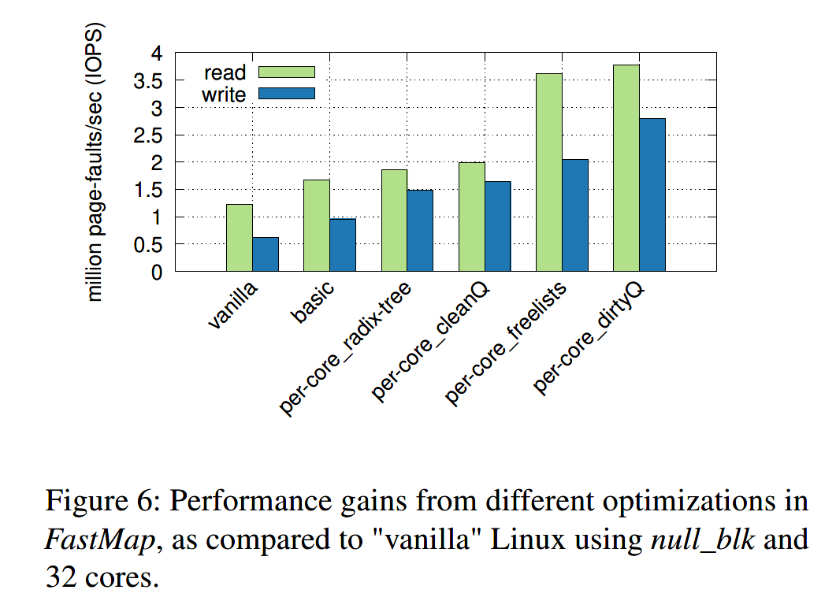
Experiments
- The per-core radix-tree optimization is important
- with increasing core counts on modern servers the single radix tree lock is by far the most contended lock
- per-core cleanQ enables the per-core LRU list for clean pages.
- The per-core freelists optimization allows for scalable page allocation, resulting in significant performance gains
- per-core dirtyQ mainly improves the write path
How each optimization affects I/O performance?

Slide 32
Experiments
In-memory Graph Processing
- Ligra, a graph processing framework, assumes that the dataset (and metadata) fit in main memory
- evaluate FastMap asa mechanism to extend the virtual address space of an application beyond the physical memory and over fast storage devices

Slide 33
Experiments
In-memory Graph Processing
- run BFS on the resulting 18GB graph
- generating a read-mostly random I/O pattern
- requires about 64GB of DRAM throughout execution
- limit the main memory of our 32-core server to 8 GB and we use the Optane SSD device

Slide 34
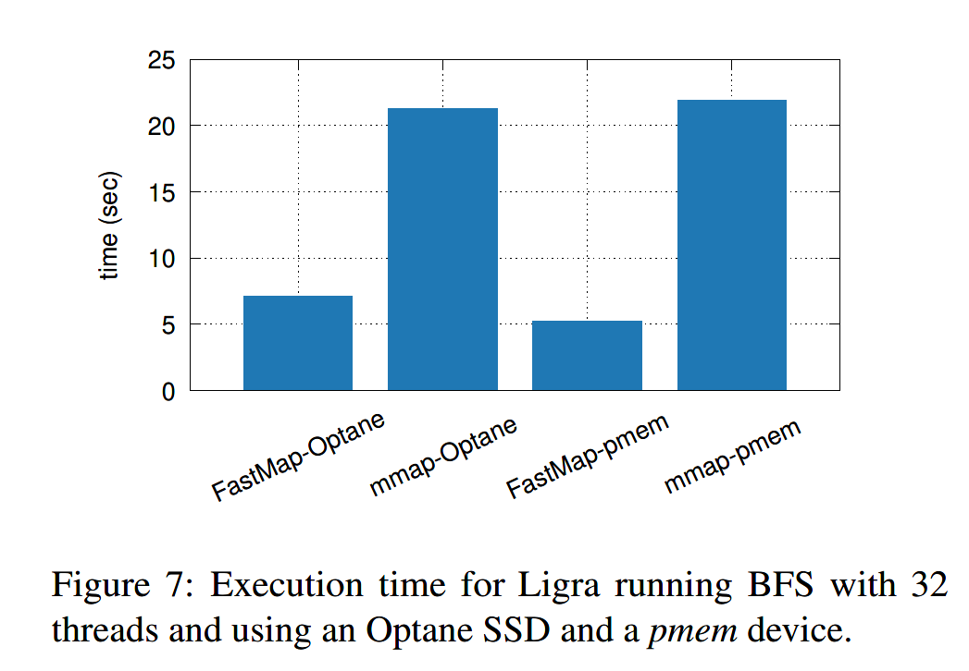
Experiments
In-memory Graph Processing
- BFS completes in 6.42s with FastMap compared to 21.3s with default mmap(3.31× improvement)
- FastMap requires less than half the system time
(10.3% for FastMap vs. 27.38% for Linux)
- stresses more the underlying storage device as seen in iowait time (19.31% for FastMap vs. 9.5% for Linux)
- leaves 2.11 more user-time available for the Ligra workload execution

Slide 35
Experiments
In-memory Graph Processing
- Using a pmem device the benefits of FastMap are even higher
- Linux mmap requires 21.9s for BFS, while FastMap requires only 4.15s(5.27× improvement)
- The default mmap results in a substantial slowdown, even with a pmem device that has throughput comparable to DRAM

Slide 36
Experiments
How much does FastMap improve storage I/O?
- Kreon, a persistent key-value store that uses memory-mapped I/O and a dataset of 80M records.
- The keys are 30 bytes long, with 1000 byte values.
- This results in a total footprint of about 76GB.
- We issue 80M operations for each of the YCSB workloads.
- in-memory experiment: 256GB DRAM
- out-of-memory experiment: 16GB DRAM
- use the Optane SSD device

Slide 37
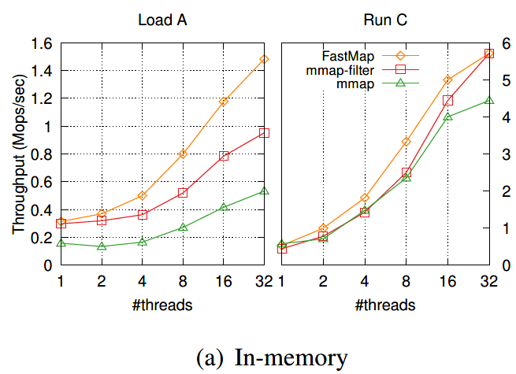
Experiments
In-memory experiment
- LoadA(insert only) workload & RunC(read only) workload
- LoadA: FastMap achieves 1.55× and 2.77× higher throughput compared to mmap-filter and mmap respectively
- RunC: FastMap achieves 9% and 28% higher throughput compared to mmap-filter and mmap respectively

Slide 38
Experiments
Out-of-memory experiment
- LoadA: FastMap achieves 3.08× higher throughput compared to mmap
- RunC: FastMap achieves 1:65 higher throughput compared to mmap

Slide 39
Experiments
What affects scalability in mmap?
How FastMap behaves with an increasing number of cores?

Slide 40
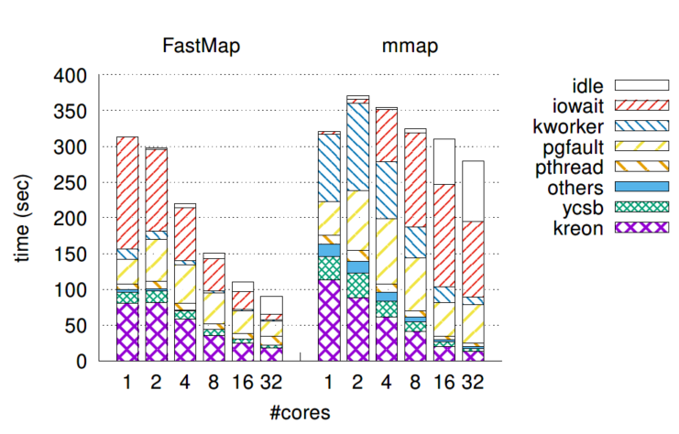
Experiments
Analysis: out-of-memory experiment
- Linux mmap: both iowait and idle time increase
- pgfault time is lower in FastMap
- 2.64× lower pgfault time
- 12.3× lower iowait time due to higher concurrency
- 3.39× lower idle time due to spinning instead of sleeping in the common path

Slide 41
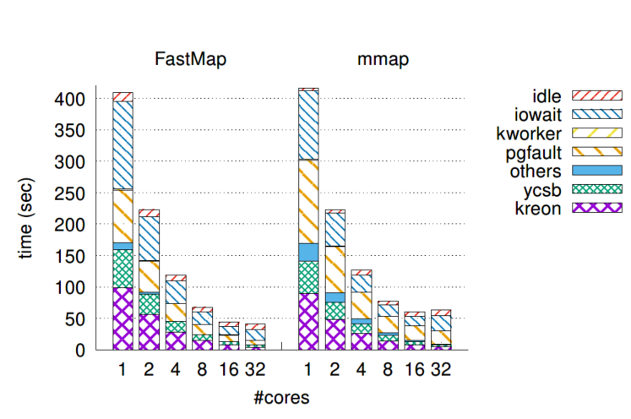
Experiments
Analysis: out-of-memory experiment
- Linux mmap spends 2.88× and 1.41× more time for pgfault and iowait

Slide 42
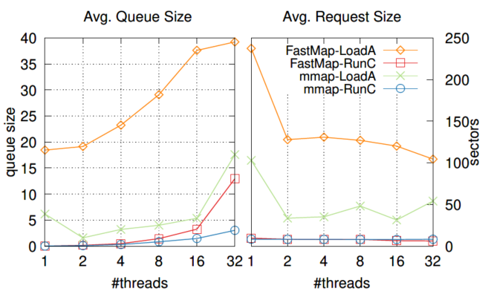
Experiments
Analysis: out-of-memory experiment
- LoadA average queue size
- FastMap: 39.2
- Linux mmap: 17.5
- LoadA average request size
- FastMap: 100.2 sectors(51.2KB)
- Linux mmap: 51.8 sectors(26.5KB)
- RunC average request size
- FastMap: 8 sectors(4KB)
- Linux mmap: 8 sectors(4KB)
- RunC average queue size
- FastMap: 13
- Linux mmap: 3

Slide 43
Experiments
How sensitive is FastMap to false TLB invalidation?
- In TPC-C over Silo, batching for TLB invalidations results in 25.5% more TLB misses (22.6% more load and 50.5% more store TLB misses).
- 24% higher throughput (ops/s) and 23.8% lower latency (ms)
- without batching of TLB invalidations the system time spent in flush_tlb_mm_range() increases from 0.1% to 20.3%.

Slide 44
感谢观看
彭天祥

