Slide 1

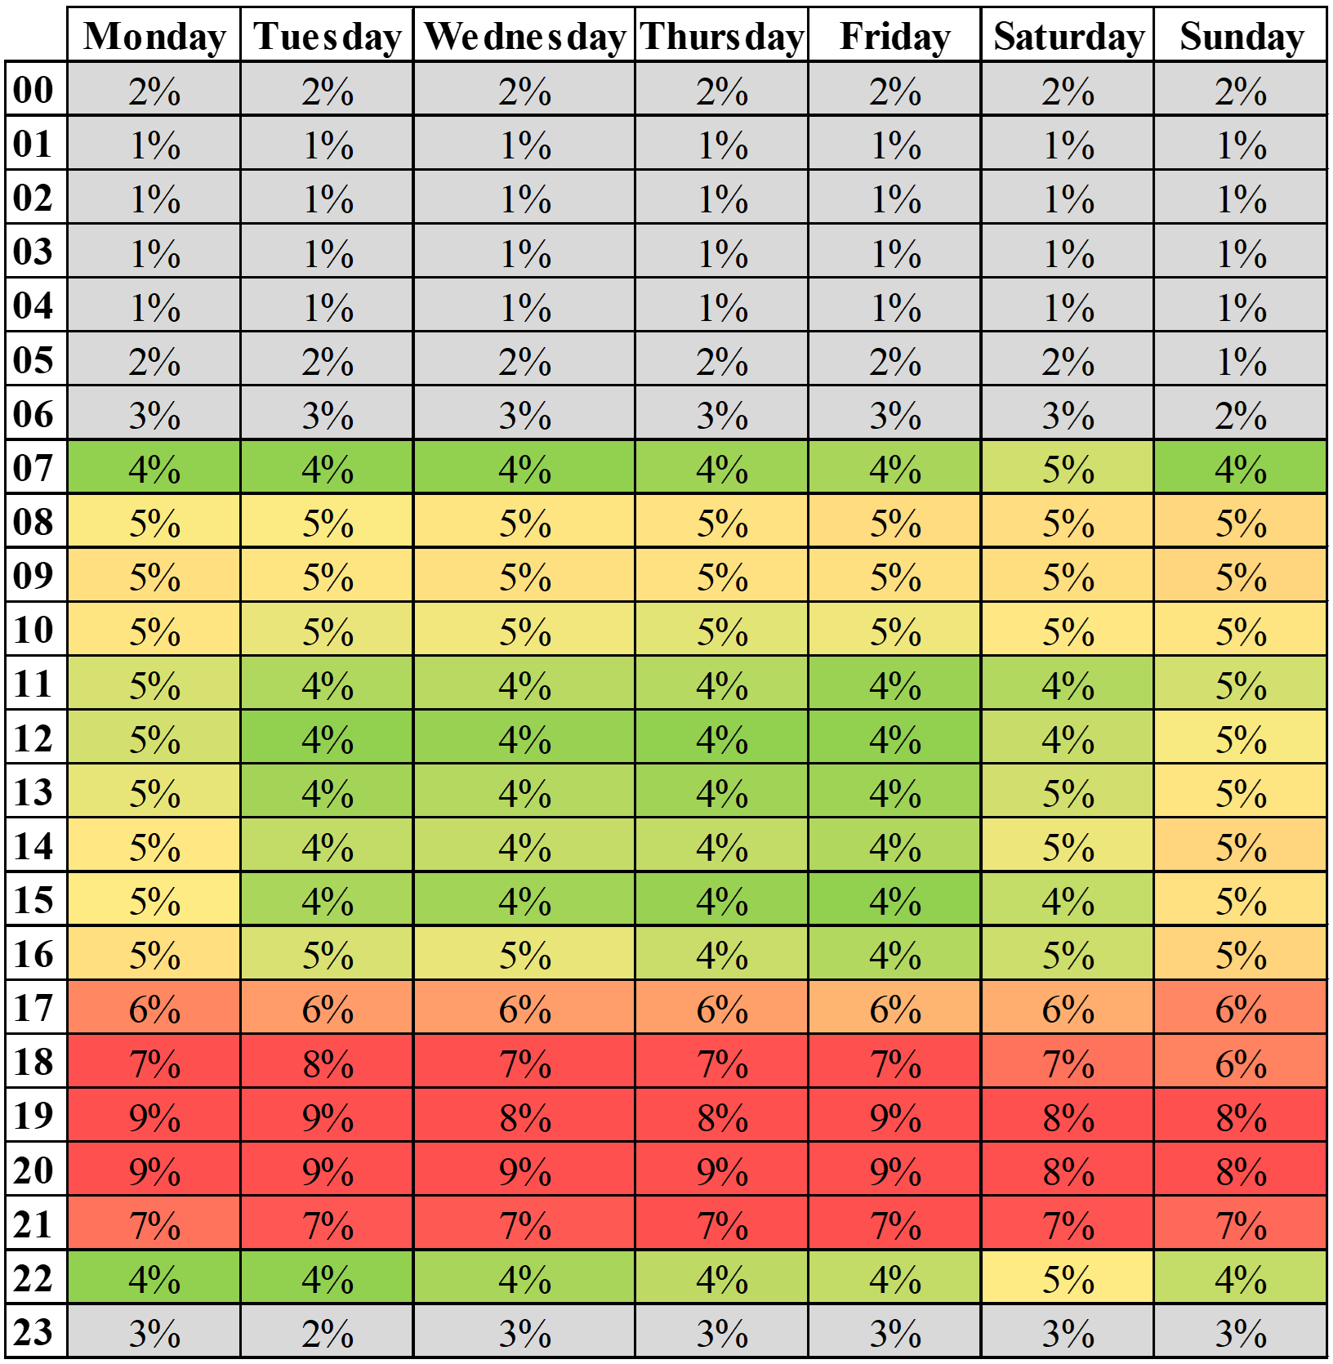
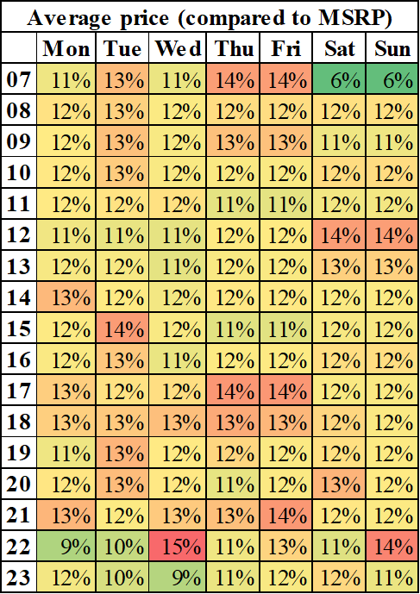
Analyzing Human Behavior in an Auction Dataset
Aaditya Khanal*, Dr. Nicholas Caporusso*, Dr. Alina Campan*
*School of Computing and Analytics, College of Informatics, Northern Kentucky University
Abstract
Auctions provide a unique lens through which human behavior can be studied, particularly in decision-making, strategy, and economic interaction. The data generated in auction environments, characterized by competitive bidding, time constraints, and varying levels of information asymmetry, offers rich insights into how individuals make decisions under pressure, uncertainty, and scarcity. Researchers can gain a deeper understanding of cognitive biases and strategic decision-making in competitive environments by analyzing bid increments, winning bids, and participant behavior across various auction types. In this paper, we present the results of a preliminary study that focused on the dataset from a popular online auction website where users can bid on different types of retail products. Our findings report three auction behaviors and human dynamics discovered in the dataset. Keywords – auctions, big data analytics, human behavior.
B. Temporal Clustering
We evaluated the hourly and weekly distribution of bids. Among the bids placed in 2023 (i.e., approximately 165 million), most of them (i.e., 99.09%) were realized at 18 warehouse locations, which are the ones taken into consideration for the purpose of this part of the study. The data (see Figure 3) clearly show a distinct pattern of user activity, with lower engagement between 11 PM and 7 PM and increased activity from 7 AM to 4 PM, with the highest engagement from 5 PM to 9 PM when competition for auction items appears fiercest.
Users’ activity patterns are influenced by the auctions’ closing times, which span from 7 AM to 11 PM. This observation could be aligned with theories suggesting that individuals participate more actively during leisure or nonworking hours, indicating a temporal preference for engagement in auction activities. Furthermore, the data shows a statistically significant reduction in bidding between 11 AM and 4 PM on Tuesday, Wednesday, Thursday, and Friday.
Following the growth trend of the platform, the dataset reports an increase in the number of auctions held and items sold. During this period, a total of 25 million items were auctioned on the website, resulting in a total of over 400 million USD in revenues. Over 7.5 million unique items were listed for auction in the past year.
They received over 193 million bids from more than 220,000 unique users. The auction website has expanded its operation since its launch in 2018. Its warehouse locations doubled in number in the first two years, reaching a peak of over 110 locations in 2021 and decreasing to approximately 100 locations from 2022 onwards.
The data shows more than a three-fold increase in the number of auctions (i.e., from approximately 30,000 to 100,000) and a slightly less than three-fold increase in the number of items sold (i.e., from 2.5 million to 8 million) in the period from 2019 to 2023. Also, the website has grown significantly from a revenue standpoint, from approximately $10 million in 2018 to over $100 million in 2023, as shown in Figure 2.
Introduction
Auctions are a popular method of selling items where the highest bid determines the price paid by the buyer.
Online auctions have gained increasing popularity since the introduction of the first Internet marketplace, in 1995. This growth is projected to continue in the future at a compound annual growth rate (CAGR) of 12.36%. In 2028, the online auction market is expected to expand by 3,076.64 million US dollars.
In this research, we present the results of a study that investigated the dataset of a popular retail auction website. Our research focused on three auction and human dynamics: competitive arousal, temporal clustering, and overbidding. Our preliminary findings are consistent with the literature and highlight the potential for additional cross-disciplinary research in various domains, from behavioral economics to user experience.
Auction Platform growth
The dataset utilized in this study consists of secondary data from 310,000 auctions held in more than 320 locations between 2018 and 2023.
Figure 3. Temporal clustering: percentage of daily user activity by hour
C. Irrational Behavior : Overbidding
In more than 270,000 instances over the website’s lifetime (i.e., nearly 1.5% of all transactions), approximately 25,000 buyers (i.e., 7% of all registered users) placed a winning bid higher than the item’s MSRP. Nearly 246,000 unique buyers paid more than their suggested market value for items categorized as refundable, representing 92% of the overpaid items. Almost 24,000 unique users won the remaining total of 20,000 overpaid items categorized as not refundable, even in the presence of evident issues. Possible causes: Lack of Knowledge, Urgency, and convenience, Bidding Addiction, Herd behavior or "Winner's curse," Information asymmetry, and availability of resources.
​
Figure 2. Growth of the website in monthly and yearly revenues.
Auction Dynamics and User Behavior
A. Competitive arousal
Our findings indicate a distinct pattern in bidding behavior, characterized by a gradual intensification toward the auction’s conclusion. Specifically, data shows that only 13.57% of bids occur at the beginning, with 38.03% in the middle, and a significant 48.39% towards the closing time.
In some specific cases, the data shows that only 5.65% of bidders from the beginning of an auction remained engaged until the end, revealing that most bidders join only in the latest phases of the auction. There could be several explanations for these findings.
Figure 1: Monthly growth of the auction house from 2018 to 2023 in terms of locations (top), auctions (bottom left), and items (bottom right).
Figure 4. Items paid more than the shown MSRP.

