Slide 1


Slide 2



Slide 3
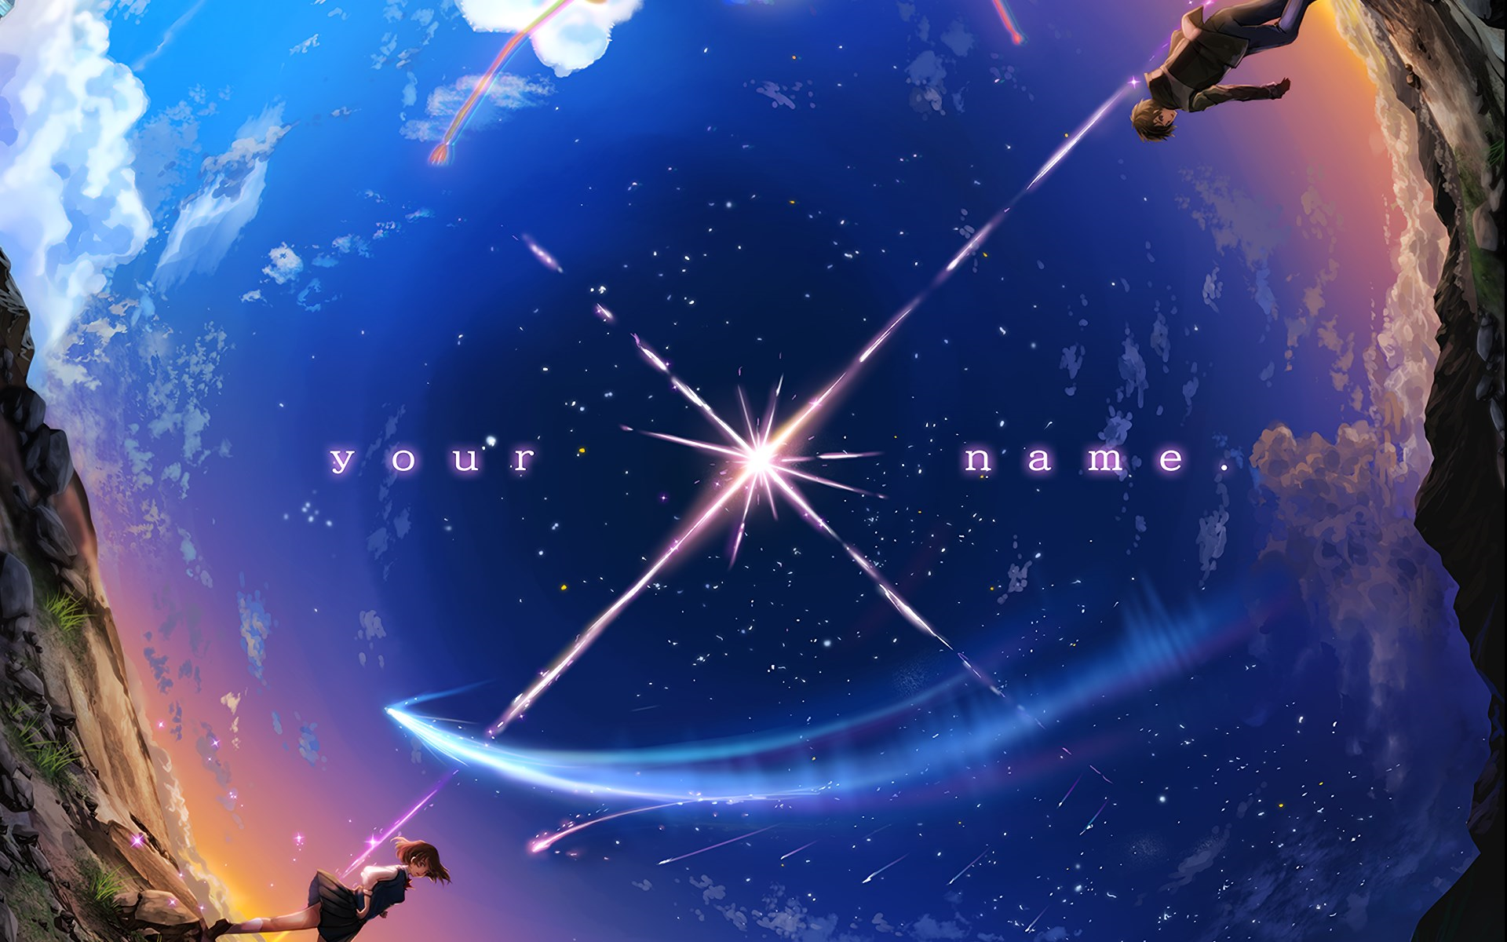
The Plot

Slide 4



Evaluation

Slide 5
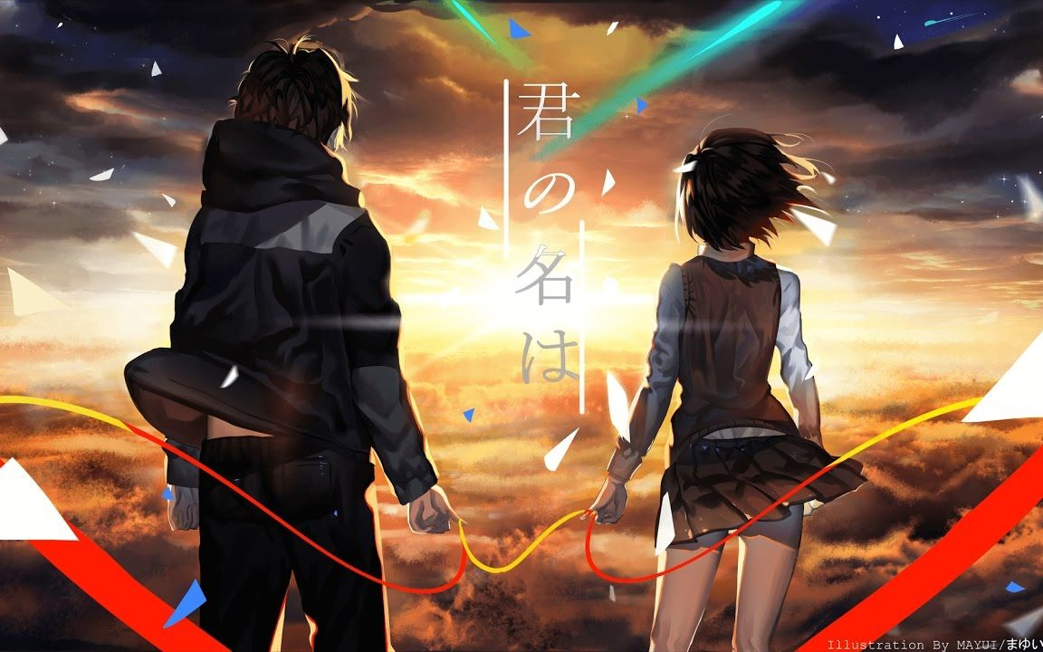
That’s All
Thank You

