Slide 1
Operating System
Chapter 1: Introduction
GuangShun Shi
Department of Computer Science, NanKai University
Email: gsshi@nankai.edu.cn
Web Site: http://202.113.25.72/osteach

Slide 2
Computer Science:Why?What?How?
Why do you choose Computer Science?
What do you get during past 2 years?
How to become a computer expert/scientist?
CS have changed the world, why?
What is CS?
How to master/promote CS?
Operating System
CITS, NanKai University

Slide 3
Science, Engineering and Technology
Science
  Primitive and general theory
  Make everything possible via computing
Engineering
  Systemic and reasonable strategy
  Rules and forms to construct digital world
Technology
  Smart and politic methods
  Algorithms and mechanisms to resolve specific problems
Operating System
CITS, NanKai University

Slide 4
Changes in IT domain
before 1990:
EE
CS
IS
Hardware
Software
Business
after 1990:
EE
CE
SE
CS
IT
IS
Business
Hardware
Software
Operating System
CITS, NanKai University

Slide 5
Difference between related majors: CS
Organization management & MIS
Application
Software method and technique
System fundamentals
Hardware
&Architecture
Theory
Creative
Deployment,Configuration
CS
Theoretical
practicably
Operating System
CITS, NanKai University

Slide 6
Difference between related majors:CE
Organization management & MIS
Application
Software method and technique
System fundamentals
Hardware
&Architecture
Theory
Creative
Deployment,Configuration
CE
Theoretical
practicably
Operating System
CITS, NanKai University

Slide 7
Difference between related majors: IS
Organization management & MIS
Application
Software method and technique
System fundamentals
Hardware
&Architecture
Theory
Creative
Deployment,Configuration
IS
Theoretical
practicably
Operating System
CITS, NanKai University

Slide 8
Difference between related majors: IT
Organization management & MIS
Application
Software method and technique
System fundamentals
Hardware
&Architecture
Theory
Creative
Deployment,Configuration
IT
Theoretical
practicably
Operating System
CITS, NanKai University

Slide 9
Difference between related majors: SE
Organization management & MIS
Application
Software method and technique
System fundamentals
Hardware
&Architecture
Theory
Creative
Deployment,Configuration
SE
Theoretical
practicably
Operating System
CITS, NanKai University

Slide 10
What is CS-----CC2005
design and implement software
  Computer scientists take on challenging programming jobs. They also supervise other programmers, keeping them aware of new approaches.
devise new ways to use computers.
  Progress in the CS areas of networking, database, and human-computer-interface enabled the development of the World Wide Web. Now CS researchers are working with scientists from other fields to make robots become practical and intelligent aides, to use databases to create new knowledge, and to use computers to help decipher the secrets of our DNA.
develop effective ways to solve computing problems.
  computer scientists develop the best possible ways to store information in databases, send data over networks, and display complex images. Their theoretical background allows them to determine the best performance possible, and their study of algorithms helps them to develop new approaches that provide better performance.
Operating System
CITS, NanKai University

Slide 11
How to master/promote CS skills
与数学的研究方法类似，要素为定义和公理、定理、证明、结果的解释，基本特征为构造性数学特征
理论
模型化能力，要素为数据采集、假设的形式说明、模型构造与预测、实验与结果分析，抽象的结果为概念、符号、模型
抽象
工程能力，要素为需求分析、规格说明、测试和分析，用于实现解决实际问题的系统和设备
设计
Operating System
CITS, NanKai University

Slide 12
The most important concepts
数学
方法
系统科
学方法
用数学描述解释
形式化语言
数量分析与计算
逻辑推理
从不同抽象层次看待研究对象
系统整体优化
系统级分析模拟
Operating System
CITS, NanKai University

Slide 13
What is OS?
Operating
  Drive all hardware devices in computer
  Manage all software in computer
  Provide proper service environment
System
  Virtual machine and resource manager
  theories, mechanisms, algorithms and techniques
My opinion
  CPU is the heart of computer
  OS is the soul of computer
Operating System
CITS, NanKai University

Slide 14
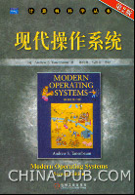
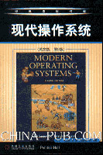
Teaching books and reference
Operating System
CITS, NanKai University

Slide 15
Other reference books
操作系统教程 王素华 人民邮电出版社
计算机操作系统教程 张尧学史美林 清华大学出版社
计算机操作系统教程 周长林 左万历 高等教育出版社
操作系统基础 屠立德 屠祁 清华大学出版社
操作系统教程 孟庆昌 西安电子科大出版社
计算机操作系统 汤子瀛等 西安电子科大出版社
操作系统原理DOS篇 张昆苍 清华大学出版社
操作系统教程 孙钟秀主编 高等教育出版社
操作系统原理技术与编程 蒋静 徐志伟 机械工业出版社
Operating System Concept Abrahan Silberschatz,etc
Applied Operating System Concept Abrahan Silberschatz,etc
Operating System
CITS, NanKai University

Slide 16
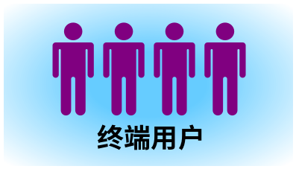
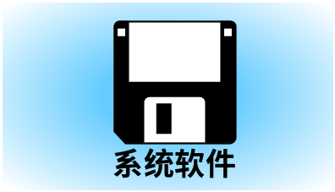
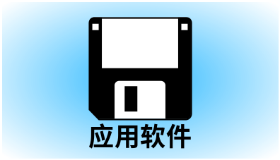
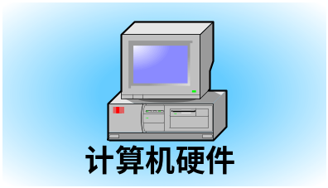
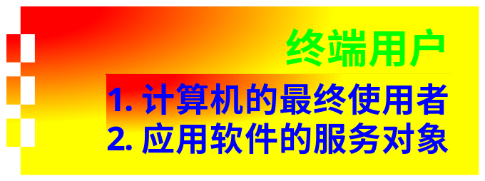
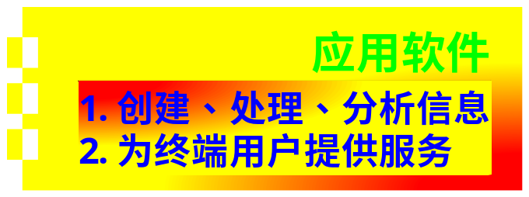
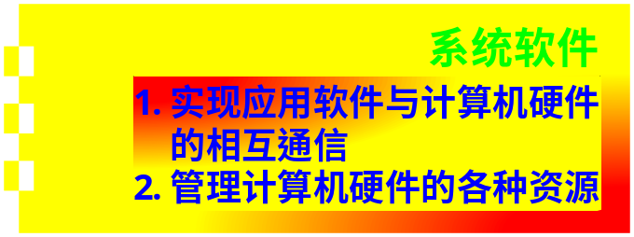
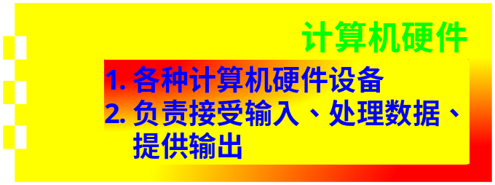
Concept of Software
Operating System
CITS, NanKai University

Slide 17
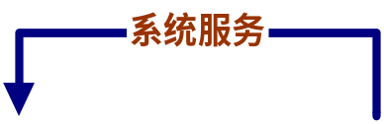
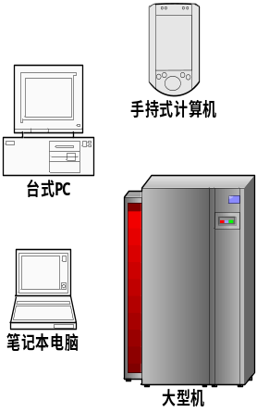




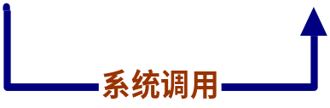
Role of OS in computer system
处理结果
如何使用？
底层硬件控制
用户输入
计算机硬件设备
Operating System
CITS, NanKai University

Slide 18
What happens behind “Hello World”
#include <stdio.h>
int main(int argc, char *argv[])
{
puts("hello world");
return 0;
}
Operating System
CITS, NanKai University

Slide 19
Processing steps of OS
Human-Computer Interaction
  Input the content of the program (keyboard)
  Command IDE to compile the program (mouse)
  Output the exe file to disk (file system)
  Question 1: How can computer know your input?
  Question 2: How can IDE compile and generate exe files?
Exe file loading
  Create a thread to run the program (Thread)
  Load the Exe file from disk to memory (Memory)
  Schedule the thread to occupy CPU time (Thread)
  Question 3: How to allocate memory for a thread?
  Question 4: How to schedule the thread?
Program running
  Load instruction from memory to CPU register (Thread)
  Execute the first instruction of the program
  Question 5: The mechanism of instruction execution
Operating System
CITS, NanKai University

Slide 20
Processing steps of OS (cont.)
Interaction between Graphic card and CPU
  Load graphic card driver (I/O device)
  Set the content to be displayed (BUS & DMA)
  Question 6: The working mode of driver and BUS&DMA
Print the string on monitor
  Convert the string to be pixel-matrix (I/O device)
  Start printing….
  Question 7:The working mode of monitor
Exiting steps
  Block the graphic driver thread, it will wait for next calling
  Release all resource allocated for “hello world” program
  Load next thread, or sleep until next command reached….
Overview of this example
  All modules of OS kernel are activated
  OS is the basement for almost all programs
Operating System
CITS, NanKai University

Slide 21
Basic concepts
System
  A philosophy word derived from ancient Greece
  Organism consisted of interactive components
Structure
  A word used in building industry, means “construction”
  The schema of relationship between components in a System
Operating
  Functions: How many things it can do
  Performance: speed, efficiency, stability, security etc.
The meaning of “Operating System”
  A system with many components.
  Different application purposes lead to different structures
  The function and performance of OS is very important
Operating System
CITS, NanKai University

Slide 22
Functions of OS
Hardware abstraction
  Provide unified, friendly UI for users
  Hide the configuration difference of hardware components
Application integration
  Provide simple and useful methods for programs designing
  Schedule and control the running of programs
Environment management
  Monitor whole environment of computer
  Provide a secure, stable and comfortable space for uses
OS
Hardware
Operating System
CITS, NanKai University

Slide 23

Architecture of OS
Programming
interface
Basic concept
File system
OS
CPU management
Memory management
Device management
Operating System
CITS, NanKai University

Slide 24
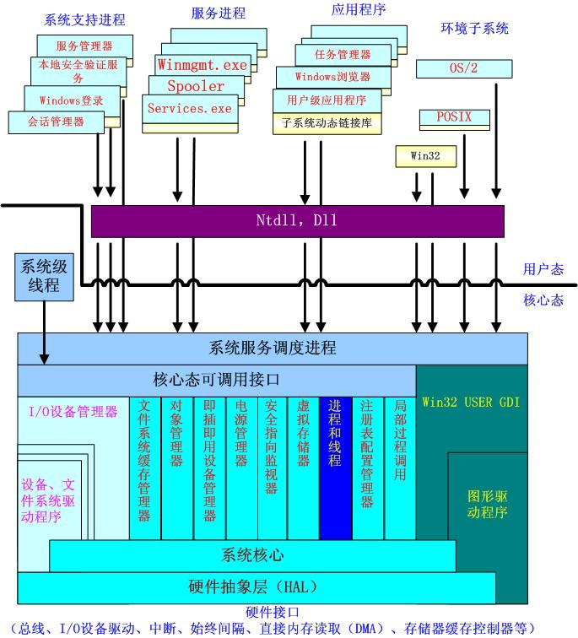
Architecture of Win 2k/XP
Operating System
CITS, NanKai University

Slide 25
Architecture of Minix
Init
进程
用户
进程
用户
进程
用户
进程
用户
进程
……
Level 4
User space
内存
管理器
文件
系统
网络
服务器
……
Service
Level 3
磁盘
任务
终端
任务
时钟
任务
系统
任务
以太网
任务
……
Level 2
I/O Task
进程管理
Level 1
Kernel
Operating System
CITS, NanKai University

Slide 26
Topics of OS
Introduction and prerequisites knowledge (4~6 lessons)
  Opinion of OS: resource manage VS extended machine
  Concept: batch system/cocurrency/real-system
  Knowledge about interruption, CPU, clock, DMA, storage system, bus, motherboard….
CPU management (8~10 lessons)
  Concept: process/thread, CPU instruction
  Process/thread scheduling
  Interprocess communication
Memory management (8~10 lessons)
  Concept: swapping, virtual memory, paging, segmentation
  Memory allocation, relocation, protection and sharing
  Multiprogramming, running image of thread
Device management (6~8 lessons)
  Concept: DMA, I/O channel, I/O software
  Working mechanism of different kinds of I/O devices
  Dead lock and related processing
Operating System
CITS, NanKai University

Slide 27
Topics of OS (cont.)
File system (Disk management) (6~8 lessons)
  Concept: files, directories, volume, file format and system
  Disk space management
  File system design and implementation
  File system security
System call and user interface (2~4 lessons)
  Concept: soft interruption, hard interruption, CPU trap
  Initialization and system service loading of OS
  Interaction between user space and kernel spaces
Environment management (2 lessons)
  Power management
  Security and stability maintenance
Case analysis and advanced topics discussion (2 lessons)
  Source code review of several OS
  Research on OS and some academic topics
Operating System
CITS, NanKai University

Slide 28
Overview of OS history
The motivation of OS
  Using computer in an easier way
  Using computer in a more efficient way
  Provide more powerful functions based on hardware
The history of hardware
  Vacuum tubes and plugboards: no OS existed
  Transistors and batch systems
  Integrated Circuits and multiprogramming
  Personal computers
  Network and digital world
Operating System
CITS, NanKai University

Slide 29
History of OS: Stone Age
Prehistoric age of OS (1940s ~mid-1950s)
  Famed persons: Babbage, Ada, Howard Aiken, John von Neumann, J. Presper Eckert and William Mauchley, Konrad Zuse (Germany)
  They constructed computing machines with vacuum tubes
  Programming is done in absolute machine language, which means changing the structure of circuit.
  The primary function of computer is scientific computing
Please remember this age
  The foundation of Computing Science and Technology
  They dreamed of automatic computing machines, and they realized this dream with terrible basic facilities
Operating System
CITS, NanKai University

Slide 30
History of OS: Bronze Age
Batch system (mid-1950s ~1965)
  Famed persons & organizations & OS: IBM, DEC, IBM 7094/1401, FMS
  Computer is consisted of transistors
Structure of the operating system
  Batch process, a smart job scheduling method
  On line VS Off line
  Programming language: Fortran, Assember
Operating System
CITS, NanKai University

Slide 31








History of OS: Bronze Age
早期批处理系统
卡片
磁带机
打印机
卡片阅读机
IBM1401
IBM7094
IBM1401
输入磁带
输出磁带
Operating System
CITS, NanKai University

Slide 32
FMS: Bronze Age
$END
Data for program
$RUN
$LOAD
Fortran program
$FORTRAN
$JOB, 10,429754
Cherry Chen
Operating System
CITS, NanKai University

Slide 33
History of OS: Industrial Age
Multiprogramming System (1965~1980)
  Famed persons & organizations & OS: Intel, IBM OS/360, Multics, Ken Thompson and Unix, Tanenbaum and Minix, Linus and Linux
  Industrial standard for computer and OS
Structure of the operating system
  Compatible: the beginning of standard
  Multiprogramming, Spooling, Time-sharing
  Software engineering
  Programming language: C, Fortran, Assembler
Operating System
CITS, NanKai University

Slide 34
Compatible and Soft Engineering
Compatible
  Different purpose need different structures, different OS
  It is too expensive for any company to maintain distinct and totally incompatible produce line
  One produce line, series product, different functions
Software engineering
  Compatible VS Integration
  No way to write a software to meet conflicting requirements
  Software dinosaurs: too complex, too enormous
  IBM OS/360, released with more than 1000 bugs
Operating System
CITS, NanKai University

Slide 35

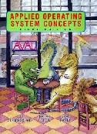
Compatible and Soft Engineering
Operating System
CITS, NanKai University

Slide 36
Multics: seed of modern OS
Multics (1963~ 1965~ 1969)
  Multiplexed information and computing services
  Another software dinosaurs
Multiprogramming and Time-sharing
  Allocate CPU time to multi programs in simultaneous way
  Time-sharing, one mainframe can support 100 online terminal
Operating System
CITS, NanKai University

Slide 37



Multics: seed of modern OS
终端
主机
Operating System
CITS, NanKai University

Slide 38
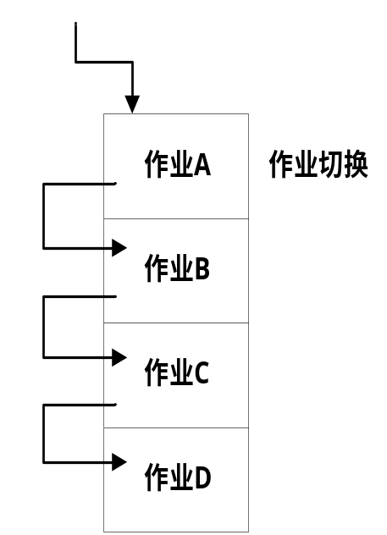
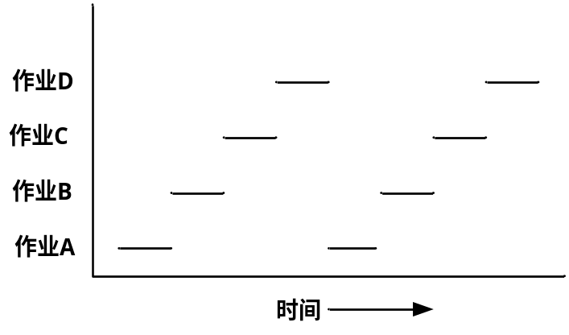
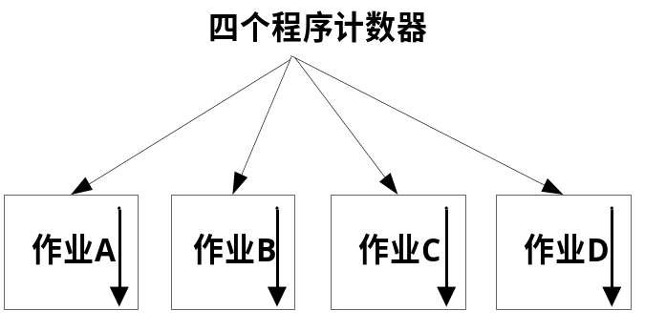
Multics: seed of modern OS
It seems that each job owns independent PCs
Timesharing: only one job can use CPU at any tick
OS manage only one PC register for all jobs
Operating System
CITS, NanKai University

Slide 39

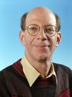

Ken Thompson: I want to play game
brilliantly achievement
  Multics in 1965, Unix in 1969
  B language, the precursor to Ritchie's C
  QED in Unix, Belle in chess computer
  Turing award in 1983,National Medal of Technology in 1999, Tsutomu Kanai Award in 1999
Minix and Linux
  Tanenbaum(1980): mini unix
  Linux(1991): Linus’s minix
Operating System
CITS, NanKai University

Slide 40
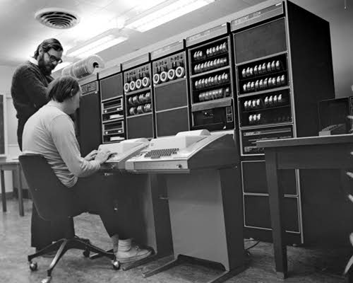
Ken Thompson
Operating System
CITS, NanKai University

Slide 41
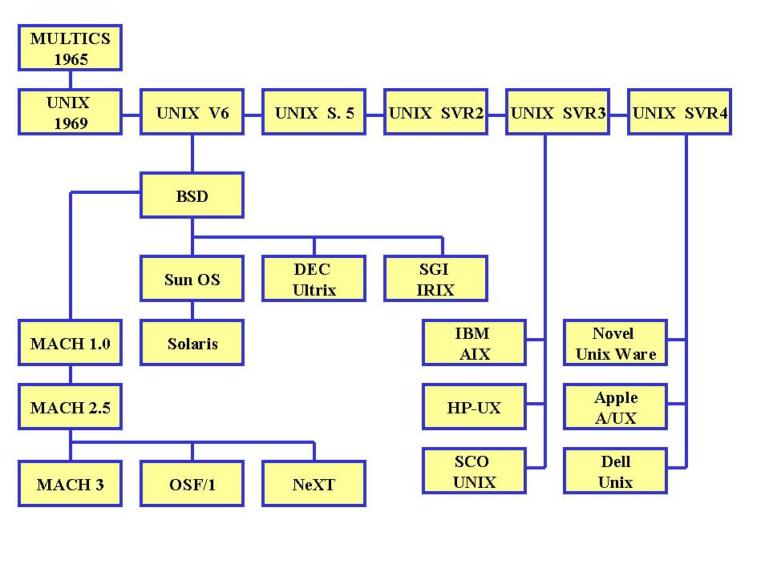
Unix family: more popular than CN&KN
Operating System
CITS, NanKai University

Slide 42
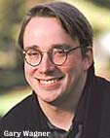
Linus Torvalds: Just do it
Linus’s minix = Linux
  He create an OS for himself, also for the world
  DIY: do it yourself, the world will be changed
Modern opinion for software
  Open Mind: Everyone can change it
  Team Work: All people work for it
The essential of Linux
  Compatible and extendable
  Efficiency and Security is the most important thing
Operating System
CITS, NanKai University

Slide 43
History of OS: Golden Age
Personal Computer & Network (1981~)
  Famed persons & organizations & OS: Gary Kildall and CP/M, Bill Gates and DOS, Steve Jobs and Mac, IBM OS/2, Open Source and GPL, Embedded system
  Digital world based on computing
Structure of the operating system
  GUI: virtual world constructed by computer
  Distributed and Sharing: C/S,B/S, Grid…
  Multiprogramming and parallel
Computer & Network: new world, new life
Operating System
CITS, NanKai University

Slide 44
Gary Kildall: There was a chance for me…
CP/M
  A successful OS that suitable for PC
  Intel: they think that PC is valueless
Academic, Technology and Business
  Academic: Find the essential of the world
  Technology: Change the world in more efficient way
  Business: Create a world based on law, science and technology
Operating System
CITS, NanKai University

Slide 45
Bill Gates & Microsoft
Bill Gates
  Find the request, and hold the chance
  Law is more important than technology
The story of Microsoft
  DOS: the first popular PC OS
  Win32: GUI + WYSWYG
  Win95: Bill cheated IBM, but changed the world
  WinNT,2K,XP….
Operating System
CITS, NanKai University

Slide 46
Steve Jobs & Macintosh
Steve Jobs
  Make computer to be more interested
  Apple, Lisa, Macintosh
The story of Steve Jobs
  Doul Engelbar: father of GUI
  Xerox PARC: omitted the value of GUI
  Steve Jobs: more romantic than Bill Gates
Digital media world
  Fashion & Immersion
  efficient, effective, easy to learn, easy to remember, easy to apply to new problem
Operating System
CITS, NanKai University

Slide 47
Future of OS: Nothing Impossible
Service and Intelligence (Now~)
  From tool to service
  From automatic machine to intelligent facility
Structure of the operating system
  Micro-kernel operating system: RIG(1975), Mach(1984)
  Mainframe OS: IBM OS/390
  Embedded system: Vxworks, µcos-II
  Free communication and Mobile computing
  Intelligence and humanity
More complex, more powerful and more intelligent
Operating System
CITS, NanKai University

Slide 48
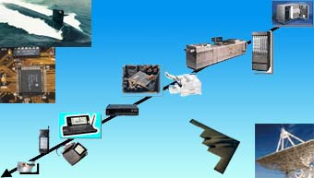
Future of OS: Nothing Impossible
电话交换设备
印刷机
零售设备
互联网服务器
复印机
移动通信
机顶盒
智能卡
计算机外设
Operating System
CITS, NanKai University

Slide 49
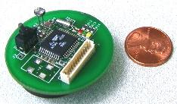
Future of OS: Nothing Impossible
美国加州伯克利大学研制：微型智能传感器，安装TinyOS
Operating System
CITS, NanKai University

Slide 50
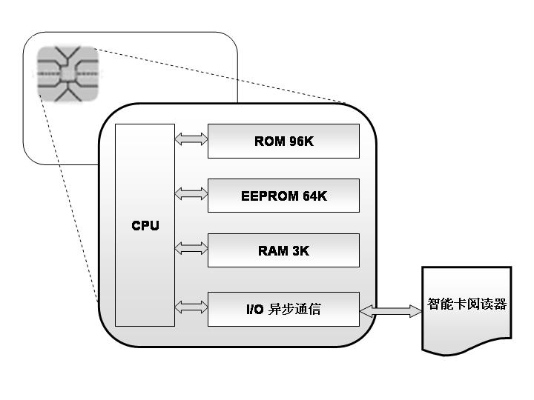
Future of OS: Nothing Impossible
在读写器与智能卡之间通过“命令-响应对”方式进行通信和控制
读写器发出操作命令，智能卡接收命令
操作系统对命令加以解释，完成命令的解密与校验
操作系统调用相应程序来进行数据处理，产生应答信息，加密后送给读写器
Operating System
CITS, NanKai University

Slide 51
SANGUO KILL
IOS: Apple
Android:
Google
&Motorola
Winphone:
Microsoft
& Nokia
Operating System
CITS, NanKai University

Slide 52
History of OS in CHINA
mid-1960s ~ 1970s
  YangfuQing & 150 System (1MIPS)
  It was used in oil prospection
Mid-1970s
  DJS200/XT2: developed with high-level programming language
1978, GX73 Multi-CPU real-time OS
1983, series of YHOS
Unix/Linux: COSIX, Hopen, Delta OS, Smart EOS,中软Linux, 红旗Linux, 东方Linux
Operating System
CITS, NanKai University

Slide 53
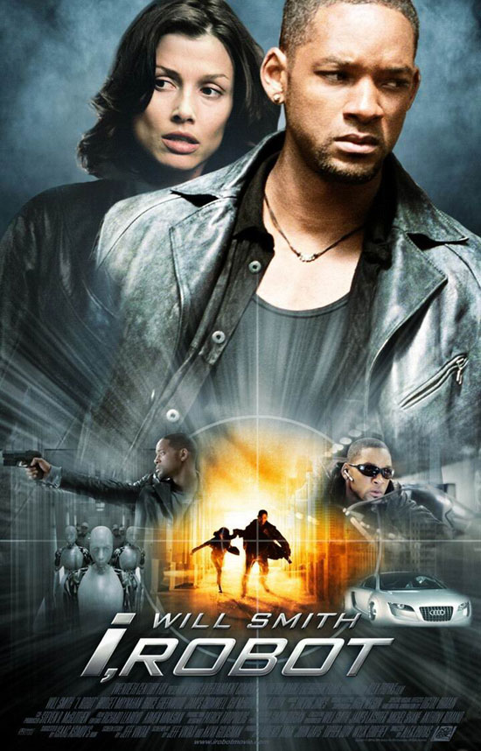
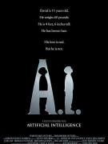
The culture of OS and Computing
Powerful, Efficient and Convenient
  The world is created by “lazy” guys (lazybones)
Recycling of concepts and ideas
Do you like this digital world?
Do you dread this digital world?
Operating System
CITS, NanKai University

Slide 54
Thanks for your time!
Questions & Answers
Operating System
CITS, NanKai University

