Slide 1
House Price Prediction
By Neeraj Walia

Slide 2
Problem to solve
Provide research tool to homebuyer for searching houses and predict the home prices .
Homeowners can use this to get an estimate of price their house before putting it on sale.

Slide 3
Introduction
Home buyers need a tool that can easily narrow down their search selection for the house based on their budget, requirements like number of bedrooms etc. and location.
Predict/forecast home prices so home buyers can have an estimate and make an informed decision at the time of home purchase.
Home owners can use this tool to estimate the market value of their house.

Slide 4
Introduction
I will be using advanced regression models to prediction:
Linear regression
Random forest regression.
Website will be designed for easy to use and visual representation of data.

Slide 5
Tools used
Tableau for website design
Python for predictive analytics.

Slide 6
Data
The dataset is available on kaggle website and its direct link is provided below.
https://www.kaggle.com/c/house-prices-advanced-regression-techniques/data
The dataset contain residential homes information from Ames, Iowa. It contains 80 features (variables) representing every aspect of a house.
There are two datasets train and test. Both has 1461 records of data. Train data has house price information. This data will be used to build the model.

Slide 7
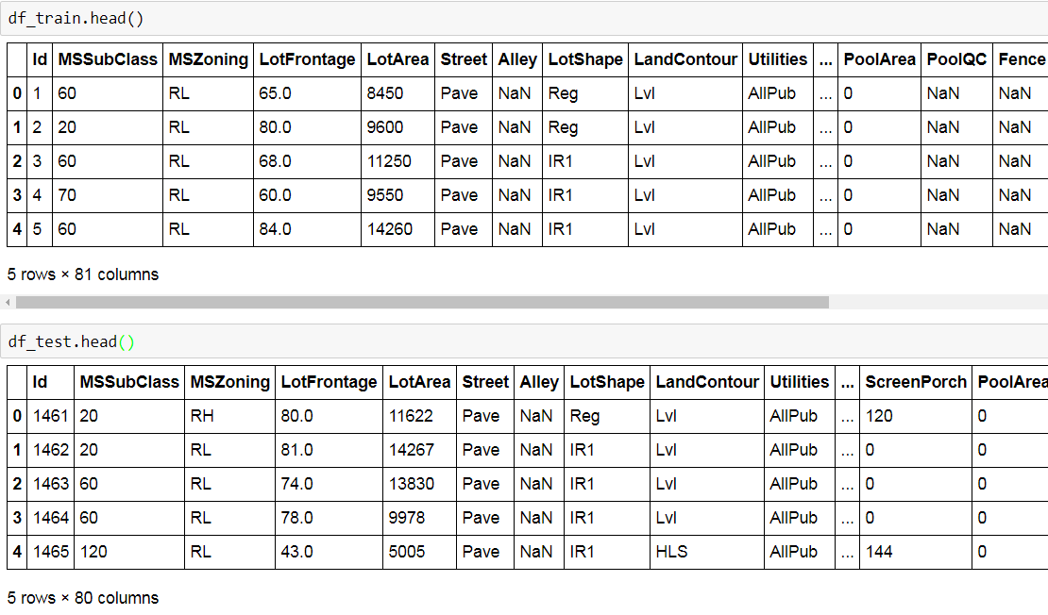
Data

Slide 8
Data: Features
MSSubClass: type of dwelling (category)
20 1-STORY 1946 & NEWER ALL STYLES
30 1-STORY 1945 & OLDER
40 1-STORY W/FINISHED ATTIC ALL AGES
45 1-1/2 STORY - UNFINISHED ALL AGES
50 1-1/2 STORY FINISHED ALL AGES
60 2-STORY 1946 & NEWER
70 2-STORY 1945 & OLDER
75 2-1/2 STORY ALL AGES
80 SPLIT OR MULTI-LEVEL
85 SPLIT FOYER
90 DUPLEX - ALL STYLES AND AGES
120 1-STORY PUD (Planned Unit Development) - 1946 & NEWER
150 1-1/2 STORY PUD - ALL AGES
160 2-STORY PUD - 1946 & NEWER
180 PUD - MULTILEVEL - INCL SPLIT LEV/FOYER
190 2 FAMILY CONVERSION - ALL STYLES AND AGES
MSZoning: zoning classification (category)
A Agriculture
C Commercial
FV Floating Village Residential
I Industrial
RH Residential High Density
RL Residential Low Density
RP Residential Low Density Park
RM Residential Medium Density

Slide 9
Data: Features
LotFrontage: Linear feet of street connected to property (numerical)
Street: Type of road access to property (category)
Grvl Gravel
Pave Paved
Alley: Type of alley access to property (category)
Grvl Gravel
Pave Paved
NA No alley access
LotShape: General shape of property
Reg Regular
IR1 Slightly irregular
IR2 Moderately Irregular
IR3 Irregular
LandContour: Flatness of the property
Lvl Near Flat/Level
Bnk Banked - Quick and significant rise from street grade to building
HLS Hillside - Significant slope from side to side
Low Depression
Utilities: Type of utilities available
AllPub All public Utilities (E,G,W,& S)
NoSewr Electricity, Gas, and Water (Septic Tank)
NoSeWa Electricity and Gas Only
ELO Electricity only

Slide 10
Data: Features
LotConfig: Lot configuration
Inside Inside lot
Corner Corner lot
CulDSac Cul-de-sac
FR2 Frontage on 2 sides of property
FR3 Frontage on 3 sides of property
LandSlope: Slope of property
Gtl Gentle slope
Mod Moderate Slope
Sev Severe Slope
Neighborhood: Physical locations within Ames city limits
Blmngtn Bloomington Heights
Blueste Bluestem
BrDale Briardale
BrkSide Brookside
ClearCr Clear Creek
CollgCr College Creek
Crawfor Crawford
Edwards Edwards
Gilbert Gilbert
IDOTRR Iowa DOT and Rail Road
MeadowV Meadow Village
Mitchel Mitchell
Names North Ames
NoRidge Northridge
NPkVill Northpark Villa
NridgHt Northridge Heights
NWAmes Northwest Ames
OldTown Old Town
SWISU South & West of Iowa State University
Sawyer Sawyer
SawyerW Sawyer West
Somerst Somerset
StoneBr Stone Brook
Timber Timberland
Veenker Veenker

Slide 11
Data: Features
Condition1: Proximity to various conditions
Artery Adjacent to arterial street
Feedr Adjacent to feeder street
Norm Normal
RRNn Within 200' of North-South Railroad
RRAn Adjacent to North-South Railroad
PosN Near positive off-site feature--park, greenbelt, etc.
PosA Adjacent to postive off-site feature
RRNe Within 200' of East-West Railroad
RRAe Adjacent to East-West Railroad
Condition2: Proximity to various conditions (if more than one is present)
Artery Adjacent to arterial street
Feedr Adjacent to feeder street
Norm Normal
RRNn Within 200' of North-South Railroad
RRAn Adjacent to North-South Railroad
PosN Near positive off-site feature--park, greenbelt, etc.
PosA Adjacent to postive off-site feature
RRNe Within 200' of East-West Railroad
RRAe Adjacent to East-West Railroad
BldgType: Type of dwelling
1Fam Single-family Detached
2FmCon Two-family Conversion originally built as one-family dwelling
Duplx Duplex
TwnhsE Townhouse End Unit
TwnhsI Townhouse Inside Unit

Slide 12
Data: Features
HouseStyle: Style of dwelling
1Story One story
1.5Fin One and one-half story: 2nd level finished
1.5Unf One and one-half story: 2nd level unfinished
2Story Two story
2.5Fin Two and one-half story: 2nd level finished
2.5Unf Two and one-half story: 2nd level unfinished
SFoyer Split Foyer
SLvl Split Level
OverallQual: Rates the overall material and finish of the house
10 Very Excellent
9 Excellent
8 Very Good
7 Good
6 Above Average
5 Average
4 Below Average
3 Fair
2 Poor
1 Very Poor
OverallCond: Rates the overall condition of the house
10 Very Excellent
9 Excellent
8 Very Good
7 Good
6 Above Average
5 Average
4 Below Average
3 Fair
2 Poor
1 Very Poor

Slide 13
Data: Features
YearBuilt: Original construction date
YearRemodAdd: Remodel date (same as construction date if no remodeling or additions)
RoofStyle: Type of roof
Flat Flat
Gable Gable
Gambrel Gabrel (Barn)
Hip Hip
Mansard Mansard
Shed Shed
RoofMatl: Roof material
ClyTile Clay or Tile
CompShg Standard (Composite)
Shingle
Membran Membrane
Metal Metal
Roll Roll
Tar&Grv Gravel & Tar
WdShake Wood Shakes
WdShngl Wood Shingles
Exterior1st: Exterior covering on house
AsbShng Asbestos Shingles
AsphShn Asphalt Shingles
BrkComm Brick Common
BrkFace Brick Face
CBlock Cinder Block
CemntBd Cement Board
HdBoard Hard Board
ImStucc Imitation Stucco
MetalSd Metal Siding
Other Other
Plywood Plywood
PreCast PreCast
Stone Stone
Stucco Stucco
VinylSd Vinyl Siding
Wd Sdng Wood Siding
WdShing Wood Shingles

Slide 14
Data: Features
Exterior2nd: Exterior covering on house (if more than one material)
AsbShng Asbestos Shingles
AsphShn Asphalt Shingles
BrkComm Brick Common
BrkFace Brick Face
CBlock Cinder Block
CemntBd Cement Board
HdBoard Hard Board
ImStucc Imitation Stucco
MetalSd Metal Siding
Other Other
Plywood Plywood
PreCast PreCast
Stone Stone
Stucco Stucco
VinylSd Vinyl Siding
Wd Sdng Wood Siding
WdShing Wood Shingles
MasVnrType: Masonry veneer type
BrkCmn Brick Common
BrkFace Brick Face
CBlock Cinder Block
None None
Stone Stone
MasVnrArea: Masonry veneer area in square feet
ExterQual: Evaluates the quality of the material on the exterior
Ex Excellent
Gd Good
TA Average/Typical
Fa Fair
Po Poor

Slide 15
Data: Features
ExterCond: Evaluates the present condition of the material on the exterior
Ex Excellent
Gd Good
TA Average/Typical
Fa Fair
Po Poor
Foundation: Type of foundation
BrkTil Brick & Tile
CBlock Cinder Block
PConc Poured Contrete
Slab Slab
Stone Stone
Wood Wood
BsmtQual: Evaluates the height of the basement
Ex Excellent (100+ inches)
Gd Good (90-99 inches)
TA Typical (80-89 inches)
Fa Fair (70-79 inches)
Po Poor (<70 inches
NA No Basement
BsmtCond: Evaluates the general condition of the basement
Ex Excellent
Gd Good
TA Typical - slight dampness allowed
Fa Fair - dampness or some cracking or settling
Po Poor - Severe cracking, settling, or wetness
NA No Basement
BsmtExposure: Refers to walkout or garden level walls
Gd Good Exposure
Av Average Exposure (split levels or foyers typically score average or above)
Mn Mimimum Exposure
No No Exposure
NA No Basement

Slide 16
Data: Features
BsmtFinType1: Rating of basement finished area
GLQ Good Living Quarters
ALQ Average Living Quarters
BLQ Below Average Living Quarters
Rec Average Rec Room
LwQ Low Quality
Unf Unfinshed
NA No Basement
BsmtFinSF1: Type 1 finished square feet
BsmtFinType2: Rating of basement finished area (if multiple types)
GLQ Good Living Quarters
ALQ Average Living Quarters
BLQ Below Average Living Quarters
Rec Average Rec Room
LwQ Low Quality
Unf Unfinshed
NA No Basement
BsmtFinSF2: Type 2 finished square feet
BsmtUnfSF: Unfinished square feet of basement area
TotalBsmtSF: Total square feet of basement area
Heating: Type of heating
Floor Floor Furnace
GasA Gas forced warm air furnace
GasW Gas hot water or steam heat
Grav Gravity furnace
OthW Hot water or steam heat other than gas
Wall Wall furnace
HeatingQC: Heating quality and condition
Ex Excellent
Gd Good
TA Average/Typical
Fa Fair
Po Poor

Slide 17
Data: Features
CentralAir: Central air conditioning
N No
Y Yes
Electrical: Electrical system
SBrkr Standard Circuit Breakers & Romex
FuseA Fuse Box over 60 AMP and all Romex wiring (Average)
FuseF 60 AMP Fuse Box and mostly Romex wiring (Fair)
FuseP 60 AMP Fuse Box and mostly knob & tube wiring (poor)
Mix Mixed
1stFlrSF: First Floor square feet
2ndFlrSF: Second floor square feet
LowQualFinSF: Low quality finished square feet (all floors)
GrLivArea: Above grade (ground) living area square feet
BsmtFullBath: Basement full bathrooms
BsmtHalfBath: Basement half bathrooms
FullBath: Full bathrooms above grade
HalfBath: Half baths above grade
Bedroom: Bedrooms above grade (does NOT include basement bedrooms)
Kitchen: Kitchens above gradeKitchenQual: Kitchen quality
Ex Excellent
Gd Good
TA Typical/Average
Fa Fair
Po Poor
TotRmsAbvGrd: Total rooms above grade (does not include bathrooms)
Functional: Home functionality (Assume typical unless deductions are warranted)
Typ Typical Functionality
Min1 Minor Deductions 1
Min2 Minor Deductions 2
Mod Moderate Deductions
Maj1 Major Deductions 1
Maj2 Major Deductions 2
Sev Severely Damaged
Sal Salvage only

Slide 18
Data: Features
Fireplaces: Number of fireplaces
FireplaceQu: Fireplace quality
Ex Excellent - Exceptional Masonry Fireplace
Gd Good - Masonry Fireplace in main level
TA Average - Prefabricated Fireplace in main living area or Masonry Fireplace in basement
Fa Fair - Prefabricated Fireplace in basement
Po Poor - Ben Franklin Stove
NA No Fireplace
GarageType: Garage location
2Types More than one type of garage
Attchd Attached to home
Basment Basement Garage
BuiltIn Built-In (Garage part of house - typically has room above garage)
CarPort Car Port
Detchd Detached from home
NA No Garage
GarageYrBlt: Year garage was built
GarageFinish: Interior finish of the garage
Fin Finished
RFn Rough Finished
Unf Unfinished
NA No Garage
GarageCars: Size of garage in car capacity
GarageArea: Size of garage in square feet
GarageQual: Garage quality
Ex Excellent
Gd Good
TA Typical/Average
Fa Fair
Po Poor
NA No Garage
GarageCond: Garage condition
Ex Excellent
Gd Good
TA Typical/Average
Fa Fair
Po Poor
NA No Garage

Slide 19
Data: Features
PavedDrive: Paved driveway
Y Paved
P Partial Pavement
N Dirt/Gravel
WoodDeckSF: Wood deck area in square feet
OpenPorchSF: Open porch area in square feet
EnclosedPorch: Enclosed porch area in square feet
3SsnPorch: Three season porch area in square feet
ScreenPorch: Screen porch area in square feet
PoolArea: Pool area in square feet
PoolQC: Pool quality
Ex Excellent
Gd Good
TA Average/Typical
Fa Fair
NA No Pool
Fence: Fence quality
GdPrv Good Privacy
MnPrv Minimum Privacy
GdWo Good Wood
MnWw Minimum Wood/Wire
NA No Fence
MiscFeature: Miscellaneous feature not covered in other categories
Elev Elevator
Gar2 2nd Garage (if not described in garage section)
Othr Other
Shed Shed (over 100 SF)
TenC Tennis Court
NA None
MiscVal: $Value of miscellaneous feature
MoSold: Month Sold (MM)
YrSold: Year Sold (YYYY)

Slide 20
Data: Features
SaleType: Type of sale
WD Warranty Deed - Conventional
CWD Warranty Deed - Cash
VWD Warranty Deed - VA Loan
New Home just constructed and sold
COD Court Officer Deed/Estate
Con Contract 15% Down payment regular terms
ConLw Contract Low Down payment and low interest
ConLI Contract Low Interest
ConLD Contract Low Down
Oth Other
SaleCondition: Condition of sale
Normal Normal Sale
Abnorml Abnormal Sale - trade, foreclosure, short sale
AdjLand Adjoining Land Purchase
Alloca Allocation - two linked properties with separate deeds, typically condo with a garage unit
Family Sale between family members
Partial Home was not completed when last assessed (associated with New Homes)

Slide 21
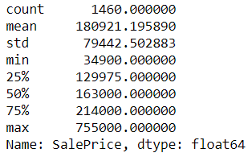
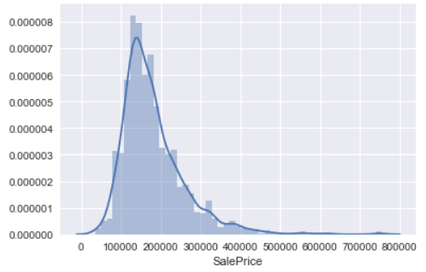
Data: Exploration
Sales Price

Slide 22
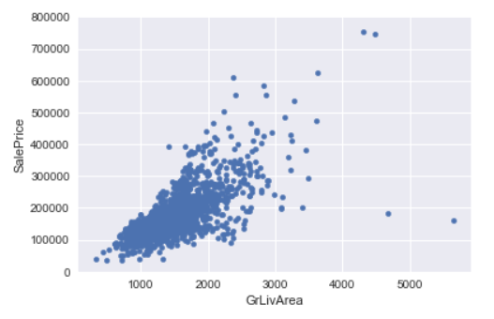
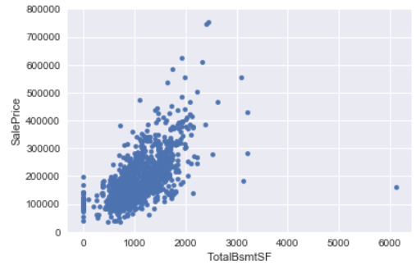
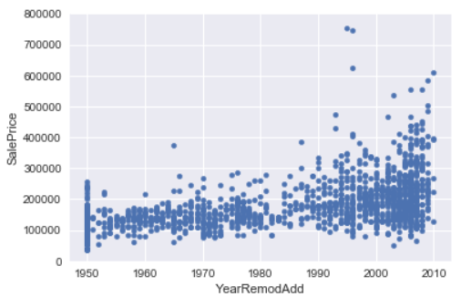
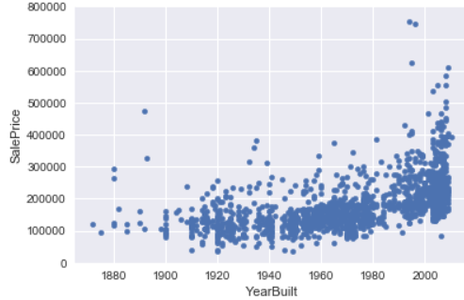
Data: Exploration
Sales Price vs GrLiv Area
Sales Price vs Total Basement SF
Sales Price vs Year Built
Sales Price vs Year Remod Add

Slide 23
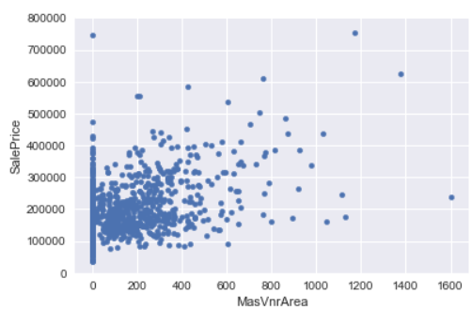
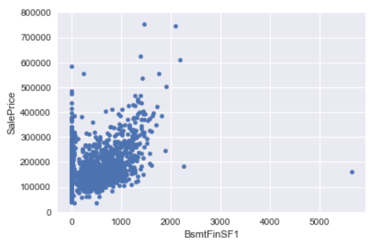
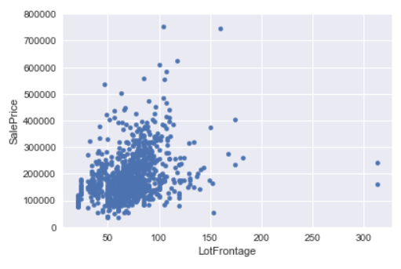
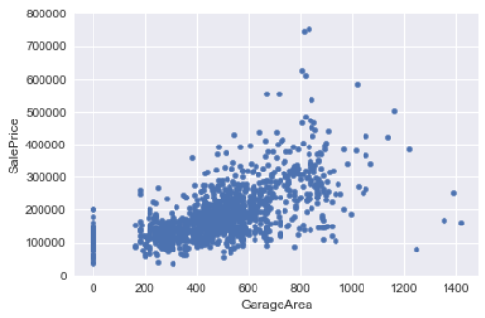
Data: Exploration
Sales Price vs MasVnrArea
Sales Price vs Basement FinishedSF
Sales Price vs Lot Frontage
Sales Price vs Garage Area

Slide 24
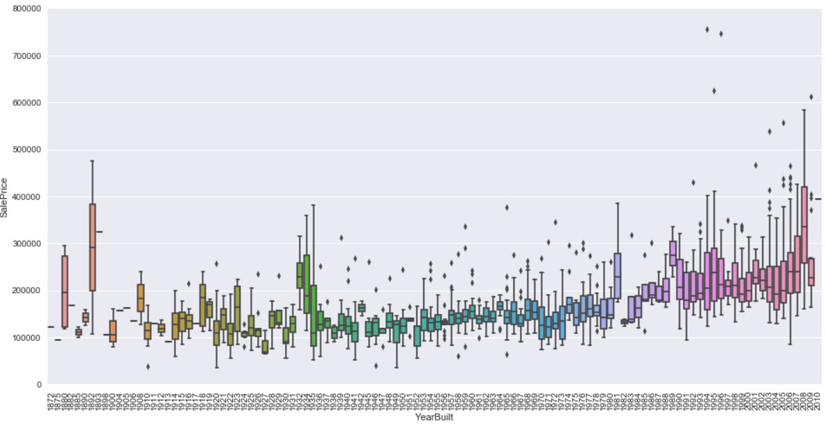
Data: Exploration
Sale Price vs Year Built

Slide 25
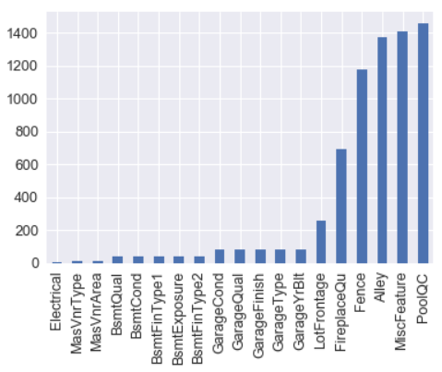
Train Data: Missing Values
Train Data will NA values
In PoolQA (pool quality), NA is No pool.
Alley: NA is No alley access.
Fence: NA is No fence.
FireplaceQu: NA is no fireplace

Slide 26
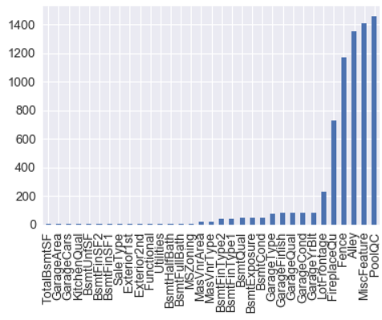
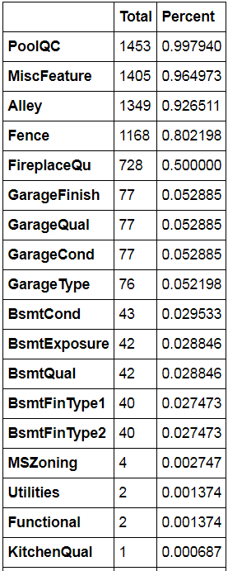
Test Data: Missing Values
Test Data will NA values

Slide 27
Data: Missing Values
Following features are removed due to missing values:
LotFrontage: 17% of missing values.
MasVnrType
MasVnrArea
GarageYrBlt
Id
Remove any row of NULL values that may be in dataset.

Slide 28
Categorical Data
Convert text data to numerical by using One hot encoder from Sklearn.
It converts categorical values into binary.
Train Dataset
OLD Column New Columns
Alley
Grvl
NA
Pave
Alley_Grvl | Alley_Pave
1 | 0
0 | 0
0 | 1

Slide 29
Categorical Data
Convert text data to numerical by using One hot encoder from Sklearn.
Test Dataset may not have all the data values as train dataset so after One hot encoder transformation, test dataset will not have same number of columns as train dataset.
To avoid this issue, we will have column names of train data set in test and if data is not available in test will be given zero value.
one_hot_encoded_training_predictors = pd.get_dummies(df_train)
one_hot_encoded_test_predictors = pd.get_dummies(df_test)
final_train, final_test = one_hot_encoded_training_predictors.align(one_hot_encoded_test_predictors, join='left', axis=1)

Slide 30
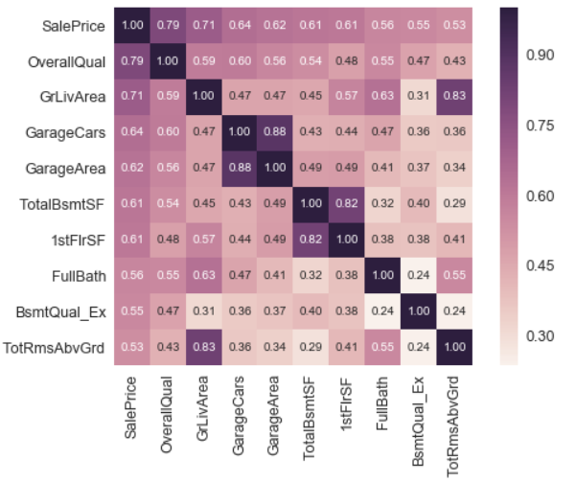
Correlation Matrix

Slide 31
Feature Selection
Run data through sklearn cross validation cross_val_score function.
Data is split into k folds and (k-1) folds are used to train the data and one fold is to test. Repeat this process number of times and take the average of the target values.
This process works in avoiding overfitting.

Slide 32
Linear Regression
Linear regression model is build on the processed train data.
Cross validation cross_val_score function is used five times.
cross_validation.cross_val_score(model_name,X,y,cv=5, scoring='mean_squared_error')
Root mean square of Linear regression is 35154.66

Slide 33
Random Forest Regression
Random forest is an estimator that fits classifying decision tree on various samples of data and uses average to improve the predictive accuracy and control overfitting.
Random forest regression model
rf = RandomForestRegressor(n_estimators = 1000, random_state = 42)rf.fit(X_train, y_train)
Root mean square error of Random Forest Regressor is 29921.69
Prediction on test data is going to be done using this model as this has lower root mean square error value.

Slide 34
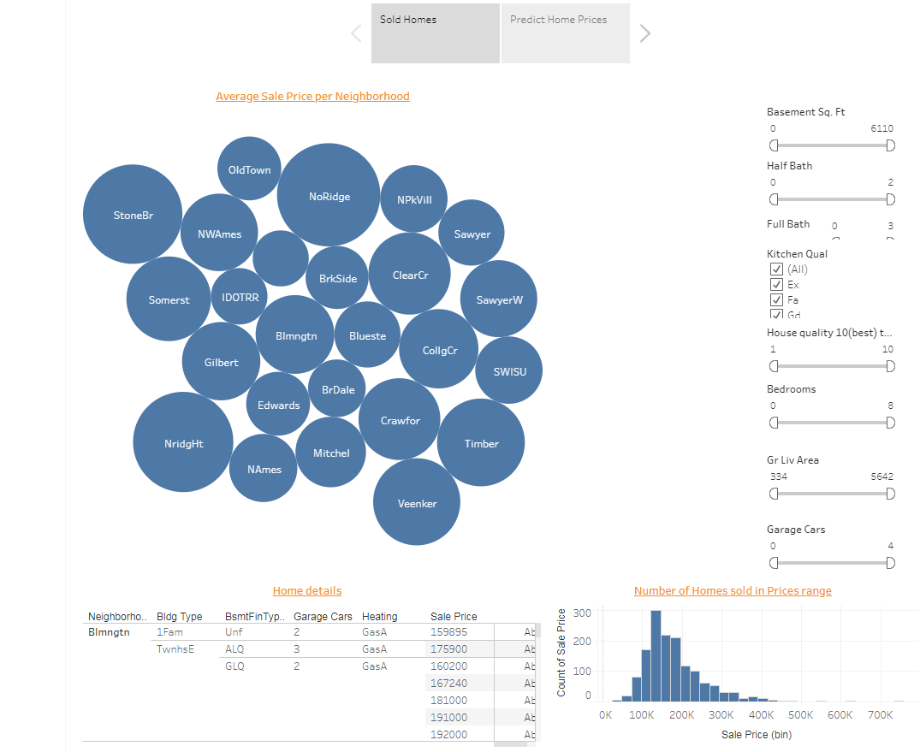
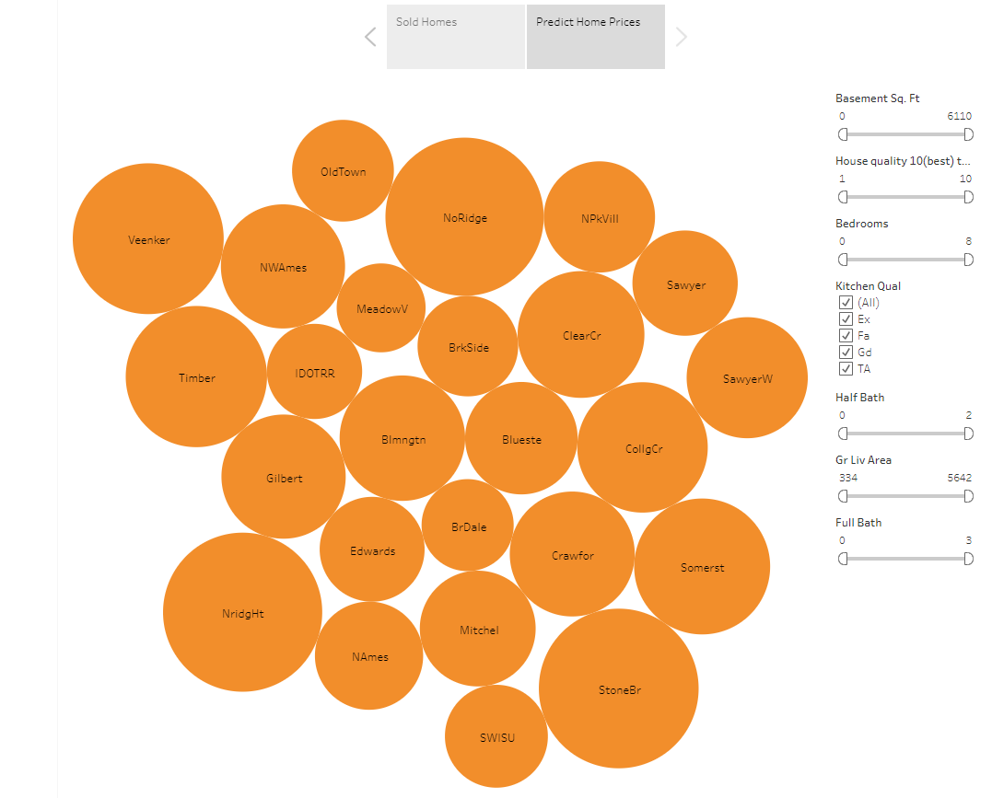
Website
Research tool for home buyers and seller is the following website:
https://public.tableau.com/profile/neeraj3209#!/vizhome/AmnesHousing/AmnesHousing

Slide 35
References
https://www.kaggle.com/c/house-prices-advanced-regression-techniques

