Slide 1

Tech mate

Slide 2


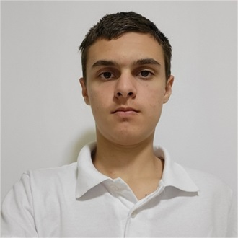
Team Members
NKYanakiev22
Developer
SNGochev22
Scrum
VBTodorov22
Developer

Slide 3
Action Plan
Making a discussions about
The project essentials.
Working on the code
Keeping the time lines
And presentation

Slide 4




Applications Used

Slide 5
Let’s jump into project

