Slide 1
User
API Gateway
API Server
Redis cache
Event Bus
API
PSelector
DL Model
Web
Shell
Scheduler
Relational DB
Executor
Helm Charts
Developer
Spark
Pytorch
Flink
…
Web
Monitor Panel
Image Repository
Log

Slide 2
“SELECT sum(v) FROM t1 JOIN t2 WHERE t1.id = t2.id”
aggregate
project
filter
join
scan(t1)
scan(t2)
scan(t2)
CPU: 2.3 GHz intel
GPU: 3080ti 32 G
SSD/HDD: SSD
bandwidth: 9.77 gbs
CPU: 2.3 GHz intel
GPU: 3080ti 32G
SSD/HDD: SSD
bandwidth: 9.77 gbs
CPU: 4.0 GHz intel
GPU: 3080ti 32 G
SSD/HDD: SSD
bandwidth: 200 gbs
Spark(SQL)
Tensorflow
PyTorch

Slide 3



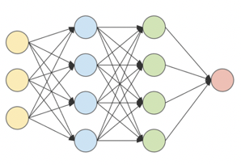
…
Embedding Dictionary
+
+
𝑓(*)
…
max
CBOW
“sort”:
sort
map
filter
“map”:
…
“max”:
…
join
“join”:
“filter”:
K * |V|
Logical Plans
Training
Operator Embedding
Normalization
Vectorized Logical Plan
Convolution
Classification

Slide 4
GPU memory
CPU freq.
bandwidth
select
flatmap
join
cos
SSD
JOIN
1
…
JOIN
SELECT
1
…
SELECT
…
…
…
…
COS
1
COS
SIN
1
SIN
dim. ≈ 100
dim. = 8 + 4

Slide 5
Embedding 的可视化
GCN的实验——硬件环境变化导致的选择变化(不仅说明GCN能选平台，而且说明能对环境变化作出响应）

Slide 6
Embedding Dictionary
max
CBOW
“sort”:
sort
map
filter
“map”:
…
“max”:
…
join
“join”:
“filter”:
Logical Plans
Training
Operator Embedding

