Slide 1



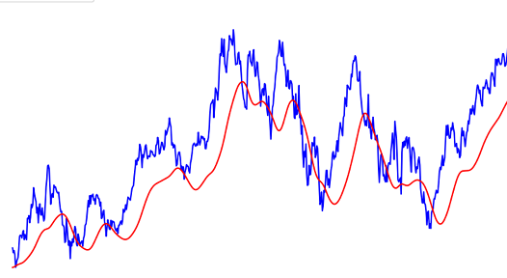
“Stock price PREDICTION" P-335
A
project on

Slide 2

Mentor :- Snehal mam Group no 6
Team members :-
Amrutwad Anuja Pandurang
Ashwinikumar Mukteshwar Singh
Mandar Santosh Bhere
Navgire Kirankumar Prakash
Omkar Satish Kumbhar
Rushikesh Panditrao Dhumal
Saswatee Das

Slide 3

The stock market, a dynamic and complex financial ecosystem, has always captivated the attention of investors, economists, and data scientists alike. Predicting stock prices has been a longstanding challenge, as it involves navigating through the intricate interplay of various factors, including economic indicators, market sentiment, and company performance. In recent years, the integration of data science techniques has brought about a paradigm shift in how we approach stock market prediction. Leveraging vast datasets, advanced algorithms, and machine learning models, data scientists aim to uncover patterns, trends, and signals that may influence future stock prices. Machine learning and Data science is a game changer in this domain so there is a lot of data to find patterns in for predicting with high degree of accuracy. In future we'll try to predict the values based on multiple factors such as politics, global economic conditions, unexpected events like covid, companies financial performance, and so on. We are going to implement multiple types of algorithms because different types of data requires different types of techniques.
Introduction

Slide 4


STEPS PERFORMED1. Importing and Cleaning data2. Split the Data into training / test sets.3. Creating and Training the Model4. Making Predictions5. Evaluating and Improving Model4. Making Predictions5. Evaluating and PERFORMED1. Importing and Cleaning data2. Split the Data into training / test sets.3. Creating and Training the Model4. Making Predictions5. Evaluating and Improving *
STEPS PERFORMED
Importing and Cleaning data
Data visualization
Creating and Training the Model
Making Predictions
Model Evaluation
Model Deployment.

Slide 5
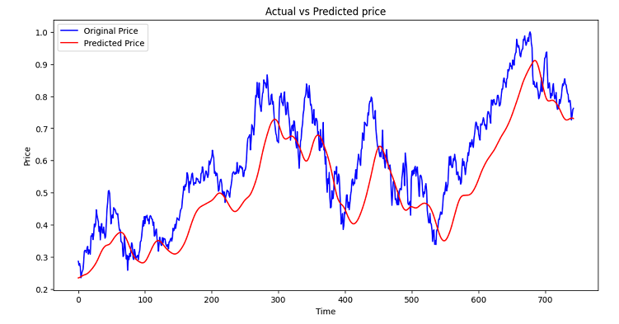
LTSM Model:
LTSM stands for Long Short-Term Memory.
In this task, the future stock prices of APPLE are predicted using the LSTM Recurrent Neural Network. Our task is to predict stock prices for a few days, which is a time series problem. The LSTM model is very popular in time-series forecasting, and this is the reason why this model is chosen in this task.

Slide 6
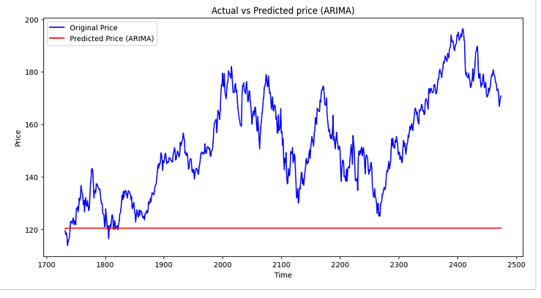
ARIMA Model:
At o average
ARIMA stands for autoregressive integrated moving average.
ARIMA models predict future values based on past values.
ARIMA makes use of lagged moving averages to smooth time series data.
They are widely used in technical analysis to forecast future security prices.
Autoregressive models implicitly assume that the future will resemble the past. Therefore, they can prove inaccurate
under certain market conditions, such as financial crises or periods of rapid technological change.

Slide 7
SARIMAX model:
SARIMAX stands for Seasonal Autoregressive Integrated Moving Average Exogenous model.
This model is a powerful time series forecasting technique that extends the traditional ARIMA model to account for seasonality and external factors.
It’s a versatile model that can accommodate both autoregressive (AR) and moving average (MA) components, integrate differencing to make the data stationary, and incorporate external variables or regressors.
SARIMAX is particularly valuable when dealing with time-dependent data that exhibits recurring patterns over specific time intervals.

Slide 8
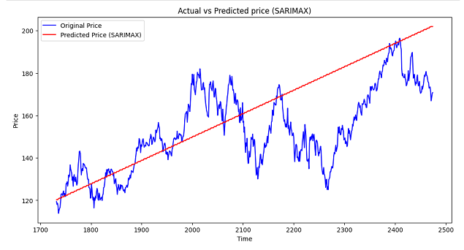
Components of SARIMAX:
Seasonal Component (S): Captures the periodic patterns in the data, such as weekly, monthly, or yearly cycles.
Autoregressive Component (AR): Represents the relationship between the current value and previous values in the time series.
Integrated Component (I): Involves differencing to make the time series stationary by removing trends and seasonality.
Moving Average Component (MA): Accounts for the dependency of the current value on past error terms, used to calculate trend.
Exogenous Regressors (X): Allows the inclusion of external variables that may affect the time series.

Slide 9
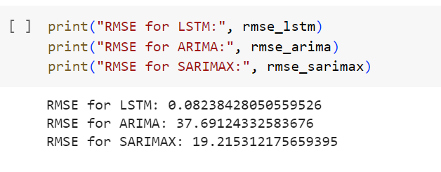
RMSE:
Regression analysis is a technique we can use to understand the relationship between one or more predictor variables and a response variable.
One way to assess how well a regression model fits a dataset is to calculate the root mean square error, which is a metric that tells us the average distance between the predicted values from the model and the actual values in the dataset.
The lower the RMSE, the better a given model is able to “fit” a dataset.
The formula to find the root mean square error, often abbreviated RMSE, is as follows:
RMSE = √Σ(P_{i} – O_{i})² / n
where:
Σ is a fancy symbol that means “sum”
P_{i} is the predicted value for the i^{th} observation in the dataset
O_{i} is the observed value for the i^{th} observation in the dataset
n is the sample size

Slide 10
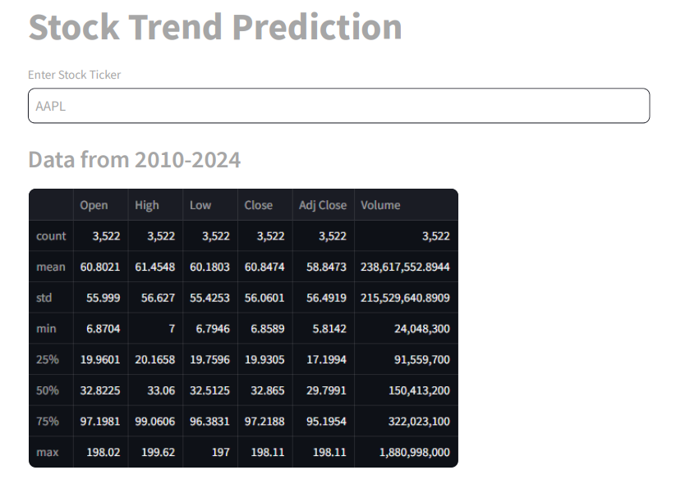

Slide 11

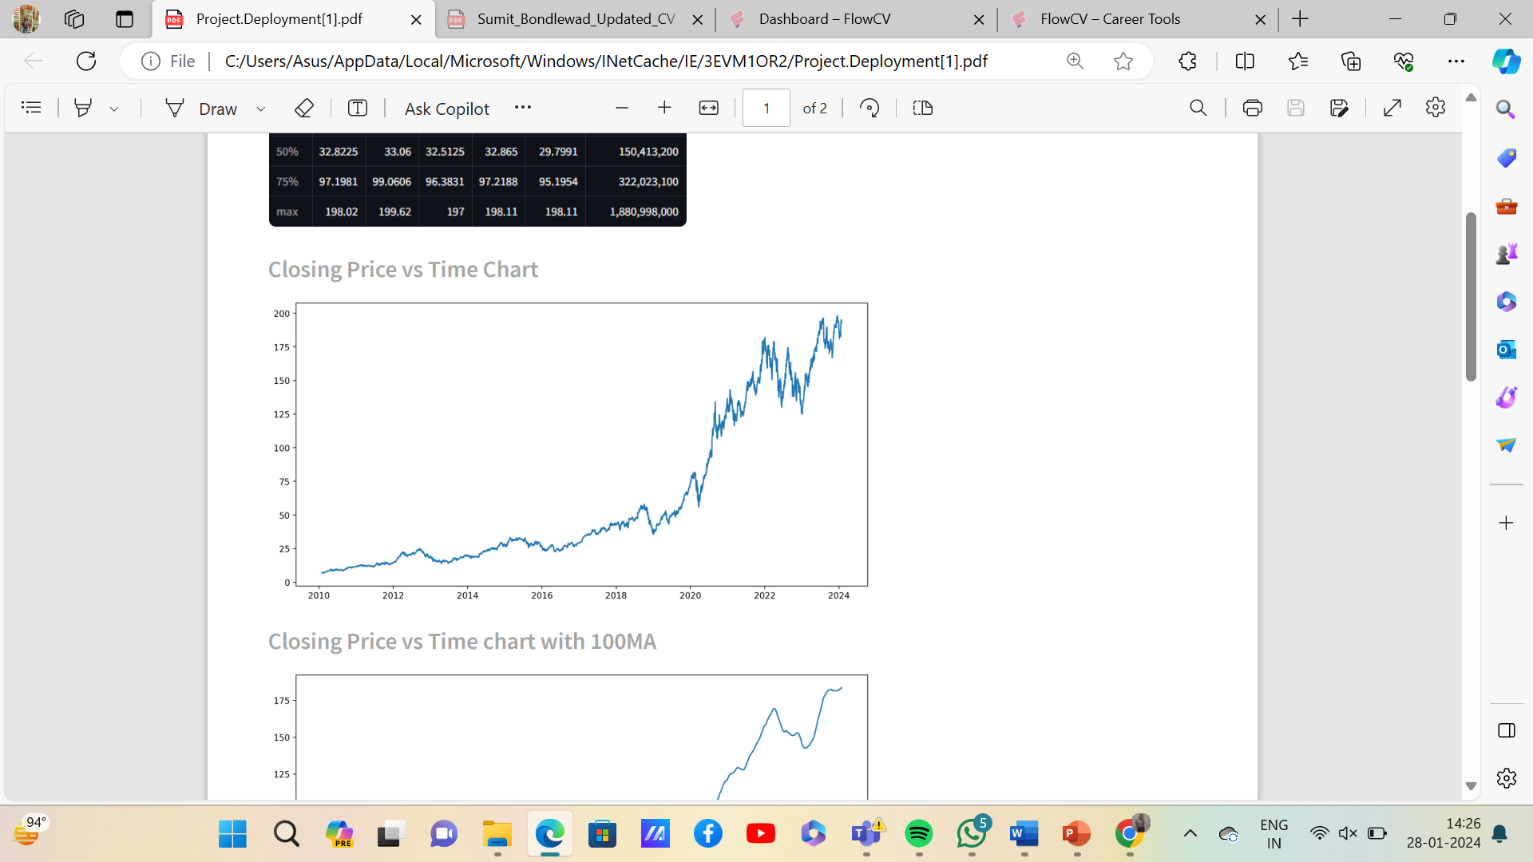
The price of a stock market at the end of the trading hours is known as closing price.
Here in this graph we will show how the closing price are changing overtime in a stock market.

Slide 12
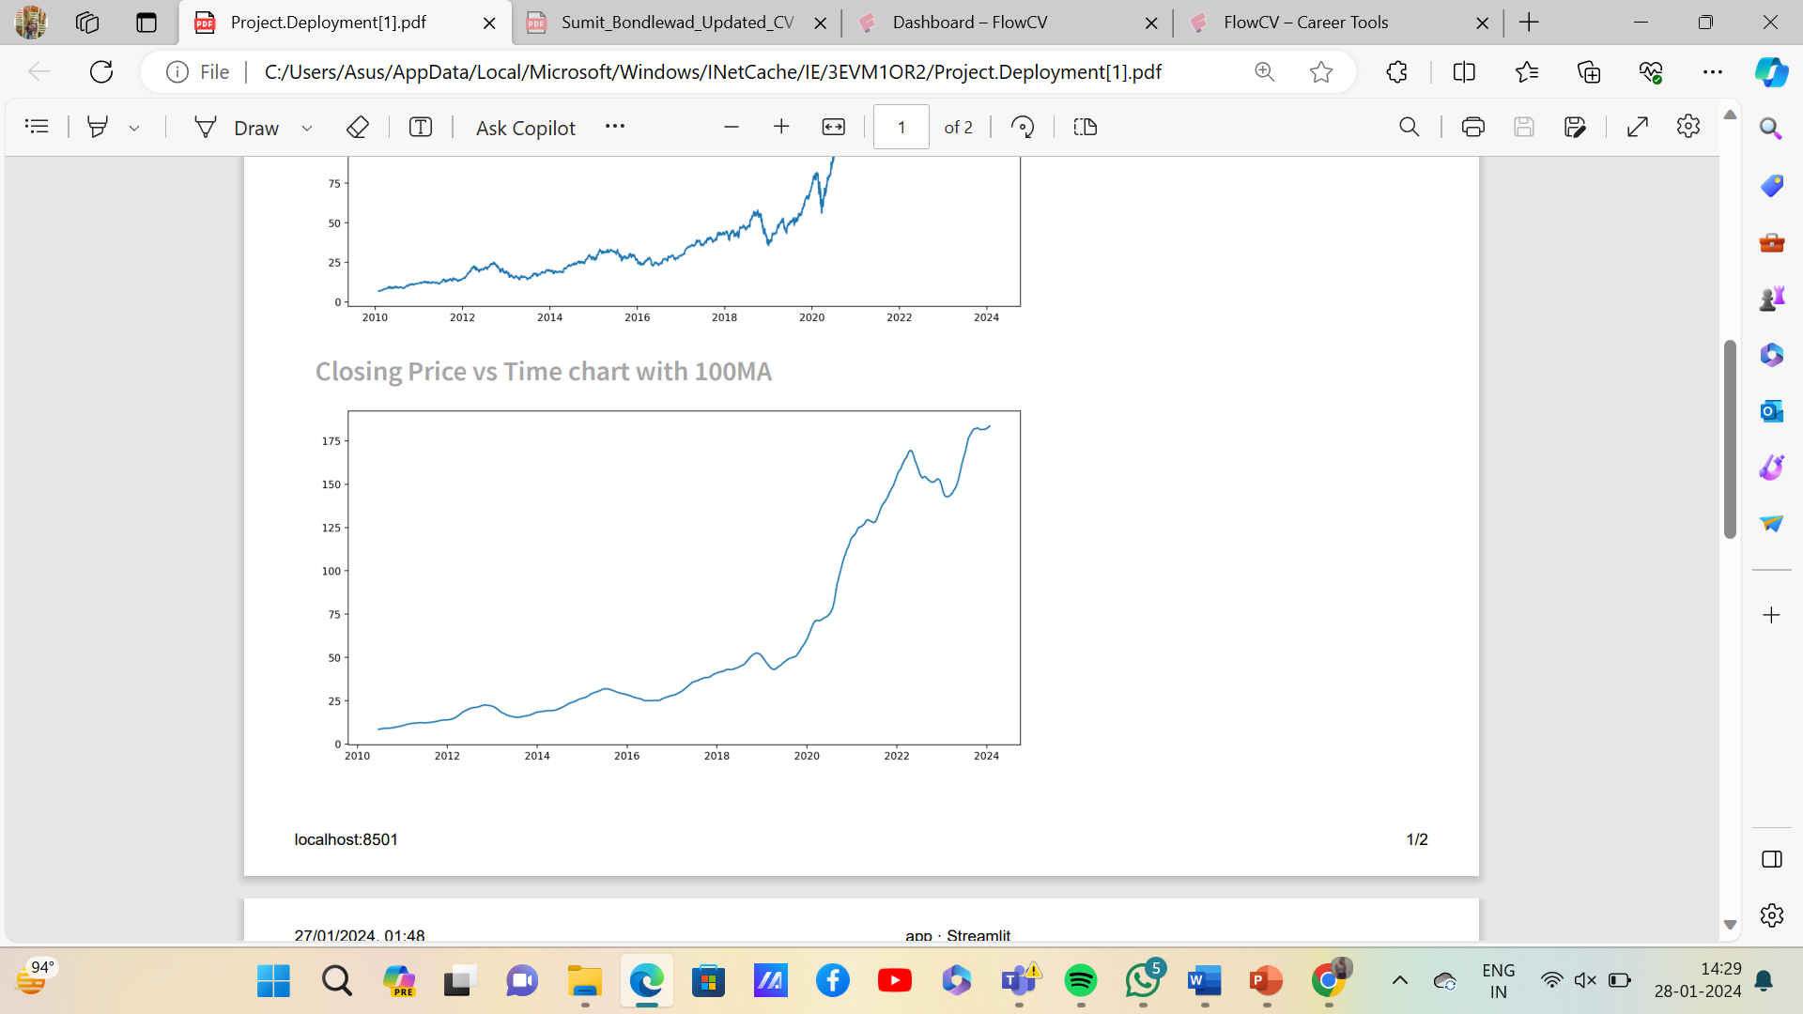
MA is nothing but Moving Average.
This is simple technical analysis tool that smooths out data by creating a constantly updated average price.

Slide 13
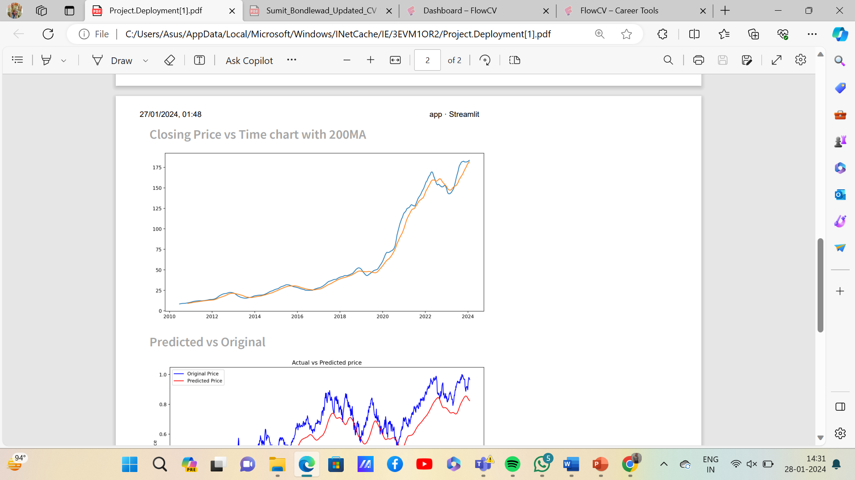

Slide 14
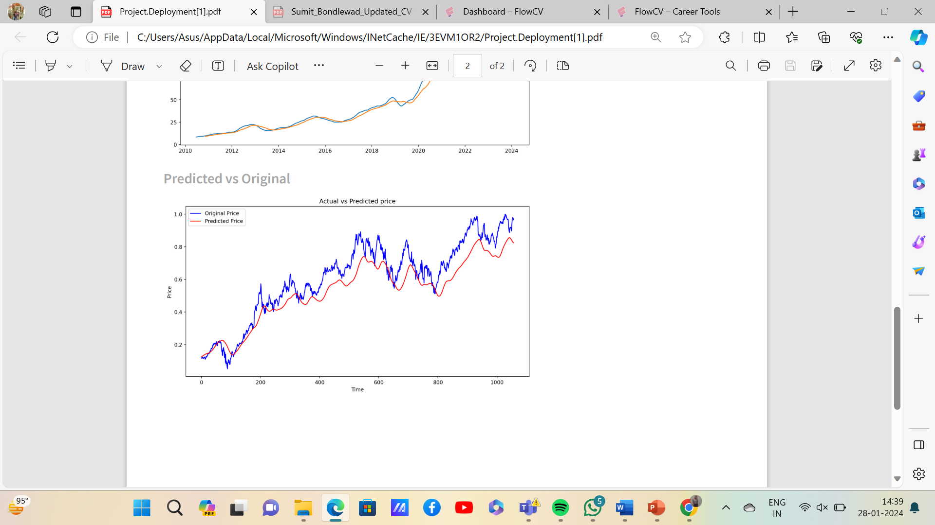
A graph of the observed (actual) response values versus the predicted response values.It helps to detected by the model.
The difference between this graph and the seen diagnostics is that model with transformations can be in original scale

Slide 15
THANK YOU

