Slide 1
Optimizely from Sitecore Lens
Nikhil Kulkarni – Senior Sitecore Developer
Manager Project

Slide 2
About Speaker
8+ years of IT experience across both hemispheres.
Expertise in: Sitecore, EPiServer (Optimizely), Kentico, Umbraco, Contentful, Azure Cloud, DevOps, Identity Management (Okta, Auth0), Omni-Channel, .NET, Bespoke Commerce platforms, CDP platforms, Personalization and Marketing Automation, Headless, Jamstack, CDNs, RedShield, jQuery, JavaScript like React, JSS, Git, Information Architecture, Solution Architecture, Digital Transformation.
Certified with Sitecore, CSM, DevOps, MTA, AWS.
Working experience of Product, Program, Practice, Vendor, Release/Deployment Management.
Worked in all type of business ranging from B2B, B2C, D2C, B2B2C.
Worked in almost all domains from Insurance, Manufacturing, E-commerce, Utilities, Consumer Electronics, Governments, Travel and Visa.

Slide 3
Agenda
Optimizely overview
Optimizely for Sitecore Developer with Basics
Project setup
CMS introduction.
Summary.

Slide 4
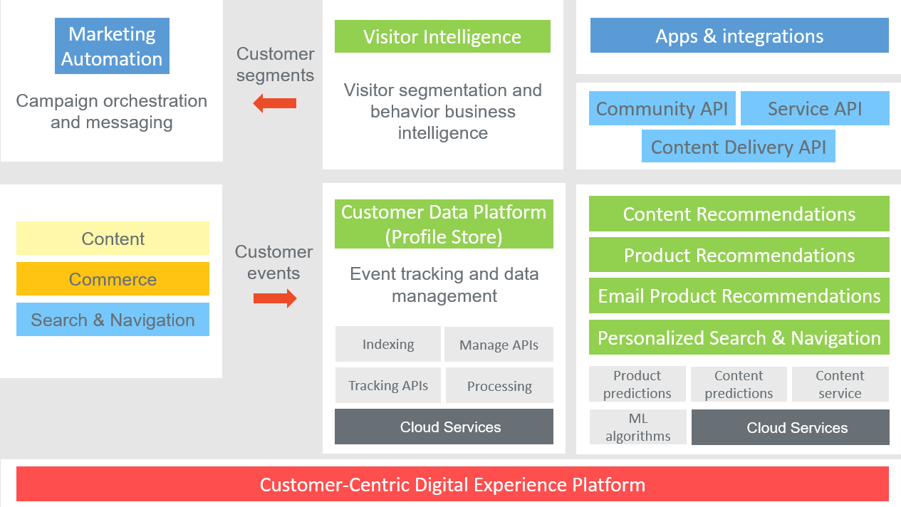
Optimizely Overview
Optimizely Digital Experience Platform (DXP) with included products and features, and how to get started developing. With Optimizely, you can create truly customer-centric experiences, using a best-in-class CMS, robust ecommerce, and advanced personalization and marketing automation features.
Optimizely is based on a secure platform with a modular product suite, and multiple APIs and extensions offering flexible customization and integration possibilities.
Refer: Optimizely World

Slide 5
Optimizely for Sitecore Developer with Basics
Practically both platforms are similar with few differences (or designed differently). For developers coming from Sitecore background.
Content template.
Blocks.
Renderings.
Forms.
Search.
Media.
Visitor Groups.
Projects.

Slide 6
Project Setup
1. To start a CMS or Commerce application, install the following templates:
dotnet new -i EPiServer.Templates
2. Installing Content Cloud (CMS 12)(Create an empty site):
dotnet new epi-cms-empty
3. Create a sample site with Alloy templates:
dotnet new epi-alloy-mvc
Detailed installations step by step could be found here.
For legacy you can go here. In this presentation will work on Optimizely 11 as 12 is very recent release.

Slide 7
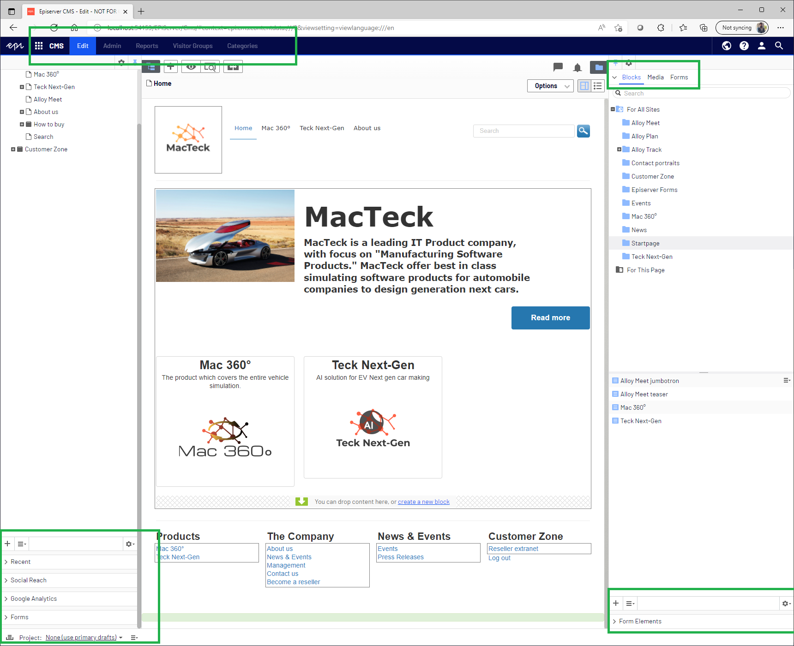
CMS Introduction

Slide 8
Sitecore Links for Optimizely Developers
Templates:
https://doc.sitecore.com/xp/en/developers/103/sitecore-experience-manager/data-templates.html
Components (Blocks in Optimizely):
https://www.valtech.com/blog/4-patterns-for-sitecore-component-development/
Renderings:
https://doc.sitecore.com/xp/en/developers/103/sitecore-experience-manager/mvc-and-renderings.html
Forms:
https://doc.sitecore.com/xp/en/users/103/sitecore-experience-platform/sitecore-forms.html
Search:
https://doc.sitecore.com/search/
Media Library (Media in Optimizely):
https://doc.sitecore.com/xp/en/users/103/sitecore-experience-platform/the-media-library.html
Segments (Visitor Groups in Optimizely):
https://doc.sitecore.com/xp/en/users/103/sitecore-experience-platform/create-a-segment.html
Sitecore Docs:
https://doc.sitecore.com/xp/en/developers/103/index.html

Slide 9
Thank You

