Slide 1

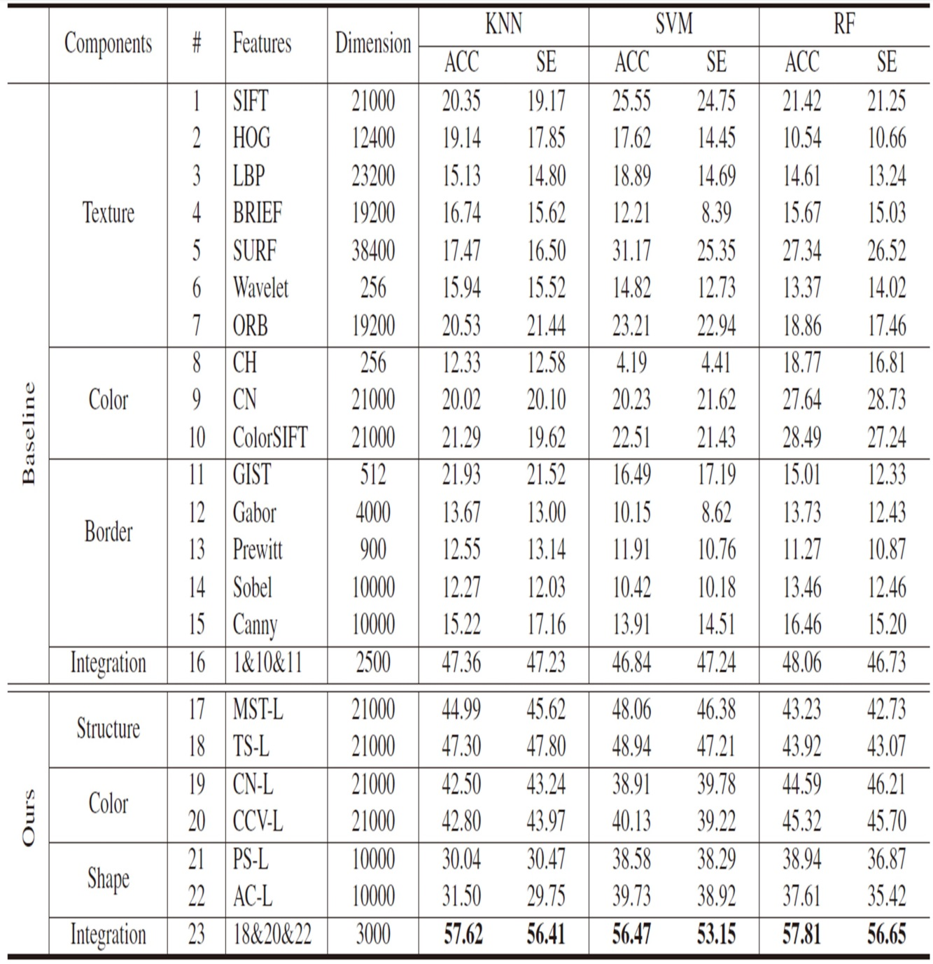
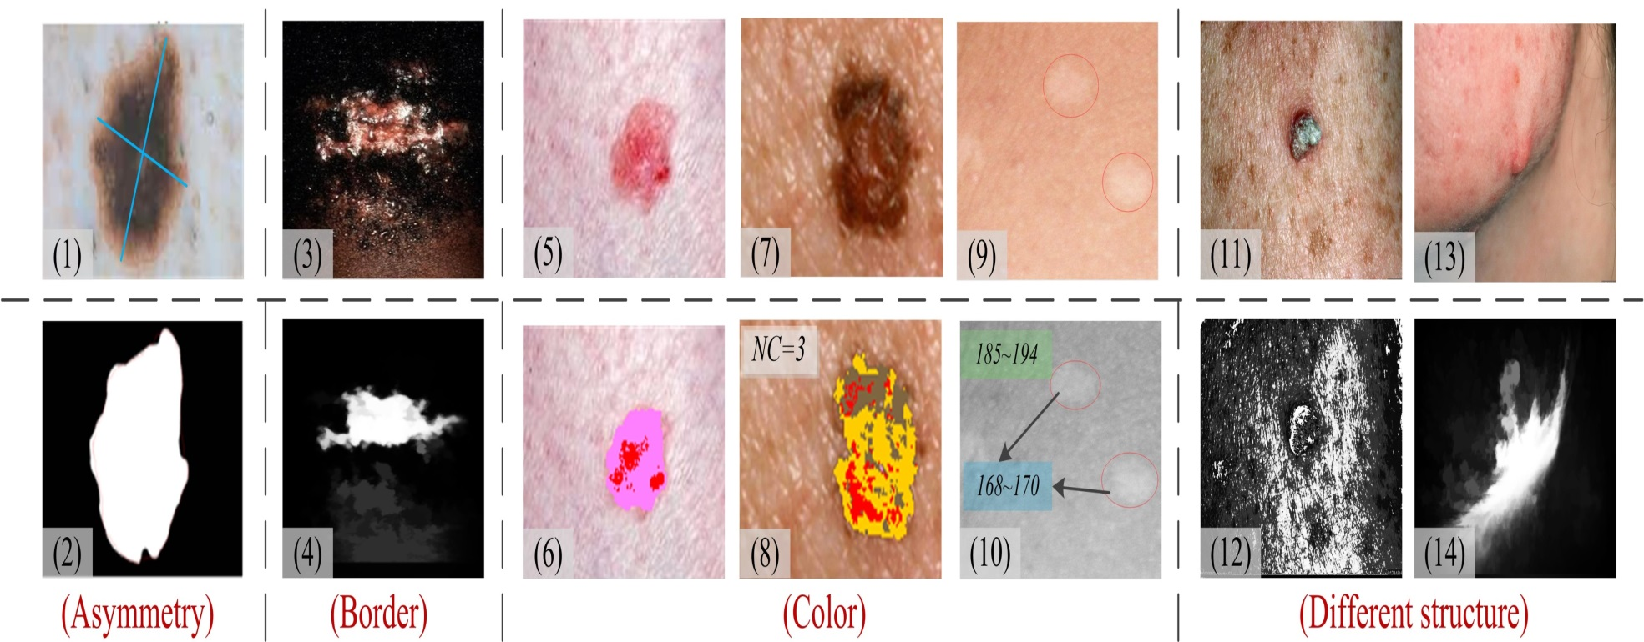
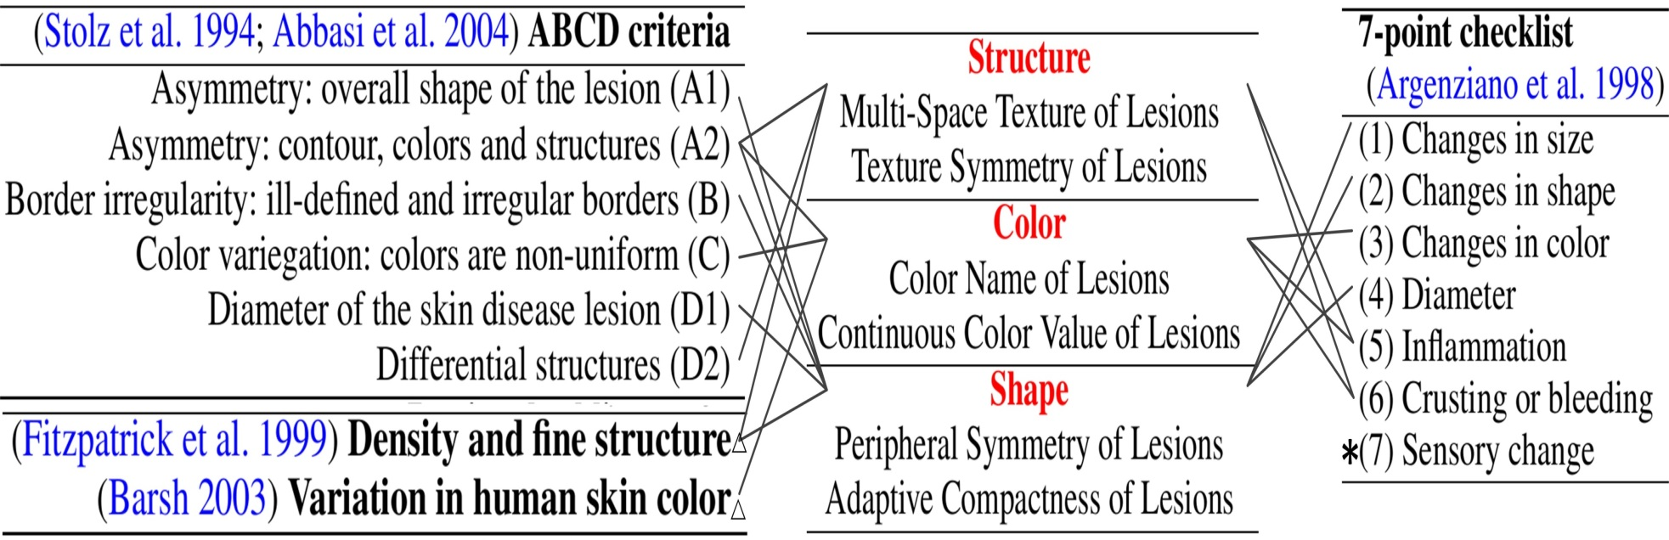
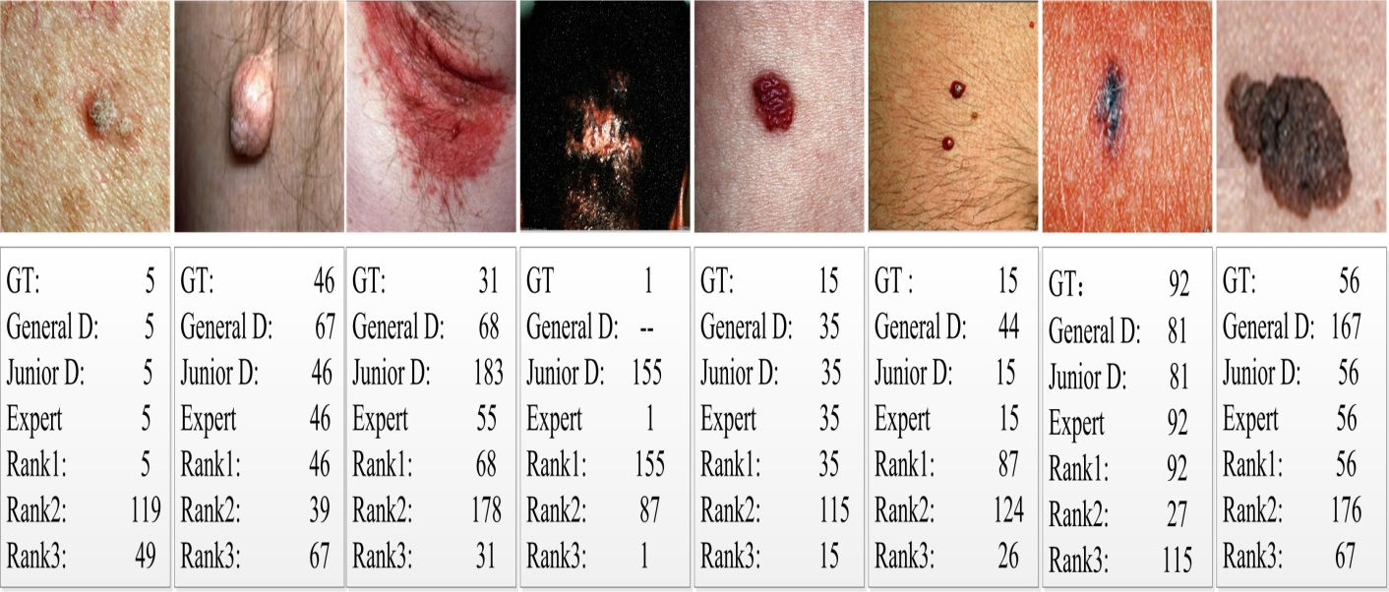
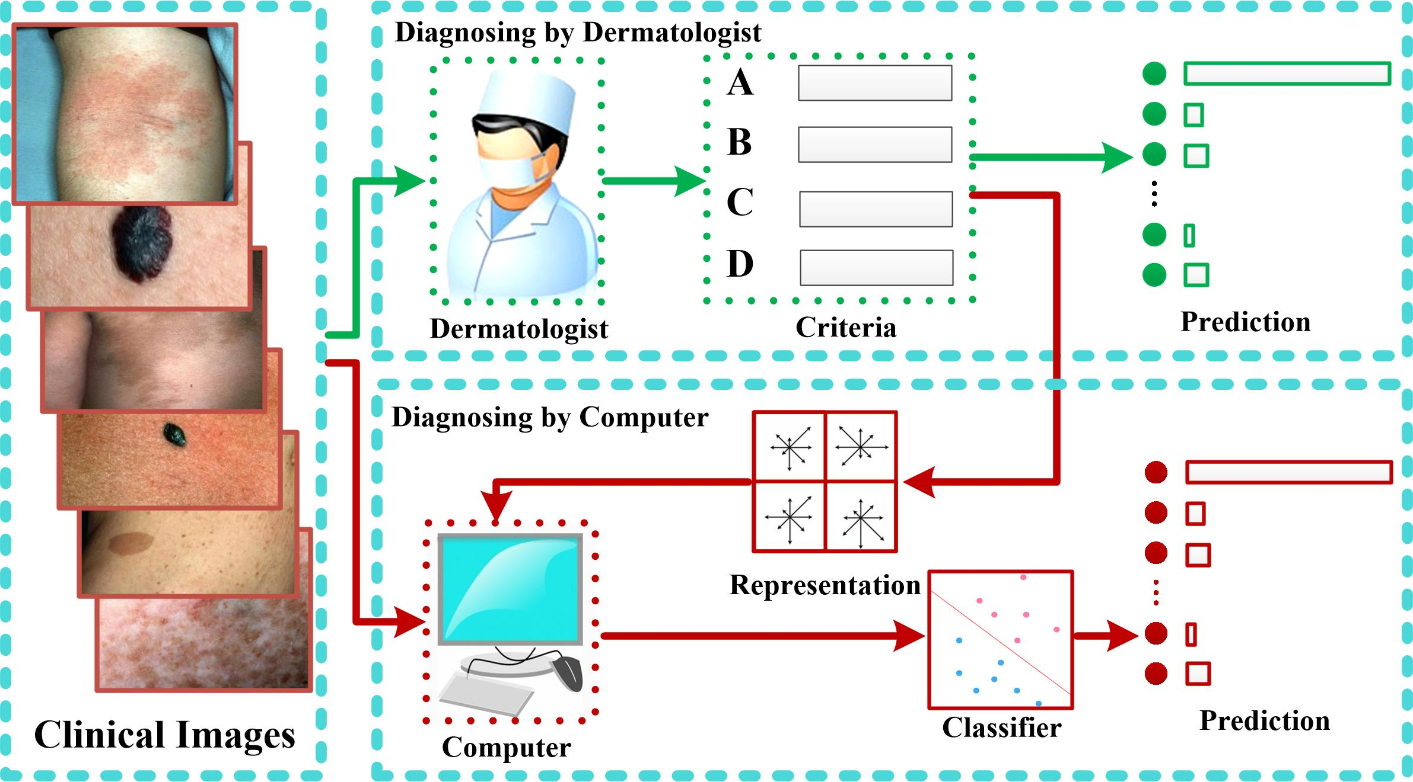
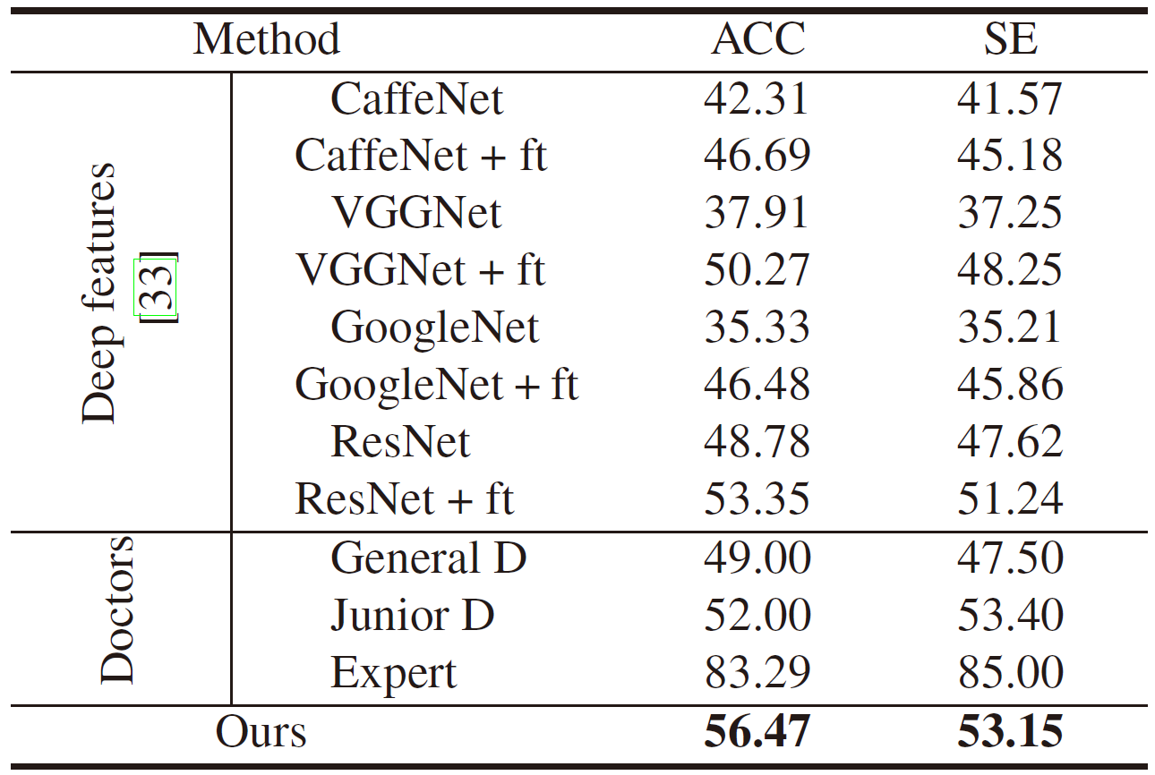
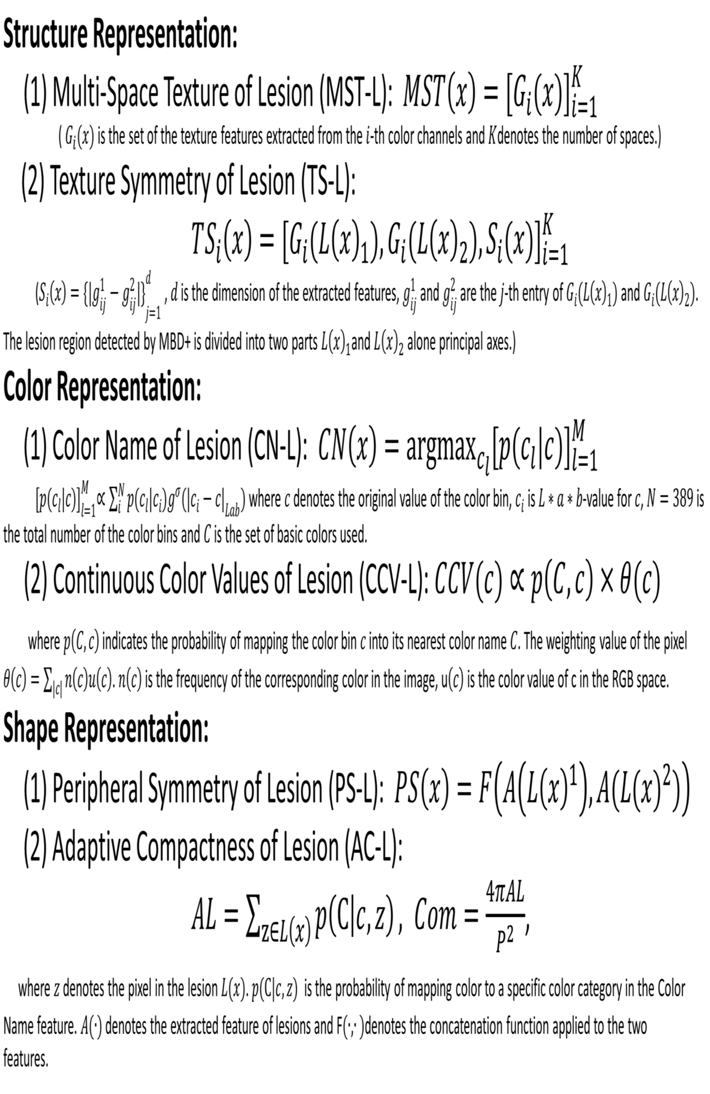




Skin Lesion Diagnosis using Representations Inspired by Dermatologist Criteria
Jufeng Yang¹, Xiaoxiao Sun¹, Jie Liang¹, Paul L. Rosin¹
¹Nankai University, ²Cardiff University
This paper has been accepted by CVPR 2018
Abstract
Criteria of Skin Disease
Experiment Results
We proposed medical representations inspired by the dermatological criteria for diagnosing clinical skin lesions. The dermatological criteria are highly correlated with measurable visual components, which cover three aspects: structure, color and shape of each skin disease. Major improvements includes:
the interpretable representation for effectively capturing the manifestations of skin lesions;
the integrated diagnostics of the diagnosis system for accurate recognizing.
The final performance on clinical images with 198 categories of skin disease is comparable with dermatologists
ABCD ^{[1]}criteria: (A)symmetry: the property on shape, color, contour and structures; (B)order; (C)olor; (D)ifferent structure (Diameter): pustule, wrinkle, inflammation and so on:
The mapping to visual components from dermatological criteria: ABCD^{[1-2]}, 7-point^{[3]}, and the two specialized criteria^{[4-5]} :
Comparison with CNN & Doctors
Motivation
Medical Representations
‘GT’ is the ground-truth; the number represents a class of skin disease. ‘–’ denotes that the doctor cannot provide a diagnosis. ‘General D’ is general doctor who does not focus on one specific kind of disease. ‘Junior D’ is junior dermatologist and ‘Expert’ is an expert for diagnosing skin lesions.
For common skin disease (the left box):
dermatologists make a diagnosis by observing the appearance of the lesions (the top right box).
The designed skin disease recognition system (the bottom right box) based on clinical images and dermatological criteria has two major steps: firstly, the medical information observed by the doctors during diagnosis is exploited. Then, measurable medical representations for skin lesions are designed for diagnosis.
Accordingly, the designed representations for skin lesions relate to three aspects, i.e., structure, color and shape of the lesion.
Dataset:
Demo:
[1] N. R. Abbasi, H. M. Shaw, D. S. Rigel, R. J. Friedman, W. H. Mc Carthy, I. Osman, A. W. Kopf, and D. Polsky. Early diagnosis of cutaneous melanoma: revisiting the ABCD criteria. The Journal of the American Medical Association, 292(22), 2004.
[2] W. Stolz, A. Riemann, A. Cognetta, L. Pillet, W. Abmayr, D. Holzel, P. Bilek, F. Nachbar, and M.Landthaler. ABCD rule of dermatoscopy-a new practical method for early recognition of malignant-melanoma. European Journal of Dermatology, 4(7), 1994.
[3] G. Argenziano, G. Fabbrocini, P. Carli, V. De Giorgi, E. Sammarco, and M. Delfino. Epiluminescence microscopy for the diagnosis of doubtful melanocytic skin lesions: comparison of the ABCD rule of rmatoscopy and a new 7- point checklist based on pattern analysis. Archives of Dermatology, 134(12), 1998.
[4] T. Fitzpatrick, J. Bernhard, T. Cropley, et al. The structure of skin lesions and fundamentals of diagnosis. Dermatology in General Medicine, 5, 1999
[5] G. S. Barsh. What controls variation in human skin color? PLoS Biology, 1(1), 2003.

