Slide 1





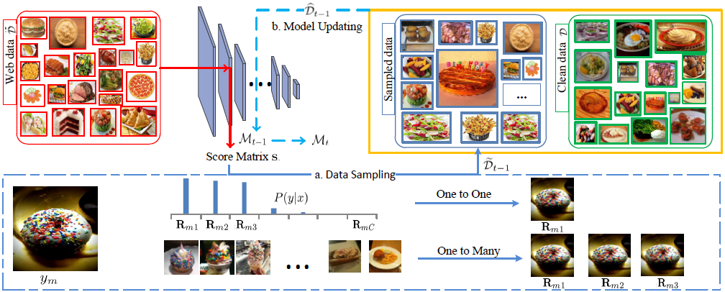
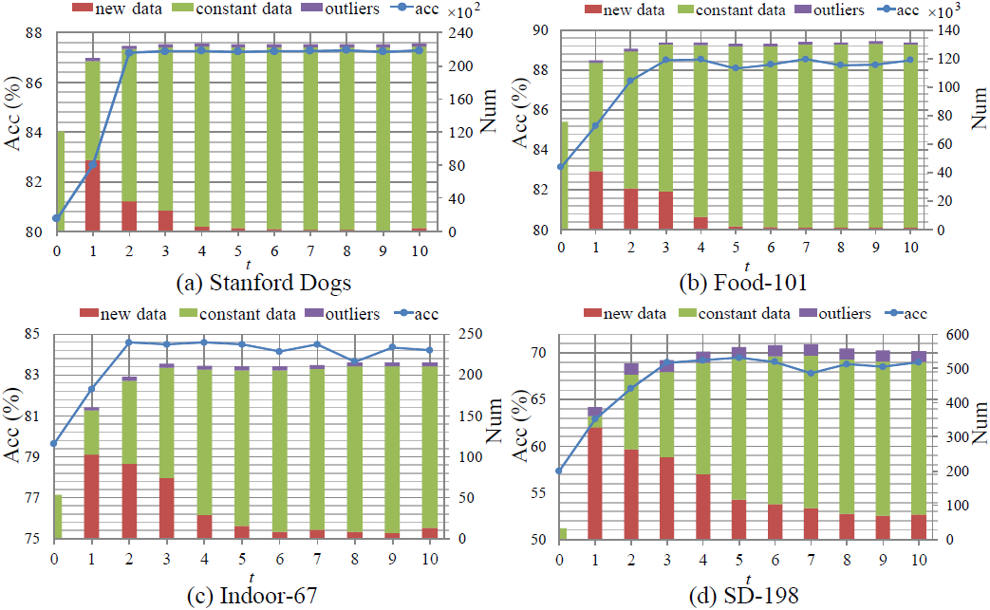
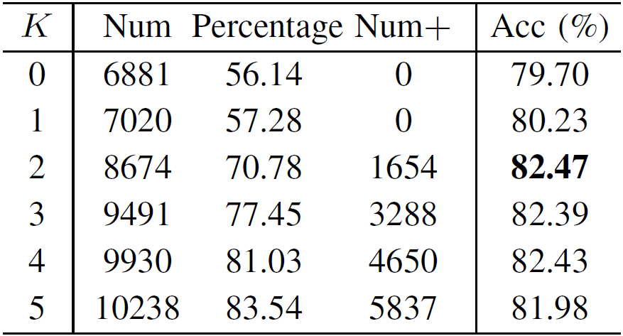
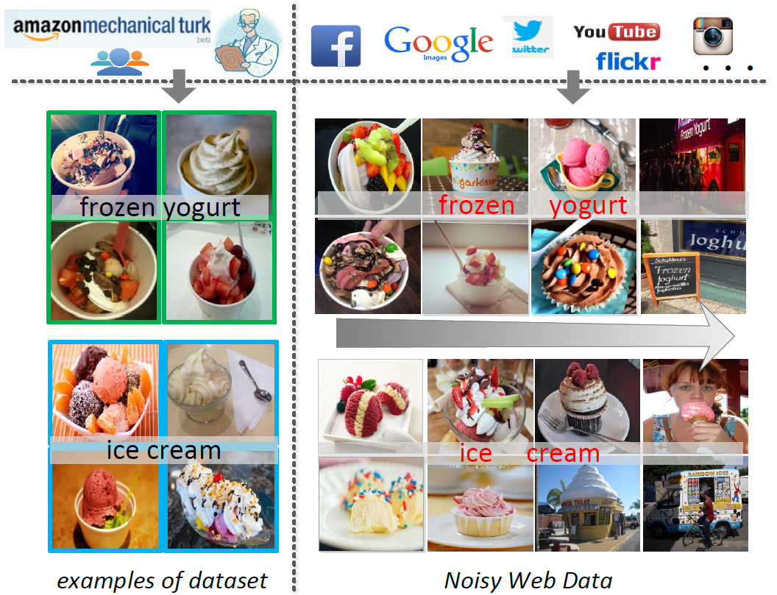


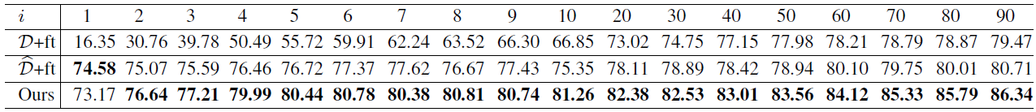
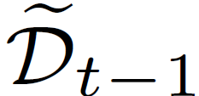
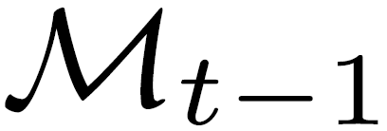

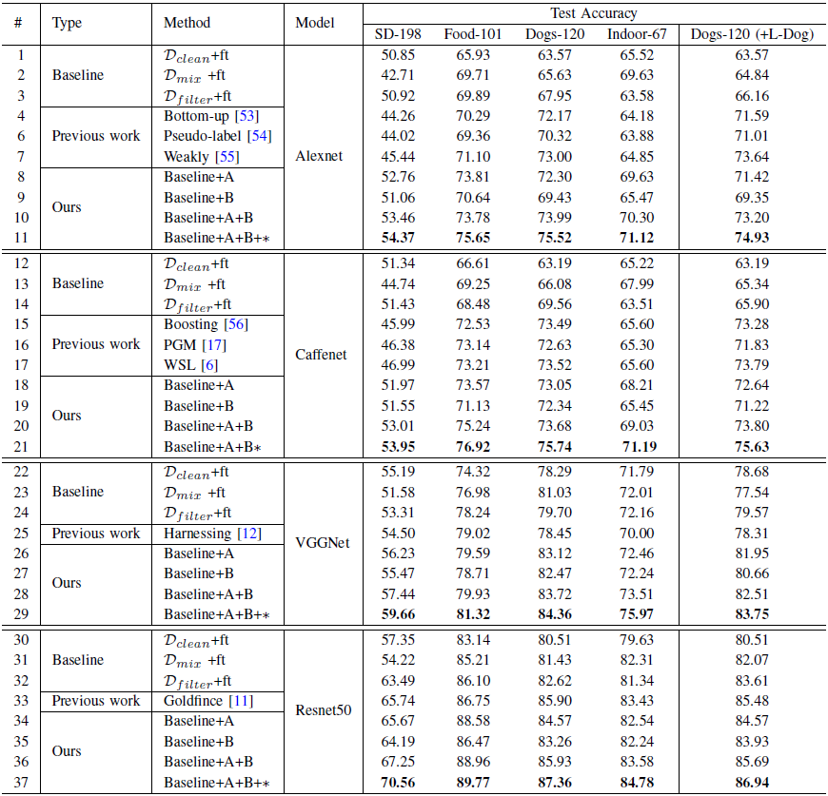
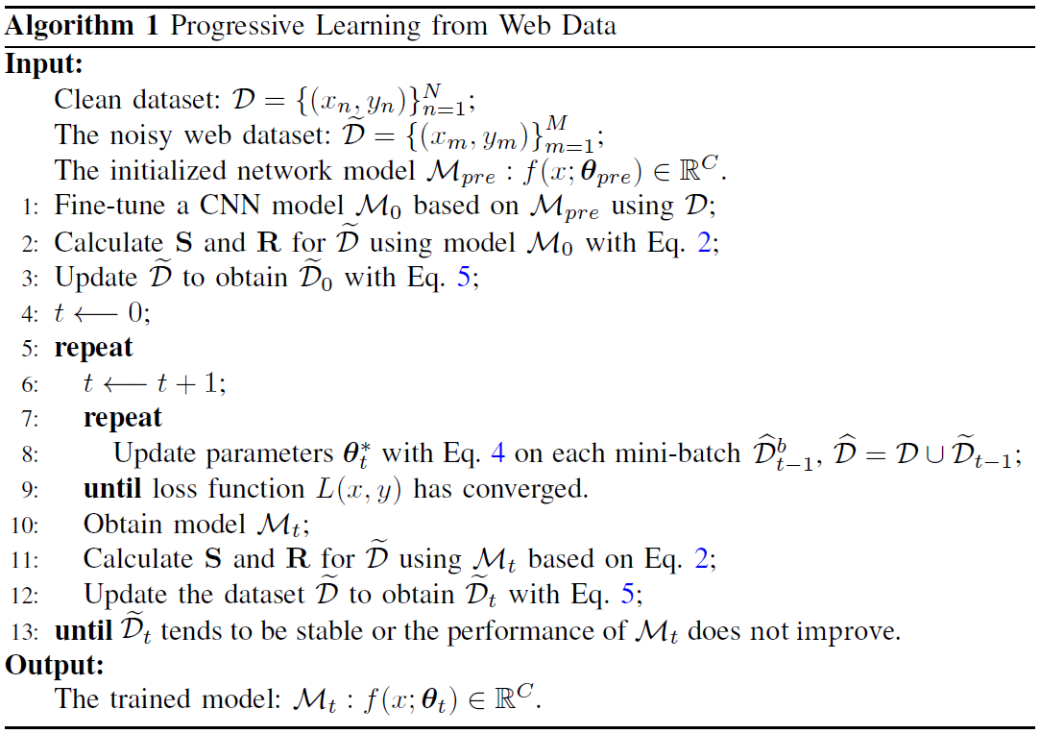
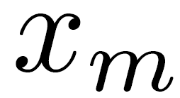
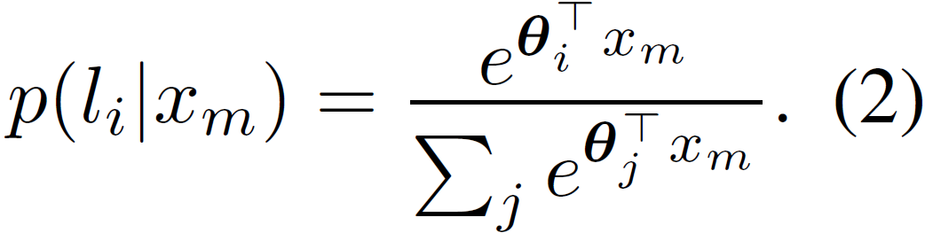
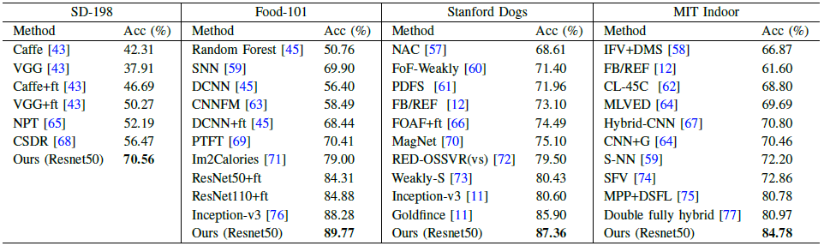
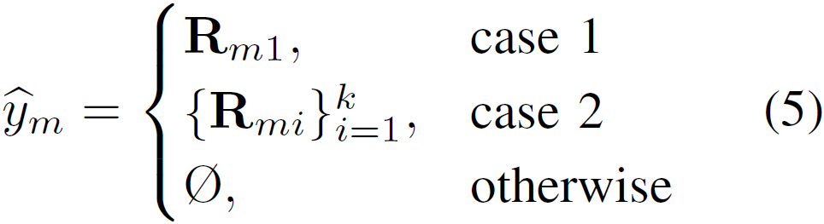
Recognition from Web Data: A Progressive Filtering Approach
Jufeng Yang¹, Xiaoxiao Sun¹, Yu-Kun Lai², Liang Zheng³, Ming-Ming Cheng¹ Email: sunxiaoxiaozrt@163.com
¹Nankai University, ²Cardiff University , ³Australian National University Website: cv.nankai.edu.cn
This paper has been accepted by TIP 2018
VALSE 2019
April 11 – 14, 2019
Method
Experiment
Introduction
Classification accuracies (Acc) of different iterations.
Leveraging the abundant number of web data is a promising strategy in addressing the problem of data lacking when training convolutional neural networks (CNNs). However, web images often contain incorrect tags, which may compromise the learned CNN model.
Ablation study.
Fig. 2. Pipeline of the proposed progressive learning method, which includes two major steps, namely data sampling and model updating. For data sampling, we obtainaaaaa , score matrix S and label matrix R of web data based on model aaaaa , and use such information to obtain the dataset aaaa through a sampling scheme. Here, one to one and one to many are two types of label sampling strategies. For model updating, model is initialized with the parameters of a aaa and updated on the combined dataset aaaa in the t-th iteration.
Performance on different scales of clean training set on STANFORD DOGS.
Accuracies (%) on four datasets with different methods.
Fig. 1. Examples of the Food-101 dataset (left) and noisy web data (right) from the classes ice cream and frozen yogurt. On the left are images from the public dataset, and the right shows the images collected from the web by searching with the category names, listed in the decreasing order of reliability. We observe that images in the two middle columns of the web images are ambiguous w.r.t. their categories, and those in the rightmost column are outliers.
Our contributions:
We propose an iterative filtering method that progressively learns from web data to improve the performance of CNN model.
Instead of hard label assignment, images are assigned with multiple labels, which increases the recall of web training data selection.
We have collected four web image datasets in correspondence to four public classification tasks. Extensive experiments demonstrate that our method yields competitive recognition accuracy against the state-of-the-art approaches.
Progressive Learning from Noisy Web Labels
Web data selection for CNN training: We use a softmax function to generate the probability for each web image aaaa:
One-to-Many Correction for Noisy Labels
One-to-many label assignment: We replace
the one-to-one label assignment method
with one-to-many scheme:
Comparison with state-of-the-art methods on four datasets.

