Slide 1

Paper Writing & Response Letter
CVLab
Nankai University
1/7/2019

Slide 2

Outline
Paper Writing
Response Letter

Slide 3
Paper Writing
Avoid too many clauses. Good presentations, Poor presentations.
Class imbalance is a ...
It induces biased classification results ...
Class imbalance is a ... , which produces a biased result ...
... focus on the imbalanced distribution of ...
Such distribution indicates a large gap ...
... focus on the imbalanced distribution of ... , i.e., a large gap ...

Slide 4
Paper Writing
Consistent format.
Training/testing set or train/test set
Figure~1 (recommended) or Fig. ~1
Eq.~1 or (1)

Slide 5
Paper Writing
Tense. Good presentations, Poor presentations.
use current tense
the SPBL model becomes ...
the SPBL model will become ...

Slide 6
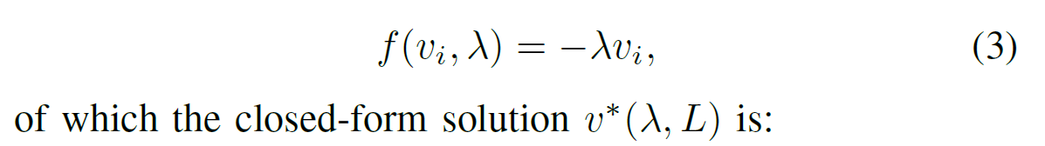
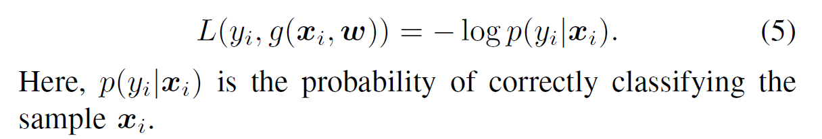
Paper Writing
Punctuation at the end of equation.
If the equation is the end of the sentence use a period, otherwise use a comma.

Slide 7
Paper Writing
Coherence and logic. Good presentations, Poor presentations.
In comparison, the cost-sensitive based methods ... Different from them, the ensemble-based methods ...
The cost-sensitive based methods ... The ensemble-based methods ...
we empirically evaluate and analyze ...
we empirically analyze and evaluate ...

Slide 8
Paper Writing
More logical issues. Good presentations, Poor presentations.
Finally, we re-train the classifier ...
Finally, we re-train an SVM classifier ...
a random set which contains 1/K of the entire training set
a random set which contains one-fifth of the entire training set

Slide 9
Paper Writing
Be Concise, Clear, and Direct. Good presentations, Poor presentations.
Note in the early learning paces ...
A noticeable phenomenon is that in the early learning stage ...
After initializing the parameters ...
As illustrated, after the parameter initialization step ...

Slide 10
Paper Writing
Be Concise, Clear, and Direct. Good presentations, Poor presentations.
A is calculated based on a trade-off of both B and C.
A is calculated based on B and C, for which there is a trade-off between these two items.
penalizing the classification errors with larger weights on the more complex categories
penalizing the loss with different weights to let the classifier pay more attention to complex categories

Slide 11
Paper Writing
The first word of a sentence. Wrong presentations.
Not start a sentence with references, letters or formulas.
[49], [50] employ bagging to re-sample neighbor instances from minority classes.However, this data augmentation process might inherently produce information redundancy.
$\Phi$ denotes the ...
$f(.)$ is the ...

Slide 12
Paper Writing
Add references where needed
According to empirical medical knowledge [5], some rare skin diseases ... , while some common skin diseases, ...
In this section, we briefly review the literature [25], [26] of ...

Slide 13
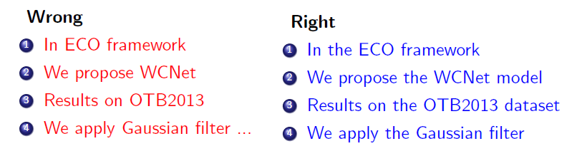
Paper Writing
The usage of `the’. Good presentations, Poor presentations.
the SPL
the sampling based, cost-sensitive based, and ensemble based methods
the sampling based, the cost-sensitive based, and the ensemble based methods
sampling based, cost-sensitive based, and ensemble based methods

Slide 14
Paper Writing
Chinglish. Good presentations, Poor presentations.
the class imbalance problem is also critical in clinical skin disease recognition task.
it is critical that clinical skin disease recognition is treated as a class imbalance problem.
This is because that ... during training.
This is because during the training phase ...

Slide 15
Paper Writing
Avoid ambiguity. Good presentations, Poor presentations.
We employ a weighted SVM in this paper as the classifier, where we assign the penalty weight in Eq. 10 to each class before classification.
For the hinge loss, the standard weighted SVM in the one-vs-rest scheme can be employed ...

Slide 16



Paper Writing
Better presentation. Good presentations, Poor presentations.
(1) ... (2) ... (3) ...
Fig.~1~(a)
$L_1$
$||$
A, but B
negative influence
contrast methods
firstly, secondly, thirdly
often
1) ... 2) ... 3) ...
Fig.~1(a)
$\ell_1$
$\lVert X – XZ \rVert$
A yet B
negative impact
comparative methods
first, second, third
usually

Slide 17
Paper Writing
Better presentation. Good presentations, Poor presentations.
it relies heavily on
it is heavily reliant on
we experimentally demonstrate the effectiveness of ...
we design comprehensive experiments to demonstrate the effectiveness of ...
... methods. Among them, the sampling-based ones attempt to ...
... methods. Among them, the sampling-based methods try to ...
... may add redundant noisy data or lose the informative training samples.
... may cause redundancy of noisy data or the loss of informative samples.

Slide 18


Paper Writing
Space. Good presentations, Poor presentations.
If there is a unusual space appear in the ICCV19 latex template, try to add a `%’ after the end of figure command.

Slide 19
Outline
Paper Writing
Response Letter

Slide 20
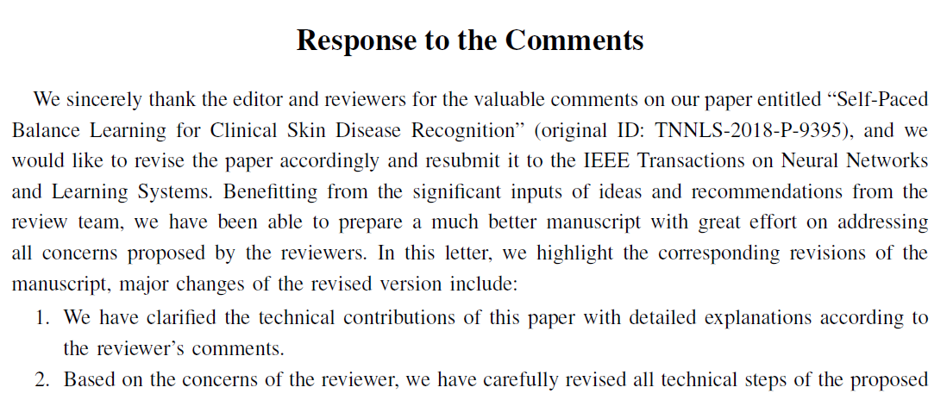
Response Letter
Summarize the RL.
List the major changes of the revised version.
...

Slide 21
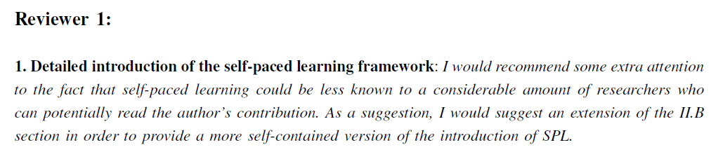
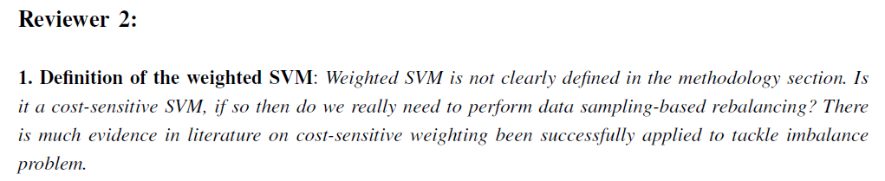
Response Letter
Reply to each reviewer separately.
Add a extra line after each paragraph for better looks.

Slide 22
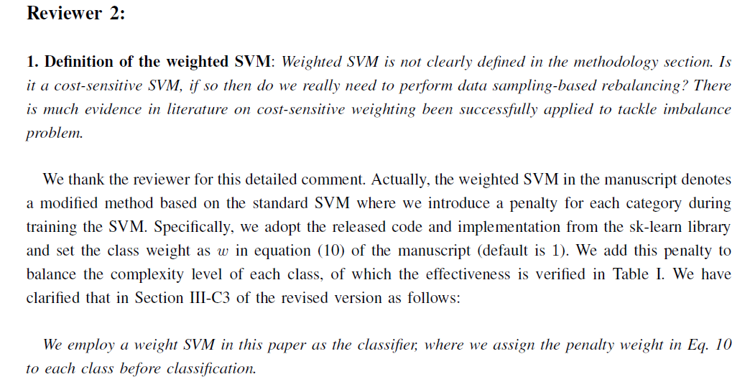
Response Letter
Summarize the comment.

Slide 23
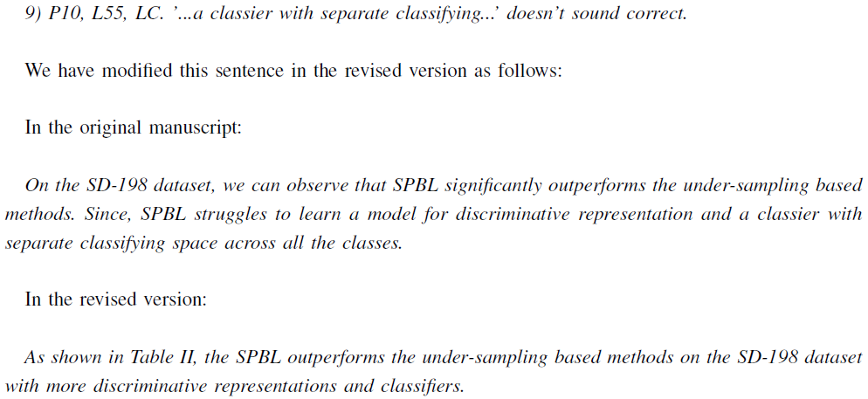
Response Letter
Clear the sentence modification process.
Use italic to denote the comments, original manuscript, and revised sentences.

Slide 24
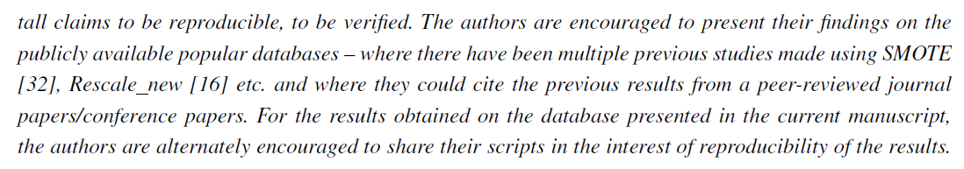
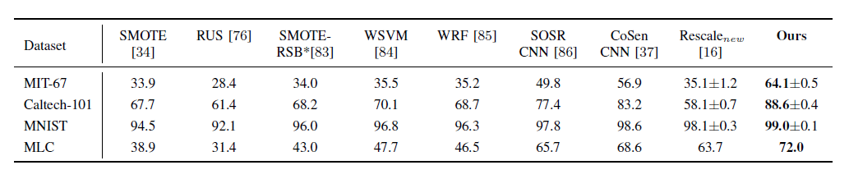
Response Letter
Take every comments and suggestions of the reviewers seriously.

Slide 25
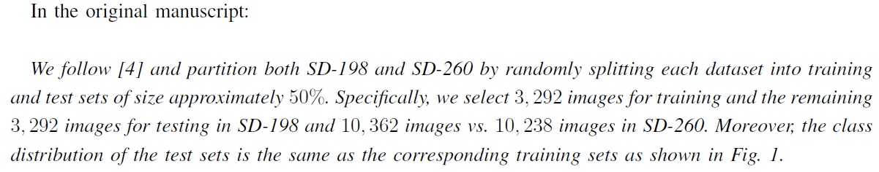
Response Letter
In most cases, satisfying reviewers instead of arguing with them
When the reviewer makes an opinion on a certain issue, even if the reviewer's understanding is biased, it is generally because we did not clearly explain the problem in the manuscript.

Slide 26
Response Letter
The response of comments.
Explain in RL
Explain in RL + Revise the manuscript
Explain in RL + Revise the manuscript + Supplement experiment

Slide 27
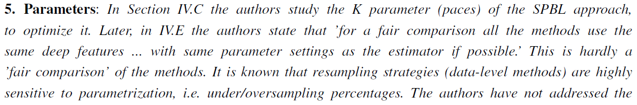
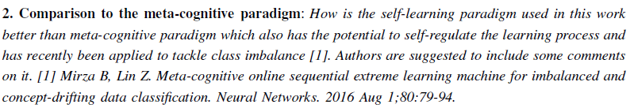
Response Letter
The response of comments.
Explain in RL
normal questions (e.g., novelty, parameter setting)
advantages to some methods (no code)

Slide 28

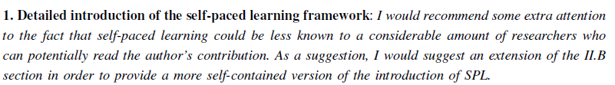
Response Letter
The response of comments.
Explain in RL + Revise the manuscript
not clearly described in the manuscript
extension
minor issues

Slide 29
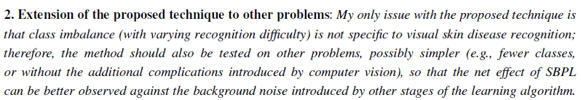
Response Letter
The response of comments.
Explain in RL + Revise the manuscript + Supplement experiment
rationality of experimental results (e.g., the training/testing split)
extend to other problems/datasets
more compared methods

Slide 30
Response Letter
The tone of comments.
Reviewer 1’s positive comments may be an important basis for responsing to Reviewer 2’s question.

Slide 31
The End!

